Slide 1
UNCERTAINTY DECOMPOSITION FOR RISK CONTROL IN AUTOMATED STOCK TRADING

Slide 2
Introduction
One natural application of reinforcement learning is automated stock trading and portfolio management. A simple formulation of stock trading as an RL problem would aim to maximize the change in the portfolio value. This approach, however, will not be appropriate for all individuals. Depending on their financial circumstances, some individuals would prefer more conservative portfolios that do not maximize returns but have lower risk. Others might prefer high risk portfolios that have lower expected returns but have the potential (albeit with low probability) for much greater returns over time. Risk assessment is crucial for such portfolio customization. More generally, risk assessment can help improve the exploration exploitation trade-off by ensuring that exploratory actions are not too risky. One approach to risk aversion could be to use a measure of uncertainty in the evaluated value functions. A more risk tolerant portfolio should be more likely to take actions with high uncertainty/variance in their expected return while more conservative portfolios should be less likely to select such actions even if the expected return is high. This project investigates the suitability of risk control via uncertainty estimation for stock trading problems by building on the uncertainty decomposition algorithm developed by Clements et al
Notes:
For my project I was working on automated stock trading. You know simply applying an RL algorithm that maximizes expected returns isn’t suitable in finance applications because people have different preferences for risk tolerance and an automated investment portfolio should be able to customize for that. So Risk assessment is important for this type of customization, but it also helps with the exploration exploitation trade-off. So I wanted to see if an uncertainty decomposition algorithm could be applied for risk control purposes in the context of stock trading.

Slide 3
Related Works
Various approaches have been proposed for estimating uncertainty in different reinforcement learning algorithms for both model based and model free problems. Leno et al. use bootstrapped neural networks to estimate the variance in the Q-function and request human intervention when the variance/uncertainty is above a threshold. Tamar et al. also use the mean-variance trade-off for risk assessment but in the context of policy gradient algorithms. O’Donoghue et al. propose the Uncertainty Bellman Equation for propagating local uncertainty estimates to global estimates and suggest various techniques for approximating local uncertainties. These approaches do not attempt to disentangle aleatoric and epistemic uncertainties in their estimates.
Notes:
The traditional way of getting uncertainties in RL is to use the estimated variance in the action value function as an approximation for uncertainty. But this approach doesn’t decompose aleatoric and epistemic uncertainties. so why would we want that?

Slide 4
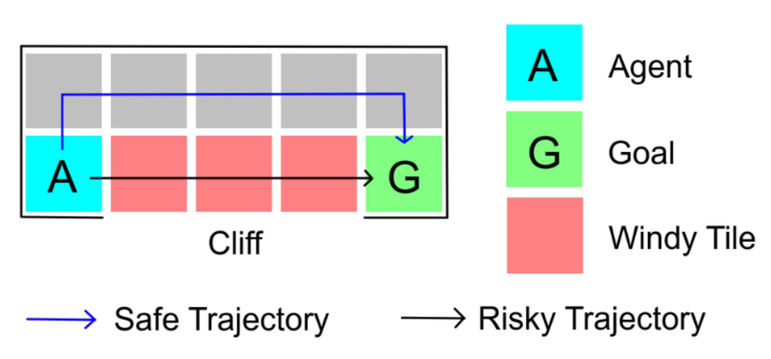
Related Works
Aleatoric uncertainty is uncertainty that is inherent to the data and stems from stochasticity of the environment or our observations of the environment while epistemic uncertainty stems from limitations in our model or training data. Disentangling these sources of uncertainty allows the algorithm to avoid states with high aleatoric uncertainty for risk aversion purposes while not limiting exploration too much by ensuring that states with high epistemic uncertainty are not penalized as much. Clements et al. tackled the problem of disentangling aleatoric and epistemic uncertainties in Deep Q Learning. Rather than learning a single point estimate, they learned several quantiles of the Q-function distribution and used these quantiles to estimate aleatoric and epistemic uncertainties. They showed that their algorithm could avoid the cliff in a grid world and that the probability of finding the safer route could be tuned with their risk aversion parameter
Notes:
Well aleatoric uncertainty is uncertainty that’s inherent to the data it can stem from the stochasticity of the environment. For example in the grid world where there is a cliff near the fastest route but there is also a high probability of falling off the cliff, the aleatoric uncertainty in returns is large because you can get the worst case scenario of falling off but also the best case of getting the fastest route. On the other hand epistemic uncertainty is because of model or training data limitations and we can reduce it by exploring more and getting more training data. So disentangling these sources of uncertainty is important because you don’t wanna penalize for epistemic uncertainty and hinder exploration too much and you definitely wanna avoid states with high aleatoric uncertainty if you have low risk tolerance.
I found a paper that disentangles these uncertainties for deep q learning and they tested it for grid world and contextual bandits so I wanted to apply the ideas to the stock trading problem.

Slide 5
Methodology
This project focuses on managing a single stock portfolio where we are limited to buying or selling a single share at each time step. The problem is formulated as a Markov Decision Process (MDP) with the following components:
State: the state contains the agent's remaining balance, the number of shares owned, the stock price, and a set of common market indicators from StockStats's pandas DataFrame wrapper
Action: the agent is limited to either buying a single new share, selling one of their shares, or holding all their shares at each time step.
Reward: the immediate reward is the change in the total portfolio value (total stock value + remaining balance) at the end of a trading day.
Uncertainty Aware Deep Q Learning:
The Q-function is approximated by a deep neural network that takes the state as input and outputs N quantile estimates of the action-value distribution for each of the three plausible actions.
Notes:
I focused on a simplified problem where we are trading one stock and at each step we can either buy a single share, sell a share or just hold what we have. The reward was the total porfoliio value (that’s total stock value + remaining balance) and the state included a set of technical market indicators, the current stock price, remaining balance, and number of shares owned.

Slide 6
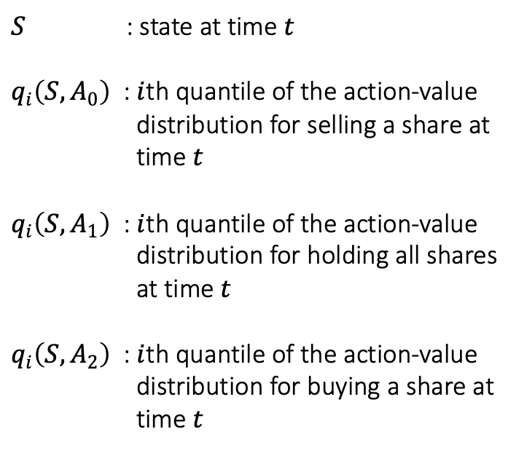










$$q_{N}\left(S, A_{2}\right)$$
Uncertainty Aware Deep Q Learning:
Methodology
…
$$q_{1}\left(S, A_{2}\right)$$
$S$ : state at time $t$
$q_{i}\left(S, A_{0}\right)$ : $i$th quantile of the action-value
distribution for selling a share at
time $t$
$q_{i}\left(S, A_{1}\right)$ : $i$th quantile of the action-value
distribution for holding all shares
at time $t$
$q_{i}\left(S, A_{2}\right)$ : $i$th quantile of the action-value
distribution for buying a share at
time $t$
$$q_{N}\left(S, A_{1}\right)$$
$$S$$
$H_{1}$
$H_{2}$
$H_{3}$
…
$$q_{1}\left(S, A_{1}\right)$$
$$q_{N}\left(S, A_{0}\right)$$
…
$$q_{1}\left(S, A_{0}\right)$$
Notes:
Now for the uncertainty aware deep q learning approach: the main difference is that our neural network isn’t predicting a single point estimate for the value of each action but it’s predicting N values for each action. And that’s because we’re treating the Q-function as a distribution and those N values are quantiles that parameterize that distribution.

Slide 7
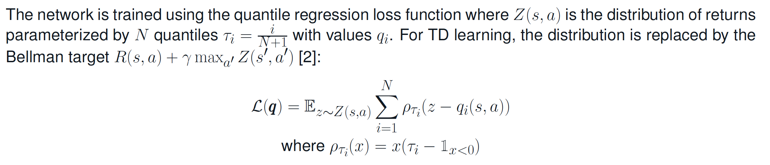
Methodology
Notes:
So yea obviously we need a different loss function for this and the loss function is from a paper on quantile regression and it’s just adapted so that the target z is replaced by the Bellman update target

Slide 8
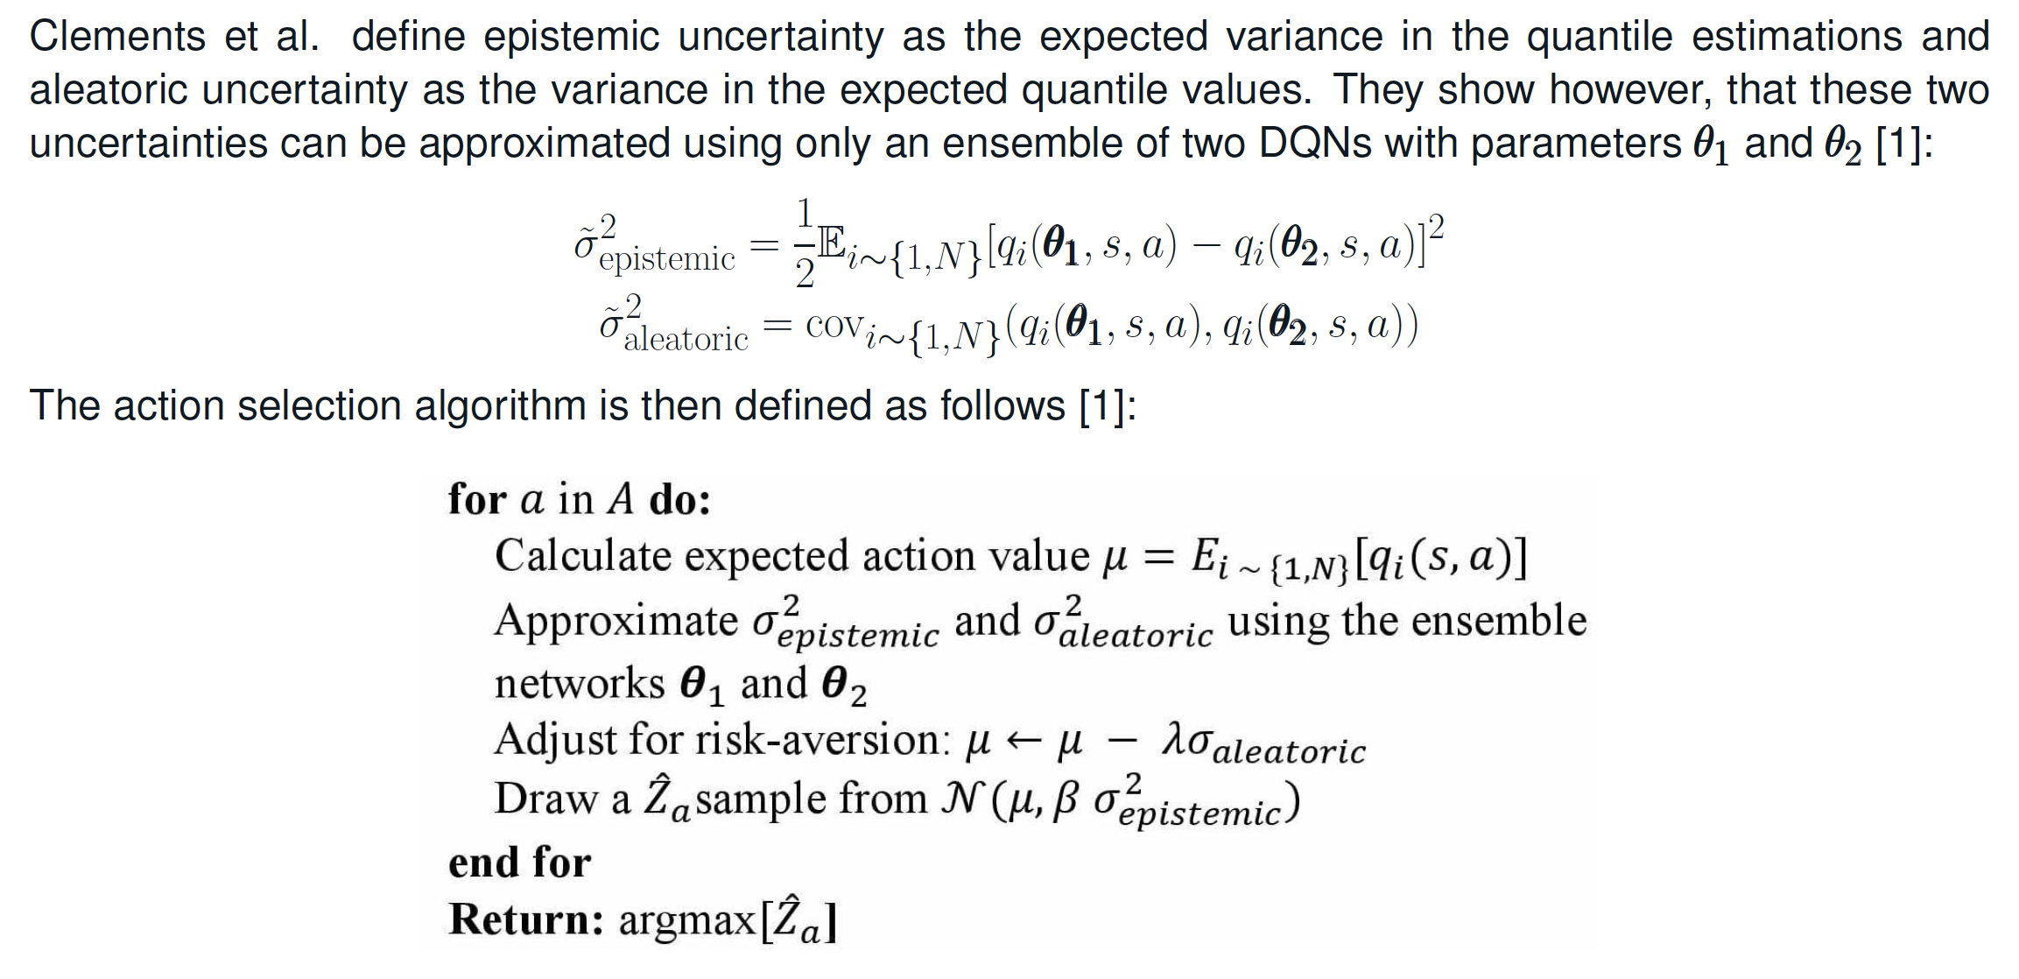
Methodology
Notes:
Now how are the uncertainties estimated? Ideally you have a large ensemble of network to get these but that’s computationally expensive so in their paper Celements shows that you can reliably approximate these uncertainties with the expected difference and covariance of the quantile estimates from only an ensemble of two networks.
So putting all that together for the action selection algorithm you do the usual get the expected values of the actions but penalize that value by subtracting away a fraction of the aleatoric uncertainty for risk aversion and then similar to Thompson sampling, sample from a normal distribution with the epistemic uncertainty as the standard deviation and that’s gonna help with the exploration exploitation trade-off

Slide 9
Results and Discussion
Financial Turbulence Index (FTI):
FTI is one measure of extreme asset fluctuation used by the stock trading library FinRL for risk control. In this project, a DQN model that uses FTI for risk assessment is also built for comparison with the UA-DQN model. All buying is halted when FTI is larger than a pre-defined threshold and shares are gradually sold until FTI drops below the tolerance threshold.
The models were trained and evaluated with historical data from Yahoo Finance for eight relatively volatile stocks. The data from 2008 to 2015 were used for training while the data from 2016 to 2020 were used for testing. Two sample plots of the total returns as a fraction of initial assets for the test data are presented below. The performance of a baseline model that always buys shares is also plotted for comparison. In general, increasing the risk penalty seems to improve total returns. The UA-DQN model tends to give the best performance as evaluated by total returns on the test data. The experimental results suggest that uncertainty decomposition can be a suitable technique for risk control in automated stock trading. Further experiments are needed to make conclusive remarks.
.
Notes:
So for comparison I had a baseline model that always buys shares because that’s usually the best approach for long term returns. Also in stock trading typically people use some measure to assess risk. Financial turbulence index is one of them. So I also setup a regular DQN which would gradually sell shares if FTI is above a threshold until it drops below that threshold.

Slide 10
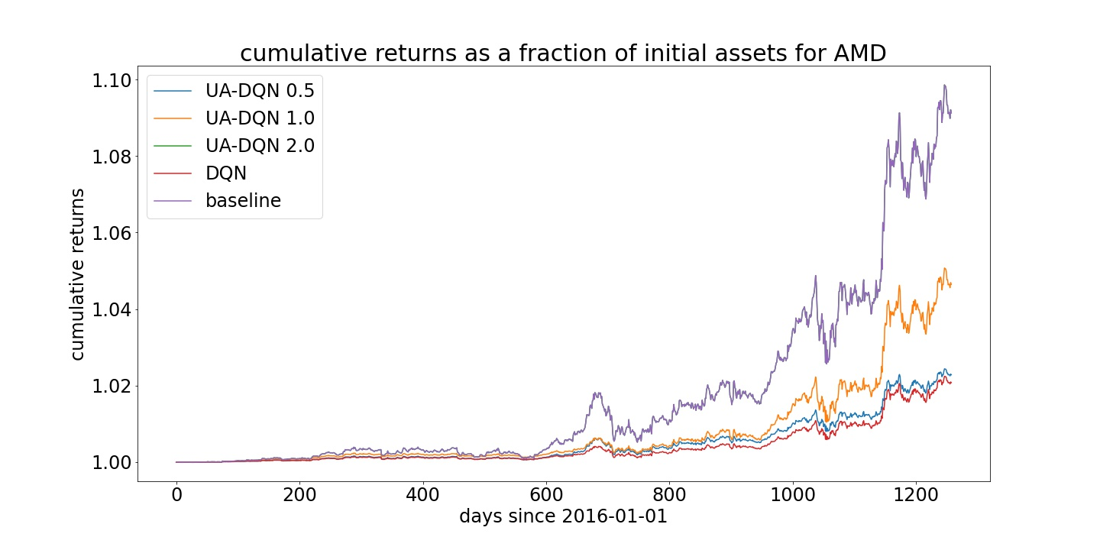
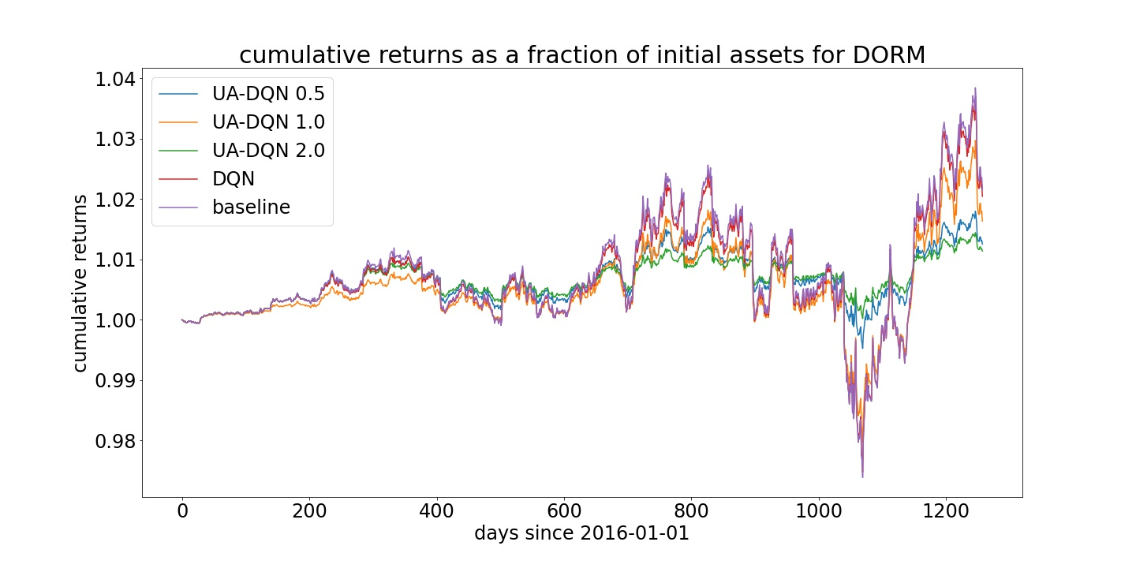
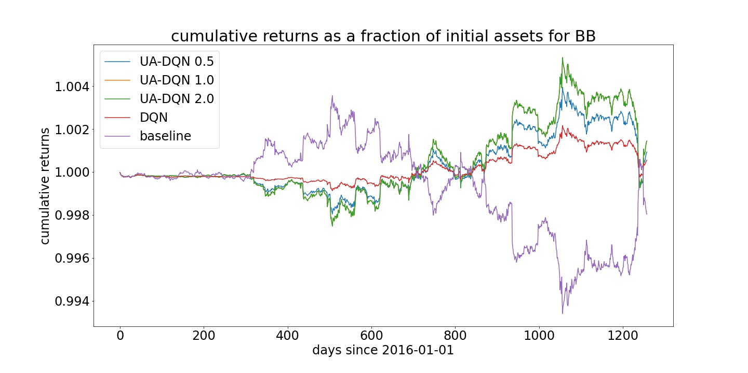
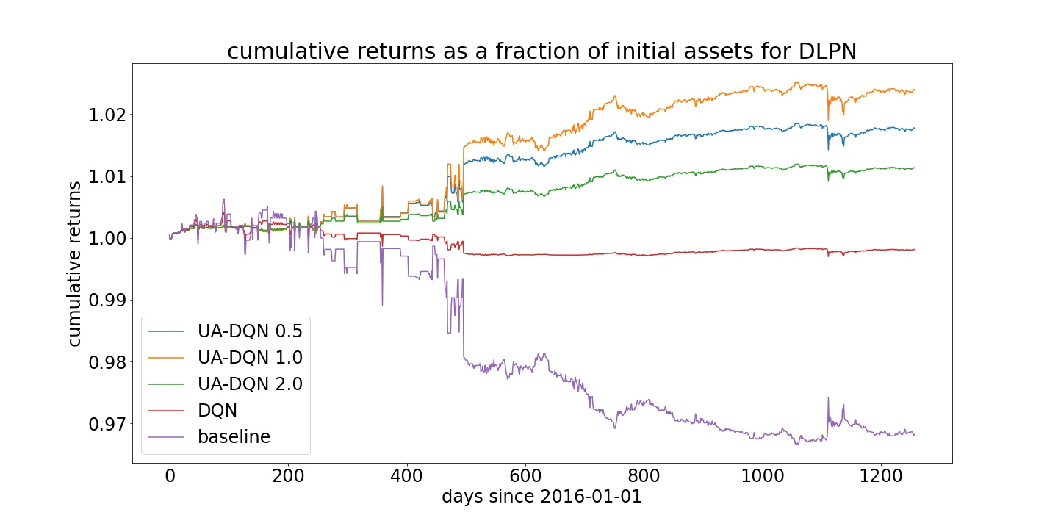
Results and Discussion
Notes:
These are plots from 4 of the 8 stocks that I experimented with. Some interesting things to note. For AMD the baseline of buying and holding was performing the best and UA-DQN converged to that policy when the risk parameter lambda was set to 2. And in general increasing the lambda value tended to give better returns.

Slide 11
Results and Discussion
In the future, experiments should be performed to see if uncertainty decomposition is necessary for good performance or if a simple measure of total uncertainty can also produce similar results. Deep Q-Learning is not the most suitable RL algorithm for stock trading. Future experiments should try to decompose uncertainties of algorithms such as Proximal Policy Optimization which are more suitable for realistic stock trading scenarios involving multiple stocks.
Table 1: cumulative returns at the end of a test episode as a fraction of the initial assets
 |  | Stock Ticker
 |  | AMD | BB | MKTY | DORM | RRD | ARLP | ATLC | DLPN
Model | baseline | 1.091 | 0.998 | 1.005 | 1.022 | 0.993 | 0.990 | 1.027 | 0.968
 | DQN | 1.021 | 1.000 | 1.005 | 1.020 | 0.999 | 1.009 | 1.022 | 0.998
 | UA-DQN 0.5 | 1.023 | 1.000 | 1.001 | 1.013 | 1.002 | 1.003 | 1.026 | 1.018
 | UA-DQN 1.0 | 1.046 | 1.001 | 1.005 | 1.016 | 1.000 | 1.001 | 1.005 | 1.024
 | UA-DQN 2.0 | 1.091 | 1.001 | 1.005 | 1.011 | 1.004 | 1.004 | 1.025 | 1.013
Notes:
To verify these results obviously there is need for experimenting with a larger set of stocks. I think it would also be interesting to see if uncertainty decomposition is necessary or if a simple measure of total uncertainty can also produce similar results. And finally deep q learning isn’t best algorithm for stock trading so it would be interesting to try and extend uncertainty decomposition to other algorithms that are more suitable for more realistic stock trading scenarios.

Slide 12
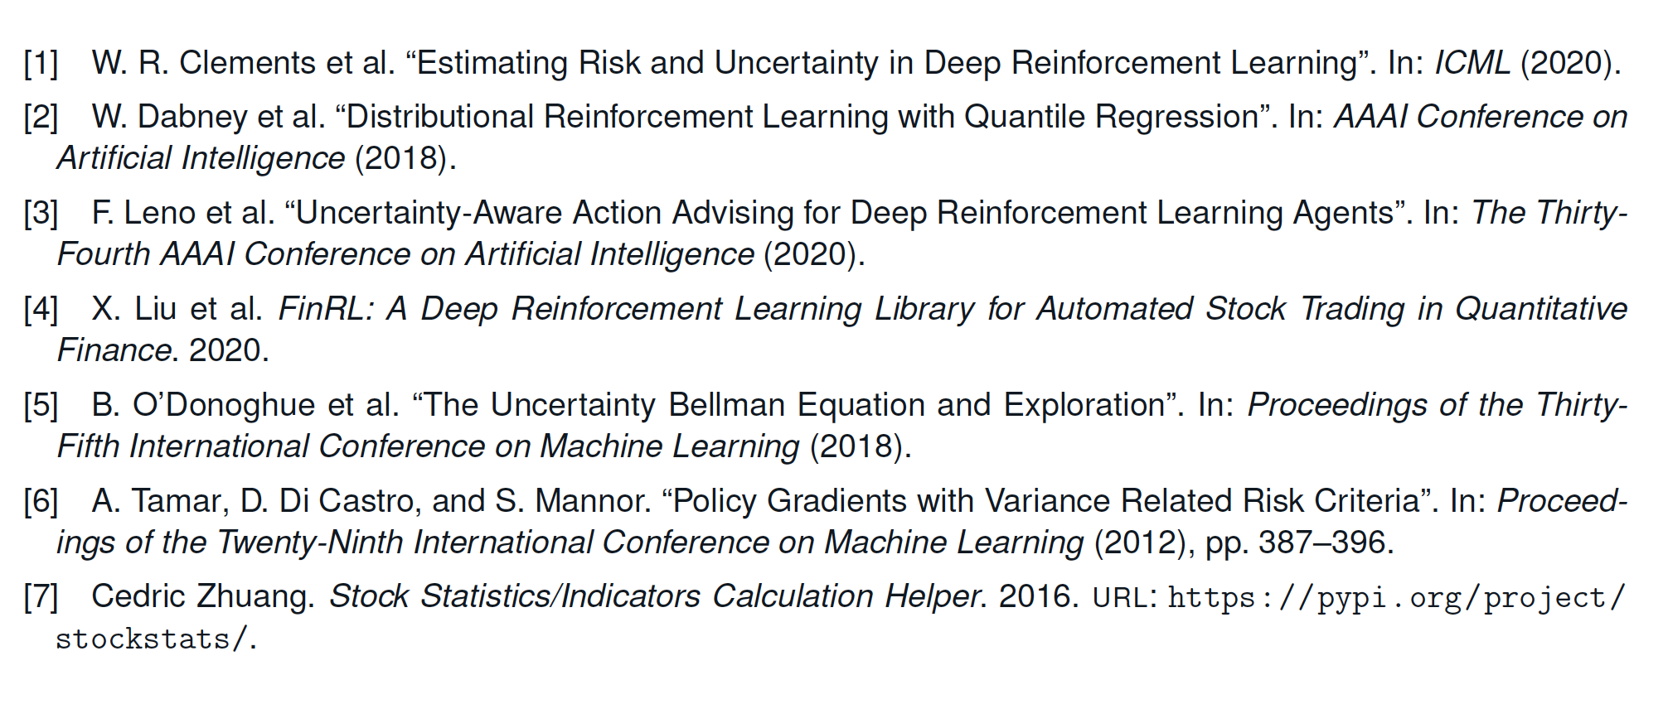
References

