Slide 1
JSON

Slide 2
JSON: Javascript Object Notation
easy to read and write even for humans
program is easy to interpret/analyze and generate
text format (text-based) and completely language independent
It is based on two types of structure:
collection of name/value pairs. In many languages, an object, a record, a structure, a dictionary (or map), a hash table, a key-indexable (~not only a number) list, or associative arrays can be considered as implementations of name/value pair collections.
ordered list of values. In most languages, this realization is an array, vector, list or sequence.

Slide 3
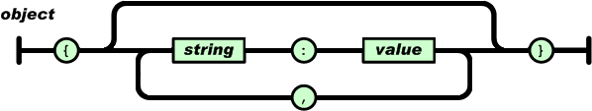
Types
object: unordered set of name value pairs. An object starts with { and ends with }. Each name is followed by a : (colon) and name/value pairs are separated by a comma (,).
Even an empty object can be entered in JSON. In this case, we get from { to } right away, and there is a line between them, so it is regular.

Slide 4
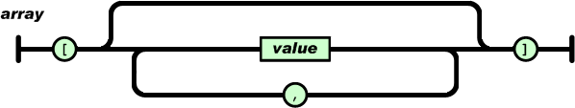
Types
array: an ordered collection of array values. An array begins with an opening square bracket ([) and ends with a closing square bracket (]). Values are separated by commas.

Slide 5
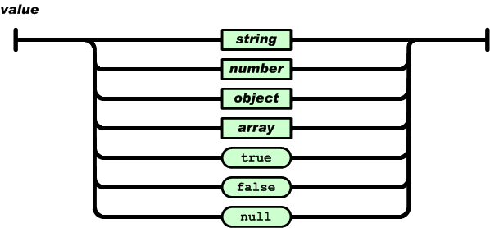
Types
value: it can be a string between double quotes, or a number, or true or false or null, or even an object or an array

Slide 6
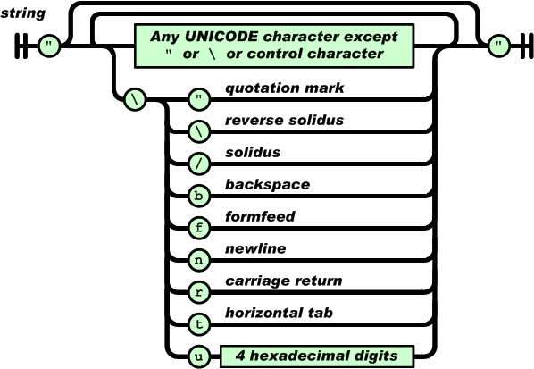
Types

Slide 7
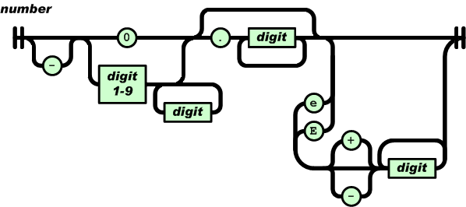
Types
So we can enter the numbers in a base 10 number system. It can also start with a sign (it can be seen that there is a path from the starting state). The fractional part is “.” precedes it. It is also possible to enter an exponent of 10 (exponential notation) with e or E and then optionally a – or a +. Numerical values that cannot be represented by a series of digits (e.g. Infinity, NaN) are not allowed.

