Slide 1
HTML

Slide 2
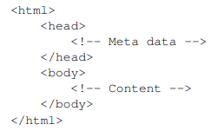
There is a basic structure and hierarchy that all HTML documents follow.

Slide 3
Head
It is used to describe the document
<title>
external CSS, JS, inline CSS,JS
Meta data : <meta/>
<head>
<meta name="keywords" content="HTML, CSS, XHTML"/>
<meta name="description" content="Tutorial"/>
</head>

Slide 4
Body
Visible elements
Common items:
text
links
lists
tables
images
forms
Attributes:
link
alink
vlink
background
text

Slide 5
In HTML, an essential part is the markup of an element. This tells the browser what kind of content it is
Example: <h1>This is a title </h1>
This element has three parts: an opening tag, a closing tag, and the content
We put the opening tag between < and > signs, the closing member as well, only after the < sign we also put a /> sign.
We can provide additional information to the browser by adding attributes to the elements.
E.g. <textarea col="30"></textarea>

Slide 6
Attributes are always defined as part of the opening member.
Attributes have names and values
Important attributes
the id and class attributes are often used. (it will be important in javascript, jquery, and CSS). id is unique in the document, class can be multiple.
<h1 id="title" class="bordertitle">Main title</h1>
<h2 id="anothertitle" class="bordertitle underlinedtitle">Subtitle</h2>

Slide 7
Void elements:
Not all elements can contain content. Those that are not are called void elements and are defined without a separating end tag.
<img src="picture.jpg" />
<meta charset="utf-8" />

Slide 8
Main tags:
html element: indicates the area of the document that contains HTML content. This element always contains two other key structural elements, head and body.
body element: Indicates the part of the document that contains content elements. Content elements are the elements that the browser displays to users and on which metadata (e.g. script, style) operations are performed.
head element: contains metadata for the document part, i.e. one or more elements that describe an operation for the content of the document, but are not directly displayed in the browser. These are e.g. style, script, title

Slide 9
script element: This can also be used to add JavaScript code to our document. Example: loading jquery
<script src="jquery-1.7.js" type="text/javascript"></script>
style element: this element is one of the ways to apply CSS settings to our document

Slide 10
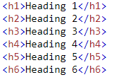
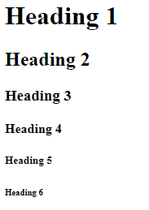

Slide 11



Slide 12
<p> paragraph. Writes the content on a new line + line spacing
<span> does not write the content on a new line
<div> it writes the content on a new line, but there is no line spacing
<br/> line break
<p> <span> <div> can also have attributes (e.g. id, class) so css and javascript can be used

Slide 13
Image:
<img src="img_girl.jpg" alt="Girl in a jacket" width="500” height="600">
Link
<a href="https://www.w3schools.com/html/">Visit our HTML tutorial</a>
Comment
<!-- comment-->

Slide 14
Form elements
Button <input type="button">
Checkbox <input type="checkbox">
File <input type="file">
input field to enter the name of the file that we want to upload to the server. The value of value is read-only! (so we cannot write in the value field with javascript code)
<input type="hidden">
The content of such an element is not visible to the user, but when the form is sent to the server, its value is also sent.
<option>
<select> an element in object (drop-down list)
<input type="password"> input field for password entries. typed characters are not visible

Slide 15
Form elements
<select>
means an item in a drop-down list from which only one can be selected
<select multiple>
represents an element of a drop-down list from which several elements can be selected
<input type="submit">
button that sends the form data to the specified URL in the action attribute of the form field
<input type="text">
text input field with one line
<textarea>
text input field with multiple lines
<input type="radio">
Radio button
<input type="reset">
button to reset the form to its initial state

Slide 16

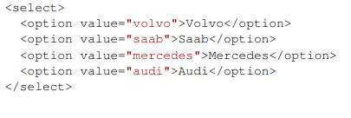
Form elements
If only one of several options must be selected (name attribute is the same)
Select:

Slide 17
Table
<table> element
Contains elements for the table
Attributes
WIDTH
–The width of the table.

Slide 18
Table
<tr> element: describes a row in the table
<th> element: Defining a cell containing header information
<td> element: A cell that contains data
Cell merging:
It can be accessed with the th or td attributes, the colspan and rowspan attributes.

Slide 19
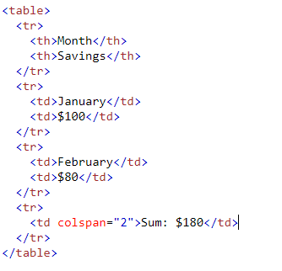
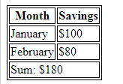
Table

Slide 20
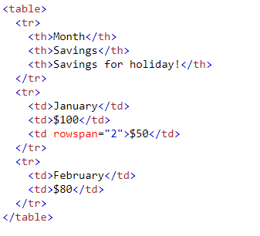

Table

Slide 21

List
<ol> ordered list
<ul> unordered list
<li> list item
Pl:
<ul>
<li>Coffee</li>
<li>Tea</li>
<li>Milk</li>
</ul>

Slide 22

List
<ol>
<li>Coffee</li>
<li>Tea</li>
<li>Milk</li>
</ol>

Slide 23
PRE element :
preformatted text
Its content appears exactly as it appears in the document
So if e.g. the
<pre>
This is a
two lines of text with a big enter
</pre>
then it will appear in the browser as well (there was no need to mark line breaks with <br>)

Slide 24
Subscript and superscript:
SUB : the content is displayed as a subscript
SUP : the content is displayed as a superscript

Slide 25
HTML5
HTML5 new input elements:
color
date
email
number
range
search
tel
time
url
week

Slide 26
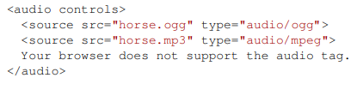
HTML5
Placeholder:
<input type="text" name="search" placeholder="search the web"/>
Audio

Slide 27
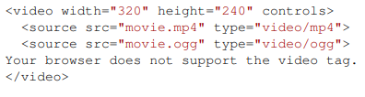
HTML5
Video

Slide 28
Website structure
The page can be structured in several ways (structure can be the layout of the banner, menu, body, footer, etc.).
It can be designed with frames
Dividing a page into frames
Browser dependent display
HTML 5 is no longer supported

Slide 29
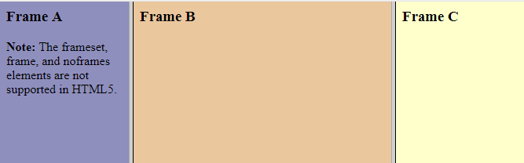
Frame example:
<frameset cols="25%,*,25%">
<frame src="frame_a.htm">
<frame src="frame_b.htm">
<frame src="frame_c.htm">
</frameset>

Slide 30
It can be created with tables (We combine a couple of rows and there will be a banner, a large section in the middle and the content there, a row of menus, etc.). Its characteristics are:
The whole page is a table
Unified display
Beautiful
A document
A lot of data
Complex structure

Slide 31
Div, span + CSS
It can be designed with <div>s.
Each page section (footer section, content section, menu section, etc.) is expressed with a div.
These are relatively simple building blocks
Each div defines a block. Two divs are located below each other.
We usually give it an ID and create a CSS style for it and define the appearance and positioning of the divs (e.g. relative to each other) with CSS

Slide 32
Another important element is the <span > element. This is a line item. This is placed opposite to the div, as two consecutive <span> are not displayed below each other, but next to each other.
(Note: CSS can be used to place two consecutive divs next to each other, for example, and the original behavior can also be reversed with span...)

