Slide 1
Javascript

Slide 2
Features:
weakly typed: we can assign a value of any type to a variable and later assign a value of another type to this variable.
object based
not object oriented
script language
client-side programming: one reason client-side JavaScript exists is to turn static HTML documents into interactive web applications.
run by the client
simple language, plus functionality, form control, moving elements, ajax

Slide 3
Variables
JavaScript variables
JavaScript types can be divided into two categories. Primitive types and object types. Primitive types: numbers, texts, logical values.
Special javascript values: null, undefined. These are also primitive, but not numbers, not logical values, not texts

Slide 4
Variables
Number:
JavaScript does not distinguish between integers and floating-point numbers. Each number is represented as a floating point number in JavaScript.
String:
Text characters are enclosed in quotation marks (can be between ' ' or " ").
Text delimited by single quotation marks can contain double quotation marks and text delimited by double quotation marks can contain single quotation marks.

Slide 5
Variables
Logical values:
two possible values in JavaScript: true, false.
Any JavaScript value can be converted to a Boolean value.
undefined, null, 0, -0, NaN, "" (empty string) return false
result in a true value: everything else that was not included in the previous list

Slide 6
Variables
null
null is a language keyword that evaluates to a special value and is most often used to express the absence of a value. In JavaScript, the typeof operator returns "object" on null, i.e. null can be thought of as a special object value, indicating that there is no object

Slide 7
Variables
undefined
This has a slightly deeper meaning than null.
the value of a variable that has not yet been initialized
we query the value of a property of an object that does not exist
or we get undefined when querying a non-existent array element.
Functions also return with this if they have no return value.
undefined is not a language keyword (like null), but a predefined global variable.
null and undefined both express the absence of a value and are often interchangeable.
== operator takes them as equal
=== operator no longer considers them equal.
undefined is used to represent the absence of an unexpected, error-like value at system level,
null program-level, normal, expected value missing.

Slide 8
Variables
Declaring variables:
before we use a variable in the javascript program, we can declare it before it. Variables can be declared using the var keyword. If we declare a variable, it is valid within a function block. If we do not declare and give a value to a variable, it becomes a global variable.
there i;
var sum;
Multiple variables can be declared with the same var keyword.
var i, sum;
Declaration and initialization can be combined:
var i=4;

Slide 9
Variables
If we don't specify an initial value for the variable when we use the var statement, the variable will be declared, but its value will be undefined until our code assigns it a value.
A var statement can also appear in a for or for/in as part of a loop variable declaration.
for(var i=0; i<5; i++) {..}
Javascript is case-sensitive.
JavaScript identifiers must begin with a letter, underscore, or dollar sign

Slide 10
Variables
Arrays:
var empty=[];
var primes=[2,3,5,7,11];
var mixed = [1.1, true, "a"];
Array literals can't just be constants
var i=1045;
var numberarray [ i, i+1, i+2 ];
We can create an array not only with literals, but also with the Array() constructor var a = new Array(); //u.a as []
Accessing array elements
using the [] operator
We index from 0

Slide 11
Variables
Array length
Each array has a length property,
Elements of arrays can be elements of simple types, arrays, objects, functions
Adding a new element to an array: add a value to a new index
a=[]; //empty array
a[0]="str1"; //add an element
a[1]="str2"; //add another element

Slide 12
Variables
But we can also add one or more elements using the push() method.
a=[];
a.push("str1")
a.push("str2","str3");
Delete from array:
we can delete it with the delete operator, but this does not reduce the size, but changes the value to undefined:
a=[1,2,3];
delete a[1];
a.length //still 3
A solution may be to delete from the end and set the length property manually, or move the elements after deletion

Slide 13
Variables
Traversing blocks:
with a for loop:
for(var i=0;i<a.length; i++) {
console.log(a[i]);
}
Another way:
for(var index in a) { console.log(a[index]); }

Slide 14
Operators
Arithmetic operators:
+ addition
- subtraction
* multiplication
/ division
% modulo (remainder of whole division)

Slide 15
Operators
Relational operators:
< smaller
<= smaller or equal
> bigger
>= greater or equal
!= not equal
== is equal to
=== same type and value
a=5, b="5" a == b is true, a === b is false

Slide 16
Operators
Logical operators
&& AND
| | OR
! NOT
Specialties
a++; b--; ↔ increase a by 1, decrease b by 1
b - = 4; ↔ b = b – 4;

Slide 17
Instructions
Conditional instruction
if (condition) statement; [else if (condition) statement;] [else statement;]
if (a < b) x = a; else x = b; if (a == 2) …
For cycle
for ([start expression]; [loop condition]; [step expression]) statement;
for (i=1; i<11;i++) {}
Do cycle
do{ statement;} while (condition);
do { document.writeln(a); a++;} while (a<20);

Slide 18
Instructions
While loop
while (condition) {statement};
while (a<25){ document.writeln(a)};

Slide 19
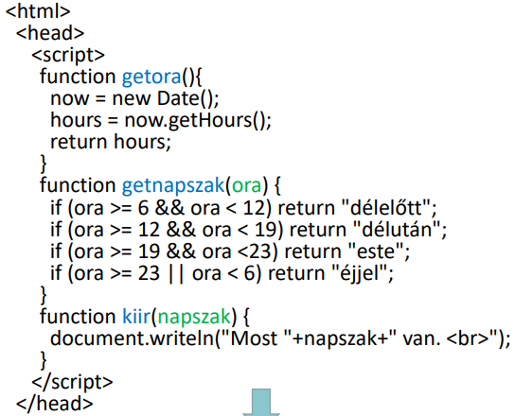
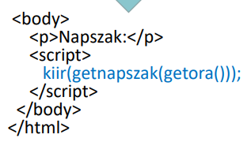
Functions
function function_name(parameter1, parameter2, ....) { instructions [return value;] }

Slide 20
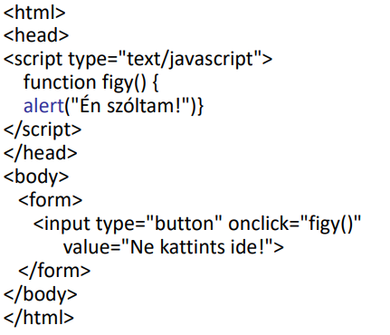
Instructions

Slide 21
Objects
The fundamental data type of JavaScript is object. (object consists of several values; an unordered collection of properties, each of which has a name and value
Data members (~property): they have a name and a value. A property name can be any string, even an empty string, but the same object cannot have two properties with the same name. Its value can be any JavaScript value. Creating objects: Method: with object literal, new keyword, Object.create() function

Slide 22
Objects
object literal: contains comma-separated name:value pairs enclosed in braces.
var empty={}; var point={x:0, y:0}; var point2 = {x:point.x, y:pont.y+1 }; var book= { "main title": "JavaScript", author: {
name: "Endre",
age : 23
}};

Slide 23
Objects
with new keyword: creating and initializing an object.
The new keyword must be followed by a function call.
Function used in this way: constructor. var o=new Object(); var d=new Date(); var r=new RegExp("js");

Slide 24
Objects
Property query:
var author=book.author; var name=author.name; var title=book["main title"]; //this is only possible because of the name of the propery, because it does not comply with the identification training rules (e.g. there is a space in it...)
Property can be created or set using these two operators. book.author.name = "xyz"; book["main title"]="js book";

Slide 25
Objects
Define and calling a method
Method in JavaScript: JavaScript function stored in the data member of an object.
var car={}; car.color="red"; car.engine="disele"; car.refueling = function () {//…};
Function calling: car.refueling()

Slide 26
Objects
Important objects:
String – length(), toUpperCase(), match(), indexOf(), replace()
Date – getTime() – getFullYear(), getMonth(), getDate(), getDay()
Array – concat(), sort(), push(), pop(),
Math – random(), max(), min(), round()

Slide 27
Important events
onLoad - When loading a web page
onUnload- When leaving a website
onFocus - entering a form element -
onBlur - omit form element
onChange – the content of the form element changes
onSubmit - submit form
onMouseOver - the mouse hovers over an element
onMouseOut - mouse leaves the element
onClick – button click

