Slide 1
Citizens
Citizens Consumer Ecosystem & Loyalty Synthesis
Research synthesis and working discussion (Prepared for LOB Leads) · August 2026

Slide 2
WHY WE'RE HERE
The goal of this project is to ensure Citizens’ future ecosystem of core consumer products is built to do two things
01
Increase product adoption and use, strengthen primary
relationships, and grow share of wallet and long-term value.
BUSINESS OUTCOMES
Grow the relationship
02
Give customers clear entry points, meaningful next steps, and
understandable recognition across products.
CUSTOMER EXPERIENCE
Make the journey clear

Slide 3
WHY WE'RE HERE
Today we are focused on phase one, which helps set the stage for what’s to come
Builds on what today confirms or corrects.
Phase 1
Phase 2 (TO BE SHARED IN R2)
Ecosystem Architecture, Loyalty
Analysis & Implications
→
Checking Product
Positioning
Research synthesis with ecosystem & loyalty possibilities for Citizens
Builds on today’s read and the positioning work.
Phase 3 (TO BE SHARED IN R2)
→
Naming:
Checking & Private Client

Slide 4



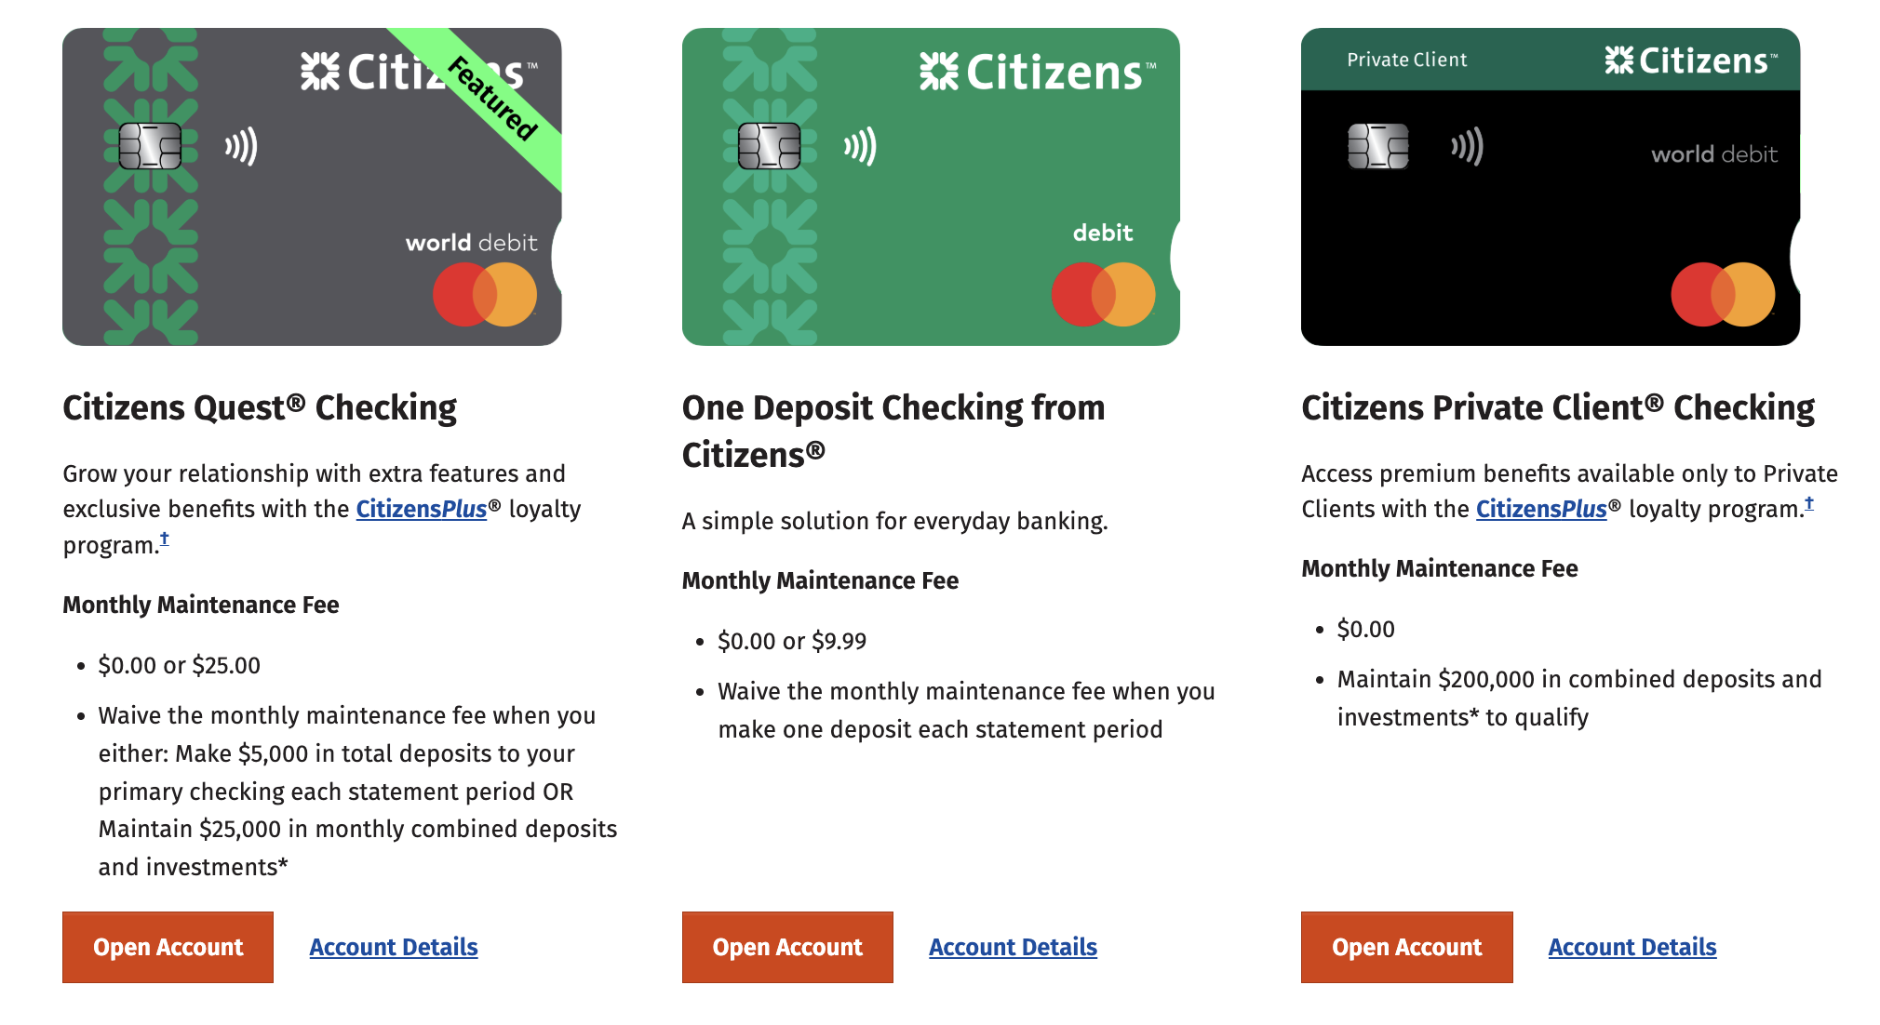
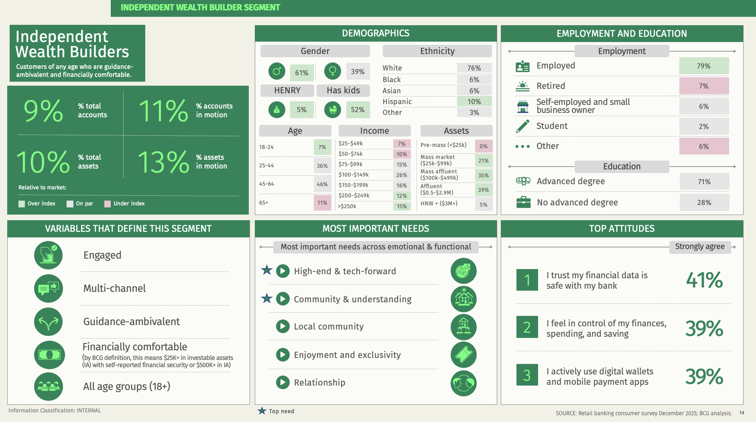






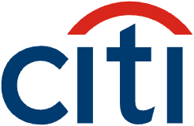


WHY WE'RE HERE
We're sharing key insights from our ecosystem and
loyalty research – and the choices they open for the new lineup
What we synthesized
1
2
3
4
5
Stakeholder
interviews
Citizens product
ecosystem
Audience research –
Wealth Builders
Competitive &
category analysis
Cross-category
loyalty
Understanding Citizens’ goals & ambitions
Checking, Private Client, cards, and CitizensPlus, mapped from published content and provided materials.
Independent and Premium Wealth
Builder: assets, banking
behavior, and advice
preferences.
Eight competitors audited across the same four ecosystem layers, with a documented evidence base.
Loyalty models within and beyond banking, and what they change about recognition and value.
Ted Rosenberg
SVP, Deposits
Product Director
Caitlin Lane
SVP, Product
Marketing Director
David Hixon
SVP, Head of
Consumer
Product Marketing
Jill Kamman
SVP, Deposits & Customer
Engagement Director

Slide 5
CITIZENS ECOSYSTEM & LOYALTY SYNTHESIS
Today
1
How we analyze ecosystems
2
Citizens today
3
The customer to win
4
What we learned from the category
5
Where loyalty is going
6
Initial ecosystem recommendation

Slide 6
Citizens
How we analyze ecosystems
1
Citizens today
2
The customer to win
3
What we learned from the category
4
Where loyalty is going
5
Initial ecosystem recommendation
6

Slide 7
HOW WE ANALYZE ECOSYSTEMS
We unpack banking ecosystems across four layers
that each answer a different customer question
How a bank decides to connect these layers shapes how customers use and grow the relationship
PRODUCT CHOICE
“Which products fit what I need?”
RELATIONSHIP RECOGNITION
RELATIONSHIP STATUS
“How does the bank see my relationship?”
RELATIONSHIP VALUE
“What do I get for it?”
SERVICE & ADVICE
“When does the way I’m served change?”

Slide 8
Citizens
How we analyze ecosystems
1
Citizens today
2
The customer to win
3
What we learned from the category
4
Where loyalty is going
5
Initial ecosystem recommendation
6

Slide 9
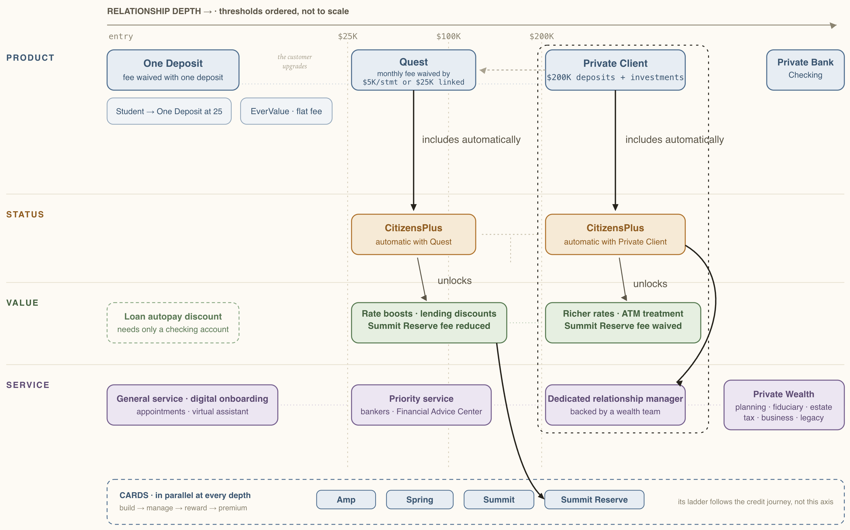
CITIZENS TODAY
Citizens’ current
ecosystem
is governed
by checking
SAVINGS · one per checking product
One Deposit · Quest · Private Client
Our read, in five notes
Richer value needs a higher account
Rate boosts and fee treatment follow CitizensPlus, which follows the account.
No relationship state exists below Quest
The entry products stand alone. A customer there earns no recognition
CitizensPlus has no independent role
It arrives with the product, and only passes product benefits through.
Balances qualify products, not status
Balances qualify customers for product upgrades, not any separate status
Private Client is four things at once
Map scope: we found no public-facing pathway connecting HELOC or other lending products into the core banking ecosystem. Lending appears through discrete product benefits or discounts rather than as an ecosystem pathway.
The account, status, benefits, and higher-touch service in one bundle.
Source: Citizens published product pages, June to August 2026.

Slide 10
LEARNINGS FROM INTERVIEWS
What we heard: the current model makes it difficult to understand the path upward and deliver a clear affluent promise
Too many similar products make the choice hard
Little distinction between the five checking products
drives decision fatigue and leaves customers stuck with no way to graduate up.
Upper tiers do not give customers a clear reason to move up
The entry product's old fee-waiver edge is now standard everywhere, and upper tiers don't offer enough value to justify moving up.
Private Client vs. Private Bank blur the path upward
Overlapping names for the checking tier and the separately branded private bank confuse customers and colleagues alike.
CitizensPlus benefits are too occasional to shape behavior
One-time, transactional benefits are difficult for customers to feel and heavy for Citizens to deliver consistently.
PCRM capacity doesn't match the service promise
The relationship-manager model is understaffed relative to demand, so customers can't reach the person they're required to go through.
"We have 5 products and no one has any idea… which product they should be in. And it's not a good experience at all."
“Bankers have difficulty promoting the benefits of some of the upper end products.”
"Private client and private bank are really confusing."
"You don't pick a checking account because you might someday buy a house and want a discount on your closing costs."
"One PCRM is servicing like 10 branches… the model's just a bit frustrating for some customers."
Source: Four Citizens stakeholder interviews, Aug 2026 · Quotes lightly edited.

Slide 11
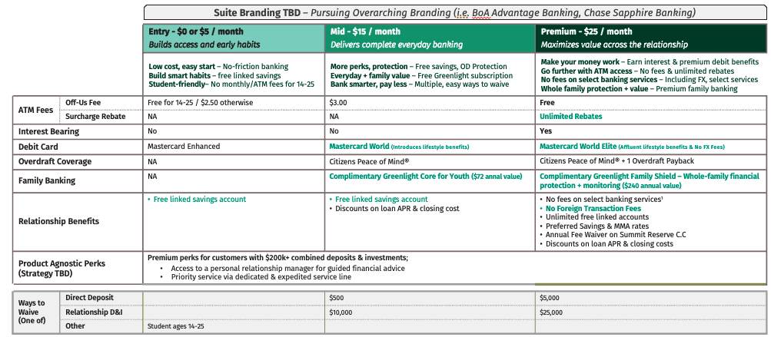
LEARNINGS FROM INTERVIEWS
The immediate priority is a simpler checking continuum with clearer reasons to choose and move up
Simplify into three tiers – an entry, a
mid, and a premium product in place of
today’s five.
Bring more value with Greenlight – family
banking as a reason the account matters
day to day.
Make the differences legible – account
fees, ATM fees, cards, overdraft coverage,
and relationship benefits that separate
the tiers at a glance.
“The biggest challenge for us is making sure these products come to life in such a way that …there's a real reason why customers would want to open each one of them.”
The working three-tier concept, as shared
Sources: Citizens stakeholder interviews and working materials, Aug 2026 · Quotes lightly edited.
“This is an entry level product. This is a
mid-level product. This is a more mature
product so that … it’s obvious to
the consumer.”
Notes:
“"What we've heard from customers is like they want financial value out of the product...”
“...where we're building our differentiation is really around the family banking side of the house, the ATM access... I think that's going to be really important with all of this... making sure that the narrative comes through and how we talk about these products and the problems, the real-world problems we're trying to solve.””
“"I think what we learned through the process was our current deposit suite is very much a, as some of our leaders like to use the phrase, a dog's breakfast. It's a bit fragmented, a bit complex, a bit overcrowded. We have too many products. There's very little distinction between the products, which creates for very difficult sales conversations in the field..."

Slide 12
LEARNINGS FROM INTERVIEWS
This checking continuum will launch before a broader loyalty revamp
NOW
Simplify the checking products to three
tiers, and position and name them in a
way that is competitive and descriptive.
The lineup launches first – the naming and
positioning work lands here.
FUTURE
Differentiate the loyalty program –
an additional layer of recognition on
top of checking.
The rewards component follows the lineup
rather than launching with it.
“It will launch sometime after the checking product lineup – we also have to think about how we handle that program that will not be tethered to a product.”
Source: Four Citizens stakeholder interviews, Aug 2026 · Quotes lightly edited.

Slide 13
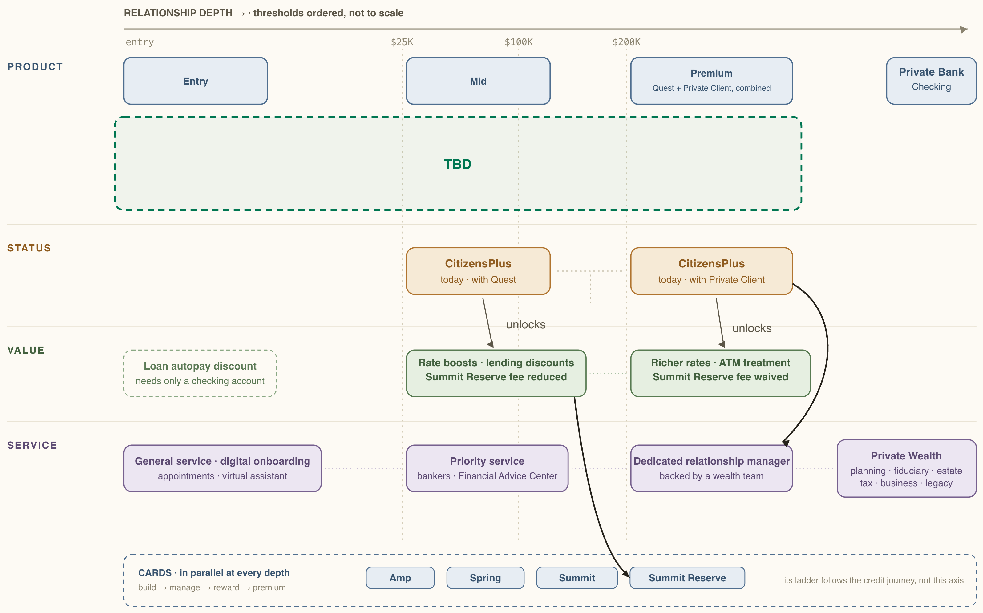
CITIZENS TODAY
The products
are set, but the
connections
are still open
replaces Quest and
Private Client checking
savings simplifies with the launch:
TBD
a new account, free with checking,
as currently understood
already decided: Private Client and the premium checking product will be separate
There are still decisions to be made on how the products connect to recognition, value, and service. Names and positioning inherit those decisions.
Still to be decided
What earns recognition, and what
value follows it
How Private Client works
Where service genuinely changes
What CitizensPlus becomes
How names and positioning stay in step
Sources: Citizens project brief · Stakeholder interviews, Aug 2026.

Slide 14
Citizens
How we analyze ecosystems
1
Citizens today
2
The customer to win
3
What we learned from the category
4
Where loyalty is going
5
Initial ecosystem recommendation
6

Slide 15
THE CUSTOMER TO WIN
Both Wealth Builder segments already hold
real assets and use several financial providers
79/88%
76%
5.6/6.0
1st
hold $100K+ in assets (IWB/PWB)
use at least 5 financial
products (IWB)
products held on average
(IWB/PWB)
advice preference:
an advisor
44%/56% hold $500K or more.
Financial comfort is part of
the definition.
55% use 7 or more.
Diversifying how they bank is key.
Only 3.7 (IWB) sit with their primary bank. Multi-provider
is the norm.
The top-ranked advice
channel. IWB is guidance-ambivalent. PWB is guidance-inclined.
Source: BCG Wealth Builders segment study, Dec 2025.
Alt: 13% assets in motion
indicating higher mobility with their money compared to the average consumer.

Slide 16
THE CUSTOMER TO WIN
But Citizens holds only 3% of primary checking for Wealth Builders, which means they mostly bank somewhere else today
For Independent Wealth Builders (PWB view is similar)
#1 Bank of America
27%
#2 Chase
17%
#3 Capital One
7%
#4 TD Bank
5%
#5 Wells Fargo
4%
#6–#8 three banks
#9 Citizens
3%
Measured on primary checking relationships – customers holding any Citizens product are a separate, wider count.
Source: BCG Wealth Builders segment study, Dec 2025.

Slide 17
THE CUSTOMER TO WIN
While growing with WBs has three levers, this means the first two should be greater priorities for the ecosystem
1
Win new customers
Needs credible front doors, and clear reasons to choose Citizens.
2
Turn secondary
relationships primary
Needs to recognize customers who already hold something here.
3
Deepen existing primary
relationships
Needs a visible next move beyond the account.
Real, and already underway – but a 3% base makes it the narrower path for segment growth.
Note: this is an ecosystem-led perspective; opportunity sizing / financial analysis would be needed to conclusively validate
Sources: Citizens project brief · BCG Wealth Builders segment study · Working sessions, Aug 2026.

Slide 18
THE CUSTOMER TO WIN
However, in today’s ecosystem, a deeper relationship can only be accessed with Quest or Private Client Checking
There are viable Wealth Builder paths into Citizens that the ecosystem isn’t designed for right now.
ILLUSTRATIVE
CASE 1 · $200K IN BALANCES, NO QUALIFYING CHECKING
THE DEEPER RELATIONSHIP
Money market
Savings
Credit card
Mortgage
Recognized status · CitizensPlus
THE ONE OPENING
Quest or Private Client
Relationship benefits
checking
CASE 2 · CHECKING HERE, PRIMARY CHECKING ELSEWHERE
One Deposit · $50K
a real balance – but their primary checking is elsewhere, so the ecosystem gives no obvious reason to switch
Dedicated service and a pathway
Sources: Citizens published program rules and working sessions, Aug 2026 · Illustrative, not customer records.

Slide 19
THE CUSTOMER TO WIN
Ultimately, the question to answer for Wealth Builders and beyond: how should Citizens recognize and grow a customer relationship, before and after it becomes primary?

Slide 20
Citizens
How we analyze ecosystems
1
Citizens today
2
The customer to win
3
What we learned from the category
4
Where loyalty is going
5
Initial ecosystem recommendation
6

Slide 21

WHAT WE LEARNED FROM THE CATEGORY
The category uses three primary ecosystem types, each a different answer to the recognition question
1
Status in the product
2
Status earned by balances
3
Status earned by behavior + breadth
The checking product determines the relationship
state – Wells Fargo leaves it inside the product;
Citizens names it CitizensPlus.
A status layer across all accounts – combined
balances set the tier.
A status layer across all accounts – activity and
product breadth earn it.
$
$
$
✓✓✓✓✓
+1
the account carries the relationship
earned by combined balances
earned by activity and breadth
Who runs it
Who runs it
Who runs it
TD builds a service state instead – $100K in deposits or investments qualifies a customer for TD Premier. No status program beneath it.
Chase publishes no relationship program – branches,
referrals, and the card engine carry coherence instead.
Source: Eight-institution audit of published program terms, verified Aug 2026.

Slide 22
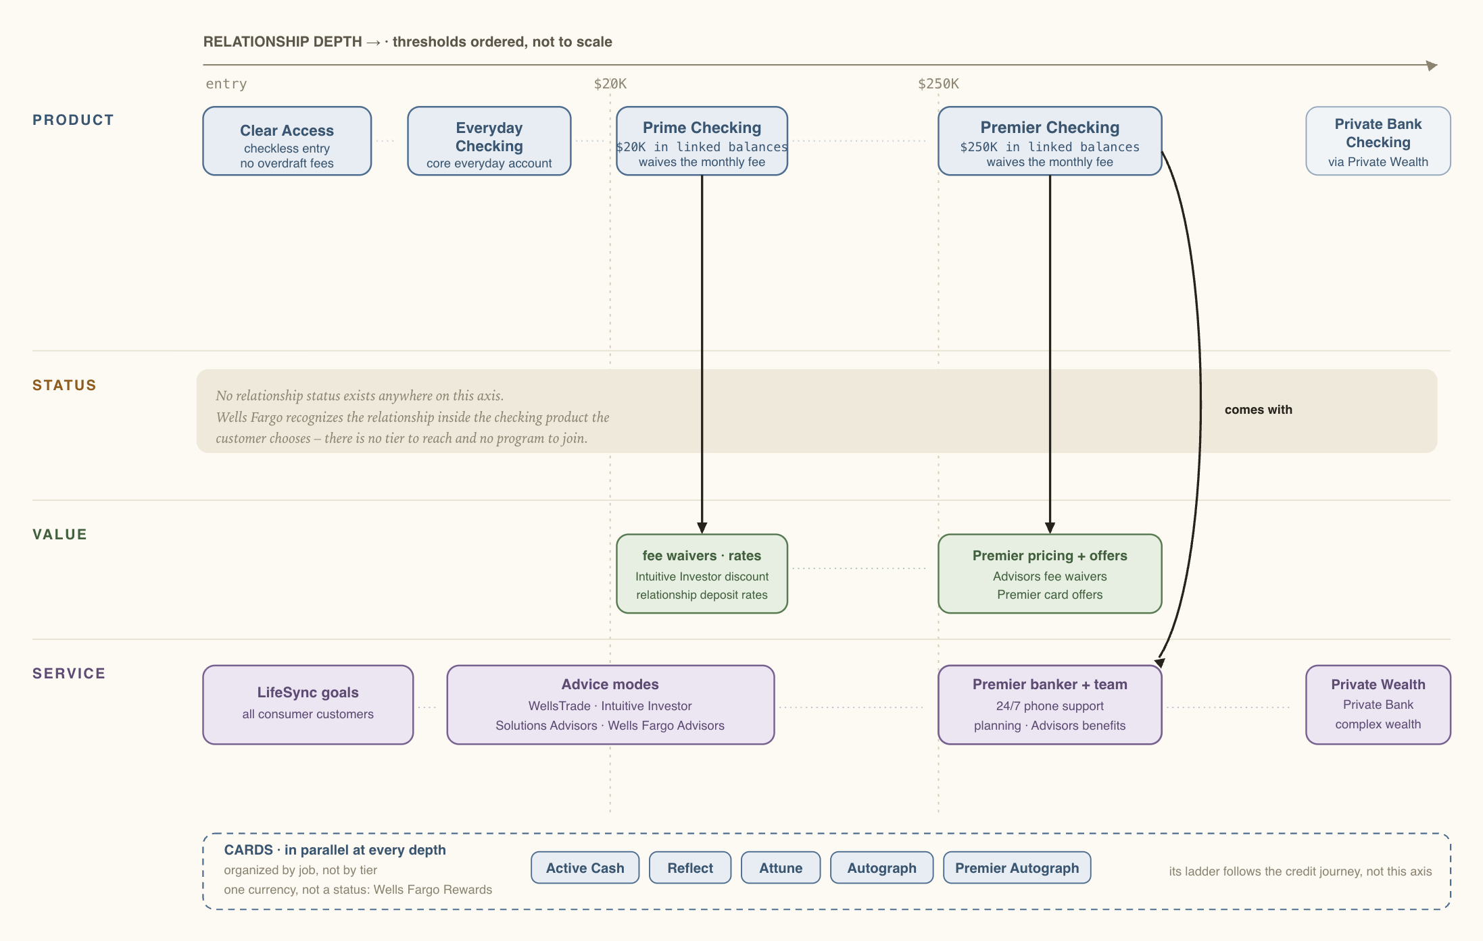
WHAT WE LEARNED FROM THE CATEGORY
In the product
Earned by balances
Earned by behavior + breadth
Wells Fargo
is closest
to Citizens:
the account
is the status
The rule
The account is the status –
moving up means switching
products; $20K and $250K
set fees, not recognition
What it buys
Each product carries its
own benefits – Premier
adds bankers, planning, and
advisor access
The limit
No status object and
nothing automatic –
affluent growth runs
through Premier bankers
and referrals, not
a mechanic
Sources: Wells Fargo published product and program terms · Wells Fargo 2025 Annual Report.

Slide 23
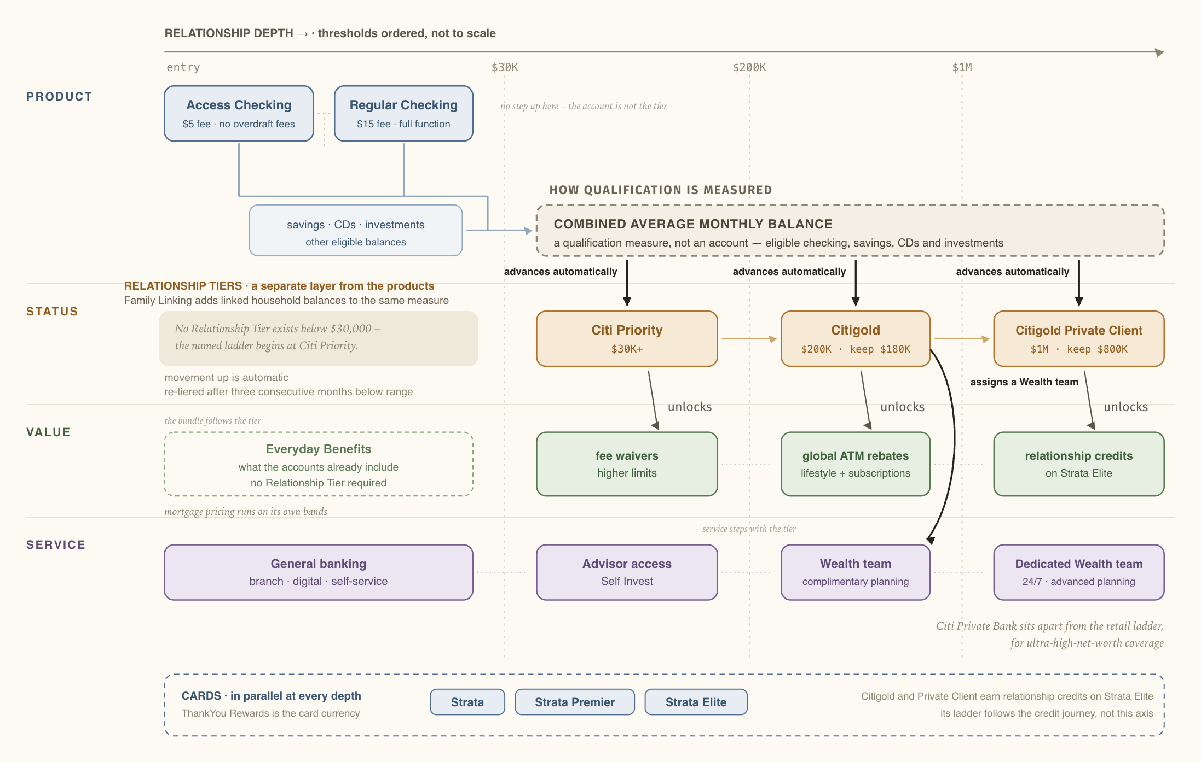
WHAT WE LEARNED FROM THE CATEGORY
In the product
Earned by balances
Earned by behavior + breadth
Citi, PNC &
BofA set status
by combined
balances
across products
The rule
Combined deposits and
investments set the tier,
automatically – floors at
$30K Citi, $25K PNC, $0 BofA
What it buys
Value rises by tier –
rates, lending discounts,
fee treatment, and
service access
The limit
It rewards consolidation –
some customers move
exactly enough to qualify,
and park the rest
Citi shown – the same shape runs at PNC
and BofA.
Sources: Citi, PNC, and Bank of America published program terms, verified Aug 2026.

Slide 24
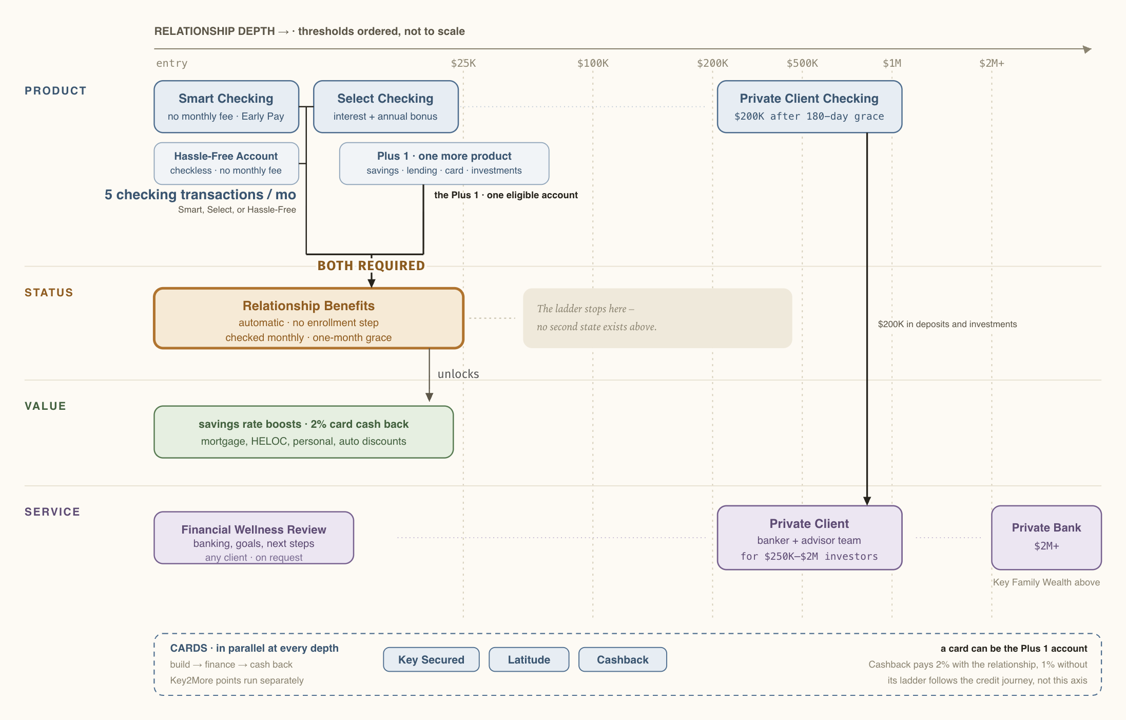
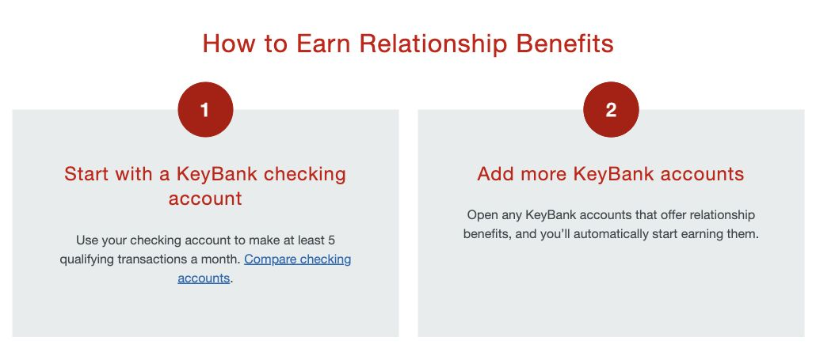
WHAT WE LEARNED FROM THE CATEGORY
In the product
Earned by balances
Earned by behavior + breadth
KeyBank lets activity & breadth earn status: a design aimed at primacy
The rule
Five checking transactions a
month, plus one more Key
product – no balance test
The published rule behind the highlighted region – key.com,
captured Aug 2026
What it buys
Better savings rates, 2%
card cash back,
loan discounts
The limit
No next recognized step
until Private Client at $200K
– the middle goes unmarked
Source: KeyBank published program terms and disclosures, verified Aug 2026.

Slide 25
WHAT WE LEARNED FROM THE CATEGORY
Five key findings across the models
1
2
3
4
5

Slide 26


WHAT WE LEARNED FROM THE CATEGORY · FINDING 1 OF 5
1
2
3
4
5
Most banks treat checking as the start of a primary relationship,
but many customers treat it as just another account
WHERE CHECKING IS REQUIRED TO ACCESS STATUS / BENEFITS
Primacy often comes later
Quest or Private Client checking
49%
26%
A checking product, or enrollment built on one
of new checking openings were
secondary accounts
replaced a prior
checking account
WHERE CHECKING IS NOT THE ONLY WAY TO ACCESS STATUS / BENEFITS
49% secondary
26% replacement
25% first account
J.D. Power account-opening analysis, Q4 2025
Checking, savings, or CD – more doors
Affluent customers increasingly define their main relationship
through their card and where they build wealth – not only the
checking account.
$100K in deposits or investments – more doors
Curinos shopper survey, Q1 2025 – affluent and HENRY segments
Citizens’ own test points the same way – moving customers to a better checking product did not pull their money in: “While there is an incremental lift,
there is very little balance augmentation post upgrade.” – Cycle Upgrades readout
Sources: Published program terms · J.D. Power account-opening analysis, Q4 2025 · Curinos shopper survey, Q1 2025 · Citizens Cycle Upgrades.

Slide 27
WHAT WE LEARNED FROM THE CATEGORY · FINDING 2 OF 5
1
2
3
4
5
The role of checking determines what
its product names need to communicate
When moving up means changing checking accounts, names tend to signal progression. When status is separate, names can describe fit.
Checking Ecosystem Role
Carries the relationship progression
Checking Ecosystem Role
Serves different everyday banking needs w/ relationship progress determined by something else
Names that progress
One family name, described
Standalone, descriptive
Gives customers a progression they can read
Creates a cohesive brand with need variants
Makes account choice easy
Everyday
Prime
Premier
Advantage SafeBalance
Advantage Plus
Advantage Relationship
Access · Regular
Virtual Wallet
Citizens’ checking names are currently standalone, descriptive — but should signal progression if that’s how we want customers to progress
TD attaches no status to its products, yet its names climb anyway – Essential → Complete → Beyond. The tradeoff: climbing names imply a
progression, and without a status object behind them, the products alone have to deliver it.
Source: Ogilvy analysis of published product names across the audited set, verified Aug 2026.

Slide 28
WHAT WE LEARNED FROM THE CATEGORY · FINDING 3 OF 5
1
2
3
4
5
Cards and lending are mostly separate from the core banking ecosystem with light connections via targeted benefits
The CATEGORY PATTERN
Banking status gives you select card and lending benefits
The CONNECTION
Who runs it
YOUR BANKING RELATIONSHIP STATUS
Banking status boosts card rewards –
up to +75% (points bonus) at the top tier
PNC · Bank of America
Gives benefits
Gives benefits
Banking status reduces the premium-card fee
(Summit Reserve)
Citizens
CARDS
LENDING
Banking status discounts lending
rates and fees
across the set
has its own system
mortgage, HELOC, auto
Why this is likely common
Cards and lending have their own economics, underwriting, risk and servicing. Full integration creates real cost + complexity. KeyBank is the outlier: cards can be the “+1” that unlocks status.
Where the opportunity is
Cards now account for 35% of consumer payments (up from 18% in 2016). Citizens can keep cards separate, but targeted bridges could make the broader relationship more valuable and visible.
Sources: Published program terms · Federal Reserve Diary of Consumer Payment Choice, 2016 to 2024.

Slide 29



WHAT WE LEARNED FROM THE CATEGORY · FINDING 4 OF 5
1
2
3
4
5
Some banks are recognizing the relationship from Day 1, granting status without a balance requirement
In May 2026, BofA moved its rewards entry from $20K to $0 – every customer now starts as a Member.
THE FULL BOFA REWARDS LADDER
thresholds ordered, not to scale
moved May 2026
Member
Preferred Rewards
Preferred Plus
Preferred Honors
Premier
$0
entry was $20K
$30K
$100K
$1M
What Member changes
Small new value below the old $20K entry – a 10% card-reward boost and a $100 mortgage-fee reduction now start at $0.
Existing features renamed as membership – merchant deals and fraud monitoring customers already had.
Mainly a naming change – a recognized state from the first dollar, with the next level visible and worth moving up to.
Where digital banks start
What customers want
At digital banks, membership comes with the account itself – tiers, where they exist, are earned by direct deposit and activity, not assets. SoFi also has “SoFi Plus” — an upgraded subscription membership.
60%
want rewards based on the whole relationship
Accenture 2025, 39 markets
Sources: Published program terms · Accenture Global Banking Consumer Study, 2025.

Slide 30

WHAT WE LEARNED FROM THE CATEGORY · FINDING 5 OF 5
1
2
3
4
5
The category runs the affluent relationship three ways
and “Private Client” or “Premier” can name any of them
A product the customer upgrades to
A status the customer earns
A managed relationship the customer enters
Moving up means a new checking account
Status changes – the checking account doesn’t
The team changes – the checking account doesn’t
Wells Fargo Premier – the checking
product is the affluent relationship
$250K
Citigold Private Client – combined
balances move the customer up the
tiers automatically
TD Premier, then Private
Client Group – two steps; checking account stays while team and coordination change
$1M
$100K · $1M+
Chase Private Client – checking,
benefits, and banker in one account
$150K
BofA Rewards Premier – the renamed
program’s $1M top tier, on any eligible
checking account
$1M
J.P. Morgan Private Client –
Chase’s integrated banking-
and-wealth relationship
above Private Client
TODAY
Private Client Checking – account,
benefits, and service in one
$200K
not published
PNC Premier Client – a banker-
and-advisor team, with status
named separately
The only other banks running this form are the two audited banks with no named relationship program
$100K+
Across the audited set, every highest named affluent step uses either Premier, Private Client, or both. (Citi uses Citigold as $200K status, then uses Private Client above it). Citizens’ choice is whether to make Private Client clearly distinct from Private Bank or take on the education burden of a new name.
Source: Eight-institution audit of published program terms, verified Aug 2026.

Slide 31
WHAT WE LEARNED FROM THE CATEGORY
1
2
3
4
5
The category doesn’t prescribe a model – it gives
Citizens five considerations for the new ecosystem
What the category shows
For the ecosystem
Checking is the usual gateway, but primacy often comes later.
Keep checking as a core entry point without making
it the only route to recognition
Checking names signal either progression or fit, depending
on its role in the ecosystem.
Align checking names to whether the products signal
progression or serve distinct needs.
Cards and lending usually stay separate, with targeted
benefits connecting them.
Connect cards and lending selectively through benefits
that make broader relationship value visible.
Recognition can begin before customers consolidate
large balances.
Allow recognition to begin with membership or activity
before balances are large.
Premier and Private Client are familiar labels used for different upper-affluent structures.
Clarify the roles of premium checking, Private Client, and Private Bank while weighing any new name against its education cost.
Source: Ogilvy analysis of published program terms across the audited set, verified Aug 2026.
Notes:
Keep checking as a core entry point without making it the only route to recognition.
Align checking names to whether the products signal progression or serve distinct needs.
Connect cards and lending selectively through benefits that make broader relationship value visible.
Allow recognition to begin with membership or activity before balances are large.
Clarify the roles of premium checking, Private Client, and Private Bank while weighing any new name against its education cost.
1 Checking is the usual gateway, but primacy often comes later. 2 Checking names signal either progression or fit. 3 Cards and lending usually stay separate, with targeted benefits connecting them. 4 Recognition can begin before customers consolidate large balances. 5 Premier and Private Client are familiar labels used for different upper-affluent structures.

Slide 32
Citizens
How we analyze ecosystems
1
Citizens today
2
The customer to win
3
What we learned from the category
4
Where loyalty is going
5
Initial ecosystem recommendation
6

Slide 33
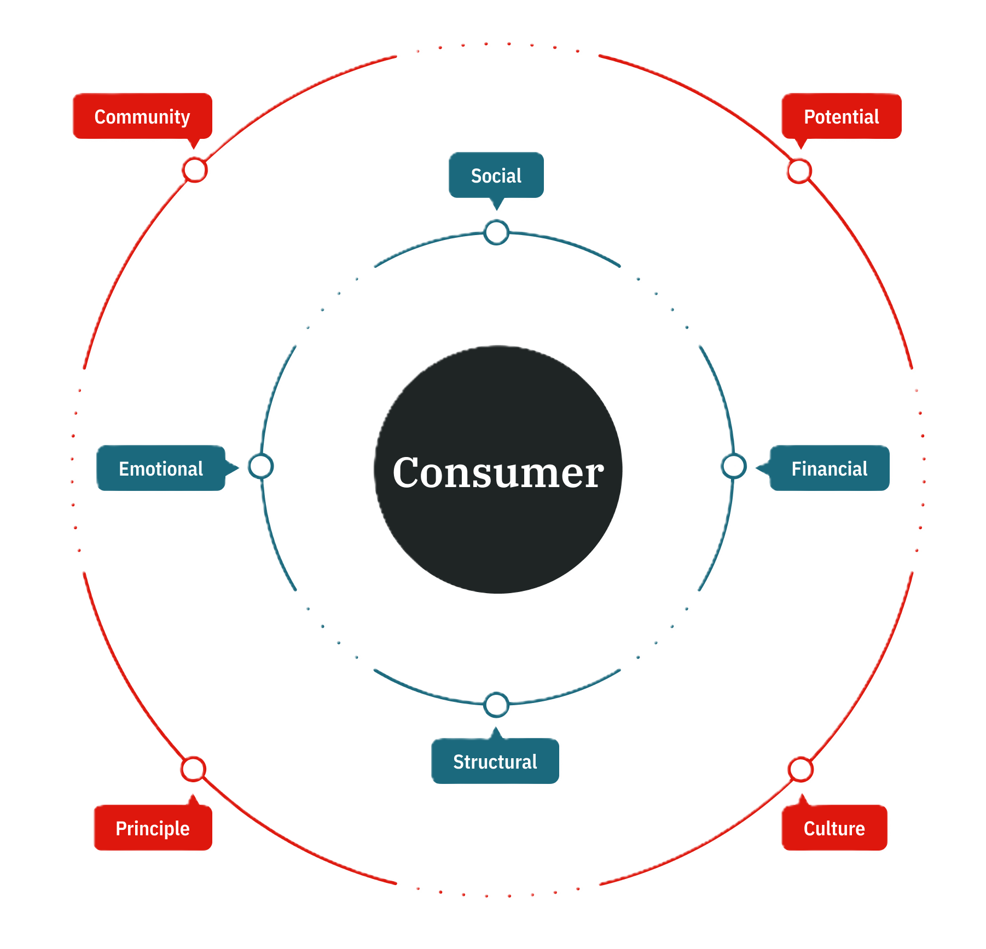
THE STATE OF CUSTOMER LOYALTY
Modern loyalty is expanding from isolated transactional perks to holistic, relationship-wide recognition
Loyalty isn't a program—it's personal.
The Unbound Consumer
Daily marketing noise and historic lows in trust have broken traditional loyalty norms. Consumers no longer default to brand rules - they reward banks that actively enable their financial lives.
Principles of Brand Devotion in Banking
Drive Financial Progress (Financial & Structural Bonds) Provide active tools and guidance that build momentum to unlock true customer Potential.
Recognize Total Engagement (Emotional & Social Bond) Measure loyalty through cross-product depth and shared milestones to build Community.
Make Value Persistently Visible (Culture & Awareness) Proactively show unlocked benefits in real time.
Fewer than 1 in 6 bank customers realize when they unlock new resources.
Loyalty benefits are invisible if not continuously communicated.
Brand Devotion
The Four Bonds establish a strong
foundation for consumer–brand relationships.
The Four Dimensions sustain those consumer–brand relationships.
33

Slide 34

WHERE LOYALTY IS GOING
Best-in-class programs make relationship value visible through continuous communication, visual progress, and lifestyle framing
Cross Category Loyalty Analysis
LOYALTY MECHANICS
WHAT MEMBERS GET
STRATEGIC IMPLICATION FOR CITIZENS
Mobile Habit Engine
Real-time in-app Star progress bars, push notifications for streak challenges, and instant post-swipe reward alerts.
Visual Progress: Highlights how digital habit-tracking can turn everyday banking into active daily engagement.
(Starbucks Rewards)
Aspirational Status Hierarchy
Pre-stay benefit reminders (upgrades, late checkout), dedicated Ambassador messaging, and milestone annual reviews.
Service Recognition: Demonstrates how upper-tier status can be expressed through priority service routing and human handoffs rather than rate discounts alone.
Digital Customer Advocacy
Smart "Savings Bucket" milestone notifications, automated booster alerts, and surprise-and-delight perk emails.
Automated Advocacy: Illustrates how automated savings tools and goal-tracking build long-term deposit retention without relying purely on promo rates.
(Loyally)
Hybrid Digital Membership (Subscription / Direct Deposit)
High-yield APY boosts, credit card matches, loan discounts, and weekly financial digests.
Cross-Product Coherence: Shows how digital banks use "membership framing" to unify checking, savings, lending, and investing under one roof.
Subscription-Based Value
Real-time IRA match calculators in-app, monthly subscription savings summaries, and high-yield interest earned trackers.
Behavioral Fast-Tracks: Proves emerging wealth builders respond to transparent ROI and behavior-driven access over rigid balance walls.
(Robinhood Gold)
34
Notes:
Strategic Loyalty Principle: The strongest programs make participation visible, give customers a sense of progress, and connect benefits to the broader brand experience rather than treating loyalty as a separate rewards catalog.

Slide 35
Citizens
How we analyze ecosystems
1
Citizens today
2
The customer to win
3
What we learned from the category
4
Where loyalty is going
5
Initial ecosystem recommendation
6

Slide 36
ECOSYSTEM DIRECTION · OUR RECOMMENDATION
We explored three ecosystem directions and recommend the one that best fits where Citizens is going
These directions are developed enough to compare, but the recommended ecosystem still needs validation and design.
OUR RECOMMENDATION
A · PRODUCT-LED
B · BALANCE-LED
C · RELATIONSHIP-GROWTH-LED
Build around
the checking
product they hold
Build around
the balances
they consolidate
Build around
how they use & grow
the relationship
SET ASIDE
WHY WE RECOMMEND IT
SET ASIDE
A relationship can grow without the product
changing – Citizens’ own upgrade data showed little
balance growth after product moves.
Given the decisions already made and what the
research shows, this is the direction that best supports Citizens’ objectives
Requires behavioral rules, data, and comms that introduce greater complexity. But its core concept is compelling and could be a long-term vision.
Full direction in Appendix
Full direction in Appendix

Slide 37
ECOSYSTEM DIRECTION · OUR RECOMMENDATION
THE BALANCE-LED ECOSYSTEM
We recommend building around combined balance to determine relationship status
Simplified checking-continuum view
PRODUCT
Entry checking
Mid checking
Premium checking
1. Relationship status is determined by combined balances
Combined eligible balances
Deposits + savings + investments
Eligible deposits and investments place customers at to-be-set levels. Customers move up as they bring more of those balances to Citizens.
STATUS (# of level TBD)
To define: which balances count, whose can be combined, and when they are measured.
Level 1
Level 2 · timing TBD
Level 3 (tied to PC)
2. Checking choice is separate from relationship status
Customers choose the checking product that fits what they need. Their status changes with combined balances, not with an account upgrade.
VALUE
One system of status levels (# TBD). Names are placeholders.
To define: whether checking is required to enter status and when upgrades are reco’d.
Launch benefits step up with the levels – rate boosts, fee treatment, recognition
3. Benefits and service increase with status levels
+ From 2028, the program expands: experiences, access, partner perks
Benefits increase as customers move up. Level 1 keeps standard digital+branch service. Advisory offer in Level 2 is still to be shaped. Level 3 is tied to Private Client ($200k).
To define: the service commitment that can be consistently delivered at each level.
SERVICE
Digital baseline
Advisory step · TBD
Private Client service*
4. The 2028 program connects activity to new forms of value
at entry
near the mid level
dedicated relationship
At launch, balance-led status, benefits, and service. In 2028, the program can add partner perks, experiences, and access without changing how the status levels work.
*working label – final names, including the premium product, come from the naming work
To define: which names need to be set at launch and which can wait for the loyalty work

Slide 38
ECOSYSTEM DIRECTION · OUR RECOMMENDATION
Balance-led is the strongest working
hypothesis across three key lenses
This is our current assessment. Full validation still requires financial, operational, and organizational analysis.
IS IT FEASIBLE?
IS IT DESIRABLE?
IS IT VIABLE?
1
2
3
Fits decisions already made
Serves the key customer groups
Prepares for 2028
The premium merge and Private Client direction both separate the relationship level from checking choice.
Wealth builders bank across providers, affluent
customers say they want coordinated service, and
the everyday base is recognized from day one.
The balance-led levels give the planned loyalty revamp a clear structure to add to.
Ecosystem direction recommendation · August 2026

Slide 39
WHY BALANCE-LED · 1 OF 3
1 · Fits decisions already made
2 · Serves the key customer groups
3 · Prepares for 2028
The Private Client decision separates recognition from the product
– our recommendation extends that principle to every level
The merged premium product can no longer define Private Client
THE CURRENT DECISION AT THE TOP
Once Quest and Private Client Checking become one premium product, the checking product can no longer determine who is a Private Client.
Any checking
+
$200,000 combined
Private Client*
product
balances
status + service
The $200,000 threshold already depends on combined balances
decided direction: balances set Private Client, from any checking product
Combined balances set the threshold, making Private Client available from any checking product.
EXTENDED TO EVERY LEVEL
One rule for every level is simpler than two
Entry checking
Mid checking
Premium checking
Extending the same principle everywhere avoids product rules for some customers and
relationship rules for others.
The counter-scenario: Balances could qualify only the Private Client relationship, while the rest is product-led. TD shows that this lighter model is viable. Simpler at launch, but gives customers less visible progression across the relationship.
Combined eligible balances
L1 · L2 · L3 (Private Client*)
On the name: Private Client is the working label. The choice to make:
Use Private Client for both the level and service
Extend the name, as Citi does with Citigold Private Client
Give the level another name and reserve Private Client for the service
one qualification rule, regardless of the checking product the customer holds
*working label
Citizens product direction, August 2026 · Citizens published Private Client threshold · Citi and TD published program materials · *working label

Slide 40
WHY BALANCE-LED · 2 OF 3
1 · Fits decisions already made
2 · Serves the key customer groups
3 · Prepares for 2028
This ecosystem designs for Wealth Builders, while serving the broader affluent and the everyday base, too
3.7
products at the
primary bank vs. products held overall
(IWB; PWB: 4.1 of 6.0)
Wealth builders hold products beyond their primary bank, and Citizens is the primary
checking bank for about 3% of the segment. Counting combined balances gives them a clear reason to bring more here and gives Citizens more ways to grow with them.
WEALTH BUILDERS
The growth target
of 5.6
About 3 in 10 affluent clients prefer one firm for banking and wealth. At $200,000, Private Client* pairs the top relationship level with dedicated service without requiring a checking upgrade.
~30%
of $1M–$25M clients
prefer one firm for
banking and wealth –
2023 stated preference
THE BROADER AFFLUENT
What they have asked for
of new checking
accounts opened as
secondary in late 2025 –
industry-wide,
not Citizens-specific
Every checking customer starts at the Level 1 entry with a visible first benefit, creating a connection that can encourage banking primacy. The relationship deepens after the account is opened.
49%
THE EVERYDAY BASE
Richer everyday relationships
Client-supplied retail banking survey, December 2025 fieldwork (products held; paraphrased) · McKinsey affluent consumer research, 2023 · J.D. Power U.S. retail banking research, Q4
2025 · Citizens published Private Client threshold · *working label

Slide 41
WHY BALANCE-LED · 3 OF 3
1 · Fits decisions already made
2 · Serves the key customer groups
3 · Prepares for 2028
In 2028, loyalty can connect activity to experiences, access, and partner benefits without changing the status system
Sequence is illustrative — could be a single launch in 2028
PRE-2028
FROM 2028 · THE PROGRAM EXPANDS
Combined balances determine the relationship level. Benefits and service follow.
Adds more ways to earn via activity + behavior. Status stays the same.
Entry checking
Mid checking
Premium checking
Entry checking
Mid checking
Premium checking
Level 1
Level 2 · timing TBD
Level 3 (tied to PC)
Level 1
Level 2
Level 3 (tied to PC)
Relationship benefits increase with status
Relationship benefits continue to increase with status
Space held for the program
Activity can unlock experiences, access, and partner benefits
The levels reflect what customers keep at Citizens – deposits and investments
The program rewards how actively customers bank with Citizens
The design intent: Whether launched in two parts or at once, this shape ties together two measures into one program. Combined balances determine status. Activity and engagement can unlock additional value without changing that status. Timing, naming, and program design remain to be validated.
Citizens loyalty sequencing as discussed, August 2026 · Loyalty program design remains future scope with its own validation path · *working label

Slide 42
ECOSYSTEM DIRECTION · FOR DISCUSSION
Let’s discuss — open questions
Entry checking
Mid checking
Premium checking
1
THE SHAPE
Is one set of relationship levels, determined by combined balances and separate from checking choice, the right direction? What challenges or questions does it raise?
Combined eligible balances
2
LAUNCH SCOPE
One status system
What should launch with the checking continuum, and what should wait for 2028?
Entry · Mid · Private Client*
3
SERVICE COMMITMENT
Relationship benefits step up with the levels
What service can Citizens consistently deliver at each relationship level?
+ Activity + engagement add behavioral perks
4
THE RULES
Service, connected to the levels
Which balances count, whose balances can be combined, when are levels measured, and who owns the rules?
*working label
5
NAMING AHEAD
Would we be comfortable naming the relationship program and its levels before the 2028 version of the program is fully designed? Could we use CitizensPlus?
We recommend the overall shape. The detailed rules and thresholds still need validation.
For discussion · August 2026 · Private Client is a working label throughout

Slide 43
CLOSE
Next Steps
1
Gather feedback on the findings and initial recommendation
2
Incorporate feedback and confirm the high-level ecosystem direction
3
Kick off positioning and naming from the agreed direction

Slide 44
Citizens
Thank you

