Slide 1
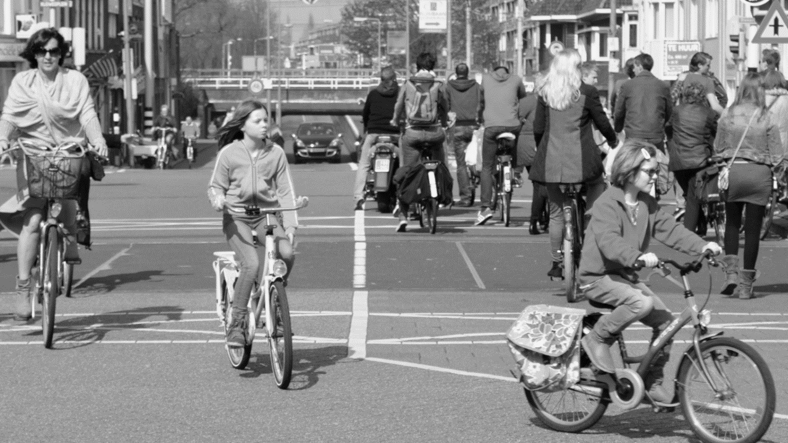
CASE-STUDY
CYCLISTIC BIKE-SHARE COMPANY
Done By:
Anita Dash
This Photo FROM GOOGLE IMAGES.

Slide 2
BUSINESS TASK
Analyze the Cyclistic bike trip data from past one year (May 2021 to April 2022) to identify how annual members and casual riders use Cyclistic bikes differently.

Slide 3
FACTORS THAT MAY LEAD TO DIFFERENCES
D
M
S
B
Days of the week
Month
Season
Type of Bikes
Identify trends or patterns on how Annual Members and Casual Riders use the bikes in different days of the week
Identify trends or patterns on how Annual Members and Casual Riders use the bikes on different Months
Identify trends or patterns on how Annual Members and Casual Riders use the bikes in different Seasons
Identify trends or patterns on how Annual Members and Casual Riders use different types of bikes

Slide 4
Days of the week
Casual Riders Tend to ride more often on the weekends
Annual Members Tend to ride more during the weekdays

Slide 5
Month
Even though the Average ride length is higher for Casual Riders, Annual Members tend to ride more frequently from around the end of September to mid June
There is a steep decline in the average ride length for Casual Riders in the month of November which gradually increases around the month of January
Average ride length for Members is more or less consistent with a slight decline

Slide 6
Season
Both Casual Riders and Annual members tend to ride more frequently during the fall season, and the least during the season of spring.
Average ride length is the highest for Casual Riders during the season of summer.
The average ride length is almost consistent for Annual Members throughout the seasons.

Slide 7
Type of Bike
Casual Members are the only riders that use the docked bike, even though used the least frequently amongst them it has the largest average ride length.
Annual members and Casual Riders tend to use classic bike more frequently

Slide 8
Key insights
Annual Members tend to ride more often during the weekdays, while Casual Riders tend to ride more often during weekends, hence implying Casual Riders normally tend to use cyclistic for leisure purposes while Annual Members use it mostly to commute to work.
The above insight can also be supported by the frequency of rides for Casual Riders being the Highest during Summer-fall, as these seasons are normally the season for vacation and leisure travels
The frequency of Casual Riders decreasing in the months November-December can imply that due to the cold Casual Riders do not want to ride in cycles, While the consistent travel ride length for Annual Members Show that despite the season the riders need to commute for work.
Both the type of riders tend to use classic bike more frequently however Casual Riders are the only users of docked bike

Slide 9
Recommendations
Casual Riders have higher average ride lengths compared to Annual Members in almost all the factor based findings. Higher time of travel each ride might encourage them to buy annual memberships.
Casual Riders tend to ride more frequently in the weekends and in the months of summer-fall, Encouraging them to use the bikes to commute for work and other non-leisure activities will lead to increase in conversions from Casual Riders
Casual Riders tend to use classic bike the most frequently, and docked bikes have the highest average ride length, targeting docked bike riders for the larger ride length and classic bike riders for a higher frequency can increase conversions.

Slide 10
Thank you

