Slide 1
跳空方向

Slide 2
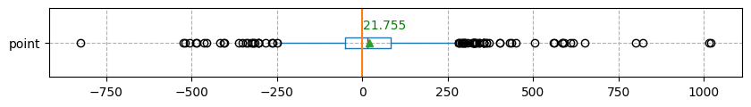

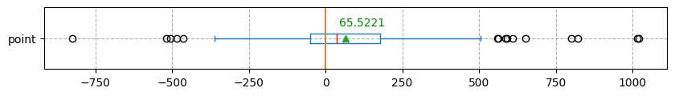

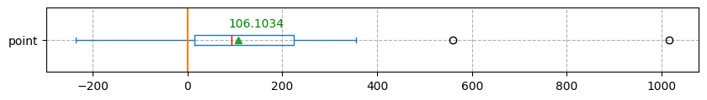

日盤收盤到夜盤開盤 V.S 到隔日日盤開盤
2019-01-01 ~ 2025-02-05
Accuracy: 56.2804%
2024-02-01 ~ 2025-02-05
Accuracy: 62.8319 %
2024-11-01 ~ 2025-02-05
Accuracy :77.5862%
2024-08-05

Slide 3
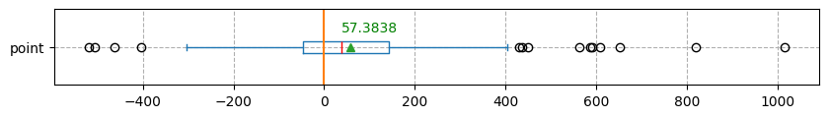

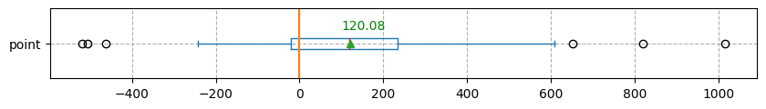

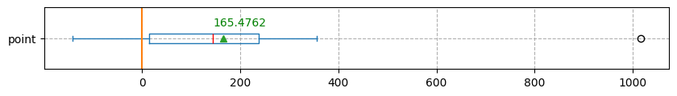

日盤收盤到夜盤開盤 V.S 到隔日日盤開盤 (若日盤到收盤跳空>20點)
2019-01-01 ~ 2025-02-05
Accuracy: 61.6162%
2024-02-01 ~ 2025-02-05
Accuracy: 72.0000 %
2024-11-01 ~ 2025-02-05
Accuracy : 80.9524%

Slide 4
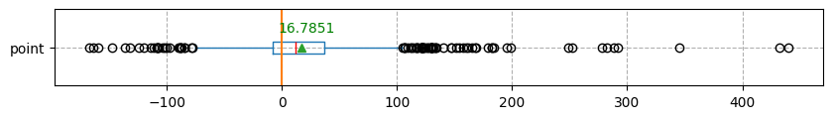

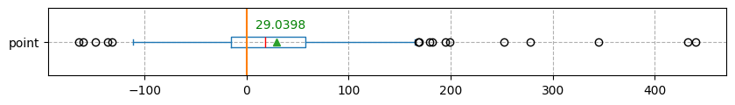

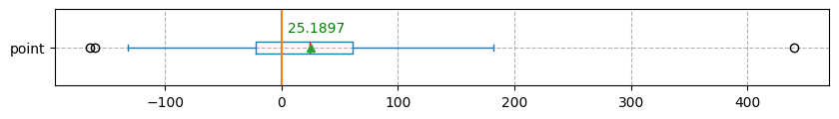

日盤收盤到夜盤開盤 V.S 到台積電期貨開盤前
2019-01-01 ~ 2025-02-05
Accuracy:65.9264%
2024-02-01 ~ 2025-02-05
Accuracy: 66.8142 %
2024-11-01 ~ 2025-02-05
Accuracy: 68.8655%

Slide 5
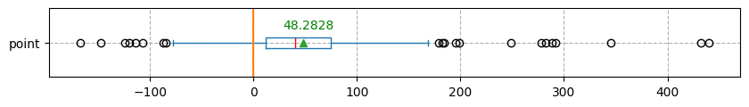

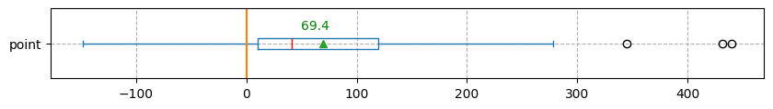

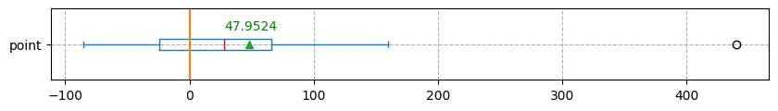

日盤收盤到夜盤開盤 V.S 到台積電期貨開盤前 (若日盤到收盤跳空>20點)
2019-01-01 ~ 2025-02-05
Accuracy: 58.9226%
2024-02-01 ~ 2025-02-05
Accuracy: 80.0000 %
2024-11-01 ~ 2025-02-05
Accuracy: 66.6667%

Slide 6
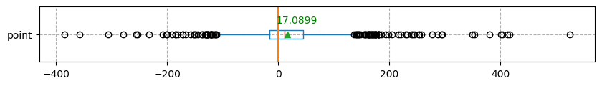

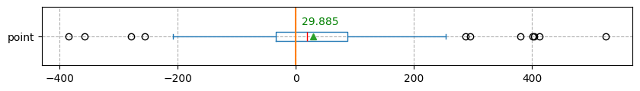

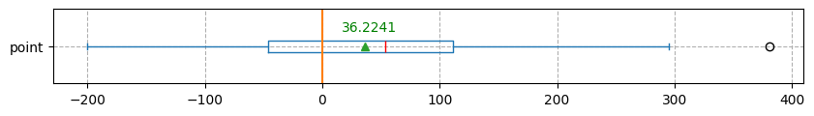

日盤收盤到夜盤開盤 V.S 到美股開盤前(分冬夏令)
2019-01-01 ~ 2025-02-05
Accuracy: 61.0687 %
2024-02-01 ~ 2025-02-05
Accuracy: 60.6195 %
2024-11-01 ~ 2025-02-05
Accuracy: 65.5172 %

Slide 7
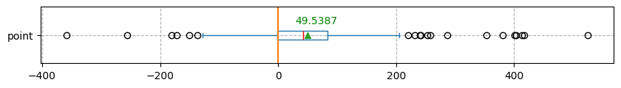

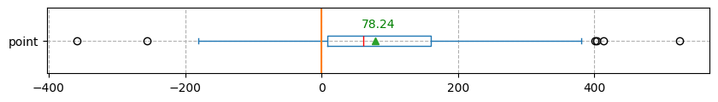

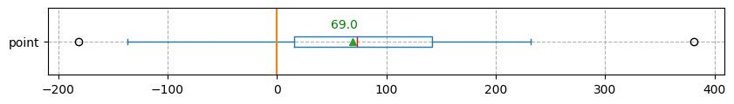

日盤收盤到夜盤開盤 V.S 到美股開盤前(分冬夏令) (若日盤到收盤跳空>20點)
2019-01-01 ~ 2025-02-05
Accuracy: 74.4108 %
2024-02-01 ~ 2025-02-05
Accuracy: 77.3333 %
2024-11-01 ~ 2025-02-05
Accuracy: 80.9524 %

Slide 8
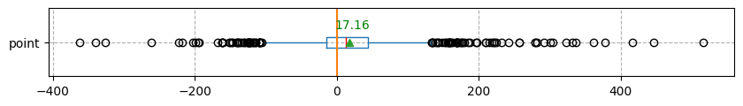

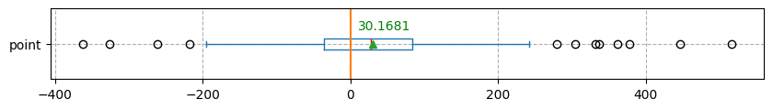

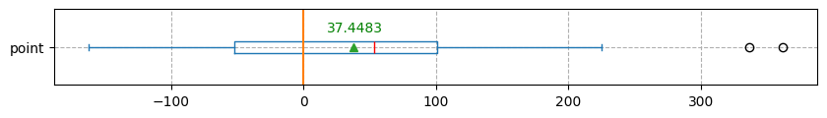

日盤收盤到夜盤開盤 V.S 夜盤開盤到美股開盤前30M(分冬夏令)
2019-01-01 ~ 2025-02-05
Accuracy: 61.4851 %
2024-02-01 ~ 2025-02-05
Accuracy: 61.0619 %
2024-11-01 ~ 2025-02-05
Accuracy: 63.7931 %

Slide 9
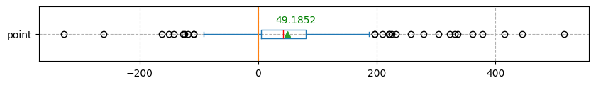

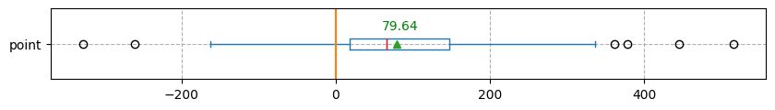

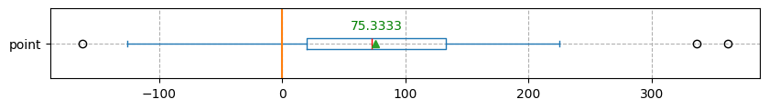

日盤收盤到夜盤開盤 V.S 夜盤開盤到美股開盤前30M(分冬夏令) (若日盤到收盤跳空>20點)
2019-01-01 ~ 2025-02-05
Accuracy: 75.7576 %
2024-02-01 ~ 2025-02-05
Accuracy: 77.3333 %
2024-11-01 ~ 2025-02-05
Accuracy: 80.9524 %

Slide 10
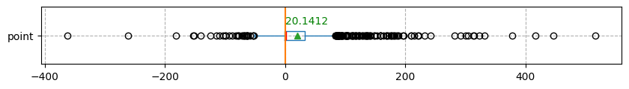

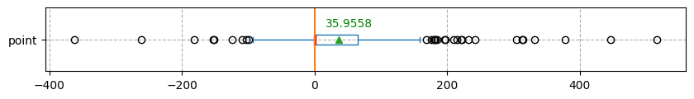

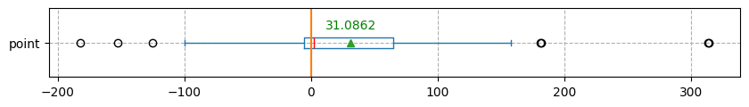

日盤收盤到夜盤開盤 V.S 到美股開盤前(2100)
2019-01-01 ~ 2025-02-05
Accuracy: 62.5954 %
2024-02-01 ~ 2025-02-05
Accuracy: 61.0619 %
2024-11-01 ~ 2025-02-05
Accuracy: 60.3448 %

Slide 11
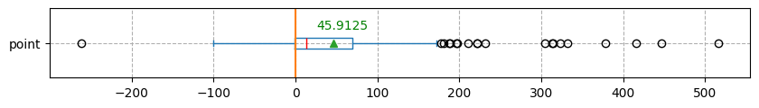

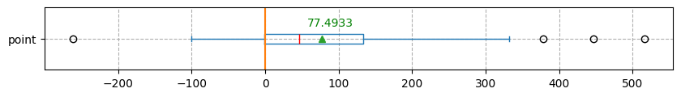

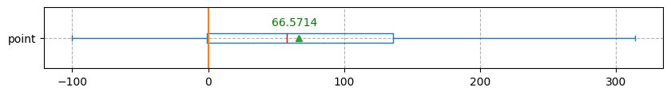

日盤收盤到夜盤開盤 V.S 到美股開盤前(2100) (若日盤到收盤跳空>20點)
2019-01-01 ~ 2025-02-05
Accuracy: 75.4209 %
2024-02-01 ~ 2025-02-05
Accuracy: 73.3333 %
2024-11-01 ~ 2025-02-05
Accuracy: 66.6667 %

Slide 12
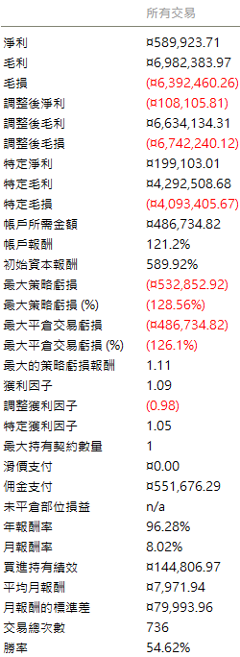
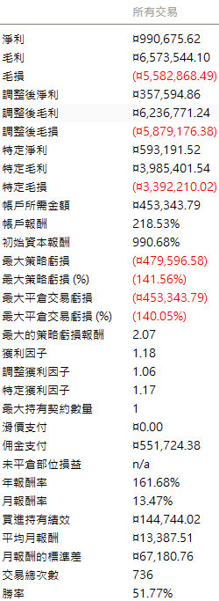
回測
2019-01-01 ~ 2025-02-14
若依照 0900~1344的方向做多到隔日開盤。
無任何條件
+跳空方向是否同向

Slide 13
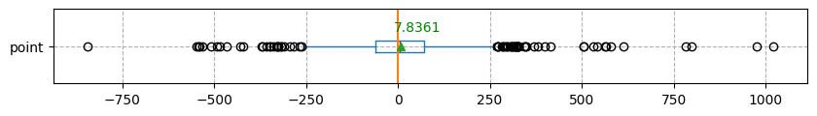

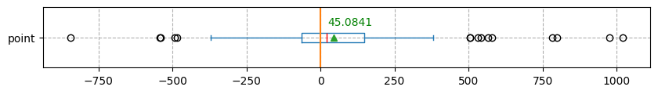

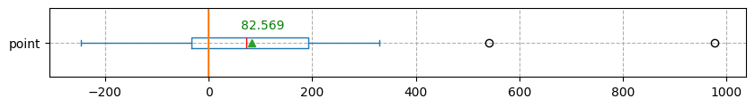

日盤收盤到夜盤開盤 V.S 夜盤開盤到隔日日盤開盤
2019-01-01 ~ 2025-02-05
Accuracy: 52.2554%
2024-02-01 ~ 2025-02-05
Accuracy: 58.8496%
2024-11-01 ~ 2025-02-05
Accuracy :72.4138%
2024-08-05

Slide 14
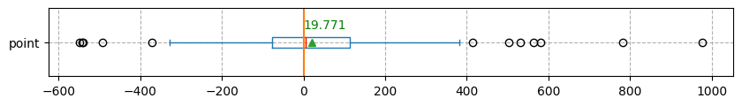

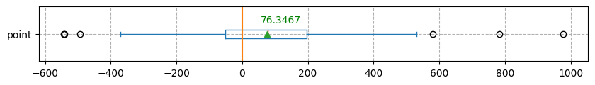

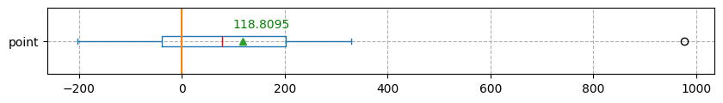

日盤收盤到夜盤開盤 V.S 夜盤開盤到隔日日盤開盤 (若日盤到收盤跳空>20點)
2019-01-01 ~ 2025-02-05
Accuracy: 52.1886%
2024-02-01 ~ 2025-02-05
Accuracy: 62.6667 %
2024-11-01 ~ 2025-02-05
Accuracy : 66.6667%

Slide 15
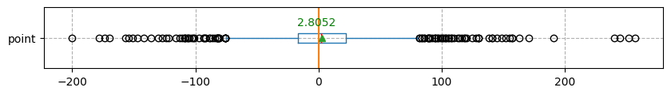

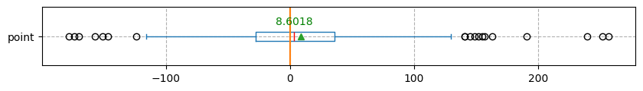

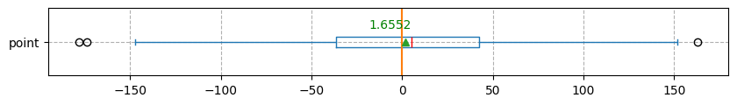

日盤收盤到夜盤開盤 V.S 夜盤開盤到台積電期貨開盤前
2019-01-01 ~ 2025-02-05
Accuracy: 53.2269%
2024-02-01 ~ 2025-02-05
Accuracy: 53.9923 %
2024-11-01 ~ 2025-02-05
Accuracy: 55.1724%

Slide 16
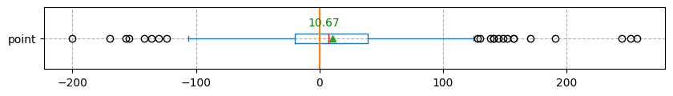

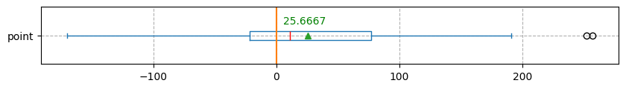

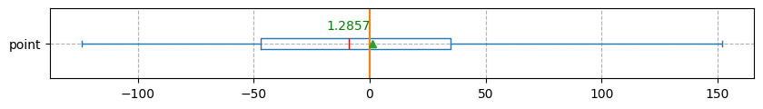
日盤收盤到夜盤開盤 V.S 夜盤開盤到台積電期貨開盤前 (若日盤到收盤跳空>20點)
2019-01-01 ~ 2025-02-05
Accuracy: 58.9226%
2024-02-01 ~ 2025-02-05
Accuracy: 58.6667 %
2024-11-01 ~ 2025-02-05
Accuracy: 47.6190%

Slide 17
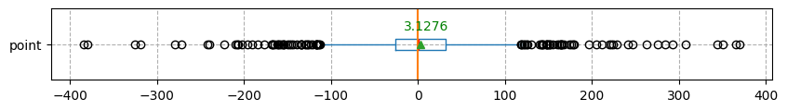

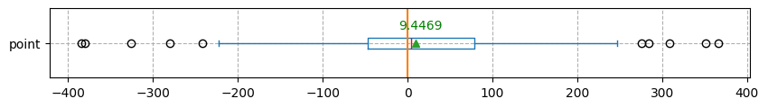

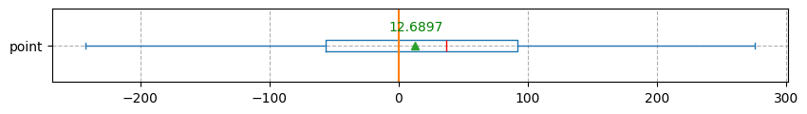

日盤收盤到夜盤開盤 V.S 夜盤開盤到美股開盤前(分冬夏令)
2019-01-01 ~ 2025-02-05
Accuracy: 51.145 %
2024-02-01 ~ 2025-02-05
Accuracy: 53.0973 %
2024-11-01 ~ 2025-02-05
Accuracy: 58.6207 %

Slide 18
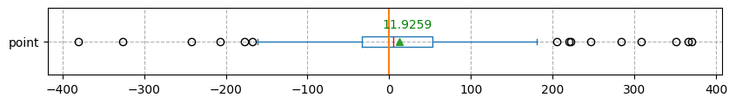

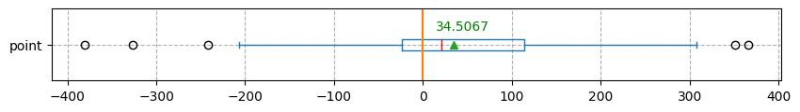

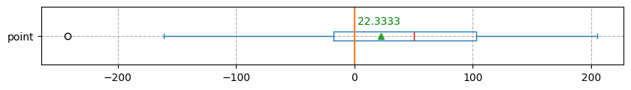

日盤收盤到夜盤開盤 V.S 夜盤到美股開盤前(分冬夏令) (若日盤到收盤跳空>20點)
2019-01-01 ~ 2025-02-05
Accuracy: 53.8721 %
2024-02-01 ~ 2025-02-05
Accuracy: 61.3333 %
2024-11-01 ~ 2025-02-05
Accuracy: 61.9048 %

Slide 19






日盤收盤到夜盤開盤 V.S 夜盤開盤到美股開盤前30M(分冬夏令)
2019-01-01 ~ 2025-02-05
Accuracy: 53.0187 %
2024-02-01 ~ 2025-02-05
Accuracy: 55.7522 %
2024-11-01 ~ 2025-02-05
Accuracy: 56.8966 %

Slide 20






日盤收盤到夜盤開盤 V.S 夜盤開盤到美股開盤前30M(分冬夏令) (若日盤到收盤跳空>20點)
2019-01-01 ~ 2025-02-05
Accuracy: 55.8923 %
2024-02-01 ~ 2025-02-05
Accuracy: 66.6667 %
2024-11-01 ~ 2025-02-05
Accuracy: 61.9048 %

Slide 21






日盤收盤到夜盤開盤 V.S 夜盤開盤到美股開盤前(2100)
2019-01-01 ~ 2025-02-05
Accuracy: 52.6718 %
2024-02-01 ~ 2025-02-05
Accuracy: 55.7522 %
2024-11-01 ~ 2025-02-05
Accuracy: 55.1724 %

Slide 22






日盤收盤到夜盤開盤 V.S 夜盤開盤到美股開盤前(2100) (若日盤到收盤跳空>20點)
2019-01-01 ~ 2025-02-05
Accuracy: 55.2189 %
2024-02-01 ~ 2025-02-05
Accuracy: 64.0000 %
2024-11-01 ~ 2025-02-05
Accuracy: 53.381 %

Slide 23






NQ V.S TXF到隔日日盤開盤
2019-01-01 ~ 2025-02-05
Accuracy: 58.5010%
2024-02-01 ~ 2025-02-05
Accuracy: 54.4248 %
2024-11-01 ~ 2025-02-05
Accuracy :53.4482%
2024-08-05

Slide 24



美盤中NQ與TXF的關係
TXF與NQ 1分鐘的 Corr=0.2071，Beta=0.1007，R2=0.043
TXF與NQ 5分鐘的 Corr=0.2215，Beta=0.1056，R2=0.049
TXF與NQ30分鐘的 Corr=0.2423，Beta=0.1133，R2=0.059
利用TXF與NQ每分鐘的價格變化計算兩者的差異，當差異超過2bp則視為岔開。
當岔開產生時，未來一段時間內TXF是否會跟著NQ的方向。
1 min
5 min

Slide 25
美盤中NQ與TXF的關係
NQ(1min) v.s TXF (1 min)

Slide 26




岔開 >2bp | 3min | 5min | 10min | 15min
Corr | -0.0054 | -0.0069 | 0.0006 | 0.0004
Beta | -0.0052 | -0.0085 | 0.0010 | 0.0086
R2 (%) | 0.0029 | 0.0048 | 0.0000 | 0.0018
Dir Accuracy (%) | 56.1577 | 55.43 | 54.7228 | 54.6067
3min
5min
10min
15min

Slide 27




岔開 >4bp | 3min | 5min | 10min | 15min
Corr | -0.0056 | -0.0082 | -0.0001 | 0.0032
Beta | -0.0053 | -0.0098 | -0.0001 | 0.0063
R2 (%) | 0.0032 | 0.0067 | 0.0000 | 0.0010
Dir Accuracy (%) | 55.8492 | 55.1891 | 54.5556 | 54.8956
3min
5min
10min
15min

Slide 28




岔開 >6bp | 3min | 5min | 10min | 15min
Corr | -0.0083 | -0.0116 | -0.0025 | -0.0020
Beta | -0.0076 | -0.0134 | -0.0040 | -0.0037
R2 (%) | 0.0069 | 0.0132 | 0.0006 | 0.0004
Dir Accuracy (%) | 55.7995 | 54.8952 | 54.5119 | 54.5482
3min
5min
10min
15min

Slide 29




岔開 >8bp | 3min | 5min | 10min | 15min
Corr | -0.0078 | -0.0135 | -0.0048 | -0.0039
Beta | -0.0070 | -0.0152 | -0.0074 | -0.0071
R2 (%) | 0.0061 | 0.0182 | 0.0023 | 0.0015
Dir Accuracy (%) | 54.2786 | 54.4606 | 54.1552 | 54.3667
3min
5min
10min
15min

Slide 30


每30分鐘的變化岔開
岔開 >8bp | min | min | 60min | 15min
Corr |  |  | 0.0200 | 0.0077
Beta |  |  | 0.0153 | 0.0031
R2 (%) |  |  | 0.0403 | 0.0059
Dir Accuracy (%) |  |  | 55.1862 | 54.3667
3min
5min
60min
15min

Slide 31



TXF日盤與夜盤方向的關係
若TXF夜盤跌落大於特定點數，查看隔日日盤是否會有回升的跡象。
Accuracy : 55.9748 %
門檻 = 0 點 | 日盤 漲 | 日盤 跌
夜盤 漲 | 329 | 319
夜盤 跌 | 267 | 210
Accuracy : 57.5758 %
門檻 = 100 點 | 日盤 漲 | 日盤 跌
夜盤 漲 | 91 | 76
夜盤 跌 | 76 | 56
Accuracy : 56.7901 %
門檻 = 150 點 | 日盤 漲 | 日盤 跌
夜盤 漲 | 41 | 47
夜盤 跌 | 46 | 35
總結 : 約六成會回升但平均回升點數不高。
改進方向 : 加入台積電ADR的漲跌，看是否台積電ADR跌落特定值，則回升機會不高。

Slide 32
結論
日盤到夜盤跳空方向，與日盤收盤到特定時間點的方向相似度較高，約60%以上。若篩選跳空點數>20點，則相似度會提高到約70-80%，且平均跳空點數約>50點。其中表現較好的時間點為隔天日盤開盤及美股開盤(2100-2230任意時間點皆相似結果)。
日盤到夜盤跳空方向，與夜盤開盤到特定時間點的方向相似度約50%，且平均獲利點數不高。
日盤到夜盤的跳空方向在日盤是否持倉到夜盤的策略中可以當作濾網。
TXF 13:45-1500對相應的NQ時，兩者的方向相同性只有約53%。
若以將日盤到夜盤跳空方向至換成同一時間NQ的方向，則與任一時間點的機率都下降，且點數減少。

