Slide 1
Simultaneous Pre- and Free-assignment Routing for Multiple Redistribution Layers with Irregular Vias
Yu-Jie Cai1, Yang Hsu1, and Yao-Wen Chang1,2 1Graduate Institute of Electronics Engineering, National Taiwan University, Taipei 106, Taiwan 2Department of Electrical Engineering, National Taiwan University, Taipei 106, Taiwan
jerrytsai@eda.ee.ntu.edu.tw; yanghsu@eda.ee.ntu.edu.tw; ywchang@ntu.edu.tw

Slide 2
Outline
Introduction
Preliminaries
Algorithms
Experimental Results

Slide 3
Outline
Introduction
Preliminaries
Algorithms
Experimental Results

Slide 4
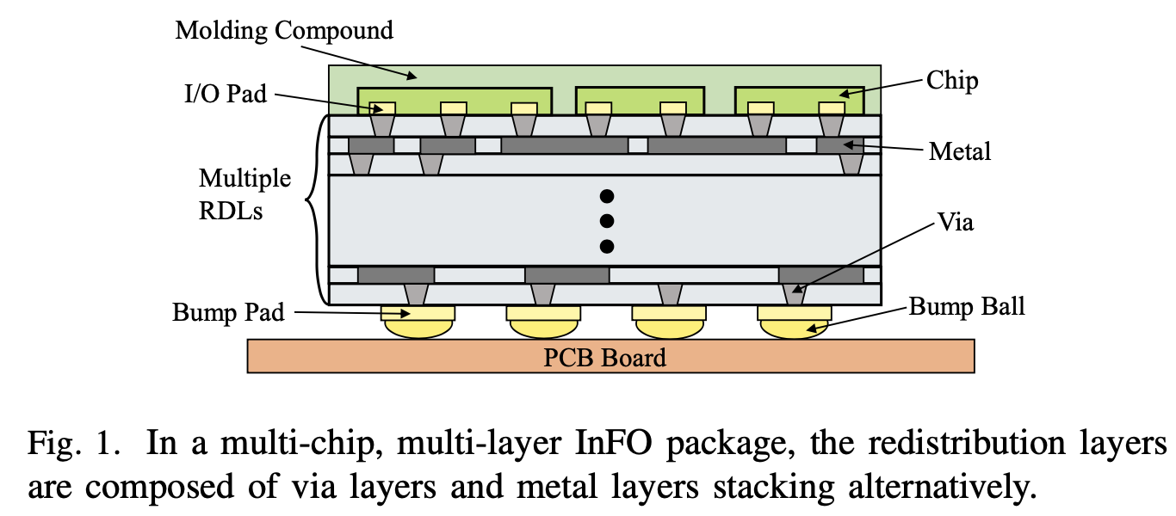
Introduction
As the demands of high-performance applications increase significantly, advanced multi-chip packaging for integrating multiple chips with various functions becomes popular.
Inside a package, RDLs are used for completing connections between I/O pads and bump pads.

Slide 5
Introduction
The RDL routing problem can be classified into three types:
Free-assignment (FA) routing
In FA routing, the router has the freedom to assign a net between an I/O pad and an arbitrary bump pad.
Most previous works applied the network-flow algorithm to solve FA routing [6], [7], [8] with well-designed tile models [9].
Pre-assignment (PA) routing
In contrast, PA routing is much more challenging because its net assignments between I/O pads and bump pads are predefined before routing.
Fang et al. [10] handled the PA routing problem with an integer linear programming (ILP) formulation and proposed a variable/constraint reduction technique to speed up the ILP process.
Unified-assignment (UA) routing
UA routing considers both PA and FA routing, where some net assignments are predefined but some are not.
For UA routing, most previous works handled PA and FA routing in two separate stages [13], [14], [15], [16]. Fang et al. [13] applied the MCMF algorithm to generate PA and FA routing guides sequentially based on Delaunay Triangulation (DT) and the Voronoi Diagram (VD).

Slide 6
Motivation
For UA routing, most previous works handled FA and PA nets in two separate stages.
For example, the state-of-the-art work [16] extended from [12] first handled PA routing and then applied the MCMF algorithm for FA routing.
Though this work can obtain better routing solutions over other previous works mainly because it considers flexible vias during routing, its solution space in the second stage is often limited by the result from the first stage.
Besides, the routing graphs in [12], [16] may also have some scalability issues.
[12] H.-T. Wen, Y.-J. Cai, and Y. Hsu, “Via-based redistribution layer routing for info packages with irregular pad structures”
[16] H.-T. Wen, “Via-based Redistribution Layer Routing for InFO Packages with Irregular Pad Structures”

Slide 7
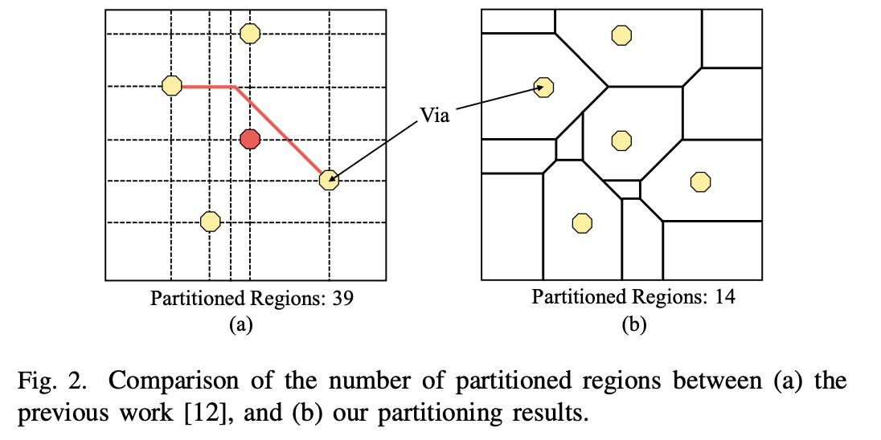
Motivation
Obviously, the size of its resulting routing graph may grow dramatically while more segments are generated.

Slide 8
Contribution
The number of partitioned regions to be within O(|V|²), where |V| is the number of vias.
We develop a novel simultaneous routing framework with a chord-based tile model and net-sequence list to search for FA and PA global routing guides on the same routing graph.
We present a geometry-based pattern routing algorithm to obtain a routing solution, and then a net padding method to handle failed routes.
Experimental results show that our algorithm can achieve 100% routability and an average of 30X speedup over the state-of-the-art work [16].

Slide 9
Outline
Introduction
Preliminaries
Algorithms
Experimental Results

Slide 10
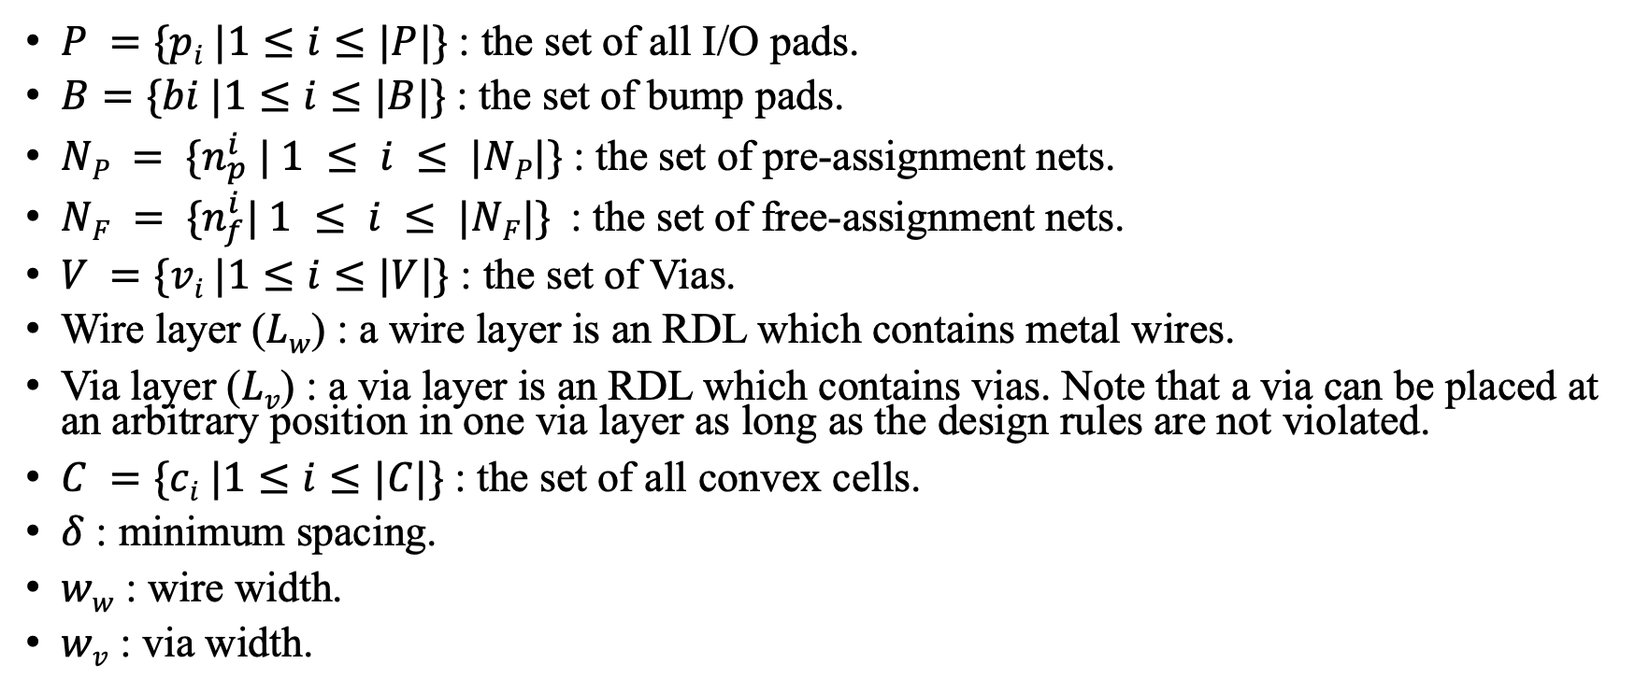
Terminologies and Notations
$P =\{pi |1≤i≤|P|\}$: the set of all I/O pads.
$B=\{bi |1≤i≤|B|\}$: the set of bump pads.
$NP = \{n_{p}^{i} | 1 ≤ i ≤ |NP|\}$: the set of pre-assignment nets.
$NF = \{n_{f}^{i}| 1 ≤ i ≤ |NF|\}$: the set of free-assignment nets.
$V =\{vi |1≤i≤|V|\}$ : the set of Vias.
Wire layer ($Lw$) : a wire layer is an RDL which contains metal wires.
Via layer ($Lv$) : a via layer is an RDL which contains vias. Note that a via can be placed at an arbitrary position in one via layer as long as the design rules are not violated.
$C =\{ci |1≤i≤|C|\}$: the set of all convex cells.
$δ$ : minimum spacing.
$ww$ : wire width.
$wv$ : via width.

Slide 11
RDL Routing Constraints
X-architecture wire:
A wire segment in an RDL can only be routed in four kinds of orientations: (1) vertical, (2) horizontal, (3) 45-degree, and (4) 135-degree.
Minimum spacing rule:
A minimum spacing is required between two components of different nets.
There are four kinds of components: (1) wire segments, (2) vias, (3) I/O pads, and (4) bump pads.
Routing-angle constraint:
Two connected wire segments can have a 90-degree turn or a 135-degree turn. However, a 45-degree turn is not allowed.

Slide 12
Problem Formulation
The Multi-chip Multiple Redistribution Layers Routing Problem:
Given design rules, a set of I/O pads, a set of bump pads, and a set of pre- and free-assignment netlists.
Connect all the nets with irregular vias such that the routability is maximized, the total wirelength is minimized, and no design rules are violated.

Slide 13
Outline
Introduction
Preliminaries
Algorithms
Experimental Results

Slide 14
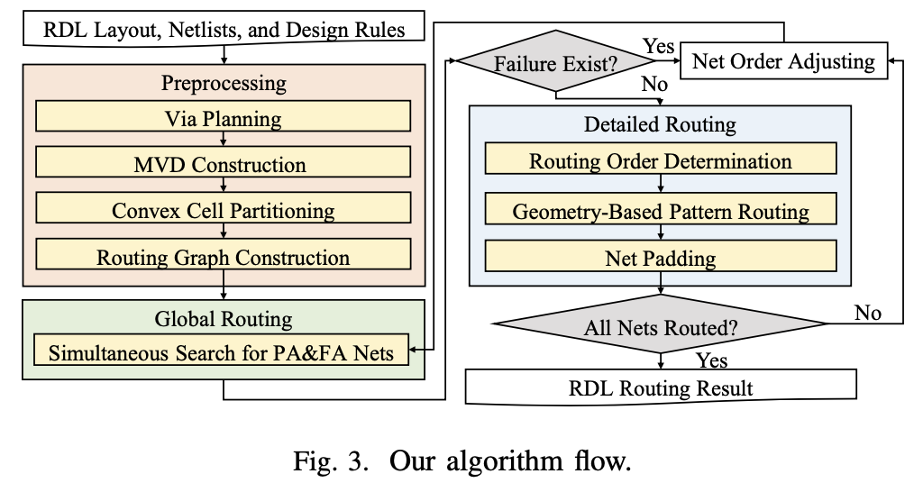
Algorithm Flow

Slide 15
Preprocessing
Via Planning:
Estimate the number of required vias and partition the layout into rectangular bins.
If there are less than two objects (I/O pads, bump pads, and the inserted vias in adjacent layers) whose vertical projections are located in the target bin, we will insert a via in this bin.
Choose the centroid or circumcentre of the reference points (bin corners and the vertical projections of the centers of the reference objects) to avoid via congestion.
Since the positions of the I/O pads are not regular, the generated vias may be distributed irregularly, i.e., the irregular via structure.

Slide 16
Preprocessing
Manhattan-Distance-Based Voronoi Diagram Construction
To handle the irregular via structure, the previous work [13] applied the normal Voronoi Diagram (VD) and triangular tile models.
However, the perpendicular bisectors in the normal VD could be with arbitrary angles and thus may cause routing resource estimation errors in the X-architecture.

Slide 17
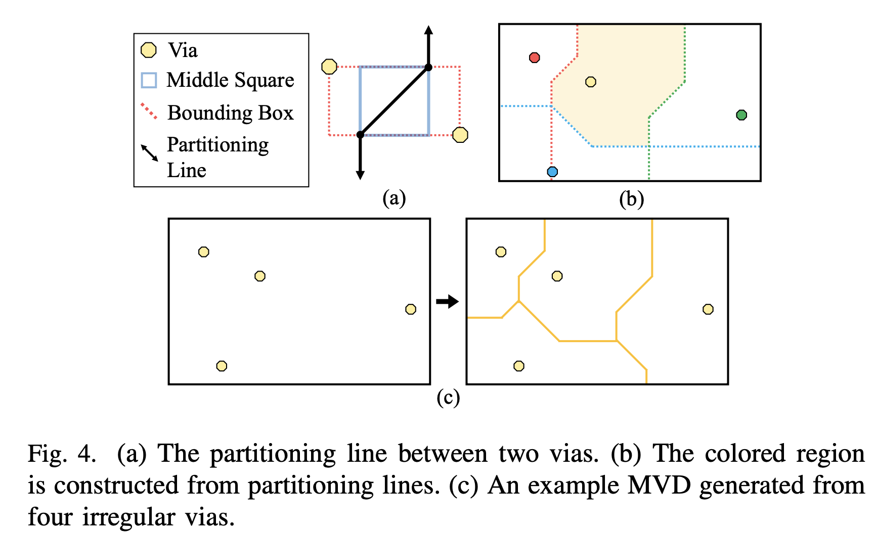
Preprocessing
Manhattan-Distance-Based Voronoi Diagram Construction
For each metal layer in RDLs, we consider vias in two adjacent via layers. For every two vias, we obtain a partitioning line to partition the layout.

Slide 18
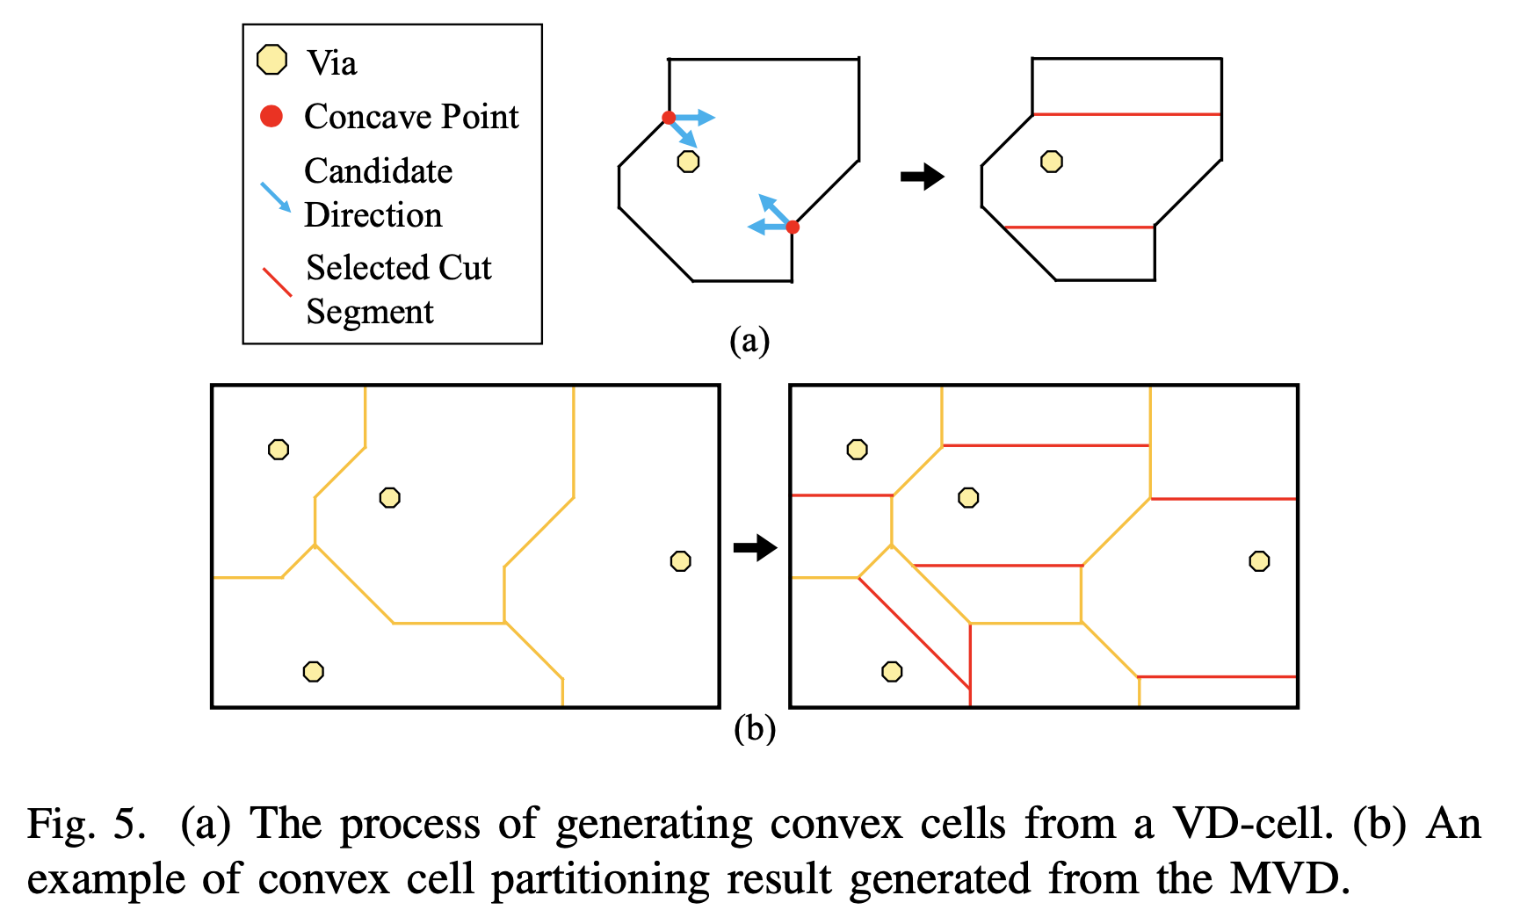
Preprocessing
Convex Cell Partitioning
Choose the cut segment with a larger vertical projection distance from the via.
If the vertical projection distances from the via of two cut segments are the same, we choose the cut segment of shorter length.

Slide 19
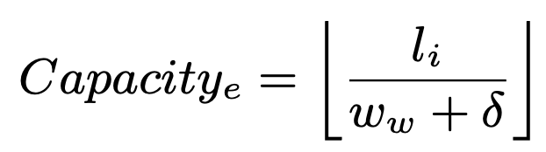
Preprocessing
Multi-Layer Routing Graph Construction
The routing graph is composed of three kinds of search nodes: (1) supernodes, (2) edge nodes, and (3) via nodes.
capacity of the edge node e :

Slide 20
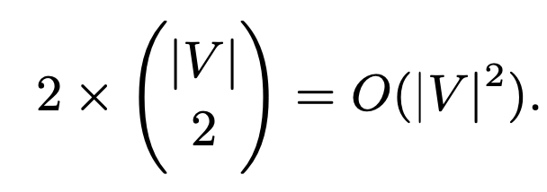
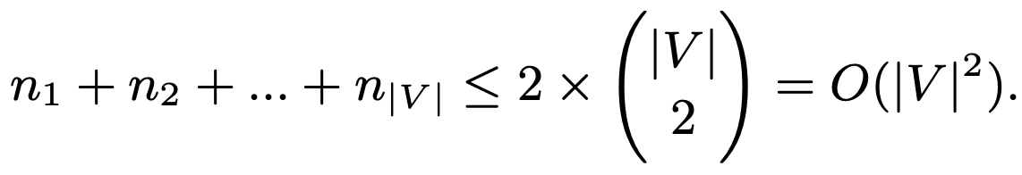
Number of convex cells
The above partitioning algorithm guarantees that the total number of convex cells is O(|V|²), where |V| is the total number of vias.
For each pair of vias, one partitioning line generates at most two concave points. Therefore, the total number of concave points has an upper bound as follows:
Because a via belongs to exactly one VD-cell, the number of VD-cells must be |V |. Assume that there are n_{i} concave points in the i^{th} VD-cell, we have

Slide 21
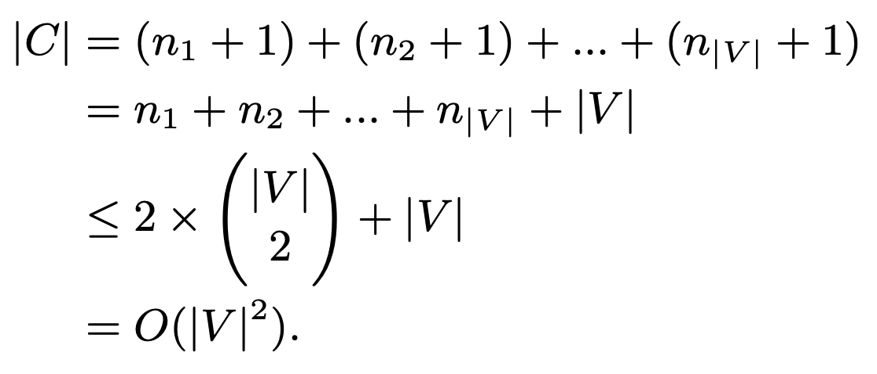
Number of convex cells
In the i^{th} VD-cell, the n_{i} concave points generate n_{i} + 1 convex cells. Therefore, the total number of convex cells |C | can be computed as follows:

Slide 22
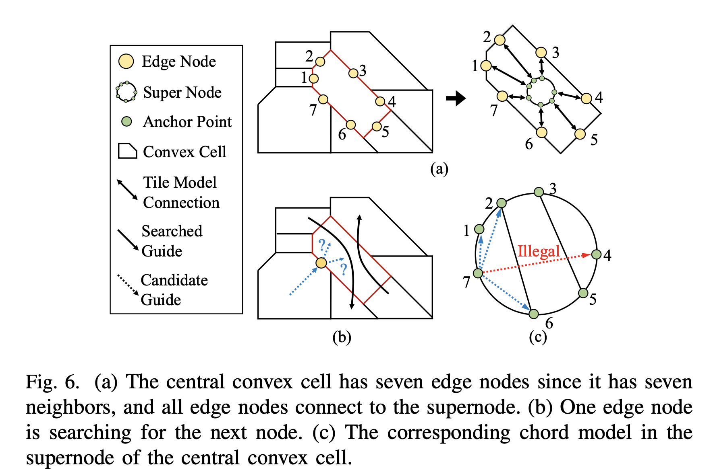
Global Routing
Chord-Based Tile Model

Slide 23
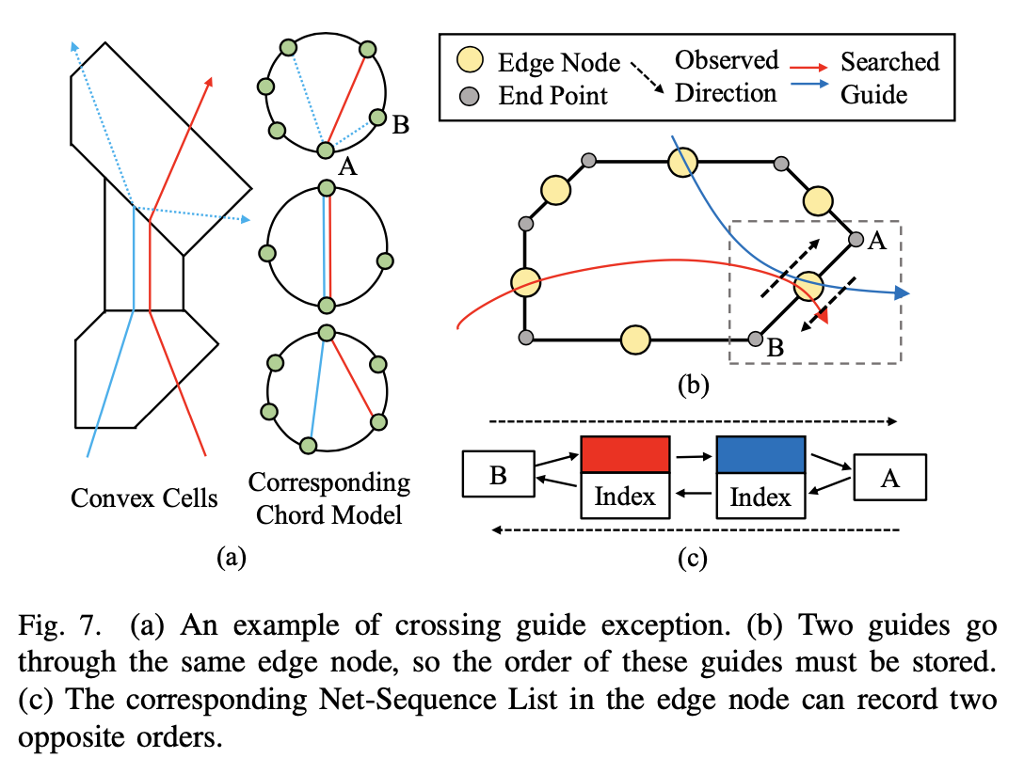
Global Routing
Net-Sequence List

Slide 24
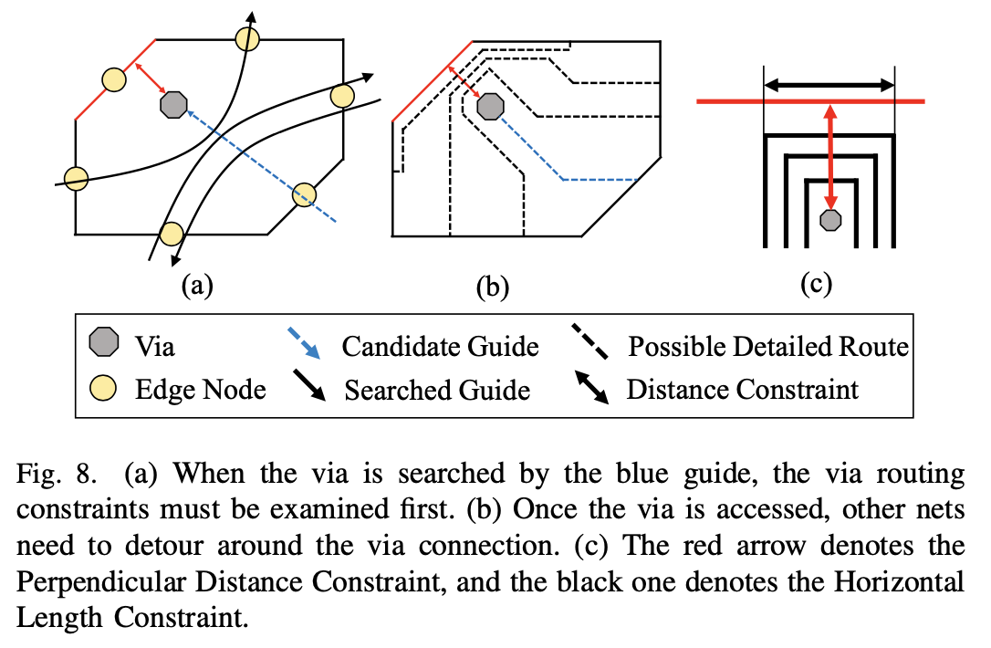


Global Routing
Via Routing Constraint
Perpendicular Distance Constraint :
Horizontal Length Constraint :

Slide 25
Global Routing
Simultaneous Global Routing Guide Generation
A PA net will have one starting node and one terminating node, while an FA net will have one starting node and multiple terminating nodes because an FA net can connect to arbitrary bump pads.
During the crossing-aware A*-search for each net, we will examine the node capacity, the Chord-Based Tile model, the Net-Sequence Lists, and the via routing constraints to judge the legality of the searched nodes.
Only legal nodes will be pushed into the queue for further searching.

Slide 26
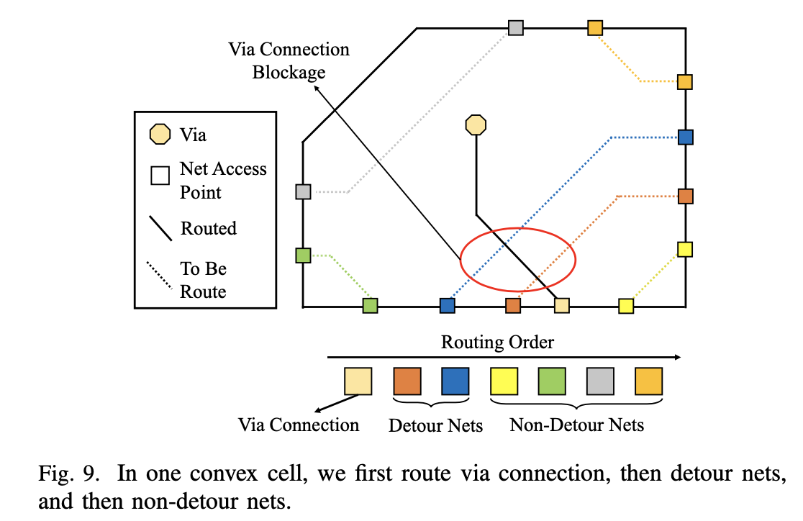
Detailed Routing
Routing Order Determination

Slide 27
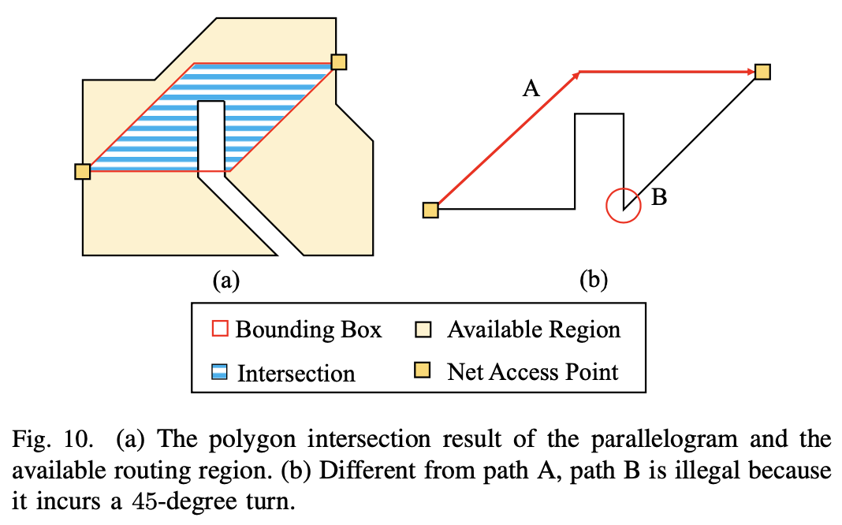
Detailed Routing
Geometry-Based Pattern Routing (non-detour net)
After determining the path, the routed wire segments are expanded to rectangle. With this method, non-detour nets can be routed directly.

Slide 28
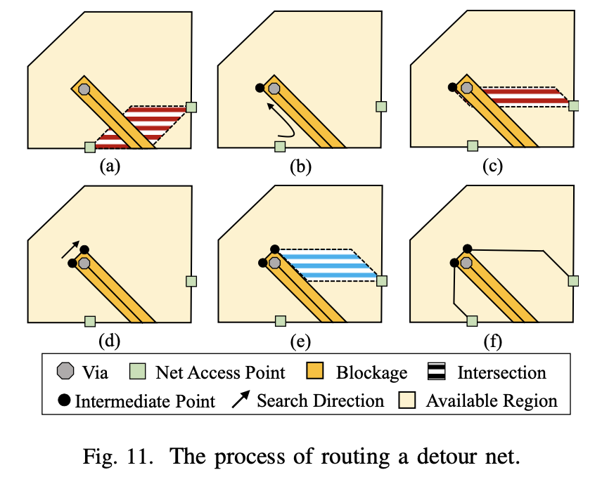
Detailed Routing
Geometry-Based Pattern Routing (detour net)
Search along the borders of the available routing region until we meet the first concave point, named the intermediate point.
Generate another parallelogram between this intermediate point and the target net access point to check whether a path can be obtained.

Slide 29
Detailed Routing
Net Padding
After we finish Geometry-Based Pattern Routing for all convex cells, Net Padding is applied if any routing failure occurs.
We trace the routed segments in the adjacent convex cells to search for the closest two net access points belonging to the same net from the pair of failed net access points. The closest two net access points are then set as a starting point and an endpoint.
We then rip-up the routed segments, find a larger rectangular bounding box, and apply intermediate points to obtain the solutions.

Slide 30
Outline
Introduction
Preliminaries
Algorithms
Experimental Results

Slide 31
Experimental Setting
We implemented our proposed routing algorithm in the C++ programming language on an Intel Xeon 3.50GHz Linux workstation with 72G memory.
In Geometry-Based Pattern Routing, we used Boost Geometry 1.72.0 [19] for the polygon computations.
We performed the experiments based on the two sets of benchmarks used in [12] and [16].
[12] H.-T. Wen, Y.-J. Cai, and Y. Hsu, “Via-based redistribution layer routing for info packages with irregular pad structures”
[16] H.-T. Wen, “Via-based Redistribution Layer Routing for InFO Packages with Irregular Pad Structures”

Slide 32
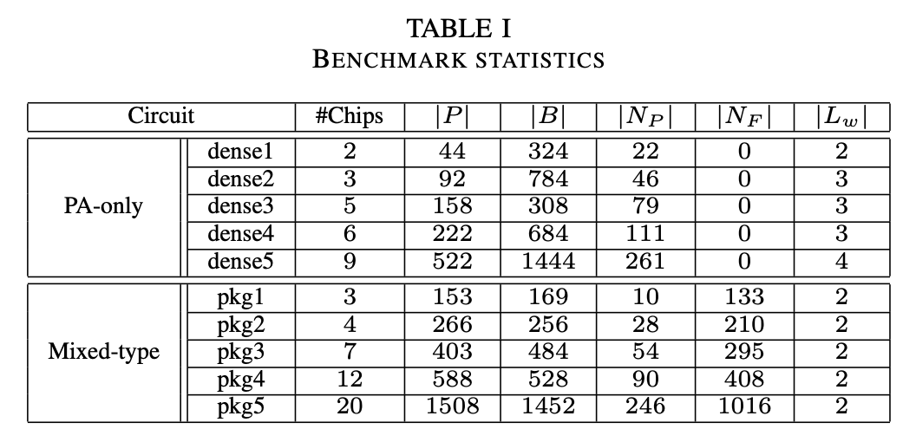
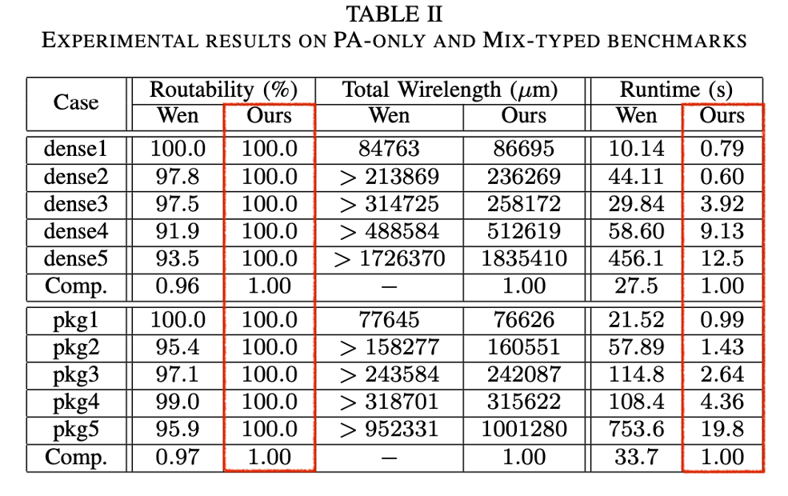
Experimental Results

Slide 33
Thanks for Listening.

Slide 34
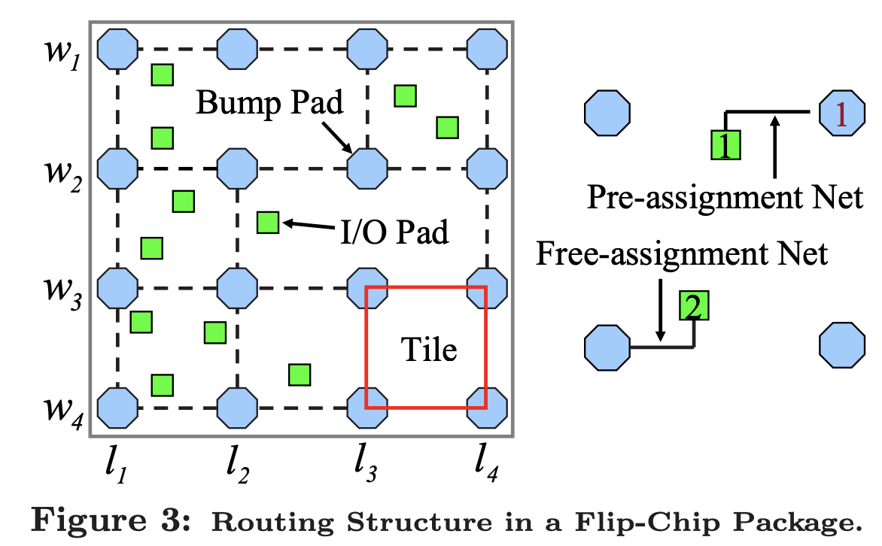
Backups Free/pre – assignment with tile model
[13] J.-W. Fang, M. D. F. Wong, and Y.-W. Chang, “Flip-chip routing with unified area-I/O pad assignments for package-board co-design,” in Proc. of DAC, 2009, pp. 336–339.

Slide 35
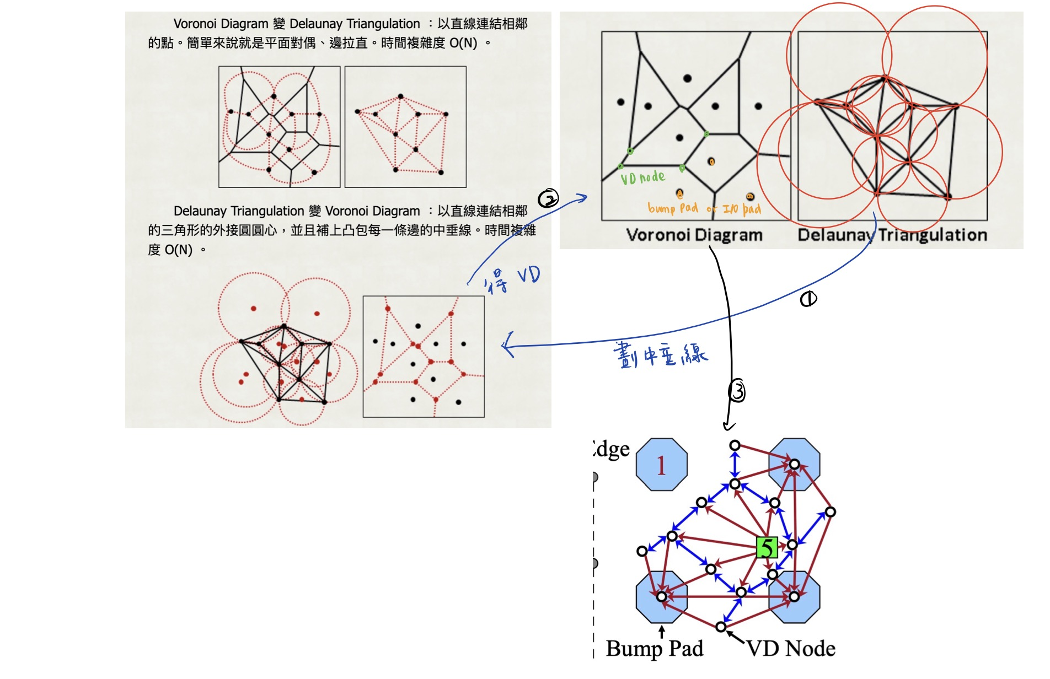
Backups Delaunay Triangulation (DT) vs Voronoi Diagram (VD)

