Slide 1
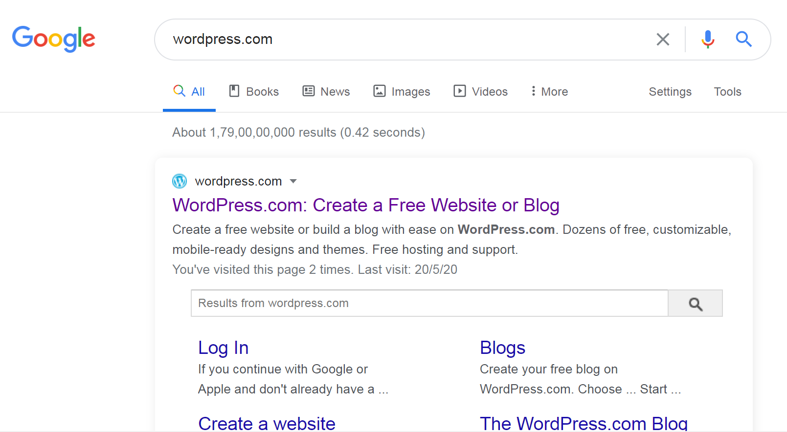
1. Logged out WordPress if you had logged in earlier. Type WordPress.com in google.
2. Click on the link as shown below:

Slide 2
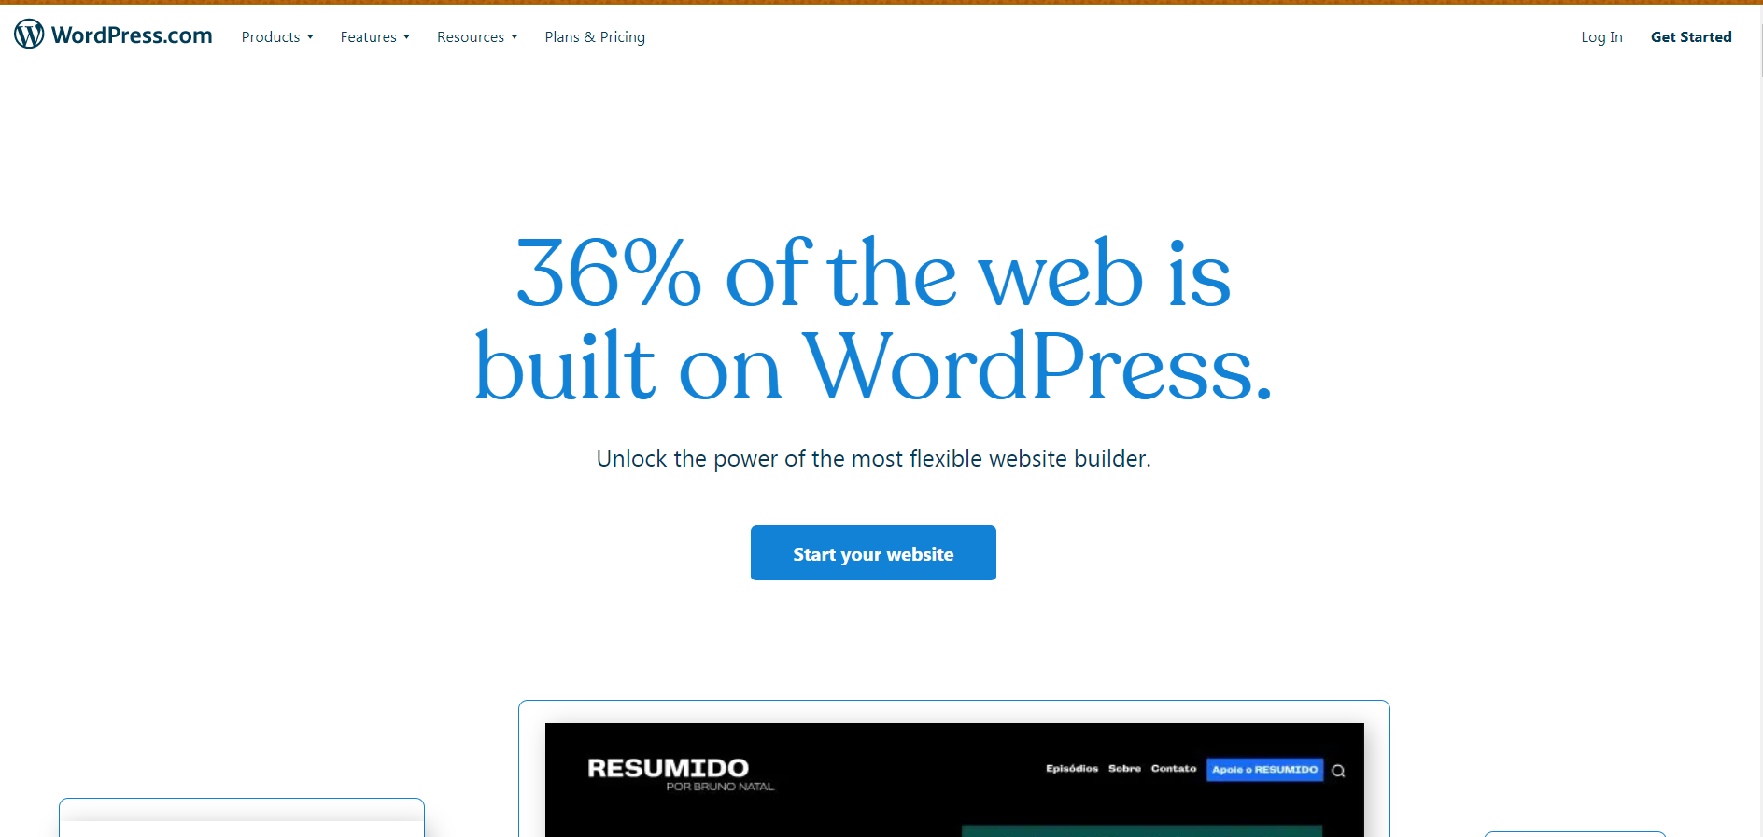
3. Select Start your website as shown below:

Slide 3
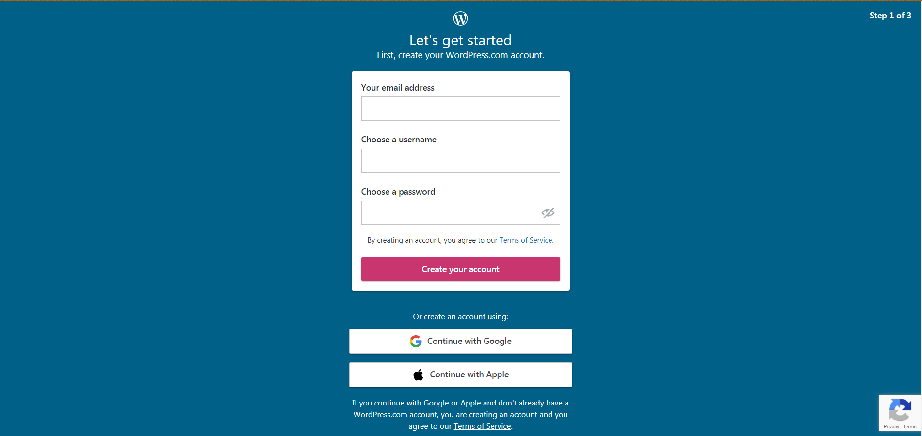
4. Sign up for a free WordPress.com account. You need to enter a valid Email address that hasn’t already been used for a wordpress account. Pick a username in the second text box. This should be just as unique as your email address. Finally add a strong password that’s hard to guess. Select create your account.

Slide 4
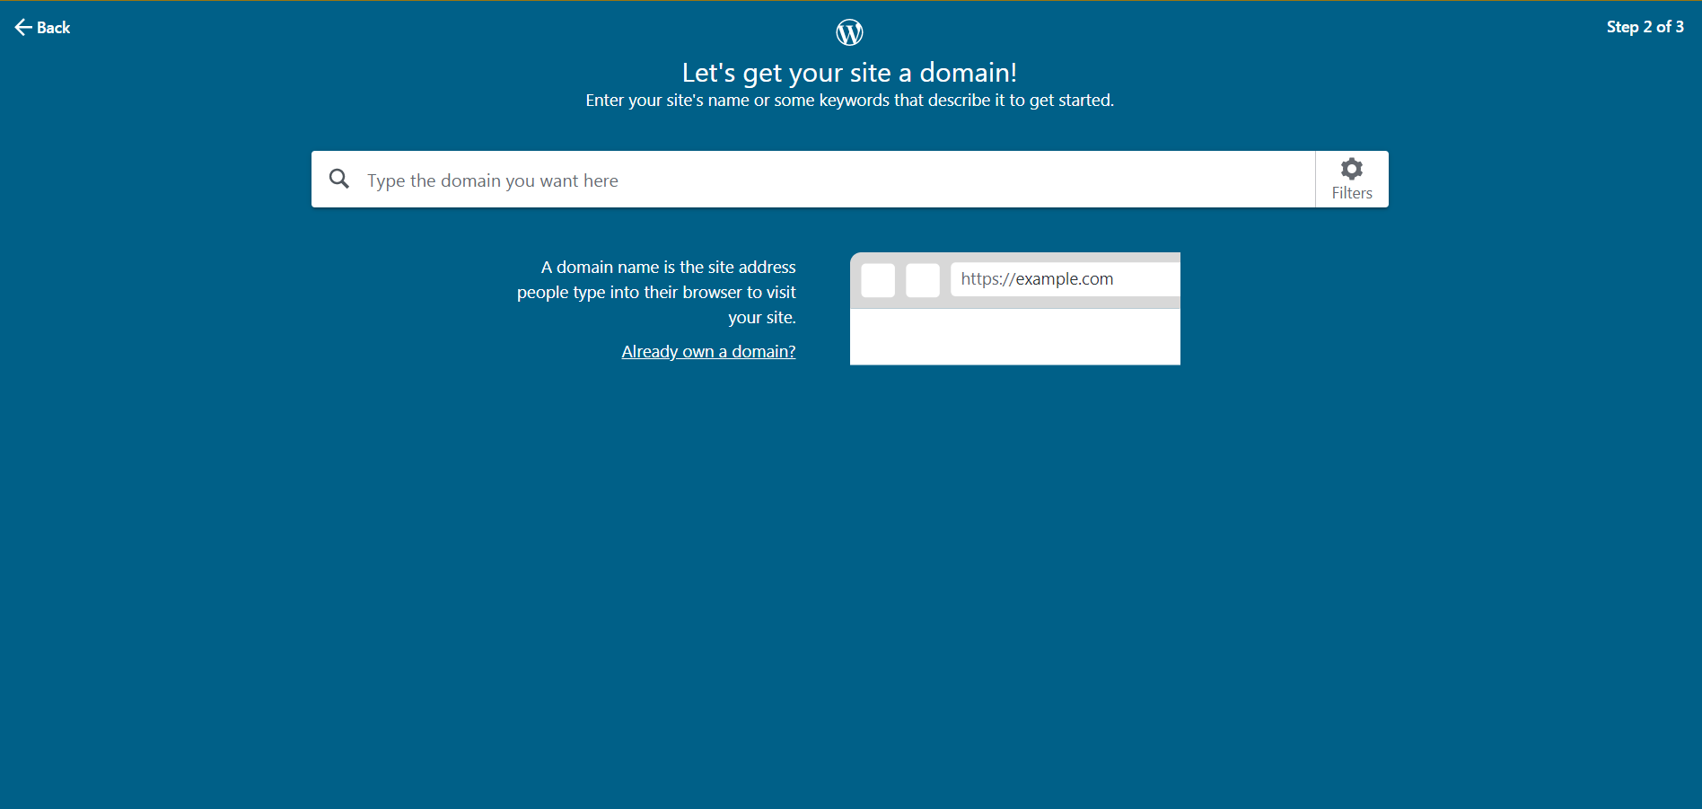
5. Now, you need to enter your blog information. Enter your blog name in the first text box. This is what people will assume your blog is about when they visit. Make it reflect the blog’s content but also make it interesting and unique. Free blogname must end with .blog for example cbseitclass.blog(if blogname is cbseitclass).

Slide 5
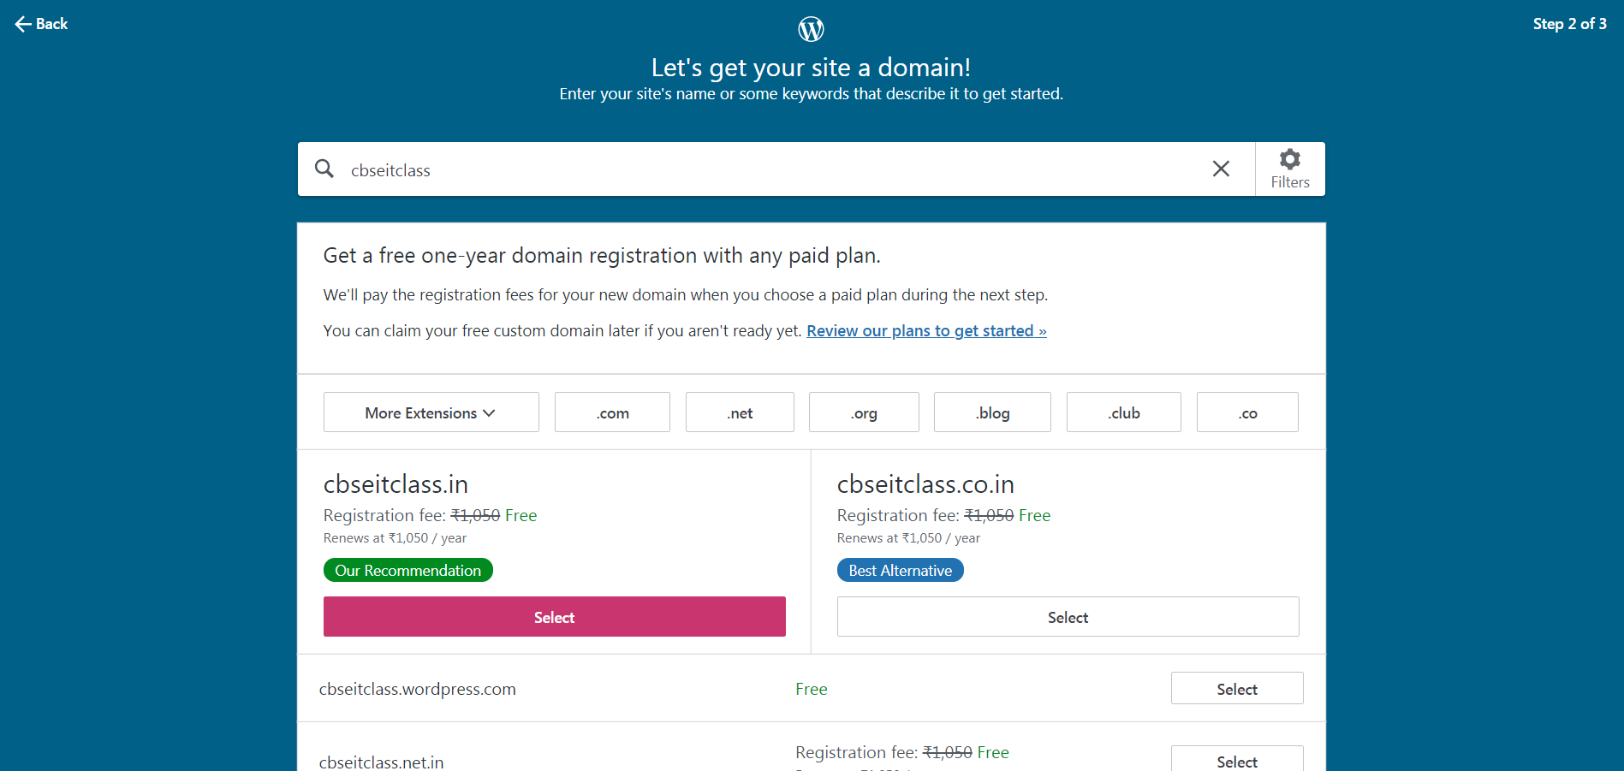
6. In the above window, if you have written .blog after your blog name only then option of free will be displayed as shown below. Below the search box are various addresses with different top-level domains, but only one is free. Pick the free option (cbseitclass.wordpress.com) with the Select button.

Slide 6
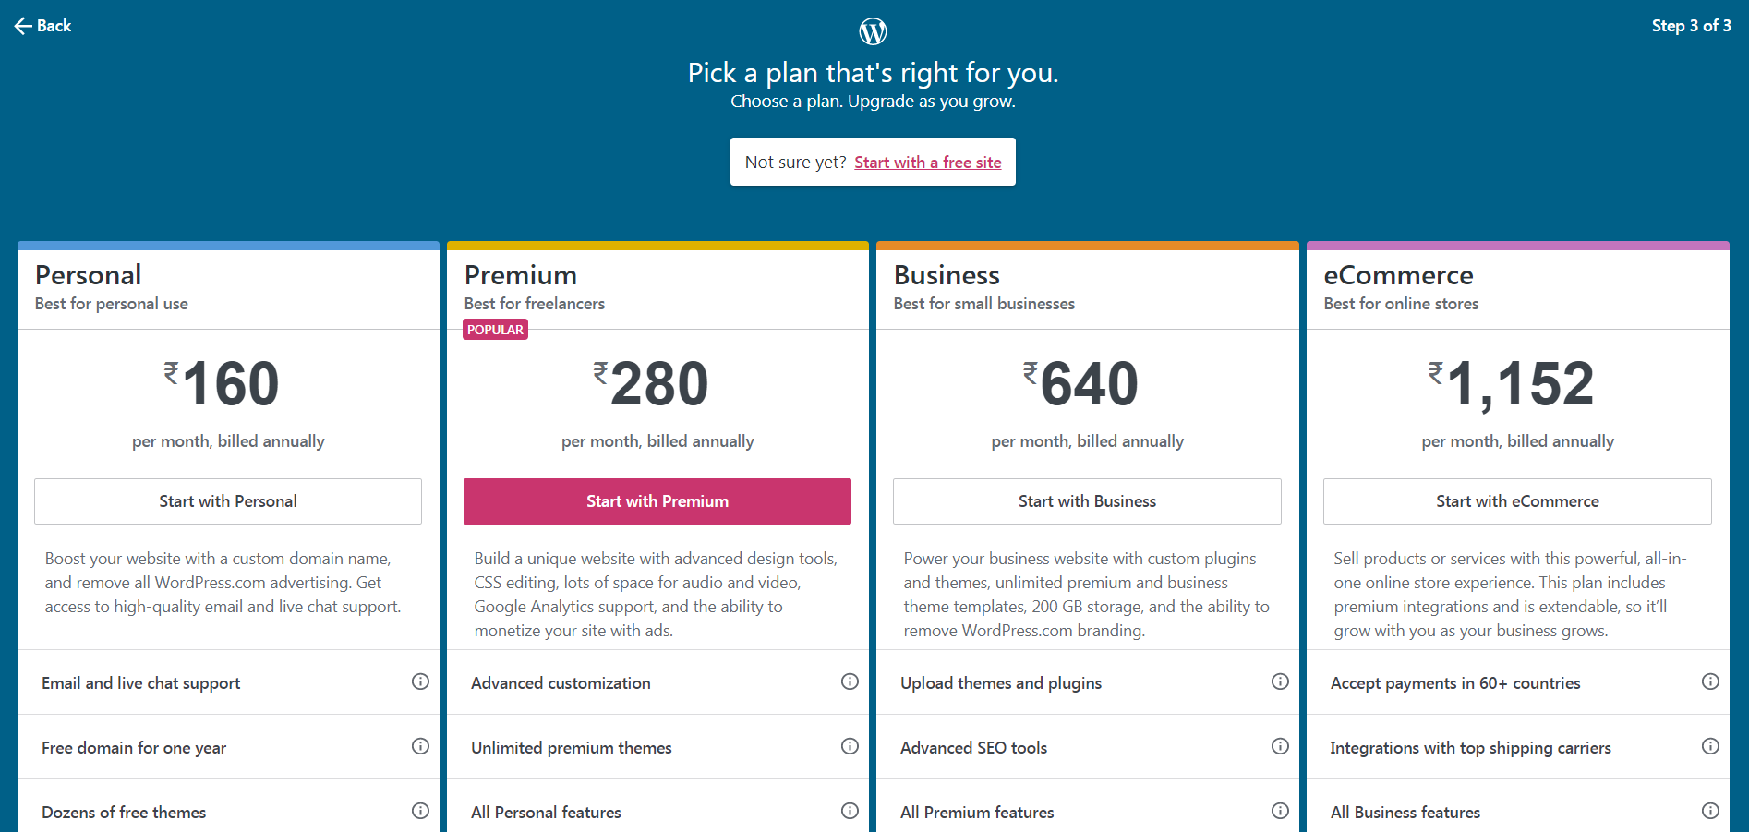
7. Then click Start with a Free site on the following page to see your new blog.

Slide 7
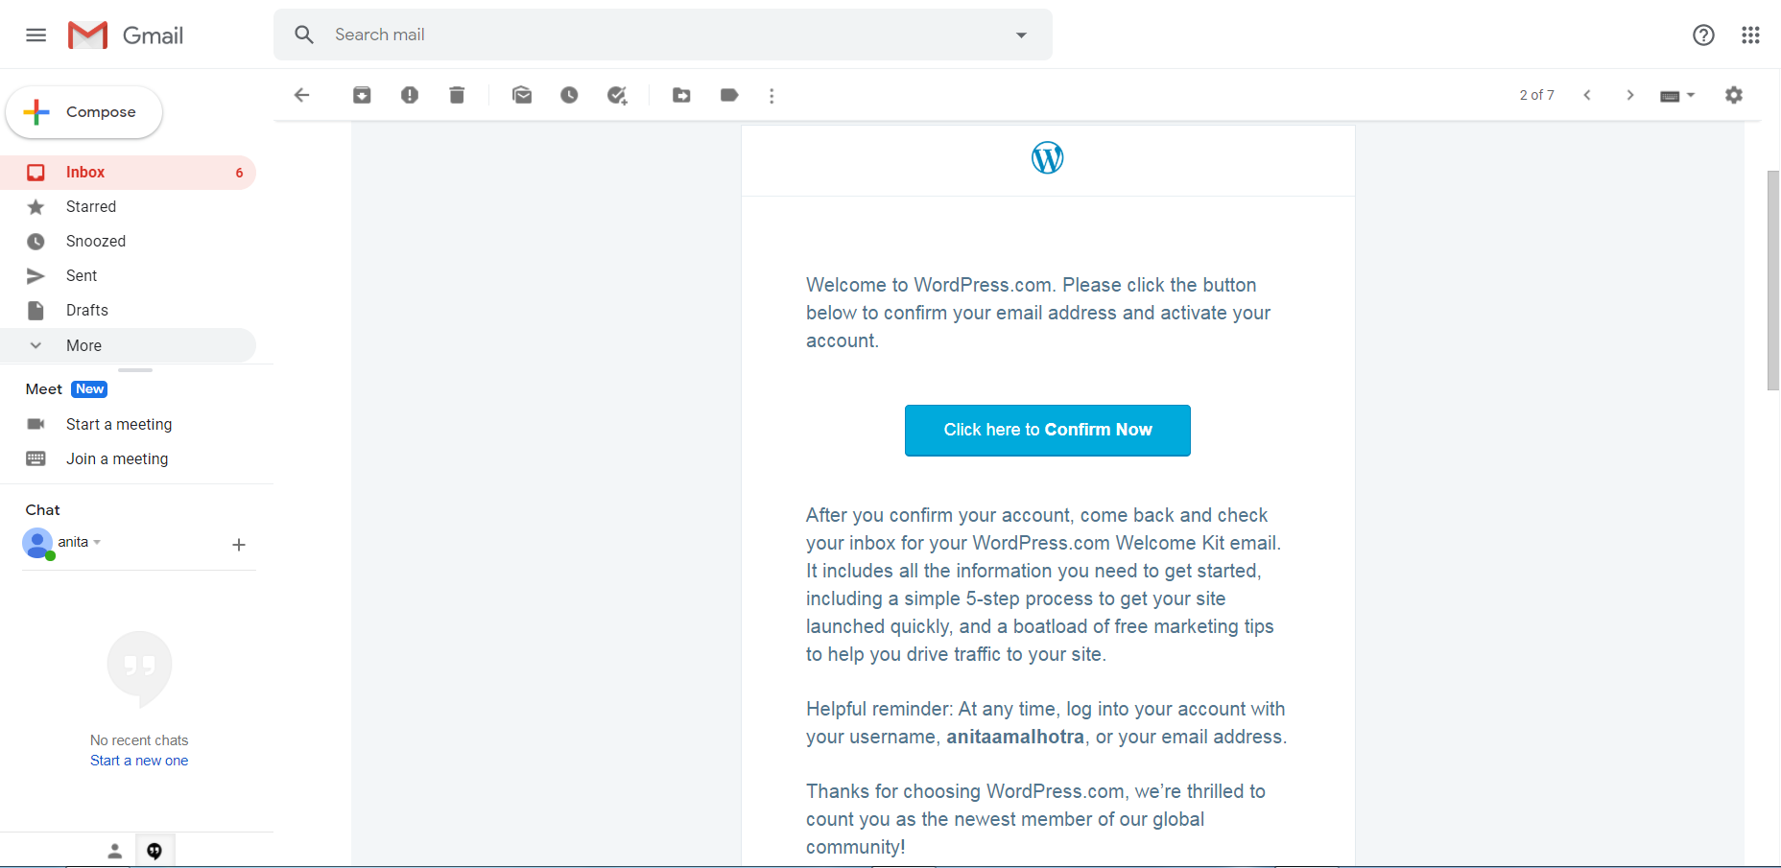
8. Check your mailbox and click on the WordPress link Click here to confirm now as shown below:

Slide 8
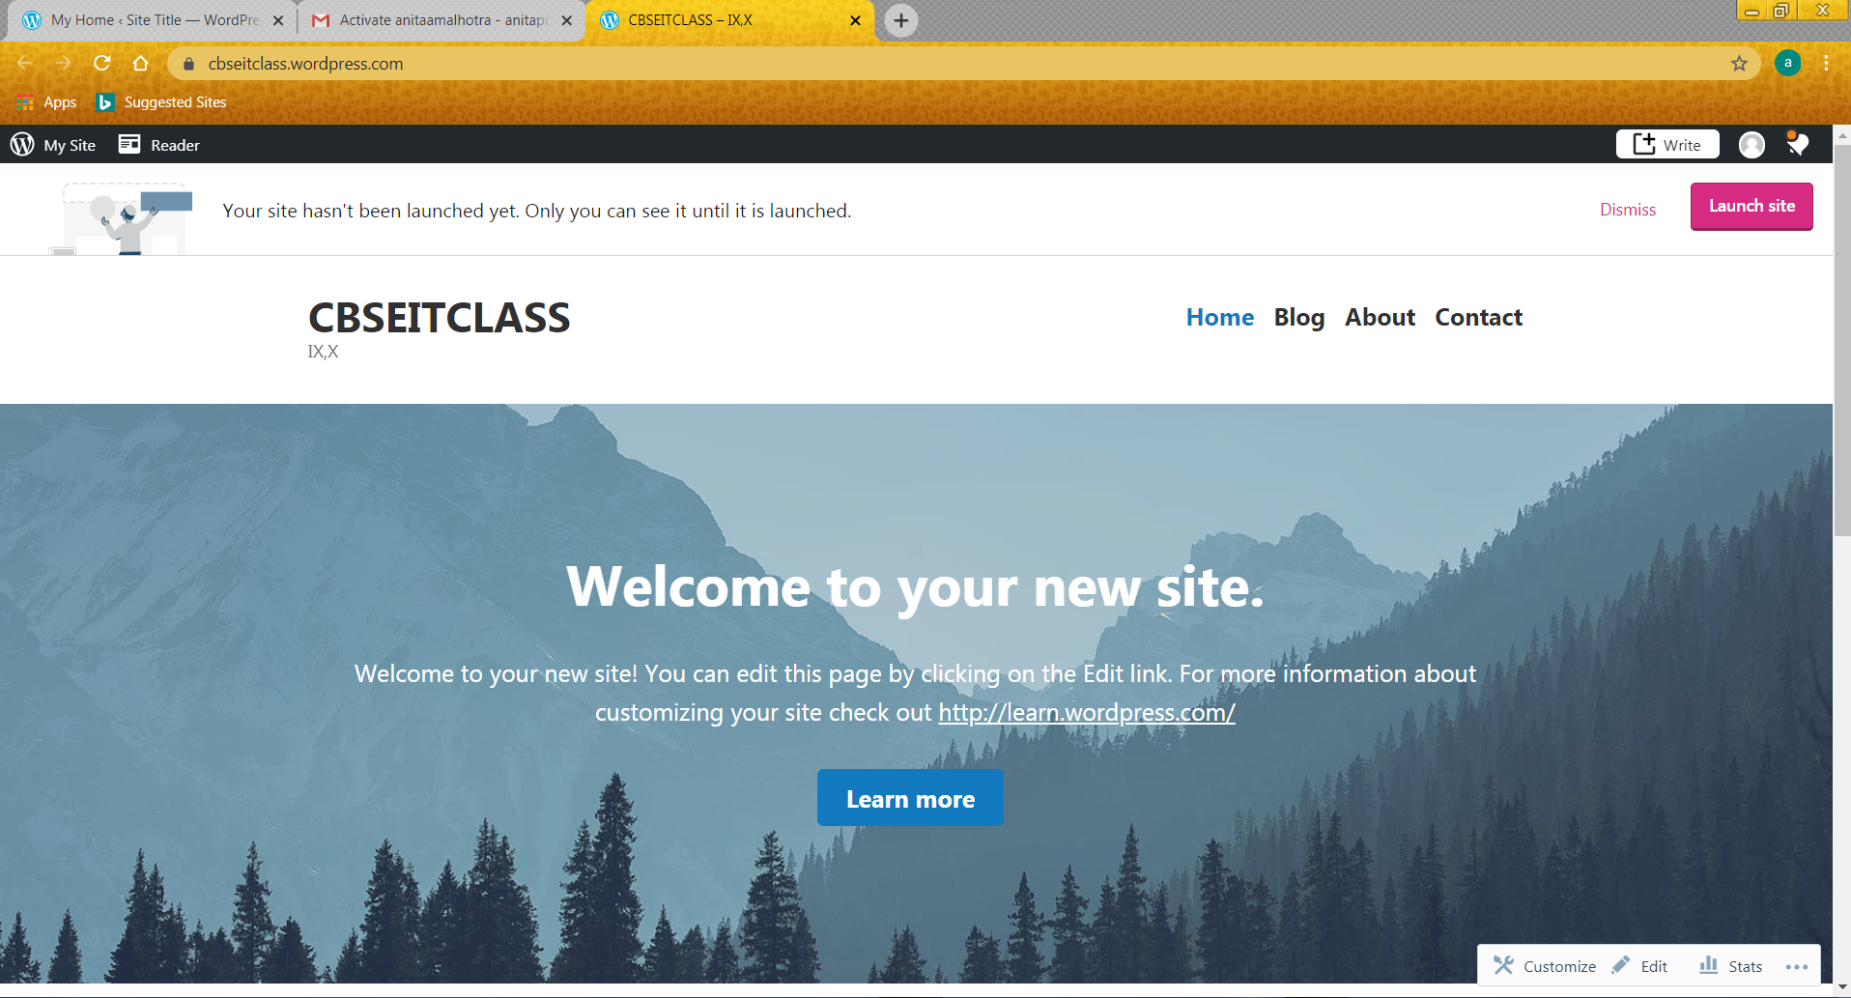
9. This screen will open.

Slide 9
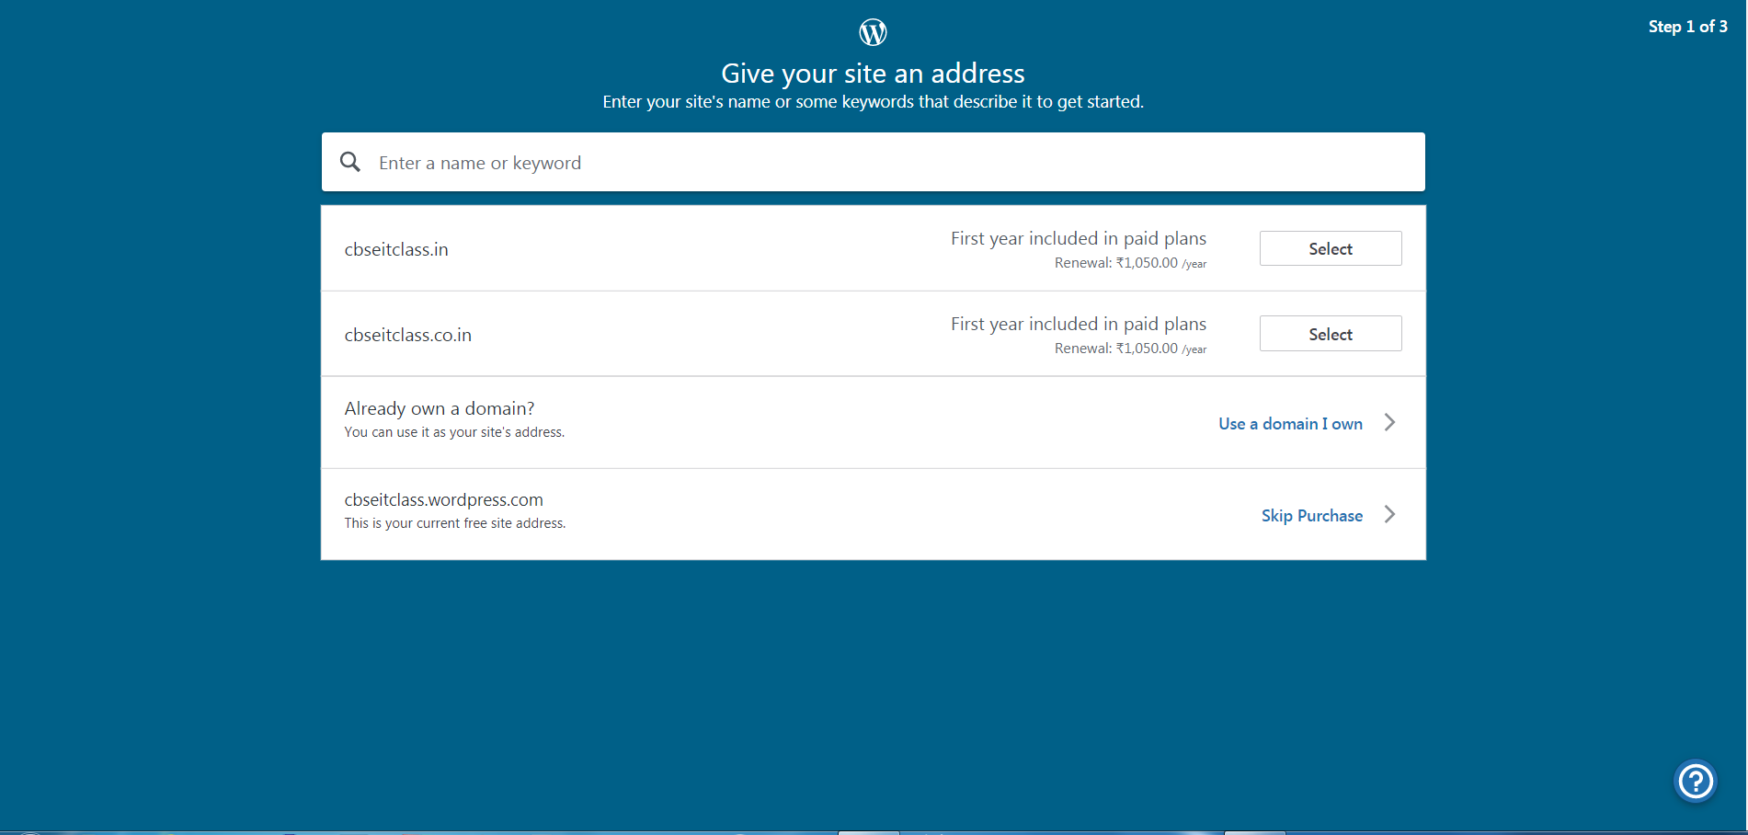
10. Write the given address as shown with Skip purchase.

Slide 10
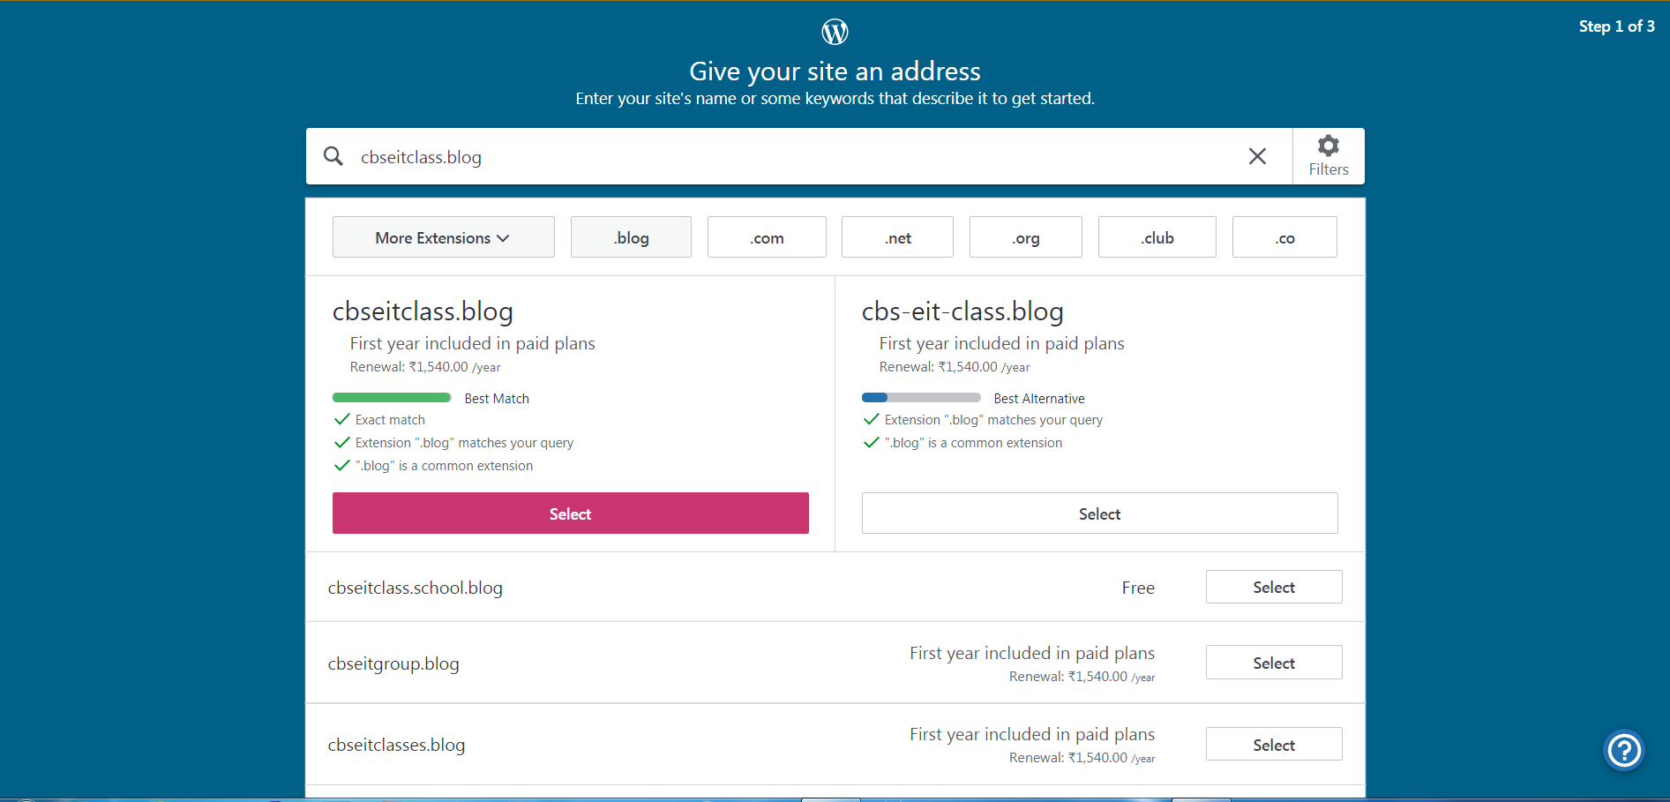
11. Type the site’s address which is free available with .blog and click Select.

Slide 11
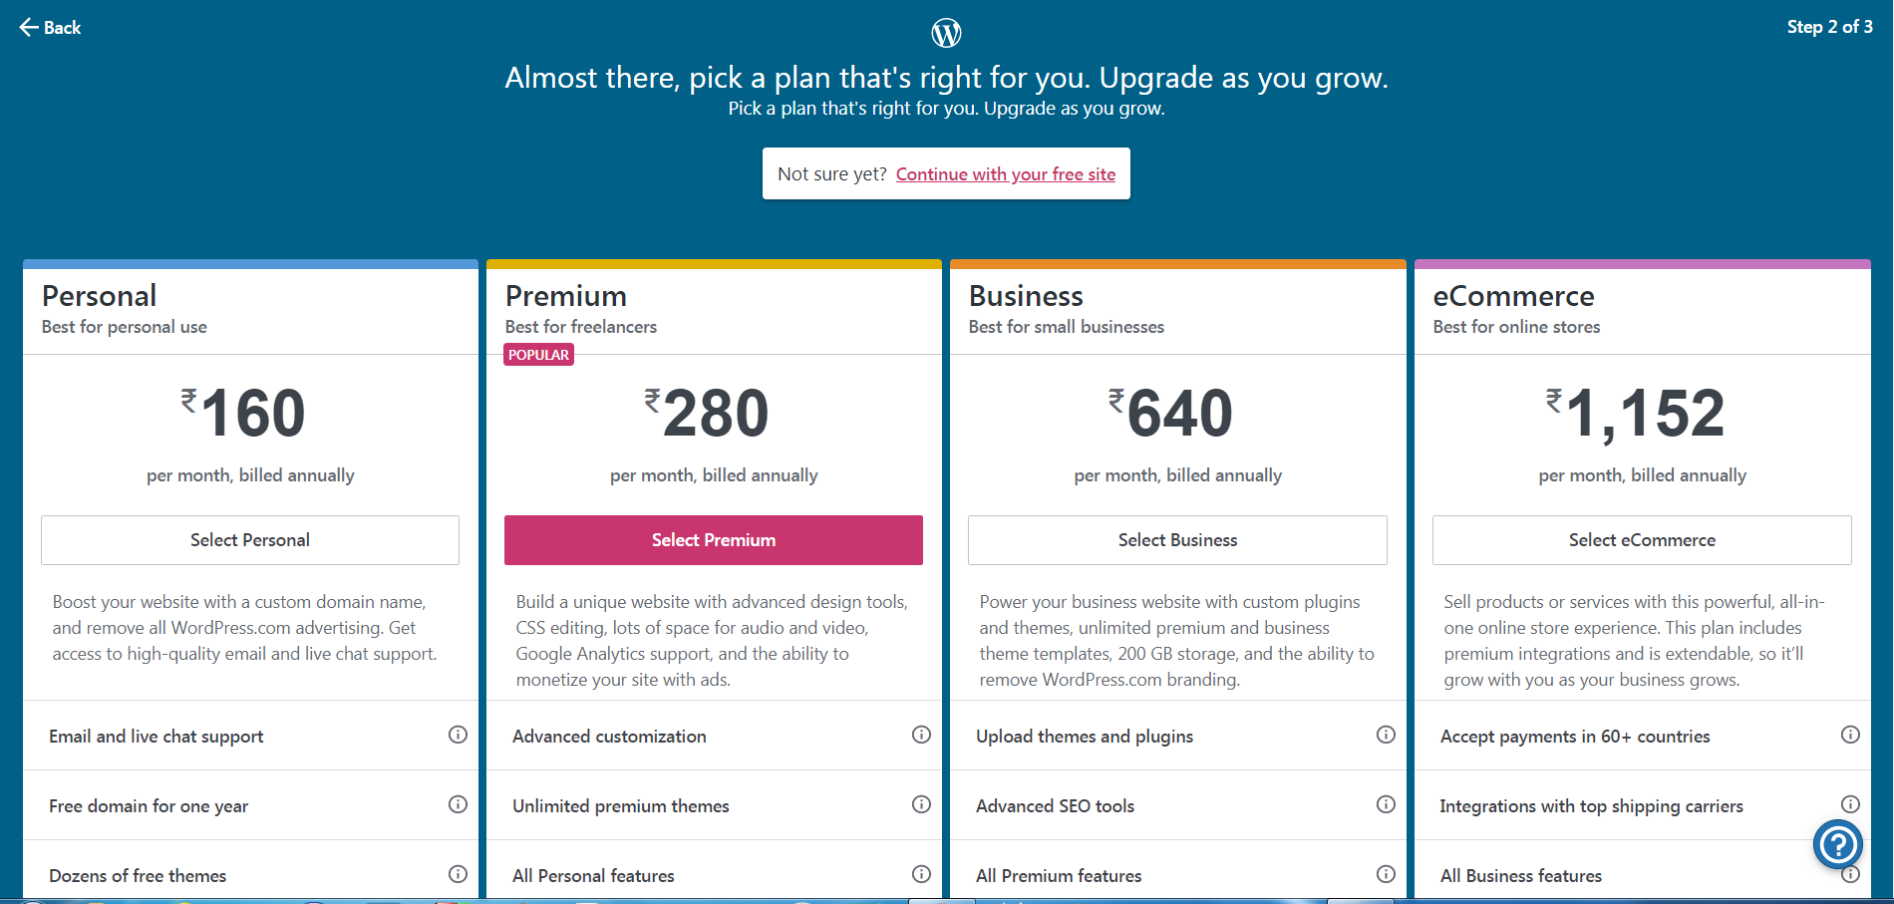
12. Click Continue with your free site.

Slide 12
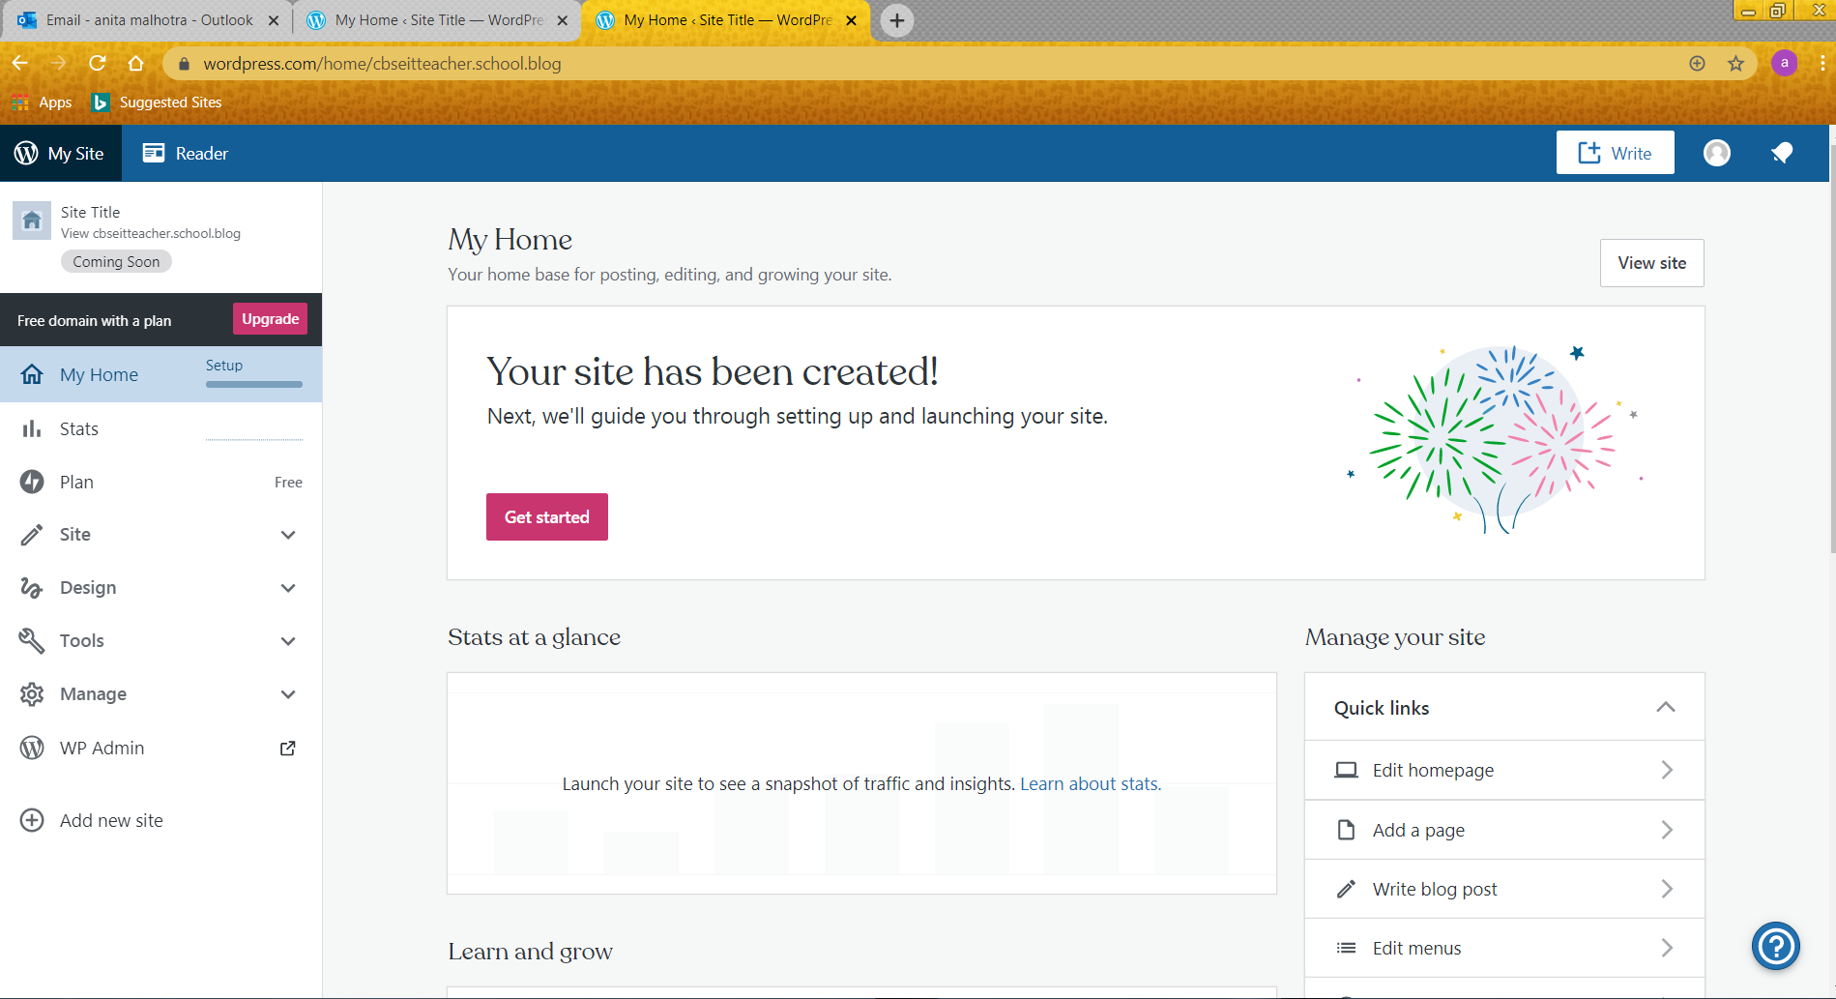
13. Click Get started.

Slide 13
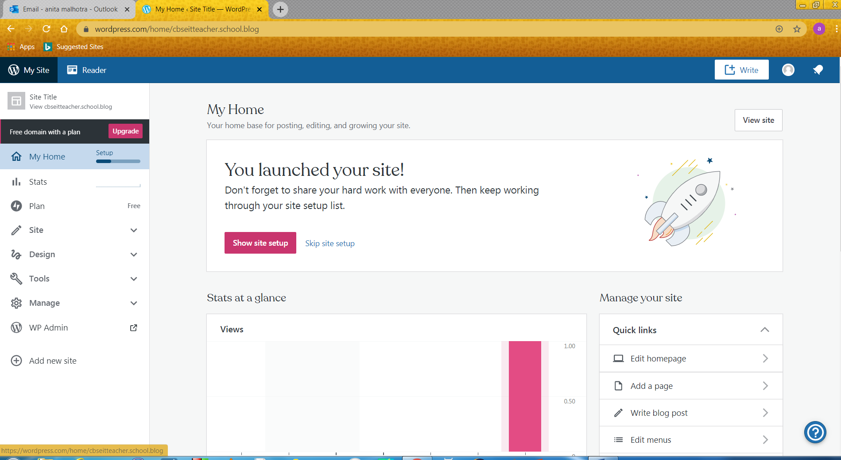
14. Click skip site setup.

Slide 14
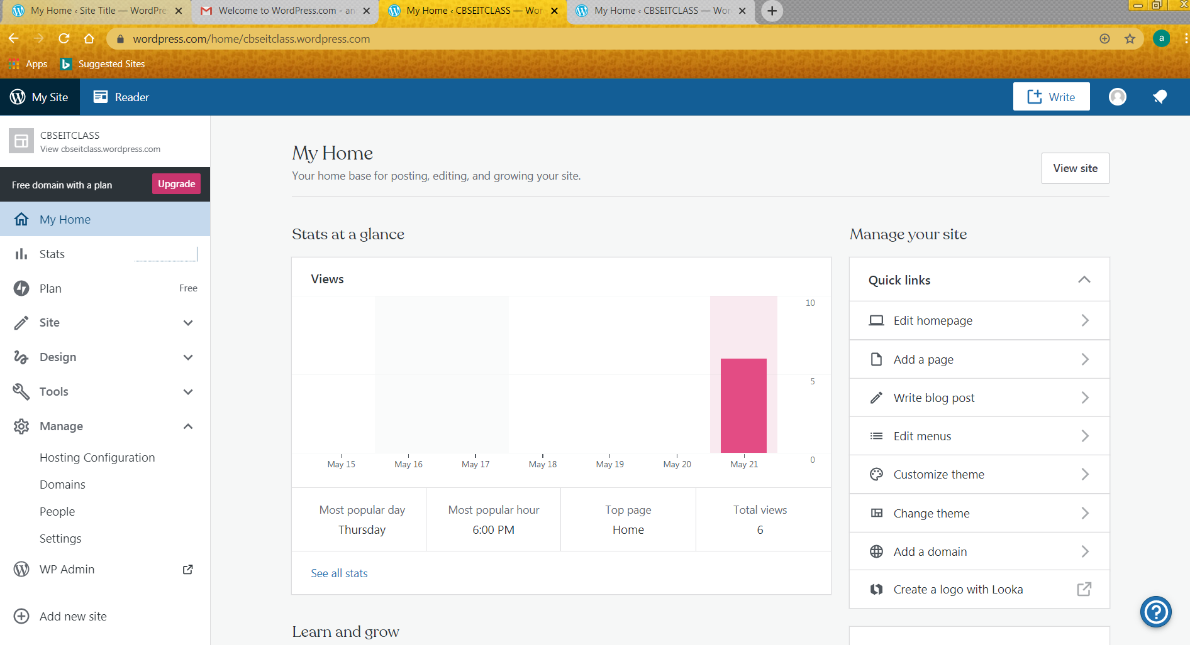
15. click +Write (create a new post) button.

Slide 15
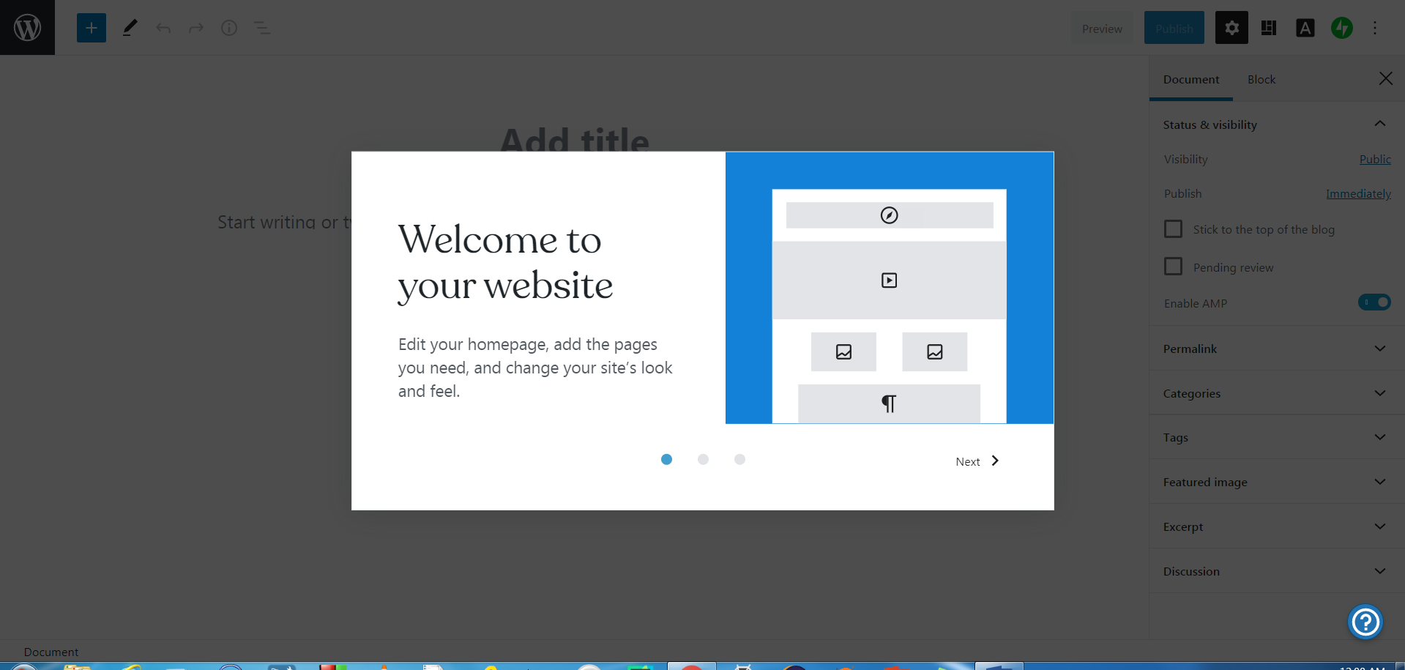
16. Click Next →Next → Get started

Slide 16
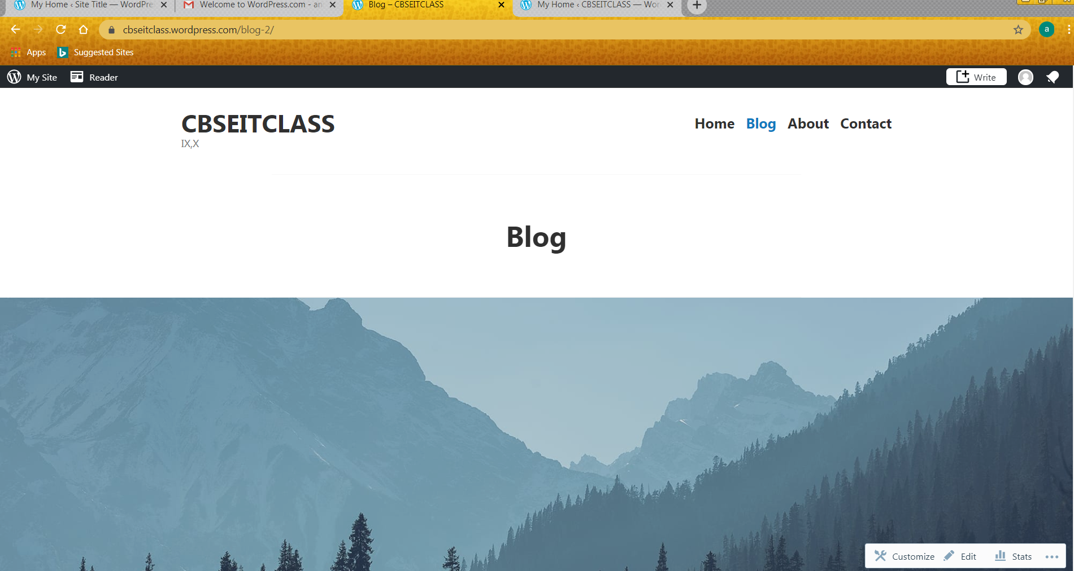
This type of screen will appear. Click on Blog to get this screen.

Slide 17
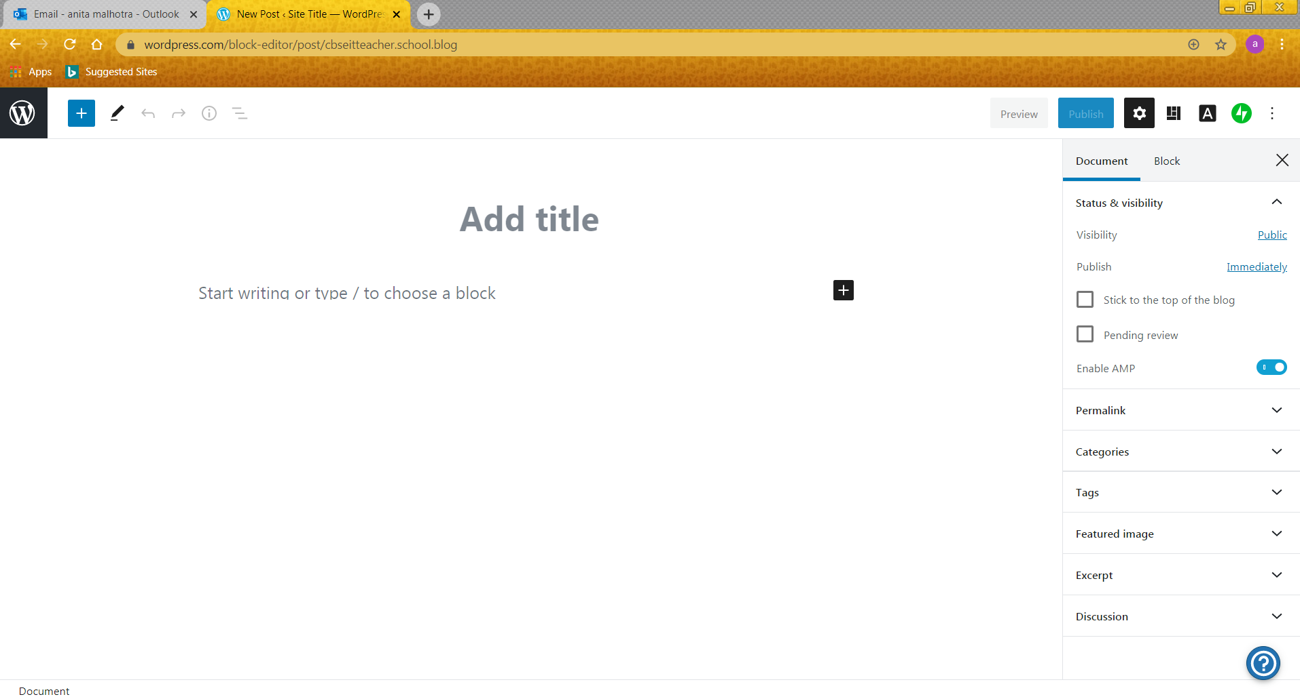
17. Type title and the content and click on publish.

Slide 18
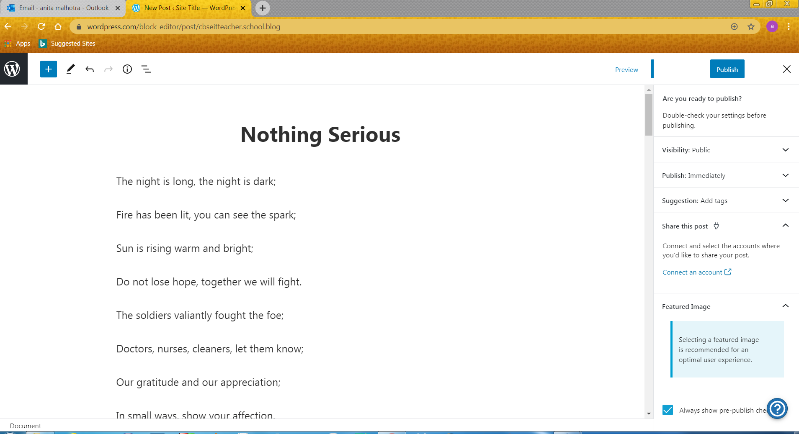
18. Again click on Publish.

Slide 19
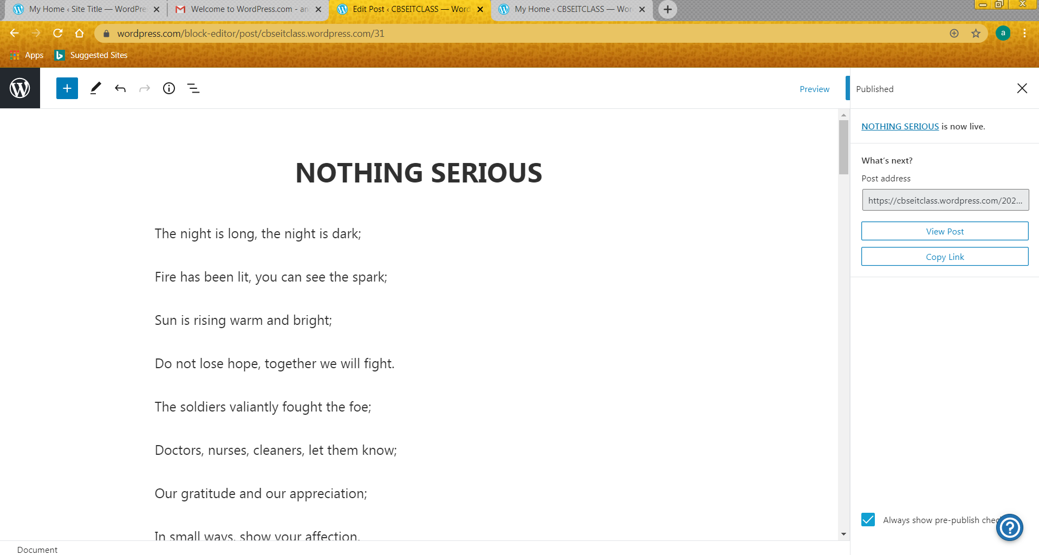
19. Click copy link. Mail it to me and logout.

Slide 20
This was a representational demo for creating a blog in WordPress. There may be some variation when you actually try to create a blog in WordPress. However, the steps shown in the ppt will help you in creating the free blog.

