Slide 1
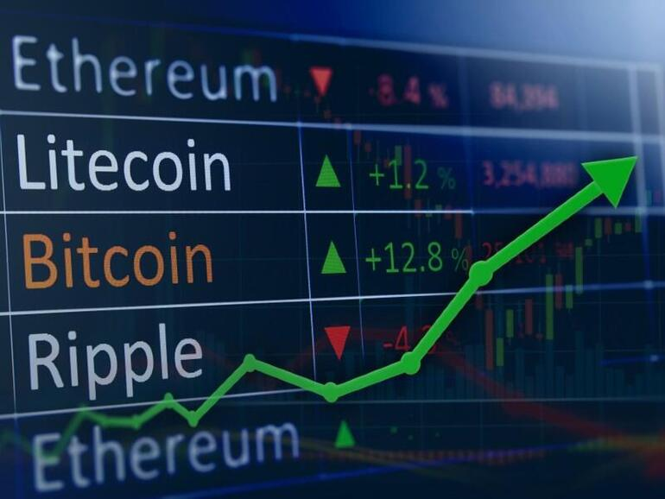
A Hybrid Approach of LSTM and NLP to Crypto Price Prediction
By:
Anita, Rakeshwer, Awais

Slide 2
Project’s Goal
To accurately predict the trend if the price goes up or down and the actual price using different architecture.
We have used 4 different models with different features and compared their effectiveness for our parameters and size of the data.

Slide 3
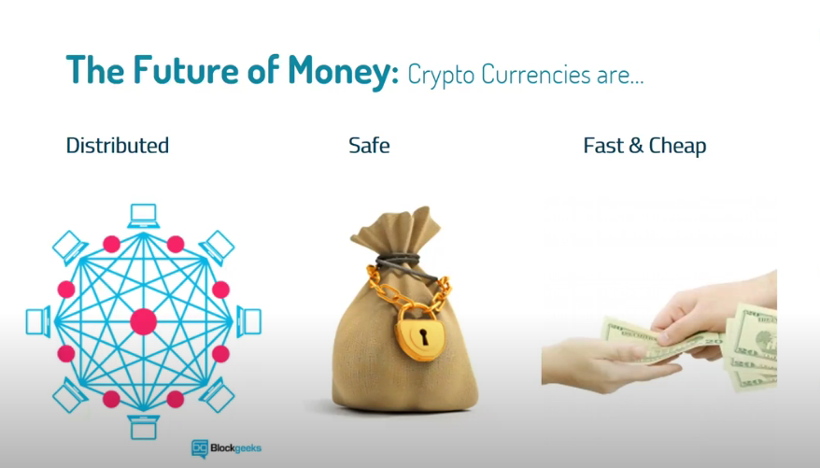

Slide 4
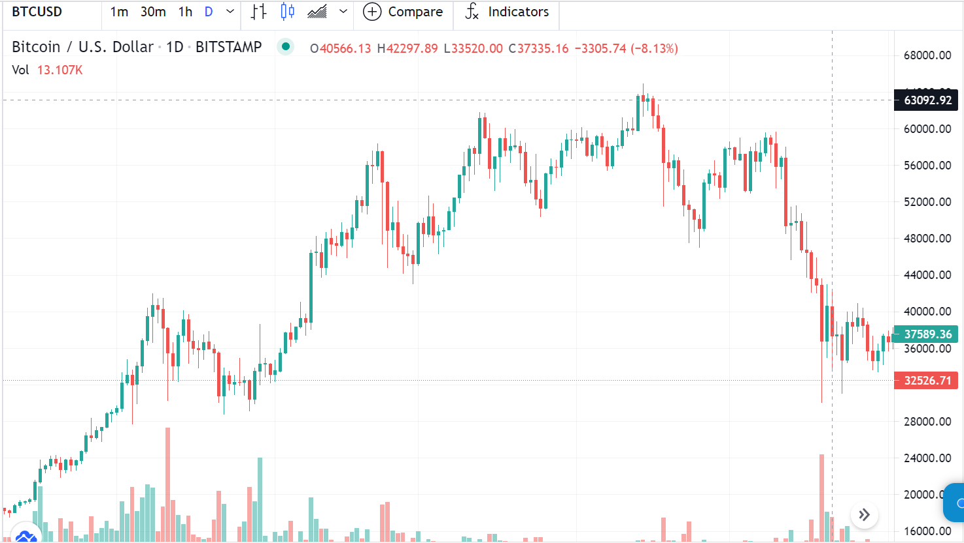
What makes the prediction a difficult task? A volatile market with swinging prices

Slide 5

Key Factors
Technical analysis
Fundamental analysis
Sentimental analysis
Notes:
For an accurate interpretation of price movements, the market should be evaluated with these three approaches
Technical analysis: All historical statistics, including price movement, trading volume and many other past indicators and metrics. By following historical prices, it maybe possible to notice some similar pattern and catch hints when the price goes up or down.
Fundamental analysis : it approaches price direction from an other perspective. Not from the crypto price itself but from macro viewpoint and other external factors. These are things like demand, world economy, company revenue, the weather forecast and maybe an upcoming superstorm.
Sentiment analysis: the last key element, sentimental analysis, is the human factor, including not only crypto trader but everyone. The market is not only driven by fundamentals but also short term sentiments which makes currencies volatile on a day to day basis. These sentiment come from different group of people, The more influential these people are, it’s more likely to affect crypto demand and price.
In this model, technical and sentimental approaches have been considered.

Slide 6
What we have tried?
Combining technical and sentimental features we designed three models
A LSTM model with historical prices
A NLP + FFNN & CNN/LSTM model with historical prices and sentiment scores
A LSTM model with historical prices and Fear&Greed Index

Slide 7
Data Collection
Historical Prices from Yahoo Finance API
( contains High, Low, Open, Close, Volume, and Adj Close Price)
Twitter Bitcoin dataset from Kaggle. (latest one)
(contains more than 50000 tweets)
Fear and greed indexes from bitcoinstools website
(Index for year 2021)

Slide 8
Data Preprocessing
The texts are used only for this study: Column header ‘tweets’
Rows containing non-English tweets removed
All currency signs, URLS, emoticons, #hashtags and @mentions remained

Slide 9
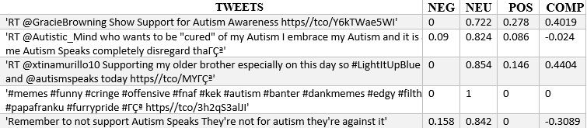
Tweets Sentiments
Vader
A commonly used tool for sentiment analysis.
Labeled data corpus for Sentiment Analysis
SentimentIntensityAnalyzer: library for classifying into groups of sentiments
Outputs:
Probability of positive, neutral and negative
Compound values in a range of -1 to 1, where -1 represents negative for each tweet
The compound value is comparable to a single measure of polarity

Slide 10
How ? We did?
Data Collection from mentioned APIs and sites.
Preprocessed (took a lot of time)
Received the sentiments as pos (1) or neg(0)
Used sentiments as labels
Merged the two datasets crpto and sentiments.
Trained and predicted.

Slide 11
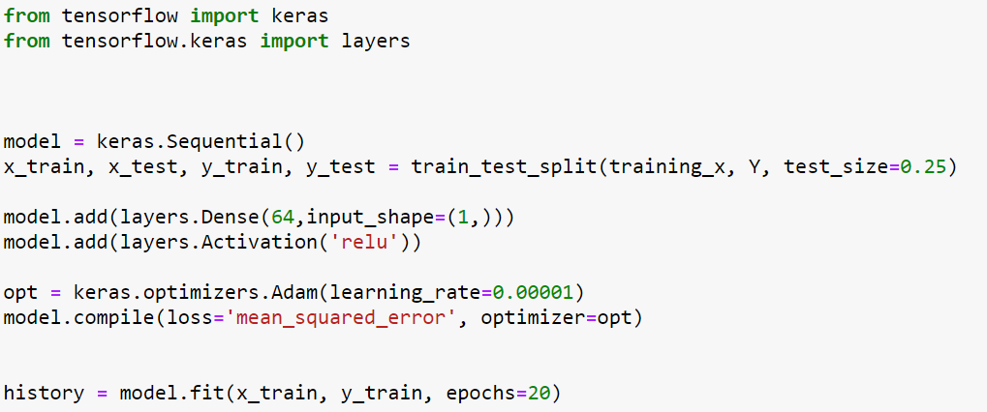
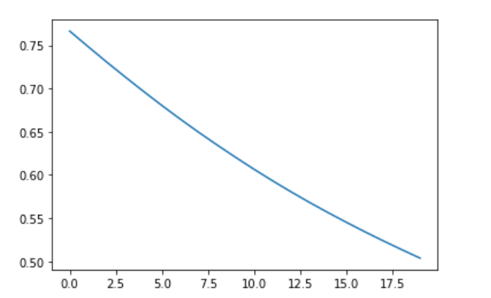
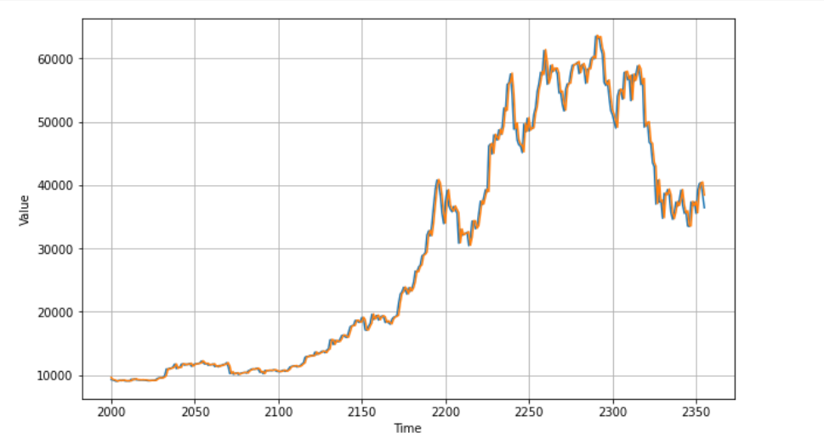
Feed Forward NN
With this simple model of we have great great results.
2 layers
Some of the models also use drop out to avoid over fitting in sequential model.
But In our case does not improve the performance.

Slide 12
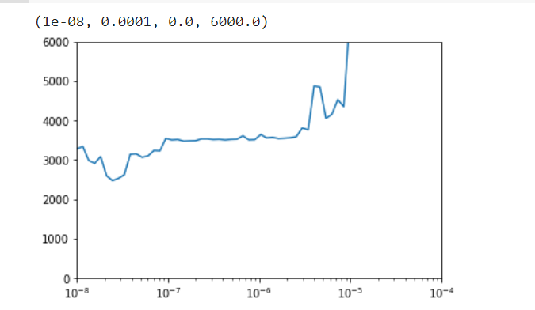
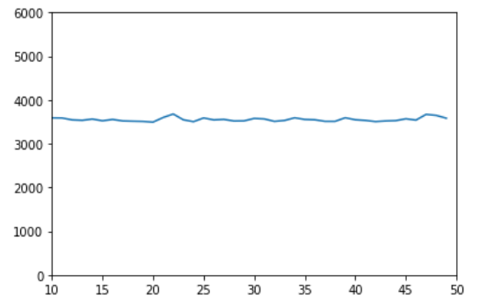
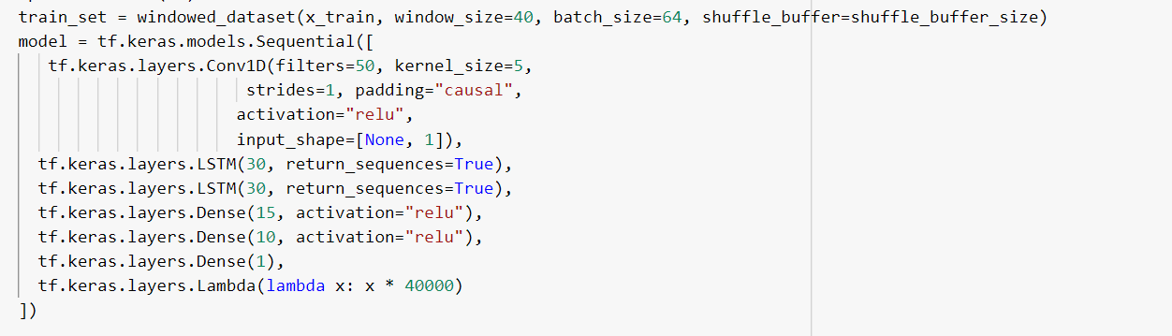
CNN + LSTM + Normal Layer
Learning rate of 1e-6
Conv1D : with 15/50/30 filters and 3/5 kernels , stides : 1 and padding is casual
2 layers LSTM with 30 layers
2 layers of Dense with 15 and 10 neurons
Adjusting hyper parameters did not improve the model.
The shown figure is of loss. Which is in fluctuation mode.
Changing epochs also does not make the model more generous.

Slide 13
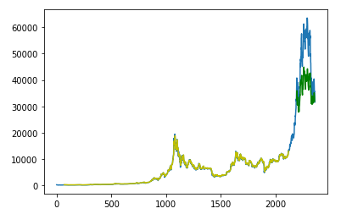
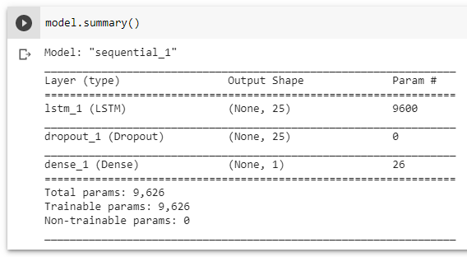
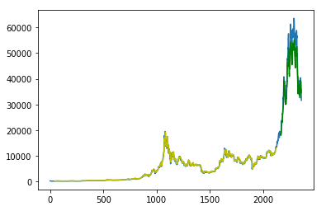

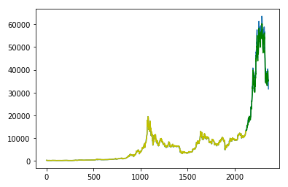
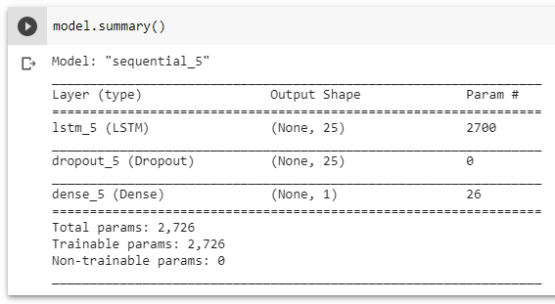
Prediction Model LSTM
Lookback: 70 days
Lookback: 42 days
Lookback: 1 day
No significant correlation between general Tweets and price action.
Volatility Clustering is exhibited by the data.
Very short memory retention.
Significant differences in predicted vs actual values for longer windows.
Much better results for shorter window size.
Results reinforce the autoregressive nature of the price action.

Slide 14
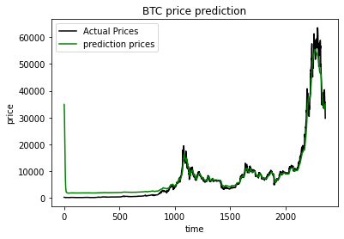
LSTM (Best in our case)
A model with the window size of 14-> lower performs outclass some how.
2 lstm layers, optimizer: “Adam”. Activation relu.
It says : it will go down even in future.

Slide 15
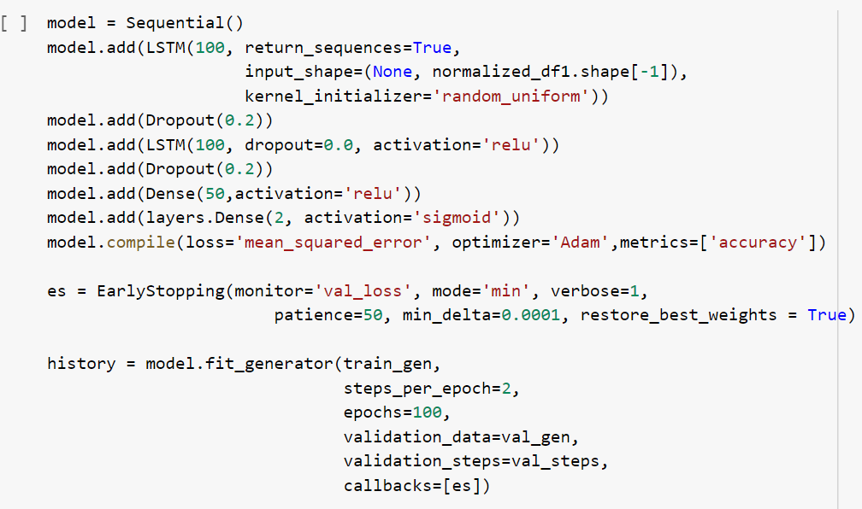
Prediction Model with Fear&Greed Index
Fear&Greed Index: volume, open interest, social media and search data
What success look like: price goes up or down?
Inputs: one year prices + Fear and Greed Index
Model architecture: One layer LSTM and one dense layer, with 0.2 dropout and a dense output layer

Slide 16
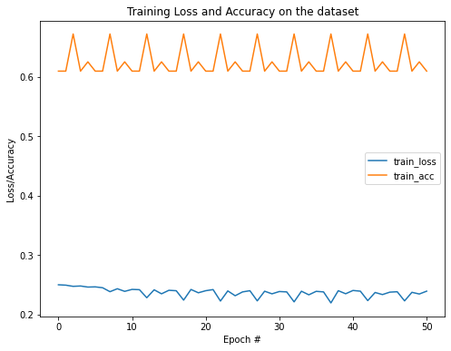
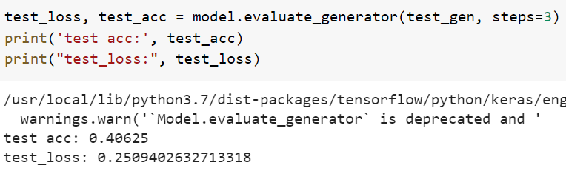
Prediction Model with Fear&Greed Index
Result: was not satisfying

Slide 17
Conclusion
In our case, LSTM performs well.
Undoubtedly Other methods can works fine, but not as LSTM due to its nature of remembering values via gates architecture.
CNN+LSTM should have worked well but the results were not satisfying. Adjusting hypermeters does not improve even the performance.
Trying with different classification like fear and greed index makes us believe the LSTM model performs more rational in terms of financial data.

