Slide 1
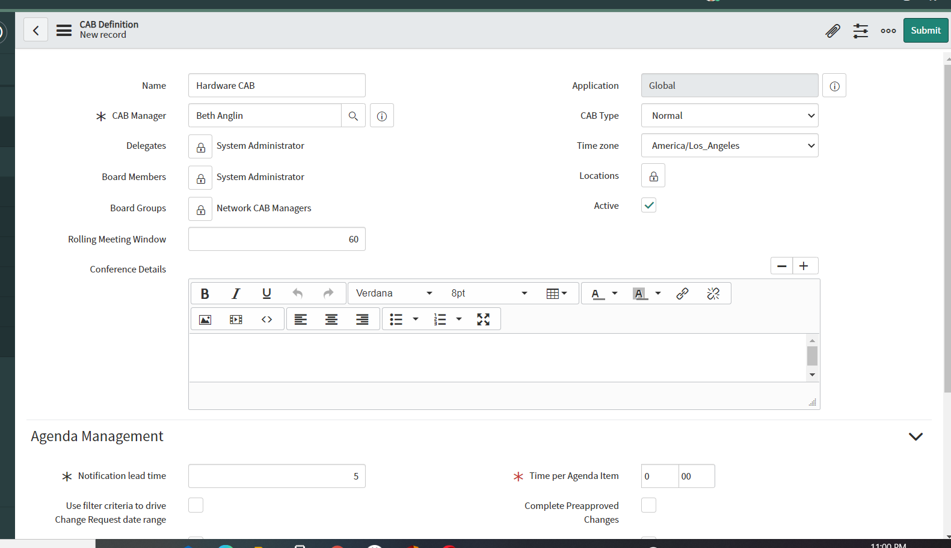
Meeting name
CAB Manager
CAB Manager Delegates with CAB Manager role
Meeting link, Passwords, Phone Numbers etc.
CAB Attendee groups / individuals
Days this definition remains valid
Meeting link, Passwords, Phone Numbers etc.

Slide 2
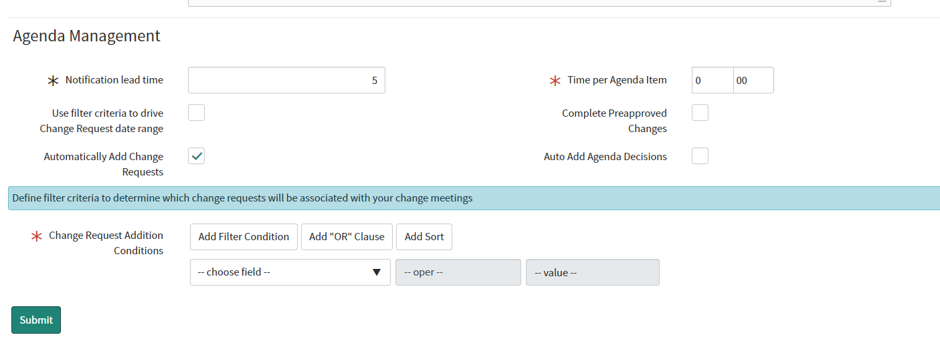
Number of agenda items prior to the change of the assignee gets a notification
Amount of time planned for each change review – treat as estimated timeframe e.g. 10 min per item
Checking this box will use below filters for Change range selection
Does not bring approved changes for CAB review
Selected by default. This enables the filters shown below
CAB decisions are added to each CAB instance with notes against each agenda item

Slide 3
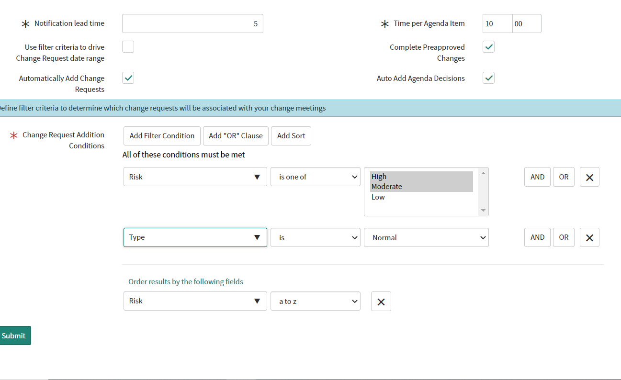

Slide 4
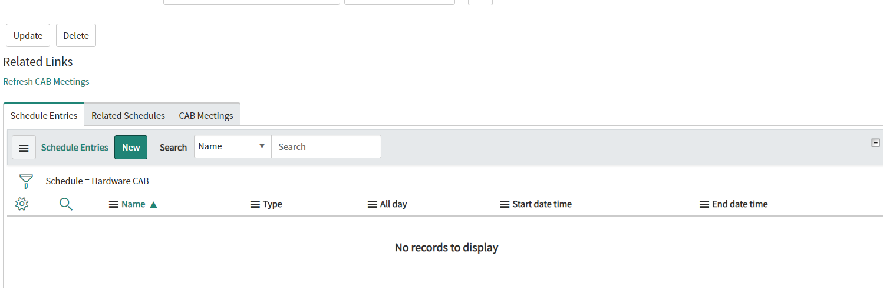
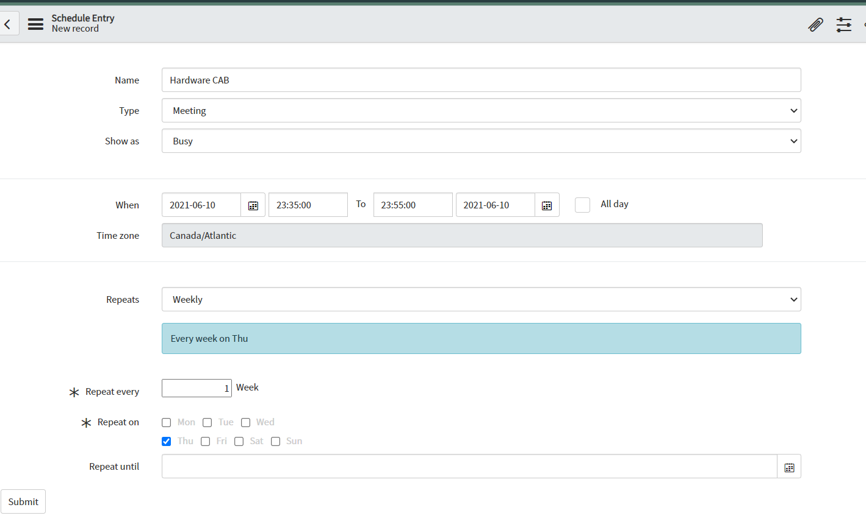

Slide 5
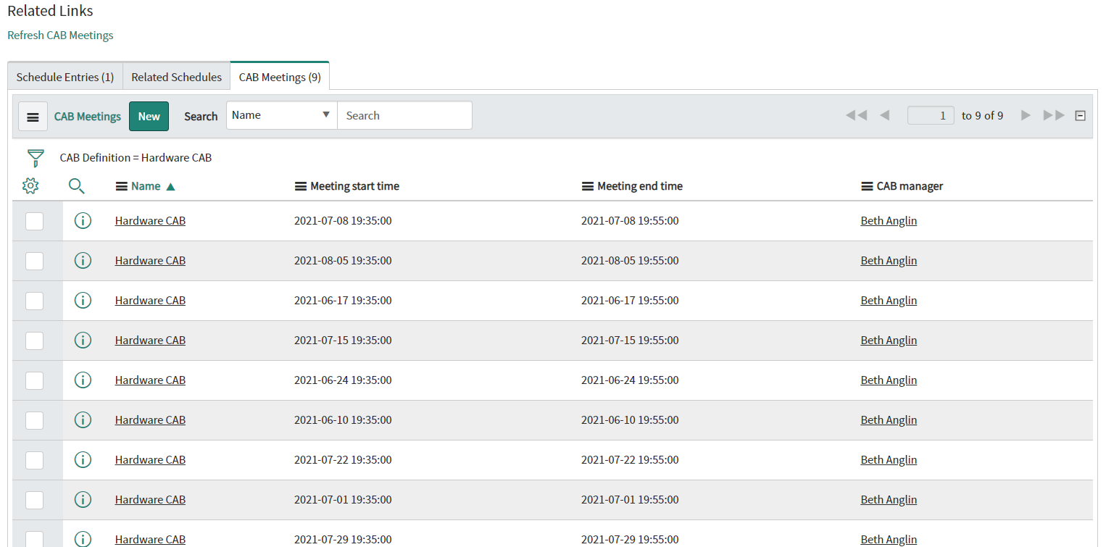

Slide 6
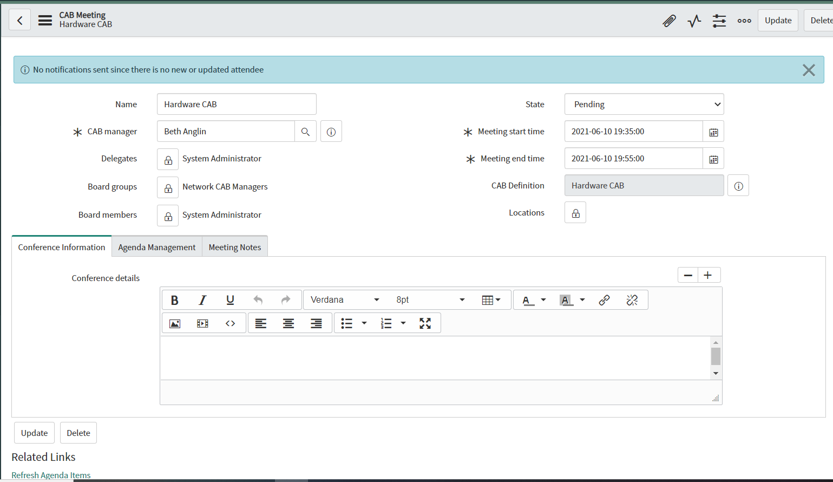

Slide 7
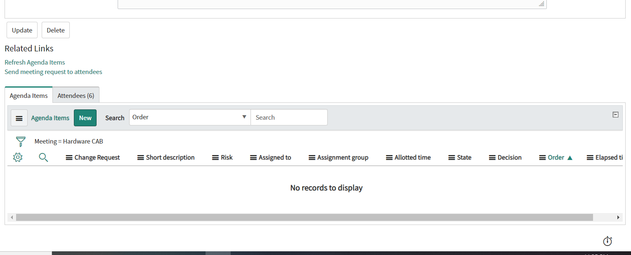




Many CAB agenda items i.e.Change Records will appear here after refresh – all these will follow CAB Definition filter condition.
Any other new changes can also be added here using the new button

Slide 8
Individual CAB meeting can get additional changes added
Individual CAB meetings can get time changed to suit changed circumstances

