Slide 1
Trends in home prices in King County, WA
Spoiler alert: if you’re a teacher, buy some ear plugs because you’re living near the airport on your salary.

Slide 2
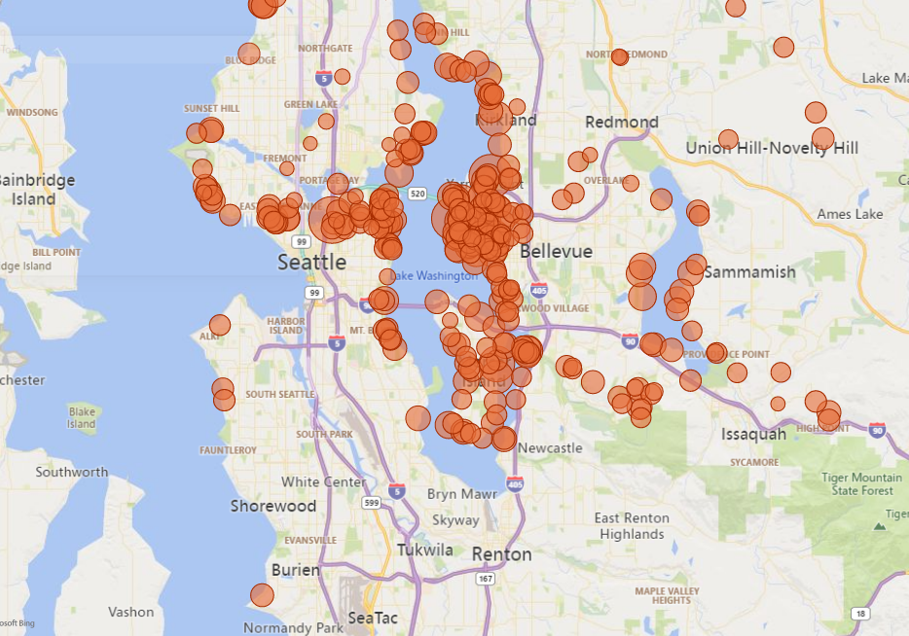
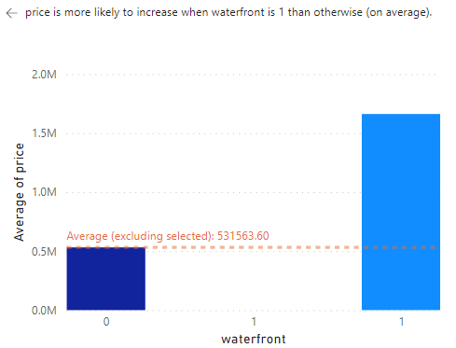
WATERFRONT PROPERTIES ARE LIT
Here are the houses with 3+ bedrooms that cost > $1.8M
$1,661,876
$531,564

Slide 3
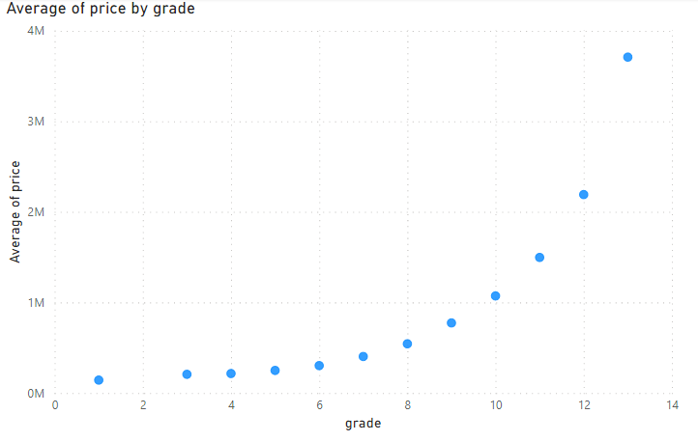
Exponential increase in price per grade

Slide 4
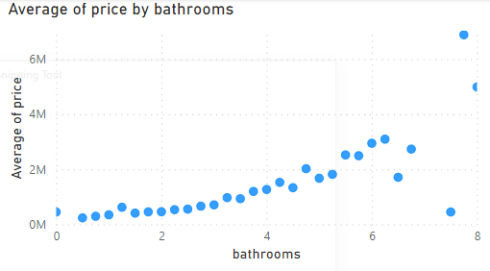
You can have too many bathrooms

Slide 5
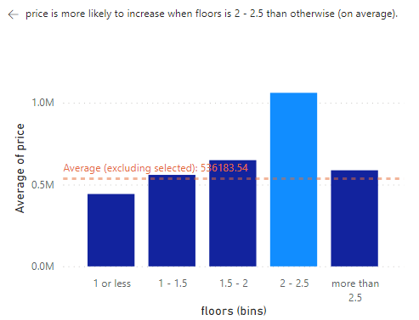
Ditto for floors
$1,060,346

Slide 6
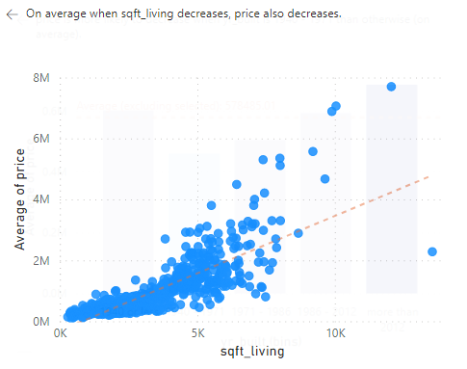
increase in price per original home size

Slide 7
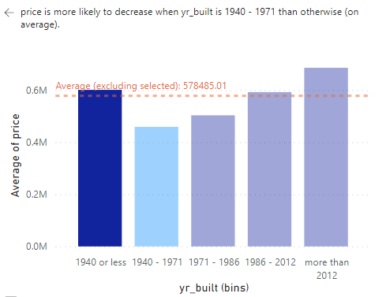
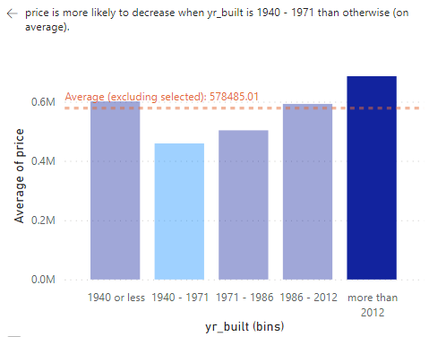
Historic or brand new
Before 1940
After 2012
Mean price $601,222
Mean price $686,012

Slide 8
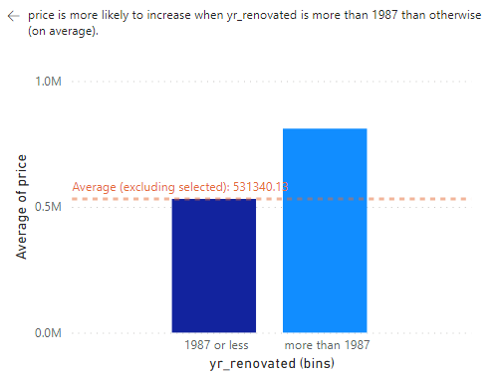
Renovations should be newer than a millenial
$810,617

Slide 9
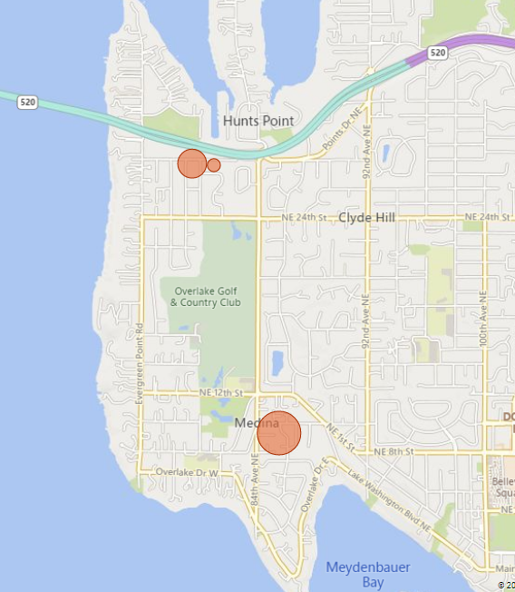
Want a bargain?
There are three 3 – 4 bedroom homes less than $1,000,000 in 98039

Slide 10
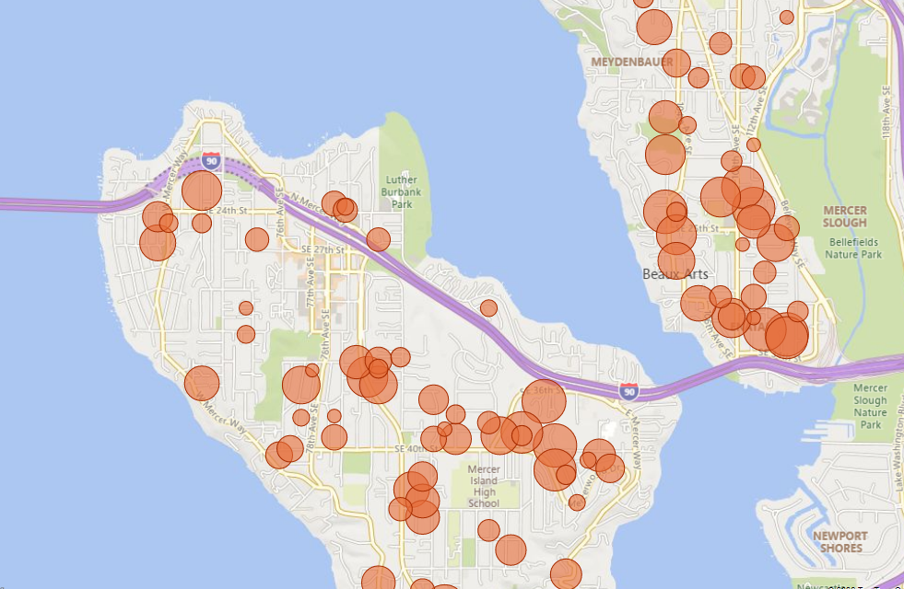
Want a bargain?
But 98004 and 98040 have many more options in 3+ bedrooms less than $1,000
AND are near the water

Slide 11
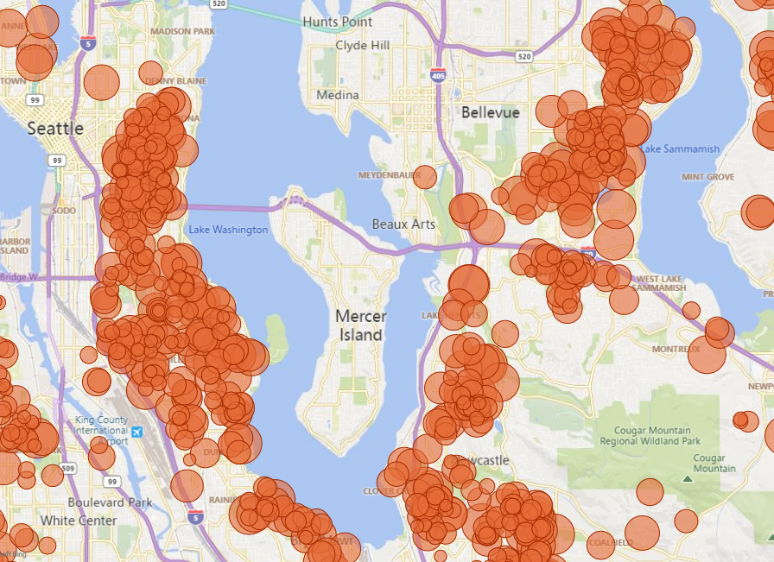
On a budget?
Stay away from the water and the islands and head towards the airport if you’re looking for 3+ bedrooms under $500,000

