Slide 1




I N I T I A L D E F E N C E P R E S E N T A T I O N
CO M PU T E R S CIE N CE DE PA RT M E N T
Quantum-Inspired Network Intrusion Detection System
Optimizing ML-based NIDS using Quantum-Inspired Algorithms for Feature Selection & Classification
Presented by Anita Bashir Nayab Bashir
Roll No
92
74
Supervisor Session
Prof. Dr Syed Ali Abbas 2022–2026

Slide 2







Why Do We Need This System?
P R O B LE M S T AT E M E N T
Network intrusion is a growing threat — existing solutions fall short
Global
DDoS
$10.5 Trillion cybercrime cost by 2025
Cyberattacks ↑ 15% every year
Traditional NIDS = high false-positive rates
U2R
MitM
Nationally
Banks & telecom sectors under attack
No indigenous cybersecurity tools
Real-time detection gap in critical infra
R2L
DoS
Local
Probe
Campus networks unprotected
Manual monitoring — inefficient
Research gap: quantum-ML NIDS not explored

Slide 3










Hybrid ML-NIDS with Quantum-Inspired Optimization
P R O P O S E D S O L U T I O N
Combining classical ML with QPSO for smarter, faster intrusion detection
Smart Feature Selection
41 features → 18-22 via QPSO
Classical ML
HYBRID NIDS
Quantum-Inspired
Higher Accuracy
~88% → ~94%+ detection rate
Random Forest
Decision Tree
Feature Extraction
QPSO Algorithm
Feature Selection
Superposition Concept
Lower False Positives
12% FPR → ~5% FPR
GUI Simulator
Visual dashboard + report

Slide 4







Data Input & Preprocessing
M E T H O DO LO G Y 1 / 3
① Data Input & Preprocessing
② ML Model Training & QPSO
③ Detection & GUI
Data Input
NSL-KDD Dataset & UNSW-NB15 Dataset
Real-world network traffic logs
Datasets Used
NSL-KDD (UNB.ca)
UNSW-NB15 (ADFA)
Data Preprocessing
Normalization — Min-Max Scaling · Z-Score Remove noise, nulls & duplicates
Feature Engineering & Split Extract 41 initial features from traffic data 80% Train / 20% Test — Stratified split
Output → Clean, Normalized, Feature-ready Dataset — Passes to Phase 2

Slide 5





ML Model Training & QPSO Optimization
M E T H O DO LO G Y 2 / 3
① Data Input & Preprocessing
② ML Model Training & QPSO
③ Detection & GUI
Classical ML Model Training
Random Forest (100 trees) & Decision Tree (CART)
Train on dataset → Save Baseline Metrics
Quantum-Inspired Opt.
Particle Swarm Algorithm
Fitness Evaluation
Convergence Detection
QPSO Feature Selection
Initialize particles (each = feature subset), evaluate fitness
Quantum velocity update → converge to best 19 features
QPSO Algorithm
Feature Subset Optimization
Dimensionality Reduction
Optimal Feature Subset
41 → 19 features (53% ↓)
Hybrid RF + QPSO Model
Re-train Random Forest on 19 optimized features Evaluate: Accuracy · Precision · Recall · F1 · FPR
Output → Hybrid QPSO+RF Model Trained · Baseline Metrics Saved → Passes to Phase 3
Quantum-Inspired NIDS | Ini tial Defence

Slide 6




Attack Detection & GUI Simulation
M E T H O DO LO G Y 3 / 3
① Data Input & Preprocessing
② ML Model Training & QPSO
③ Detection & GUI
Attack Detection & Classification
Apply Hybrid RF model — Attack / Normal classification
Confidence Scoring & Alert Generation
GUI Features
Live Attack Feed
Metrics Dashboard
Classical vs QPSO View
Custom Attack Injection
Classical vs Quantum Comparison
Compare baseline RF vs QPSO+RF metrics
Validate improvement in Accuracy, FPR & F1-Score
GUI Visualization & Reporting
Real-Time Dashboard — live detection, metrics & charts Export Results — PDF / CSV Report
Complete QPSO-Enhanced NIDS — Detection · Analysis · Visualization

Slide 7







What This Project Achieves
C O N C L U S I O N
A novel Quantum-Inspired approach to Network Intrusion Detection — making cybersecurity smarter
Benchmark Datasets
Quantum-Inspired Feature Selection
Leverages two internationally recognized datasets — NSL-KDD and UNSW-NB15 — ensuring reproducible and credible evaluation
QPSO algorithm reduces 41 raw features to an optimal subset —
removing noise and improving model focus on meaningful signals
Hybrid ML Architecture
Real-World Simulation
Combines Random Forest with QPSO optimization — bridging
classical machine learning with quantum-inspired intelligence
A Python GUI simulator enables live attack detection visualization and side-by-side comparison of classical vs. quantum-enhanced results
A novel contribution to cybersecurity research in Pakistan · Achievable within a 4 -month timeline · Open-source tools

Slide 8







Technical Stack
T O O LS & T E C HN O L O G I E S
All tools are free, open-source, and well-documented
Core Language
ML Libraries
Quantum (QPSO)
Python 3.x
scikit-learn
DEAP library
Jupyter Notebook
TensorFlow / Keras
pyswarm
VS Code IDE
NumPy / Pandas
Custom QPSO impl.
Visualization
GUI Framework
Datasets
Matplotlib
Tkinter / PyQt5
NSL-KDD (UNB.ca)
Seaborn
Dark dashboard
UNSW-NB15
Plotly
Live chart embed
Publicly available

Slide 9
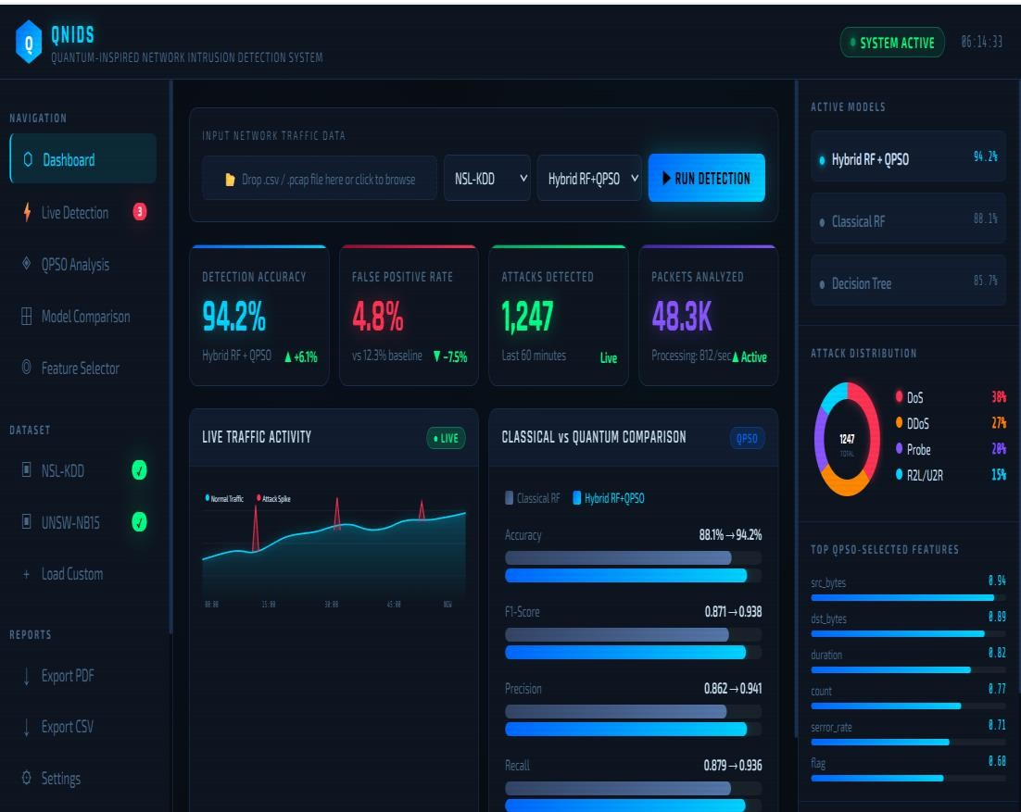
Expected Interface
Supervised by: Prof. Dr Syed Ali Abbas | BSCS 2022–2026

