Slide 1
CROSS BORDER INTRUSION DETECTION
CAPSTONE PROJECT – DATA Incubator

Slide 2

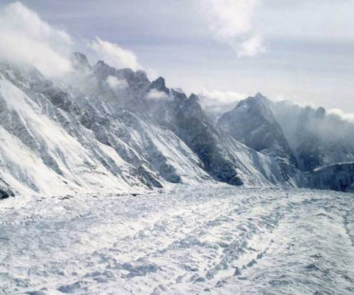
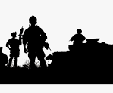
Use CASE – PROBLEM STATEMENT
Goal
To identify anomalies of movements in border areas which has extreme climatic conditions, hostile terrains and non-passable landforms such as glaciers, swamps, marshes, forests, etc.,
Background
Every year, hundreds of soldiers who guard the border suffer from ailments or deaths due to the extreme weather conditions .
A lot of these sensitive areas can be brought under machine induced surveillance rather than human monitoring
Satellite imagery and drone technologies have helped in capturing the digital snapshots which can be processed for identifying potential threats

Slide 3
PROPOSED SOLUTION
ALGORITHM
K –Means Clustering
Raster IO package
TOOLS
Python 3.0
Microsoft Azure AI (Cognitive Services ) - Computer vision
Azure Data Bricks/ Azure Data Lake
GitHub source link:
https://github.com/anitcan/TeamTangent/blob/master/BSF-Monitor-Prediction.ipynb

Slide 4
THANK YOU !

