Slide 1

Texas Home Buyers Guide

Slide 2

Brainstorming Ideas
Who is the Audience?
Texas Homeowners
Audience Interest?
Housing price
How to achieve it?
Assign a score to each category.
Find livability grade by county using the score
COVID rate?
Is the place safe?

Slide 3

Main Questions ?
Housing Price: Where are housing prices rising the most in the past 6 years? Where have prices fallen? AKA where do you want to stay away from in your home investment?
COVID transmission: Does the place have higher COVID transmission rate?
Public safety: Is the place safe to live in? What is the crime rate?

Slide 4


Data Source Search
Housing Price: Zillow Housing Data https://www.zillow.com/research/data/
COVID transmission: Texas Health and Human service COVID-19 data https://www.dshs.texas.gov/covid-19-coronavirus-disease-2019/texas-covid-19-data
Public safety: Texas Open Data Portal https://data.texas.gov/browse?Dataset-Category_Category-Tile=Public+Safety

Slide 5

Analysis
Review the datasheet
Clean the datasheet
Perform Analysis

Slide 6

Housing Analysis

Slide 7
Housing Analysis – Approach
Datasheet observation
Cleaning the Datasheet
Identifying Limitations
Only the Cumulative Confirmed Cases over Time by County dataset will used for this analysis.
Only 2 years have full year dataset (year 2021 and 2022)
Retain only month wise data
4 years data(2020 to 2023).
Remove all informational text
254 Unique Counties records.
Each row is cumulative addition
Informational contents
Total and Unknows date records
Remove null values

Slide 8
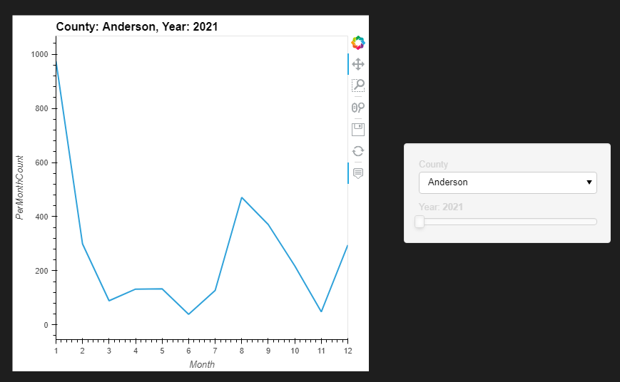
Housing Analysis
Visualization

Slide 9
Housing Analysis – Data display
Display any chart data here
COUNTY | Avg Count | Count Rank | Spread Rate | Spread Rank | Livability Score
King | 0.15 | 0.00 | -44.44 | 0.05 | 5.0
Shackelford | 0.86 | 0.09 | -61.86 | 0.01 | 5.0
Foard | 0.74 | 0.07 | -54.17 | 0.02 | 5.0
Stonewall | 0.16 | 0.01 | -59.09 | 0.01 | 5.0
Runnels | 3.29 | 0.26 | -44.25 | 0.05 | 4.5

Slide 10
Housing Analysis

Slide 11
Safety Analysis

Slide 12


Safety Analysis

Slide 13
Housing Analysis – Approach
Datasheet observation
Cleaning the Datasheet
Identifying Limitations
Only the Cumulative Confirmed Cases over Time by County dataset will used for this analysis.
Only 2 years have full year dataset (year 2021 and 2022)
Retain only month wise data
4 years data(2020 to 2023).
Remove all informational text
254 Unique Counties records.
Each row is cumulative addition
Informational contents
Total and Unknows date records
Remove null values

Slide 14
Safety Analysis
Visualization

Slide 15
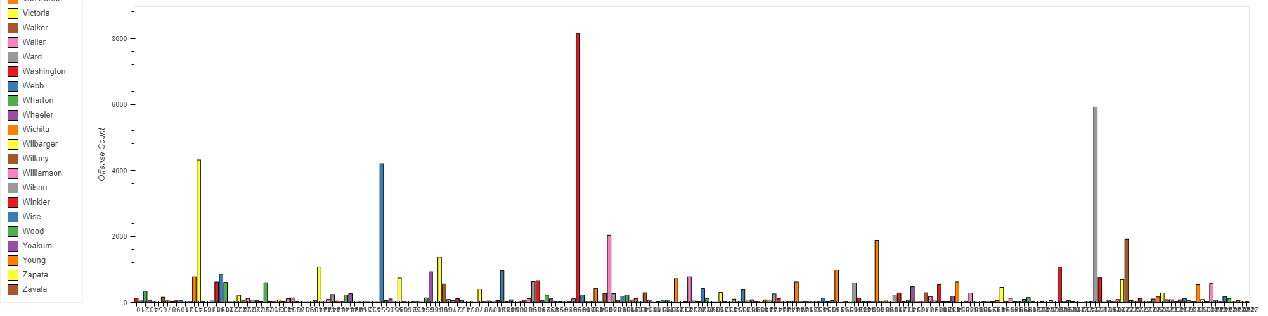
Safety Analysis
Visualization
Offense Count by County

Slide 16
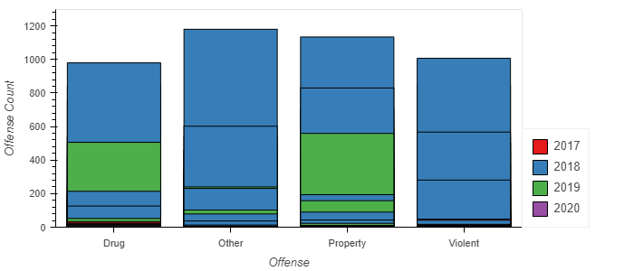
Safety Analysis
Offense Count by County, Year, Type

Slide 17
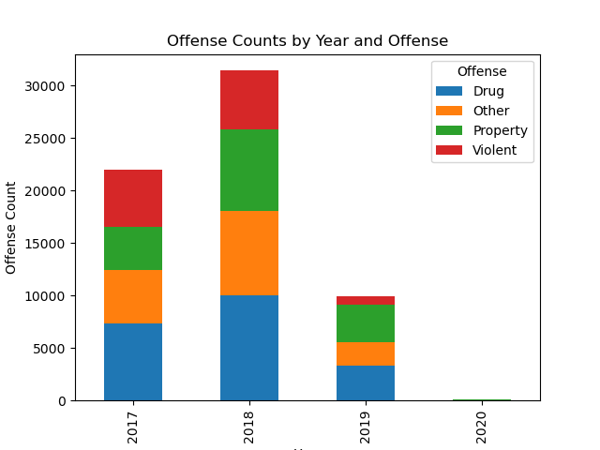
Safety Analysis
Offense Count by Year

Slide 18
Safety Analysis – Data display
Display any chart data here
COUNTY | Avg Count | Count Rank | Spread Rate | Spread Rank | Livability Score
King | 0.15 | 0.00 | -44.44 | 0.05 | 5.0
Shackelford | 0.86 | 0.09 | -61.86 | 0.01 | 5.0
Foard | 0.74 | 0.07 | -54.17 | 0.02 | 5.0
Stonewall | 0.16 | 0.01 | -59.09 | 0.01 | 5.0
Runnels | 3.29 | 0.26 | -44.25 | 0.05 | 4.5

Slide 19
Saftey Analysis

Slide 20

COVID Analysis – Initial prework
Datasheet observation
Cleaning the Datasheet
Identifying Limitations
Only the Cumulative Confirmed Cases over Time by County dataset will used for this analysis.
Only 2 years have full year dataset (year 2021 and 2022)
Retain only month wise data
4 years data(2020 to 2023).
Remove all informational text
254 Unique Counties records.
Each row is cumulative addition
Informational contents
Total and Unknows date records
Remove null values

Slide 21
COVID Analysis – Approach
Full year Dataset 2021 and 2022 years only
County Level
Average Percent and Spread Variance
Livability score
Ranking
Average Percent and Spread Variance

Slide 22
COVID Data Analysis
Timeseries Visualization

Slide 23
COVID Data Analysis
Interesting Findings
Low Spread Swisher County
Lowest
High Spread Yoakum County
Highest
High Count
Harris County
Low Count Kings County

Slide 24
COVID Analysis – Livability Score
Top 5 Best Counties based on livability score
COUNTY | Avg Count | Count Rank | Spread Rate | Spread Rank | Livability Score
King | 0.15 | 0.00 | -44.44 | 0.05 | 5.0
Shackelford | 0.86 | 0.09 | -61.86 | 0.01 | 5.0
Foard | 0.74 | 0.07 | -54.17 | 0.02 | 5.0
Stonewall | 0.16 | 0.01 | -59.09 | 0.01 | 5.0
Runnels | 3.29 | 0.26 | -44.25 | 0.05 | 4.5

Slide 25
COVID Analysis – Livability Score
Top 5 Least preferred Counties based on livability score
COUNTY | Avg Count | Count Rank | Spread Rate | Spread Rank | Livability Score
Grimes | 29.52 | 0.72 | 15.63 | 0.73 | 1.0
McLennan | 197.98 | 0.91 | 30.59 | 0.83 | 1.0
Williamson | 594.69 | 0.96 | 22.19 | 0.79 | 1.0
Cameron | 318.43 | 0.94 | 52.39 | 0.91 | 1.0
Maverick | 92.99 | 0.88 | 32.72 | 0.83 | 1.0

Slide 26

Time to Merge
Housing
Score
COVID Score
Safety Score

Slide 27

Top 5 best county by Livability Score
COUNTY | LIVABILITY GRADE | COVID SCORE | HOUSING SCORE | SAFTEY SCORE
Mason | 4.5 | 4.5 | 5 | 4
Stephens | 4.17 | 4.5 | 5 | 3
Delta | 4.17 | 3.5 | 5 | 4
Presidio | 4.17 | 2.5 | 5 | 5
San Augustine | 4 | 4 | 4 | 4

Slide 28

Top 5 least preferred county by Livability Score
COUNTY | LIVABILITY GRADE | COVID SCORE | HOUSING SCORE | SAFTEY SCORE
Midland | 1 | 1 | 1 | 1
San Patricio | 1 | 1 | 1 | 1
Nueces | 1 | 1 | 1 | 1
Webb | 1.33 | 1 | 2 | 1
Fort Bend | 1.33 | 1 | 2 | 1

Slide 29
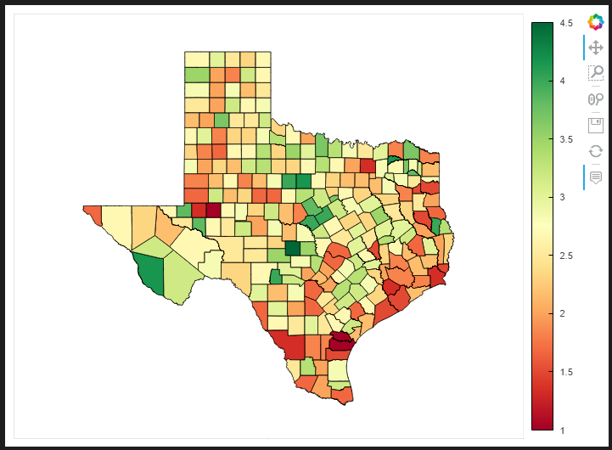
Texas Map Visualization Counties by their liability grade

Slide 30

Questions ?

Slide 31
Thank you!!!

