Slide 1
IncidentIQ Agentic AI Incident Management System
Name: Anitha J
Technology:
FastAPI | LangGraph | LangChain | ChromaDB | RAG

Slide 2
Problem Statement
Challenges
Manual incident triage is time consuming
Knowledge retrieval requires searching multiple systems
Remediation actions are repetitive
Lack of centralized automation
Solution
IncidentIQ automates:
Triage
Knowledge Retrieval
Remediation
Notification

Slide 3
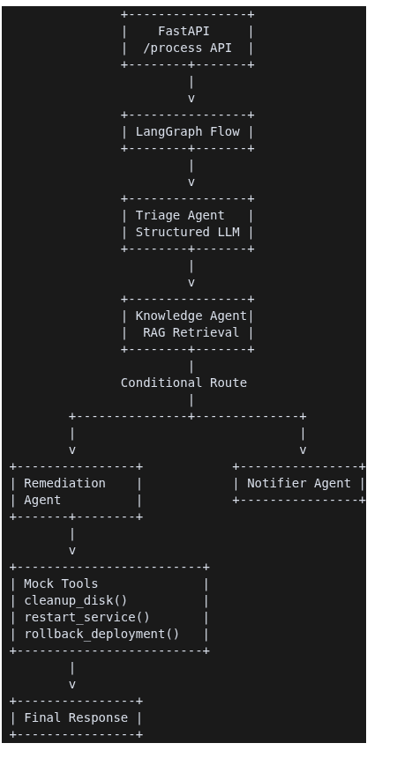
Architecture

Slide 4
RAG Pipeline
Data Sources
Historical Incidents
Operational Runbooks
Workflow
Documents
↓
Chunking
↓
Embeddings
↓
ChromaDB
↓
Similarity Search
↓
Retrieved Context

Slide 5
Tool Invocation
Incident | Tool Invoked
Disk Full | cleanup_disk()
Service Down | restart_service()
Failed Deployment | rollback_deployment()
Remediation Agent automatically selects the appropriate tool based on classification.

Slide 6
Demo Results
Scenario 1:
Disk usage exceeded 95% on server01
Output:
Infra Classification
Runbook Retrieval
cleanup_disk()
Scenario 2:
Customer Portal Down
Output:
restart_service()
Scenario 3:
Deployment Failure
Output:
rollback_deployment()

Slide 7
Observability & Lessons Learned
Observability
Trace IDs
Structured JSON Logs
Prometheus Metrics
Lessons Learned
LangGraph simplifies orchestration
RAG improves grounding
Tool calling enables automation
Structured outputs improve reliability
Future Enhancements
Human-in-the-loop approvals
SSE Streaming
Real LLM integration

