Slide 1
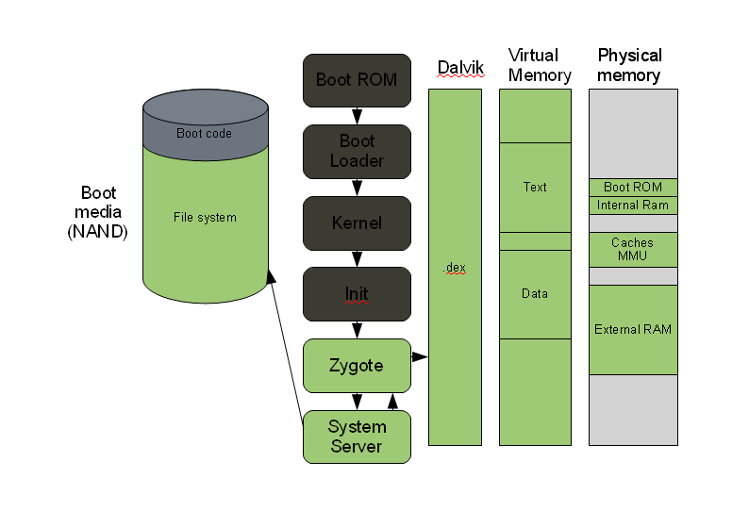
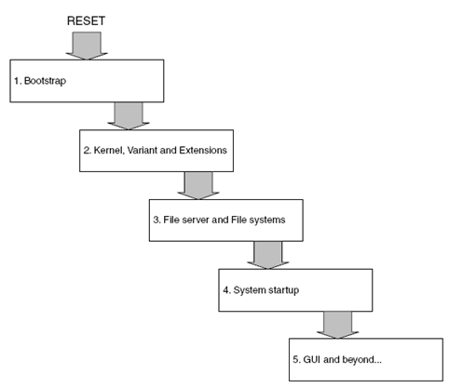
Android Boot up Process Mobile Boot up process

Slide 2
BOOTSTRAP:
The code which executes the task at the initial stages of booting is hardwired and is stored at a fixed location. As the hardware connected to mobile is always fixed, so the preliminary task is very basic which includes checking of all chip components working properly
Bootloader, whose job is to locate and load the kernel. Bootloader setups the network, memory, etc, which requires to run kernel. The bootloader is able to provide configuration parameters or inputs to the kernel for specific purposes.
KERNEL:
Android kernel starts in a similar way as the linux kernel. As the kernel launches, is starts to setup cache, protected memory, scheduling and loads drivers. When the kernel finishes the system setup, it looks for “init” in the system files.
INIT PROCESS:
The init process has two responsibilities.
1. Mounts directories like /sys , /dev or /proc
2. Runs init.rc script
At this stage, you can finally see the Android logo in your screen.
Zygote and Dalvik:
The Zygote enables code sharing across the Dalvik VM, achieving a lower memory footprint and minimal startup time. Zygote is a virtual machine process that starts at system boot. The Zygote preloads and initializes core library classes
System service: After the above steps are completed, Zygote launches the system services. The Zygote forks a new process to launch the system services.
Core Services | System Services
Starting power manager | Starting status bar service
Creating the Activity Manager | Starting hardware service
Starting telephony registry | Starting NetStat service
Starting package manager | Starting connectivity service
Set activity manager service as system process | Starting Notification Manager
Starting context manager | Starting Device Storage Monitor service
Starting context manager | Starting Location Manager
Starting system contact providers | Starting Search Service
Starting battery service | Starting Clipboard Service
Starting alarm manager | Starting check-in service
Starting sensor service | Starting Wallpaper service
Starting window manager | Starting Audio Service
Starting Bluetooth service | Starting Headset Observer
Starting mount service | Starting Adb Settings Observer

Slide 3
Kernel Services:
1. Portability
2. Features i. Process Management: ii. Driver Model iii. File System Management iv. Network Stack v. User account (Security)
3. Security
Testing Scope:
In QA perspective we have HB (Head Build) and HLB (Head Less Build)
In boot up process tester need to validate below mentioned use case
1. Boot up time – How much time is taking for boot up
2. Kernel, Core, System services are enabled or not
3. If Head Build , user need to validate the display
Adb commands will use to take the logs
Ex: To fetch the boot process log user need to use - adb logcat –d –b events|grep “boot
To fetch the kernel logs user need to use --- adb dmsg
Python automation will useful to pass commands and apply the filters to take particular service calls either enabled or disabled while boot up process

Slide 4
In QA perspective we have HB (Head Build) and HLB (Head Less Build)
In boot up process tester need to validate below mentioned use case
1. Boot up time – How much time is taking for boot up
2. Kernel, Core, System services are enabled or not
3. If Head Build , user need to validate the display
Adb commands will use to take the logs
Ex: To fetch the boot process log user need to use - adb logcat –d –b events|grep “boot
To fetch the kernel logs user need to use --- adb dmsg
Python will useful to pass commands and apply the filters to take particular service either enabled or disabled
Testing Scope:

