Slide 1
AGENTIKA 2.0 · NASCON 2026
Witness
AI proposes. A check audits. A human decides.
A decision desk for high-stakes eligibility screening,
where the automated pipeline has no way to deny an application.
Glue Sticks
witness · live on Clouds
Aryan Zia · Muhammad Rubait Zakria
Notes:
Witness. Two students, one deployed system. The claim is narrow and testable: the machine may propose, an independent check may refuse, and only a named person may decide.

Slide 2
THE PROBLEM
A denial has no owner.
01 The autonomous scorer
02 The cosmetic reviewer
A model issues approve or deny. It is fast, but a refusal has
no reviewable basis and nobody accountable for it.
A person clicks confirm on whatever the model produced.
The human step exists on the diagram but holds no authority.
In benefits screening the cost of error is asymmetric. A wrongly refused applicant
loses support, and an automated refusal is the hardest kind to contest.
Glue Sticks | Witness | Agentika 2.0
02
Notes:
Two failure modes, both common. An autonomous scorer puts the cost of error on the applicant; a cosmetic reviewer gives the appearance of oversight without the substance.

Slide 3
THE DESIGN RULE
The human is a stage, not a reviewer.
Received
Verified
Needs review
Officer decides
Case packet read
Every clause met
Doubt or failure
Named, with a reason
Outcomes of the officer stage
Approved
Denied
Info requested
No code path in the automated pipeline writes Approved or Denied.
The lowest state the pipeline can reach is Needs review. A final decision exists only as a recorded human act.
Glue Sticks | Witness | Agentika 2.0
03
Notes:
Case state is a closed set. Verified and Needs review are both pre-decision. Denied is only produced by an explicit officer action, which is recorded.

Slide 4
HOW A CASE MOVES
Six steps, one of which is a person.
01
02
03
04
05
06
Read
Extract
Ground
Clauses
Verify
Decide
PDF or text becomes citable documents
A model proposes values with quotations
Each quotation is checked verbatim
Seven rules evaluated in code
An independent check may abstain
An officer records the decision
The model may add caution. It cannot remove it: an abstention is always allowed, a failed clause is never cleared.
Glue Sticks | Witness | Agentika 2.0
04
Notes:
Five of the six steps are automated. The sixth is a person, and it is the only one that can end a case.

Slide 5
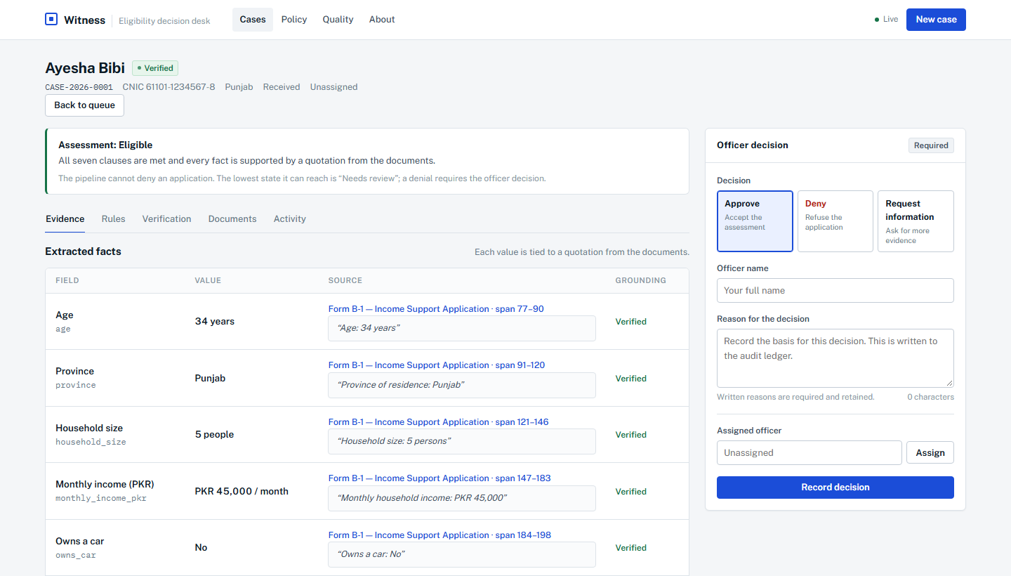
GROUNDED EVIDENCE
Every value carries the sentence it came from.
The extractor returns a value and an exact quotation. Witness re-reads the
quotation against the source document before the value is used.
A value without a verbatim quotation is not grounded.
Clicking a source opens the document and highlights the span.
An invented quotation produces no citation.
Evidence tab, case 2026-0001: value, quotation, source, grounding
Glue Sticks | Witness | Agentika 2.0
05
Notes:
Grounding is not a prompt instruction, it is a check. The quotation is compared to the document text, and a mismatch removes the citation.

Slide 6
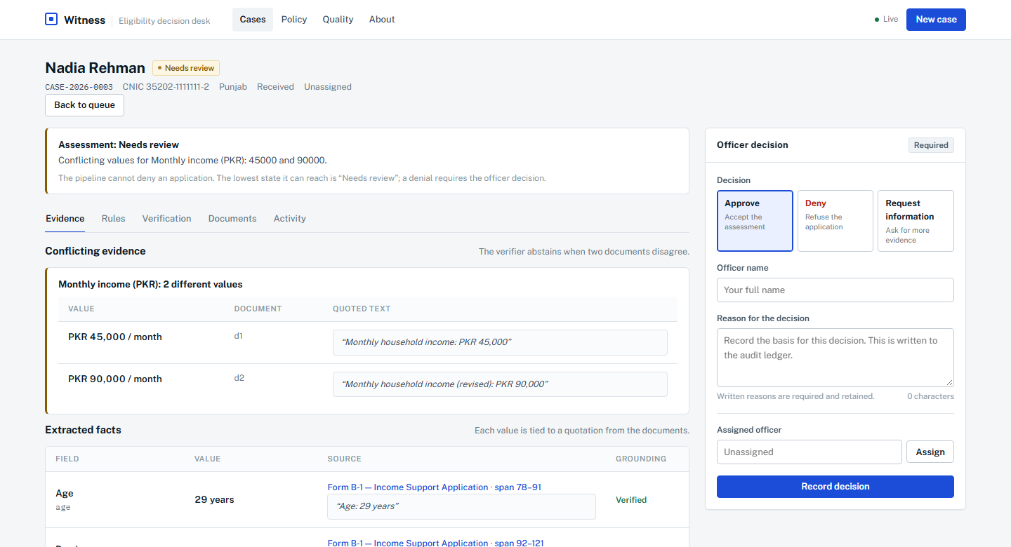
ABSTENTION
The verifier is allowed to refuse.
Three conditions force an abstention:
Quoted text does not appear in the source.
The same field holds conflicting values.
A clause cannot be decided from the evidence.
An abstention is a success, not a failure:
the case reaches the person who can resolve it.
Case 2026-0003: two income figures, both quoted, state stays Needs review
Glue Sticks | Witness | Agentika 2.0
06
Notes:
This is the opposite of a confident chatbot. In the seeded set, 60 percent of cases abstain for exactly these reasons, and all of them reach a person.

Slide 7
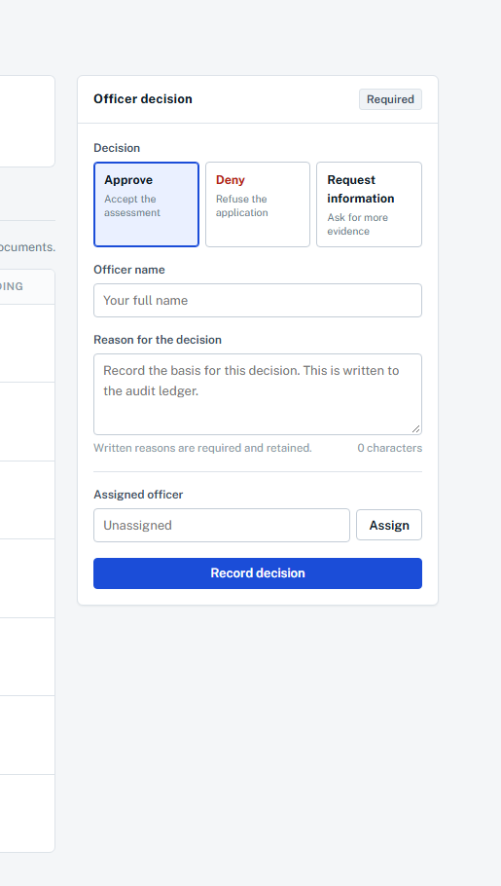
THE DECISION GATE
The officer's decision is enforced by the backend.
The interface is not the safeguard. The rules live in the service.
An officer name is required.
An override of an abstention is
recorded explicitly, not silently.
A written reason is required, and retained.
Invalid or duplicate decisions are rejected.
If the ledger cannot be written, the request fails and the case is unchanged.
Officer panel: action, name, written reason
Glue Sticks | Witness | Agentika 2.0
07
Notes:
The backend validates the actor, the action, the reason and the case state. A decision cannot be written without a record.

Slide 8
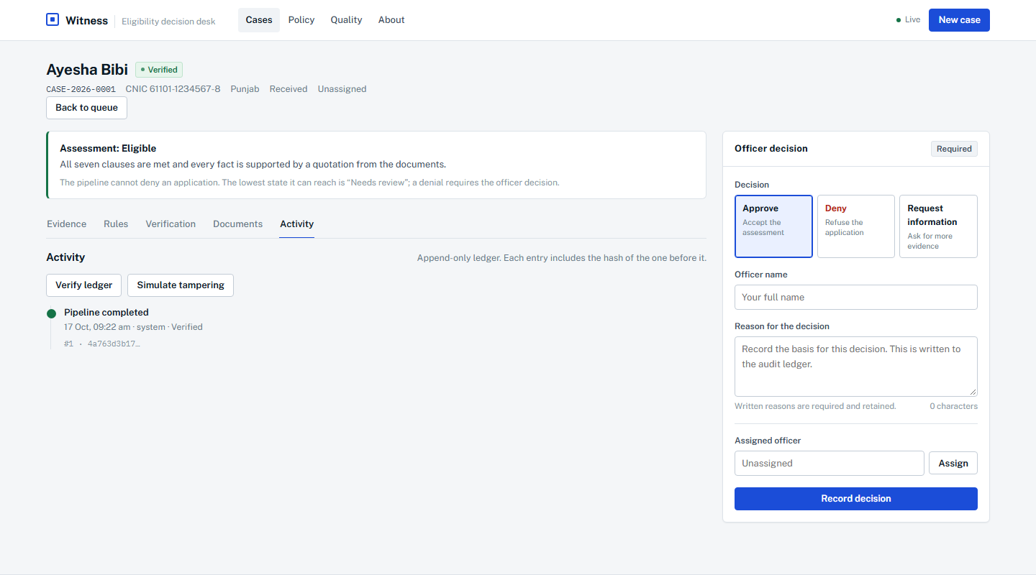
ACCOUNTABILITY
Every decision is hash-chained.
Each entry stores the hash of the one before it.
Verification recomputes the whole chain.
A forged copy breaks at the changed entry.
The real ledger is never modified by the demo.
Integrity is proven. Durability is stated, not implied.
Activity tab: append-only entries, verification and tamper simulation
Glue Sticks | Witness | Agentika 2.0
08
Notes:
A verifying chain proves integrity, not durability. The interface says which one it is instead of implying more.

Slide 9
QUALITY GATE
The service checks itself before it serves.
55 / 55
97.1%
60%
Holds
Recorded expectations met
Facts with a verbatim quotation
Cases escalated instead of guessed
No automatic denial, before a human
The gate runs at start-up over a fixed case set. With the strict setting enabled,
a failing expectation stops the service from serving requests at all.
7
policy clauses,
each traceable to a written rule
/api/eval · 17 October 2026 · version 0.5.0
Glue Sticks | Witness | Agentika 2.0
09
Notes:
Every number here is from the running service, not a slide. The gate is the reason we can claim reliability: it is checked, not asserted.

Slide 10
DEPLOYMENT
Live on Clouds by Alternate Futures.
One container, one port, one public URL. The model is a dependency with a
deterministic fallback, not a single point of failure.
Stated limits
The ledger is local to the deployment: it survives a restart, not a redeploy.
https://alternate-echo-whale-5578-github-app.alternatefutures.ai
status ok · gate all_passed · version 0.5.0
Deployed from a public repository on every commit, with the image tag equal to the commit.
The policy is synthetic and inspired by social protection practice, not official.
Unfamiliar documents abstain rather than guess.
Browser
Container
Model
Ledger
hash-routed console
FastAPI · port 8000
Groq, with fallback
SQLite hash chain
Glue Sticks | Witness | Agentika 2.0
10
Notes:
Naming per brand guide: Clouds by Alternate Futures on first mention, then Clouds. The limits are on the slide because a judge will ask.

Slide 11
IMPACT AND NEXT
Built for the decision, not the demo.
Who it serves
What is proven now
Next
Social protection agencies screening high volumes
Seven clauses, deterministic and traceable
Configurable policy per programme
Caseworkers who must sign off on each outcome
Grounded extraction with abstention
Durable ledger across deployments
Auditors who need a verifiable trail
Enforced human gate and hash-chained ledger
Officer identity and role separation
Quality gate in the running service
Exportable decision packs for audit
The design claim is modest and testable: the machine may propose, a check may refuse, and only a named person may decide.
Glue Sticks | Witness | Agentika 2.0
11
Notes:
Impact first, then the honest roadmap. Everything in the middle column exists today and can be shown in the live service.

Slide 12
THANK YOU
Witness
AI proposes. A check audits. A human decides.
LIVE
alternate-echo-whale-5578-github-app.alternatefutures.ai
Glue Sticks
Aryan Zia
Muhammad Rubait Zakria
REPOSITORY
github.com/anithepani/GlueSticks-agentika
Agentika 2.0 · NaSCon 2026 · FAST NUCES Islamabad
Notes:
Close on the rule, not on a feature list.

