Slide 1

Logistics and Inventory Management Application
Team – Digital Hacktivists

Slide 2
Problem Statement
Neev is a charitable organization based in Shivpuri, Madhya Pradesh, runs projects for supporting women empowerment cause. The projects provide trainings and produce a variety of products such as gift bags, greeting cards, photo frames etc.
Neev is in need of logistics and inventory management application for managing the raw materials and finished products.
The main requirements of the application are:
Ability to view reports on the KPIs of inventory and logistics of raw material and finished products.
Ability to update stock information (both raw material and products inventory)
Ability to work offline and synchronize with the server when network is available.

Slide 3
Application - Features
Dashboard – Featuring the KPIs
Detailed graphical views for the KPIs
Detailed graphical views for custom period
Dashboard Customization
Manage Data – for Book Keeping
Data Integration with Cloud Backend

Slide 4
Application Solution
The solution consists of a native application developed for Android devices with Android Lollipop OS (5.1.1 version) and a cloud backend (parse.com).
The native device application offers the following benefits:
Ability to work offline.
Sync between multiple devices and backend server
Good application performance.
Good UI/UX support for displaying the detailed graphical reports for the KPIs.
Support for swipe gestures.
Parse.com cloud backend offers the following benefits:
Local storage to the application, even in offline mode.
Seamless synchronization of the device application local storage with the backend.
Provides web interface to browse/manage the cloud data easily.
Comprehensive backend analytics support.
Rates vary per data usage requirements. Free plan chosen for this implementation.
www.parse.com

Slide 5
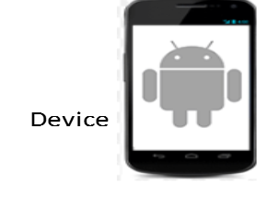
Application - Solution
Application Layer
Business Layer
Data Access Layer
Parse
ANDROID APP
Android SDK and libraries

Slide 6
Application Design
Technical Design
Android Lollipop 5.1.1 chosen as the platform for development
Open source, Vibrant developer community, Stable Build, several low cost devices can be chosen from per Neev’s preferences.
App can be easily resized for different screen form factors once device selection is confirmed.
Software Tested on Nexus 5 phone as well as Emulator on Android Studio

Slide 7
Application Design
Parse.com is a backend service provider which offers complete backend solution.
Parse offers data storage for the mobile applications and ability to store the data on cloud securely and efficiently.
Parse simplifies the push notifications process. Notifications can be sent to the entire application user base with ease.
Parse offers the feature to export the backend data. Exported contents are emailed to the registered email address.
Parse provides data analytics feature with capabilities to
view data on application usage, API request data
create custom data analysis – track/analyze any application data
Application growth analysis – active users, installations etc

Slide 8
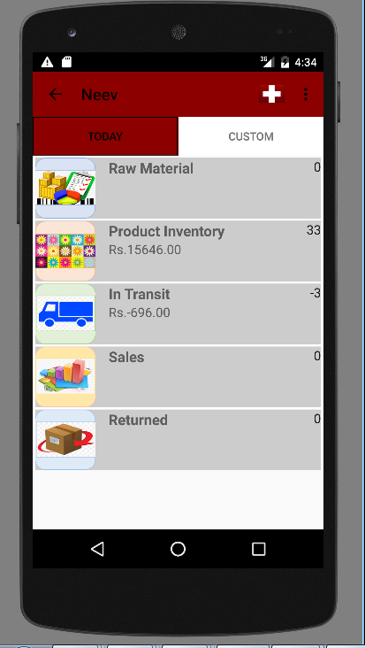
Dashboard
Landing screen of the application
2 Summary Views of the Inventory are provided – Today and Custom
Today View:
Summary view of all the KPIs for Today
Quantity and Value of each KPI as per Today’s status is displayed
Swipe right to navigate to Custom view
Click on the KPI to navigate to the detailed view
Personalization:
The + symbol on the action bar help to personalize the list of KPIs displayed

Slide 9
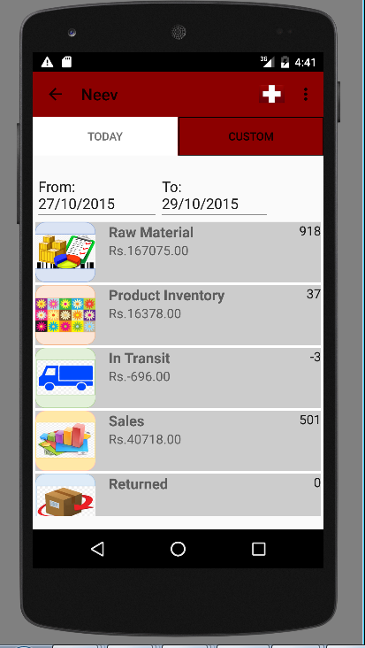
Dashboard
Custom View:
Summary view of all the KPIs for a date range
Use the date picker to select a date range
Quantity and Value of each KPI for the selected date range is displayed
Click on the KPI to navigate to the detailed view (Slide 15)
Currently, the date range is restricted to the last 3 months. But can be made configurable as per Neev requirements
Menu :
Navigate to the Manage data screen by clicking on the ‘Manage Data’ menu item

Slide 10
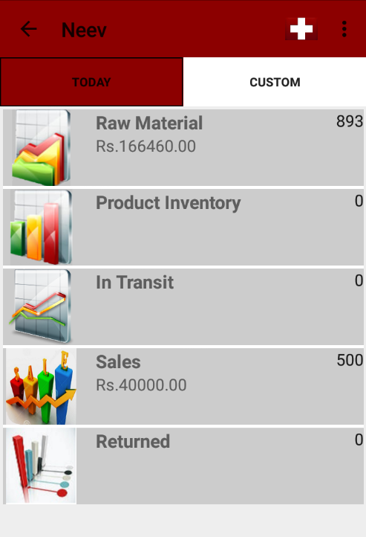
Dashboard Multiple Selection
This feature of dashboard multiple selection helps us to customize our dashboard view.
Users can long press on any of the items on the dashboard to activate this functionality.
This feature can be invoked from both the Today and Custom views of the dashboard.
Application screenshot to be added here

Slide 11
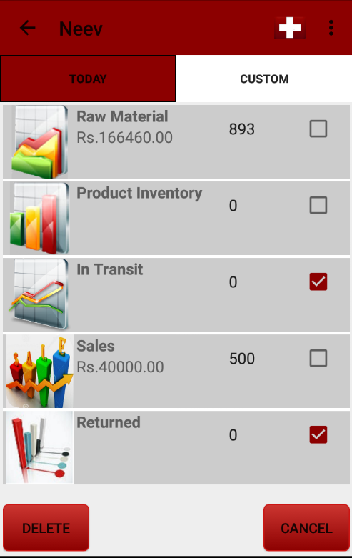
Dashboard Multiple Selection
The users can select which screens to remove from the default dashboard by clicking on the checkboxes.
The users then need to click on “Delete” Button for removing the selected items.
On clicking the “Cancel” Button this screen will be exited to go back to default dashboard.
Only the relevant items can be then visualized on the dashboard.
Application screenshot to be added here

Slide 12
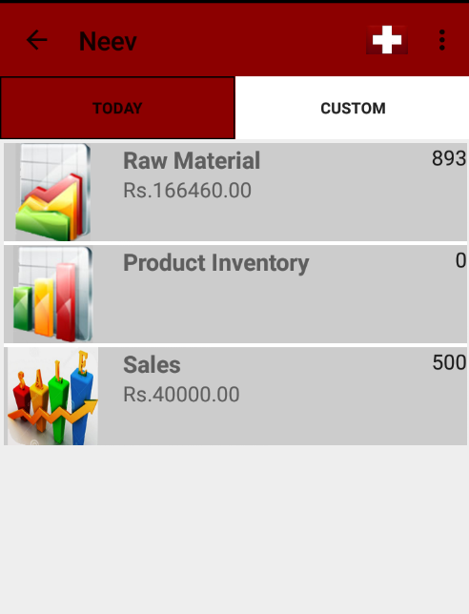
Dashboard Multiple Selection
The modified list of relevant items is then displayed.
Application screenshot to be added here

Slide 13
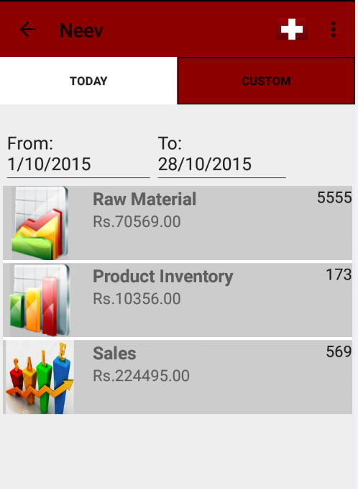

List View Multiple Selection
The button on the top right corner of the screen helps us to add the to the list of items visible on the dashboard.
It is applicable in both Today and Custom screens.
Application screenshot to be added here

Slide 14
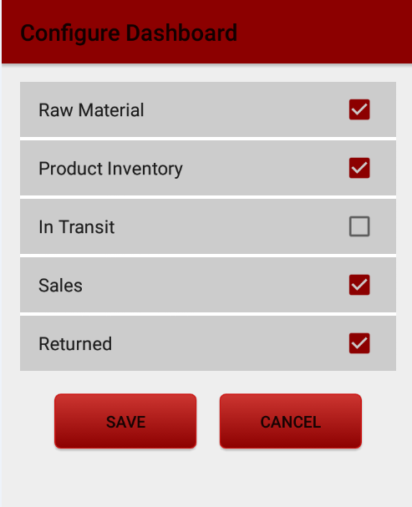
List View Multiple Selection
On clicking the button, the adjacent screen appears.
The users can choose the relevant screens to be visible on their dashboard.
Application screenshot to be added here

Slide 15
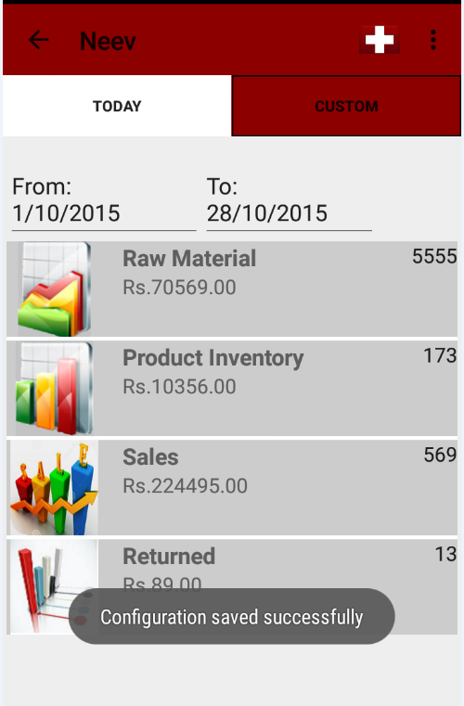
List View Multiple Selection
On clicking of “Save” button, a success message will be displayed and then the modified dashboard view will be displayed.
On Click of “Cancel” button, the changes made to the list view will not be reflected on the dashboard.
Application screenshot to be added here

Slide 16
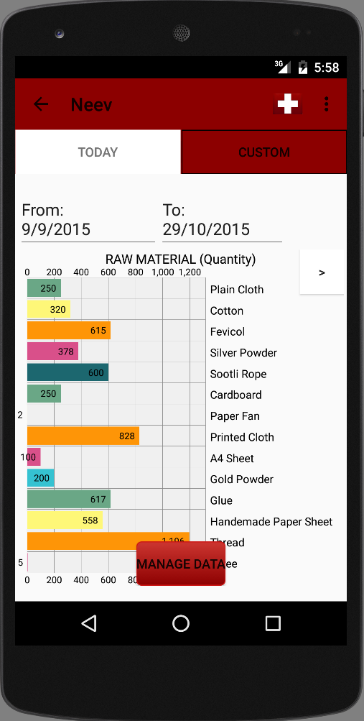
Detail View
Detail data for each dashboard item.
Provides 2 data views of the Dashboard item – Graph for Quantity and the value in Rupees.
Horizontal Bar Graph chosen because it is scrollable and can scale in case Neev adds more items to its Inventory.
Quantity View:
Bar graph for the quantity of the raw material or the finished products depending on the item selected in the dashboard.
Value in Rupees View:
Bar graph for the amount in rupees of the raw material or the finished products depending on the item selected in the dashboard.
The navigation between 2 views can be done on clicking the > button on the top corner of the graph.
Depending on the today or custom view in the dashboard the data will be represented accordingly.
On upward fling the Manage Data button will appear on the screen and the user can navigate to manage data screen.
The button will disappear on a subsequent screen touch.
Application screenshot to be added here

Slide 17
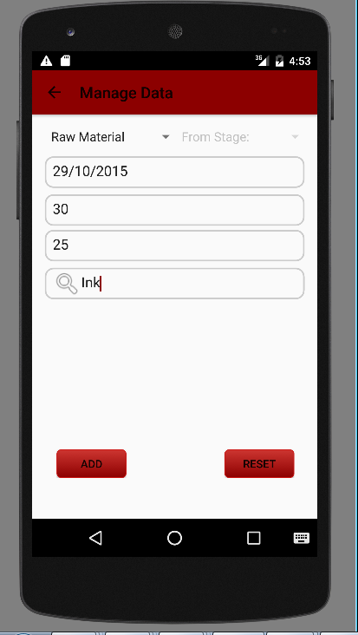
Manage Data
Facilitates the data management for all the KPIs
Can be navigated from the Detailed View screen or Menu option
Add a new product / raw material to the inventory
Add an existing raw material / finished products to the inventory for any selected date.
Wildcard search on the list to select an item
If the product is not available in the list, type a valid name in the search text box to add the item to the backend

Slide 18
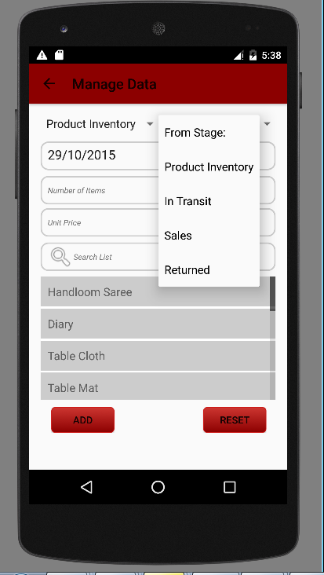
Manage Data
Handle various stages of finished products
Sales
In Transit
Returned
Finished products inventory
To move an item from one stage to another, choose a stage in ‘From Stage’ spinner (top right) and select the ‘To stage’ in the spinner on the top left
This operation will remove the quantity entered from “Product Inventory” to “In Transit” for example.
Retain the default value in the ‘From Stage’ spinner to add an item into a particular stage directly.
Reset button to reset the fields to default values

Slide 19
Data Integration - Parse
The Parse platform provides a complete backend solution for Neev application.
Parse works based on every application having its own application id and client key that is applied during SDK installation.
Parse provides various features viz- local data store, security, roles, push notifications and handling errors.
Data can be browsed and modified in Parse browser directly.

Slide 20
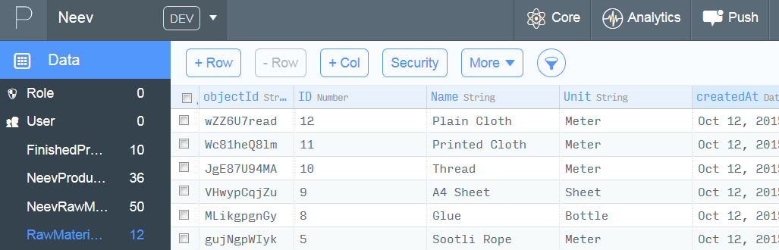
Data Integration – Parse for Neev
Neev application exposes 4 tables in Parse.
RawMaterialMaster – Static table with all the raw materials used by Neev
FinishedProductMaster – Static table with all the Neev finished products
NeevRawmaterialItem – Storing raw materials transactions from Manage Data option
NeevProductItem – Storing transactions from Manage Data option for products

Slide 21
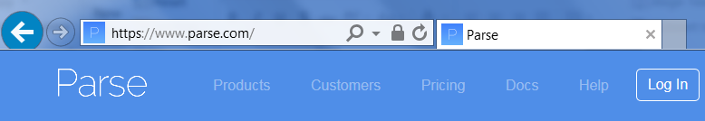

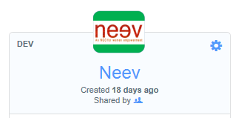

Application Data Model contd.
Procedure to access the data | Screenshot
Login to https://www.parse.com and click on Login button in the right corner Enter the below credentials – UserName - neev.hackathon2015@gmail.com Password - Neev@admin
Click on “Go to your apps” icon
Select Neev application
Click on Core icon on the menu bar to navigate to data browser.

Slide 22
Deploying the application
Source code of the application is available in the GIT hub
https://github.com/anitlaks7/neev
Build Settings:
API Version : 22
Andorid 5.1 (Lollipop)
Build steps:
Clone the source code into a local folder and open using Android Studio
Follow the instructions in the given link to build and run the application
http://developer.android.com/tools/building/building-studio.html
The signed .apk for the application can be generated using the instructions given in the link
http://developer.android.com/tools/publishing/app-signing.html
The signed .apk of the application is also available in the Git under the Release→apk folder
The .apk can be copied to any device with Lollipop(5.1) Android version and run
The documentation and the video demo are also available in the GIT along with the .apk

Slide 23
Application Limitations / Enhancements
Data Export to .CSV / PDF formats to be implemented
Support for user account management – restriction of privileges to specific parts of the application to be implemented
Application integration with the battery status of the device. Application not to launch/to close when the device is on low battery status, to prevent the application database corruption.
Application does not listen to network (online/offline) status changes – this can be added to initiate syncs immediately on resumption of network. Currently takes 5 mins to resync upon network connectivity resumption.
Performance optimization on the data queries / filters need to happen based on updates – current strategy refreshes entire database once in 5 mins
Local Data store refresh on push notification from Parse Backend
Deletion of records is not supported from the UI. User can login to Parse backend and delete the records if needed. If these objects are in the local data store, they will still appear in the UI. Application needs to be uninstalled, data cleaned and reinstalled to get the correct data in this case. Also, if there is data in the local datastore that has not been synced to the backend it will be lost. Deletion from backend is therefore not supported.
Application does not support orientation changes correctly
Currently works on Nexus Tablet but does not resize appropriately
To navigate back – use the arrow on the top left hand corner of the menu bar. The soft button (sideways triangle) on the bottom left of the Nexus 5 phone screen does not work correctly.
Add configuration and preferences
Add Rupee conversion to different currencies
If an item is deleted from the Master Table in Parse, user needs to manually delete the records associated with that in the corresponding item tables else this will keep showing up in detailed views and not in the summary view and the numbers will not match.
First time Application boots, the device should be online else all data values will be zero. If network resumes, the device will sync within 5 minutes and data will be fetched from the network.
Other known issues are logged in Github issues section

Slide 24
Team (details to be added, alphabetical order)
Anita <anita.lakshmanan@accenture.com>
Chethana <chethana.savalgi@accenture.com>
Lakshmi <lakshmi.r.namagiri@accenture.com>
Megha <megha.sarawgi@accenture.com>
Sandhya <sandhya.r.sharma@accenture.com>
Sunandita <sunandita.sahu@accenture.com>
Rebecca <r.annamarie.dagama@accenture.com>

