Slide 1
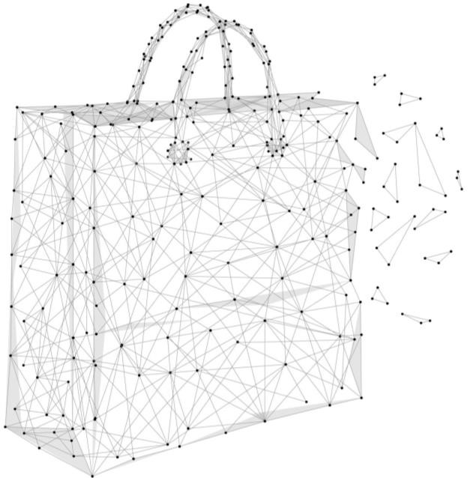
Analysis on Online Shopper's Purchasing Intention
Group 29
Under the guidance of Professor
Oleksandr Narykov
CSP571 Data Preparation and Analysis

Slide 2

Team Structure
Team Members
Aditya Niture A20521495
Shaktisharan Rajure A20519026
2

Slide 3
Project Outline
Problem Statement
Bibliography
Data Sources
Conclusion
Data Description
Model Training and Results
Data Processing
Data Analysis

Slide 4
Problem Statement
4

Slide 5

Problem Statement
Analyze trends in the online shoppers purchasing intention dataset using exploratory data analysis techniques and build machine learning models to predict the purchasing intentions of visitors to a store's website both using supervised and un-supervised techniques.
5

Slide 6
Project Planning
6

Slide 7
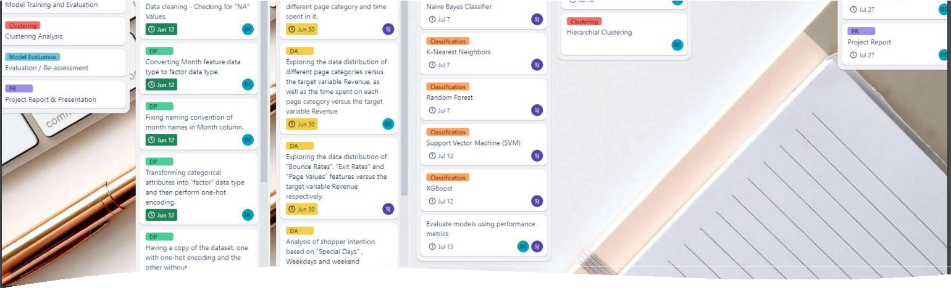
Used Trello for the planning and keeping track of the project.
Project Planning and execution
Logistic Regression and GMM were not implemented and put
to the backlog, will be included in the future work.
7

Slide 8

Workflow overview
Data Preparation
& Analysis
Results & Conclusion
Data Collection
Modelling
Online Shopper Purchase Intenstion Dataset from
UCI
Data cleaning.
Data Balancing.
Univariate, Bivariate and Multivariate analysis.
Supervised Modeling
Analysed conclusion.
Model reports and evaluation.
Future work.
Naive Bayes
K-NN
Random Forest
SVM
XGBoost
Un-supervised
K-means Clustering
DBScan Clustering
Hierarchical clustering
8

Slide 9

Data Sources
The data that is being used in this project was obtained from the UC Irvine Machine Learning Repository.
Data set contributors:
C. Okan Sakar : Department of Computer Engineering, Faculty of Engineering and Natural Sciences, Bahcesehir University, 34349 Besiktas, Istanbul, Turkey
Yomi Kastro: Inveon Information Technologies
Consultancy and Trade, 34335 Istanbul, Turkey
9

Slide 10
Data description
Attributes
Administrative | Administrative Duration
Informational | Informational Duration
Product Related | Product Related Duration
Bounce rate | Exit rate
Page value | Special day
Operating system | Browser
Region | Traffic type
Visitor type | Weekend
Month of the year | Revenue
The dataset consists of feature vectors belonging to 12,330 sessions.
The dataset consists of both numerical and categorical attributes. The 'Revenue' attribute can be used as the class label.
10

Slide 11
Data Preprocessing
11

Slide 12

Check number of observations with NA values
Fixing naming convention of month names in Month column “June” ->”Jun” Convert Month feature data type to factor data type
Data Processing
Transforming categorical attributes(OperatingSystems, Browser, Region, TrafficType, VisitorType) into “factor” data type and then perform one-hot encoding
Convert Revenue attribute data type to a factor.
Transforming Boolean attributes(Weekend, Revenue ) into “int” data type
Train - Test split : 70:30 split
One hot encoding of train and test set
12

Slide 13

Data Balancing
There is huge imbalance in data set as Revenue=0 is the majority. Hence the algorithm tries to over fit on majority class.
Number of observations with
Revenue as False = 10422
Number of observations with
Revenue as True = 1908
Here
we are trying to
increase minority
class
observations
using
SMOTE(Synthetic
Minority
Over-sampling algorithm.
Technique)
13

Slide 14
Data Analysis
14

Slide 15
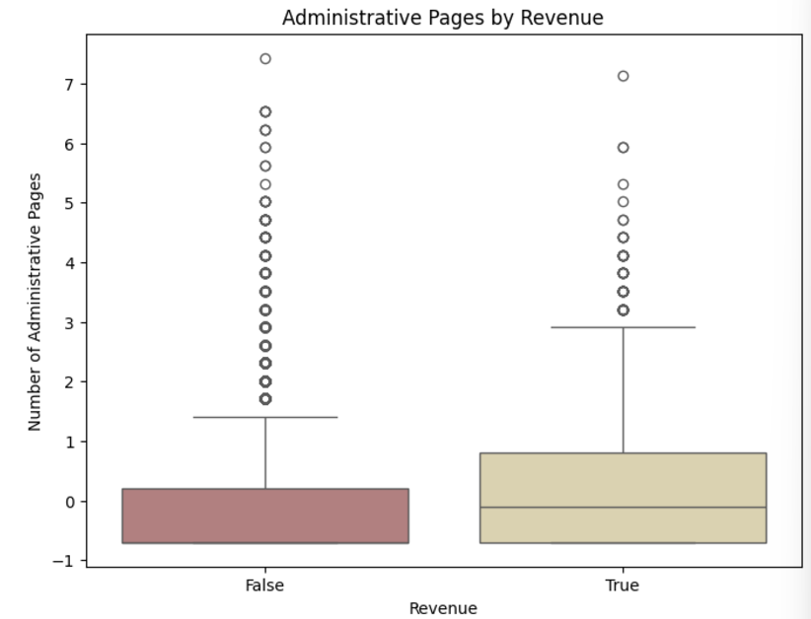
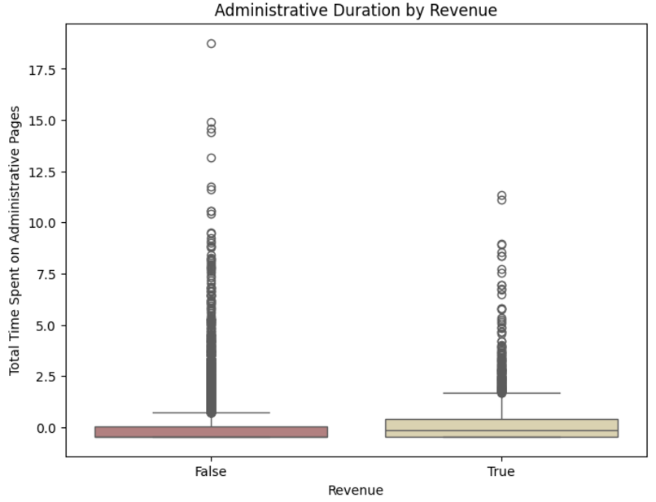
Data Analysis
1) Exploring data distribution of different page category and time spent in it.
a) Exploring data pattern of “Administrative” and “Administrative_Duration”

Slide 16
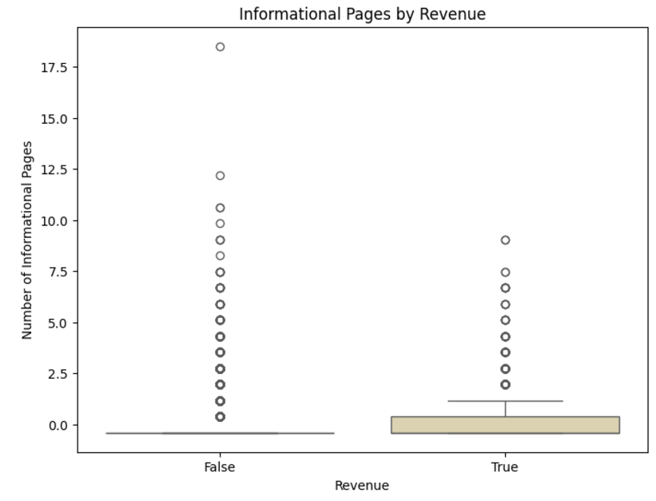
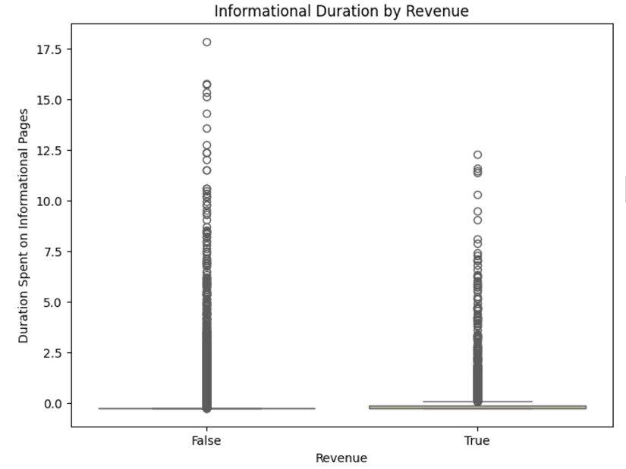
b) Exploring data pattern of “Informational” and “Informational_Duration”

Slide 17
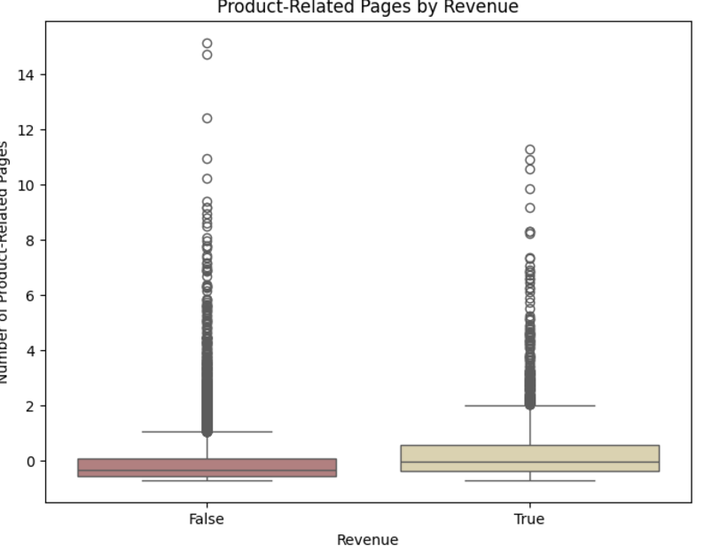
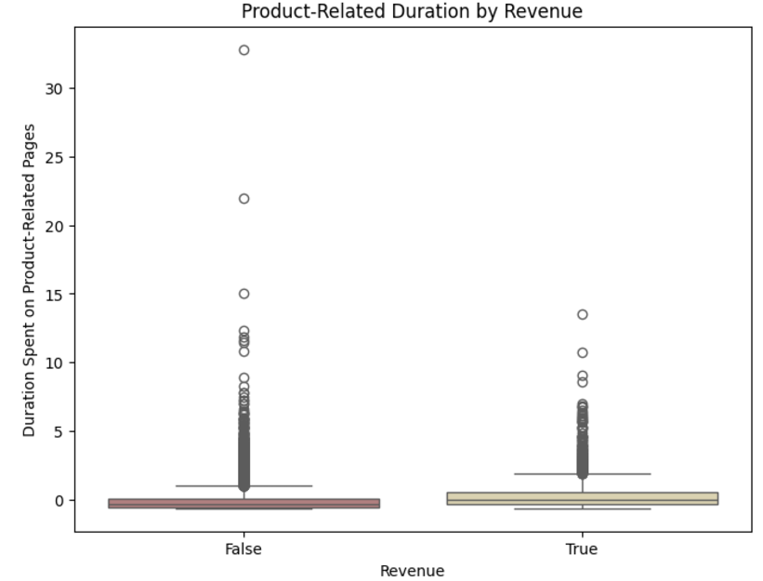
c) Exploring data pattern of “Product Related” and “Product Related Duration”

Slide 18
Summary
Analyzing number of page visit of 3 different page categories it clearly says that customers are interested more in Product related pages rather than knowing information of the product in detail.
Analyzing total time spent in 3 different page categories, it clearly says that customers spend most of the time in product related pages whereas they are not interested in spending time in information related pages.

Slide 19
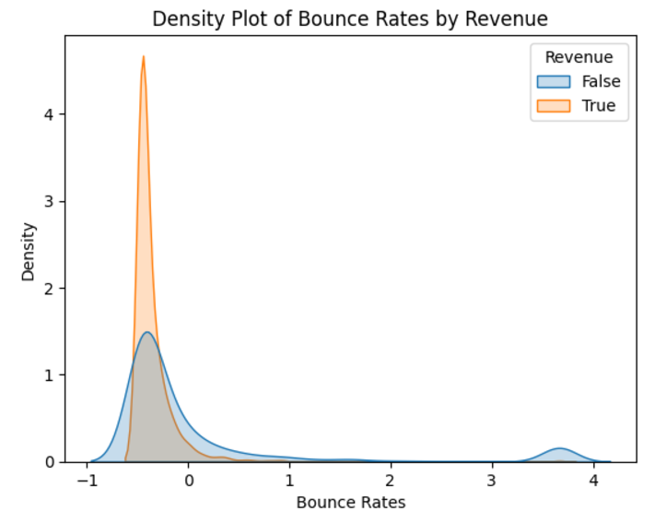
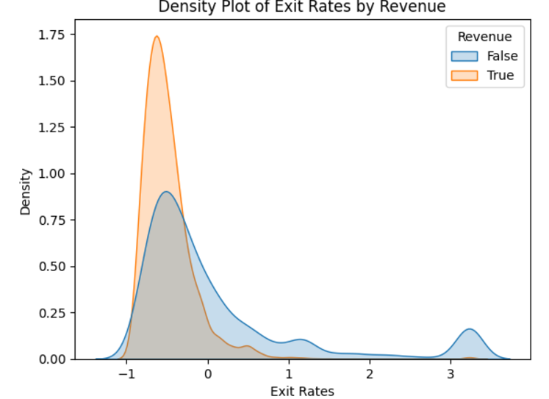
2) “Bounce Rates”, “Exit Rates” and “Page Values” features versus the target variable Revenue, respectively.

Slide 20
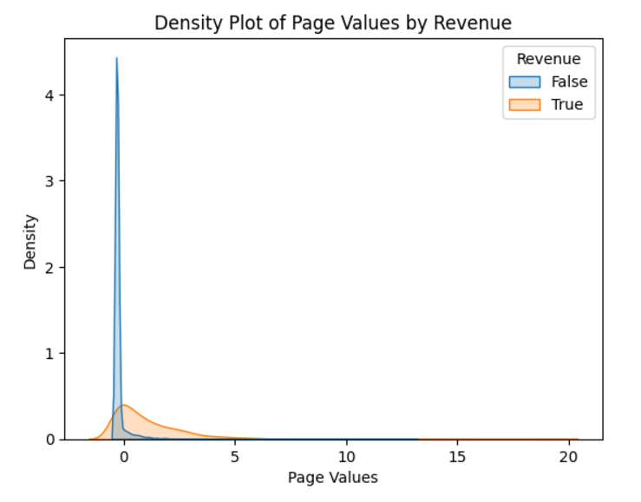
Summary
There is no noticeable disparity in Bounce Rates between customers who made a purchase and those who did not.
However, customers who ended up making a purchase had lower Exit Rates on average, indicating that they were more likely to remain on the website's pages.
Additionally, customers who did not make a purchase had significantly lower Page Values, suggesting that they spent less time on related pages.
20

Slide 21
Supervised Modeling
21

Slide 22
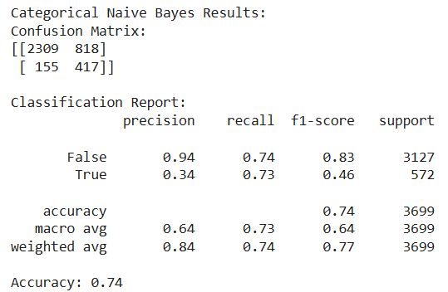
Model Training and Results
1) Naive Bayes
22

Slide 23
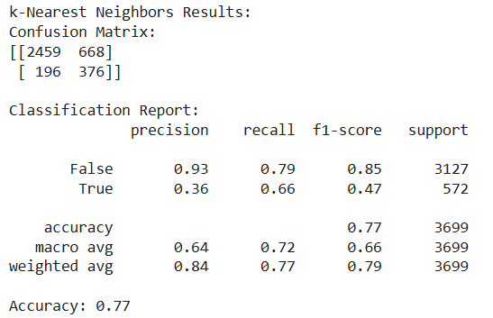
2) K-Nearest Neighbor
Trained on one-hot encoded dataset
23

Slide 24
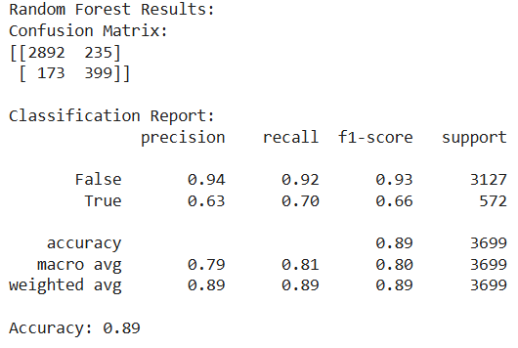
3) Random Forest
Results:
Recursive Feature Elimination
 | Attribute | Accuracy
14 | Region | 0.9667576
17 | Weekend | 0.9665521
13 | Browser | 0.9664835
16 | VisitorType | 0.9664151
15 | TrafficType | 0.9660722
12 | OperatingSystems | 0.9651126
11 | Month | 0.9651125
10 | SpecialDay | 0.9644273
9 | PageValues | 0.9629195
8 | ExitRates | 0.9603834
7 | BounceRates | 0.9568190
6 | ProductRelated_Duration | 0.9446862
5 | ProductRelated | 0.9267302
4 | Informational_Duration | 0.9051401
1 | Administrative | 0.8694320
3 | Informational | 0.8509948
2 | Administrative_Duration | 0.8483216
25

Slide 25

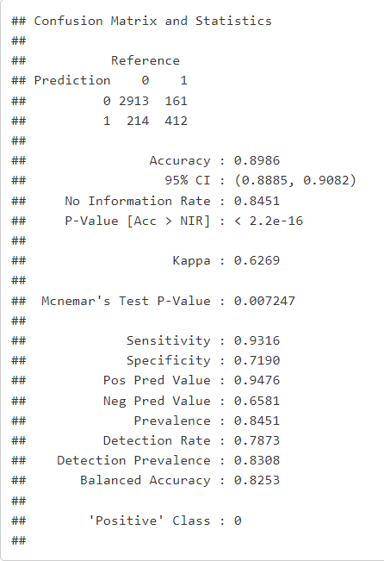
Random forest trained on top 10 features
Top 10 features
PageValues Month Region Browser
ProductRelated TrafficType
ProductRelated_Duration BounceRates
ExitRates Administrative_Duration

Slide 26

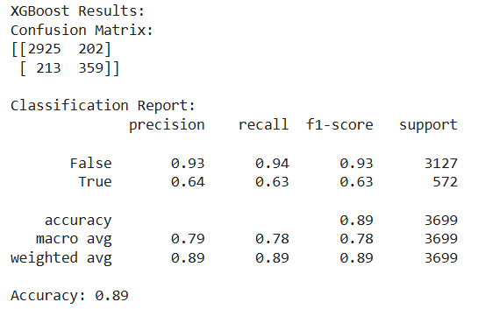
5) XG Boost
27

Slide 27
Un-supervised Learning
28

Slide 28
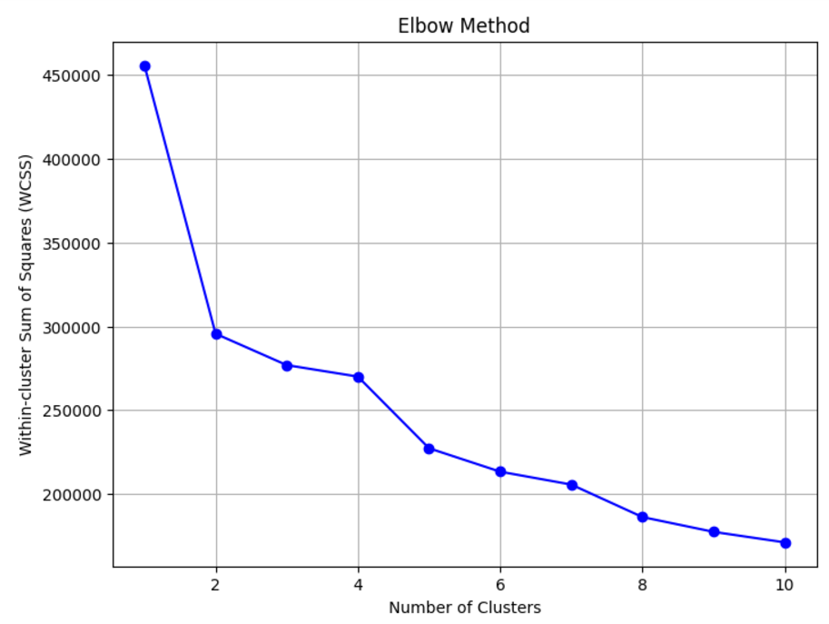
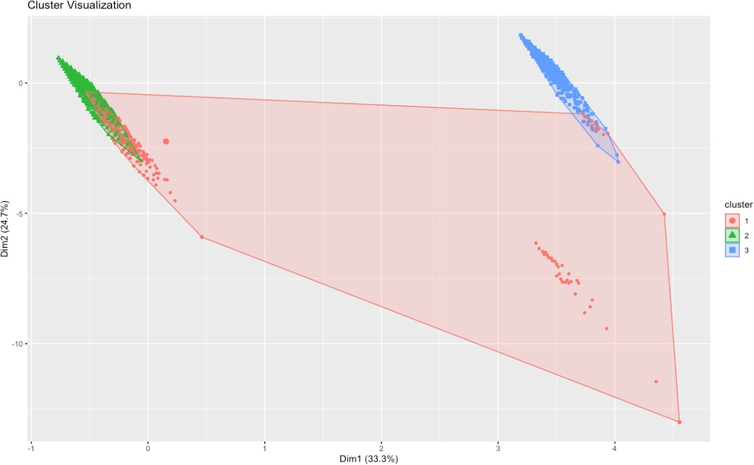
K-Means Clustering
Clusters has been identified using Elbow method, and from the clustered plot we can say that most of the data can be clustered into 3 clusters

Slide 29
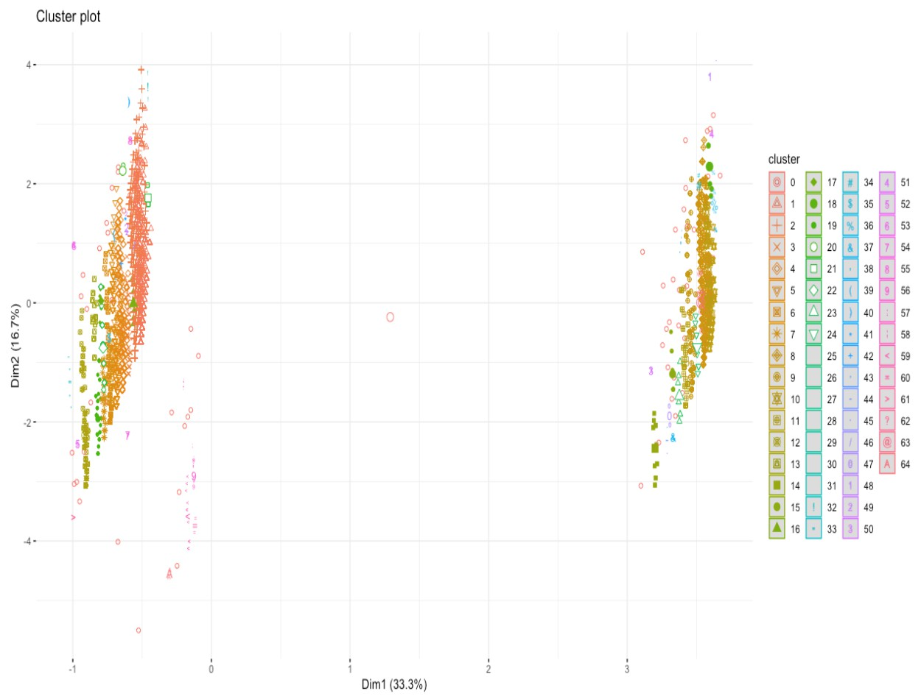
DBScan Clustering
As name says this is a density-based clustering algorithm that groups data points into clusters
based on their density. DBSCAN is particularly useful for datasets with irregular shapes and noises.
But our dataset was mostly without the noises and hence the results were as below

Slide 30
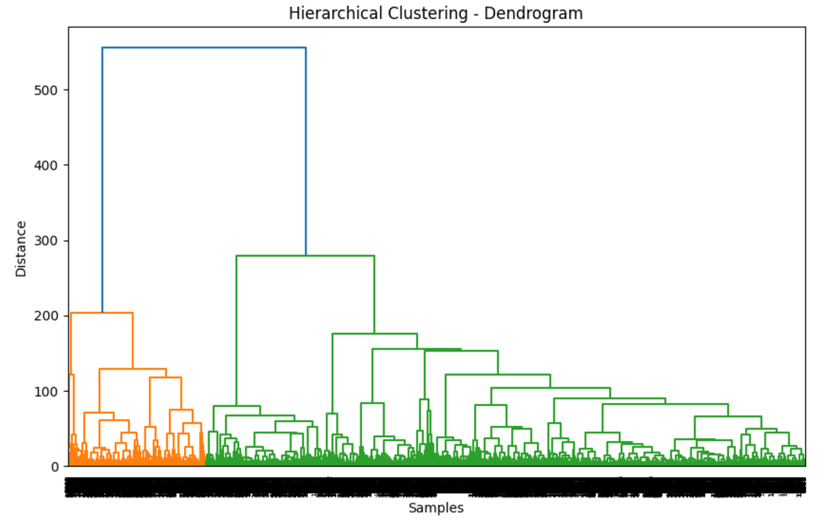
Hierarchical clustering
This is another unsupervised learning algorithm that clusters data points into a tree-like structure based on the similarity between them. Hierarchical clustering can be either agglomerative (bottom-up) or divisive (top-down).

Slide 31
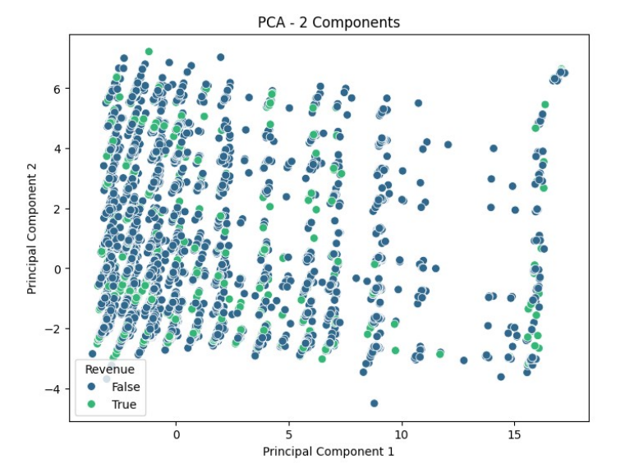
PCA(Principal Component Analysis):
Here, PCA successfully reduced the dataset's dimensionality, retaining key patterns while simplifying the data for analysis. The visualization revealed distinct groupings between purchasing and non-purchasing sessions, helping identify the most influential features.

Slide 32
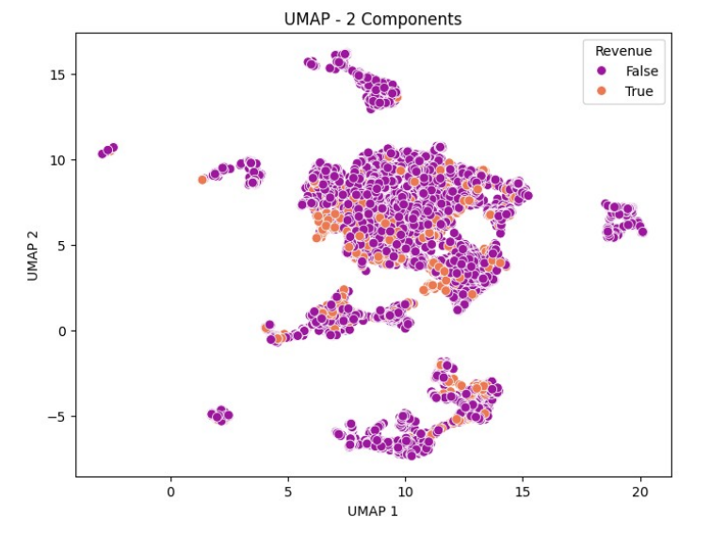
UMAP (Uniform Manifold Approximation and Projection):
UMAP performed well in capturing both local and global structures of the data, creating a clear separation between different customer behaviors. Its visualization highlighted clusters of purchasing and non-purchasing sessions, supporting further segmentation analysis.

Slide 33
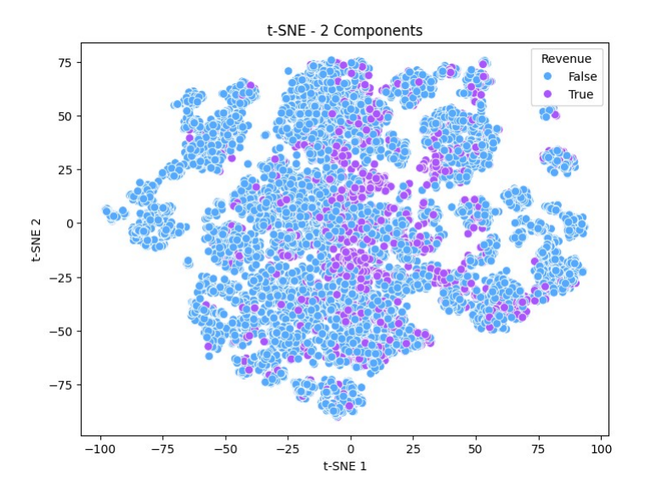
t-SNE (t-distributed Stochastic Neighbor Embedding):
t-SNE provided detailed and intuitive visualizations of the data by emphasizing local relationships. It clearly demonstrated the separability of purchasing versus non-purchasing customers, although it required careful tuning of perplexity for optimal results.

Slide 34
Future Work
32

Slide 35

Future Work
We would plan to work more on the data gathering, we did look into it but couldn’t find the similar datasets.
Work on couple more research question for example, “How does web metrics influence the revenue”
Will explore and try to implement MLOps best practices by designing and creating a end-to-end pipelines.
Would explore Gaussian Mixture Models for the clustering and also analyse the clusters indepth.
33

Slide 36
Conclusion
34

Slide 37

Conclusion
Analyzing number of page visit of 3 different page categories it clearly says that customers are interested more in Product related pages rather than knowing information of the product in detail.
Revenue is generated by the customers who visit the product page and spend more time on it, which intuitively mean whom ever spends more time on administrative and informational page will only hop around rather than end up buying.
Discounts can be given to the ones who spend more time on Product related page.
There is no noticeable disparity in Bounce Rates between customers who made a purchase and those who did not.
However, customers who ended up making a purchase had lower Exit Rates on average, indicating that they were more likely to remain on the website's pages.
Additionally, customers who did not make a purchase had significantly lower Page Values, suggesting that they spent less time on related pages.
35
37

Slide 38

Bibliography
[1]. https://jurnalppi.kominfo.go.id/index.php/jppi/article/view/341
[2]. Real-time prediction of online shoppers’ purchasing intention using multilayer perceptron and LSTM recurrent neural networks [ https://link.springer.com/article/10.1007/s00521-018-3523-0 ]
[3]. Data Clustering: A Review [https://dl.acm.org/doi/pdf/10.1145/331499.331504 ]
[4]. A Comparison Study of Credit Card Fraud Detection: Supervised versus Unsupervised [ https://arxiv.org/pdf/1904.10604.pdf ]
[5].Real-Time Prediction of Online Shoppers Purchasing Intention Using Random Forest [ https://www.ncbi.nlm.nih.gov/pmc/articles/PMC7256375/ ]
38

Slide 39

◂
37

