Slide 1
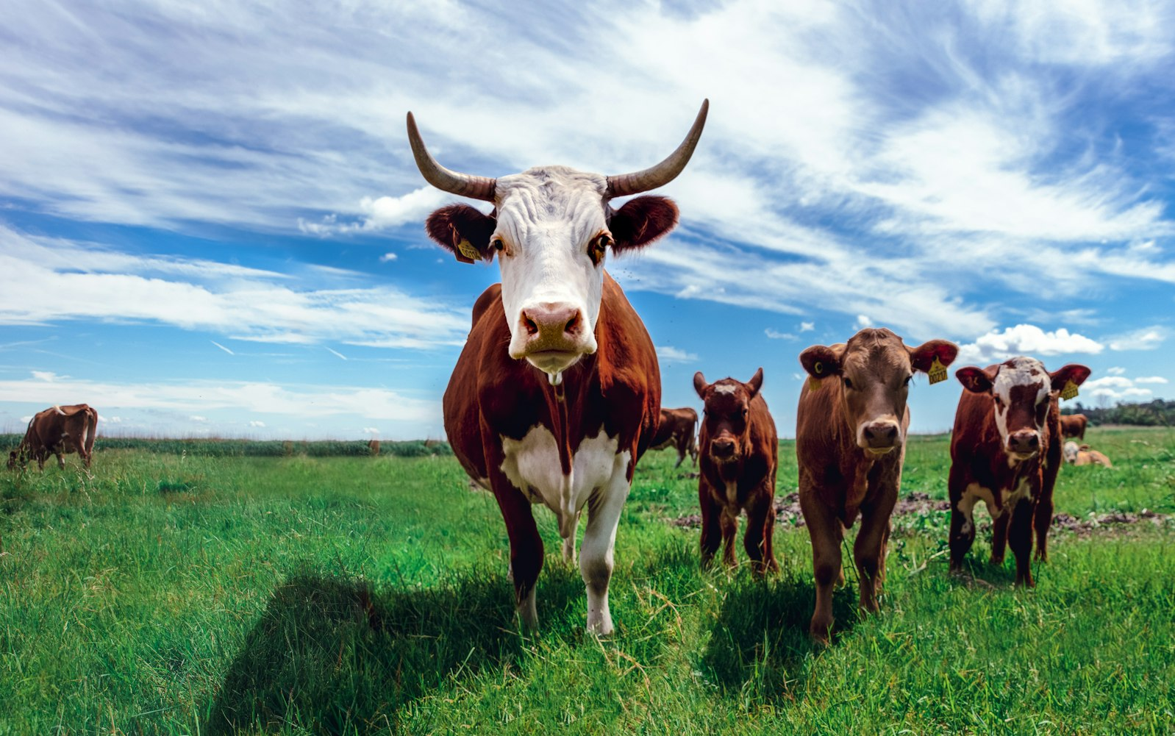
Cattle Farming
BIOLOGY FLIPPED CLASSROOM
BY. GROUP-2

Slide 2
Table of Contents
Animal Husbandry
Cattle Farming
Cross breeding
Maintenance
Food requirement
Diseases

Slide 3
What is Animal Husbandry ?
Animal husbandry is the scientific management of animal livestock. It includes various aspects such as feeding, breeding and disease control.
Animal-based farming includes cattle, goat, sheep, poultry and fish farming

Slide 4
Cattle Farming
Purpose of cattle farming :
Milk (Done by milch animals )
draught labor for agricultural work ( Done by draught animals)
Scientific Names:
Cow – Bos indicus
Buffalo- Bos bubalis

Slide 5
Cross-Breeding
Things which are taken into consideration when looking for a good milch animal:
Duration of lactation period
Resistance of Diseases
This can be done through cross breeding a foreign breed (for longer lactation period) and Indian breed (for resistance of diseases).

Slide 6
Maitainence
Proper cleaning and shelter facilities for cows and buffaloes are required for humane farming, for the health of the animals and for production of clean milk as well.
Animals require regular brushing to remove dirt and loose hair.
They should be sheltered under well-ventilated roofed sheds that protect them from rain, heat and cold.
The floor of the cattle shed needs to be sloping so as to stay dry and to facilitate cleaning.

Slide 7
Food Requirement
The food requirements of dairy animals are of two types:
maintenance requirement, which is the food required to support the animal to live a healthy life.
milk producing requirement, which is the type of food required during the lactation period.
Animal feed includes:
1. roughage, which is largely fibre
2.concentrates, which are low in fibre and contain relatively high levels of proteins and other nutrients.

Slide 8
Diseases
The diseases, besides causing death, reduce milk production.
A healthy animal feeds regularly and has a normal posture.
The parasites of cattle may be both external parasites and internal parasites. The external parasites live on the skin and mainly cause skin diseases. The internal parasites like worms, affect stomach and intestine while flukes damage the liver.
Infectious diseases are also caused by bacteria and viruses. Vaccinations are given to farm animals against many major viral and bacterial diseases.

