Slide 1
The Northern plain

Slide 2
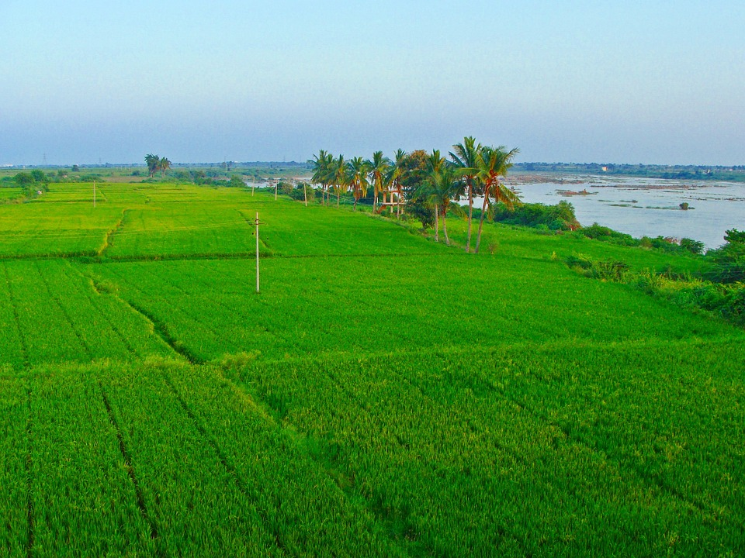
Introduction to the Northern Plain
Formed by the interplay of the Indus, the Ganga, and the Brahmaputra rivers and their tributaries.
Made of alluvial soil, deposited over millions of years.
Spreads over an area of 7 lakh sq. km, making it a densely populated physiographic division.
The plain is about 2400 km long and 240 to 320 km broad
Agriculturally productive due to rich soil, adequate water supply, and favourable climate.

Slide 3
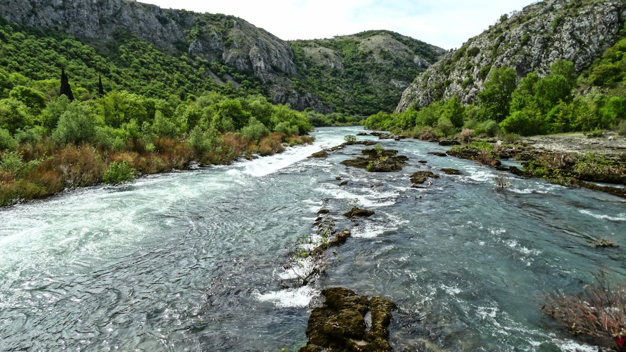
Depositional Work of Rivers
Rivers from northern mountains are involved in depositional work.
In the lower course, the velocity of the river decreases, leading to the formation of riverine islands.

Slide 4
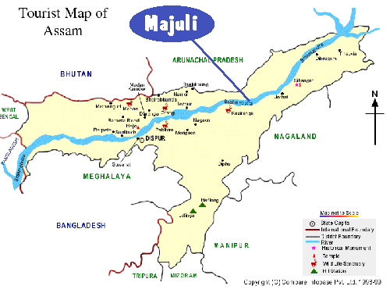
Majuli - The Largest Inhabited Riverine Island
Majuli, in the Brahmaputra river, is the largest inhabited riverine island in the world.

Slide 5
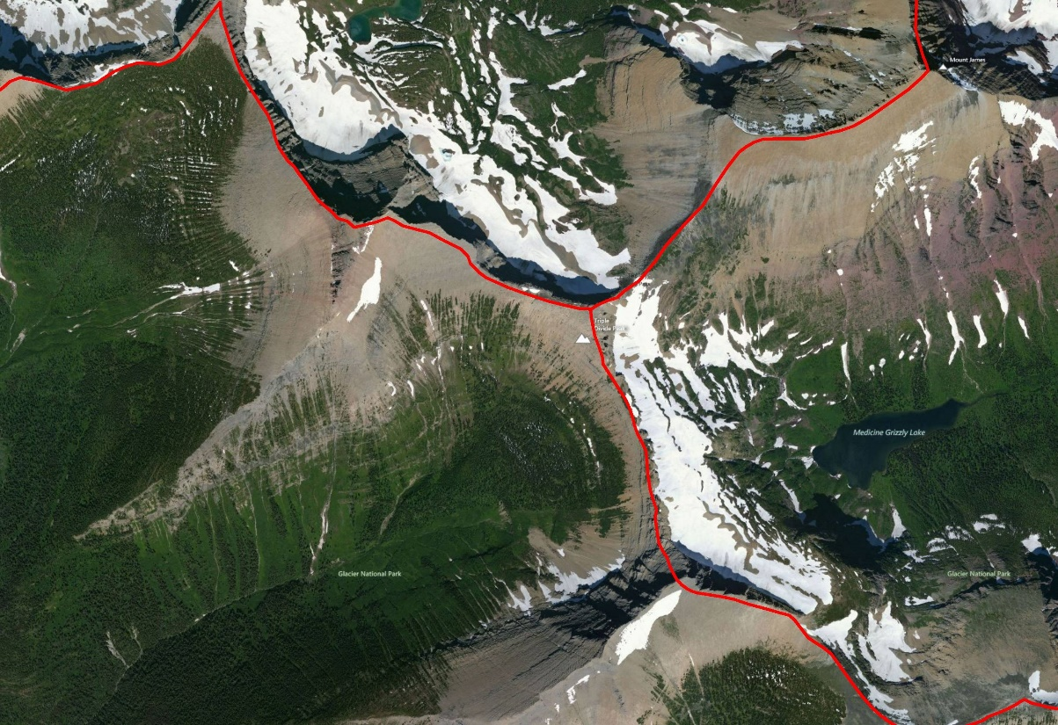
Division of the Northern Plain
Broadly divided into three sections: Western part (Punjab Plains), Ganga plain, and Brahmaputra plain.
The Punjab Plains are formed by the Indus and its tributaries, with the larger part lying in Pakistan.

Slide 6

Understanding 'Doab' and 'Punjab'
'Doab' is made up of two words — 'do' meaning two and 'ab' meaning water.
'Punjab' is also made up of two words — 'Punj' meaning five and 'ab' meaning water.

Slide 7
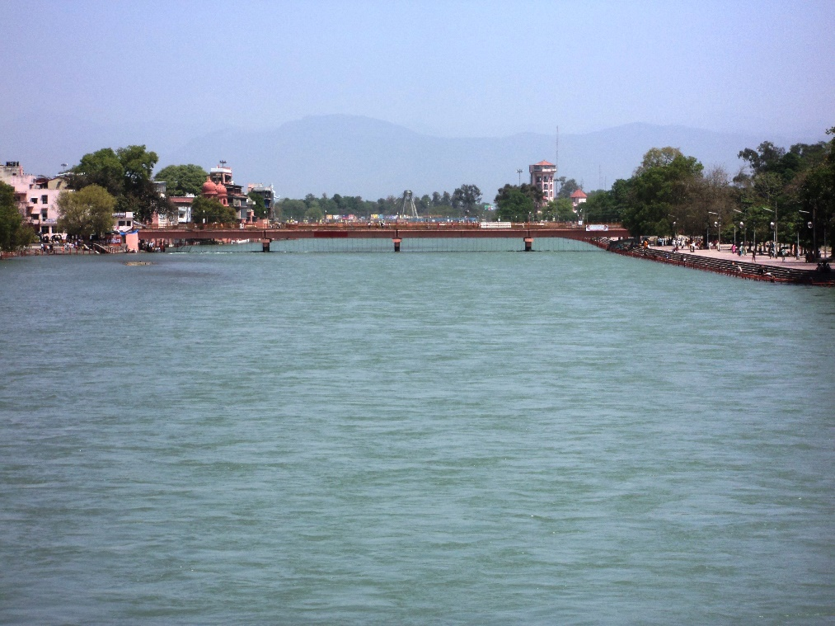
Distributaries and the Ganga Plain
Rivers in their lower course split into numerous channels due to the deposition of silt, known as distributaries.
The Ganga plain extends between Ghaggar and Teesta rivers, spread over North India in Haryana, Delhi, U.P., Bihar, partly Jharkhand, and West Bengal.

Slide 8
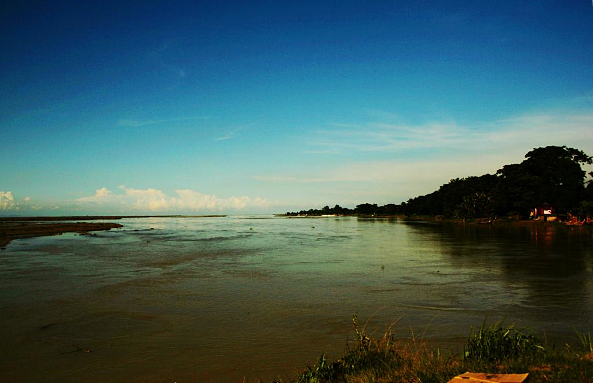
The Brahmaputra Plain
In the East, particularly in Assam lies the Brahmaputra plain.

Slide 9
Relief Features of the Northern Plains
The northern plains are not just flat land, they have diverse relief features.
According to the variations in relief features, the Northern plains can be divided into four regions.

Slide 10
Bhabar and Terai Regions
Bhabar: A narrow belt where rivers deposit pebbles after descending from the mountains.
Terai: A wet, swampy, and marshy region south of the Bhabar belt, which was once a thickly forested region full of wildlife.

Slide 11
Bhangar and Khadar Regions
Bhangar: The largest part of the northern plain, formed of older alluvium, known for its terrace-like feature and calcareous deposits known as kankar.
Khadar: The newer, younger deposits of the floodplains, renewed almost every year, thus fertile and ideal for intensive agriculture.

Slide 12
Thank you

