Slide 1
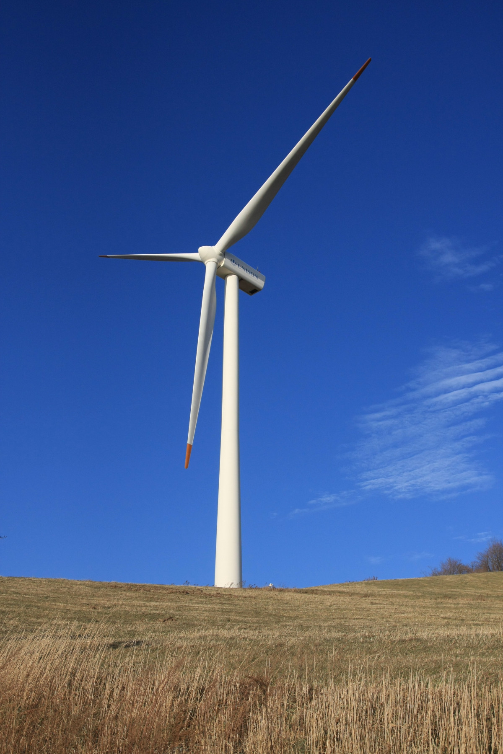
Green Skills
By: Group-1

Slide 2

Learning Objective
By the end of the class ,
Students will get an idea on natural resources ,
Their types
Difference between renewable and non-renewable resources and
Causes of depletion of natural resources

Slide 3
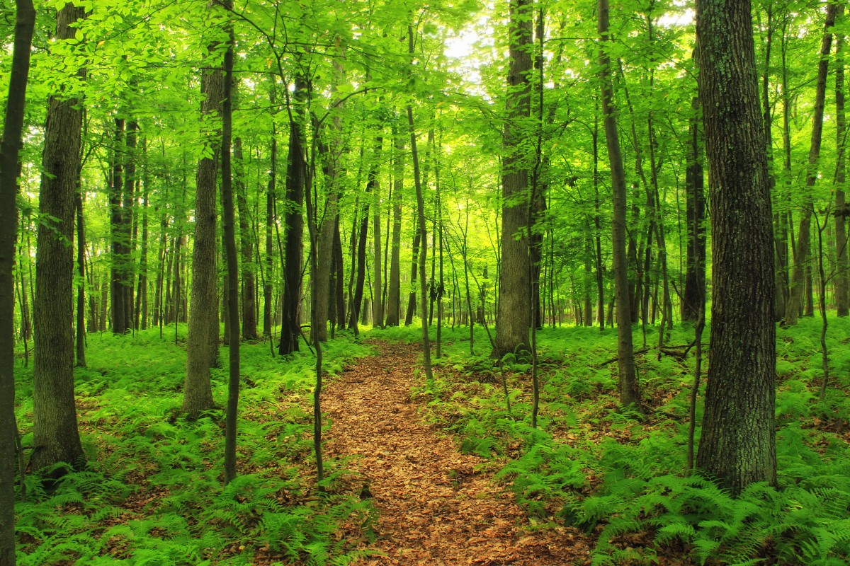
Natural resources
A natural resource is a raw material that comes from the environment.
The following are their types:
Land resources
Forest resources
Water resources
Mineral resources
Food resources
Energy resources

Slide 4
Natural resources are also divided into categories . These categories are:
Inexhaustible resources
Exhaustible resources
Renewable resources
Non renewable resources

Slide 5
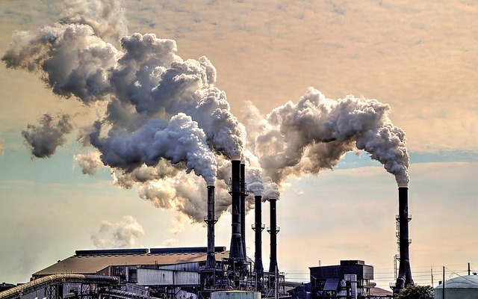
Causes of pollution
Over exploitation
Mining
Deforestation
Pollution

Slide 6


Slide 7


