Slide 1
THE SUN:OUR CLOSEST STAR

Slide 2
THE SUN:OUR CLOSEST STAR
WHAT IS A STAR?
A star is an astronomical object comprising a luminous spheroid of plasma held together by self-gravity

Slide 3
THE SUN:OUR CLOSEST STAR
WHAT IS A STAR?
A star is an astronomical object comprising a luminous spheroid of plasma held together by self-gravity

Slide 4
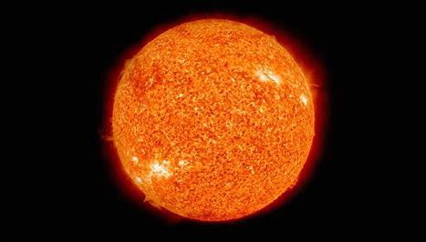
HOW WAS IT FORMED

Slide 5
HOW WAS IT FORMED
The sun, our star, was formed about 4.6 billion years ago from a giant cloud of gas and dust called the solar nebula. As the nebula collapsed under its own gravity, it spun faster and flattened into a disk. Most of the nebula’s material was pulled toward the center to form our Sun, which accounts for 99.8% of our solar system’s mass

Slide 6
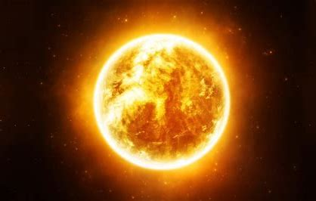
THE SUN’S LIFE CYCLE
IS IT GONNA BE WITH US FOREVER OR SOMTHING

Slide 7

THE LIFE CYCLE OF THE SUN
The sun is 4.6 billion years old and it will be with us for another 4.5 billion years.
But after that the sun is going to become a red giant and consume all planets until mars.
Then it will become a white dwarf and decay for tens of billions of years.

Slide 8
THE LIFE CYCLE OF THE SUN
The sun is 4.5 billion years old and it will be with us for another 4.5 billion years.
But after that the sun is going to become a red giant and consume all planets until mars.
Then it will become a white dwarf and decay for tens of billions of years until it runs out of nuclear fuel(h)

Slide 9
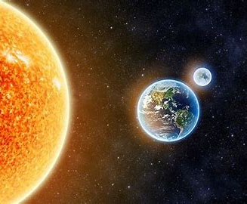
IS THE SUN EVEN IMPORTENT?

Slide 10
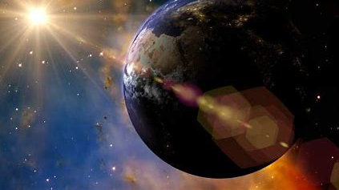
YES IT IS VERY IMPORTANT
1)IT HOLDS OUR SOLAR SYSTEM TOGETHER
2)T GIVES US HEAT AND LIGHT TO SUPPORT LIFE AS PLANT AND ANIMALS
3)IT PORTECTS US FROM COSMIC RADIATION VIA THE HELIOSPHERE

