Slide 1
Modified Keyholes
Examples

Slide 2
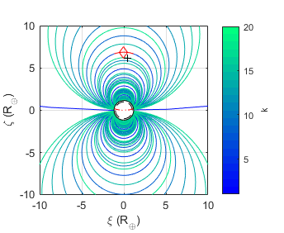
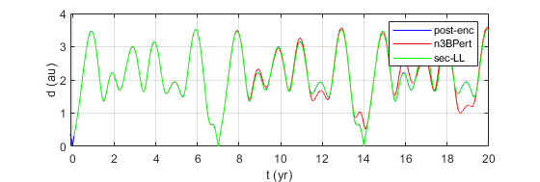
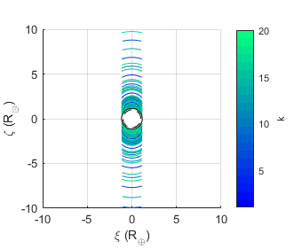
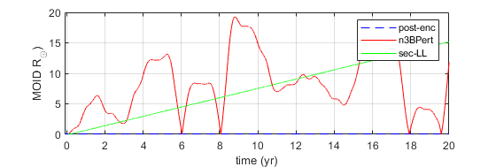
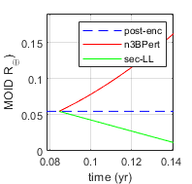

~2021 PDC – Circular+Eclip Earth
$MOID_{0}=ξ′$
k = 7

Slide 3
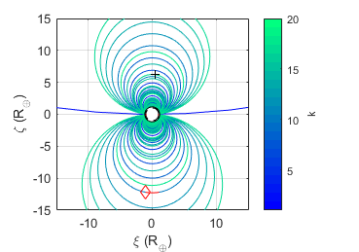
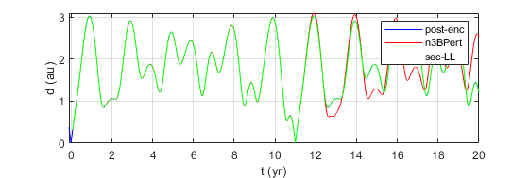
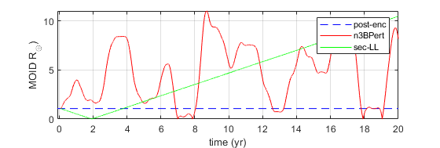
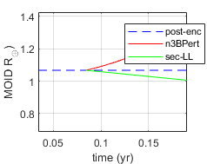

~2021 PDC – Circular+Eclip Earth
$MOID_{0}=ξ′$
k = 11

Slide 4
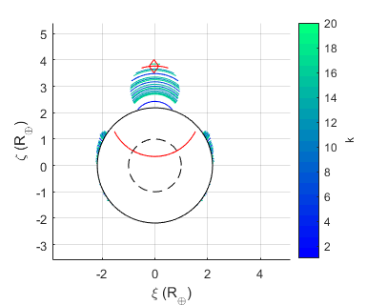
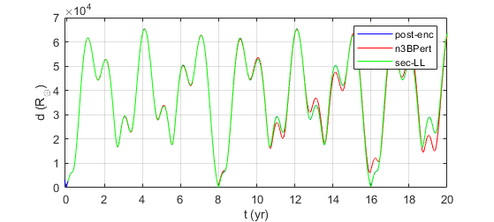
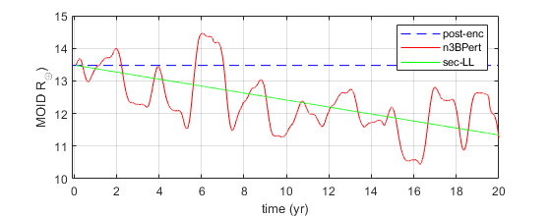

Apophis – Non-circular Earth
$MOID_{0}≠ξ′$
k = 8

Slide 5
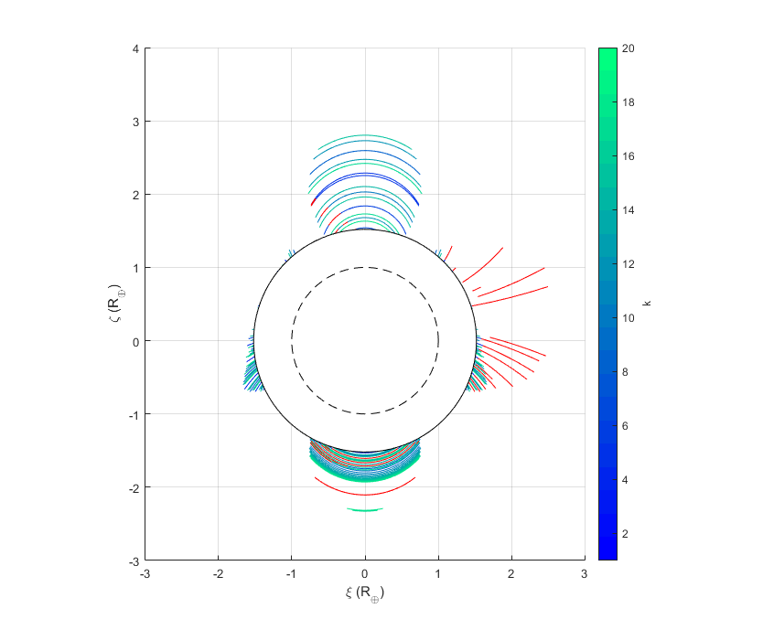

New Keyholes: Secular
2021 PDC
Need to make more robust
Output needed: $Δξ$
$$ξ"=ξ′+Δξ$$
$$Δξ=ΔMOID$$
$$ξ\text{"= }\text{MOID}" ?$$

