Slide 1

Incident Response and Root Cause Analysis
Akm Nizum

Slide 2
What is Incident Response?
Incident response is a systematic approach to managing and addressing the aftermath of a security breach or cyber attack. The primary goal is to handle the situation in a way that limits damage and reduces recovery time and costs. This process involves detecting the incident, containing and eradicating the threat, recovering from the incident, and implementing measures to prevent future occurrences (Kennesaw State University, 2022; SANS Institute, 2021).
Notes:
Kennesaw State University. (2022). Incident response and handling. Retrieved from https://www.kennesaw.eduSANS Institute. (2021). Incident response and handling. Retrieved from https://www.sans.org/incident-response

Slide 3
What is Digital Forensics?
Digital forensics is the process of identifying, preserving, analyzing, and presenting digital evidence (Kennesaw State University, 2022). Its purpose is to uncover details of an incident for legal or organizational action.
Identify: Recognize potential sources of digital evidence related to an incident.
Present: Report findings in a clear, concise manner for legal or organizational use.
Analyze: Examine collected data to extract relevant information and draw conclusions.
Preserve: Secure and protect digital evidence to maintain its integrity.

Slide 4
Incident Recognition
Identifying signs of an incident is crucial. This includes detecting unusual activity or data breaches (SANS Institute, 2021), such as unauthorized access attempts or suspicious file changes.
Anomaly Detection
Identify patterns that deviate from normal system behavior.
Security Monitoring
Continuously observe network traffic and system logs for potential threats.
User Reports
Encourage and act on incident reports from system users.

Slide 5
Evidence Gathering
Isolate affected systems to prevent further tampering or data loss.
Record all actions taken during the evidence-collection process.
Employ specialized software to create exact copies of digital evidence.
Track who has handled the evidence at every step of the process.
Collecting data from devices, networks, and other sources is a critical step. Forensic experts use specialized tools and methods to capture data without altering it (Brown, 2021).

Slide 6
Evidence Preservation
Ensuring the integrity of evidence is crucial. This involves preventing tampering or loss. Key practices include creating forensic images and documenting the chain of custody (Miller, 2022).
Forensic Imaging
Use write-blockers to prevent data alteration
Verify image integrity with hash values
Chain of Custody
Log all transfers and access to evidence
Use tamper-evident seals and secure storage
Data Preservation
Use proper storage media and conditions
Create multiple backups of critical evidence

Slide 7
Chain of Custody:
The chain of custody refers to the chronological documentation or paper trail that records the sequence of custody, control, transfer, analysis, and disposition of physical or electronic evidence. It is crucial in maintaining the integrity of the evidence throughout the investigation process.
Chain of Custody
Collection
Transfer
Analysis
Presentation
Documentation
Storage

Slide 8

Evidence Analysis
Examining evidence involves identifying the cause and impact of the incident. Methods include data recovery, pattern analysis, and anomaly detection (Davis, 2020).
Data Recovery: Retrieve deleted or hidden files using specialized software tools.
Malware Analysis: Examine suspicious files or programs for malicious behavior.
Pattern Analysis: Identify recurring themes or behaviors in the collected data.

Slide 9
Key Components for digital forensics:
Tools
Techniques
Expertise

Slide 10
Legal Proceedings
Presenting findings in court or to relevant authorities requires clear documentation and expert testimony. Adherence to legal standards is crucial for admissibility.
Documentation
Expert Testimony
Legal Standards
Detailed reports
Qualifications
Chain of custody
Evidence logs
Clear explanations
Admissibility rules
Analysis findings
Impartiality
Privacy laws

Slide 11
What is Root Cause Analysis?
Root cause analysis (RCA) is a method used to identify the fundamental cause of problems or incidents. The goal of RCA is to determine the underlying issues that lead to an event or problem, rather than just addressing its symptoms. By understanding and addressing these root causes, organizations can implement effective solutions that prevent recurrence and improve overall performance (International Society of Six Sigma Professionals, 2020; Juran & Godfrey, 2010).
Notes:
International Society of Six Sigma Professionals. (2020). Root cause analysis. Retrieved from https://www.sixsigmaprograms.orgJuran, J. M., & Godfrey, A. B. (2010). Juran's Quality Handbook: The Complete Guide to Performance Excellence. McGraw-Hill Education.

Slide 12
Root Cause Analysis (RCA)
RCA is the underlying cause of an issue to prevent recurrence. Its purpose is to address the root cause rather than identify just symptoms.
Define Problem
Gather Data
Identify Causes
Implement Solutions
Analyze Causes
Detect Problem
R
C
A

Slide 13
Best Practices for root cause analysis:
Best Practice 1: Use Data-Driven Techniques
Best Practice 2: Involve All Stakeholders
Best Practice 3: Document Findings and Actions

Slide 14
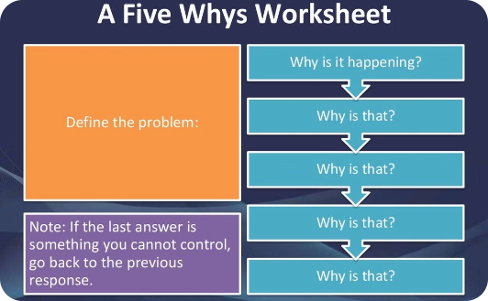
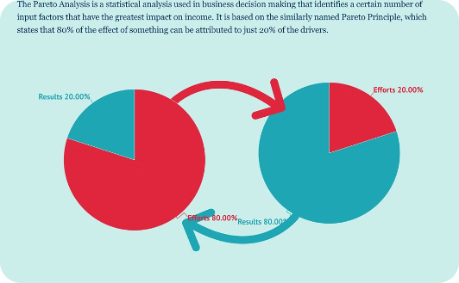
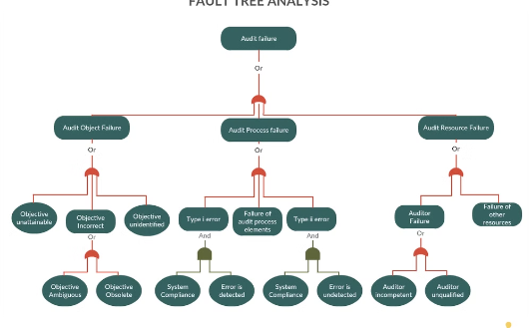
RCA Tools and Techniques
Various tools and techniques aid in root cause analysis. Examples include Fault Tree Analysis, 5 Whys, and Pareto Analysis.
5 Whys:
Pareto Analysis:
Fault Tree Analysis:
Ask "why" five times to drill down to the root cause of a problem.
Identify the most significant factors contributing to an issue.
Visual representation of potential failure paths leading to an incident.

Slide 15
Summary and Best Practices
Thorough investigation and analysis are crucial in digital forensics and RCA. Best practices include using data-driven techniques, involving all stakeholders, and documenting findings and actions.
1
Data-Driven Approach
2
Stakeholder Involvement
3
Comprehensive Documentation
Base conclusions on empirical evidence and objective analysis.
Engage relevant parties to gain diverse perspectives and insights.
Maintain detailed records of all findings, actions, and recommendations.
Lastly, Continuous improvement are necessary in this changing world of Cybersecurity.

Slide 16
References:
Brown, L. (2021). Forensic Evidence Collection. DataSec Books.
Clark, T. (2020). Effective RCA Strategies. Management Press.
Davis, R. (2020). Analyzing Digital Evidence. Forensic Press.
International Society of Six Sigma Professionals. (2020). Root Cause Analysis. Retrieved from https://www.sixsigmaprograms.org
Juran, J. M., & Godfrey, A. B. (2010). Juran's Quality Handbook: The Complete Guide to Performance Excellence. McGraw-Hill Education.
Kennesaw State University. (2022). Incident response and handling. Retrieved from https://www.kennesaw.edu
Miller, S. (2022). Digital Evidence Preservation. TechGuard Publications.
SANS Institute. (2021). Incident Response and Handling. Retrieved from https://www.sans.org/incident-response
Taylor, E., & Kim, J. (2019). Best Practices in RCA. Performance Publishers.
Williams, H. (2021). Root Cause Analysis Techniques. Business Insights.
Wright, J. (2018). Legal Aspects of Digital Forensics. LawTech Publishing.

