Slide 1


Slide 2
FEATURES AND LABELS
Dependent variable is called as LABELS.
Dependent variables are the variable which depends on other variable.
Independent variables are called as FEATURES.
Independent variables are the variable which do not depend upon other variables.

Slide 3
BATH | BEDS | Sq feet | Price of house
2 | 2 | 10 | 40 lakhs
3 | 3 | 20 | 60 lakhs
2 | 1 | 30 | 90 lakhs
3 | 4 | 40 | 1 crore

Slide 4
TRAINING AND TESTING DATASET
We divide the entire dataset into two parts
Training dataset
Testing dataset
Training dataset train the data.
Testing data set test the data.
After testing is done if the dataset obtains the accuracy then the dataset is use for further future prediction

Slide 5
TYPES OF MACHINE LEARNING
There are three types f machine learning
1.SUPERVISED LEARNING
2.UNSUPRVISED LEARNING
3.REINFORCEMENT LEARNING

Slide 6


Slide 7
Difference between supervised and unsupervised learning
SUPERVISED LEARNING
UNSUPERVISED LEARNING
1.Label data is provided 1.label data is not provided
2.Complete training and 2.Training is not provided
learn by its own and use
for future prediction
Testing is done.use for future prediction
Eg.prediction of stock market
Eg.emails into spam or nor spam

Slide 8
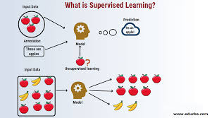
SUPERVISED LEARNING

Slide 9
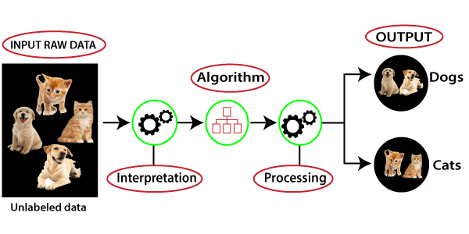
UNSUPERVISED LEARNING

Slide 10
Types of supervised learning
REGRESSION
CLASSIFICATION

Slide 11
REGRESSION
It is use for continuous data
It predicts numerical values
Example:Predicting house price

Slide 12
TYPES OF REGRESSION
Linear Regression
Polynomial regression
Support vector machine
Decision Tree
Random Forest Regression
K nearsest neighbour (KNN)
Naïve bayes

Slide 13
classification
It is use to produce discrete results.
Classify the data into specific categories
Example:Email is spam or not
Result is in the form of yess or no,pass or fail

Slide 14
TYPES OF CLASSIFICATION
Support vector machine
Decision Tree
Logistic Regression
Naïve Bayes
Random forest
K nearest neghbour

Slide 15
CLUSTERING
It is the type of unsupervised learning
It organized the data into similar groups called as clusters

Slide 16
REINFORCEMENT
It is area of ml
It is about taking suitable actions to maximise reward in particular solution

