Slide 1
Tableau

Slide 2
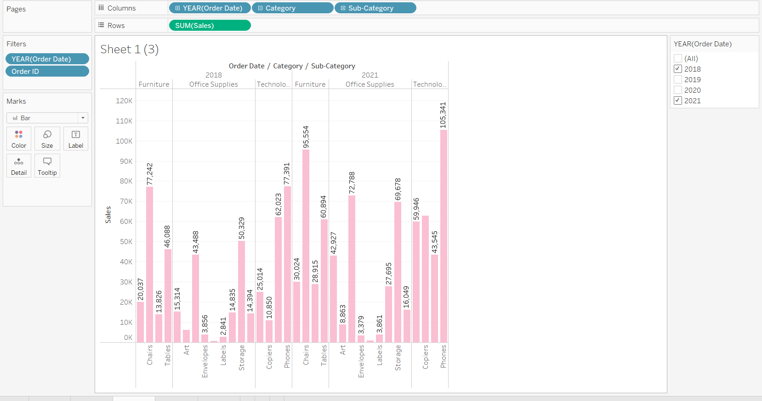
Check your view for the year 2018 and 2021.

Slide 3
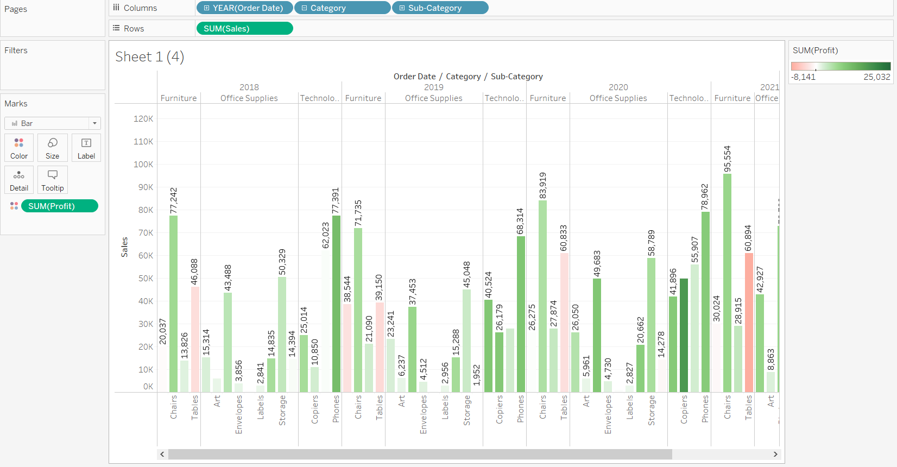
Show the profit in the tooltip for sales for each subcategory of every type of product.

Slide 4
Identify the subcategory & category that are having negative profit.2018
Category Sub-Category Year Profit Sales
Furniture Tables 2018 -3,124.0427 46,088.3655
Category Sub-Category Year Profit Sales
Furniture Bookcases 2018 -346.170700000 20,036.6776

Slide 5
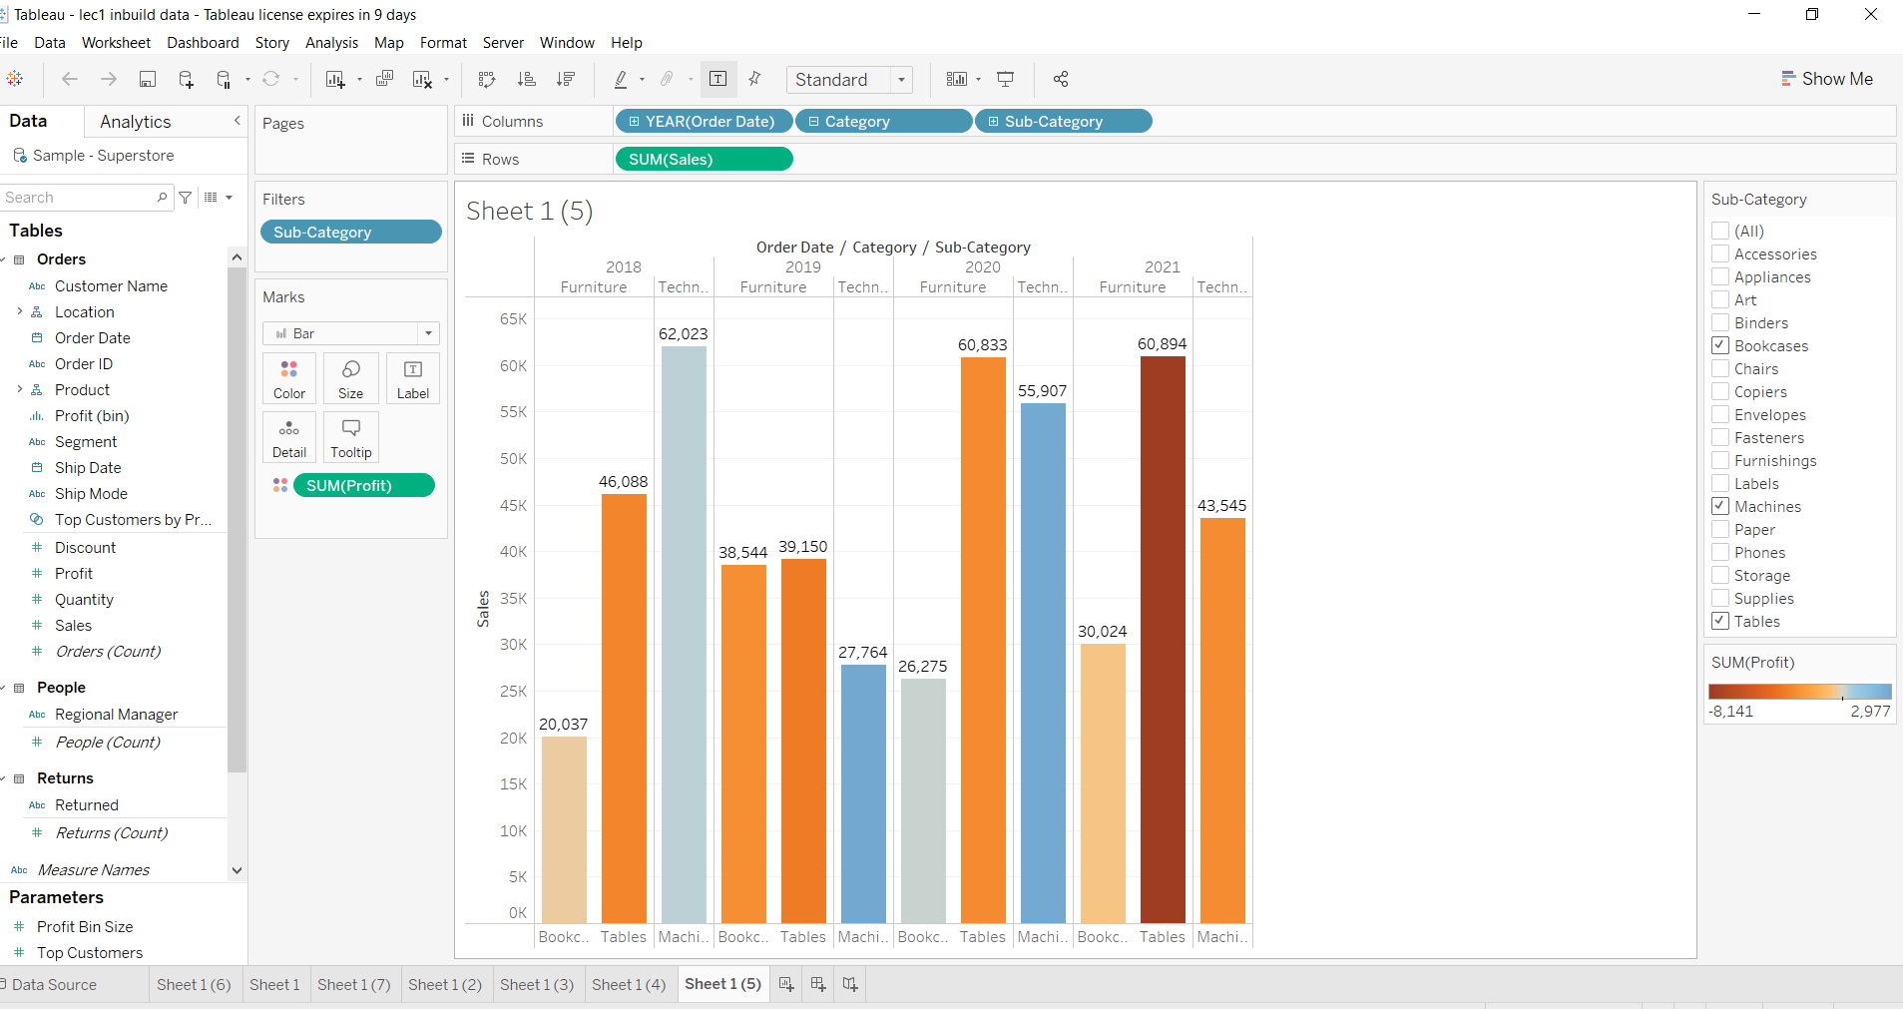
In the view, in the Sub-Category filter card, clear all of the check boxes except Bookcases, Machines, and Tables and have closer look on each value.

