Slide 1

TABLEAU
INTRODUCTION TO

Slide 2
BUSSINESS INTELLIGENCE TOOL (BI TOOL)
Business intelligence (BI) tools are types of application software which collect and process large amounts of unstructured data from internal and external systems
These tools also help prepare data for analysis so that you can create reports, dashboards and data visualisations. The results give both employees and managers the power to accelerate and improve decision making, increase operational efficiency, pinpoint new revenue potentials, identify market trends, report genuine KPIs and identify new business opportunities.

Slide 3

TYPES OF BI TOOLS

Slide 4
TABLEAU
Tableau is a powerful and fastest growing data visualization tool used in the Business Intelligence Industry. It helps in simplifying raw data in a very easily understandable format. Tableau helps create the data that can be understood by professionals at any level in an organization. It also allows non-technical users to create customized dashboards.
Data analysis is very fast with Tableau tool and the visualizations created are in the form of dashboards and worksheets.

Slide 5
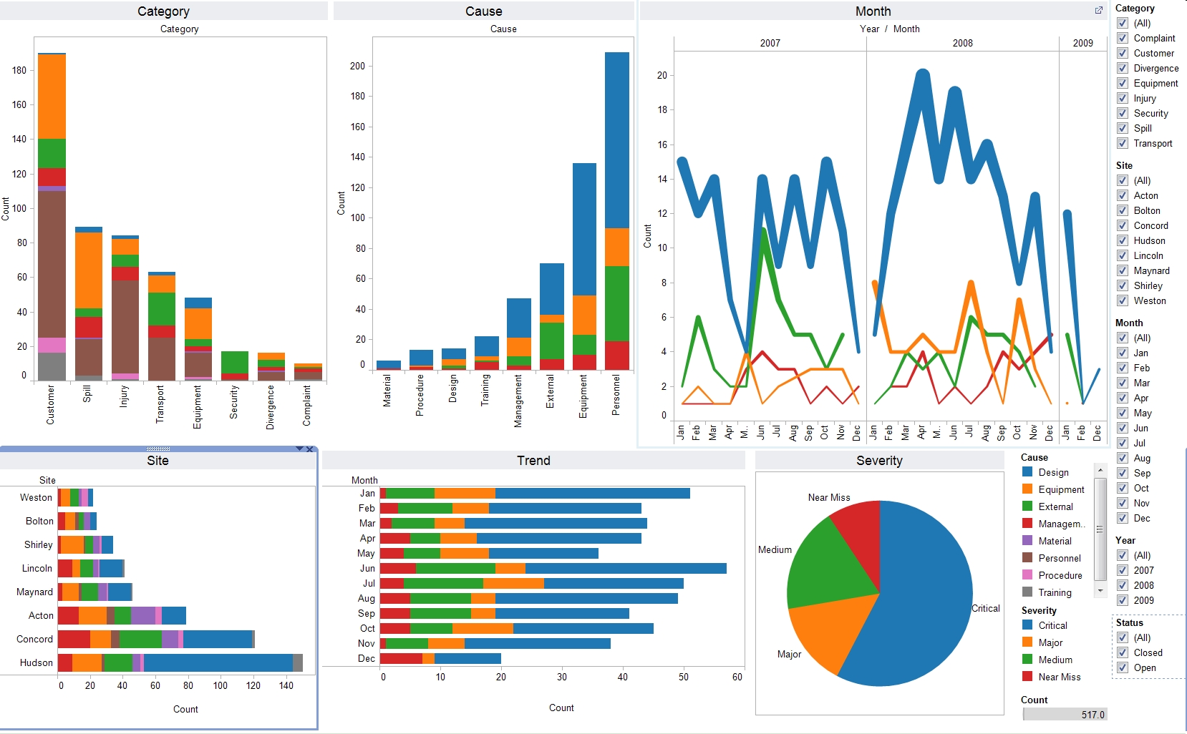

Slide 6
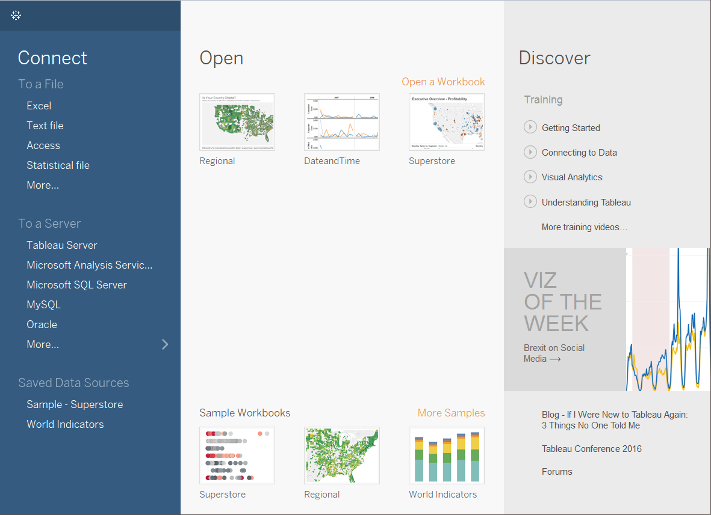

Slide 7
On the Connect pane, you can do the following:
Connect to data: Under To a File, connect to data stored in Microsoft Excel files, text files, Access files, Tableau extract files, and statistical files, such as SAS, SPSS, and R. Under To a Server, connect to data stored in databases like Microsoft SQL Server or Oracle. The server names listed in this section change based on which servers you connect to and how often.
Open saved data sources: Quickly open data sources that you have previously saved to your My Tableau Repository directory. Also, Tableau provides sample saved data sources that you can use to explore Tableau Desktop functionality. To follow along with examples in the Tableau Desktop documentation, you'll usually use the Sample – Superstore data source.

Slide 8
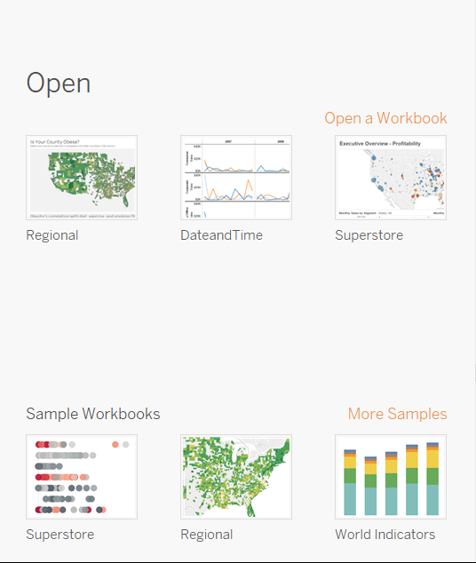
Open
Open recent workbooks, pin workbooks to the start page, and explore sample workbooks.
Open recently opened workbooks: When you open Tableau Desktop for the first time, this pane is empty. As you create and save new workbooks, the most recently opened workbooks appear here. Click the workbook thumbnail to open a workbook, or if you don't see a workbook thumbnail, click the Open a Workbook link to find other workbooks that are saved to your computer.

Slide 9
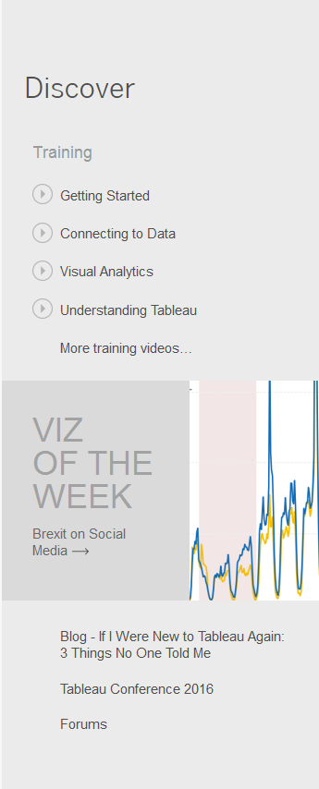
Discover
See popular views in Tableau Public, read blog posts and news about Tableau, and find training videos and tutorials to help you get started.

