Slide 1
TABLEAU

Slide 2
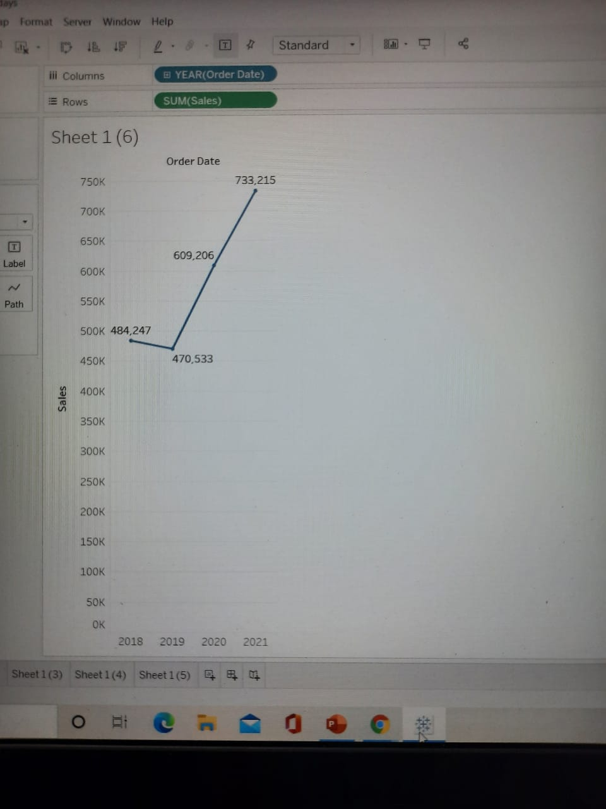
Find total aggregated sales for each year by order date.

Slide 3
In which years sales was minimum and maximum
The sale was minimum from the year 2019 and maximum in the year 2021

Slide 4
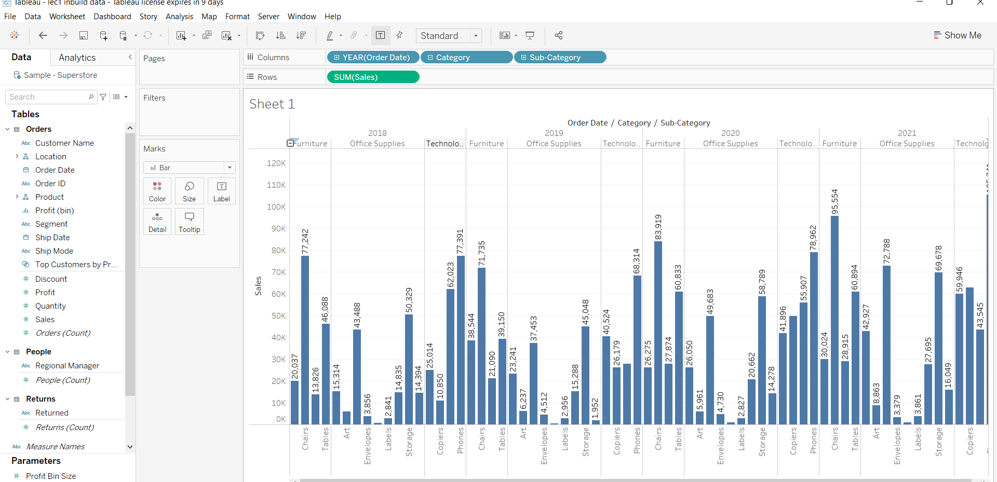
Find the highest sales and show the view in bar graph and label it.

Slide 5
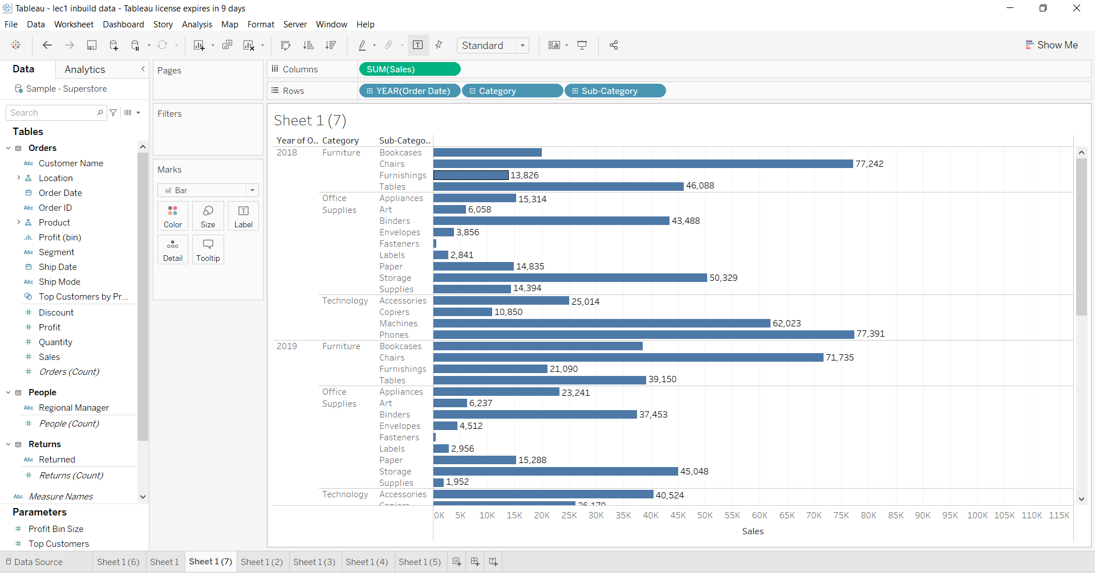
swap rows and columns using appropriate option and display the view horizontally.

Slide 6
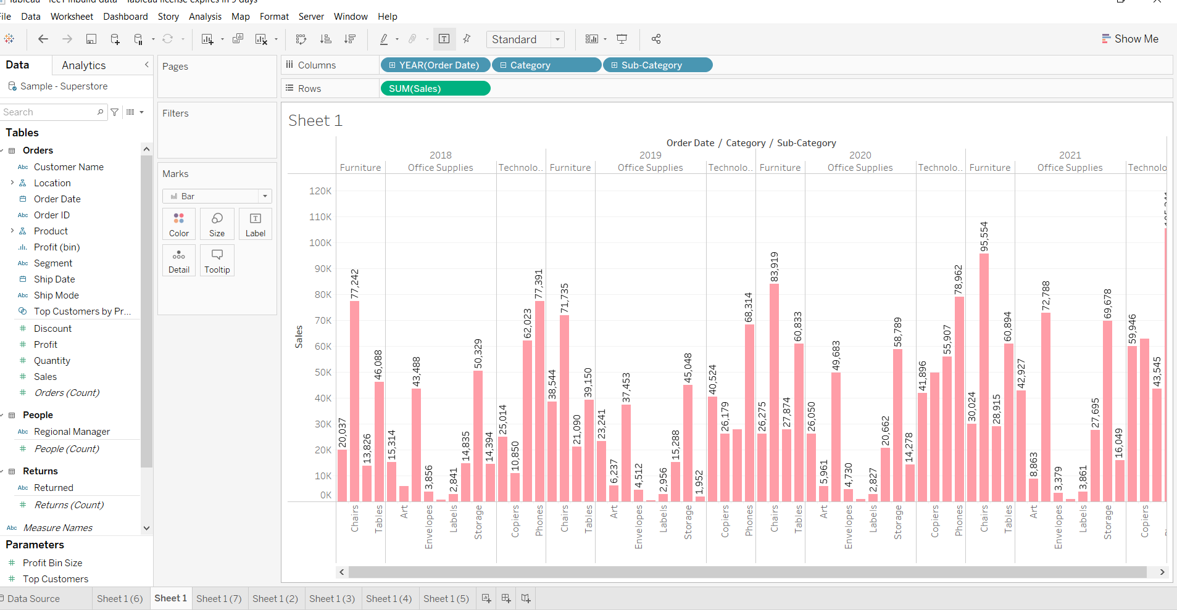
Represent your view using different colour.

Slide 7
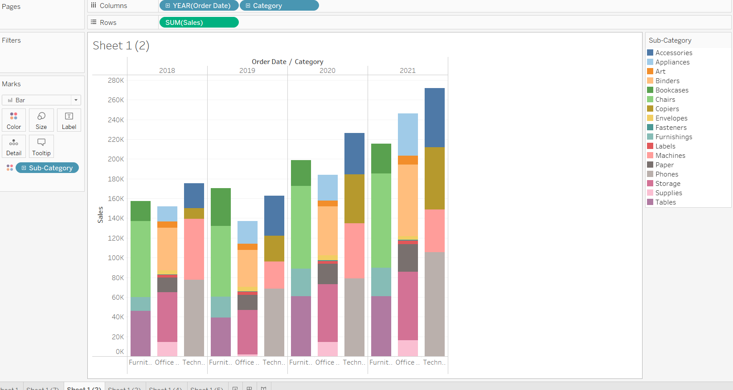
Use colour cart to show subcategory under every category.

Slide 8
Which category has highest sales in every year?
In 2018 Technology has highest sale(77391)
In 2019 Furniture has highest sale(71735)
In 2020 Furniture has highest sale(83,919)
In 2021 Technology has highest sale(105,341)

Slide 9
What is the total sales of machine and phones type subcategory in the year 2018.
62023 is the total sale of machine in 2018
77391 is the total sale of phone in 2018

Slide 10
Which subcategory of furniture type category has highest sales in 2018.
Chairs has highest sale of 77242 in 2018 which is subcategory of furniture

Slide 11
In the year 2021 which subcategory has highest sales under each category.
Category Sub-Category Year of Order date Sales
Office Supplies Binders 2021 72,788.045000000
Category Sub-Category Year of Order Date Sales
Furniture Chairs 2021 95,554.353000000
Category Sub-Category Year of Order Date Sales
Technology Phones 2021 1,05,340.516

Slide 12
In the year 2021 which subcategory has lowest sales under each subcategory.
Category Sub-Category Year of Order Date Sales
Furniture Furnishings 2021 28,915.094
Category Sub-Category Year of Order Date Sales
Office Supplies Fasteners 2021 857.594
Category Sub-Category Year of Order Date Sales
Technology Machines 2021 43,544.675

Slide 13
What decision you can take to increase the profit in the next year based on Your current years analysis.
From the current year(2021) we analyse that category technology has max sale for phone subcategory so in order to increase the profit the owner should give more weightage to technology field.

