Slide 1




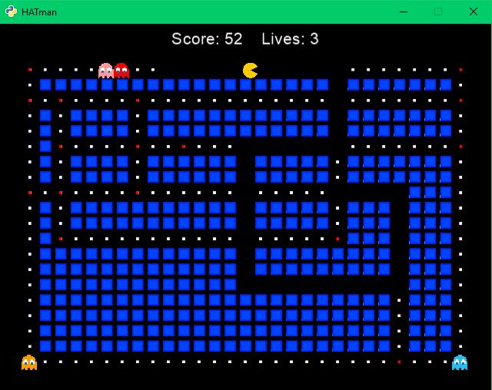
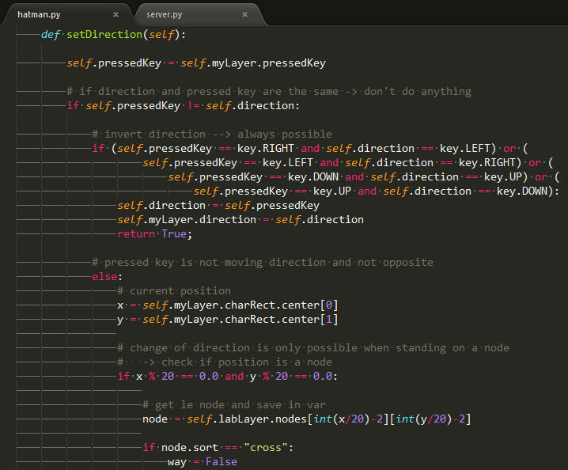


Game Development with Python
Bachelorstudium
Internettechnik
Main
Frameworks:
Twisted
&
Cocos2d
Event-driven
network programming
Multiplayer
Pacman
alias
HATman
© Johanna Kirchmaier, Anja Bergmann & Tabea Halmschlager, ITM14

