Slide 1
HATman
Game Development with Python
Anja Bergmann, Tabea Halmschlager, Johanna Kirchmaier

Slide 2
Leading Question
Is it possible to use a High-Level Programming Language (specific: Python) for the purpose of developing a multiplayer game?
→ Yes - if the journey is its own reward.
Notes:
As we presented in our first presentation, we asked ourselves the following leading question:
Now we can answer it - yes, it is possible, but you have to take into account that the journey would be its own reward.
We’ll go into that a little bit further afterwards, but for now we’ll focus on our task.

Slide 3

Task
Implementing a game similar to PACMAN
in Python
using Cocos2D
communicating via Twisted
Notes:
We concentrated on the common game PACMAN, but with our game you could not only play the pacman, but also the ghosts.
Our solution was designed with:
>Python which is normally used for scripting rather than game development
>We chose this programming language because we really liked it in our third semester in the course “Programmierkonzepte”
Cocos2D is a framework for game development, it works using sprites and scenes which can be animated to create a game
Twisted is:
> network programming framework written in Python
> that supports various protocols (TCP, UDP, AMP, …)
> based on the event-driven programming paradigm
> which means that users of Twisted write short callbacks which are called by the framework.

Slide 4


Implementation
Cocos2D GUI
Twisted Client
Twisted Server
Notes:
So like I’ve already said, we used Cocos2d to implement the Graphical User Interface
- respectively how the users see the game.

Slide 5

Implementation
Cocos2D GUI
Twisted Client
Twisted Server
Notes:
Afterwards the GUI-game will be rearranged to include some twisted classes.
By doing so, we transform the game into a client that will be able to communicate with our game server.

Slide 6

Implementation
Cocos2D GUI
Twisted Client
Twisted Server
Notes:
Then, we’ll write a game server using twisted again.
The server’s purpose will be to coordinate the clients by handling the communication between them.

Slide 7

Problems
Windows Version
Python Version
Wasted lots of time on outdated or poorly (or not at all) documented frameworks
Marauroa (Arianne)
Notes:
Unfortunately we encountered numerous problems:
Right at the beginning, we realized that our Windows 7 operating systems had problems showing the sprite objects that the framework cocos2d provided.
→ Solution: I already had Windows 10 on my laptop, Anja bought a new one and Hannah upgraded her Win7. But that was the rather easy part of our project.

Slide 8
Problems
Windows Version
Python Version
Wasted lots of time on outdated or poorly (or not at all) documented frameworks
Marauroa (Arianne)
Notes:
Soon afterwards we came across Pythons different versions (mainly 2.x and 3.x) and the accompanying troubles. Actually, this problem showed up more than once. Python’s syntax changed in a lot of ways between version 2 and 3 and also between the sub-versions. Nevertheless, Python3 offers a script file called 2to3.py that makes it possible to transform python2 to python3 files - but that didn’t work 100%. Moreover, installing Python2 AND Python3 on one (Windows) OS can lead to serious problems. So how did we solve this problem? - We didn’t really. But we learned how to work around it in the best ways possible, although unfortunately it took a lot of time and effort.

Slide 9
Problems
Windows Version
Python Version
Wasted lots of time on outdated or poorly (or not at all) documented frameworks
Marauroa (Arianne)
Notes:
ANJA
But we didn’t give up and thus, a new range of problems occurred concerning our choice of framework for the multiplayer part of our project.
We tried a lot of frameworks, but these were either outdated, full of bugs and/or poorly or not at all documented.

Slide 10
Problems
Windows Version
Python Version
Wasted lots of time on outdated or poorly (or not at all) documented frameworks
Marauroa (Arianne)
Notes:
ANJA
Still, the worst is yet to come because another big milestone in our history of problems was Arianne, respectively it’s engine Marauroa (we still don’t quite know how to pronounce it correctly^^). It’s a huge framework with lots of Java classes and configuration files and we had no idea what to do or where to start. On top of that the documentation was … creative, kindly spoken. In the readme some files were mentioned that didn’t even exist or were placed in different locations, therefore it didn’t really help us. Nor did the wiki-like pages that described the framework. There were multiple subpages and links to other (often similar titled) pages and instead of being detailed it turned out to be just confusing since we never knew which step we should do next or what exactly we were looking for.
We also tried to execute some games that were written with Marauora to have a model as an orientation. Shouldn’t be so hard, right? However, it was. We didn’t find a single game we could execute with whatever version of python we tried. And if it didn’t refuse to work because of the python version, it was due to the lack of some modules we couldn’t find anywhere or which ceased(schreib ma des so?) to exists or weren’t compatible with the python version the game was written in anymore.
At the end we gave up on Arianne and stuck with Twisted instead.

Slide 11
Live Demo
Notes:
ANJA

Slide 12

What have we learnt?
#1
How not to do your Projectwork
Python 2.x != Python 3.x
If only there was some sort of thing that could help us find helpful stuff in the inter… ouuh
Notes:
Due to all the problems mentioned before, we sadly haven’t managed to finish our project work yet. But we have learned a lot
Better time management.
As already mentioned while talking about the problems we found that Python2 and Python3 are not really compatible.
We also learnt to take advantage of Google.

Slide 13
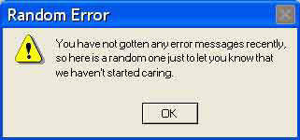
What have we learnt?
#2
How to Read TError Messages
and Documentation
Search for Tutorials
Don’t try to Solve Everything on Your Own.
-- Ask for Help.

Slide 14
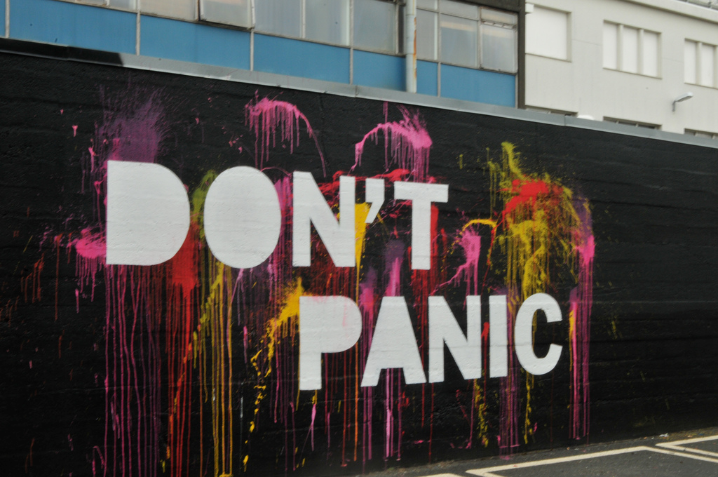
What have we learnt?
#3
Improved Programming skills in Python
Modelling Network Communication via Twisted
bla
Notes:
on a more serious basis…
# Improved programming skills in Python:
→ we learned the importance of line indentations
→ and using the correct version x of Python 2 or 3
# Modelling network communication via Twisted:
→ how client and server interact with each other
→ how Twisted “helps” us doing that

Slide 15
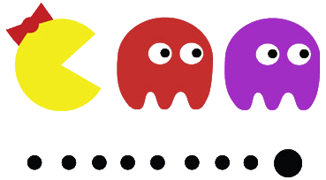
Thank You For Your Attention!
Notes:
to be changed

