Slide 1


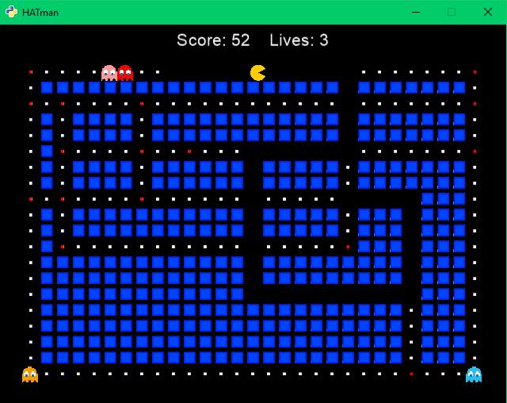
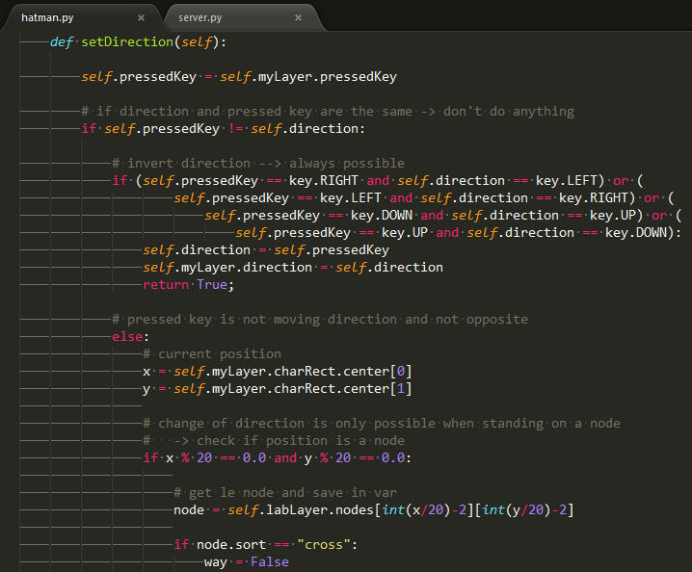

Game Development with Python
Bachelorstudium
Internettechnik
Main Frameworks:
Twisted & Cocos2d
Event-driven network programming
Multiplayer
Pacman alias HATman
© Anja Bergmann, Tabea Halmschlager & Johanna Kirchmaier, ITM14

