Slide 1
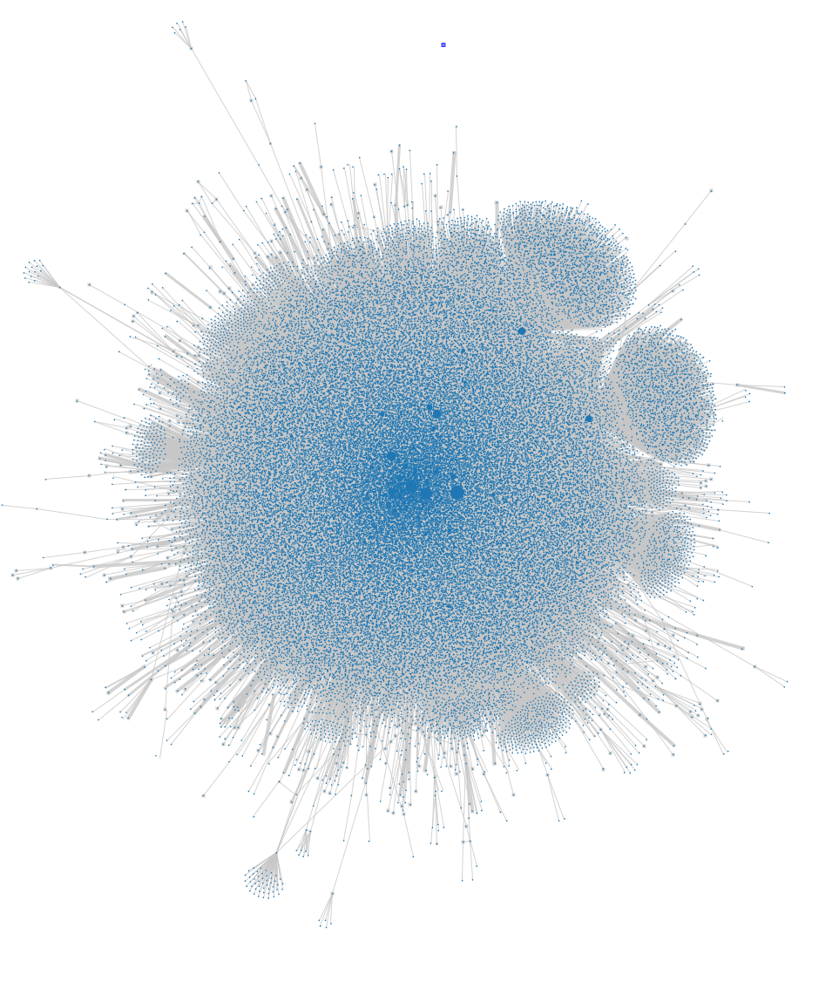
The UK Web Archive
Three collections:
Selective Archive (since 2004)
Legal Deposit Archive (since 2013)
JISC/IA Historical Archive (1996-2013)
Access spectrum:
View archived resources
Browse curated collections
Full-text search
Trend analysis
Advanced search
Analytical access
Custom report generation
Datasets

Slide 2
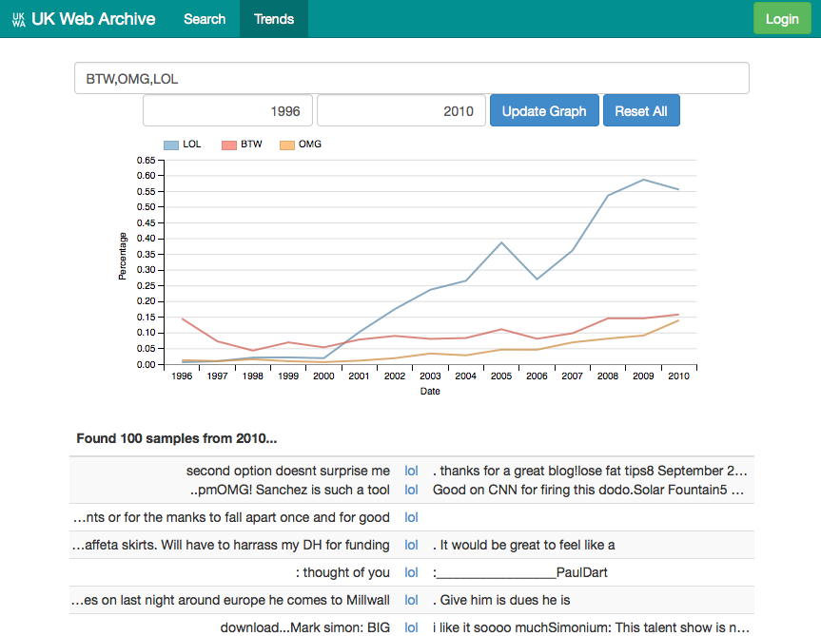
Shine: advanced search interface

Slide 3
Secondary Datasets
JISC UK Web Domain Dataset (1996-2013):
Format Profile
Geo-Index
Host-Level Links
Crawled URL Index
UK Open (Selective) Web Archive:
Website Classification Dataset
Available as CC0 downloads:
https://data.bl.uk/UKWA/
Notes:
Secondary Datasets:
Composed of facts about the content
But not ‘substitutable’ for the content
Part of a long-standing tradition:
The British Library’s bibliographic data has always been openly accessible
Probably not copyrightable:
Released as CC0 to avoid any ambiguity

Slide 4
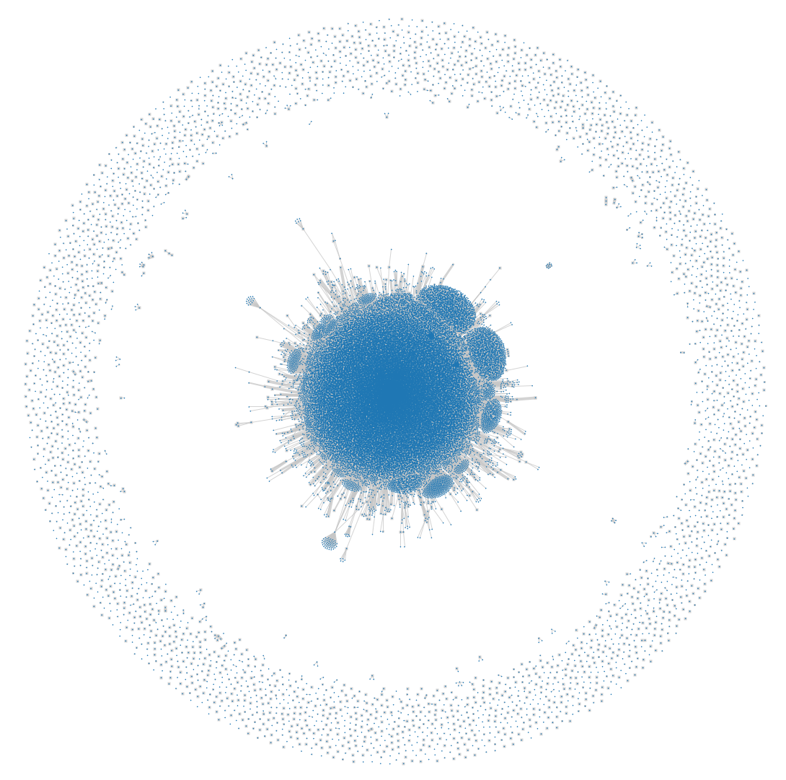
Dataset: Host-to-Host Links from 1996

Slide 5
Use Cases
Impact of academic research:
Find and analyse news articles that reference/link to academic sources
Gender in sports reporting:
Look at gender balance in web sites from the 2012 Olympics
Large-scale crawl analysis:
Our 2015 domain crawl was 70TB. 2016 was 100TB.
What happened?
Generate crawl reports, analysing quality, comparing crawls.

Slide 6
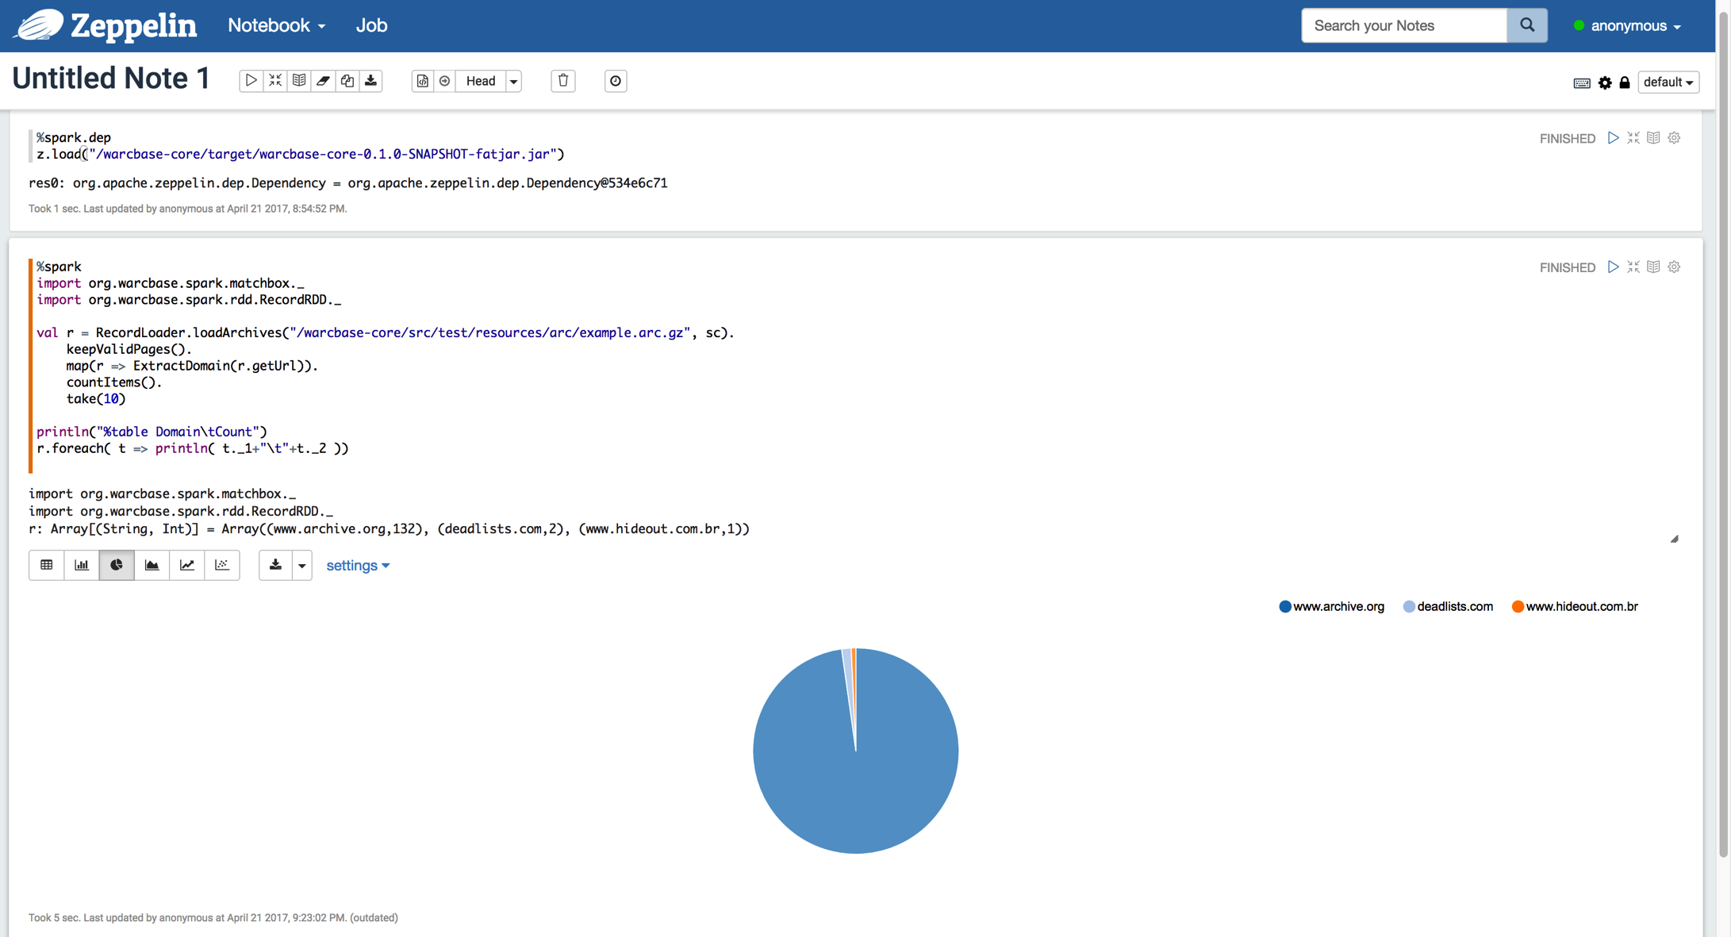
Analytical Access

