Slide 1
Digging Documents Out of the Archived Web
Andy Jackson
Web Archive Technical Lead

Slide 2
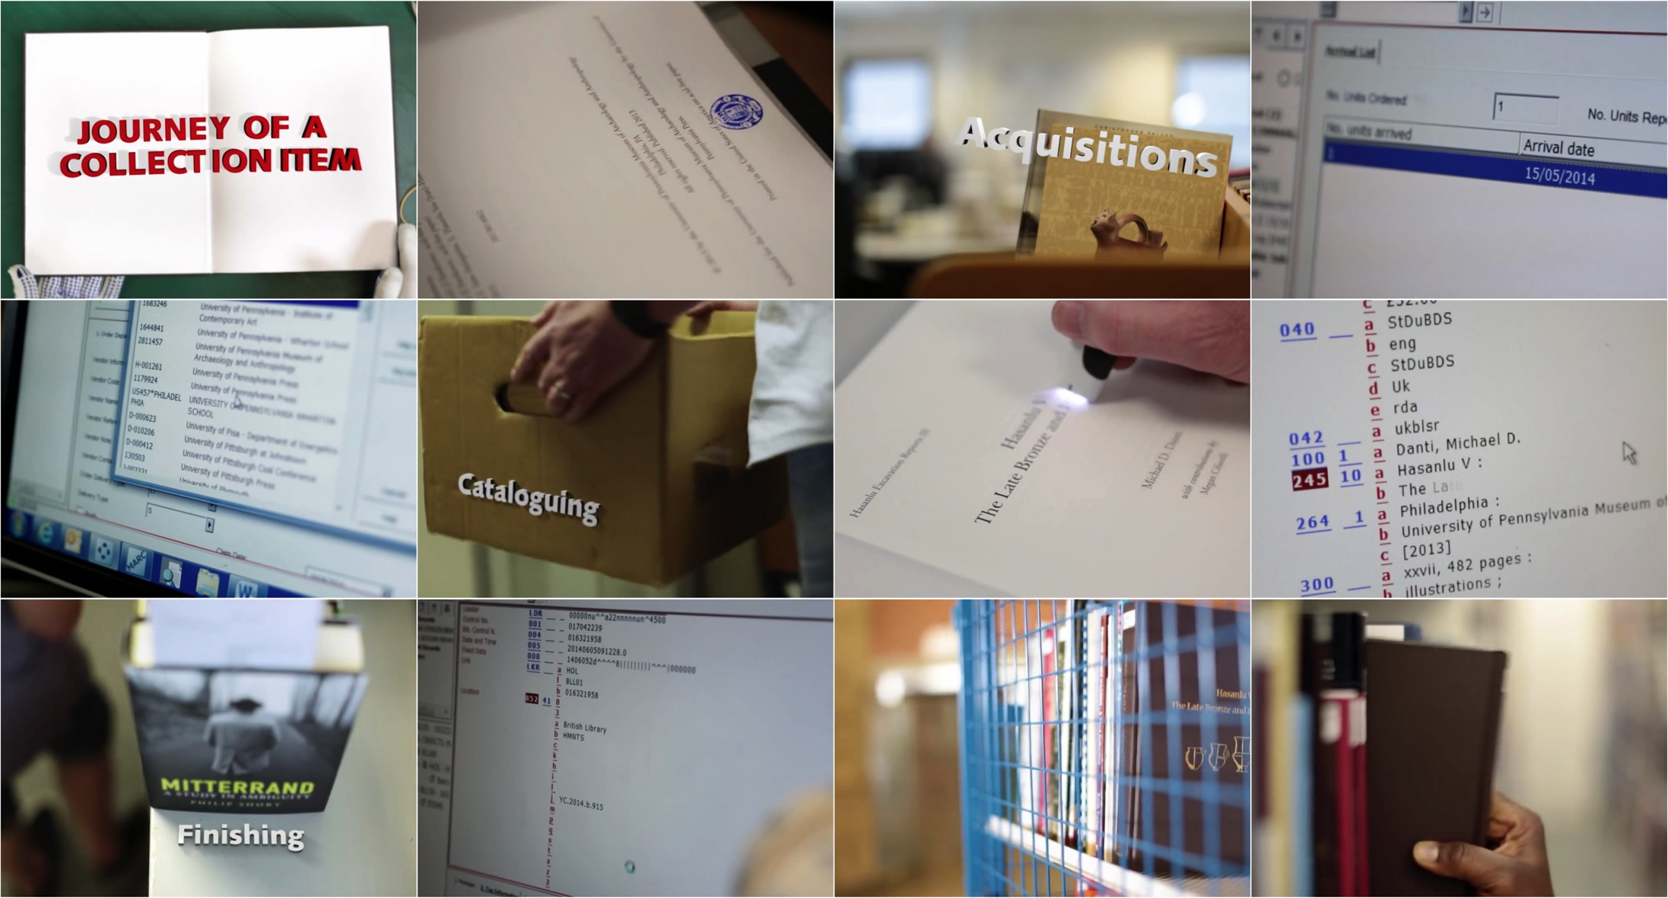
Journey of a (print) collection item

Slide 3
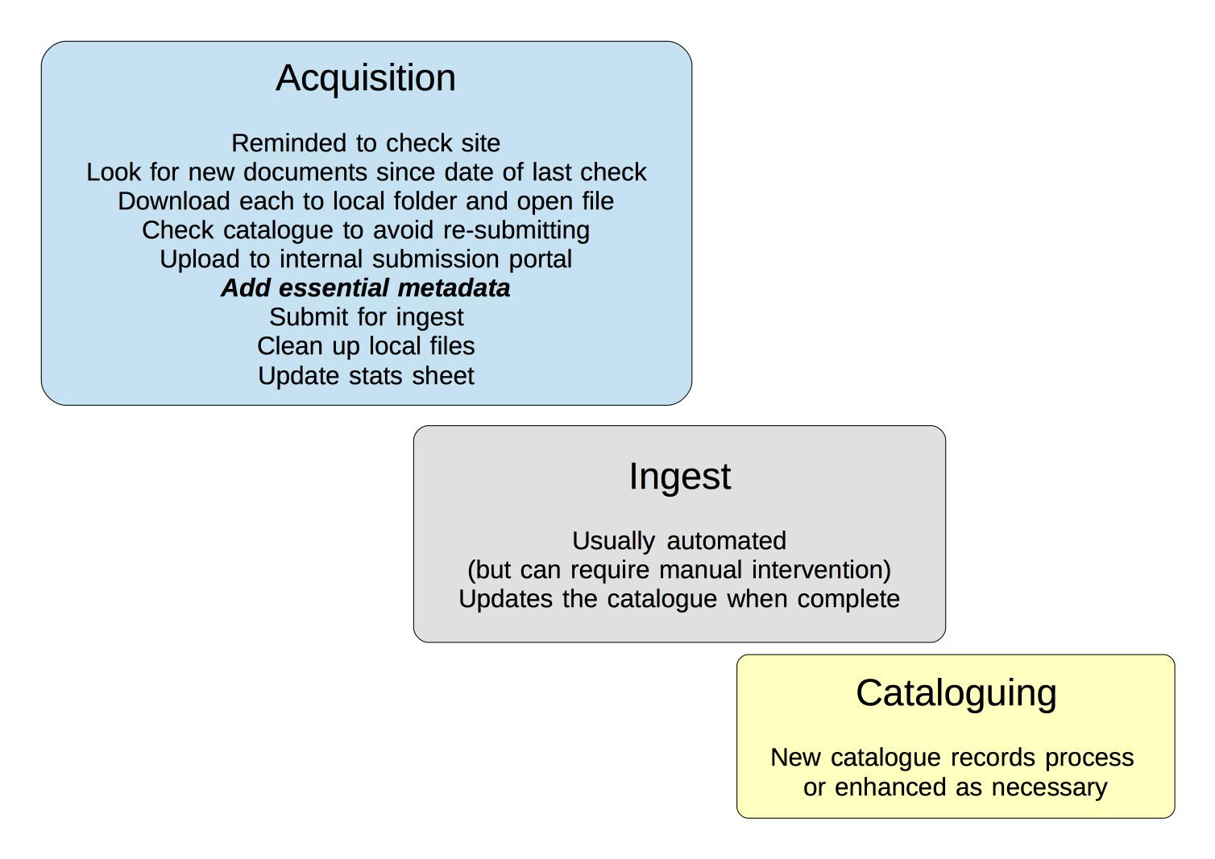
Original Digital Processing Workflow

Slide 4
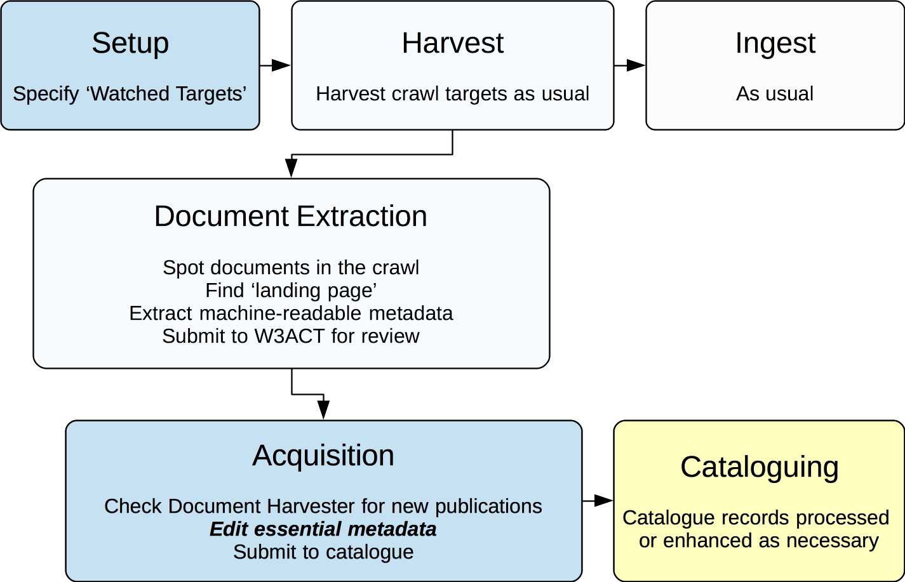
Document Harvester Workflow

Slide 5
What is a Publication?
Print:
A discrete bound volume.
Monograph or serial.
Often identified by ISBN or ISSN etc.
‘Electronic Print’:
Digital version of print volume.
Often identified by ISBN or ISSN etc.
Online:
A set of resources, usually a ‘landing page’ with the e-Print being among them.

Slide 6
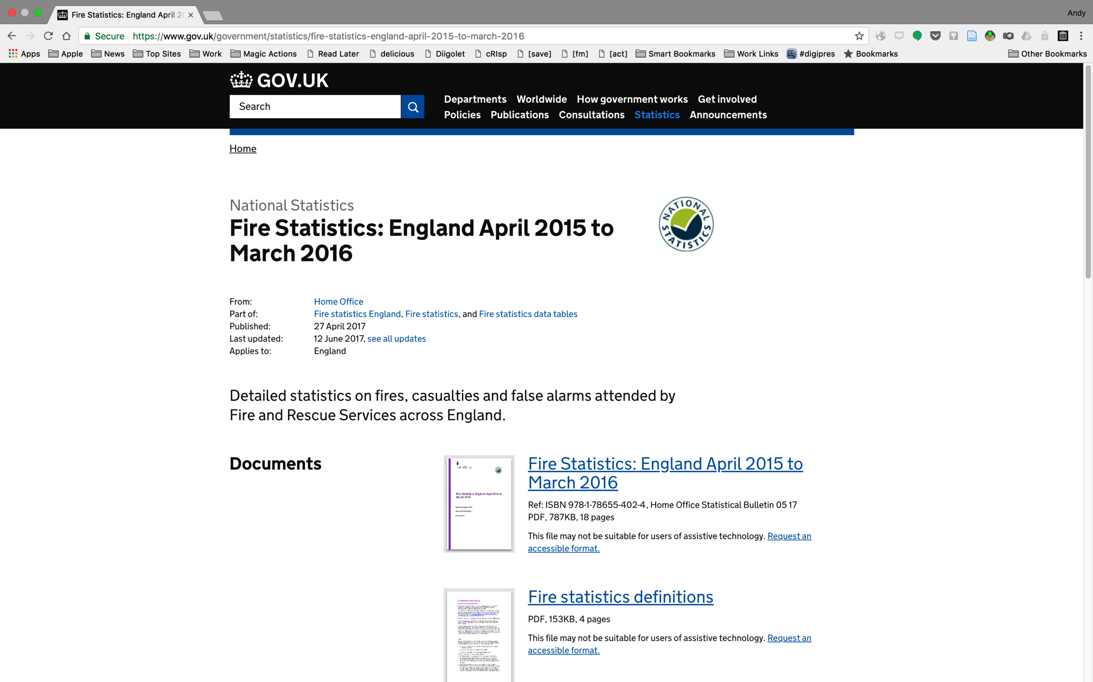
Example gov.uk publication

Slide 7
MARC & Cataloguing Standards
MARC is initially alarming:
For a developer used to current data formats, it’s quite weird to get used to
But really it’s just an encoding
Cataloguing standards are more challenging:
How we use MARC, how we say we use MARC, how we used to use MARC.
The web archive technical team need to understand this better to help resolve ‘What is a Publication?’

Slide 8
Metadata Extraction
Provides an initial ‘guess’ of the catalogue data:
Hoping to save cataloguers’ and curators’ time
Started with embedded metadata from PDFs:
Not generally terribly good for bibliographic data
Adding in metadata ‘scraped’ from HTML landing page:
Better but more difficult to implement
Take advantage of other data sources:
e.g. gov.uk has an publication metadata service

Slide 9
Example gov.uk API Data
... "title": "Fire Statistics: England April 2015 to March 2016”, "public_updated_at": "2017-06-12T14:40:08.000+00:00”, "updated_at": "2017-06-12T14:40:09.666Z", ...
From: https://www.gov.uk/api/content/government/statistics/fire-statistics-england-april-2015-to-march-2016

Slide 10
Resolving References
Multiple use cases for ‘records about this record’:
Publisher metadata
Third-party data sources (e.g. Wikipedia)
Our own annotations and catalogues
Revisit records
Need to bring these records together:
A big ‘JOIN’ based on target URL
Will be a major addition to our technical architecture

Slide 11
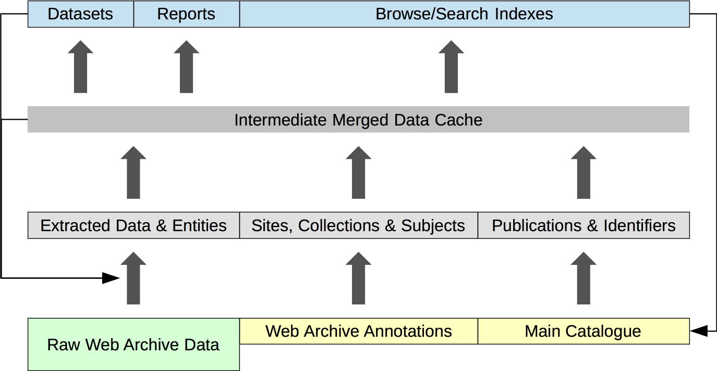
Layers of Transformation

Slide 12
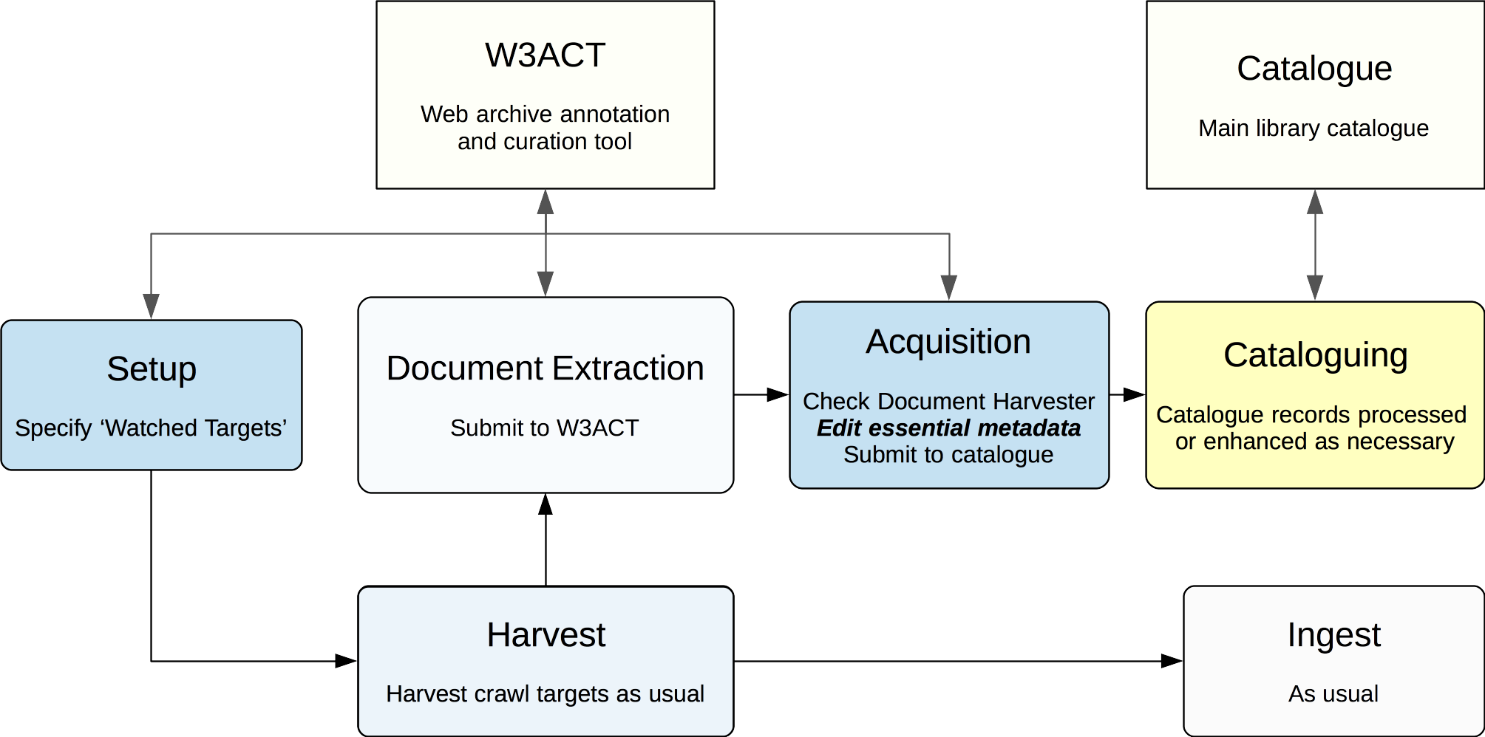
Oh No I Made Another Chain!

Slide 13
Future Experimentation
Multiple workflows brings synchronisation problems:
Need to ensure documents are accessible when discoverable
Need to be able to re-run automated extraction
Iteratively improving automated metadata extraction:
Improve HTML data extraction rules, e.g. Zotero Translators
Bring together different sources
Smarter extractors (Stanford NER, GROBID)
Which publication to catalogue?
Tension between established practice and publisher output
Trial different approaches with cataloguers and users

