Slide 1
Simulated Annealing
Similar to Iterated Local Search
System starts hot and cools as time passes
The search space gradually decreases in size
Better solutions are always accepted, worse solutions accepted depending on temperature

Slide 2
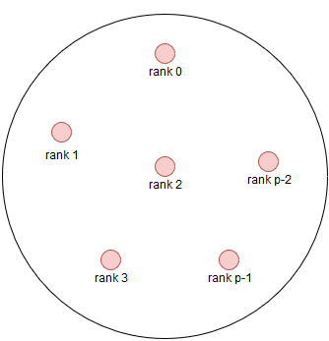
MPI
Ranks scattered throughout search space
Each rank conducts SA search
Communication to avoid overlap
Results merged by master

