Slide 1
LearnMate ai agent
IBM PROJECT
Presented By:
Student name :Anjali pathak
College Name :Makhanlal Chaturvedi National University
Department : computer science

Slide 2
OUTLINE
Problem Statement
Technology used
Wow factor
End users
Result
Conclusion
Git-hub Link
Future scope
IBM Certifications

Slide 3
Problem Statement
Many students struggle to find the right learning path among a flood of online courses. There's no one-size-fits-all roadmap, leading to confusion, wasted time, and incomplete skill development.
Proposed Solution:
LearnMate is an Agentic AI Coach that personalizes learning pathways using student interests, current skill level, and time availability. It adapts weekly based on feedback and progress to ensure a smart, guided learning journey.

Slide 4
Technology used
IBM cloud lite services
Watsonx.ai Studio
IBM Granite 8B Foundation Model
LangGraph Framework
React-based UI
Agent Lab (BETA)

Slide 5
IBM cloud services used
IBM Cloud Watsonx AI Studio
IBM Cloud Watsonx AI runtime
IBM Cloud Agent Lab
IBM Granite foundation model

Slide 6
Wow factors
Personalized Learning Paths
Learners receive weekly roadmaps customized by interest, skill level, and available time.
Structured as beginner → core → advanced → project-based flow.
Agentic AI Behavior
Acts like a supportive mentor, not just a chatbot.
Uses motivational, user-friendly language with a growth mindset.
Smart Skill Assessment
No tests required—assesses experience level via conversation.
Ensures beginners aren't overwhelmed and advanced users aren't bored.

Slide 7
Interactive Learning Experience
Includes mini-quizzes, hands-on coding tasks, and error-handling tips.
Helps users apply knowledge and reinforce understanding.
Real-Time Adaptation
Roadmap changes based on progress, feedback, or topic switch.
User never feels “stuck” or off-track.
Curated, Trusted Resources
Recommends reliable content (YouTube, docs, platforms).
Avoids overwhelming users with too many or unverified links.

Slide 8
End users
👩‍🎓 College & High School Students
👨‍💻 Career Switchers
🧑‍🏫 Educational Institutions
🧑‍🎓 Online Learners in Tech Fields (Frontend, Cybersecurity, etc.)

Slide 9
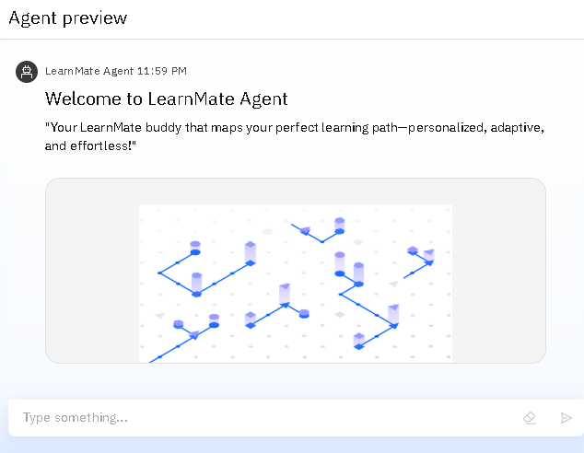
Results
LearnMate Agent offers a warm and engaging welcome, instantly setting the tone for a personalized learning experience. With a clear purpose, adaptive design, and intuitive interface, it acts as a supportive guide from the very first interaction—helping users feel confident, understood, and ready to begin their skill-building journey.

Slide 10
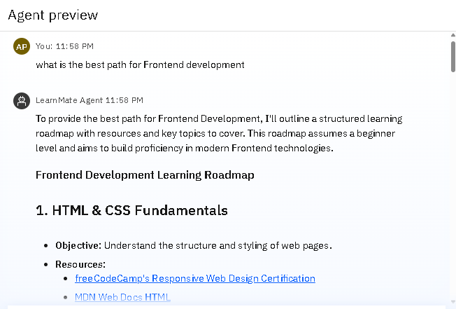
Results
User Input (Natural Query)
The user asks: “What is the best path for Frontend development?”
This is a natural language query, meaning the user can speak freely without needing structured commands.
2. AI Agent Response
The LearnMate agent interprets the query and generates a personalized learning roadmap.
It clearly explains that the roadmap:
Is structured and resource-rich
Assumes a beginner level

Slide 11
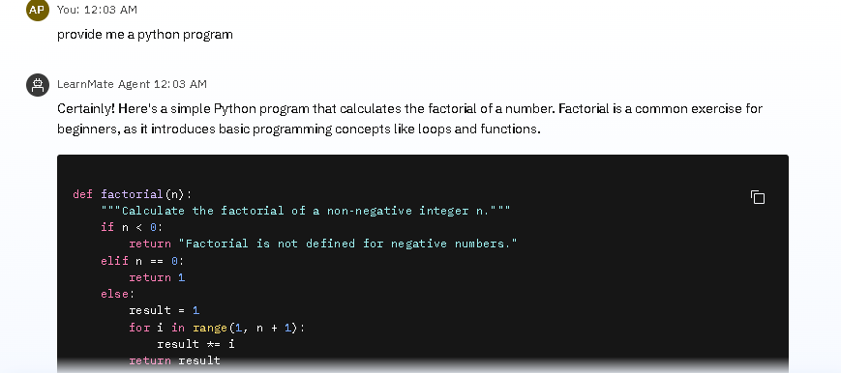
Results

Slide 12
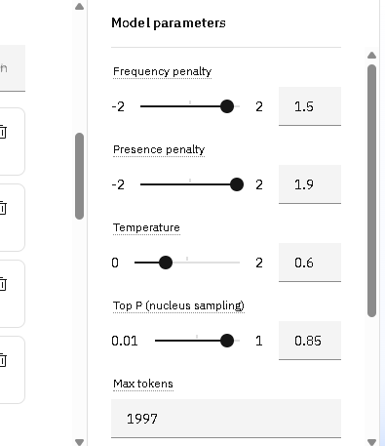
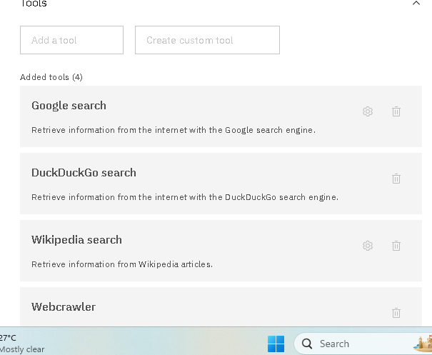
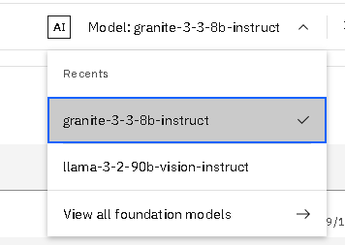
Results

Slide 13
Foundation and tools used
Foundation Model: granite-3-3-8b-instruct
The agent is powered by IBM’s Granite 8B Instruct model, a powerful large language model.
It enables context-aware responses, dynamic roadmap creation, and human-likeraction tailored for learners.
Built for natural language understanding, adaptability, and content generation.
Integrated Tools for Smart Search
Google Search – Retrieves real-time information from Google.
DuckDuckGo Search – Offers privacy-first search-based results.
Wikipedia Search – Extracts topic summaries and definitions from Wikipedia.
Webcrawler – Collects live data from open websites and pages.

Slide 14
Module parameters:
Why These Settings Are Effective for LearnMate
Balanced Creativity: With a moderate temperature (0.6), the agent gives clear, logical answers without being too robotic.
Unique Responses: High penalties (1.5–1.9) prevent boring repetition, ensuring variety in course suggestions and feedback.
Control & Precision: Top P = 0.85 makes outputs both intelligent and reliable—ideal for education use.
Rich, Informative Output: A token limit of 1997 supports detailed learning paths, summaries, and suggestions.

Slide 15
Conclusion
LearnMate builds personalized learning paths based on user interests and goals.It ensures every learner gets the right content at the right time.
▪️ The AI agent adapts dynamically to feedback and progress.This keeps the journey flexible, relevant, and motivating.
▪️ It acts as a smart mentor—guiding, encouraging, and supporting users.Learners stay confident and engaged throughout the process.
▪️ Reduces confusion by recommending only trusted, structured resources.No more course overload or random content exploration.
▪️ Helps users stay on track with weekly plans and learning checkpoints.Boosts productivity, clarity, and long-term learning outcomes.

Slide 16
GitHub Link
GITHUB- https://github.com/anjali-799-path/LearnMate

Slide 17
Future scope
Connect with real LMS like Coursera or YouTube
Dashboard for progress tracking
Voice-enabled interaction for accessibility
Collaborative learning spaces
Skill certificate recommendations after roadmap completion

Slide 18
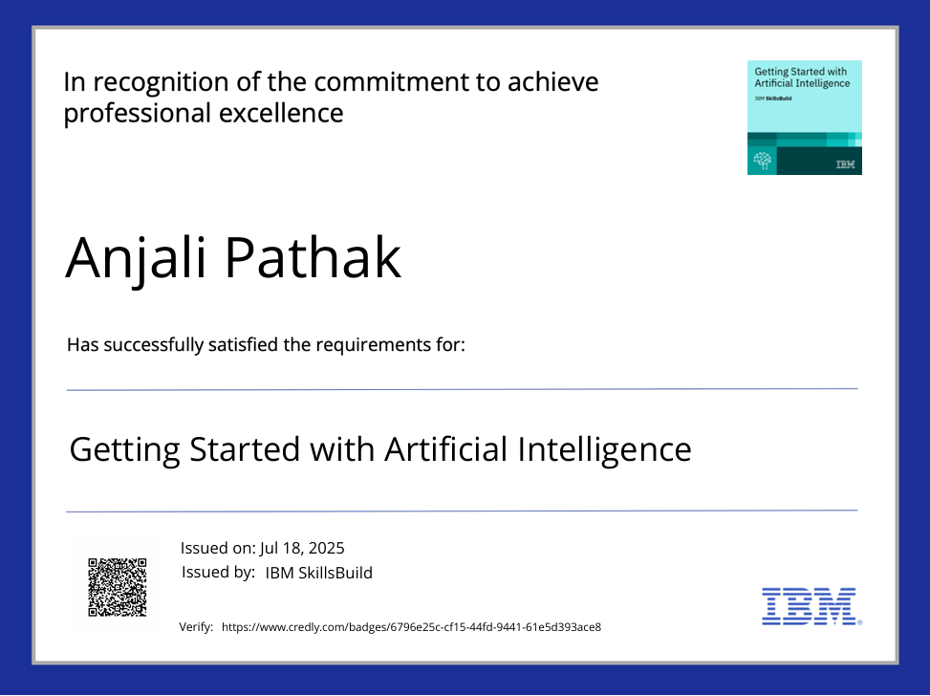
IBM Certifications

Slide 19
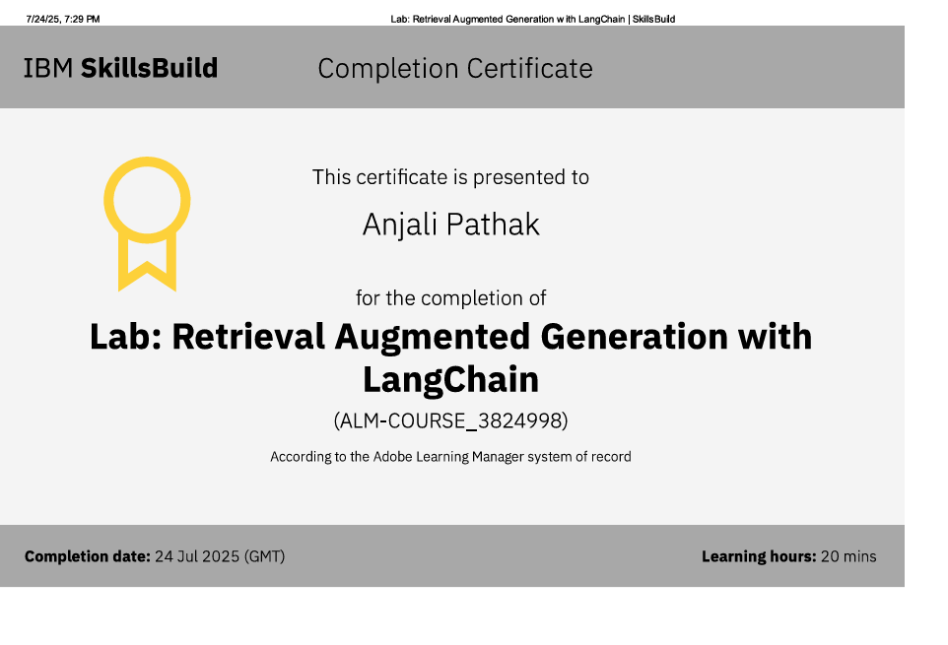

Slide 20
THANK YOU

