Slide 1


Financial News Sentimental Analysis Using NLP and Machine Learning
Batch 3
Team:
Sreenivas
Vincent
Madhu
Mahesh

Slide 2
Table of Contents
Problem Statement
Introduction
Understanding the Data
Data Analytics and Visualization
Model Training and Validation
Future Enhancements
Challenges and Learning
Conclusion

Slide 3
Problem Statement
The financial firm plans to evaluate market sentiment by analyzing both news articles and stock price trends.
The project includes collecting relevant economic data, cleaning and processing it, and employing machine learning models to categorize the sentiment as positive, negative, or neutral.
This sentiment analysis will enable the company to make smarter investment decisions and gain deeper insights into market trends.

Slide 4
Introduction
This project aims to analyze financial sentiment to support the company in making better investment decisions. Sentiment analysis plays a key role in finance, as it helps gauge market emotions, which can impact stock prices and overall financial stability.
The project will involve building a machine learning model to analyze news articles and classify market sentiment as positive, negative, or neutral. The insights gained will guide strategic financial decision-making.

Slide 5
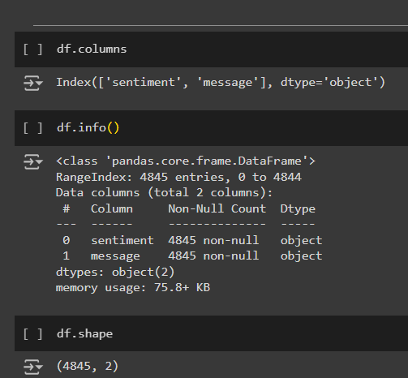
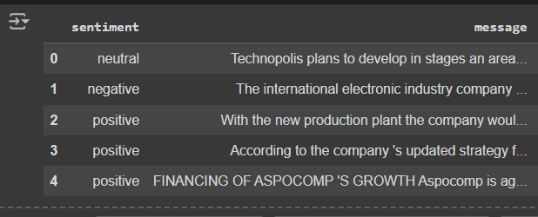
Understanding the Data
The dataset comprises two features: Sentiment and Text, with a total of 4,845 rows and Two columns of Data.
The Text column contains the actual content being analyzed for sentiment. Based on the nature of this text, the sentiment is classified into three categories: Positive, Neutral, and Negative.

Slide 6
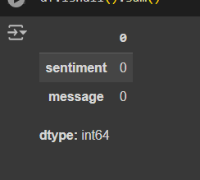
Handling Null Values
There are no Null Values in the dataset

Slide 7
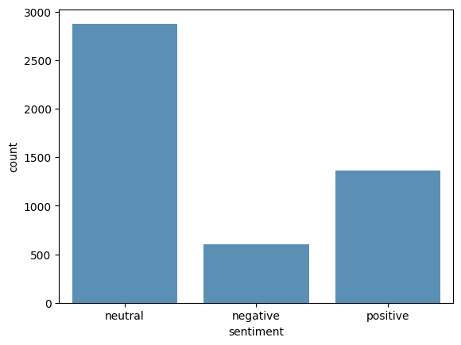
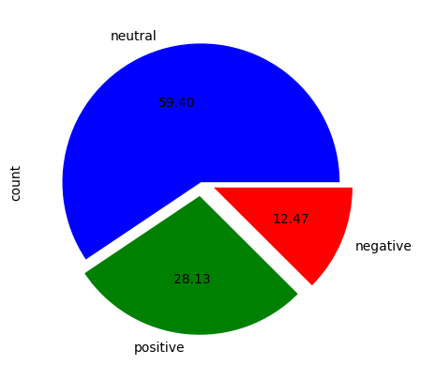
EDA (Exploratory Data Analysis)
The first plot displays the distribution of sentiment data for the messages, showing that neutral sentiments are more prevalent than positive and negative ones.
The second plot illustrates the proportions of positive, negative, and neutral sentiments.

Slide 8
Sentiment Classification
In our analysis of the dataset, we categorized sentiment into three primary classes based on the presence of specific words and phrases in the text:
Positive: Texts that include words such as “increase,” “growth,” “successful,” and “well-received” are classified as positive, indicating favorable outcomes.
Neutral: Texts that contain words like “planning,” “proposed,” and “reported” fall into the neutral category, as these words do not strongly convey favorable or unfavorable outcomes.
Negative: Texts featuring words such as “decline,” “loss,” “layoff,” and “decrease” are classified as negative, reflecting unfavorable outcomes.

Slide 9
Data Analytics and Visualization
Data Cleaning: Eliminating irrelevant or noisy data to enhance model performance.
Removing Unnecessary and Special Characters: Cleaning the text by removing symbols and unwanted characters for clearer analysis.
Lowercasing Text: Standardizing all text to lowercase to ensure uniformity during analysis.
Tokenization: Splitting the text into individual words or tokens for detailed examination.
Removing Stop Words:
Eliminating common words that do not contribute to sentiment.
Lemmatization:
Converting words to their base form to reduce redundancy.
Handling Missing Values:
Addressing any gaps in the data to avoid errors during model training.

Slide 10
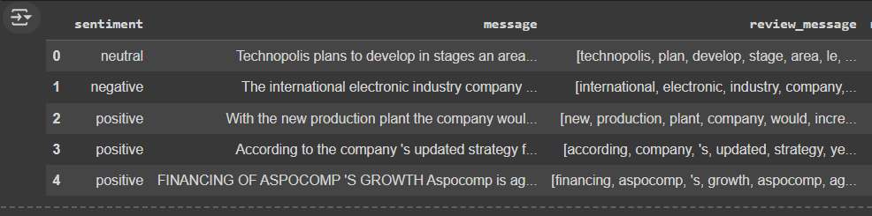
After the process of Data Cleaning

Slide 11
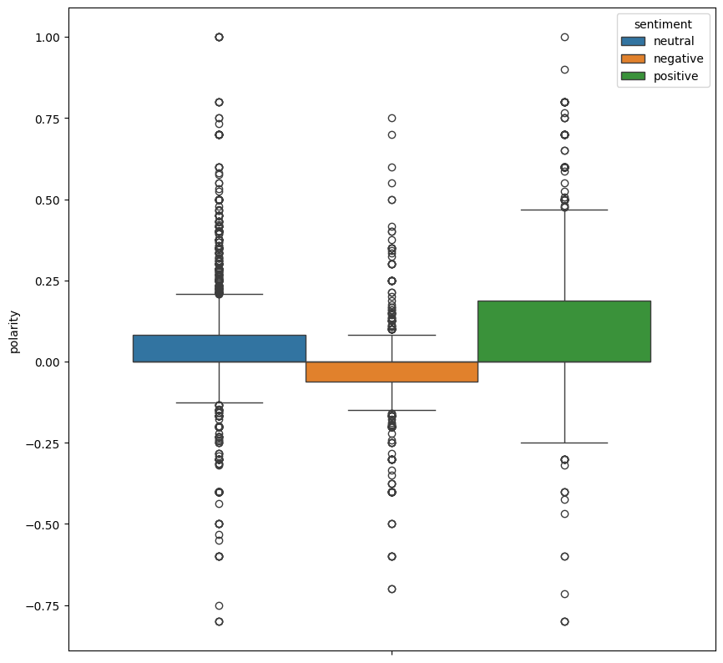
Polarity:
It is the process of determining the overall sentiment of a text, phrase, or word.
Polarity in machine learning refers to the sentiment orientation of a given text, indicating whether the sentiment is positive, negative, or neutral.
Visualizing the Polarity :
Here with respect to Polarity most of the data is neutral and and same kind of data is in positive also that may cause in wrong prediction

Slide 12
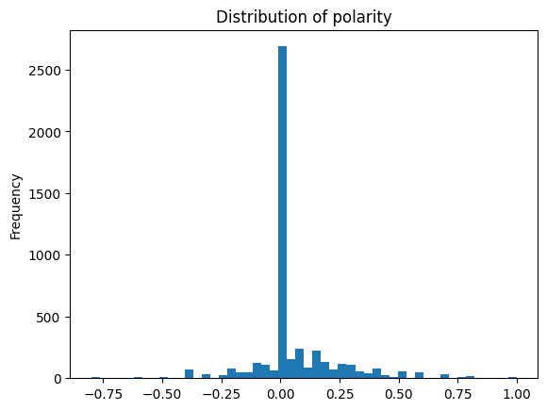
Distribution of Polarity
Here we can see that most of our message sentiment lies in -0.01 to +0.01

Slide 13
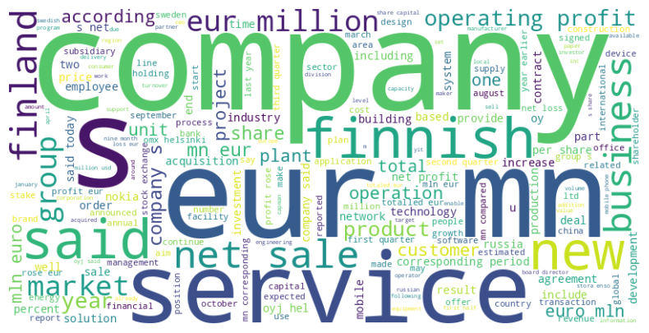
Data visualization
These are the most common words in the Given Message data
Creating word clouds for positive, negative, and neutral sentiments, showcasing the most prominent terms after the removal of stopwords .

Slide 14
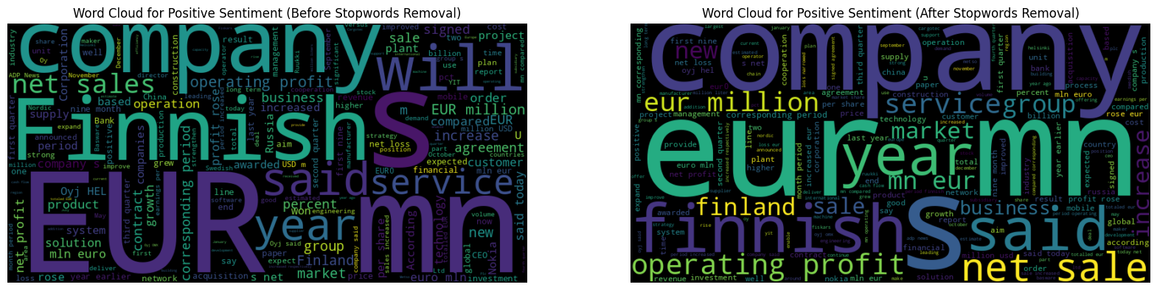
Positive Sentiment Data
Creating word clouds for Positive sentiment Data and showcasing the most prominent terms both before and after the removal of stopwords.

Slide 15
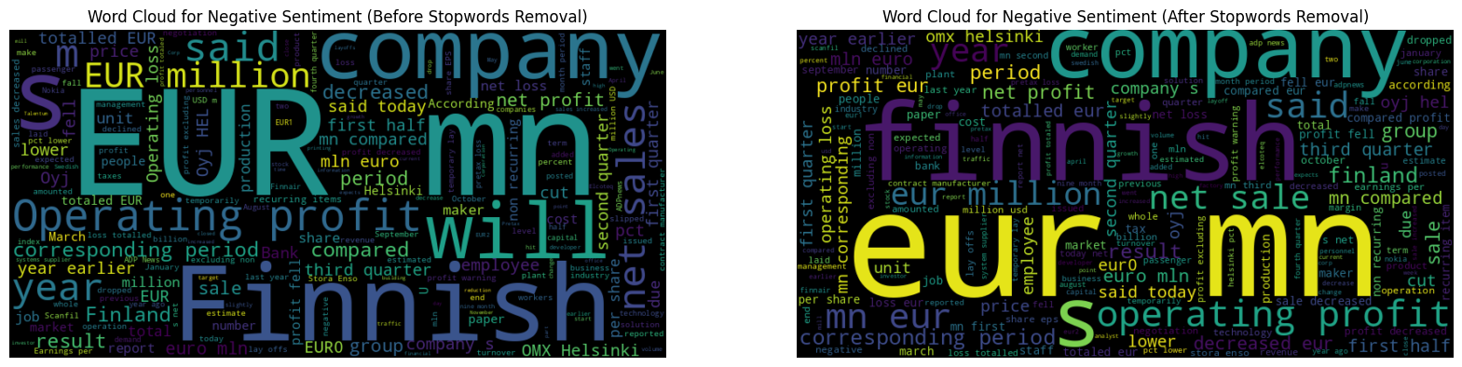
Negative Sentiment Data
Creating word clouds for Negative sentiment Data and showcasing the most prominent terms both before and after the removal of stopwords.

Slide 16
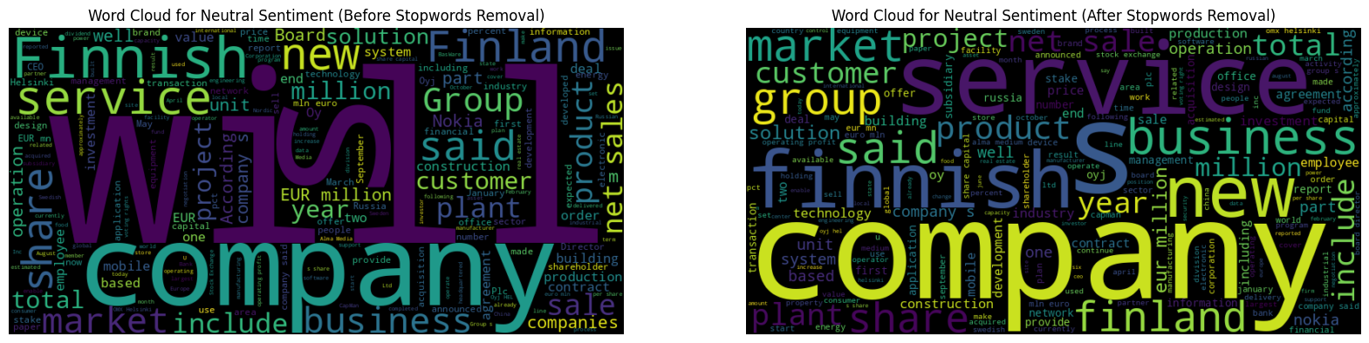
Neutral Sentiment Data
Creating word clouds for Neutral sentiment Data and showcasing the most prominent terms both before and after the removal of stopwords.

Slide 17
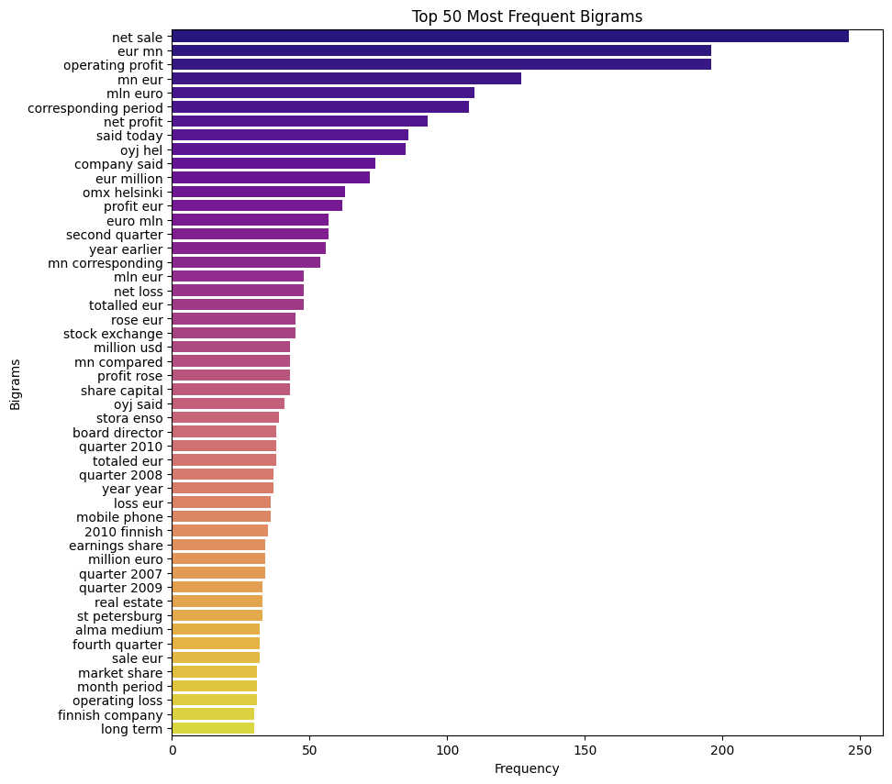
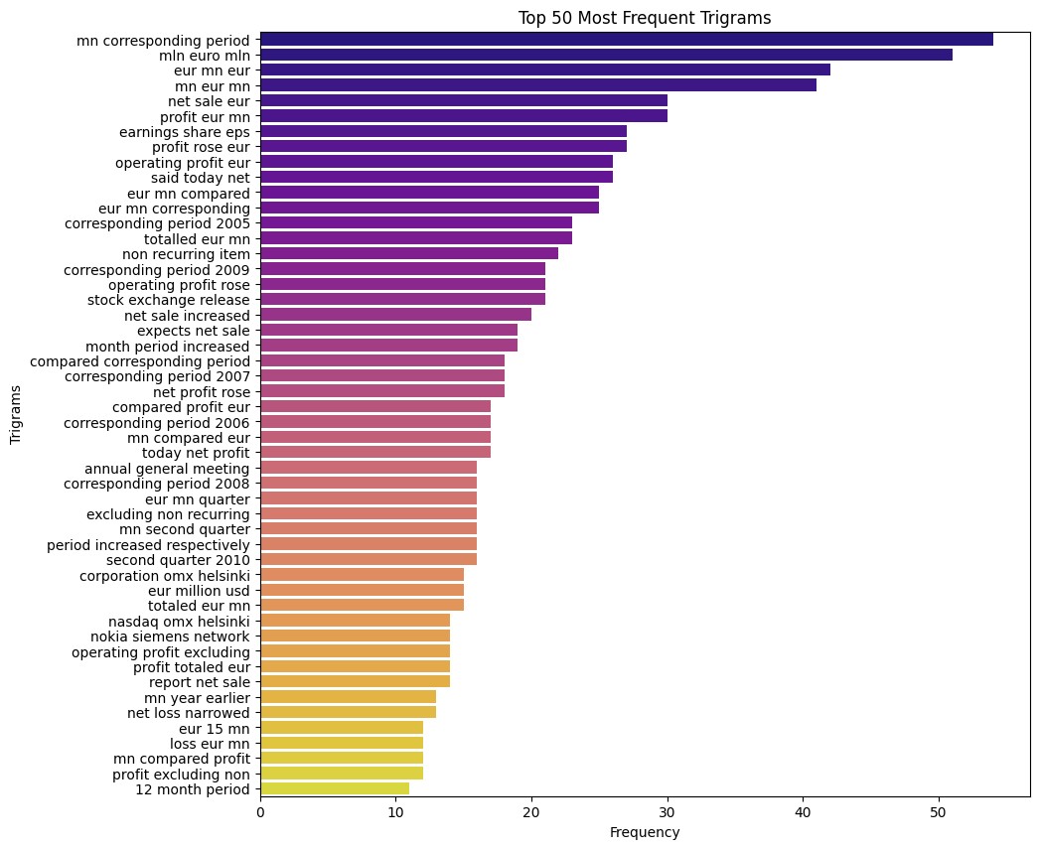
Most common words Bi-gram Visualization
Most common words Tri-gram Visualization

Slide 18
Data preprocessing
Word Embedding
Word Embedding is used to convert text data into numerical representations, enabling machine learning algorithms to process textual information. These techniques help capture word importance, frequency, context, and semantic relationships essential for model training.
1. TF-IDF (Term Frequency-Inverse Document Frequency): Measures the importance of a word in a document relative to the entire corpus. It helps in identifying words that are both frequent and discriminative.
2. Word2Vec (W2V): A neural network-based technique that captures word semantics by representing words in a continuous vector space. It preserves word context and relationships, making it effective for capturing meaning.
3. Doc2Vec (D2V): By training a neural network to predict words in a context given a unique document ID, effectively embedding the entire document into a continuous vector space. This vector captures the semantic meaning of the document, allowing for comparison and analysis across different texts.

Slide 19
Model Training and Validation
Logistic Regression: Demonstrated effectiveness in binary classification, offering clear interpretability and performing reasonably well in distinguishing between sentiment categories.
Random Forest Classifier: A random forest classifier is a collection of many decision trees that work together to improve the accuracy of predictions. It looks at different subsets of data and combines their results to make a final decision, making it more reliable than using just one decision tree.
Support Vector Classifier (SVC): Outperformed other models with its ability to find optimal hyperplanes, providing robust performance in separating positive, negative, and neutral sentiments.

Slide 20
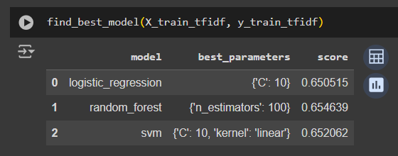
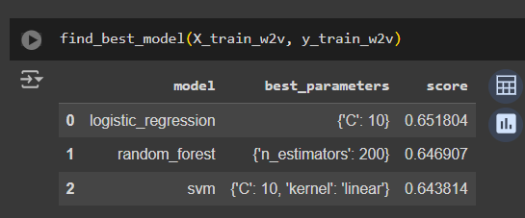
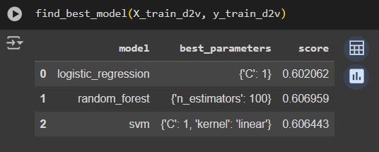
Finding the Best model after vectorization
Tf-idf Vectorization:
Word2Vec Vectorization:
Doc2VecVectorization:

Slide 21
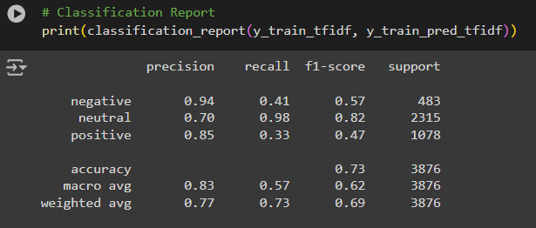
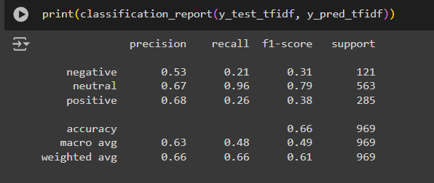
Classification Report:
For Training Data:
For Testing Data:

Slide 22
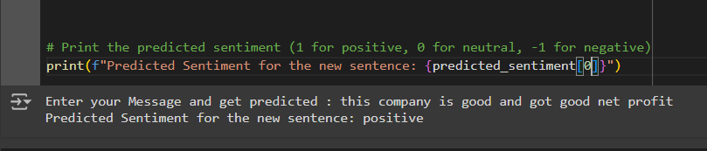
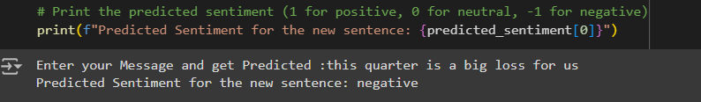
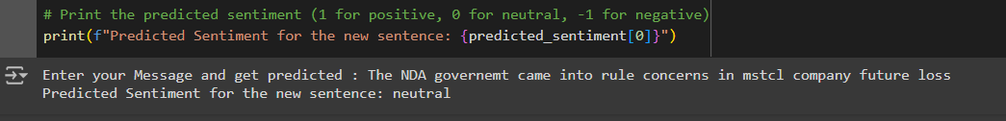
Validation:

Slide 23
Challenges and Learning
Model Generalization: Ensuring the model performs well across diverse scenarios and is not overfitted to the training data.
Changing Financial Environments: Adapting to shifts in the financial market and regulatory environments that could affect the Message criteria.

Slide 24
Conclusion
In this financial sentiment analysis, we used TF-IDF vectorization to convert text data into numerical values that highlight the significance of words based on their frequency. By applying a Random Forest classifier, we effectively classified sentiments as positive, negative, or neutral.
This method improves our understanding of market sentiment and provides stakeholders with useful insights for better investment decisions. Overall, combining TF-IDF with Random Forest proves to be a strong approach for analyzing financial sentiments and predicting market trends.

Slide 25
Thank you

