Slide 1
Important Insights Gained Using EDA (Exploratory Data Analysis)

Slide 2
Interesting Insights That Are Not Related to the Target Variable
01
02
03
04
Relation between job of client and level of Education
Relation between personal loans and job of client
Relation between housing loans and job of client
Relation between credit in default and personal loans
05
Relation between marital status and housing loan

Slide 3
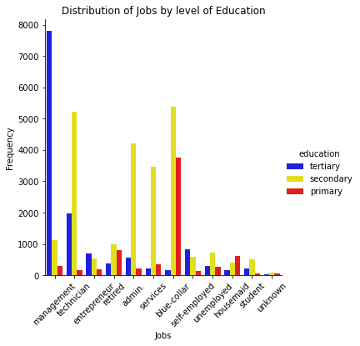
01
How Jobs Vary According to level of Education of the Clients
#Clients in management and self-employed clients have highest count in tertiary education. Clients in management often require a masters degree which is justified by their highest count in tertiary education.
#Wheresas clients with blue collar jobs and housemaids mostly have primary to secondary education only
#Lot fewer clients tend to have tertiary education, whereas most clients have secondary level of education

Slide 4
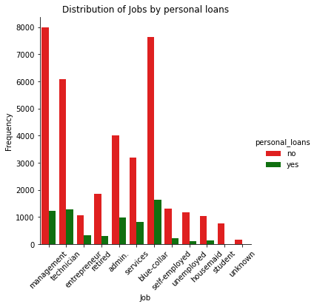
02
How Personal Loans vary with Jobs of Clients
#It turns out that proportionally, entrepreneurs or clients in service-sectors take highest amounts of personal loans. This makes sense since they need funding to start their business.
#Students and housemaids take the least amount of personal loans.

Slide 5
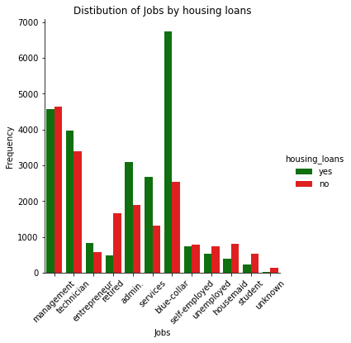
03
How Housing Loans vary with Jobs of Clients
#It turns out that people with blue-collar jobs have the most housing loans. This could be since they have a lesser pay.
#Students, housemaids and retired clients have least housing loans. This also makes sense since without a job it becomes difficult to take loans.

Slide 6
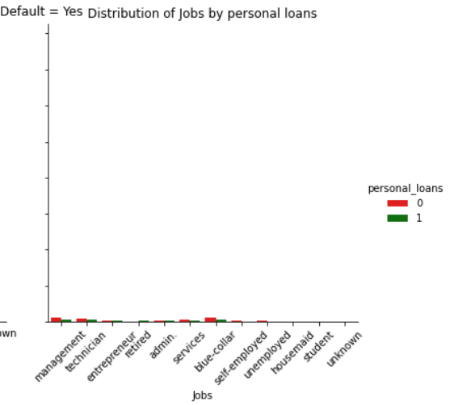
04
How Credit in Default is related to Loans
#It's notable that clients who have credit in default don't tend to have/get personal loans.

Slide 7
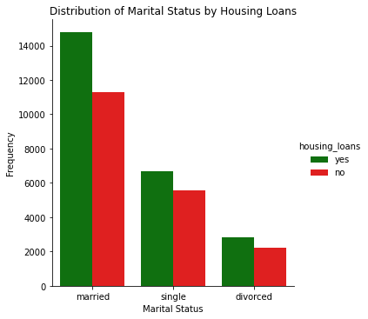
05
How Housing Loans vary with Marital Status
#It's interesting to note how married clients tend to have a higher number of housing loans as compared to single or divorced clients since they are starting a family and would likely take up a loan for a house.

Slide 8
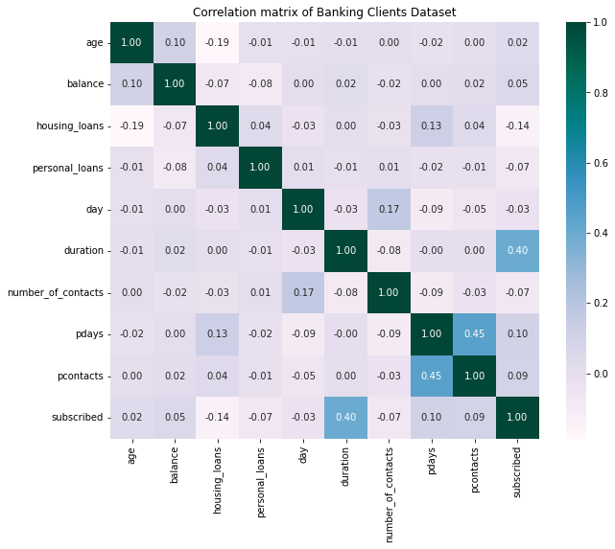
—Some Insights Not Related To the Target Variable
Let’s look at the Correlation Matrix, to gain other useful insights:
1. A weak negative correlation of -0.19 between age and housing loans shows that more is the age of the client, lesser are the housing loans taken which makes sense.
2. More are the loans taken- housing or personal, lesser is the balance of the client, this is suggested by a negative correlation.

Slide 9
Important Insights Related to the Target Variable
1. A moderate positive correlation(0.4) between Duration and Subscribed shows that higher is the duration of the call, more are the chances of subscription by the client. Thus longer calls tend to be more effective.
2. A weak negative correlation shows that clients with a personal loan don't tend to subscribe to a term deposit.

Slide 10
Important Insights Related to the Target Variable
3. A weak correlation exists but it is positive nonetheless and shows that higher is the number of contact in previous campaigns, greater are the chances of successful subscription to term deposit. This might be because the client forms a relationship with you and gains confidence that the company will deliver good results.
4. A weak negative correlation shows that a lot of phone calls or contacts with the same client in the same campaign is futile.

Slide 11
Important Insights Related to the Target Variable
5. A weak positive correlation between Pdays and Subscribed, suggests if more days have passed since previous contact the client is likely to subscribe. This could be because the term of the client is likely to have ended in the interval and the client might be looking for another term deposit.

Slide 12
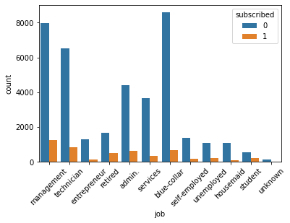
How Jobs of Clients are Related to them Subscribing
1. Clients in management, students or retired clients tend to subscribe to term deposits.
2. When we look at the approximate proportion, we find the following: management: 0.34, technician: 0.1,
entrepreneur:0.05, retired:0.27
,admin: 0.13, services: 0.08,
blue-collar: 0.083
,self-employed: 0.09
,housemaid- 0.14...

Slide 13
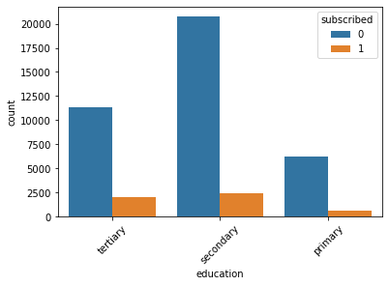
How Education Level of Clients is Related to them Subscribing
1. By proportion, clients with Tertiary Level of Education are more aware and tend to subscribe to a term deposit.

Slide 14
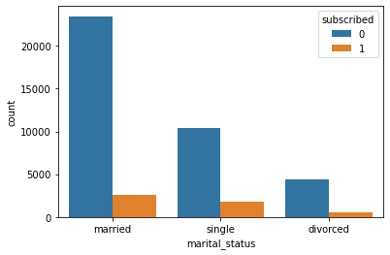
How Marital Status of Clients is related to them Subscribing
Married couples should ideally subscribe more to generate more money for their family but when we look at the approximate proportion, we find the following: married: 11.1%, single: 17%, divorced:13%
2. Thus single clients tend to subscribe more.

Slide 15
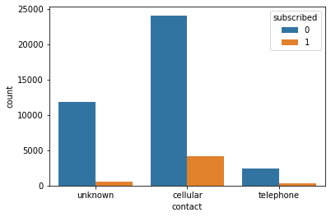
How Method of Communication used to Contact Clients is Related to them Subscribing
We see the following proportions: cellular: 17%, telephone: 14%. Thus people contacted on cell phones tend to subscribe more compared to people contacted on telephones.

Slide 16
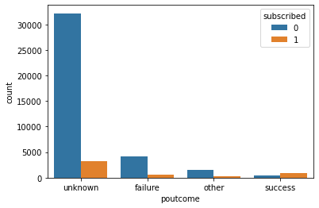
How Success or Failure in the Previous Campaign is Related to them Subscribing
From the graph, it is noticeable that success in previous campaigns tends to have a successful subscription in the current campaign whereas failure in the previous campaign doesn’t lead to a successful subscription in the current campaign.

Slide 17
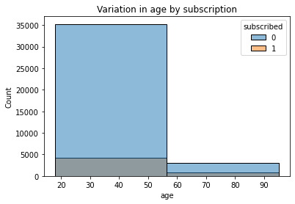
How Variation in Age is related to them Subscribing
Thus from the graph it is clearly visible that old clients above the age of 55-60 tend to subscribe way more than younger clients.

