Slide 1



Structured
Query
Language (Part-4)
Courtesy:
Anjali Jivani
Oracle manuals
https://www.guru99.com
https://www.javatpoint.com
https://www.tutorialspoint.com

Slide 2
Synonym
A SYNONYM is an object of the database like a table and an index
It is created to give different names to the same table
Unlike alias in which the new name exists only for a particular query, synonyms are stored in the data dictionary
The RENAME command changes the original name to a new name
The SYNONYM command maintains the original and creates an extra name
create synonym employee for emp;
create synonym e for emp;
The emp table has two more names now, employee and e
The original name of the table also remains as it is
You can use the synonym instead of the original name for any DDL, DML, DCL, etc. against the table
To remove a synonym,
drop synonym e;

Slide 3
Some Data Dictionary Tables…
Oracle has a very powerful Data Dictionary which stores the metadata
Metadata is data about data
All metadata is stored in tables only
Some useful Data Dictionary tables are:
The USER_CONSTRAINTS table:
This table stores details about all the constraints created on tables
select table_name, constraint_name, constraint_type, search_condition
from user_constraints;
TABLE_NAME | CONSTRAINT_NAME | CONSTRAINT_TYPE | SEARCH_CONDITION
EMP | FK_DEPTNO | R | -
EMP | CK_SAL | C | sal>0
DEPT | PK_DEPT | P | -
EMP | PK_EMP | P | -

Slide 4
Some Data Dictionary Tables…
select table_name, constraint_name, constraint_type, search_condition
from user_constraints
where table_name = ‘EMP’; (Table name is always stored in uppercase)
TABLE_NAME | CONSTRAINT_NAME | CONSTRAINT_TYPE | SEARCH_CONDITION
EMP | CK_SAL | C | sal>0
EMP | PK_EMP | P | -
EMP | FK_DEPTNO | R | -
The TAB table:
select * from tab; (Displays all table names, table type)
The TABS table:
select * from tabs; (Displays all table names and the storage/space
related information)

Slide 5
The USER_INDEXES table:
Stores information about all indexes created
select * from user_indexes; (Displays details of indexes)
select INDEX_NAME, TABLE_NAME, UNIQUENESS from user_indexes;
INDEX_NAME | TABLE_NAME | UNIQUENESS
IDNAME | DEPT | UNIQUE
ISAL | EMP | NONUNIQUE
PK_DEPT | DEPT | UNIQUE
PK_EMP | EMP | UNIQUE
select INDEX_NAME, TABLE_NAME, UNIQUENESS from user_indexes
where table_name = 'DEPT';
INDEX_NAME | TABLE_NAME | UNIQUENESS
IDNAME | DEPT | UNIQUE
PK_DEPT | DEPT | UNIQUE

Slide 6
SET operators
There are three SET operators which can be used in SQL queries
UNION / UNION ALL
INTERSECT
MINUS
To use a SET operator, certain rules are to be followed which is called SET compatibility:
e.g.
select * from emp1
union
select * from emp2
The datatypes of columns in both the select queries should match
The total number of columns should also match

Slide 7
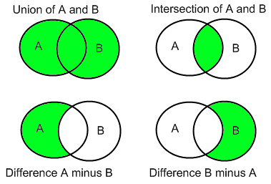
SET operators

Slide 8
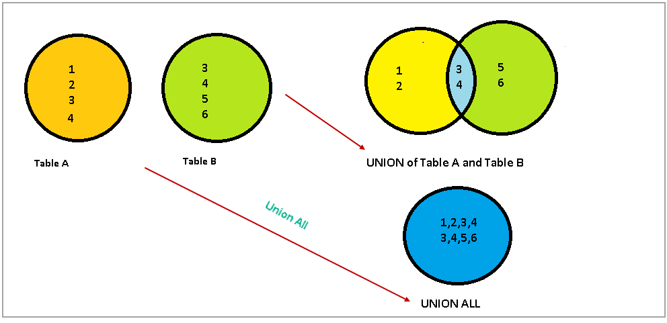
UNION and UNION ALL

Slide 9
SET operators
create table emp1 as select * from emp where sal >= 1500; (8 rows)
create table emp2 as select * from emp where deptno = 20; (5 rows)
EMPNO | ENAME | JOB | MGR | HIREDATE | SAL | COMM | DEPTNO
7839 | KING | PRESIDENT | - | 17-NOV-81 | 5000 | - | 10
7698 | BLAKE | MANAGER | 7839 | 01-MAY-81 | 2850 | - | 30
7782 | CLARK | MANAGER | 7839 | 09-JUN-81 | 2450 | - | 10
7566 | JONES | MANAGER | 7839 | 02-APR-81 | 2975 | - | 20
7788 | SCOTT | ANALYST | 7566 | 19-APR-87 | 3000 | - | 20
7902 | FORD | ANALYST | 7566 | 03-DEC-81 | 3000 | - | 20
7499 | ALLEN | SALESMAN | 7698 | 20-FEB-81 | 1600 | 300 | 30
7844 | TURNER | SALESMAN | 7698 | 08-SEP-81 | 1500 | 0 | 30
EMPNO | ENAME | JOB | MGR | HIREDATE | SAL | COMM | DEPTNO
7566 | JONES | MANAGER | 7839 | 02-APR-81 | 2975 | - | 20
7788 | SCOTT | ANALYST | 7566 | 19-APR-87 | 3000 | - | 20
7902 | FORD | ANALYST | 7566 | 03-DEC-81 | 3000 | - | 20
7369 | SMITH | CLERK | 7902 | 17-DEC-80 | 800 | - | 20
7876 | ADAMS | CLERK | 7788 | 23-MAY-87 | 1100 | - | 20

Slide 10
UNION
Rows which are in table emp1 or emp2 or both (basically rows from both tables – distinct rows)
(common rows)
select * from emp1
union
select * from emp2;
EMPNO | ENAME | JOB | MGR | HIREDATE | SAL | COMM | DEPTNO
7839 | KING | PRESIDENT | - | 17-NOV-81 | 5000 | - | 10
7698 | BLAKE | MANAGER | 7839 | 01-MAY-81 | 2850 | - | 30
7782 | CLARK | MANAGER | 7839 | 09-JUN-81 | 2450 | - | 10
7566 | JONES | MANAGER | 7839 | 02-APR-81 | 2975 | - | 20
7788 | SCOTT | ANALYST | 7566 | 19-APR-87 | 3000 | - | 20
7902 | FORD | ANALYST | 7566 | 03-DEC-81 | 3000 | - | 20
7499 | ALLEN | SALESMAN | 7698 | 20-FEB-81 | 1600 | 300 | 30
7844 | TURNER | SALESMAN | 7698 | 08-SEP-81 | 1500 | 0 | 30
EMPNO | ENAME | JOB | MGR | HIREDATE | SAL | COMM | DEPTNO
7566 | JONES | MANAGER | 7839 | 02-APR-81 | 2975 | - | 20
7788 | SCOTT | ANALYST | 7566 | 19-APR-87 | 3000 | - | 20
7902 | FORD | ANALYST | 7566 | 03-DEC-81 | 3000 | - | 20
7369 | SMITH | CLERK | 7902 | 17-DEC-80 | 800 | - | 20
7876 | ADAMS | CLERK | 7788 | 23-MAY-87 | 1100 | - | 20

Slide 11
UNION
select * from emp1
union
select * from emp2;
Total 10 rows
EMPNO | ENAME | JOB | MGR | HIREDATE | SAL | COMM | DEPTNO
7369 | SMITH | CLERK | 7902 | 17-DEC-80 | 800 | - | 20
7499 | ALLEN | SALESMAN | 7698 | 20-FEB-81 | 1600 | 300 | 30
7566 | JONES | MANAGER | 7839 | 02-APR-81 | 2975 | - | 20
7698 | BLAKE | MANAGER | 7839 | 01-MAY-81 | 2850 | - | 30
7782 | CLARK | MANAGER | 7839 | 09-JUN-81 | 2450 | - | 10
7788 | SCOTT | ANALYST | 7566 | 19-APR-87 | 3000 | - | 20
7839 | KING | PRESIDENT | - | 17-NOV-81 | 5000 | - | 10
7844 | TURNER | SALESMAN | 7698 | 08-SEP-81 | 1500 | 0 | 30
7876 | ADAMS | CLERK | 7788 | 23-MAY-87 | 1100 | - | 20
7902 | FORD | ANALYST | 7566 | 03-DEC-81 | 3000 | - | 20

Slide 12
UNION ALL
Rows which are in table emp1 or table emp2 or both (basically rows from both tables and include the duplicates also i.e. all rows of both tables)
select * from emp1
union all
select * from emp2;
EMPNO | ENAME | JOB | MGR | HIREDATE | SAL | COMM | DEPTNO
7839 | KING | PRESIDENT | - | 17-NOV-81 | 5000 | - | 10
7698 | BLAKE | MANAGER | 7839 | 01-MAY-81 | 2850 | - | 30
7782 | CLARK | MANAGER | 7839 | 09-JUN-81 | 2450 | - | 10
7566 | JONES | MANAGER | 7839 | 02-APR-81 | 2975 | - | 20
7788 | SCOTT | ANALYST | 7566 | 19-APR-87 | 3000 | - | 20
7902 | FORD | ANALYST | 7566 | 03-DEC-81 | 3000 | - | 20
7499 | ALLEN | SALESMAN | 7698 | 20-FEB-81 | 1600 | 300 | 30
7844 | TURNER | SALESMAN | 7698 | 08-SEP-81 | 1500 | 0 | 30
EMPNO | ENAME | JOB | MGR | HIREDATE | SAL | COMM | DEPTNO
7566 | JONES | MANAGER | 7839 | 02-APR-81 | 2975 | - | 20
7788 | SCOTT | ANALYST | 7566 | 19-APR-87 | 3000 | - | 20
7902 | FORD | ANALYST | 7566 | 03-DEC-81 | 3000 | - | 20
7369 | SMITH | CLERK | 7902 | 17-DEC-80 | 800 | - | 20
7876 | ADAMS | CLERK | 7788 | 23-MAY-87 | 1100 | - | 20

Slide 13
UNION
select * from emp1 (8 rows)
union all
select * from emp2; (5 rows)
Total rows: 13
EMPNO | ENAME | JOB | MGR | HIREDATE | SAL | COMM | DEPTNO
7839 | KING | PRESIDENT | - | 17-NOV-81 | 5000 | - | 10
7698 | BLAKE | MANAGER | 7839 | 01-MAY-81 | 2850 | - | 30
7782 | CLARK | MANAGER | 7839 | 09-JUN-81 | 2450 | - | 10
7566 | JONES | MANAGER | 7839 | 02-APR-81 | 2975 | - | 20
7788 | SCOTT | ANALYST | 7566 | 19-APR-87 | 3000 | - | 20
7902 | FORD | ANALYST | 7566 | 03-DEC-81 | 3000 | - | 20
7499 | ALLEN | SALESMAN | 7698 | 20-FEB-81 | 1600 | 300 | 30
7844 | TURNER | SALESMAN | 7698 | 08-SEP-81 | 1500 | 0 | 30
7566 | JONES | MANAGER | 7839 | 02-APR-81 | 2975 | - | 20
7788 | SCOTT | ANALYST | 7566 | 19-APR-87 | 3000 | - | 20
7902 | FORD | ANALYST | 7566 | 03-DEC-81 | 3000 | - | 20
7369 | SMITH | CLERK | 7902 | 17-DEC-80 | 800 | - | 20
7876 | ADAMS | CLERK | 7788 | 23-MAY-87 | 1100 | - | 20

Slide 14
INTERSECT (EXCEPT)
select * from emp1
intersect
select * from emp2;
Rows which are in table emp1 AND IN table emp2 (basically common rows from both tables)
EMPNO | ENAME | JOB | MGR | HIREDATE | SAL | COMM | DEPTNO
7566 | JONES | MANAGER | 7839 | 02-APR-81 | 2975 | - | 20
7788 | SCOTT | ANALYST | 7566 | 19-APR-87 | 3000 | - | 20
7902 | FORD | ANALYST | 7566 | 03-DEC-81 | 3000 | - | 20

Slide 15
MINUS (EMP1 – EMP2)
select * from emp1
minus
select * from emp2;
Rows which are in table emp1 BUT NOT IN table emp2
EMPNO | ENAME | JOB | MGR | HIREDATE | SAL | COMM | DEPTNO
7499 | ALLEN | SALESMAN | 7698 | 20-FEB-81 | 1600 | 300 | 30
7698 | BLAKE | MANAGER | 7839 | 01-MAY-81 | 2850 | - | 30
7782 | CLARK | MANAGER | 7839 | 09-JUN-81 | 2450 | - | 10
7839 | KING | PRESIDENT | - | 17-NOV-81 | 5000 | - | 10
7844 | TURNER | SALESMAN | 7698 | 08-SEP-81 | 1500 | 0 | 30

Slide 16
MINUS (EMP2 – EMP1)
select * from emp2
minus
select * from emp1;
Rows which are in table emp2 BUT NOT IN table emp1
EMPNO | ENAME | JOB | MGR | HIREDATE | SAL | COMM | DEPTNO
7369 | SMITH | CLERK | 7902 | 17-DEC-80 | 800 | - | 20
7876 | ADAMS | CLERK | 7788 | 23-MAY-87 | 1100 | - | 20

Slide 17
Display deptnos of departments where no employees are working
select deptno from dept
minus
select distinct(deptno) from emp (may or may not use distinct)
DEPTNO
40
50
Display details of departments where no employees are working
select * from dept
where deptno in
(select deptno from dept
minus
select distinct(deptno)from emp)
DEPTNO | DNAME | LOC
40 | OPERATIONS | BOSTON
50 | ADMIN | CHICAGO

Slide 18

VIEWS
Views are also called VIRTUAL TABLES
They are created by selecting columns and rows from existing tables
Only the definition of a view is stored in the data dictionary, it does not actually exist as a separate table
A view is like looking at the table(s) on which it is created from a different angle and thinking about it as an actual table
To reduce REDUNDANT DATA to the minimum possible, Oracle allows the creation of an object called a VIEW
For e.g. two different users may require information from the same table but all the columns/rows that they are going to use may not be the same. In such cases two views on the table could be created.
Notes:
https://tutorialink.com/dbms/views.dbms
Database views
A database view is a subset of a database and is based on a query that runs on one or more database tables. Database views are saved in the database as named queries and can be used to save frequently used, complex queries.
There are two types of database views: dynamic views and static views. Dynamic views can contain data from one or two tables and automatically include all of the columns from the specified table or tables. Dynamic views are automatically updated when related objects or extended objects are created or changed. Static views can contain data from multiple tables and the required columns from these tables must be specified in the SELECT and WHERE clauses of the static view. Static views must be manually updated when related objects or extended objects are created or changed.
When you create a dynamic view with data from two tables, you must ensure that both tables have the same PRIMARYKEYCOLSEQ columns or contain unique indexes with the same column name in the same order.

Slide 19
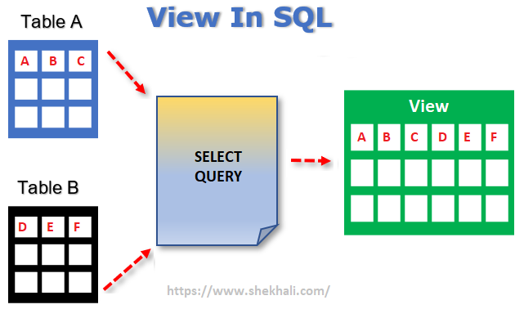

Slide 20
EMP table
DEPT table
EMPNO | ENAME | JOB | MGR | HIREDATE | SAL | COMM | DEPTNO
DEPTNO | DNAME | LOC
V1 View (empno,ename,job,sal,deptno)
and sal > 2500
V2 View (empno,sal,deptno,dname)
EMPNO | ENAME | JOB | SAL | DEPTNO
EMPNO | SAL | DEPTNO | DNAME
The following are the main advantages of the view:
Views are usually virtual and do not occupy space in systems.
Views enable us to hide some of the columns/rows from the table.
It simplifies complex queries because it can draw data from multiple tables and present it as a single table.
It helps in data security that shows only authorized information to the users.

Slide 21
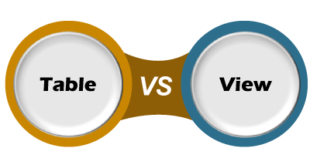
No. | Table | View
1. | A table is used to organize data in the form of rows and columns and displayed them in a structured format. | Views are treated as a virtual/logical table used to view or manipulate parts of the table. It is a database object that contains rows and columns which are the same as real tables.
2. | Table is a physical entity that means data is actually stored in the table. | The view is a virtual entity, which means data is not actually stored in the table.
3. | It is used to store the data. | It is used to extract data from the table.
4. | It generates a fast result. | The view generates a slow result because it renders the information from the table every time we query it.
5. | It is an independent data object. | It depends on the table. Therefore we cannot create a view without using tables.
6. | Table allows us to perform DML operations. | The view may or may not allow DML operations.
7. | It is not an easy task to replace the table directly because of its physical storage. | It is an easy task to replace the view and recreate it whenever needed.
8. | It occupies space on the systems. | It does not occupy space on the systems.

Slide 22
VIEWS
TYPES OF VIEWS
Simple View | Created on a single table and does not have group functions/GROUP BY
Complex View | Created on multiple tables Contains group functions/GROUP BY
Updatable View | A view which allows DMLs
Non-updatable View | A read-only view
Inline View | It is based on a subquery in FROM clause and that subquery creates a temporary table
Materialized View | A view that stores the definition as well as the data i.e. data is replicated. Normally used in Data Warehouses.
Except Materialized, the rest are all dynamic views i.e. the content in the views change as the content of the base table on which they are created change.
Notes:
** STATIC views are of three types:
DBA
ALL
USER

Slide 23
VIEWS
Syntax of views: (SIMPLE VIEWS)
create or replace view vtemp1 as (‘or replace’ is optional)
select empno, ename, sal, comm, deptno
from emp;
create or replace view vtemp2 (vno, vname, vsal, vcomm, vdeptno) as
select empno, ename, sal, comm, deptno
from emp;
In the view vtemp2, the column names have been changed
create or replace view vtemp3 as
select *
from vtemp2;
View created on a view
Consider the views as normal tables and apply any SELECTs
DMLS can be applied on updatable views

Slide 24
VIEWS
Create a view which has all the columns of emp table but only those rows where designation is MANAGER
create or replace view vtemp as
select *
from emp
where upper(job) = ‘MANAGER’;
Create a view which has the empno, sal, deptno, dname and loc as its columns and only those rows where salary is more than 2000.
create or replace view vtemp as
select empno, sal, e.deptno, dname, loc
from emp e, dept d
where sal > 2000 and e.deptno = d.deptno;
The above is a complex view (based on two tables)

Slide 25
VIEWS
Create a view which stores the deptno, maximum salary, minimum salary and average salary of each department.
create or replace view vtemp as
select deptno, max(sal), min(sal), avg(sal)
from emp
group by deptno;
The above is a complex view (uses group functions and GROUP BY)
Create a view which has empno, sal, comm and annual net pay of employees of deptno 20.
create or replace view vtemp as
select empno, sal, comm, (sal+nvl(comm,0)) * 12
from emp
where deptno = 20;

Slide 26
VIEWS
UPDATABLE VIEWS
Views which allow DMLs
Every insert/update/delete on a view is actually happening on the table on which it is created
These views contain the primary key and all not null columns of the base table on which it is created
NON – UPDATABLE VIEWS
Views which allow only SELECTs
These views are created for viewing / report generation
IMPLICITLY NON – UPDATABLE
By default views which have group functions /GROUP BYs are non – updatable.
Views which do not contain the primary key and the not null columns
EXPLICITLY NON – UPDATABLE
Contains ‘FOR READ ONLY’ in the syntax

Slide 27
VIEWS
create or replace view v1 as
select empno, ename, sal, comm, deptno
from emp
where sal > 1200
with check option;
The above is an updatable view (PK is included)
Every insert in view v1 will result in an insert in the emp table
‘with check option’ means the where condition is treated as a check constraint for the DMLs on this view
insert into v1 values (2323, ‘Jason’, 1500, null, 10);
This is executed and one row is added to the emp table
The row added will look as follows:
For columns not in the view, null values are added in the emp table
EMPNO | ENAME | JOB | MGR | HIREDATE | SAL | COMM | DEPTNO
2323 | Jason | - | - | - | 1500 | - | 10

Slide 28
Suppose the following command is given, will it execute?
insert into v1 values (8888, ‘EMILY’, 1000, 200, 20);
This will not be executed as salary is 1000 and where condition says sal > 1200 and there is with check option.
For the following view:
create or replace view v2 as
select empno, ename, sal, comm, deptno
from emp
where sal > 1200;
insert into v2 values (8888, ‘EMILY’, 1000, 200, 20);
This will be executed as there is no ‘with check option’.
select * from v2;
Will the above row be displayed?
NO!!
EMPNO | ENAME | JOB | MGR | HIREDATE | SAL | COMM | DEPTNO
8888 | EMILY | - | - | - | 1000 | 200 | 20

Slide 29


For the following views:
create or replace view v1 as
select empno, ename, sal, comm, deptno
from emp
where sal > 1200;
create or replace view v2 as
select * from v1
where deptno = 10
with check option;
View v2 will have two check constraints on it.
with check option(w.c.o.) creates a cascading effect which means if a view has w.c.o. then it inherits all where conditions of the tables/views on which it is created.
insert into v2 values (8888, ‘EMILY’, 1000, 200, 20);
insert into v2 values (8888, ‘EMILY’, 1000, 200, 10);
insert into v2 values (8888, ‘EMILY’, 2000, 200, 10);
insert into v2 values (8888, ‘EMILY’, 2000, 200, 20);

Slide 30
For the following views:
create or replace view v1 as
select empno, ename, sal, comm, deptno
from emp
where sal > 1200
with check option;
create or replace view v2 as
select * from v1
where deptno = 10;
View v2 will have only one check constraint (sal > 1200).
If parent view has w.c.o., it is inherited by every child view.
insert into v2 values (8888, ‘EMILY’, 1000, 200, 20);
insert into v2 values (8888, ‘EMILY’, 1000, 200, 10);
insert into v2 values (8888, ‘EMILY’, 2000, 200, 10);
insert into v2 values (8888, ‘EMILY’, 2000, 200, 20);

Slide 31
select * from v1;
select * from v2;
EMPNO | ENAME | SAL | COMM | DEPTNO
7839 | KING | 5000 | - | 10
7698 | BLAKE | 2850 | - | 30
7782 | CLARK | 2450 | - | 10
7566 | JONES | 2975 | - | 20
7788 | SCOTT | 3000 | - | 20
7902 | FORD | 3000 | - | 20
7499 | ALLEN | 1600 | 300 | 30
7521 | WARD | 1250 | 500 | 30
7654 | MARTIN | 1250 | 1400 | 30
7844 | TURNER | 1500 | 0 | 30
7934 | MILLER | 1300 | - | 10
8888 | EMILY | 2000 | 200 | 20
EMPNO | ENAME | SAL | COMM | DEPTNO
7839 | KING | 5000 | - | 10
7782 | CLARK | 2450 | - | 10
7934 | MILLER | 1300 | - | 10

Slide 32
create or replace view v2 as
select * from v1
where deptno = 10;
select * from v2;
insert into v2 values (8888, ‘EMILY’, 2000, 200, 20);
Row inserted
select * from v2;
select * from emp;
Row was inserted in the table emp
View v2 allowed insertion of row but the row is not part of the view because of where condition
EMPNO | ENAME | SAL | COMM | DEPTNO
7839 | KING | 5000 | - | 10
7782 | CLARK | 2450 | - | 10
7934 | MILLER | 1300 | - | 10
EMPNO | ENAME | JOB | MGR | HIREDATE | SAL | COMM | DEPTNO
7839 | KING | PRESIDENT | - | 17-NOV-81 | 5000 | - | 10
7698 | BLAKE | MANAGER | 7839 | 01-MAY-81 | 2850 | - | 30
7782 | CLARK | MANAGER | 7839 | 09-JUN-81 | 2450 | - | 10
7566 | JONES | MANAGER | 7839 | 02-APR-81 | 2975 | - | 20
7788 | SCOTT | ANALYST | 7566 | 19-APR-87 | 3000 | - | 20
7902 | FORD | ANALYST | 7566 | 03-DEC-81 | 3000 | - | 20
7369 | SMITH | CLERK | 7902 | 17-DEC-80 | 800 | - | 20
7499 | ALLEN | SALESMAN | 7698 | 20-FEB-81 | 1600 | 300 | 30
7521 | WARD | SALESMAN | 7698 | 22-FEB-81 | 1250 | 500 | 30
7654 | MARTIN | SALESMAN | 7698 | 28-SEP-81 | 1250 | 1400 | 30
7844 | TURNER | SALESMAN | 7698 | 08-SEP-81 | 1500 | 0 | 30
7876 | ADAMS | CLERK | 7788 | 23-MAY-87 | 1100 | - | 20
7900 | JAMES | CLERK | 7698 | 03-DEC-81 | 950 | - | 30
7934 | MILLER | CLERK | 7782 | 23-JAN-82 | 1300 | - | 10
8888 | EMILY | - | - | - | 2000 | 200 | 20

Slide 33


1. emp (empno, job, sal, comm, deptno)
2. v1 on emp where sal > 1200
3. v2 on v1 where deptno in (10, 20) w.c.o.
4. v3 on v2 where comm is null
5. v4 on v3 where job = ‘MANAGER’ w.c.o.
insert into v2 values (8888, ’CLERK’, 1000, 200, 20);
insert into v3 values (8888, ‘CLERK’, 1000, 50, 10);
insert into v3 values (8888, ‘CLERK’, 2000, 100, 10);
insert into v3 values (8888, ‘CLERK’, 2000, 200, 30);
insert into v4 values (8888, ‘MANAGER’ , 3000, null, 20);
(v4 inherits all conditions)
insert into v4 values (8888, ‘MANAGER’ , 3000, 50, 20);
insert into v1 values (8888, ’CLERK’, 800, 200, 20);
sal < 1200
sal < 1200
deptno=30
comm should
be null

Slide 34

READ-ONLY VIEWS
create or replace view v1 as
select empno, ename, sal, comm, deptno
from emp
where sal > 1200
with read only;
A read-only view is created
Allows only SELECTs on this view
No DMLs allowed therefore it’s a non-updatable view
These views are created when in your application you do not want certain users to modify your data but want them to view the data
Access rights are normally given on views and not tables in such applications

Slide 35
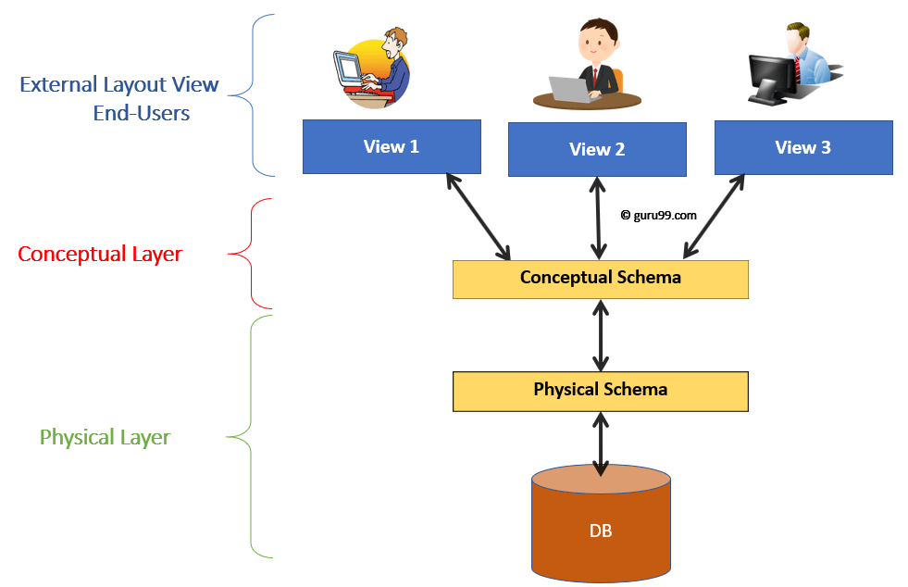
VIEWS and USERS
Tables

Slide 36
Data Dictionary Table for VIEWs
select view_name, text from user_views;
To remove a view:
drop view v1;
VIEW_NAME | TEXT
V1 | select empno, ename, sal, comm, deptno from emp where sal > 1200
V2 | select "EMPNO","ENAME","SAL","COMM","DEPTNO" from v1 where deptno = 10 with check option

Slide 37
Some more facts on VIEWS
view v1
view v2 on v1
drop view v1; – executes
select * from v2
– error msg (view v2 is not automatically removed)
create or replace view vtemp as
select empno, ename, e.deptno, d.deptno, dname, loc
from emp e, dept d
where e.deptno = d.deptno;
ORA-00957: duplicate column name (error msg) why???
In the view two columns with the same name deptno is getting created and hence the error msg
create or replace view vtemp (empno, ename, edeptno, ddeptno, dname, loc) as
select empno, ename, e.deptno, d.deptno, dname, loc
from emp e, dept d
where e.deptno = d.deptno;

Slide 38
Some more facts on VIEWS
view vtemp (empno, ename, edeptno, ddeptno, dname, loc)
insert into vtemp values (2222, 'JONAS', 60, 60, 'HR', 'BOSTON');
insert into vtemp values (2222, 'JONAS', 30, 60, 'HR', 'BOSTON');
ORA-01776: cannot modify more than one base table through a join view
insert into vtemp (empno, ename, edeptno)
values (2222, 'JONAS', 30) - executes
insert into vtemp (ddeptno, dname, loc) values (60, 'HR', 'BOSTON');
ORA-01779: cannot modify a column which maps to a non key-preserved table
If you are sure that a given row in a table will appear at most once in the view -- that table is "key preserved" in the view.
In the view vtemp every row of emp table appears at the most once
For vtemp, empno(PK) is key-preserved and d.deptno(PK of dept table) is not.
So if for the view vtemp, emp table is key-preserved and dept table is not i.e. it is non key-preserved table.

Slide 39
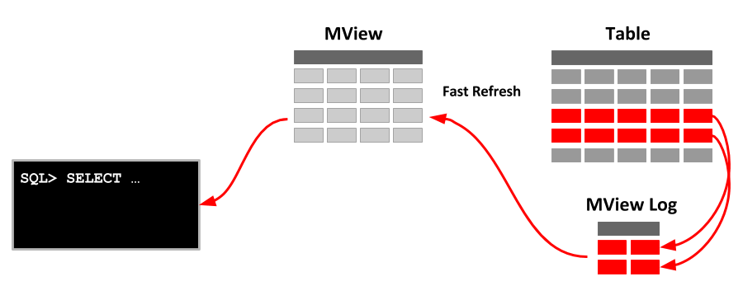
MATERIALIZED VIEWS
Oracle uses materialized views (also known as snapshots in prior releases) to replicate in Distributed Databases and to cache expensive queries in a data warehouse environment.
Definition of Materialized views is stored in databases.
Materialized views are useful in Data-warehousing concepts. When you create a Materialized view, Oracle Database creates one internal table and at least one index, and may create one view, all in the schema of the materialized views.
create materialized view mview
as select empno, sal, job from emp where deptno in (10, 20);
Notes:
In data warehouses, you can use materialized views to precompute and store aggregated data such as the sum of sales. Materialized views in these environments are often referred to as summaries, because they store summarized data. They can also be used to precompute joins with or without aggregations.

Slide 40
MATERIALIZED VIEWS
create materialized view mview as select empno, sal, job from emp where deptno in (10, 20);
select * from user_views;
Will not show the view ‘mview’.
select * from tab;
Will show mview as a table since it is actually storing data and works like an actual and not virtual table
TNAME | TABTYPE
DBMS_XPLAN | SYNONYM
DEPT | TABLE
EMP | TABLE
EMP1 | TABLE
MVIEW | TABLE
V$SESSION | SYNONYM
V$SQL | SYNONYM
V$SQLSTATS | SYNONYM
V$SQL_PLAN | SYNONYM
V$SQL_PLAN_STATISTICS_ALL | SYNONYM
VTEMP | VIEW
VTEMP1 | VIEW

Slide 41
VIEWS vs MATERIALIZED VIEWS
No. | View | Materialized View
1. | A view is a virtual table created from one or more base tables and never stored on the disk. | A materialized view is a physical copy (replica) created from one or more base tables and stored on the disk.
2. | Views are updated every time the base tables on which they are created are updated. | Materialized views are updated manually or using triggers.
3. | Processing time of views is slow. This is because if view is updated it is to be reflected on the base tables and if base tables are updated it should reflect on the views. | Processing time for Materialized views is fast. This is because they are pre-computed.
5. | Advantage is no storage space required | Advantage is very fast in execution

Slide 42
Transaction
Control
Language

Slide 43
TRANSACTION CONTROL
What is a Transaction?
Unit of Work
Transaction is a set of operations used to perform a logical set of work. A transaction usually means that the data in the database has changed.
A transaction generally represents any change in a database.
A transaction can be a single SQL statement or a set of SQL statements
Transactions group a set of tasks into a single execution unit.
Each transaction begins with a specific task and ends when all the tasks in the group successfully complete. If any of the tasks fail, the transaction fails.
Therefore, a transaction has only two results: success or failure.

Slide 44
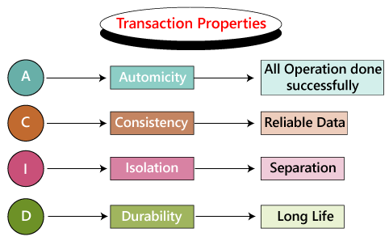
TRANSACTION CONTROL
The following commands are used to control transactions.
COMMIT − to save the changes. (permanently save the transaction)
ROLLBACK − to roll back the changes. (undo a transaction)
SAVEPOINT − creates points within the groups of transactions in which to ROLLBACK.
SET TRANSACTION − Places a name on a transaction.
The ACID properties of a transaction:
Transaction is a single
unit
Only reliable data
saved
Transactions operate
independently
Committed data is
never lost

Slide 45
TRANSACTION CONTROL
A transaction starts with a SQL command e.g. INSERT, UPDATE, DELETE, CREATE, …
A transaction ends either implicitly or explicitly
Implicitly (oracle)
- DDL - self committing
- DCL - self committing
- log out - commit
- power failure - rollback
Explicitly (user)
- commit <work> (writing work is optional)
- rollback <work> - undo the transaction
- rollback to savepoint - partially undo the transaction

Slide 46
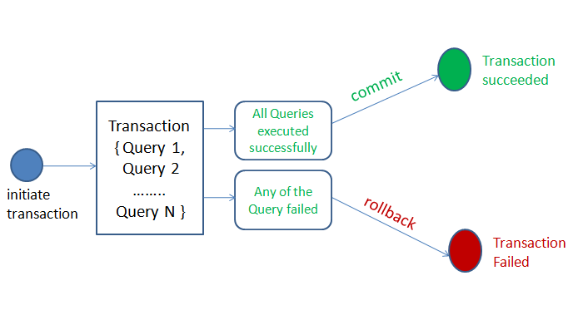
TRANSACTION CONTROL

Slide 47
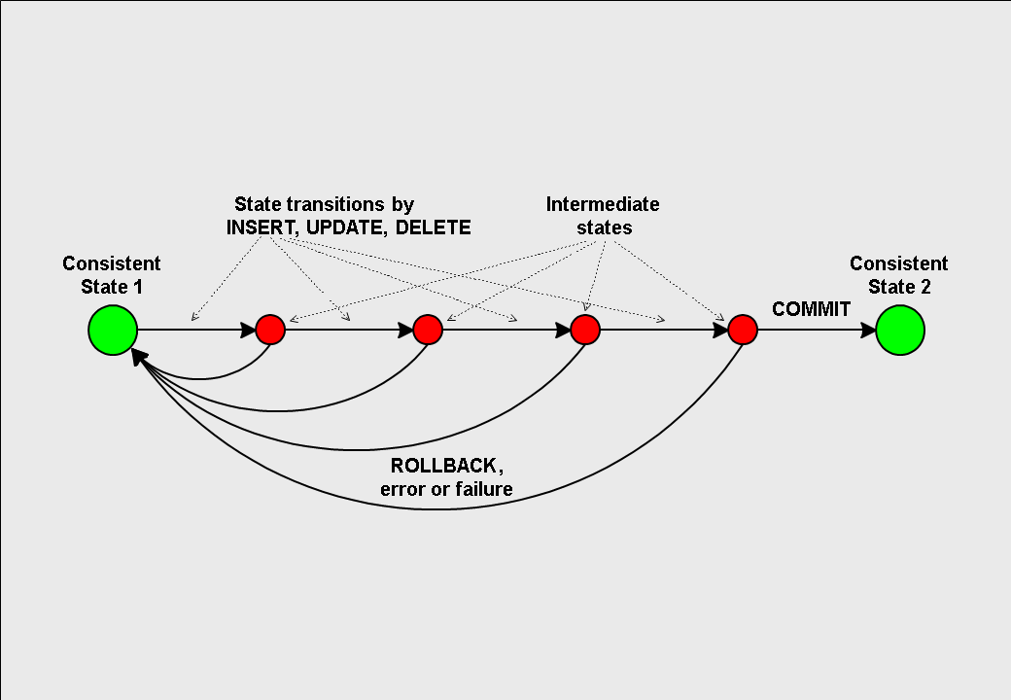
TRANSACTION CONTROL

Slide 48
TRANSACTION CONTROL
Commit example:
Suppose you start with the following command:
create table emp (empno number(3), ename varchar2(20),….);
First transaction say T1 starts.
Since every DDL is self-committing, the transaction ends and the table becomes permanent in the database (on the physical disk)
insert into emp values (111, ‘MARY’,…);
Second transaction starts.
update emp …
insert into emp …
alter table emp …
Since alter is a DDL, it is self-committing.
So second transaction ends and every action – insert, update, insert and alter become permanent in the database
REMEMBER:
By default every DML executes in the main memory (buffer) and cannot become permanent in the database on its own

Slide 49
TRANSACTION CONTROL
Rollback example:
Suppose you start with the following command:
insert into emp values (123, ‘GOLDIE’,…);
First transaction say T1 starts.
insert into emp values (111, ‘MARY’,…);
update emp set sal = sal+1000;
rollback
The transaction is undone i.e. the sal which was updated gets back the original value and the rows which were inserted are removed
Basically undo all actions of this transaction
All these changes were in the main memory and are removed
Rollback is possible of DML commands only
IMP:
If you select the option:
SET AUTOCOMMIT ON
Each DML will be committed after execution like DDL.

Slide 50
TRANSACTION CONTROL
Example:
create table
insert
insert
update
commit
delete
alter
update
update
rollback
insert
insert
delete
power failure
create
insert
commit
Explanation:
Transaction T1 starts and ends
Transaction T2 starts
-
-
T2 ends
Transaction T3 starts
DDL command – T3 ends
Transaction T4 starts
-
T4 ends
Transaction T5 starts
-
-
T5 ends
Transaction T6 starts and ends
Transaction T7 starts
T7 ends
Action:
implicit commit
explicit commit
implicit commit
explicit rollback
implicit rollback
implicit commit
explicit commit

Slide 51
TRANSACTION CONTROL
Example:
select
insert
delete
truncate
commit
delete
update
update
log out
alter
insert
insert
rollback
rename
create
insert
commit
Explanation:
Transaction T1 starts
-
-
T1 ends (DDL command)
Nothing to commit
Transaction T2 starts
-
-
T2 ends
T3 starts and ends
Transaction T4 starts
-
T4 ends
T5 starts and ends
T6 starts and ends
T7 starts
T7 ends
Action:
Data retrieval only
implicit commit
No action
implicit commit
implicit commit
explicit rollback
implicit commit
implicit commit
explicit commit

Slide 52
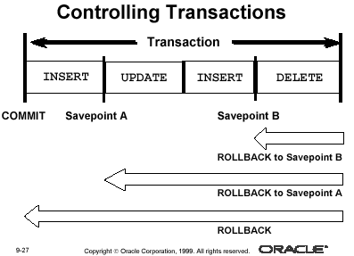
1
3
4
6
2
5

Slide 53
ROLLBACK TO SAVEPOINT
Example:
insert
delete
delete
savepoint s1
update
insert
update
delete
savepoint s2
delete
delete
update
update
savepoint s3
insert
insert
rollback to s3
Example:
insert
delete
delete
savepoint s1
update
insert
update
delete
savepoint s2
delete
delete
update
update
savepoint s3
insert
insert
rollback to s1
Used when transactions are very long
Transactions with DMLs only
When you rollback to a savepoint, the transaction is undone till that savepoint and the savepoint itself is also removed.
When you rollback to s1, all savepoints are automatically erased
release savepoint s2
Will remove the savepoint s2

Slide 54
SET TRANSACTION
Used to give name to a transaction
Also used to make a transaction read-only
e.g.
SET TRANSACTION NAME ‘RESULT’
This clause is especially useful in distributed database environments when you must identify and resolve in-doubt transactions.
e.g.
COMMIT
SET TRANSACTION READ ONLY NAME ‘REPORTS’
SELECT * FROM ...
SELECT XYZ FROM ...
COMMIT
The first COMMIT statement ensures that SET TRANSACTION is the first statement in the transaction. The last COMMIT statement does not actually make permanent any changes to the database. It simply ends the read-only transaction.

Slide 55
SET TRANSACTION
SET TRANSACTION READ ONLY
All subsequent queries in that transaction see only changes that were committed before the transaction began.
Read-only transactions are useful for report generation that run multiple queries against one or more tables
Other users could be updating these same tables at that time
The updates by other users are not visible in this transaction
It could be run at midnight of the last day of every month to count the products and quantities on hand in a warehouse or a bank where the previous month’s report is to be generated.
This report would not be affected by any other user who might be adding or removing inventory in the warehouse and if its for a bank the new credits and debits would not be visible in this transaction

Slide 56
START TRANSACTION
START TRANSACTION or BEGIN a transaction in MySQL
Both end a transaction implicitly or explicitly as discussed earlier
There are many other related options which can be explored as required

Slide 57
ADVANCED SQL
CANDIDATE (CID, CNAME, COUNTRY, CBIRTH_DT)
TEST (TID, TNAME, TOT_MRKS, PASS_MKS)
TEST_CENTRE (TCID, LOCATION, MGR, CAPACITY)
TEST_TAKEN (CID, TID, TCID, TEST_DT, SCORE)

Slide 58
ADVANCED SQL
select tid, tcid, count(*)
from test_taken
group by
grouping sets (tid, (tid,tcid))
tid tcid count(*)
t1 12
t2 20
t3 25
t1 tc1 5
t1 tc2 7
t2 tc1 10
t2 tc3 2
t2 tc5 8
...
57 (grand total)
select tt.tid, tt.tcid, c.country, count(*)
from test_taken tt, candidate c
where tt.tid = c.tid
group by
rollup (tid, tcid, country)
Rollup (a, b, c)
Grouping done on –
a
ab
abc
tid
(tid, tcid)
(tid, tcid, country)
Grand total at the end
select tt.tid, tt.tcid, c.country, count(*)
from test_taken tt, candidate c
where tt.tid = c.tid
group by
cube (tid, tcid, country)
Cube (a, b, c)
Grouping done on all possible combinations.
a
b
c
ab
bc
ca
abc
Grand total at the end

Slide 59
The EXISTS operator
The EXISTS operator is used to test for the existence of any record in a sub-query.
The EXISTS operator returns TRUE if the sub-query returns one or more records.
SELECT column_name(s)
FROM table_name
WHERE EXISTS
(SELECT column_name FROM table_name WHERE condition);
e.g. Display department names where employees are working.
select dname
from dept
where exists
(select * from emp where emp.deptno = dept.deptno);
Display department names where employees are not working.
select dname
from dept
where not exists
(select * from emp where emp.deptno = dept.deptno);

Slide 60
The Top-N Analysis
Top-N Analysis in SQL deals with How to limit the number of rows returned from ordered sets of data in SQL.
Top-N analysis are useful in cases where the need is to display only the n bottom-most or the n top-most records from a table based on a condition.
Creating a temporary table
SELECT [column_list], ROWNUM
FROM (SELECT [column_list]
FROM table_name
ORDER BY Top-N_clolumn)
WHERE ROWNUM<=N;
e.g.
SELECT ename, sal, rownum
FROM (SELECT ename, sal
FROM emp
ORDER BY sal)
WHERE ROWNUM<=3;

Slide 61
The Top-N Analysis
ENAME | SAL | ROWNUM
SMITH | 800 | 7
JAMES | 950 | 13
ADAMS | 1100 | 12
MARTIN | 1250 | 10
WARD | 1250 | 9
MILLER | 1300 | 14
TURNER | 1500 | 11
ALLEN | 1600 | 8
CLARK | 2450 | 3
BLAKE | 2850 | 2
JONES | 2975 | 4
FORD | 3000 | 6
SCOTT | 3000 | 5
KING | 5000 | 1
SELECT ename, sal, rownum
FROM emp ORDER BY sal;
First records are fetched in the order in which they were inserted and then ORDER BY is executed.
That is why the records that are displayed after the above query executes do not have the rownum in sequence.
The rownum assigned is the order in which they were fetched from the database i.e. before they were sorted.

Slide 62
The Top-N Analysis
Incorrect Output
ENAME | SAL | ROWNUM
CLARK | 2450 | 3
BLAKE | 2850 | 2
JONES | 2975 | 4
FORD | 3000 | 6
SCOTT | 3000 | 5
KING | 5000 | 1
SELECT ename, sal, rownum
FROM emp
WHERE rownum <= 6
ORDER BY sal;
Output is wrong as we are not getting the top 6 lowest paid employees.
First records are fetched, rownum is assigned and then ORDER BY takes place
Correct Output
ENAME | SAL | ROWNUM
SMITH | 800 | 7
JAMES | 950 | 13
ADAMS | 1100 | 12
MARTIN | 1250 | 10
WARD | 1250 | 9
MILLER | 1300 | 14

Slide 63
The Top-N Analysis
SELECT ename, sal, rownum FROM
(SELECT ename, sal
FROM Emp
ORDER BY sal)
WHERE ROWNUM<=6;
Inner query is executed first.
The output of the inner query is treated like a table (Temporary Table)with records
For the outer query, rownum of the records is in sequence starting from 1.
ENAME | SAL | ROWNUM
SMITH | 800 | 1
JAMES | 950 | 2
ADAMS | 1100 | 3
WARD | 1250 | 4
MARTIN | 1250 | 5
MILLER | 1300 | 6

Slide 64
Control Statements (CASE)
CASE [ expression/variable ]
WHEN value_1 THEN result_1
WHEN value_2 THEN result_2
...
WHEN value_n THEN result_n
ELSE result
END;
CASE
WHEN condition_1 THEN result_1
WHEN condition_2 THEN result_2
...
WHEN condition_n THEN result_n
ELSE result
END;
OR

Slide 65
Control Statements (CASE)
For employees of deptno 30, display their employee number, name, salary and remarks related to salary where if salary is less than 1000, display ‘Low Salary’, between 1000 and 2500 display ‘Medium Salary’ else display ‘High Salary’.
select empno, ename, sal, CASE when sal < 1000 then ‘Low Salary'
when (sal >= 1000 and sal <=2500) then ‘Medium Salary’
else ‘High Salary‘ END as Remarks
from emp
where deptno = 30;
EMPNO | ENAME | DEPTNO | SAL | REMARKS
7698 | BLAKE | 30 | 2850 | High Salary
7499 | ALLEN | 30 | 1600 | Medium Salary
7521 | WARD | 30 | 1250 | Medium Salary
7654 | MARTIN | 30 | 1250 | Medium Salary
7844 | TURNER | 30 | 1500 | Medium Salary
7900 | JAMES | 30 | 950 | Low Salary

Slide 66
Control Statements (CASE)
EMPNO | ENAME | DEPTNO | SAL | REMARKS
7839 | KING | 10 | 5000 | TEN
7698 | BLAKE | 30 | 2850 | Not Considered
7782 | CLARK | 10 | 2450 | TEN
7566 | JONES | 20 | 2975 | TWENTY
7788 | SCOTT | 20 | 3000 | TWENTY
7902 | FORD | 20 | 3000 | TWENTY
7369 | SMITH | 20 | 800 | TWENTY
7499 | ALLEN | 30 | 1600 | Not Considered
7521 | WARD | 30 | 1250 | Not Considered
7654 | MARTIN | 30 | 1250 | Not Considered
7844 | TURNER | 30 | 1500 | Not Considered
7876 | ADAMS | 20 | 1100 | TWENTY
7900 | JAMES | 30 | 950 | Not Considered
7934 | MILLER | 10 | 1300 | TEN
For each employee display their employee number, name, salary and remarks related to deptno where if deptno is 10, display ‘TEN’, if it is 20 then ‘TWENTY’, 30 then ‘THIRTY’ else ‘Not Considered’.
select empno, ename, sal,
CASE deptno
when 10 then ‘TEN'
when 20 then ‘TWENTY’
else ‘Not Considered‘ END as
Remarks
from emp;
** Similar to DECODE function

Slide 67
Control Statements (CASE in function)
Display how many employees work in deptno 10, how many employees are earning more than 2500 and how many are not getting comm.
select count(case when deptno = 10 then 1 else null end) as TotEmpIn_D10,
count(case when sal> 2500 then 1 else null end) as TotEmpSalGr2500,
count(case when comm is null then 1 else null end) as TotEmpNoComm
from emp;
TOTEMPIN_D10 | TOTEMPSALGR2500 | TOTEMPNOCOMM
3 | 5 | 10

Slide 68
Control Statements (CASE in function)
Display how many employees are in the Low Salary group, Medium Salary group and High Salary group.
select case when sal < 1000 then 'Low Salary‘
when (sal >= 1000 and sal <=2500) then 'Medium Salary‘
else 'High Salary' END as Remarks, count(*)
from emp
group by
case when sal < 1000 then 'Low Salary‘
when (sal >= 1000 and sal <=2500) then 'Medium Salary‘
else 'High Salary' end;
REMARKS | COUNT(*)
Medium Salary | 7
Low Salary | 2
High Salary | 5

Slide 69
End of SQL Tutorial Part-4

