Slide 1



Structured
Query
Language (Part-2)
Courtesy:
Anjali Jivani
Oracle manuals
https://www.guru99.com
https://www.javatpoint.com
https://www.tutorialspoint.com

Slide 2
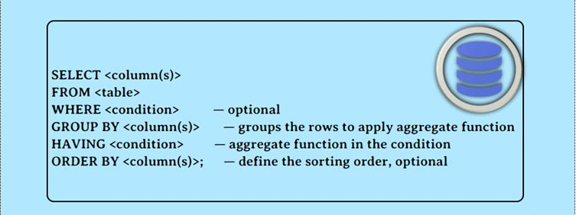
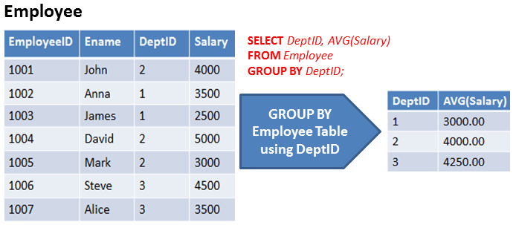
Group by

Slide 3
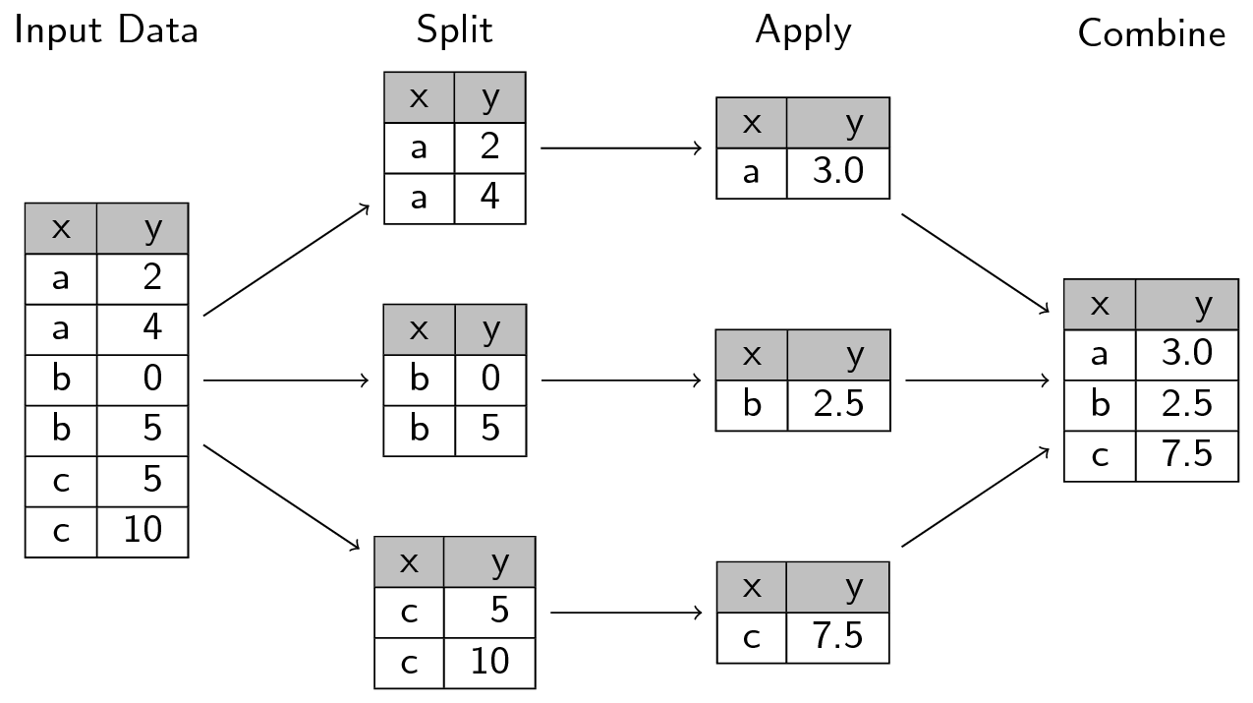
Group by
select x, avg(y) from temp group by x;
avg(y)
Temp
avg(y)
avg(y)
avg(y)

Slide 4
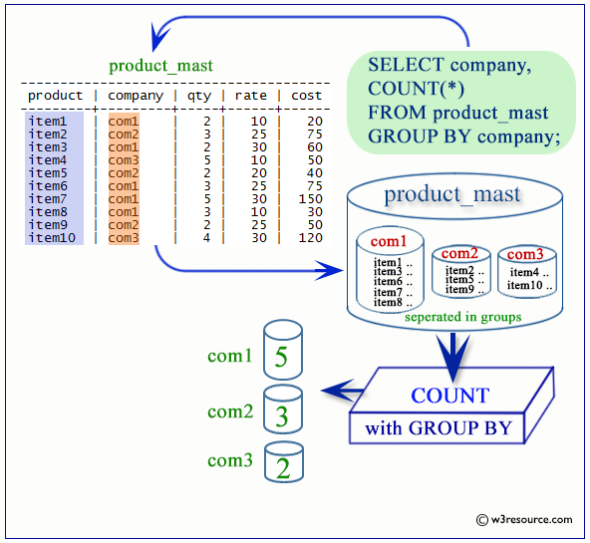

Slide 5
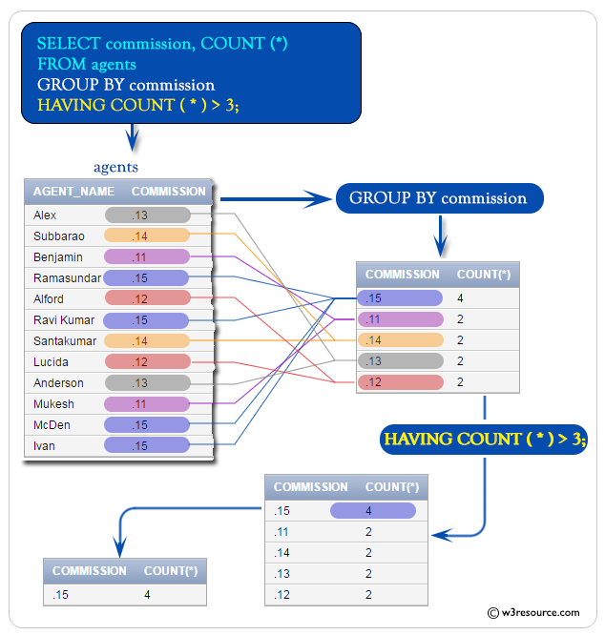
HAVING can have only aggregate function
Condition applied to each group created

Slide 6
Group by with having condition:
Display the deptnos and the number of employees in that dept.
select deptno, count(*)
from emp
group by deptno;
EMPNO | ENAME | SAL | DEPTNO
7782 | CLARK | 2450 | 10
7934 | MILLER | 1300 | 10
7839 | KING | 5000 | 10
7902 | FORD | 3000 | 20
7788 | SCOTT | 3000 | 20
7566 | JONES | 2975 | 20
7369 | SMITH | 800 | 20
7876 | ADAMS | 1100 | 20
7521 | WARD | 1250 | 30
7654 | MARTIN | 1250 | 30
7844 | TURNER | 1500 | 30
7900 | JAMES | 950 | 30
7499 | ALLEN | 1600 | 30
7698 | BLAKE | 2850 | 30
DEPTNO | COUNT(*)
10 | 3
20 | 5
30 | 6
select deptno, count(*)
from emp
group by deptno
having count(*) > 3;
DEPTNO | COUNT(*)
20 | 5
30 | 6
Display departments which have more than 3 employees.

Slide 7
select deptno, count(*)
from emp
group by deptno
having count(*) > 3;
OR
select deptno, count(*)
from emp
where count(*) > 3
group by deptno ;
where – applied to every row
having – applied to every group
Sequence of execution in the SELECT command:
SELECT
FROM
WHERE
GROUP BY
HAVING
ORDER BY
Why is this wrong??
6
1
2
3
4
5

Slide 8
Display deptnos and within each dept the total number of employees with different designations. (e.g. how many managers in dept 10, how many managers in dept 20, how many clerks in dept 30 , and so on)
DEPTNO | JOB
10 | CLERK
10 | MANAGER
10 | PRESIDENT
20 | ANALYST
20 | ANALYST
20 | CLERK
20 | CLERK
20 | MANAGER
30 | CLERK
30 | MANAGER
30 | SALESMAN
30 | SALESMAN
30 | SALESMAN
30 | SALESMAN
select deptno, job, count(*)
from emp group by deptno, job
order by deptno, job; (for better display)
G1
G2
G3
DEPTNO | JOB | COUNT(*)
10 | CLERK | 1
10 | MANAGER | 1
10 | PRESIDENT | 1
20 | ANALYST | 2
20 | CLERK | 2
20 | MANAGER | 1
30 | CLERK | 1
30 | MANAGER | 1
30 | SALESMAN | 4
G4
G5
G6
G7
G8
G9

Slide 9
Display deptnos and within each dept the total number of employees with different designations. (e.g. how many managers in dept 10, how many managers in dept 20, how many clerks in dept 30 , and so on)
select deptno, job, count(*)
from emp group by deptno, job
order by deptno, job;
What will happen if we change the sequence of deptno and job in this query?? i.e group by job, deptno
DEPTNO | JOB | COUNT(*)
10 | CLERK | 1
10 | MANAGER | 1
10 | PRESIDENT | 1
20 | ANALYST | 2
20 | CLERK | 2
20 | MANAGER | 1
30 | CLERK | 1
30 | MANAGER | 1
30 | SALESMAN | 4
NO CHANGE in output!!
Notes:
e.g. student table
How many students born in different months from different districts of Gujarat?
or
How manu students from different districts of Gujarat born in different months?
Jan Baroda
Jan Ahmedabad
Jan Surat
Feb Baroda
Feb Ahmedabad
Feb Surat
….
OR
Baroda Jan
Baroda Feb
Ahmedabad Jan
Ahmedabad Feb
…
Both are same

Slide 10
Display deptnos and within each dept the total number of employees with different designations.
Display total number of clerks in each department.
Display departments having at least 2 clerks.
select deptno,job, count(*)
from emp
where upper(job)= 'CLERK'
group by deptno, job;
group by deptno; (job not required)
DEPTNO | JOB | COUNT(*)
10 | CLERK | 1
10 | MANAGER | 1
10 | PRESIDENT | 1
20 | ANALYST | 2
20 | CLERK | 2
20 | MANAGER | 1
30 | CLERK | 1
30 | MANAGER | 1
30 | SALESMAN | 4
DEPTNO | JOB | COUNT(*)
10 | CLERK | 1
20 | CLERK | 2
30 | CLERK | 1
select deptno,job, count(*)
from emp
where upper(job)= 'CLERK'
group by deptno
having count(*) >= 2
DEPTNO | JOB | COUNT(*)
20 | CLERK | 2

Slide 11
The NVL function
select * from emp;
EMPNO | ENAME | JOB | MGR | HIREDATE | SAL | COMM | DEPTNO
7839 | KING | PRESIDENT | - | 17-NOV-81 | 5000 | - | 10
7698 | BLAKE | MANAGER | 7839 | 01-MAY-81 | 2850 | - | 30
7782 | CLARK | MANAGER | 7839 | 09-JUN-81 | 2450 | - | 10
7566 | JONES | MANAGER | 7839 | 02-APR-81 | 2975 | - | 20
7788 | SCOTT | ANALYST | 7566 | 19-APR-87 | 3000 | - | 20
7902 | FORD | ANALYST | 7566 | 03-DEC-81 | 3000 | - | 20
7369 | SMITH | CLERK | 7902 | 17-DEC-80 | 800 | - | 20
7499 | ALLEN | SALESMAN | 7698 | 20-FEB-81 | 1600 | 300 | 30
7521 | WARD | SALESMAN | 7698 | 22-FEB-81 | 1250 | 500 | 30
7654 | MARTIN | SALESMAN | 7698 | 28-SEP-81 | 1250 | 1400 | 30
7844 | TURNER | SALESMAN | 7698 | 08-SEP-81 | 1500 | 0 | 30
7876 | ADAMS | CLERK | 7788 | 23-MAY-87 | 1100 | - | 20
7900 | JAMES | CLERK | 7698 | 03-DEC-81 | 950 | - | 30
7934 | MILLER | CLERK | 7782 | 23-JAN-82 | 1300 | - | 10

Slide 12
The NVL function
select empno, ename, sal, nvl(comm,0) from emp;
EMPNO | ENAME | SAL | COMM
7839 | KING | 5000 | 0
7698 | BLAKE | 2850 | 0
7782 | CLARK | 2450 | 0
7566 | JONES | 2975 | 0
7788 | SCOTT | 3000 | 0
7902 | FORD | 3000 | 0
7369 | SMITH | 800 | 0
7499 | ALLEN | 1600 | 300
7521 | WARD | 1250 | 500
7654 | MARTIN | 1250 | 1400
7844 | TURNER | 1500 | 0
7876 | ADAMS | 1100 | 0
7900 | JAMES | 950 | 0
7934 | MILLER | 1300 | 0
nvl(comm,0) – wherever comm is null consider it as 0.
nvl(column, value)
can be used with all datatypes

Slide 13
Display the employee number, name, salary, commission and total pay of each employee.
select empno as NAME, ename, sal, comm, sal+comm as totalpay
from emp;
EMPNO | ENAME | SAL | COMM | TOTALPAY
7839 | KING | 5000 | - | -
7698 | BLAKE | 2850 | - | -
7782 | CLARK | 2450 | - | -
7566 | JONES | 2975 | - | -
7788 | SCOTT | 3000 | - | -
7902 | FORD | 3000 | - | -
7369 | SMITH | 800 | - | -
7499 | ALLEN | 1600 | 300 | 1900
7521 | WARD | 1250 | 500 | 1750
7654 | MARTIN | 1250 | 1400 | 2650
7844 | TURNER | 1500 | 0 | 1500
7876 | ADAMS | 1100 | - | -
7900 | JAMES | 950 | - | -
7934 | MILLER | 1300 | - | -
All arithmetics operations on NULL values result in a NULL value!!

Slide 14
select empno, ename, sal, comm, sal+nvl(comm,0)
from emp;
EMPNO | ENAME | SAL | COMM | SAL+NVL(COMM,0)
7839 | KING | 5000 | - | 5000
7698 | BLAKE | 2850 | - | 2850
7782 | CLARK | 2450 | - | 2450
7566 | JONES | 2975 | - | 2975
7788 | SCOTT | 3000 | - | 3000
7902 | FORD | 3000 | - | 3000
7369 | SMITH | 800 | - | 800
7499 | ALLEN | 1600 | 300 | 1900
7521 | WARD | 1250 | 500 | 1750
7654 | MARTIN | 1250 | 1400 | 2650
7844 | TURNER | 1500 | 0 | 1500
7876 | ADAMS | 1100 | - | 1100
7900 | JAMES | 950 | - | 950
7934 | MILLER | 1300 | - | 1300

Slide 15
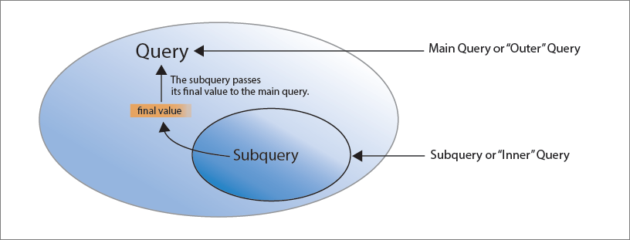
Sub-query

Slide 16
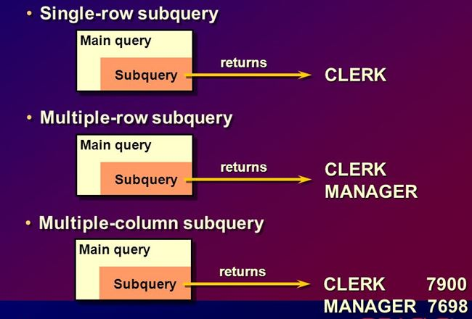

Slide 17
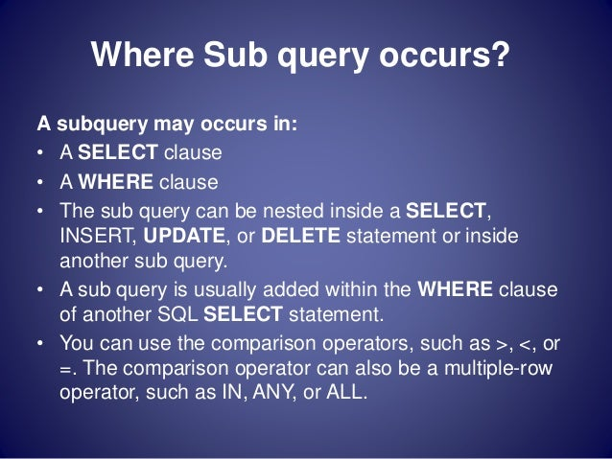

Slide 18
DEPT
DEPTNO | DNAME | LOC
10 | ACCOUNTING | NEW YORK
20 | RESEARCH | DALLAS
30 | SALES | CHICAGO
40 | OPERATIONS | BOSTON

Slide 19
EMP
EMPNO | ENAME | JOB | MGR | HIREDATE | SAL | COMM | DEPTNO
7839 | KING | PRESIDENT | - | 17-NOV-81 | 5000 | - | 10
8839 | Prince | MANAGER | 7839 | 17-NOV-81 | 3000 | - | 10
7698 | BLAKE | MANAGER | 7839 | 01-MAY-81 | 2850 | - | 30
7782 | CLARK | MANAGER | 7839 | 09-JUN-81 | 2450 | - | 10
8782 | PETER | MANAGER | 7782 | 09-JUN-81 | 2850 | - | 10
7566 | JONES | MANAGER | 7839 | 02-APR-81 | 2975 | - | 20
7788 | SCOTT | ANALYST | 7566 | 19-APR-87 | 3000 | - | 20
7902 | FORD | ANALYST | 7566 | 03-DEC-81 | 3000 | - | 20
7369 | SMITH | CLERK | 7902 | 17-DEC-80 | 800 | - | 20
7499 | ALLEN | SALESMAN | 7698 | 20-FEB-81 | 1600 | 300 | 30
7521 | WARD | SALESMAN | 7698 | 22-FEB-81 | 1250 | 500 | 30
7654 | MARTIN | SALESMAN | 7698 | 28-SEP-81 | 1250 | 1400 | 30
7844 | TURNER | SALESMAN | 7698 | 08-SEP-81 | 1500 | 0 | 30
7876 | ADAMS | CLERK | 7788 | 23-MAY-87 | 1100 | - | 20
9876 | MARTIN | ANALYST | 7788 | 23-MAY-87 | 2850 | - | 20
9976 | JOE | ANALYST | 7788 | 12-JAN-05 | 2000 | - | 20
7900 | JAMES | CLERK | 7698 | 03-DEC-81 | 950 | - | 30
7934 | MILLER | CLERK | 7782 | 23-JAN-82 | 1300 | - | 10

Slide 20
Single-row Sub-query
Display employees who are working in the ‘SALES’ department.
‘SALES’ is name of a department in the department table.
DEPTNO | DNAME | LOC
10 | ACCOUNTING | NEW YORK
20 | RESEARCH | DALLAS
30 | SALES | CHICAGO
40 | OPERATIONS | BOSTON
EMPNO | ENAME | JOB | MGR | HIREDATE | SAL | COMM | DEPTNO
7698 | BLAKE | MANAGER | 7839 | 01-MAY-81 | 2850 | - | 30
7499 | ALLEN | SALESMAN | 7698 | 20-FEB-81 | 1600 | 300 | 30
7521 | WARD | SALESMAN | 7698 | 22-FEB-81 | 1250 | 500 | 30
7654 | MARTIN | SALESMAN | 7698 | 28-SEP-81 | 1250 | 1400 | 30
7844 | TURNER | SALESMAN | 7698 | 08-SEP-81 | 1500 | 0 | 30
7900 | JAMES | CLERK | 7698 | 03-DEC-81 | 950 | - | 30

Slide 21
Single-row Sub-query
Display employees who are working in the ‘SALES’ department.
select * from emp
where deptno =
(select deptno from dept
where upper(dname) = ‘SALES’);
Inner query executed first
Returns one row and one value i.e. 30
EMPNO | ENAME | JOB | MGR | HIREDATE | SAL | COMM | DEPTNO
7698 | BLAKE | MANAGER | 7839 | 01-MAY-81 | 2850 | - | 30
7499 | ALLEN | SALESMAN | 7698 | 20-FEB-81 | 1600 | 300 | 30
7521 | WARD | SALESMAN | 7698 | 22-FEB-81 | 1250 | 500 | 30
7654 | MARTIN | SALESMAN | 7698 | 28-SEP-81 | 1250 | 1400 | 30
7844 | TURNER | SALESMAN | 7698 | 08-SEP-81 | 1500 | 0 | 30
7900 | JAMES | CLERK | 7698 | 03-DEC-81 | 950 | - | 30

Slide 22
Example:
Display the name(s) of the highest earning employees of deptno 10.
select ename from emp
where deptno = 10
and sal =
(select max(sal)
from emp
where deptno = 10);

Slide 23
Single-row Sub-query
Display employees who have the same designation as that of employee 7698.
select * from emp
where job =
(select job from emp
where empno = 7698);
Inner query executed first
Returns one row and one value i.e. MANAGER
EMPNO | ENAME | JOB | MGR | HIREDATE | SAL | COMM | DEPTNO
8839 | Prince | MANAGER | 7839 | 17-NOV-81 | 3000 | - | 10
7698 | BLAKE | MANAGER | 7839 | 01-MAY-81 | 2850 | - | 30
7782 | CLARK | MANAGER | 7839 | 09-JUN-81 | 2450 | - | 10
8782 | PETER | MANAGER | 7782 | 09-JUN-81 | 2850 | - | 10
7566 | JONES | MANAGER | 7839 | 02-APR-81 | 2975 | - | 20

Slide 24
Single-row Sub-query
Display employees who have the same designation as that of employee 7698 and do not display empno 7698.
select * from emp
where empno <> 7698
and job =
(select job from emp
where empno = 7698);
EMPNO | ENAME | JOB | MGR | HIREDATE | SAL | COMM | DEPTNO
8839 | Prince | MANAGER | 7839 | 17-NOV-81 | 3000 | - | 10
7782 | CLARK | MANAGER | 7839 | 09-JUN-81 | 2450 | - | 10
8782 | PETER | MANAGER | 7782 | 09-JUN-81 | 2850 | - | 10
7566 | JONES | MANAGER | 7839 | 02-APR-81 | 2975 | - | 20

Slide 25
Multiple-row Sub-query
Display employees who are working at New York or Boston.
select * from emp
where deptno in
(select deptno from dept
where upper(loc) in (‘NEW YORK’, ‘BOSTON’));
Use ‘in’ operator as multiple values are getting selected
Display all those employees who have the same job as ALLEN, JAMES or BLAKE.
select * from emp
where job in
(select job from emp
where upper(ename) in (‘ALLEN’, ‘JAMES’, ‘BLAKE’));
DEPTNO
10
40

Slide 26
More examples…
Display details of employees who are earning more than BLAKE and have the same designation as JONES.
select * from emp
where sal > all
(select sal from emp where upper(ename) = 'BLAKE')
and upper(job) in
(select upper(job) from emp where upper(ename) = 'JONES');
** There could be more than one BLAKE and JONES
Display details of employees who are earning more than all employees of dept 30.
select * from emp
where sal > all
(select sal
from emp
where deptno = 30);
** ‘all’ is used as inner query selects more than one value
OR
select * from emp
where sal >
(select max(sal)
from emp
where deptno = 30);

Slide 27
More examples…
Display details of employees who are earning more than at least one employee of dept 30.
select * from emp
where sal > any
(select sal
from emp
where deptno = 30);
IMP:
If inner query is going to fetch only one row / one value you can use any relational operator for comparison with outer query.
If inner query is going to fetch more than one row / value, along with the relational operator use all, any, in, some as required.
OR
select * from emp
where sal >
(select min(sal)
from emp
where deptno = 30);
Notes:
in, = any, = some would give similar output

Slide 28
One more aggregate function…
Display all designations of employees of dept 20.
select job from emp
where deptno = 20;
Some designations are repeated as more one than one
employee can have the same designation.
To display distinct values use the DISTINCT clause.
select distinct(job) from emp
where deptno = 20;
Can you execute the following?
select empno, ename, distinct(job) from emp
where deptno = 20;
NO!! (DISTINCT is an aggregate function)
JOB
MANAGER
ANALYST
ANALYST
CLERK
CLERK
ANALYST
ANALYST
JOB
MANAGER
ANALYST
CLERK

Slide 29
More examples…
Display details of employees who have the same designation as any designation of the department 20 employee.
select * from emp
where job = any
(select distinct(job)
from emp
where deptno = 20);
Display details of employees who have the same designation as any designation of the RESEARCH department employee.
select * from emp
where job = any
(select distinct(job)
from emp
where deptno in
(select deptno
from dept
where upper(dname) = ‘RESEARCH’));
Inner query level 1
Inner query level 2

Slide 30
More examples…
Display details of employees who have the same designation as any designation of the RESEARCH department employee.
select * from emp
where job = any
(select distinct(job)
from emp
where deptno in
(select deptno
from dept
where upper(dname) = ‘RESEARCH’));
IMP:
At the same level Oracle allows 255 queries.
Oracle allows upto 16 levels of sub-queries.
fetches all jobs of deptno 20
fetches deptno 20

Slide 31
Quiz question…
Display the maximum salary for each dept.
select deptno, max(sal)
from emp
group by deptno;
DEPTNO | MAX(SAL)
30 | 2850
10 | 5000
20 | 3000
Display the names of the maximum earning employee(s) of each department.

Slide 32
Quiz question…
Display the maximum salary for each dept.
select deptno, max(sal)
from emp
group by deptno;
Display the names of the maximum earning employees of each department.
select ename, deptno, sal
from emp
where sal in
(select max(sal)
from emp
group by deptno);
The above query will give a wrong answer!!
DEPTNO | MAX(SAL)
30 | 2850
10 | 5000
20 | 3000
(2850, 5000, 3000)

Slide 33
Quiz question…
Display the names of the maximum earning employees of each department.
select ename, deptno, sal
from emp
where sal in
(select max(sal)
from emp
group by deptno);
(5000, 3000, 2850)
ENAME | DEPTNO | SAL
KING | 10 | 5000
Prince | 10 | 3000
BLAKE | 30 | 2850
PETER | 10 | 2850
SCOTT | 20 | 3000
FORD | 20 | 3000
MARTIN | 20 | 2850
This happened because only salary was compared and not the salary and deptno together.

Slide 34
Multiple-column subquery
Display the names of the maximum earning employees of each department.
select ename,deptno,sal
from emp
where (sal, deptno) in
(select max(sal), deptno
from emp
group by deptno);
5000 10
3000 20
2850 30
ENAME | DEPTNO | SAL
KING | 10 | 5000
BLAKE | 30 | 2850
SCOTT | 20 | 3000
FORD | 20 | 3000

Slide 35
Quiz question…
Display the names of the third highest earning employee(s).
select * from emp order by sal desc;
EMPNO | ENAME | JOB | MGR | HIREDATE | SAL | COMM | DEPTNO
7839 | KING | PRESIDENT | - | 17-NOV-81 | 5000 | - | 10
8839 | Prince | MANAGER | 7839 | 17-NOV-81 | 3000 | - | 10
7902 | FORD | ANALYST | 7566 | 03-DEC-81 | 3000 | - | 20
7788 | SCOTT | ANALYST | 7566 | 19-APR-87 | 3000 | - | 20
7566 | JONES | MANAGER | 7839 | 02-APR-81 | 2975 | - | 20
8782 | PETER | MANAGER | 7782 | 09-JUN-81 | 2850 | - | 10
7698 | BLAKE | MANAGER | 7839 | 01-MAY-81 | 2850 | - | 30
9876 | MARTIN | ANALYST | 7788 | 23-MAY-87 | 2850 | - | 20
7782 | CLARK | MANAGER | 7839 | 09-JUN-81 | 2450 | - | 10
9976 | JOE | ANALYST | 7788 | 12-JAN-05 | 2000 | - | 20
7499 | ALLEN | SALESMAN | 7698 | 20-FEB-81 | 1600 | 300 | 30
7844 | TURNER | SALESMAN | 7698 | 08-SEP-81 | 1500 | 0 | 30
7934 | MILLER | CLERK | 7782 | 23-JAN-82 | 1300 | - | 10
7654 | MARTIN | SALESMAN | 7698 | 28-SEP-81 | 1250 | 1400 | 30
7521 | WARD | SALESMAN | 7698 | 22-FEB-81 | 1250 | 500 | 30
7876 | ADAMS | CLERK | 7788 | 23-MAY-87 | 1100 | - | 20
7900 | JAMES | CLERK | 7698 | 03-DEC-81 | 950 | - | 30
7369 | SMITH | CLERK | 7902 | 17-DEC-80 | 800 | - | 20

Slide 36
Quiz question…
Display the names of the third highest earning employee(s).
select * from emp
where sal =
(select max(sal) from emp
where sal <
(select max(sal) from emp
where sal <
(select max(sal) from emp)));
Employees with 2975 – Third Highest salary
2975 – Third Highest salary
3000 – Second Highest salary
5000 – Highest salary
EMPNO | ENAME | JOB | MGR | HIREDATE | SAL | COMM | DEPTNO
7566 | JONES | MANAGER | 7839 | 02-APR-81 | 2975 | - | 20

Slide 37
Table ALIAS
A table can be give an alias in the SELECT statement
An alias is just another name given temporarily to the table and it will work only for that query
It is useful in many complex queries (correlated subqueries, joins, etc.)
select *
from emp e;
select *
from emp e
where deptno = 10;
OR
select *
from emp e
where e.deptno = 10;

Slide 38
Correlated subquery
Correlated subqueries are those where the rows of the outer query and the rows of the inner query are connected in the WHERE condition of the inner query.
Display details about employees who are earning more than average salary of employees of the department they belong to.
select * from emp e1
where sal >
(select avg(sal) from emp e2
where e2.deptno = e1.deptno)
In correlated subqueries, for every row of outer query, inner query is executed.
Inner query is executed as many times as the number of rows in outer query
Each time inner query may fetch a different result depending on the WHERE condition and outer query value

Slide 39
EMPNO | ENAME | SAL | COMM | DEPTNO
7839 | KING | 5000 | - | 10
8782 | PETER | 2850 | - | 10
7698 | BLAKE | 2850 | - | 30
7782 | CLARK | 2450 | - | 10
8782 | PETER | 2850 | - | 10
7566 | JONES | 2975 | - | 20
Final Output
√
EMPNO | ENAME | SAL | COMM | DEPTNO
7839 | KING | 5000 | - | 10
7698 | BLAKE | 2850 | - | 30
7566 | JONES | 2975 | - | 20
√
√
Let us see step-wise how the correlated
query works
select * from emp e1
where sal >
(select avg(sal) from emp e2
where e2.deptno = e1.deptno)
First row 7839 of emp e1 is read, e1.deptno = 10
In the inner query average salary of deptno 10 is selected i.e. in the inner query table e2, deptno 10 gets selected.(avg sal of deptno=10 is 2920)
Salary of 7839 is 5000 which is greater than 2920, so that row is selected.
Next row 8782 is read, e1.deptno = 10, sal = 2850. This salary is less than average salary of deptno 10, so 8782 row is not selected.
Next row 7698 is read, e1.deptno = 30, sal = 2850, inner query finds average salary of deptno 30 now which is 1566.67. Salary of 7698 is more than the average salary so 7698 is selected
And so on…
DEPTNO | AVG(SAL)
30 | 1566.67
10 | 2920
20 | 2246.43

Slide 40
EMPNO | ENAME | SAL | MARITAL_STATUS | DEPTNO
7839 | KING | 5000 | Y | 10
8782 | PETER | 2850 | N | 10
7698 | BLAKE | 2850 | N | 30
7782 | CLARK | 2450 | N | 10
7566 | JONES | 2975 | Y | 20
DEPTNO | DNAME | LOC
10 | ACCOUNTING | NEW YORK
20 | RESEARCH | DALLAS
30 | SALES | CHICAGO
40 | OPERATIONS | BOSTON
Get names of departments which have married employees (using correlated)
select distinct(dname)
from dept d
where ‘Y’ in
(select distinct(marital_status)
from emp e
where e.deptno = d.deptno)
Steps of execution:
First row of DEPT table selected, deptno = 10
In the inner query marital_status of employees of deptno = 10 selected
If there is atleast one ‘Y’ it means there are married employees, then display that dept.
Read next record from DEPT table.
For deptno = 10, marital_status = (‘Y’, ’N’ ,’N’) so dname ‘ACCOUNTING’ displayed
For deptno = 20, marital_status = (‘Y’) so dname ‘RESEARCH’ displayed
For deptno = 30, marital_status = (‘N’) so dname not displayed, …
DNAME
ACCOUNTING
RESEARCH

Slide 41
Alternate query …
select dname
from dept
where ‘Y’ in
(select distinct(marital_status)
from emp
where deptno = dept.deptno);
select dname
from dept
where deptno in
(select distinct(deptno)
from emp
where marital_status = ‘Y’);

Slide 42
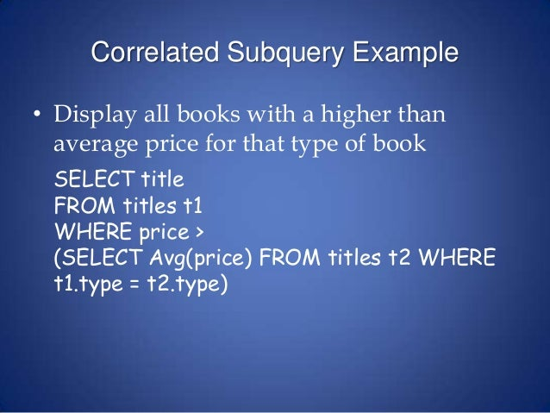
TITLES
BOOKID | TITLE | TYPE | PRICE
comic, suspense, tragedy,..

Slide 43
Some more functions:
upper(column) – convert to uppercase
lower(column) – convert to lowercase
initcap(column) – capitalize(uppercase) first letter of the column
length(column) – display length of the value in that column
e.g.
select upper(dname), lower(dname), initcap(dname), length(dname)
from dept;
UPPER(DNAME) | LOWER(DNAME) | INITCAP(DNAME) | LENGTH(DNAME)
ACCOUNTING | accounting | Accounting | 10
RESEARCH | research | Research | 8
SALES | sales | Sales | 5
OPERATIONS | operations | Operations | 10

Slide 44
rpad(column, 20, ‘*’) – put ‘*’ after the column values and total size is 20
lpad(column, 15, ‘#’) – put ‘#’ before the column values and total size is 15
select rpad(dname,20,'*'), lpad(dname,15,'#')
from dept;
RPAD(DNAME,20,'*') | LPAD(DNAME,15,'#')
ACCOUNTING********** | #####ACCOUNTING
RESEARCH************ | #######RESEARCH
SALES*************** | ##########SALES
OPERATIONS********** | #####OPERATIONS
substr(column, start_position, no_chrs) – in the column start from start_position and display no_chrs number of characters
select dname, substr(dname,1,4), substr(dname,2,4), substr(dname,3) from dept;
DNAME | SUBSTR(DNAME,1,4) | SUBSTR(DNAME,2,4) | SUBSTR(DNAME,3)
ACCOUNTING | ACCO | CCOU | COUNTING
RESEARCH | RESE | ESEA | SEARCH
SALES | SALE | ALES | LES
OPERATIONS | OPER | PERA | ERATIONS

Slide 45
instr(column, substr, start_position) – give the first occurrence position of the substring inside the column value and start search from start_position
** instr function always returns a numeric value
select dname, instr(dname,'A',1), instr(dname,‘EA',1) from dept;
DNAME | INSTR(DNAME,'A',1) | INSTR(DNAME,‘EA',1)
ACCOUNTING | 1 | 0
RESEARCH | 5 | 4
SALES | 2 | 0
OPERATIONS | 5 | 0
Display the position of ‘E’ in dname starting from 1st position and also display the position of ‘E’ in dname starting from 3rd position.
select dname, instr(dname,'E',1), instr(dname,'E',3) from dept;
DNAME | INSTR(DNAME,'E',1) | INSTR(DNAME,'E',3)
ACCOUNTING | 0 | 0
RESEARCH | 2 | 4
SALES | 4 | 4
OPERATIONS | 3 | 3

Slide 46
ltrim(column) – remove spaces from left hand side
rtrim(column) – remove spaces from right hand side
trim(column) – remove spaces from both sides
insert into dept values (50,' MARKETING ','SAN JOSE');
select deptno, dname, ltrim(dname) from dept;
DEPTNO | DNAME | LTRIM(DNAME)
10 | ACCOUNTING | ACCOUNTING
20 | RESEARCH | RESEARCH
30 | SALES | SALES
40 | OPERATIONS | OPERATIONS
50 | MARKETING | MARKETING
DEPTNO | NEWNAME
10 | Ten
20 | Twenty
30 | Hahaha
40 | Hahaha
50 | Hahaha
DEPTNO | DEPTNUM
10 | 100
20 | 200
30 | 300
40 | -
50 | -
decode(column,col1,val1,col2,val2,col3,val3,…,val) – in the column, if value is col1 display val1, if value is col2 display val2 … and so on. Last val represents the else condition.
select deptno, decode(deptno, 10,'Ten', 20, 'Twenty', 'Hahaha') as NEWNAME from dept;
select deptno, decode(deptno, 10, 100, 20, 200, 30, 300) as DEPTNUM
from dept;

Slide 47
to_char(column) – convert to character
to_number(column) – convert to numeric
|| – used to concatenate strings
greatest(val1, val2, …,valn) – selects the greatest value (all datatypes allowed)
least(val1, val2, …,valn) – selects the smallest value (all datatypes allowed)
select deptno||' this is a trial' as XYZ, to_char(deptno) as DEPTCHAR
from dept;
XYZ | DEPTCHAR
10 this is a trial | 10
20 this is a trial | 20
30 this is a trial | 30
40 this is a trial | 40
50 this is a trial | 50

Slide 48
The Work Table: DUAL
Oracle has a work table called DUAL
Which has just one column DUMMY
select * from dual;
Used for temporary calculations
No user can change the structure or insert any data
i.e. DDL or DML not allowed on this table
Only SELECTs allowed
select sysdate from dual;
select sysdate from dept;
DUMMY
X
SYSDATE
01-FEB-22
SYSDATE
01-FEB-22
01-FEB-22
01-FEB-22
01-FEB-22

Slide 49
The Work Table: DUAL
select 28*45/3 from dual;
select greatest(23,56,67,33), greatest(‘surat’,’mumbai’, ‘chennai’) from dual;
select least(23,56,67,33), least(‘surat’,’mumbai’,‘chennai’) from dual;
28*45/3
420
GREATEST(23,56,67,33) | GREATEST('SURAT','MUMBAI','CHENNAI')
67 | surat
LEAST(23,56,67,33) | LEAST('SURAT','MUMBAI','CHENNAI')
23 | chennai

Slide 50
Some Data Dictionary Tables…
select table_name, constraint_name, constraint_type, search_condition
from user_constraints
where table_name = ‘EMP’; (Table name is always stored in uppercase)
TABLE_NAME | CONSTRAINT_NAME | CONSTRAINT_TYPE | SEARCH_CONDITION
EMP | CK_SAL | C | sal>0
EMP | PK_EMP | P | -
EMP | FK_DEPTNO | R | -
The TAB table:
select * from tab; (Displays all table names, table type)
The TABS table:
select * from tabs; (Displays all table names and the storage/space
related information)
desc emp; (Displays the structure of the table)

Slide 51
End of SQL Tutorial Part-2

