Slide 1

PL/SQL part-1(Simple Programs)
Courtesy:
Anjali Jivani
Oracle manuals and online material
https://www.guru99.com/pl-sql-tutorials.html
https://www.javatpoint.com/pl-sql-tutorial
www.techtarget.com, www.kdnuggets.com
https://www.tutorialspoint.com/plsql/plsql_overview.htm
Notes:
1

Slide 2

Introduction to PL/SQL
PL/SQL stands for Programming Language extensions to SQL
The PL/SQL programming language was developed by Oracle Corporation in the late 1980s as procedural extension language for SQL – a non-procedural query language
PL/SQL works with the Oracle database and DB2 database
Provides all the functionality of a Higher Level Programming Language
PL/SQL ensures seamless processing of SQL statements by enhancing the security, portability, and robustness of the Database
Functionalities of PL/SQL:
Includes conditions and loops.
Allows declaration of constants and variables.
Can create functions, procedures and packages
Handle Exceptions
Can create event handlers – triggers
All objects created are stored in the database for reuse

Slide 3
The PL/SQL Block
PL/SQL program is called a PL/SQL block
The whole PL/SQL block is divided into broadly three blocks/sections:
Declaration section
Execution section
Exception-Handling section
Declaration section:
Declarations of variables, constants, cursors, exceptions, subprograms, pragma instructions.
This particular section is optional and can be skipped if no declarations are needed.
This should be the first section in a PL/SQL block, if present.
This section starts with the keyword ‘DECLARE’ for triggers and anonymous block.

Slide 4
The PL/SQL Block
Execution section:
It is the main and mandatory part which actually executes the code that is written inside it.
It should have at least one valid executable code line in it.
It can contain both PL/SQL code and SQL code.
It can contain one or many blocks inside it as a nested block.
This section starts with the keyword ‘BEGIN’.
This section should be followed either by ‘END’ or Exception-Handling section (if present)
Exception section:
It is an optional section of the PL/SQL blocks.
This is the section where the exception raised in the execution block is handled.
Control from this section can never return to the execution block.
This section starts with the keyword ‘EXCEPTION’.
This section should always be followed by the keyword ‘END’.

Slide 5
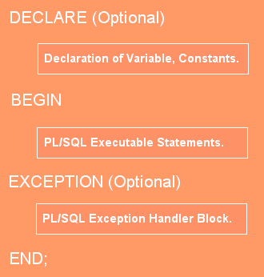
The PL/SQL Block
The PL/SQL blocks are of two types:
Anonymous blocks
Named blocks
Anonymous blocks
do not have any names assigned to them
They need to be created and used in the same session
They will not be stored in the server as database objects

Slide 6
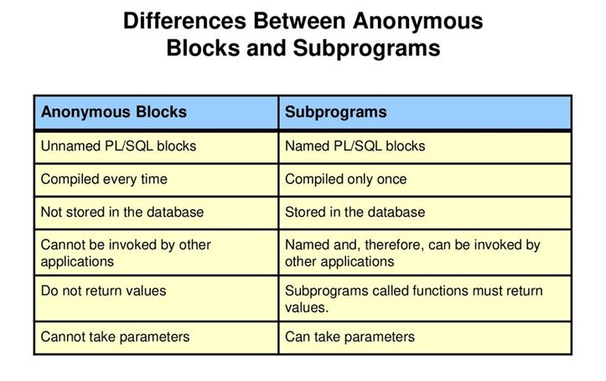
The PL/SQL Block
Named blocks
Named blocks have a specific and unique name for them.
They are stored as the database objects in the database server.
These blocks can be called from other blocks.
The block structure is same as an anonymous block, except it will never start with the keyword ‘DECLARE’. Instead, it will start with the keyword ‘CREATE’ which instruct the compiler to create it as a database object.

Slide 7
Variable Naming Rules
Naming rules for PL/SQL variables:
The variable name should not exceed 30 characters.
Alphabets, digits or special characters like _ , $, #.
It is not case sensitive so it could be either lowercase or uppercase.
Some important points:
Each statement in PL/SQL ends with a semi-colon ‘;’
In the SQL*PLUS environment, the PL/SQL block should end with a front slash ‘/’ as the only character in the last line.
A single line comment should start with two hiphens e.g.
-- this is a comment
Multiple line comment (/*……… */)
Assignment operator is ‘:=‘

Slide 8
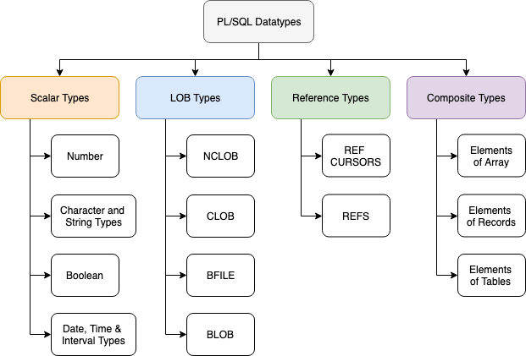
PL/SQL Datatypes (all datatpes of SQL and extra)

Slide 9
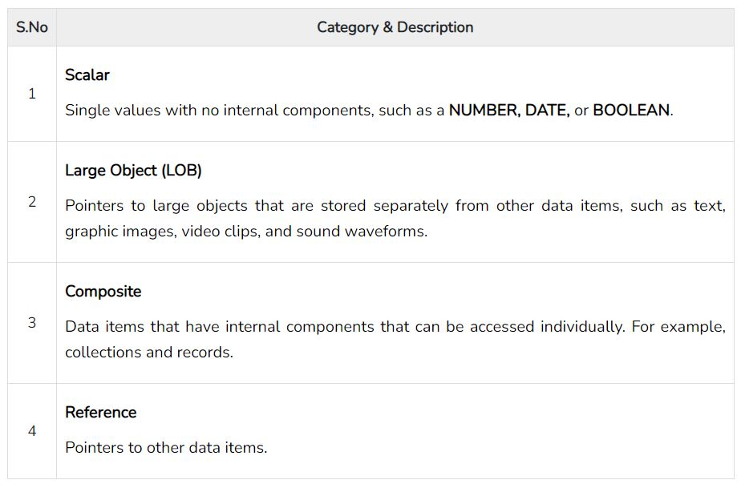
PL/SQL Datatypes (all datatpes of SQL and extra)
The BOOLEAN data type stores logical values that are used in
logical operations.
The values are TRUE and FALSE and the value NULL.

Slide 10
PL/SQL Special Datatypes
declare
a number(10);
b a%type;
name emp.ename%type;
salary emp.sal%type;
r1 emp%rowtype;
begin
….
if r1.sal > 5000 then
…
x := r1.ename;
…
end if;
end;
/
(name has the same datatype and size as that of column ename of emp table)
(r1 has the same structure as one record of emp table)

Slide 11
PL/SQL Special Datatypes
PL/SQL provides the facility to declare a variable without having to specify a particular data type using %TYPE and %ROWTYPE attributes.
Advantages of using %type:
The data type assigned to the associated variables will be determined dynamically at run time.
If the column datatype or size changes, you do not have to make any changes in the variables declared using the %type declaration.
i.e. if the ENAME column of the EMP table changes from VARCHAR2(10) to VARCHAR2(15) then you don’t need to modify the PL/SQL code.

Slide 12
Variables and Constants
declare
a number(10) := 100; (initializing the variable)
b number(2) default 10; ---- do ----
r1 emp%rowtype;
r2 r1%rowtype;
x constant number(2) := 10; (constants to be immediately
initialized)
title constant varchar2(20) := ‘Dept. of CSE’;
begin
-- Execution section begins
exception
/* this is the section where exceptions
are handled */
end;
/

Slide 13
Input and Output
For input from user:
declare
a number(2);
b varchar2(10);
d date;
e boolean;
begin
a := &a; (or :a in some versions)
b := ‘&b’;
d := ‘&d’;
e := true; (or e := false)
...
end;
By default null assigned to each variable
For output on screen:
dbms_output.put_line (‘Hello’);
dbms_output.put(‘Hello’);
Display and go to next line.
Display and cursor remains where it is (after Hello).

Slide 14
Subtypes (user-defined data type)
declare
SUBTYPE name is varchar2(20);
SUBTYPE address is varchar2(50);
emp_name name;
emp_address address;
manager_address address;
BEGIN
emp_name := 'Priya';
emp_address := 'Vadodara';
dbms_output.put_line(emp_name);
dbms_output.put(emp_address);
dbms_output.put_line('AAAAA');
dbms_output.put_line('hiiiii');
end;
/
OUTPUT:
Statement processed.
Priya
VadodaraAAAAA
hiiiii
Notes:
PL/SQL predefines the Subtypes CHARACTER and INTEGER as follows −
subtype character is char;
subtype integer is number(38,0);

Slide 15
Control Statements (Conditions)
IF condition THEN
Statement(s) to be executed;
END IF;
IF condition THEN
Statement(s) to be executed;
ELSE
Statement(s) to be executed;
END IF;
IF condition1 THEN
Statement(s) to be executed;
ELSIF condition2 THEN
Statement(s) to be executed;
ELSIF condition3 THEN
Statement(s) to be executed;
ELSIF condition4 THEN
Statement(s) to be executed;
...
ELSE (optional)
Statement(s) to be executed;
END IF;
** ELSE IF is written as ELSIF

Slide 16
Control Statements (CASE)
CASE [ expression/variable ]
WHEN value_1 THEN result_1
WHEN value_2 THEN result_2
...
WHEN value_n THEN result_n
ELSE result
END;
CASE
WHEN condition_1 THEN result_1
WHEN condition_2 THEN result_2
...
WHEN condition_n THEN result_n
ELSE result
END;
OR

Slide 17
Control Statements (CASE)
DECLARE
grade char(1) := 'A';
grade2 char(1) := 'D';
BEGIN
CASE grade
when 'A' then dbms_output.put_line('Excellent');
when 'B' then dbms_output.put_line('Very good');
when 'C' then dbms_output.put_line('Good');
when 'D' then dbms_output.put_line('Average');
when 'F' then dbms_output.put_line('Passed with Grace');
else dbms_output.put_line('Failed');
END CASE;
CASE
when grade2 = 'A' then dbms_output.put_line('Excellent');
when grade2 ='B' then dbms_output.put_line('Very good');
when grade2 ='C' then dbms_output.put_line('Good');
when grade2 ='D' then dbms_output.put_line('Average');
when grade2 ='F' then dbms_output.put_line('Passed with Grace');
else dbms_output.put_line('Failed');
END CASE;
END;

Slide 18
Iterative Statements
Iterative (LOOP) statements of PL/SQL are:
Basic Loop (infinite)
Basic Loop with EXIT or EXIT WHEN
While Loop
For Loop
Nested Loops
Cursor For Loop
Basic Loop (infinite)
LOOP
statements;
END LOOP;
or
END LOOP L1;
(Can give a name i.e. L1)
Basic Loop with EXIT or EXIT WHEN
LOOP
statements;
EXIT;
{or EXIT WHEN condition;}
END LOOP;

Slide 19
Basic Loop (EXIT)
Write a PL/SQL block which displays the multiplication table of 3.
declare
i number(2);
begin
i := 1;
loop
if i > 10 then
exit;
end if;
dbms_output.put_line (3||' X '||i||' = '||3*i);
i := i + 1;
end loop;
end;
/
3 X 1 = 3 3 X 2 = 6 3 X 3 = 9 3 X 4 = 12 3 X 5 = 15 3 X 6 = 18 3 X 7 = 21 3 X 8 = 24 3 X 9 = 27 3 X 10 = 30

Slide 20
Basic Loop (EXIT WHEN)
Write a PL/SQL block which displays the multiplication table of 3.
declare
i number(2);
begin
i := 1;
loop
exit when i > 10; /* using exit when */
dbms_output.put_line (3||' X '||i||' = '||3*i);
i := i + 1;
end loop;
end;
3 X 1 = 3 3 X 2 = 6 3 X 3 = 9 3 X 4 = 12 3 X 5 = 15 3 X 6 = 18 3 X 7 = 21 3 X 8 = 24 3 X 9 = 27 3 X 10 = 30

Slide 21
WHILE Loop
WHILE <condition>
LOOP
statements;
END LOOP;
declare
i number(2) := 1;
begin
while i < 11
loop
dbms_output.put_line(3||' X '||i||' = '||3*i);
i := i + 1;
end loop;
end;
3 X 1 = 3 3 X 2 = 6 3 X 3 = 9 3 X 4 = 12 3 X 5 = 15 3 X 6 = 18 3 X 7 = 21 3 X 8 = 24 3 X 9 = 27 3 X 10 = 30

Slide 22
FOR Loop
FOR counter IN initial_value .. final_value
LOOP
statements;
END LOOP;
** (NO NEED to declare counter in declare section)
e.g.
FOR i IN 1 .. 10 /* no need to declare i */
LOOP
statements;
END LOOP;
i value starts from 1, step size is 1 and final value is 10.
Cannot change step size.

Slide 23
FOR Loop (IN REVERSE)
FOR counter IN REVERSE initial_value .. final_value
LOOP
statements;
END LOOP;
** (NO NEED to declare counter in declare section)
e.g.
FOR i IN REVERSE 1 .. 10 /* no need to declare i */
LOOP
statements;
END LOOP;
i value starts from 10, step size is -1 and final value is 1.

Slide 24
The CONTINUE command
DECLARE
a NUMBER := 0;
BEGIN
LOOP
a := a + 1;
IF a < = 3 THEN
DBMS_OUTPUT.PUT_LINE ('*');
CONTINUE;
END IF;
DBMS_OUTPUT.PUT_LINE ('#');
EXIT WHEN a = 6;
END LOOP;
DBMS_OUTPUT.PUT_LINE (' After loop: a = ' || TO_CHAR(a));
END;
/
-- After CONTINUE statement, control resumes here
* * * # # # After loop: a = 6

Slide 25
Nested Loops
DECLARE
i number(1);
j number(1);
BEGIN
<< outer_loop >>
FOR i IN 1..3
loop
statements;
<< inner_loop >>
FOR j IN 1..3
loop
statements;
END loop;
statements;
END loop;
END;
/
A loop inside a loop
Can have any number of nested loops
<<label name>> (Can give a name to that point of program)

Slide 26
The Unconditional Jump (GOTO)
DECLARE
variables/constants/etc..
BEGIN
statements;
<<label1>>
statement(s);
<<label2>>
statement(s);
if condition then
goto label1;
end if;
goto label2;
...
...
END;
/
GOTO label
Have to create labels first
There should be at least one executable statement after the label
Cannot jump inside a CASE, another IF statement, Exception handler
Should normally NOT be used

Slide 27
SELECT inside the PL/SQL Block
SELECT column(s) INTO variable(s) FROM table WHERE condition
e.g.
declare
name emp.ename%type;
r1 emp%rowtype;
begin
...
select ename into name from emp where empno = 789;
...
select * into r1 from emp where empno = 789;
...
end;
/

Slide 28
Examples
Take as input employee number from the user. If this employee is earning more than 50000, display ‘Good Salary’ else display ‘Average Salary’.
declare
n emp.empno%type;
s emp.sal%type;
begin
n := &n; -- does not work on liveSQL
select sal into s from emp where empno = n;
if s > 50000 then
dbms_output.put_line (‘Good Salary');
else
dbms_output.put_line (‘Average Salary');
end if;
end;
/

Slide 29
Take as input employee number from the user. If this employee’s salary is less than 5000 give him a 10% raise, if it is between 5000 and 20000 give him 12% raise else give him 25% raise.
declare
n emp.empno%type;
r1 emp%rowtype;
begin
n := &n; -- does not work on liveSQL (take any explicit value)
select * into r1 from emp where empno = n;
if r1.sal < 5000 then
r1.sal := r1.sal * 1.1;
elsif r1.sal between 5000 and 20000 then
r1.sal := r1.sal * 1.12;
else
r1.sal := r1.sal * 1.25;
end if;
update emp set sal = r1.sal
where empno = n; -- (or empno =r1.empno)
commit;
end;
/

Slide 30
declare
n emp.empno%type;
r1 emp%rowtype;
begin
n := &n; -- (n := 7895)
select * into r1 from emp where empno = n;
if r1.sal < 5000 then
r1.sal := r1.sal * 1.1;
elsif r1.sal between 5000 and 20000 then
r1.sal := r1.sal * 1.12;
else
r1.sal := r1.sal * 1.25;
end if;
update emp set sal = r1.sal
where empno = n; -- (or empno =r1.empno)
commit;
exception
when no_data_found then
dbms_output.put_line(‘Employee does not exist’);
end;
/
Exception
handler

Slide 31
Exception Basics
Exceptions
System-defined
User-defined
Named
Approx. 15
Numbered
Approx. 20000
Define it
Raise it
Write handler
Can assign a
user-defined
name to it.

Slide 32
Exception Basics
Named Exceptions:
no_data_found - select does not fetch any values
too_many_rows - select fetches more than one row
value_error - data type mismatch
zero_divide - division by zero somewhere
invalid_cursor - cursor operation is incorrect
---
---
many other –
Once the control goes to the EXCEPTION part of PL/SQL block, the code for the related exception i.e the exception handler is executed and program stops. (control does not go back to the executable block)
Only one exception handler executes at a time
List

Slide 33
Exception Basics
DECLARE
<declarations section>
BEGIN
<executable command(s)>
EXCEPTION
WHEN exception1 THEN
exception1-handling-statements;
WHEN exception2 THEN
exception2-handling-statements;
WHEN exception3 THEN
exception3-handling-statements;
........
WHEN others THEN
exception3-handling-statements;
END;

Slide 34
User Defined Exception
DECLARE
exception_name EXCEPTION;
BEGIN
IF condition THEN
RAISE exception_name;
END IF;
EXCEPTION
WHEN exception_name THEN
statement(s);
END;
/

Slide 35
Take as input employee name from the user.
If this employee exists, change his designation to Director.
If the employee does not exist enter the name in table temp(name).
If there are more than one employees with the same name, give appropriate message.
declare
n emp.ename%type;
r1 emp%rowtype;
begin
n := ‘&n’; -- does not work on liveSQL (take any explicit value)
select * into r1 from emp where ename = n;
update emp set job = ‘DIRECTOR’ where ename = n;
commit;
exception
when no_data_found then
insert into temp values (n);
commit;
when too_many_rows then
dbms_output.put_line(‘Many employees with the name ‘||n);
end;
/

Slide 36
Take as input any string from the user and display the reverse of that string.
declare
s varchar2(15) := ‘ABCDEF’; -- (or s varchar2(15) := ‘&s’)
rs varchar2(15);
begin
for i in reverse 1..length(s)
loop
rs := rs||substr(s, i, 1);
end loop;
dbms_output.put_line(‘Reverse of string ‘||s||’ is ‘||rs);
end;
/
Statement processed.
Reverse of string ABCDEF is FEDCBA

Slide 37
End
of
PL/SQL (Part-1)

Slide 38
Exception | Oracle Error | SQL Code | Description
access_into_null | 06530 | -6530 | it is raised when a null object is automatically assigned a value.
case_not_found | 06592 | -6592 | it is raised when none of the choices in the "when" clauses of a case statement is selected, and there is no else clause.
collection_is_null | 06531 | -6531 | it is raised when a program attempts to apply collection methods other than exists to an uninitialized nested table or varray, or the program attempts to assign values to the elements of an uninitialized nested table or varray.
dup_val_on_index | 00001 | -1 | it is raised when duplicate values are attempted to be stored in a column with unique index.
invalid_cursor | 01001 | -1001 | it is raised when attempts are made to make a cursor operation that is not allowed, such as closing an unopened cursor.
invalid_number | 01722 | -1722 | it is raised when the conversion of a character string into a number fails because the string does not represent a valid number.
login_denied | 01017 | -1017 | it is raised when s program attempts to log on to the database with an invalid username or password.
no_data_found | 01403 | +100 | it is raised when a select into statement returns no rows.

Slide 39
Exception | Oracle Error | SQL Code | Description
not_logged_on | 01012 | -1012 | it is raised when a database call is issued without being connected to the database.
program_error | 06501 | -6501 | it is raised when pl/sql has an internal problem.
rowtype_mismatch | 06504 | -6504 | it is raised when a cursor fetches value in a variable having incompatible data type.
self_is_null | 30625 | -30625 | it is raised when a member method is invoked, but the instance of the object type was not initialized.
storage_error | 06500 | -6500 | it is raised when pl/sql ran out of memory or memory was corrupted.
too_many_rows | 01422 | -1422 | it is raised when a select into statement returns more than one row.
value_error | 06502 | -6502 | it is raised when an arithmetic, conversion, truncation, or size-constraint error occurs.
zero_divide | 01476 | 1476 | it is raised when an attempt is made to divide a number by zero.
Back

