Slide 1
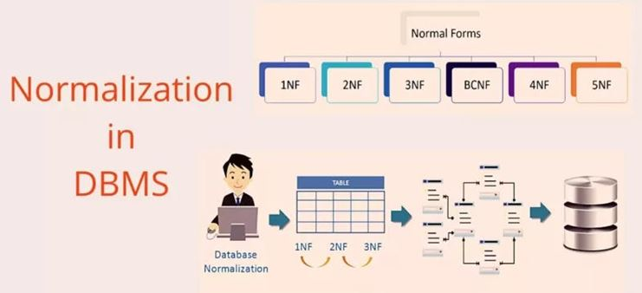
normalization
Courtesy: Silberschatz Korth and Sudarshan, Ramakrishnan and Gehrke
courses.ischool.berkeley.edu, Pratik Parimal, tutorial point
geeksforgeeks, javapoint Anjali Jivani
Notes:
1

Slide 2
what is normalization?
Normalization is
a process of organizing the data in the database.
used to minimize the redundancy from a relation or set of relations.
used to eliminate the undesirable characteristics like Insertion, Update and Deletion Anomalies.
divides the larger table into the smaller table and links them using relationship.
5NF
4NF
BCNF
3NF
2NF
1NF

Slide 3
functional dependencies
Functional dependencies (FDs) are used to specify formal measures of the "goodness" of relational designs.
FDs and keys are used to define normal forms for relations.
FDs are constraints that are derived from the meaning and interrelationships of the data attributes.
Definition:
A set of attributes X functionally determines a set of attributes Y if the value of X determines a unique value for Y.
e.g. empno → sal, passportno → name, rollno → birthdate,
empno,ename → sal,comm
For a value of LHS, only one value for RHS.
e.g. sal → empno (is not a functional dependency)
5000 → many employee numbers, so not a FD.

Slide 4
functional dependencies
X → Y holds if whenever two tuples have the same value for X, they must have the same value for Y.
If t1[X]=t2[X], then t1[Y]=t2[Y] in any relation instance r(R)
e.g. if sal → comm is a FD, then two people having the same salary will have the same commission.
e.g. Project Number determines project name and location
PNUMBER → {PNAME, PLOCATION}
e.g. EMPNO and project number determines the hours per week that the employee works on the project
{EMPNO, PNUMBER} → HOURS
X → Y in R specifies a constraint on all relation instances r(R)
FDs are derived from the real-world constraints on the attributes

Slide 5
functional dependencies
If X → Y holds, X is called the determinant.
If K is a key of R, then K functionally determines all attributes in R {since two tuples (records) of a relation (table) are never same}
i.e. empno → ename,hiredate,sal,comm,job,deptno (empno is key)
e.g. empno → hiredate
empno,ename → hiredate (hiredate actually is not dependent
on both)
This is called partial dependency.
e.g. seatno,subno → marks_obt (marks_obt depends on both the
attributes)
This is called Fully Functionally Dependent (FFD).
A trivial dependency X → Y is one where Y is a subset of X.
e.g. seatno,subno → subno

Slide 6
inference rules of fds
Given a set of FDs F, we can infer additional FDs that hold whenever the FDs in F hold
Armstrong's inference rules (Armstrong’s Axioms)
A1. Reflexive - If Y is a subset-of X, then X → Y
e.g. empno,ename → ename, empno → empno
A2. Augmentation - If X → Y, then XZ → YZ (Notation: XZ stands for X U Z)
e.g. if empno → sal
then empno,ename → sal,ename
A3. Transitive - If X → Y and Y → Z, then X → Z
e.g. if empno → sal and sal → comm
then empno → comm
A1, A2, A3 form a sound and complete set of inference rules
sound (generate only functional dependencies that actually hold) and
complete (generate all functional dependencies that hold).
There are three other rules which are derived from these basic rules.

Slide 7
additional inference rules
Armstrong's inference rules (Armstrong’s Axioms)
A1. Reflexive - If Y is a subset-of X, then X → Y
A2. Augmentation - If X → Y, then XZ → YZ
A3. Transitive - If X → Y and Y → Z, then X → Z
Additional Armstrong’s Axioms: (Proofs)
A4. Decomposition - If X → YZ, then X → Y and X → Z
e.g. if empno → ename,sal then
empno → ename and empno → sal
A5. Union - If X → Y and X → Z, then X → YZ
e.g. if empno → ename
and empno → sal
then empno → ename,sal
A6. Psuedotransitivity - If X → Y and WY → Z, then WX → Z
e.g. if empno → sal
and sal,comm → netpay
then empno,comm → netpay
Closure of a set F of FDs is the set F+ of all FDs that can be inferred from F
GoToSlide38

Slide 8
the 1st normal form
Normal form: Condition using keys and FDs of a relation to certify whether a relation schema is in a particular normal form.
The First Normal Form says that a relation is in the 1NF iff :
The domain of each attribute contains only atomic values, and
The value of each attribute contains only a single value from that domain.
There should not be repeating groups.
OR
‘Every value in a relation should be atomic’
e.g.
1NF
Mem_ID | Borrowed book
C45 | B33
C45 | B44
C45 | B55
C12 | B56
Mem_ID | Borrowed books
C45 | B33, B44, B55
C12 | B56
Not in 1NF
Split the tables

Slide 9
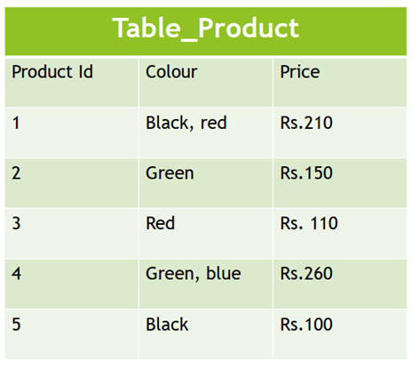
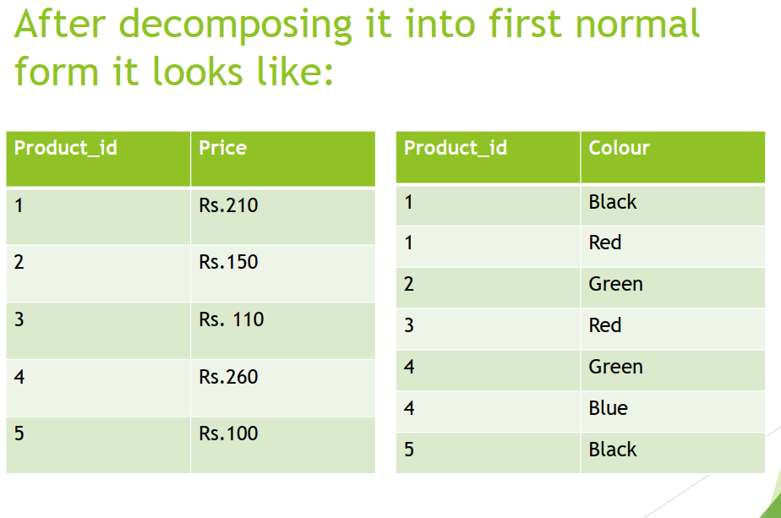
the 1st normal form
This table is not in first normal form because the “Colour” column contains multiple Values.
First normal form enforces these criteria:
Eliminate repeating groups in individual tables.
Create a separate table for each set of related data.
Identify each set of related data with a primary key.
Notes:
student(rollno, name, phone, birthdate, hobbies, deptno)
phone and hobbies are not atomic

Slide 10
the 2nd normal form
The Second Normal Form says that a relation is in the 2NF iff :
The relation should be in 1NF
Every non-key (non-prime) attribute is fully functionally dependent on each candidate key. (That is, we don’t have any partial functional dependency.)
An attribute that is a part of any one of the candidate keys is known as prime attribute.
An attribute that is not part of any of the candidate keys is known as non-prime attribute.

Slide 11
the 2nd normal form
SNO | PNO | SNAME | SADDR | PRICE
S1 | P1 | ACCENTURE | AKOTA | 78
S1 | P2 | ACCENTURE | AKOTA | 50
...
S2 | P1 | EDUSOFT | ALKAPURI | 67
S3 | P4 | EDUSOFT | ALKAPURI | 45
Candidate key is SNO+PNO
SNO,PNO → SNAME,SADDR,PRICE
The table is in 1NF
Partial dependency:
SNAME and SADDR depend only on SNO
Table is not in 2NF
What are the anomalies?
Insertion Anomaly: Cannot insert new supplier details till supplier supplies a part
Updation Anomaly: If supplier address changes, have to change multiple records
Deletion Anomaly: Assume a supplier is supplying only one part e.g. S3 is supplying only part P4. If for some reason S3 stops supplying P4, removing this record would result in loosing information about S3 too.
2NF:
Split the table: SUPPLIER(SNO,SNAME,SADDR), SUPPLY(SNO,PNO,PRICE)
Anomalies resolved:
Insertion: Can insert new supplier anytime in SUPPLIER table
Updation: Only one record to be updated if address changes
Deletion: If S1 stops supplying P1, a record deleted from SUPPLY table, S1 details remain.

Slide 12
the 2nd normal form
Seatno | Sno | Name | Bdate | Subname | Maxmarks | Passmarks | Marks_obt
Seatno | Name | Bdate
Sno | Subname | Maxmarks | Passmarks
Seatno | Sno | Marks_obt
Check for 2NF only if the key is concatenated. (Else FFD will not occur)

Slide 13
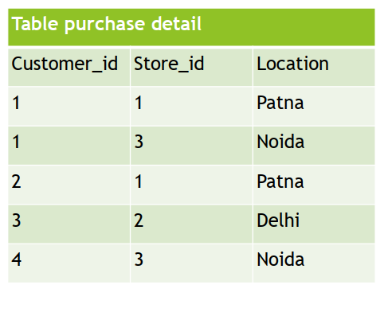
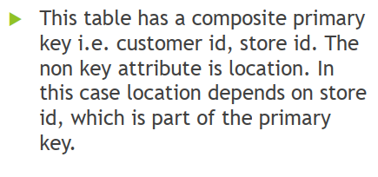

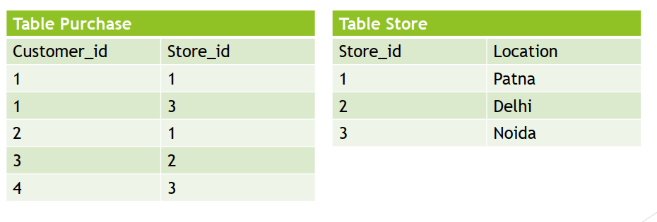
the 2nd normal form

Slide 14
the 3rd normal form
The Third Normal Form says that a relation is in the 3NF iff :
The Relation must be in 2NF
Transitive functional dependency of non-prime attribute on any candidate key should be removed.
OR
A table is in 3NF if,
It is in 2NF
All non-prime attributes are non-transitively dependent on every candidate key. i.e.
Basically, if A → B and B → C then A → C should not exist if A is a candidate key and B and C are non-prime.
Check for 3NF only if there are at least two non-prime attributes. (Else transitivity will not occur)

Slide 15
the 3rd normal form
Empno | Ename | Sal | Job | ProjNo | Comp_dt | Comm | Deptno
Conditions:
Every employee works on only one project.
Every project has a completion date
FDs based on the conditions:
empno → projno
projno → comp_dt
⸫ empno → compl_dt (transitivity)
Is this relation in the 3NF?
Relation is in 2NF as there are no concatenated keys (first condition satisfied)
Transitivity present (second condition not satisfied)
Relation is not in 3NF.
What are the anomalies?
Insertion Anomaly: Cannot insert new project details till an employee works on it.
Updation Anomaly: If completion date of a project changes, have to change multiple records.
Deletion Anomaly: Assume a project has only one employee working on it. If that employee leaves, removing the employee record would result in loosing information about the project too.

Slide 16

the 3rd normal form
Every employee works on only one project.
Empno | Ename | Sal | Job | ProjNo | Comp_dt | Comm | Deptno
Empno | Ename | Sal | Job | Comm | Deptno | ProjNo
ProjNo | Comp_dt
3NF:
Split the table: EMP(EMPNO,ENAME,SAL,JOB,COMM,DEPTNO,PROJNO), PROJECT(PROJNO,COMP_DT)
Anomalies resolved:
Insertion: Can insert new project anytime in PROJECT table
Updation: Only one record to be updated if compl_dt changes
Deletion: Even if emp leaves, project details remain.

Slide 17
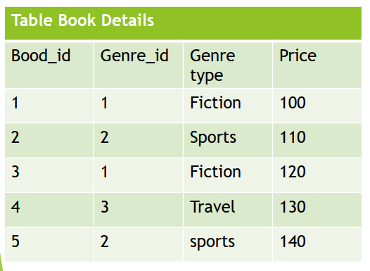

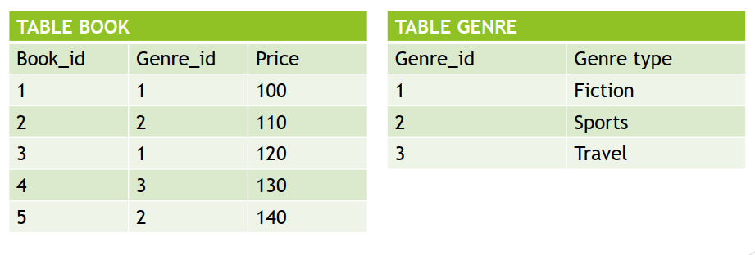
the 3rd normal form
In the given table there is transitivity.
Book_id Genre_id
Genre_id Genre_type
⸫ Book_id Genre_type
Table is not in the 3rd Normal Form.
y

Slide 18
Example
PID | District | Lotno | Area | Price | Tax
P1 | Abad | 1 | 2500 | 500 | 60
P2 | Abad | 2 | 5000 | 3000 | 60
... | ...
P25 | Bda | 1 | 500 | 50 | 40
P26 | Bda | 2 | 1500 | 250 | 40
... | ...
This relation stores details about different empty plot areas in Gujarat.
Price depends on area and every district has its own tax rate.
What are the Functional Dependencies??
area → price
district → tax
Which are the candidate keys?
PID
District+Lotno
PID would be chosen as the primary key
The above relation is in 1NF

Slide 19
Example
1
PID | District | Lotno | Area | Price | Tax
2
3
PID | District | Lotno | Area | Price
District | Tax
Is it in 2NF?
NO!
district, Lotno → tax (partial dependency) as,
district → tax
After splits, we have table 2 and 3 which are in 2NF.

Slide 20

Example
2
PID | District | Lotno | Area | Price
4
5
PID | District | Lotno | Area
Area | Price
Is the relation 2 in 3NF?
NO!
PID → area
area → price
PID → price (Transitivity)
After splits, we have table 4 and 5 which are in 3NF.

Slide 21
Example
1
PID | District | Lotno | Area | Price | Tax
1NF
2
3
PID | District | Lotno | Area | Price
District | Tax
2NF
4
5
PID | District | Lotno | Area
Area | Price
3NF
Final normalized tables: 3, 4 and 5.

Slide 22
the boyce codd normal form (BCNF)
A table is in BCNF if,
It is in the 3NF and,
for every functional dependency X → Y, X is the super key of the table i.e. X cannot be non-prime if Y is prime.
‘A relation is in BCNF, if and only if, every determinant is a candidate key.’
A 3NF relation is NOT in BCNF if:
Candidate keys in the relation are composite keys (they are not single attributes)
There is more than one candidate key in the relation, and
The keys are not disjoint, that is, some attributes in the keys are common

Slide 23
BCNF
For the college enrollment table given on the RHS, the FDs are:
One student can enrol for multiple subjects.
For each subject, a professor is assigned to the student.
And, there can be multiple professors teaching one subject like we have for Java.
One professor can teach only one subject
Keys??
Case 1.
student_id + subject → professor
or
Case 2.
student_id + professor → subject
student_id | subject | professor
101 | Java | P.Java1
101 | C++ | P.Cpp
102 | Java | P.Java2
103 | C# | P.Chash
104 | Java | P.Java1
Case 1.
student_id + subject → professor
but, professor → subject
i.e. non-prime identifies prime
or
Case 2.
student_id + professor → subject
(Better option)

Slide 24
BCNF
student_id | subject | professor
101 | Java | P.Java
101 | C++ | P.Cpp
102 | Java | P.Java2
103 | C# | P.Chash
104 | Java | P.Java
student_id | professor
101 | P.Java1
101 | P.Cpp
102 | P.Java2
103 | P.Chash
104 | P. Java1
professor | subject
P.Java1 | Java
P.Cpp | C++
P.Java2 | Java
P.Chash | C#

Slide 25
the boyce codd normal form (BCNF)
Consider a relation R(A,B,C,D) with FDs
A→BCD (1)
BC→AD (2)
D→B (3)
Find the key(s) and normal form.
A→A (4) reflexivity
A→ABCD from (1), (4), union, A is the key
BC→ABCD (5) (2), reflexivity, union, BC is key
DC→ABCD (5), (3) pseudo-transitivity, DC is key
Keys – A, BC, DC
All are prime attributes
Relation is in 3NF but not in BCNF as keys are BC and DC are overlapping
So split the table,
R1 (A, D, C) 2. R2 (D, B)
Notes:
property(pid, district, lotno, area, price, tax)
For every district, lotno starts from 1
Price depends on area
tax depends on district
Keys: pid and district+lotno
FDs: area → price (1)
district → tax (2)
property(pid, district, lotno, area, price, tax) – 2 candidate keys
it is 1NF
Not in 2NF because of (2) – partial dependency
property(pid, district, lotno, area, price), taxdetails(district, tax) - In 2NF now
Not in 3NF because of (1) – transitivity present
property(pid, district, lotno, area), Pricetable(area, price) – In 3NF now
Final normalized tables(upto 3NF):
property(pid, district, lotno, area)
Pricetable(area, price)
taxdetails(district, tax)
If according to the data available we find that if area is,
500, 1500, 2500, etc. district is Abad
1000, 2000, 3000, etc. district is Surat
200, 1200, 2200, etc. district is Vda
i.e FD now is area → district
In table-1, non-prime identifies prime attribute so relation is not in BCNF.
Split the table-1,
property(pid, district, lotno, area) into –
4. property(pid, lotno, area)
5. areatable(area, district)
We can join table-2 and table-5 (denormalization)
a_p_table(area, price, district)
Final tables after normalizing till BCNF:
property(pid, lotno, area)
taxdetails(district, tax)
a_p_table(area, price, district)

Slide 26
the 4th normal form
Empno | Projno | dependent
101 | P1 | D1
101 | P2 | D2
101 | P1 | D3
102 | P5 | Dnull
Any relation is in Fourth Normal Form if it is BCNF and any multivalued dependencies are trivial
Eliminate non-trivial multivalued dependencies by projecting into simpler tables
e.g. one employee can work on many projects and one employee can have zero or more dependents
Empno | Projno
101 | P1
101 | P2
102 | P5
… | …
Empno | dependent
101 | D1
101 | D2
101 | D3
… | …
Notes:
trivial dependency – FDs that include the LHS on the RHS.
A trivial functional dependency is a database dependency that occurs when you describe a functional dependency of an attribute or of a collection of attributes that includes the original attribute.

Slide 27
the 4th normal form
Empno | Projno | dependent
101 | P1 | D1
101 | P2 | D2
101 | P1 | D3
102 | P5 | Dnull
Empno | Projno
101 | P1
101 | P2
102 | P5
… | …
Empno | dependent
101 | D1
101 | D2
101 | D3
… | …
What are the anomalies?
Insertion Anomaly: To insert a project for an employee, a dependent is required and to insert a dependent, a project is required .
Updation Anomaly: If a project number changes, multiple records to be changes. e.g. if P1 changes to P6 for empno 101, then two records to be updated.
Deletion Anomaly: If an employee stops working on a project, deleting that record could result in losing information about the dependent and vice-versa. E.g. if 101 stops working on P1, deleting that record results in deleting information about D1 and D3.

Slide 28
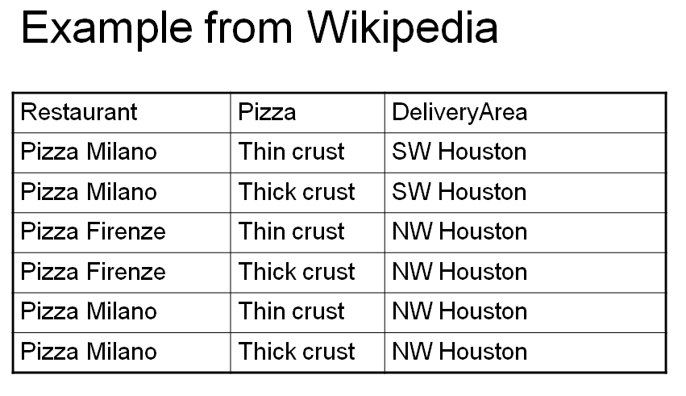
the 4th normal form
The table has no non-key attributes
Key is { Restaurant, Pizza, DeliveryArea}
Two non-trivial multivalued dependencies
Restaurant → → Pizza
Restaurant → → DeliveryArea
since each restaurant delivers the same pizzas to all its delivery areas

Slide 29
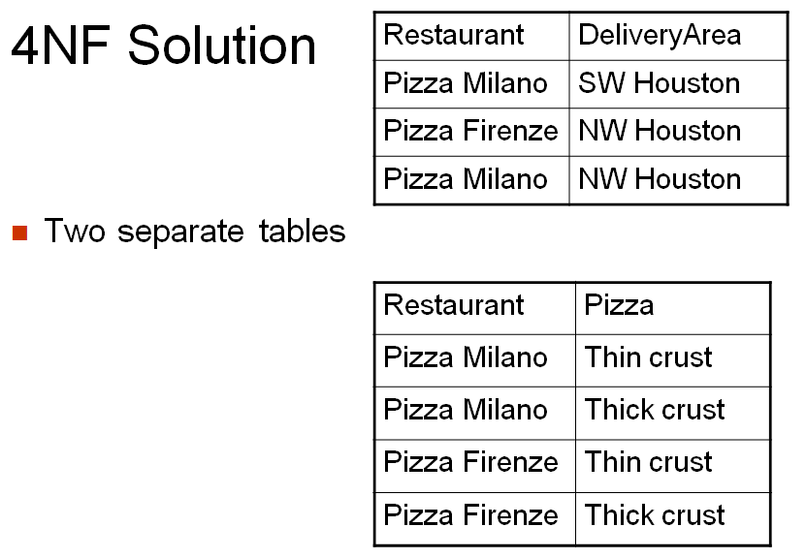
the 4th normal form

Slide 30
the 5th normal form
A relation is in 5NF if every join dependency in the relation is implied by the keys of the relation
Implies that relations that have been decomposed in previous normal forms can be recombined via natural joins to recreate the original relation.
Also called the Project-Join Normal form
SNO | PNO | JNO
SNO | PNO
PNO | JNO
JNO | SNO
Top down is projection and bottom up is join
Split the table in such a way that a natural join on the bottom relations gives the original top relation

Slide 31
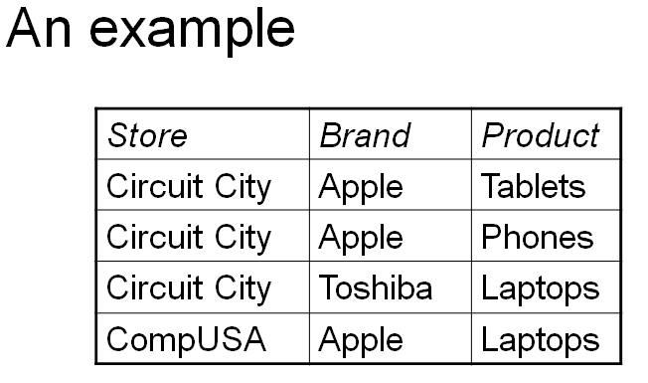
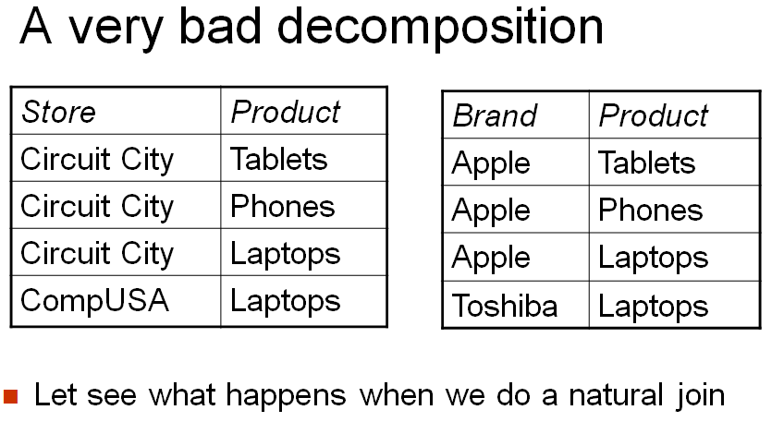
the 5th normal form
Note that Circuit City sells Apple tablets and phones but only Toshiba laptops

Slide 32
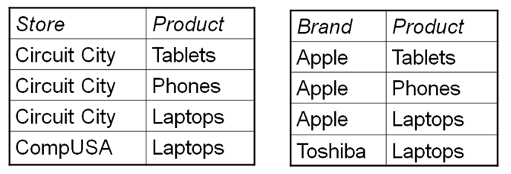
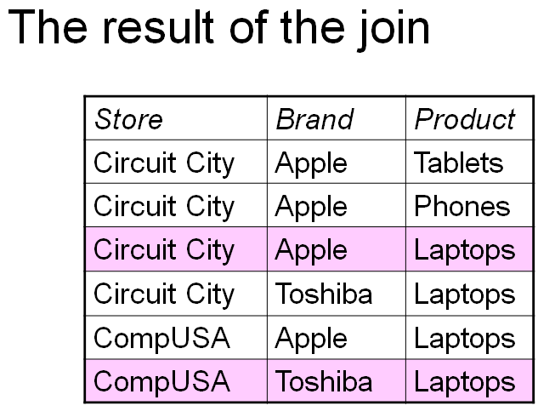
the 5th normal form
Introduces two spurious tuples (Extra)

Slide 33
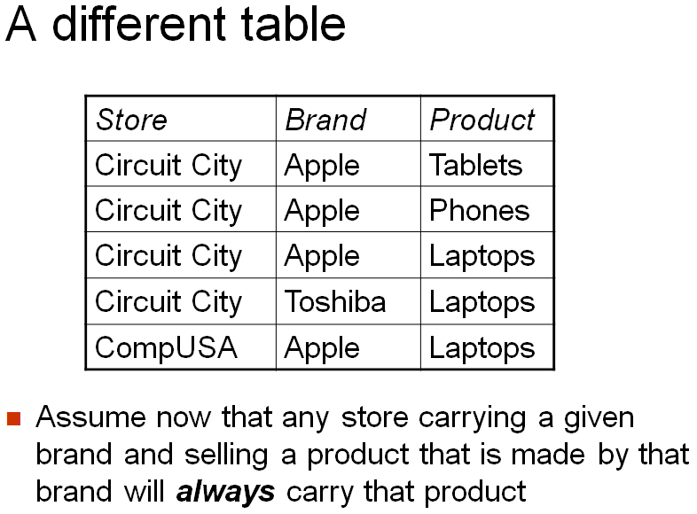
the 5th normal form

Slide 34
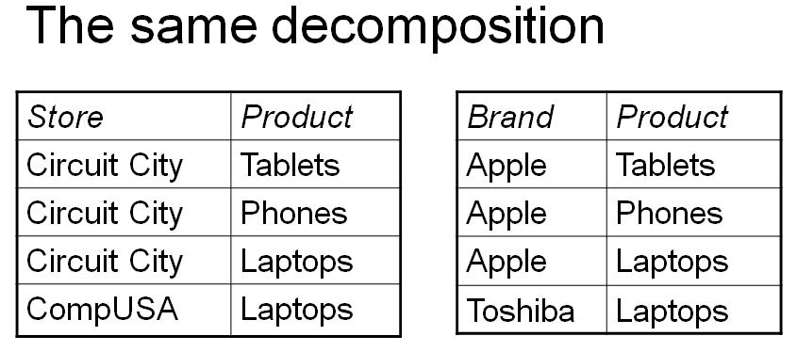
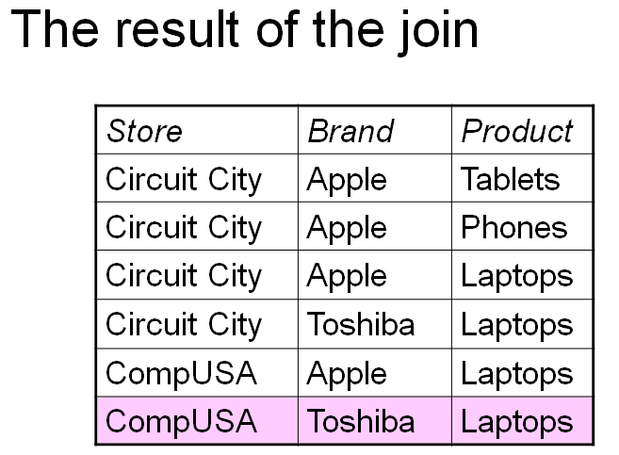
the 5th normal form
Let see what happens when we do a natural join:
Still one spurious tuple

Slide 35
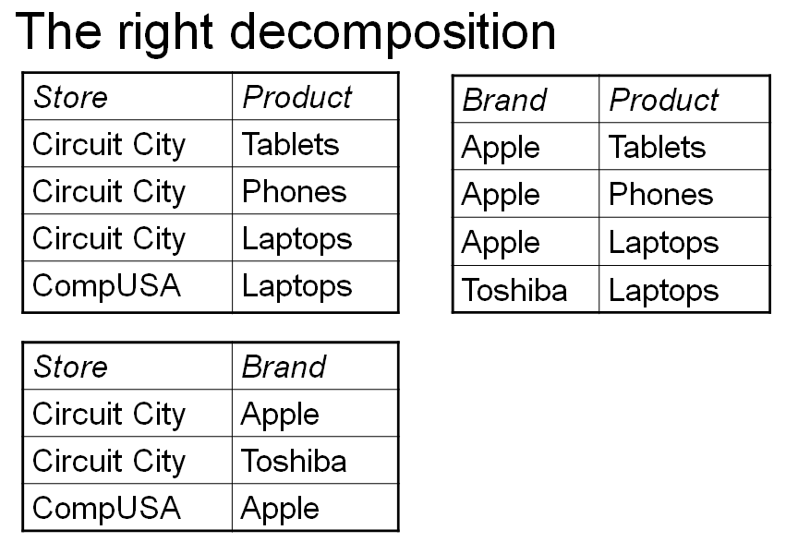
the 5th normal form
The first "big" table was 5NF
A natural join between these three tables will give the original one

Slide 36
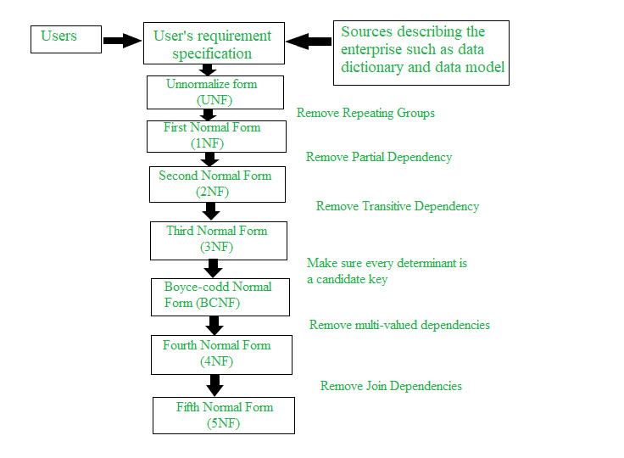
normal forms

Slide 37
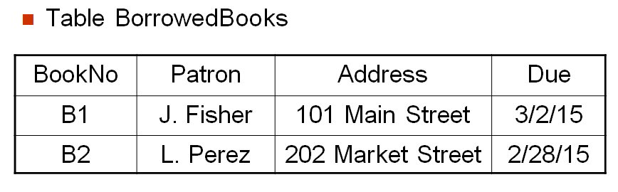
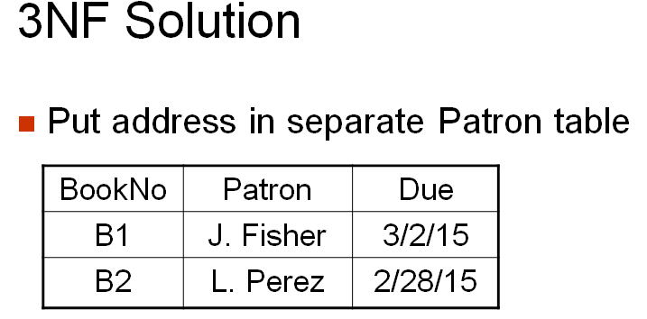
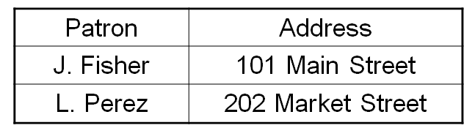
examples
Conditions:
A patron can borrow more than one book
A book is borrowed by one patron only
Candidate key?
BookNo
Patron → Address
Transitivity present

Slide 38
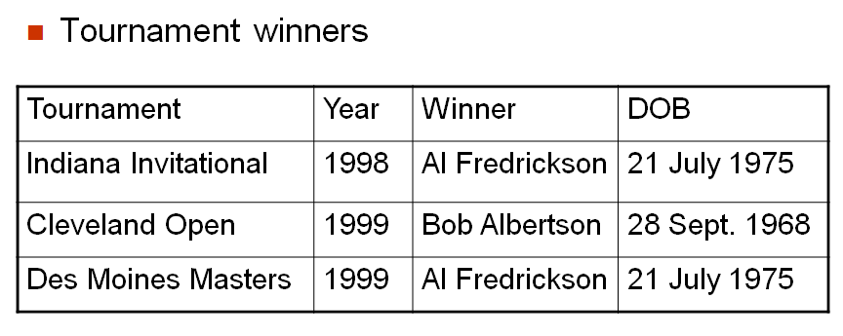
examples
Key is {Tournament, Year}
Normal Form??
It is in 1NF
All non-prime attributes – Winner and DOB depend on the whole key (FFD)
It is in 2NF
Winner → DOB
Not in 3NF
Tournament, Year → Winner
Winner → DOB
Tournament, Year →DOB (Transitivity)
Tournament_Winner(Tournament, Year, Winner)
Winner_details(Winner, DOB)
3NF

Slide 39
examples
Consider a relation R(A,B,C,D,E) with FDs
A→BCDE (1)
BC→ADE (2)
D→E (3)
Find the key(s) and normal form. Armstrong
A→A (4) reflexivity
A→ABCDE from (1), (4), union, A is the key
BC→ABCDE (2), reflexivity, union, BC is key
R(A BC DE)
From (3), there is transitivity hence it is not in 3NF.
BC is key and all the rest are fully functionally dependent on both, hence relation is in 2NF.
Consider a relation R(city,street,zip) or R(C,S,Z) and FDs,
CS→Z (1)
Z→C (2)
Find the key(s) and normal form.
CS→CS (3) reflexivity
CS→CSZ (4) from (1), (3), union CS is a key
ZS→CS (5) from (2), augmentation
ZS→CSZ from (5), (4), transitivity ZS is a key
There are no non-prime attributes so it is in 3NF. (Not in BCNF)
Notes:
R(CSZ)
Splits (BCNF)
R1(ZC) R2(SZ)

Slide 40
examples
Consider the relation R(ABCDEFGHIJ) and FDs are:
AB→C (1)
A→DE (2)
B→F (3)
F→GH (4)
D→IJ (5)
---------------------------------------------------------------------
AB→ABC (6) from reflexivity, (1)
AB→ABCDE (7) from (2), (6) union (AB→A and A→DE, so AB→DE)
AB→F (8) from (6), (3), transitivity
AB→GH (9) from (8), (4), transitivity
AB→IJ (10) from (7), (5), transitivity
AB→ABCDEFGHIJ from (7),(8),(9),(10), union AB is the key
----------------------------------------------------------------------
R(ABCDEFGHIJ)
A→DE (2), which means D and E depend on only A and not AB (not FFD)
So R is not in 2NF.
R is in 1NF.

Slide 41
examples
Consider a relation R(ABCDEF) with the following set of FDs: (Find key(s) and NF).
A→C (1)
C→A (2)
C→E (3)
B→F (4)
AD→B (5)
--------------------------------------------------
A→ACE (6)
C→ACE (7)
B→BF (8)
AD→BF (9) from (5), (4), transitivity
AD→ACED (10) from (6), augment. D
AD→ABCDEF (11) from (9), (10), union
CD→ABCDEF from (2), (11), pseudotransitivity
AD→ABCDEF key
CD→ABCDEF key
--------------------------------------------------
R(ADBCEF)
From (3) E depends only on C and not CD together (not FFD).
The relation is not in 2NF, it is in 1NF.

Slide 42
examples
Consider a relation R(A,B,C,D,E) with F = { A →B, BC→E, ED→A}. Given R is in which highest normal form?
A→B (1)
BC→E (2)
ED→A (3)
---------------------------------------------------
AC→E (4) from (1), (2), pseudo-transitivity
ACD→ED (5) from (4), augmentation D
BCD→A (6) (2), (3), pseudo-transitivity
ACD→ABCDE from (5), (1) (ACD→A, A →B), decomp., transitivity
BCD→ABCDE from (6), (2)
ECD→ABCDE
ACD, BCD and ECD are keys.
---------------------------------------------------
All are prime attributes. Overlapping keys so not in BCNF.

Slide 43
examples
AE → AE (augment)
AE → ABCDEF (1,2,3,4 transitivity)
AE is key
CE → CE
CE → ABD (5,1,2,3)
CE → ABCDEF
CE is key
BE → BE
BE → CDA (2,3,5)
BE → ABCDEF
BE is key
DE → DE
DE → F (4)
DE → DEF
DE is not a key
Keys are: AE, BE, CE
Not FFD as D depends only on C, so R is in 1NF.
A relation schema R(ABCDEF) have the following FDs:
A → B 1
B → C 2
C → D 3
E → F 4
C → A 5
-------------------------------------------
A → ABCD
B → BCDA
C → CDAB
E → EF
-------------------------------------------

Slide 44
closure
Given a set F set of functional dependencies, there are certain other functional dependencies that are logically implied by F.
For example: If A → B and B → C, then we can infer that A → C
The set of all functional dependencies logically implied by F is the closure of F.
We denote the closure of F by F⁺.
R = (A, B, C, G, H, I) F = { A → B A → C CG → H CG → I B → H}
Some members of F⁺
A → H
by transitivity from A → B and B → H
AG → I
by augmenting A → C with G, to get AG → CG and then transitivity with CG → I
CG → HI
by augmenting CG → I to infer CG → CGI,
and augmenting of CG → H to infer CGI → HI, and then transitivity

Slide 45
attribute closure
R = (A, B, C, G, H, I)
F = { A → B A → C CG → H CG → I B → H}
(A)⁺
A → A
A → AB
A → ABC
A → ABCH
(A)⁺ is ABCH
(AG)⁺
AG → AG
AG → AGBC (A → C and A → B)
AG → ABCGH (CG → H and CG ⊆ AGBC)
AG → ABCGHI (CG → I and CG ⊆ AGBCH)
(AG)⁺ is ABCGHI

Slide 46
uses of attribute closure
There are several uses of the attribute closure algorithm:
Testing for superkey:
To test if α is a superkey, we compute α^{+,} and check if α⁺ contains all attributes of R.
Testing functional dependencies
To check if a functional dependency α → β holds (or, in other words, is in F⁺), just check if β ⊆ α⁺.
That is, we compute α⁺ by using attribute closure, and then check if it contains β.
Is a simple and cheap test, and very useful
Computing closure of F
For each γ ⊆ R, we find the closure γ⁺, and for each S ⊆ γ⁺, we output a functional dependency γ → S.

Slide 47
canonical cover
Sets of functional dependencies may have redundant dependencies that can be inferred from the others
For example: A → C is redundant in: {A → B, B → C}
Parts of a functional dependency may be redundant
E.g.: on RHS: {A → B, B → C, A → CD} can be simplified to -
{A → B, B → C, A → D}
E.g.: on LHS: {A → B, B → C, AC → D} can be simplified to –
{A → B, B → C, A → D}
Intuitively, a Canonical Cover of F is a “minimal” set of functional dependencies equivalent to F, having no redundant dependencies or redundant parts of dependencies.

Slide 48
extraneous attributes
Example: Given F = {A → C, AB → C }
B is extraneous in AB → C because {A → C, AB → C} logically implies
A → C (i.e. the result of dropping B from AB → C).
Example: Given F = {A → C, AB → CD}
C is extraneous in AB → CD since AB → C can be inferred even after deleting C
Final Fc is:
A → C
AB → D

Slide 49
extraneous attributes
Consider a set F of functional dependencies and the functional dependency
α → β in F.
Attribute A is extraneous in α if A ∈ α and F logically implies (F – {α → β}) ∪ {(α – A) → β}.
Attribute A is extraneous in β if A ∈ β and the set of functional dependencies (F – {α → β}) ∪ {α →(β – A)} logically implies F.
Note: implication in the opposite direction is trivial in each of the cases above, since a “stronger” functional dependency always implies a weaker one

Slide 50
testing for extraneous attributes
Consider a set F of functional dependencies and the functional dependency α → β in F.
To test if attribute A ∈ α is extraneous in α
compute ({α} – A)⁺ using the dependencies in F
check that ({α} – A)⁺ contains β; if it does, A is extraneous in α
To test if attribute A ∈ β is extraneous in β
compute α⁺ using only the dependencies in F’ = (F – {α → β}) ∪ {α →(β – A)},
check that α⁺ contains A; if it does, A is extraneous in β

Slide 51
canonical cover
A canonical cover for F is a set of dependencies F_{c} such that
F logically implies all dependencies in F_{c} , and
F_{c} logically implies all dependencies in F and
No functional dependency in F_{c} contains an extraneous attribute, and
Each left side of functional dependency in F_{c} is unique.
To compute a canonical cover for F: repeat Use the union rule to replace any dependencies in F α₁ → β₁ and α₁ → β₂ with α₁ → β₁ β₂ Find a functional dependency α → β with an extraneous attribute either in α or in β If an extraneous attribute is found, delete it from α → β until F does not change
Note: Union rule may become applicable after some extraneous attributes have been deleted, so it has to be re-applied

Slide 52
canonical cover example
R = (A, B, C) F = {A → BC B → C A → B AB → C}
Combine A → BC and A → B into A → BC
Set is now {A → BC, B → C, AB → C}
A is extraneous in AB → C
Check if the result of deleting A from AB → C is implied by the other dependencies
Yes: in fact, B → C is already present!
Set is now {A → BC, B → C}
C is extraneous in A → BC
Check if A → C is logically implied by A → B and the other dependencies
Yes: using transitivity on A → B and B → C.
Can use attribute closure of A in more complex cases
The canonical cover is: A → B B → C

Slide 53
Decomposition in normalization
When a relation in the relational model is not in appropriate normal form then the decomposition of a relation is required.
In a database, it breaks the table into multiple tables.
If the relation has no proper decomposition, then it may lead to problems like loss of information.
Decomposition is used to eliminate some of the problems of bad design like anomalies, inconsistencies, and redundancy.
Types of Decomposition
Lossless Decomposition
Dependency Preserving

Slide 54
lossless decomposition
If the information is not lost from the relation that is decomposed, then the decomposition will be lossless.
The lossless decomposition guarantees that the join of relations will result in the same relation as it was decomposed.
The relation is said to be lossless decomposition if natural joins of all the decomposition give the original relation. e.g. if the split is incorrect
R
Empno | Ename | Sal | Deptno | Dname | Loc
R1
Empno | Ename | Sal | Loc
R2
Deptno | Dname | Loc

Slide 55
R
Empno | Ename | Sal | Deptno | Dname | Loc
111 | James | 5000 | 10 | Sales | Boston
112 | Peter | 6500 | 20 | Accounts | Chicago
113 | Martin | 4670 | 30 | Admin | Boston
114 | John | 6540 | 40 | Marketing | null
... | ... | ...
R1
R2
Empno | Ename | Sal | Loc
111 | James | 5000 | Boston
112 | Peter | 6500 | Chicago
113 | Martin | 4670 | Boston
114 | John | 6540 | null
... | ... | ...
Deptno | Dname | Loc
10 | Sales | Boston
20 | Accounts | Chicago
30 | Admin | Boston
40 | Marketing | null

Slide 56
Empno | Ename | Sal | Loc
111 | James | 5000 | Boston
112 | Peter | 6500 | Chicago
113 | Martin | 4670 | Boston
114 | John | 6540 | null
Deptno | Dname | Loc
10 | Sales | Boston
20 | Accounts | Chicago
30 | Admin | Boston
40 | Marketing | null
⨝
Empno | Ename | Sal | Loc | Deptno | Dname | Loc
111 | James | 5000 | Boston | 10 | Sales | Boston
111 | James | 5000 | Boston | 30 | Admin | Boston
112 | Peter | 6500 | Chicago | 20 | Accounts | Chicago
113 | Martin | 4670 | Boston | 10 | Sales | Boston
113 | Martin | 4670 | Boston | 30 | Admin | Boston
114 tuple is not connected to any tuple of Dept table because of null value

Slide 57
Original Table
R
Empno | Ename | Sal | Deptno | Dname | Loc
111 | James | 5000 | 10 | Sales | Boston
112 | Peter | 6500 | 20 | Accounts | Chicago
113 | Martin | 4670 | 30 | Admin | Boston
114 | John | 6540 | 40 | Marketing | null
... | ... | ...
Table after joining the splits: (Lossy Decomposition)
Empno | Ename | Sal | Loc | Deptno | Dname | Loc
111 | James | 5000 | Boston | 10 | Sales | Boston
111 | James | 5000 | Boston | 30 | Sales | Boston
112 | Peter | 6500 | Chicago | 20 | Accounts | Chicago
113 | Martin | 4670 | Boston | 10 | Sales | Boston
113 | Martin | 4670 | Boston | 30 | Admin | Boston
... | ... | ... | ...
Extra rows created (Spurious tuples)

Slide 58
lossless decomposition
The actual decomposition should have been:
R
Empno | Ename | Sal | Deptno | Dname | Loc
R1
Empno | Ename | Sal | Deptno
R2
Deptno | Dname | Loc
The lossy decomposition was due to the split containing Loc instead of Deptno i.e. the foreign key was not included.

Slide 59
Empno | Ename | Sal | Deptno
111 | James | 5000 | 10
112 | Peter | 6500 | 20
113 | Martin | 4670 | 30
114 | John | 6540 | 40
Deptno | Dname | Loc
10 | Sales | Boston
20 | Accounts | Chicago
30 | Admin | Boston
40 | Marketing | null
⨝
Empno | Ename | Sal | Deptno | Deptno | Dname | Loc
111 | James | 5000 | 10 | 10 | Sales | Boston
112 | Peter | 6500 | 20 | 20 | Accounts | Chicago
113 | Martin | 4670 | 30 | 30 | Admin | Boston
114 | John | 6540 | 40 | 40 | Marketing | null
We get the original table R

Slide 60
Checking for lossless decomposition
If we decompose a relation R into relations R1 and R2,
Decomposition is lossy if R ⸦ (R1 ⋈ R2)
i.e. the natural join after the splits contains more tuples than the
original relation (spurious tuples exist).
Decomposition is lossless if R1 ⋈ R2 = R
To check for lossless join decomposition using FD set, following conditions must hold:
Union of Attributes of R1 and R2 must be equal to attributes of R. Each attribute of R must be either in R1 or in R2.
Att(R1) U Att(R2) = Att(R)
Intersection of Attributes of R1 and R2 must not be NULL.
Att(R1) ∩ Att(R2) ≠ Φ (deptno is common in EMP and Dept)
Common attribute must be a key for at least one relation (R1 or R2)
R1 ∩ R2 → key of (R1) or key of (R2)

Slide 61
Dependency preserving
The splits (the new relations) created due to normalization should satisfy the following:
In the dependency preservation, at least one decomposed table must satisfy every dependency.
If a relation R is decomposed into relation R1 and R2, then the functional dependencies of R either must be a part of R1 or R2 or must be derivable from the combination of functional dependencies of R1 and R2.
For example, suppose there is a relation R (A, B, C, D) with functional dependency set (A → BC).
The relational R is decomposed into R1(ABC) and R2(AD) which is dependency preserving because FD A → BC is a part of relation R1(ABC).
So basically no functional dependency should be lost when tables/relations are split.

Slide 62
examples
A relation R (ABCDE) with id set of FDs:
A → BC 1
C → DE 2
D → E 3
And the decomposition: R1 (ABCD) & R2 (DE)
Is it dependency preserving?
R1 (ABCD) would have FDs,
A → BC 4
C → D 5
R2 (DE) would have FDs,
D → E 6
Combining them we have 4, 5 and 6.
From 5, 6 and transitivity we have,
C → E 7
C → DE 8 from 5, 7, union
Original FDs of R - 1, 2, 3 are same as 4, 8, 6 as derived from R1 and R2
Therefore it is dependency preserving.

Slide 63
examples
A relation R (ABCDE) with id set of FDs:
A → BC 1
C → DE 2
D → E 3
And the decomposition: R1 (ABCD) & R2 (DE)
Is it lossless decomposition?
R1 (ABCD) would have FDs,
A → BC 4
C → D 5
A → ABCD – A is key
R2 (DE) would have FDs,
D → E 6 – D is key
For lossless decomposition,
R1 ∩ R2 = D (which is key of R2)
Hence it is lossless decomposition.

Slide 64
examples
Consider a schema R(A,B,C,D) and functional dependencies
A → B 1
C → D 2
Find whether the decomposition of R into R1(AB) and R2(CD) is lossless and dependency preserving.
R1(AB)
A → B 3 A is key
R2(CD)
C → D 4 C is key
R1 ∩ R2 = Ø - it is NOT LOSSLESS (It is lossy)
FDs on R are 1 and 2 and combined FDs of R1 and R2 are 3 and 4.
1, 2 are same as 3, 4 - it is DEPENDENCY PRESERVING
Actual splits should have been: R1(ABC) C is Fk, and R2(CD)
R1 ∩ R2 = C which is a key

Slide 65
effects of normalization
Normalization is performed to reduce or eliminate Insertion, Deletion or Update anomalies.
However, a completely normalized database may not be the most efficient or effective implementation.
“Denormalization” is sometimes used to improve efficiency.
Normalization splits database information across multiple tables.
To retrieve complete information from a normalized database, the JOIN operation must be used.
JOIN tends to be expensive in terms of processing time, and very large joins are very expensive.
Denormalization
Usually driven by the need to improve query speed
Query speed is improved at the expense of more complex or problematic DML (Data manipulation language) for updates, deletions and insertions.

Slide 66
downward denormalization
Before:
Customer
ID
Address
Name
Telephone
After:
Customer
ID
Address
Name
Telephone
Order
Order No
Date Taken
Date Dispatched
Date Invoiced
Cust ID (Fk)
Order
Order No
Date Taken
Date Dispatched
Date Invoiced
Cust ID
Cust Name

Slide 67
upward denormalization
Before:
Order
Order No
Date Taken
Date Dispatched
Date Invoiced
Cust ID
Cust Name
After:
Order
Order No
Date Taken
Date Dispatched
Date Invoiced
Cust ID
Cust Name
Order Amt (Added)
Order Item
Order No
Item No
Item Price
Num Ordered
Order Item
Order No
Item No
Item Price
Num Ordered

Slide 68


Deriving the secondary Armstrong’s axioms
Decomposition:
Proof:

Slide 69

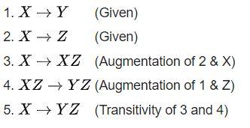
Deriving the secondary Armstrong’s axioms
Union:
Proof:

Slide 70

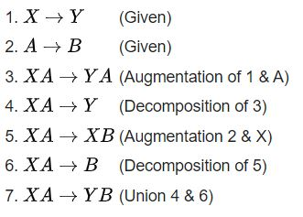
Deriving the secondary Armstrong’s axioms
Composition:
Proof:

Slide 71

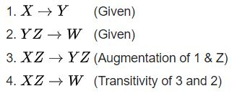
Deriving the secondary Armstrong’s axioms
Pseudo-transitivity:
Proof:
Return

