Slide 1
The relational model
Courtesy: Silberschatz Korth and Sudarshan
Ramakrishnan and Gehrke Anjali Jivani
Notes:
1

Slide 2
The Basics
Edgar F. Codd at IBM developed the relational database in 1970. He is called ‘Father of RDBMS’.
The main elements of RDBMS are based on Codd’s 12 rules for a relational system.
Tables (or relations) are related to each other by sharing common characteristics
A relational database allows the definition of data structures, storage and retrieval operations and integrity constraints.
In such a database the data and relations between them are organized into tables.
A table is a collection of records and each record in a table contains the same fields.
The word relation comes from the concept of ‘Relation’ as in mathematics.

Slide 3
Relation
Let there be n domains, D₁, D₂, …. D_{n.} The cartesian product between two sets is defined as D₁ x D_{2 ,} which is all possible combinations of elements of D₁ with elements of D_{2.}
The cartesian product between n sets is called the extended cartesian product, D₁ x D₂ x … x D_{n.} It can also be denoted as:
X (D₁, D₂, …. D_{n})
Formally, given sets D₁, D₂, …. D_{n} a relation r is a subset of the extended cartesian product. R ⸦ (D₁ x D₂ x … x D_{n})
Thus, a relation is a set of n-tuples (a₁, a₂, …, a_{n}) where each a_{i} ∈ D_{i}

Slide 4
Relation example
Customer_name = {Jones, Smith, Curry, Lindsay, …} /* Set of All Customer Names */
Customer_street = {Main, North, Park, …} /* Set of All Street Names*/
Customer_city = {Harrison, Rye, Pittsfield, …} /* Set of All City Names */
(Customer_name X Customer_street X Customer_city) –
All possible combinations of values from all three sets.
But our actual table would have only some of these values.
So it is a subset of this extended cartesian product.
Then R = { (Jones, Main, Harrison), (Smith, North, Rye), (Curry, North, Rye) },
R ⸦ (Customer_name X Customer_street X Customer_city )
Therefore the name Relational Database. It is a two-dimensional table structure.

Slide 5
Properties of a Relation
Properties of Relational Tables:
Data is presented as a collection of relations.
Each relation is depicted as a table.
Columns are attributes that belong to the entity modelled by the table (e.g. In a student table, you could have name, address, student ID, major, etc.).
Each row ("tuple") represents a single entity (e.g. In a student table, John Smith, 14 Oak St, 9002342, Accounting, would represent one student entity).
Every table has a set of attributes that taken together as a "key" uniquely identifies each entity (Ex. In the student table, “student ID” would uniquely identify each student – no two students would have the same student ID).
Column order and row order is not important.
Every value is atomic.

Slide 6
concepts
Tables - In relational data model, relations are saved in the format of Tables. This format stores the relation among entities. A table has rows and columns, where rows represents records and columns represent the attributes.
Tuple - A single row of a table, which contains a single record for that relation is called a tuple.
Relation instance - A finite set of tuples in the relational database system at any point of time represents relation instance. Relation instances do not have duplicate tuples (data).
Relation schema - A relation schema describes the relation name (table name), attributes, and their names (structure).
Relation key - Each row has one or more attributes, known as relation key, which can identify the row in the relation (table) uniquely.
Attribute domain - Every attribute has some pre-defined value scope, known as attribute domain.

Slide 7
An instance
Cardinality = 3, degree = 5, all rows are distinct.
The order of fields does not matter if the fields are named.
A relation is a set of rows, so the order of rows is not important.

Slide 8
Relational integrity constraints
Every relation has some conditions that must hold for it to be a valid relation. These conditions are called Relational Integrity Constraints. There are three main integrity constraints –
Key constraints
Domain constraints
Referential constraints
Key constraints:
There must be at least one minimal subset of attributes in the relation, which can identify a tuple uniquely. This minimal subset of attributes is called key for that relation. If there are more than one such minimal subsets, these are called candidate keys. Key constraints force that - in a relation with a key attribute, no two tuples can have identical values for key attributes. A primary key attribute can not have NULL values.
Key constraints are also referred to as Entity Constraints.

Slide 9
Relational integrity constraints
Domain constraints:
Attributes have specific values in real-world scenario. Every attribute is bound to have a specific range of values. For example, age cannot be less than zero and telephone numbers cannot contain a digit outside 0-9.
Referential integrity constraints:
Referential integrity constraints work on the concept of Foreign Keys. A foreign key is a key attribute of a relation that can be referred in other relation. Referential integrity constraint states that if a relation refers to a key attribute of a different or same relation, then that key element must exist.
Integrity
Data integrity refers to maintaining and assuring the accuracy and consistency of data over its entire life-cycle, and is a critical aspect to the design, implementation and usage of any system which stores, processes, or retrieves data.

Slide 10
assertions
An assertion is a predicate expressing a condition that we wish the database to always satisfy. Applies to entire database (not just the individual rows of a single table).
create assertion <assertion-name> check <predicate>
Example:
create assertion dont_fire_everyone
check (0 < select count (*) from employee);
Notes:
. create assertion sum-constraint check (not exists (select * from branch where (select sum(amount) from loan where loan.branch_name = branch.branch_name) >= (select sum(balance) from account where account.branch_name = branch.branch_name)))

Slide 11
query languages
Language in which user requests information from the database.
There are the following languages:
Relational algebra - SQL
Relational calculus
Tuple relational calculus - QUEL
Domain relational calculus - QBE
SQL has already been discussed
SQL is based on Relational Algebra and implements all the basic operations of RA as well as many extra ones.

Slide 12
Relational algebra
Relational algebra is a procedural query language, which takes instances of relations as input and yields instances of relations as output. It uses operators to perform queries.
An operator can be either unary or binary. They accept relations as their input and yield relations as their output.
Relational algebra is performed recursively on a relation and intermediate results are also considered relations.
Six basic operators
Unary operators
select: σ
project: ∏
rename: ρ
Binary operators
union and intersect: ∪ and ∩
set difference: –
Cartesian product: x

Slide 13
Select (σ) AND assignment (←)
Notation: σ _{p}(r)
p is called the selection predicate (condition), r is the relation.
Assignment notation: ← (in some implementations it is :=)
Example 1: select those tuples of the dept relation where the location is ‘Mumbai’.
T1 ← σ_{loc = ‘Mumbai’} (dept)
Example 2: find those tuples pertaining to emp relation who are earning more than $1200 and are managers.
T2 ← σjob =‘MANAGER’ and salary > 1200 (emp)

Slide 14
project (∏ )
Notation: П _{A1,A2, … Ak}(r)
where A₁, A₂ are attribute names and r is a relation name.
The result is defined as the relation of k columns obtained by erasing the columns that are not listed.
Duplicate rows removed from result, since relations are sets
Example 1: Select the emp name, salary and designation. ∏_{ename, salary, job} (emp)
(b) Example 2: Select the empno, emp name and commission
of employees earning more than 5000.
∏_{empno, ename, comm} (σ_{sal > 5000} (emp))

Slide 15
∏_{Empno, ename, comm} (σ_{sal > 5000} (emp))
σ_{sal > 5000}(∏_{Empno, ename, comm}(emp))
Will not work as sal is not included in inner bracket
σ_{sal > 5000}(∏_{Empno, ename, sal, comm}(emp))

Slide 16
union (U)
Notation: r U s
Defined as: r Us = {t | t ∈ r or t ∈ s} – t are the tuples
For r Us to be valid:
r, s must have the same arity (same number of attributes)
The attribute domains must be compatible (example: 2nd column of r deals with the same type of values as does the 2nd column of s)
Example 1: to find all customers with either an account or a loan:
∏_{customer_name} (depositor) U ∏_{customer_name} (borrower)
Example 2: to find departments which are in emp1 table or emp2 table:
∏_{deptno} (emp1) U ∏_{deptno} (emp2)

Slide 17
intersect (U)
Notation: r ∩ s
Defined as: r ∩ s = {t | t ∈ r and t ∈ s} – t are the tuples
For r ∩ s to be valid:
r, s must have the same arity (same number of attributes)
The attribute domains must be compatible (example: 2nd column of r deals with the same type of values as does the 2nd column of s)
Example 1: to find all customers who have an account and a loan:
∏_{customer_name} (depositor) ∩ ∏_{customer_name} (borrower)
Example 2: to find departments which are in emp and dept tables i.e deparments which have employees:
∏_{deptno} (emp) ∩ ∏_{deptno} (dept)

Slide 18
minus (–)
Notation: r – s
Defined as: r – s = {t | t ∈ r and t ∉ s} – tuples which are in r but not in s.
For r – s to be valid:
r, s must have the same arity (same number of attributes)
The attribute domains must be compatible (example: 2nd column of r deals with the same type of values as does the 2nd column of s)
Example 1: to find all customers who have an account but not a loan:
∏_{customer_name} (depositor) – ∏_{customer_name} (borrower)
Example 2: to find departments where no employees are working:
∏_{deptno} (dept) – ∏_{deptno} (emp)

Slide 19
Cartesian product
Notation for Cartesian Product: X
Defined as: r x s = {t q | t ∈ r and q ∈ s}
Assume that attributes of r(R) and s(S) are disjoint. (That is, R ∩ S = ∅).
If attributes of r(R) and s(S) are not disjoint, then renaming must be used.
(a) Example 1: Find empno, ename and salary of employees working in the ‘SALES’ dept.
r1 ← σ_{emp.depno = dept.deptno} (emp x dept)
r2 ← σ_{dname = ‘SALES’} (r1)
r3 ← ∏_{empno, ename, salary} (r2)
∏_{empno, ename, salary} (σ_{dname = ‘SALES’} (σ_{emp.depno = dept.deptno} (emp x dept)))

Slide 20
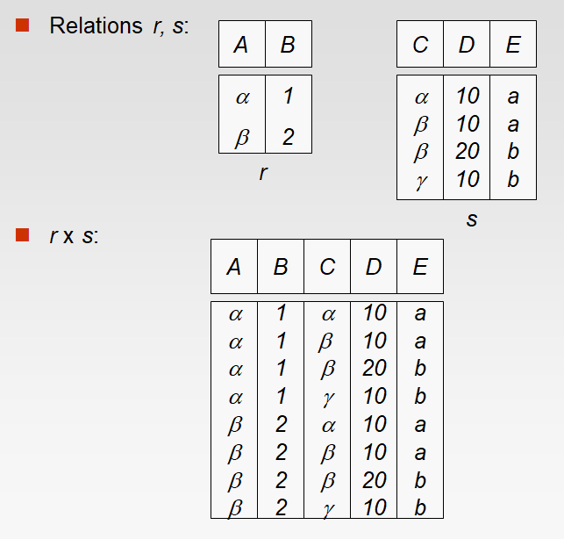
Cartesian product

Slide 21
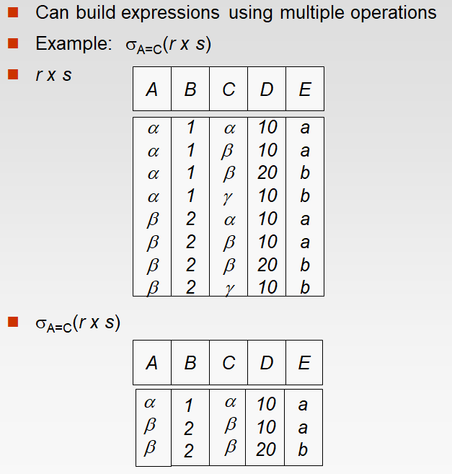
Cartesian product

Slide 22
rename
Allows us to refer to a relation by more than one name.
Notation: ρ _{x} (E ), returns the expression E under the name X.
If a relational-algebra expression E has arity n, then
returns the result of expression E under the name X, and
with the attributes renamed to A₁ , A₂ , …., A_{n} .
Find employee names of those employees who earn more
than their managers.
r1 ← ρ _{E} (Emp) x ρ _{M} (Emp)
r2 ← σ((E.mgr=M.empno) and (E.sal > M.sal)) (r1)
r3 ← ∏_{E.ename} (r2)
∏_{E.ename} (σ((E.mgr=M.empno) and (E.sal > M.sal)) (ρ _{E} (Emp) x ρ _{M} (Emp) ))

Slide 23
Self-JOIN
Example: Find employee names of those employees who earn more
than their managers.
r1 ← ρ _{E} (Emp) x ρ _{M} (Emp)
r2 ← σ((E.mgr=M.empno) and (E.sal > M.sal)) (r1)
r3 ← ∏_{E.ename} (r2)
∏_{E.ename} (σ((E.mgr=M.empno) and (E.sal > M.sal)) (ρ _{E} (Emp) x ρ _{M} (Emp) ))
The following SQL is equivalent to the above relational algebra:
select e.ename
from emp e, emp m
where e.mgr = m.empno
and e.sal > m.sal;

Slide 24
joins
There the following JOINs:
Inner Join (Cartesian product with a condition)
Theta Join (⋈_{θ} ), where θ is any relational condition
Natural Join (⨝), ‘=‘ with same column names
Outer Join
Left Outer Join (⟕)
Right Outer Join (⟖)
Full Outer Join (⟗)
Example 1: Find employee name, salary, dept name and loc for all employees.
∏_{ename,sal,dname,loc} (Emp ⨝ Dept)

Slide 25
Find empno, ename and salary of employees working in the ‘SALES’ dept.
∏_{empno, ename, salary} (σ_{dname = ‘sales’} (σ_{emp.depno = dept.deptno} (emp x dept)))
Instead,
σ_{emp.depno = dept.deptno} (emp x dept) = Emp ⨝ Dept
∏_{empno, ename, salary} (σ_{dname = ‘sales’} (Emp ⨝ Dept))

Slide 26
joins
Example 2: Find employee name, salary, dname for all employees as well as those employees who have not been assigned any department.
∏_{ename,sal,dname} (Emp ⟕ Dept)
Example 3: Find ename, dname, salary for all employees as well as those departments where no employees are working.
∏_{ename, dname, sal} (Emp ⟖ Dept)
Example 4: Find details of all employees and departments they are working in as well as those employees who have not been assigned any department and those departments where no employees are working.
Emp ⟗ Dept

Slide 27
division
Notation: r ÷ s or r / s
Suited to queries that include the phrase “for all”.
Let r and s be relations on schemas R and S respectively where
R = (A₁, …, A_{m} , B₁, …, B_{n} ) (A₁, …, B₁, …) are columns
S = (B₁, …, B_{n})
The result of r ÷ s is a relation on schema
R – S = (A₁, …, A_{m})
r ÷ s = { t | t ∈ ∏ _{R-S} (r) ∧ ∀ u ∈ s ( tu ∈ r ) }
Where tu means the concatenation of tuples t and u to produce a single tuple.
Simply,
R(A, B, C, D) and S(B, D) then,
R ÷ S will have columns A, C

Slide 28
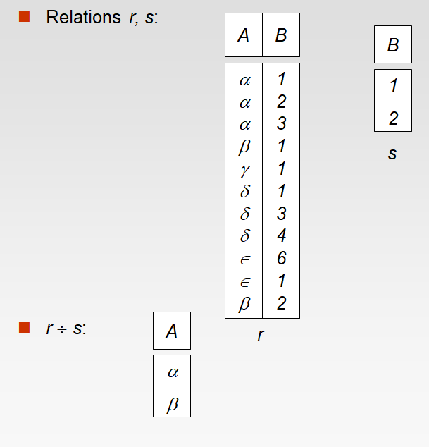
Division Example
How does it work?
B in relation s has two values 1 and 2.
Find the values of A in r corresponding to these two values.
1 - α, β, γ, δ, ∈
2 - α, β
α, β are common in both so that is the output.

Slide 29
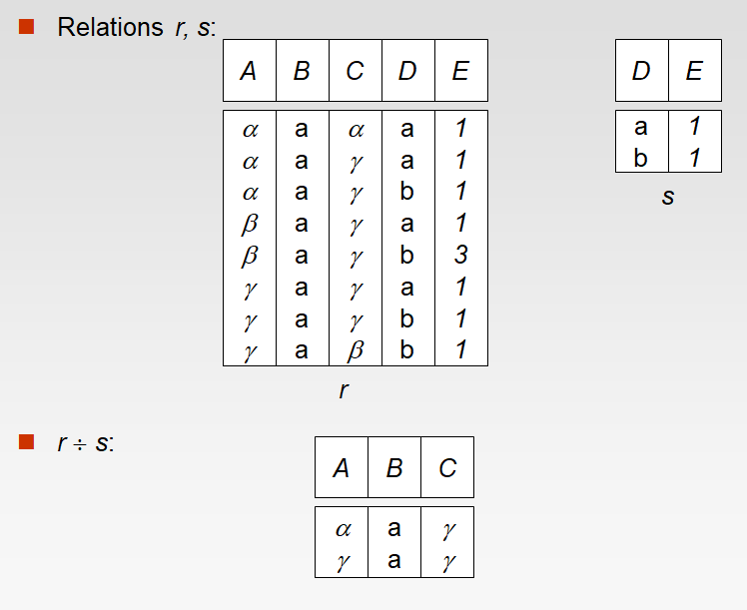
Division Example
Find the values of A, B and C in r corresponding to those of D and E values of s.
s r
D E A B C
a 1 α a α
α a γ
β a γ
γ a γ
b 1 α a γ
γ a γ
γ a β
α a γ
γ a γ
common

Slide 30
Division Example
DeptLoc
DeptName | Floor
CSE | GF
CSE | FF
CSE | SF
EE | GF
EE | FF
MH | GF
MH | FF
MH | SF
CHE | FF
CHE | SF
AllFloors
Floor
GF
FF
SF
Which departments are located on all the floors?
DeptLoc ÷ AllFloors
Floor DeptName
GF CSE, EE, MH
FF CSE, EE, MH, CHE
SF CSE, MH, CHE
Common are CSE and MH. So these two departments are located on all the floors.

Slide 31
extended RA operations
Generalized Projection
Notation: П _{F1,F2, … Fk}(R)
where F₁, F₂ can be arithmetic operations involving constants and attributes.
List the emp name, total income and 10% of the salary of each employee.
∏_{ename, sal+comm, sal*0.1} (emp)
(b) Select the emp name, age in days and 15% of commission of
employees having salary more than 5000.
∏ename, sysdate - bdate, comm*0.15 (σ_{sal > 5000} (emp))

Slide 32

extended RA operations( )
Aggregate functions and Group-by (Calligraphic G)
Notation:
where F₁, F_{2, …} can be aggregate functions like – avg, min, max,
sum, count.
Notation:
where A₁, A_{2, …} are the grouping columns and F₁, F₂ can be
aggregate functions like – avg, min, max, sum, count.
Find the average and maximum salary in the employee relation.
G _{avg(sal), max(sal)}(EMP)
(b) Find the average and maximum salary for each department.
_{deptno} G _{avg(sal), max(sal)}(EMP)
G _{F1,F2, … Fk}(R)
_{A1,A2, … Am}G _{F1,F2, … Fk}(R)

Slide 33
DMLs in RA (INSERT)
Insert
To insert data into a relation, we either:
specify a tuple to be inserted
write a query whose result is a set of tuples to be inserted
In relational algebra, an insertion is expressed by:
r ← r U E
where r is a relation and E is a relational algebra expression.
The insertion of a single tuple is expressed by letting E be a constant relation containing one tuple.
E.g.
EMP ← EMP U {(111, ‘Martin’, 5000,…..)}
EMP ← EMP U (∏_{empno, ename, …} (σ_{sal > 5000} (EMP1)))

Slide 34
DMLs in RA (UPDATE)
Update
A mechanism to change a value in a tuple without charging all values in the tuple.
Use the generalized projection operator to do this task
Each F_{i} is either
the I ^{th} attribute of r, if the I ^{th} attribute is not updated, or,
if the attribute is to be updated F_{i} is an expression, involving only constants and the attributes of r, which gives the new value for the attribute
Example 1: Increase the salary by 10%
EMP ← ∏ _{empno, ename, sal*1.1,...} (EMP)

Slide 35
DMLs in RA (delete)
Delete
A delete request is expressed similarly to a query, except instead of displaying tuples to the user, the selected tuples are removed from the database.
Can delete only whole tuples; cannot delete values on only particular attributes
A deletion is expressed in relational algebra by:
r ← r – E
where r is a relation and E is a relational algebra query.
Example 1: Remove all managers of department 10.
EMP ← EMP – (σ job = ‘MANAGER’ and deptno = 10 (EMP))

Slide 36
DMLs in RA Examples
Delete all employees working at Boston.
r₁ ← σ _{loc = ‘BOSTON’} (EMP ⨝ DEPT )
r₂ ← ∏ _{empno, ename, sal, ...} (r₁) - all columns of EMP relation only
EMP ← EMP – r₂
Increase the salaries by 5% of employees earning more than 5000 and by 6% for others.
r₁ ← ∏ _{empno, ename, sal*1.05,...} (σ _{sal > 5000} (EMP))
r₂ ← ∏ _{empno, ename, sal*1.06,...} (σ _{sal <= 5000} (EMP))
EMP ← r₁ U r₂

Slide 37
Relational Algebra Examples
emp(empno, ename, bdate, sal, mgr, deptno)
dept(deptno, dname, loc, dmanager)
project(pno, pname, deptno)
works_on(empno, pno, no_hours)
dependent (depname, empno, relation)
Delete all employees working in dept 10.
r₁ ← σ _{deptno = 10} (emp)
emp ← emp – r₁
Select employee name, birthdate and sal of employees working on a project for more than 10 hours.
r₁ ← σ _{no_hours >= 10} (emp ⨝ works_on )
r₂ ← ∏ _{ename, bdate, sal} (r₁)

Slide 38
emp(empno, ename, bdate, sal, mgr, deptno)
dept(deptno, dname, loc, dmanager)
project(pno, pname, deptno)
works_on(empno, pno, no_hours)
dependent (depname, empno, relation)
RA Examples
Retrieve employees working in the SALES department.
r₁ ← σ _{dname = ‘sales’} (emp ⨝ dept)
Retrieve the employee numbers of those employees who either work in deptno 10 or directly supervise an employee who works in department 10.
r₁ ← ∏ _{empno} (σ _{deptno = 10} (emp))
r₂ ← ∏ _{mgr} (σ _{deptno = 10} (emp))
r₃ ← r₁ U r₂

Slide 39
emp(empno, ename, bdate, sal, mgr, deptno)
dept(deptno, dname, loc, dmanager)
project(pno, pname, deptno)
works_on(empno, pno, no_hours)
dependent (depname, empno, relation)
RA Examples
List the names of employees who do not have dependents.
r₁ ← ∏ _{empno} (emp) - all employees
r₂ ← ∏ _{empno} (dependent) - emp. who have dependents
r₃ ← r₁ – r₂ - emp. with no dependents
r₄ ← ∏ _{ename} (r₃ ⨝ emp) - emp. names
List the names of department managers who have at least one dependent.
r₁ ← ∏ _{dmanager} (dept) - empnos of all managers
r₂ ← ∏ _{empno} (dependent) - emp. who have dependents
r₃ ← r₁ ∩ r₂ - managers with dependents
r₄ ← ∏ _{ename} (r₃ ⨝ emp) - manager names.

Slide 40
emp(empno, ename, bdate, sal, mgr, deptno)
dept(deptno, dname, loc, dmanager)
project(pno, pname, deptno)
works_on(empno, pno, no_hours)
dependent (depname, empno, relation)
RA Examples
List the names of employees who work on all projects controlled by department 20.
r₁ ← ∏ _{pno} (σ _{deptno = 20} (project)) - projects controlled by depno 20
r₂ ← ∏ _{empno,pno} (works_on) - list of empno. with projnos.
r₃ ← r₂ / r₁ - emp. working on all projects
controlled by dept. 20
r₄ ← ∏ _{ename} (r₃ ⨝ emp) - emp. names.
List the names of employees who work on more than 4 projects.
r₁ ← _{empno} G _{count(*) as c}(works_on) - no. of projects each emp works on
r₂ ← σ _{c > 4} (r₁) - employees working on > 4 projects
r₃ ← ∏ _{ename} (r₃ ⨝ emp) - emp. names.

Slide 41
Null values
It is possible for tuples to have a null value, denoted by null, for some of their attributes
null signifies an unknown value or that a value does not exist.
The result of any arithmetic expression involving null is null.
Aggregate functions simply ignore null values (as in SQL)
For duplicate elimination and grouping, null is treated like any other value, and two nulls are assumed to be the same (as in SQL)

Slide 42
Null values
Comparisons with null values return the special truth value: unknown
If false was used instead of unknown, then not (A < 5) would not be equivalent to A >= 5
Three-valued logic using the truth value unknown:
OR: (unknown or true) = true,
(unknown or false) = unknown
(unknown or unknown) = unknown
AND: (true and unknown) = unknown,
(false and unknown) = false,
(unknown and unknown) = unknown
NOT: (not unknown) = unknown
In SQL “P is unknown” evaluates to true if predicate P evaluates to unknown
Result of select predicate is treated as false if it evaluates to unknown
Notes:
If for a column A, it has a null value,
Not(A < 5) cannot become false as it implies that A >= 5. Therefore the result is unknown or null.

Slide 43
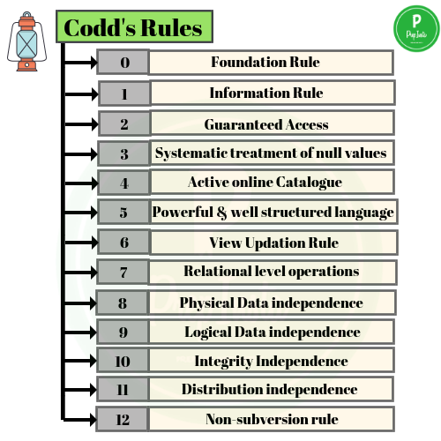
Codd’s rules
Dr Edgar F. Codd, after his extensive research on the Relational Model of database systems, came up with twelve rules of his own, which according to him, a database must obey in order to be regarded as a true relational database.
These rules can be applied on any database system that manages stored data using only its relational capabilities. This is a foundation rule, which acts as a base for all the other rules.

Slide 44
Codd’s rules
Rule 0: Foundation Rule
For any system that is advertised as, or claimed to be, a relational data base management system, that system must be able to manage data bases entirely through its relational.
Rule 1: Information Rule
The data stored in a database, may it be user data or metadata, must be a value of some table cell. Everything in a database must be stored in a table format.
Rule 2: Guaranteed Access Rule
Every single data element (value) is guaranteed to be accessible logically with a combination of table-name, primary-key (row value), and attribute-name (column value). No other means, such as pointers, can be used to access data.

Slide 45
Codd’s rules
Rule 3: Systematic Treatment of NULL Values
The NULL values in a database must be given a systematic and uniform treatment. This is a very important rule because a NULL can be interpreted as one the following − data is missing, data is not known, or data is not applicable.
Rule 4: Active Online Catalog
The structure description of the entire database must be stored in an online catalog, known as data dictionary, which can be accessed by authorized users. Users can use the same query language to access the catalog which they use to access the database itself.
Rule 5: Comprehensive Data Sub-Language Rule
A database can only be accessed using a language having linear syntax that supports data definition, data manipulation, and transaction management operations. This language can be used directly or by means of some application. If the database allows access to data without any help of this language, then it is considered as a violation.(SQL)

Slide 46
Codd’s rules
Rule 6: View Updating Rule
All the views of a database, which can theoretically be updated, must also be updatable by the system.
Rule 7: High-Level Insert, Update, and Delete Rule
A database must support high-level insertion, updation, and deletion. This must not be limited to a single row, that is, it must also support union, intersection and minus operations to yield sets of data records.
Rule 8: Physical Data Independence
The data stored in a database must be independent of the applications that access the database. Any change in the physical structure of a database must not have any impact on how the data is being accessed by external applications.
Rule 9: Logical Data Independence
The logical data in a database must be independent of its user’s view (application). Any change in logical data must not affect the applications using it. For example, if two tables are merged or one is split into two different tables, there should be no impact or change on the user application. This is one of the most difficult rule to apply.

Slide 47
Codd’s rules
Rule 10: Integrity Independence
A database must be independent of the application that uses it. All its integrity constraints can be independently modified without the need of any change in the application. This rule makes a database independent of the front-end application and its interface.
Rule 11: Distribution Independence
The end-user must not be able to see that the data is distributed over various locations. Users should always get the impression that the data is located at one site only. This rule has been regarded as the foundation of distributed database systems.
Rule 12: Non-Subversion Rule
If a system has an interface that provides access to low-level records, then the interface must not be able to subvert the system and bypass security and integrity constraints.
END

