Slide 1
BIRD SPECIES OBSERVATION PROJECT
PRESENTED BY :-ANJALI MISHRA

Slide 2
THE dataset contains detailed records of bird observations collected from Forest and Grassland habitats. It includes information such as: Species details – Common name and scientific name of the observed bird. Observation details – Date, time, observer name, and number of sightings. Environmental conditions – Sky, wind, temperature, and humidity at the time of observation. Location details – Type of habitat (Forest/Grassland) and geographical area. Disturbance factors – Presence of human or environmental disturbances affecting bird activity.
INTRODUCTION

Slide 3
OBJECTIVE
The primary aim of this project is to conduct an in-depth analysis of bird observation data collected from two distinct habitats Forest and Grassland — to uncover meaningful patterns and trends that can contribute to conservation planning, eco-tourism development, and environmental awareness initiatives.
This project seeks to:
Identify and rank the most frequently observed bird species, along with their scientific names, to understand species diversity and dominance in different habitats.
Examine habitat preferences by comparing bird sightings between Forest and Grassland locations, highlighting species that are habitat-specific and those that are more adaptable.
Study seasonal patterns in bird sightings by analysing monthly observation trends, helping to identify peak activity periods and potential migration seasons.
5. Investigate disturbance factors (human activity, environmental disruptions, etc.) to understand their effect on observation success rates and bird presence.
6. Generate actionable recommendations for field survey planning, eco-tourism packages, and targeted conservation measures.
7. Promote awareness and engagement among local communities and stakeholders by sharing data-driven insights about biodiversity and habitat preservation.

Slide 4
Data cleaning and processing
1.Importing Required Libraries
Imported Pandas for data handling.
Imported os for file management.
2. Reading Multiple Excel Files and Sheets
Loaded Bird_Monitoring_Data_FOREST.xlsx and Bird_Monitoring_Data_GRASSLAND.xlsx.
Used pd.read_excel() with sheet_name=None to read all sheets from each file.
Combined all sheets into a single dataframe for each file (Forest & Grassland).
Merged both dataframes into one master dataset called bird_observation_master_data.
3. Removing Unnecessary Columns
Deleted completely empty / unnamed columns such as "Unnamed: 1".
Dropped any irrelevant metadata columns not required for analysis.
4. Handling Missing Values
Sky column → filled missing values with "Unknown".
Wind column → filled missing values with "Unknown".
Disturbance column → filled missing values with "No Effect".
5. Formatting and Standardisation
Converted Date to proper datetime format.Converted Start_Time and End_Time to time format.
Extracted Month_Name, Year, and Day from the Date column for seasonal analysis.
6. Final Dataset Preparation Verified dataset shape after cleaning → 17,077 rows × 33 columns.
Saved the cleaned file as Bird_Final_Data.csv for further EDA and Power BI dashboard creation.

Slide 5
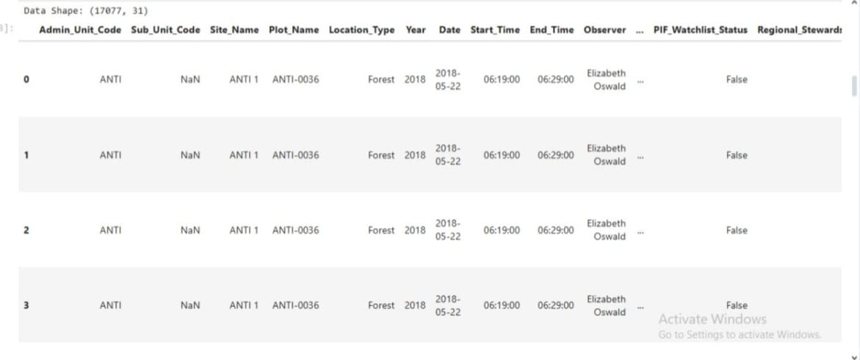
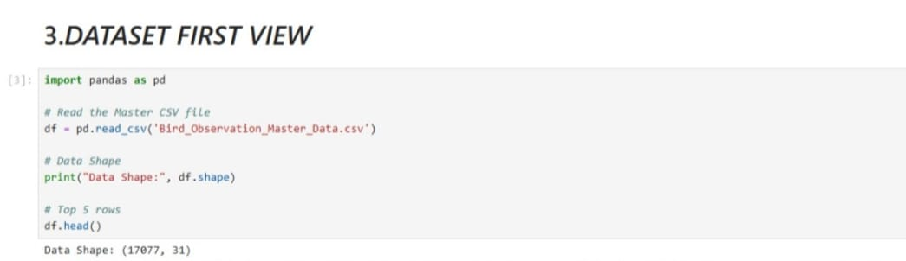

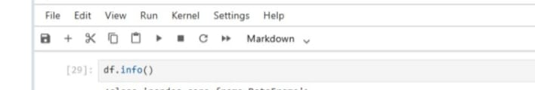
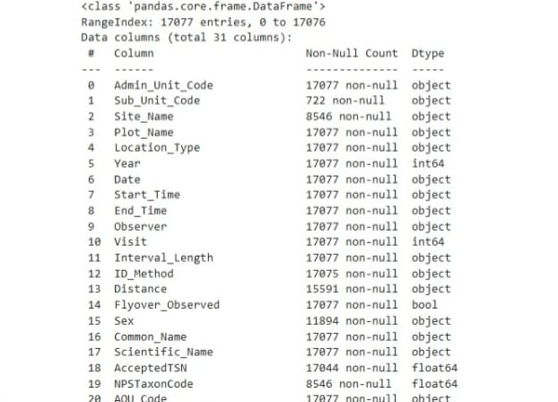
RUNNING CODES IN JUPYTER NOTEBOOK

Slide 6
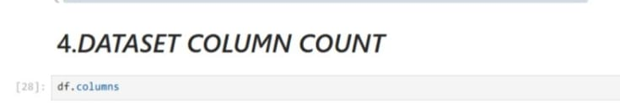
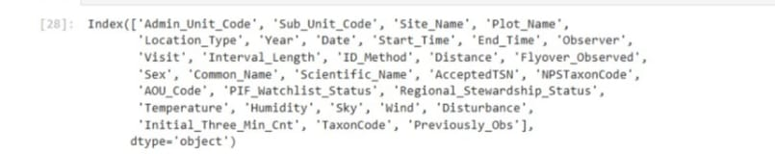

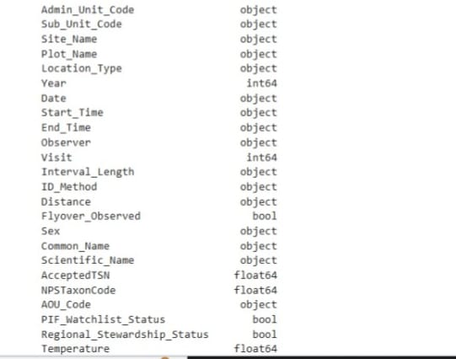
RUNNING CODES IN JUPYTER NOTEBOOK-CONTINUED

Slide 7
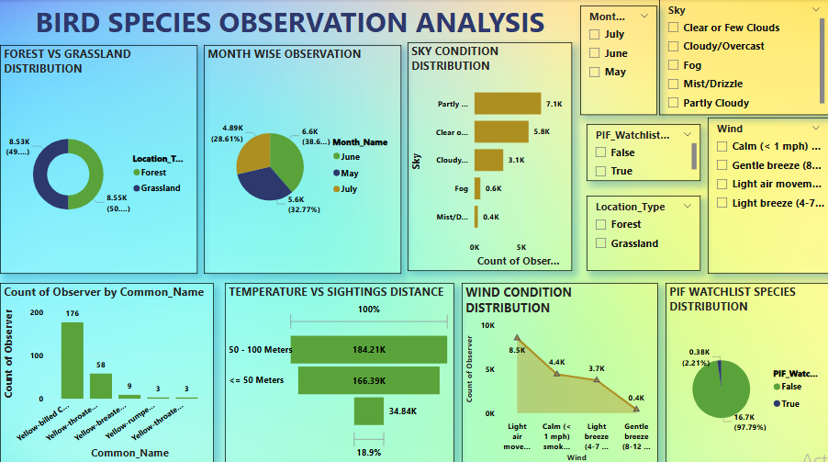
POWER BI DASHBOARD

Slide 8
DASHBOARD OBSERVATION
The Bird Species Observation Dashboard provides an interactive visualisation of bird sightings from Forest and Grassland habitats. Key features include:
Species Distribution: Displays the most frequently observed birds and their habitat preferences.
Seasonal Trends: Line and column charts highlight peak observation months, aiding seasonal planning
.Environmental Impact: Visuals on sky condition, wind, and temperature show how weather affects sightings.
Disturbance Analysis: Donut charts reveal the proportion of observations affected by human or environmental disturbances.
Interactive Filters & Slicers: Allow users to filter data by location type, month, year, or species for targeted insights.
This dashboard enables eco-tourism planners, researchers, and conservationists to make data-driven decisions on biodiversity monitoring and habitat protection.

Slide 9
DISCUSSION AND INTERPRETATION
The dataset combined observations from Forest and Grassland habitats, resulting in a large and diverse master dataset of 17,077 records.
Species Analysis revealed that a few species dominate the sightings, but there is still a wide diversity across both habitats.
Location Analysis showed Forest areas have slightly more species variety, whereas Grasslands recorded certain habitat-specific birds.
Seasonal Trends indicated clear peak months for sightings, useful for field planning and tourism.
Environmental Factors such as clear sky and calm winds were linked to higher observation counts, suggesting weather plays a crucial role in bird activity.
Disturbance Impact analysis showed that “No Effect” was the most frequent category, but certain disturbances had a noticeable negative impact on sightings.

Slide 10
RECOMMENDATION
Focus Fieldwork in Peak Months – Allocate more survey resources during high-activity periods to maximise sightings.
Habitat-specific Strategies – Protect Forest-specific and Grassland-specific species with targeted conservation measures.
Weather-Optimised Surveys – Schedule observations in favourable weather to improve data quality.
Community Engagement – Involve top observers in awareness programs to inspire wider participation.
Data Enhancement – In future surveys, include GPS coordinates and more detailed environmental metrics for richer analysis.
Ongoing Monitoring – Repeat similar analysis annually to track biodiversity changes over time.

