Slide 1
FLY EMIRATES PERFORMANCE
PRESENTED BY:- ANJALI MISHRA

Slide 2
INTRODUCTION
Flight delays and cancellations are some of the most pressing challenges faced by the aviation industry today. They not only affect the operational efficiency of airlines but also lead to substantial financial losses and deteriorate the customer travel experience. Factors like adverse weather conditions, technical malfunctions, crew unavailability, airport congestion, and air traffic control delays contribute to schedule disruptions.
This project focuses on analyzing large-scale flight performance data using advanced data visualization techniques in Power BI. The goal is to uncover patterns in delays, cancellations, and on-time performance (OTP), and provide actionable insights that airlines and airports can leverage to optimize their operations.

Slide 3
OBJECTIVE
To perform an in-depth analysis of flight delays and cancellations using historical flight records.
To measure and compare airline performance based on their On-Time Performance (OTP) rate.
To identify the primary reasons behind flight cancellations and understand their distribution.
To evaluate how factors like airport operations, departure time of the day, and seasonal trends influence flight delays.
To create an interactive Power BI dashboard that enables real-time exploration of these insights for better decision-making.

Slide 4
CONTENT
Project Introduction and Objective
Understanding Flight Performance Dataset
Data Cleaning and Time Conversion (SQL Operations)
Mapping Cancellation Reasons and Categorization
Relational Joins with Airlines and Airports Data
Data Import and Relationship Building in Power BI
Creation of DAX Measures and KPI Calculations
Interactive Dashboard Design in Power BI
Flight Delay and Cancellation Insights
Challenges Faced During Data Preparation
Conclusion
Recommendations for Operational Improvements

Slide 5
Data cleaning and transformation
Time Columns Formatting
Converted scheduled_departure, scheduled_arrival, wheels_off, wheels_on, and actual arrival times from numeric formats (e.g., 1435 → 14:35) into proper TIME data types.
Handled null and missing time values to ensure consistency across the dataset.
Cancellation Reason Mapping
Cancellation reasons provided as codes (A, B, C, D) were standardized for easier filtering and analysis in Power BI.
Ensured flights with blank cancellation_reason were treated as non-cancelled flights during analysis.
Column Additions for Analysis
Created new derived columns such as scheduled_departure_time, wheels_off_time, arrival_time_converted for clean time-based analysis .
Added a binary flag column (Cancelled_Flag) to identify cancelled flights easily for KPI calculations.
Data Standardization & Null Handling
Replaced missing values in delay columns (departure_delay, arrival_delay) with appropriate null handling to prevent calculation errors.
Ensured all code fields (airline codes, airport codes) matched with master data from airlines and airports tables
Relational Joins for Data Enrichment
Joined the flights table with airlines and airports master tables using IATA codes to enrich data context.
Enabled the inclusion of Airline Names and Airport Names in the final dataset for dashboard visualizations.
Final Clean Table Creation
Structured the cleaned and enriched dataset into a final table (flights_cleaned_view) which was directly used for Power BI visualization and KPI generation.

Slide 6

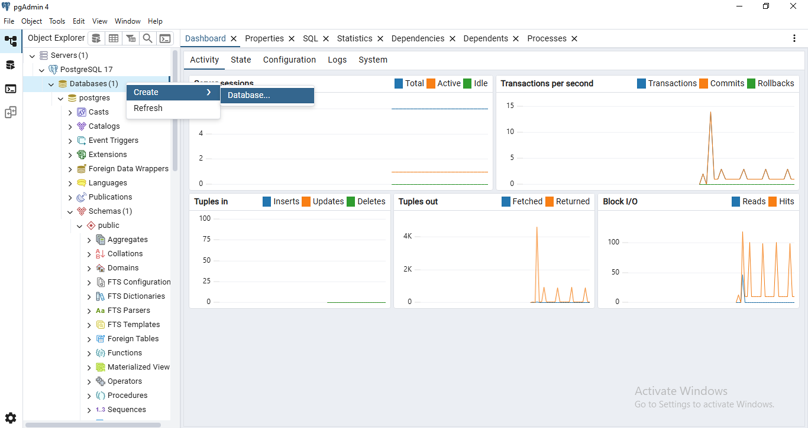
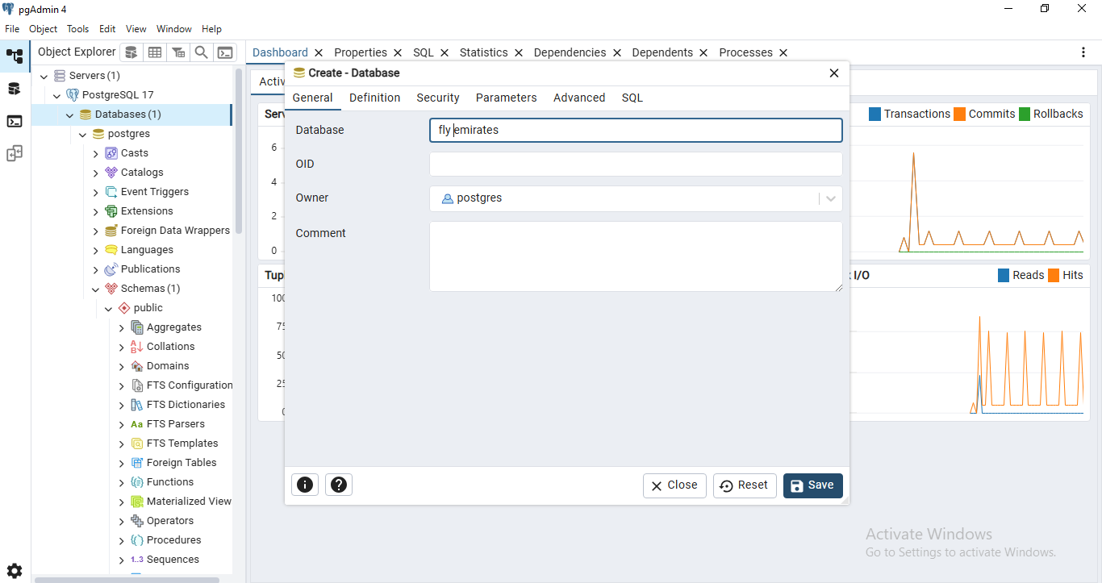


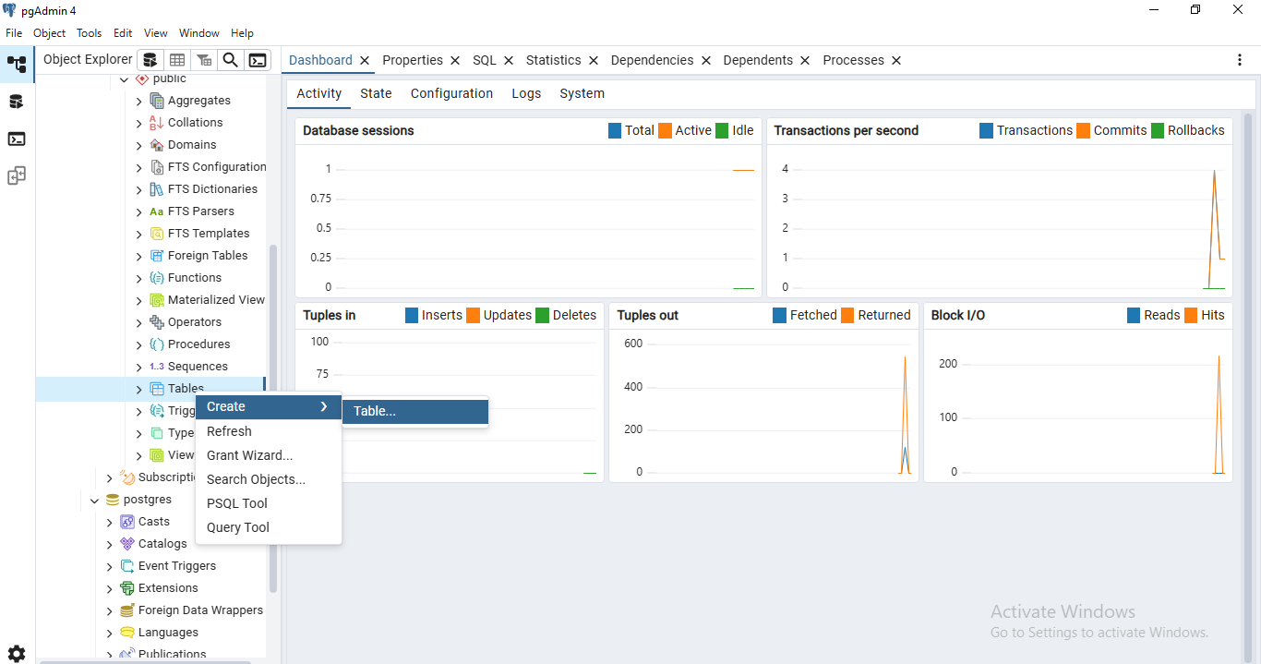
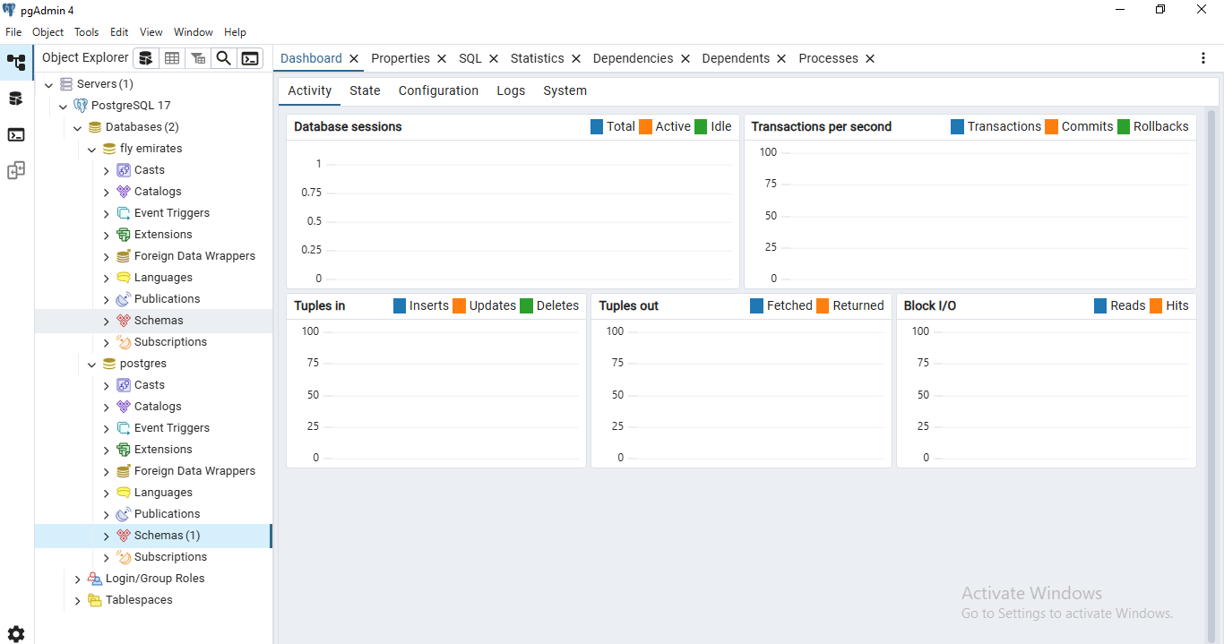

DATABASE SETUP AND OPERATION

Slide 7
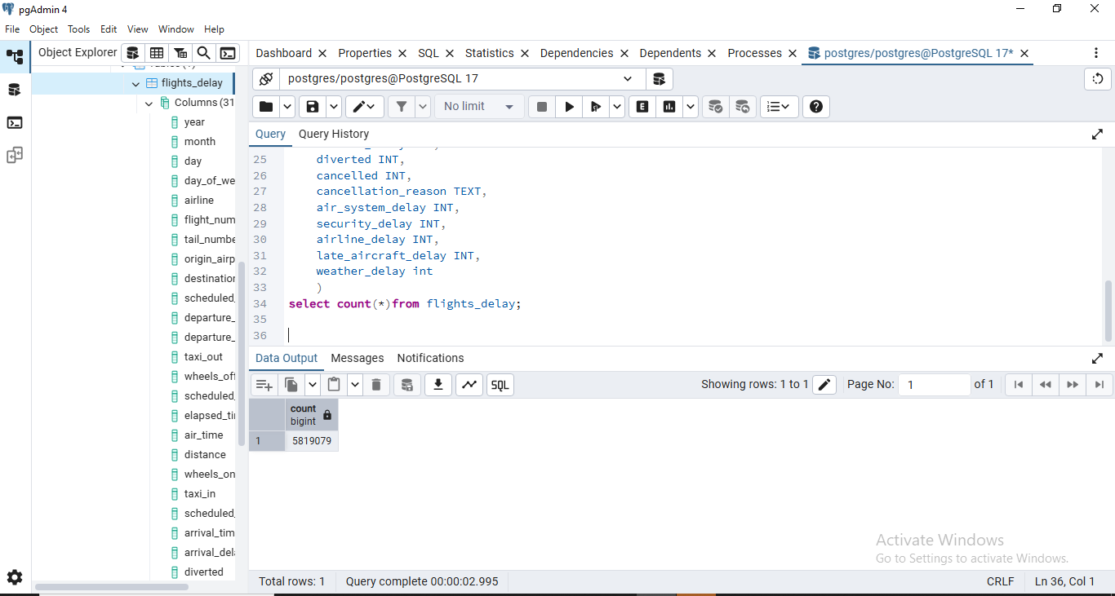
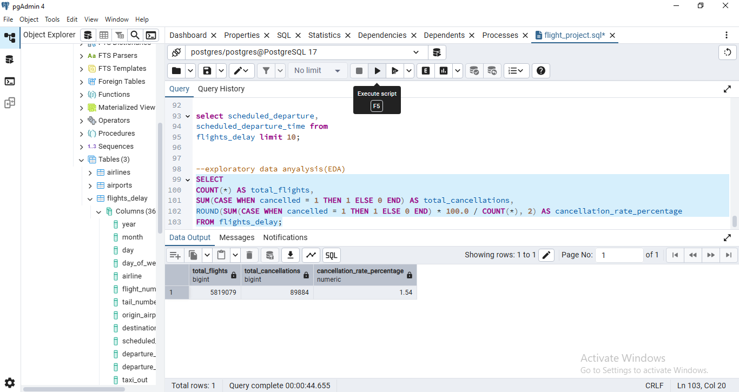
RUNNING QUERIES IN SQL

Slide 8
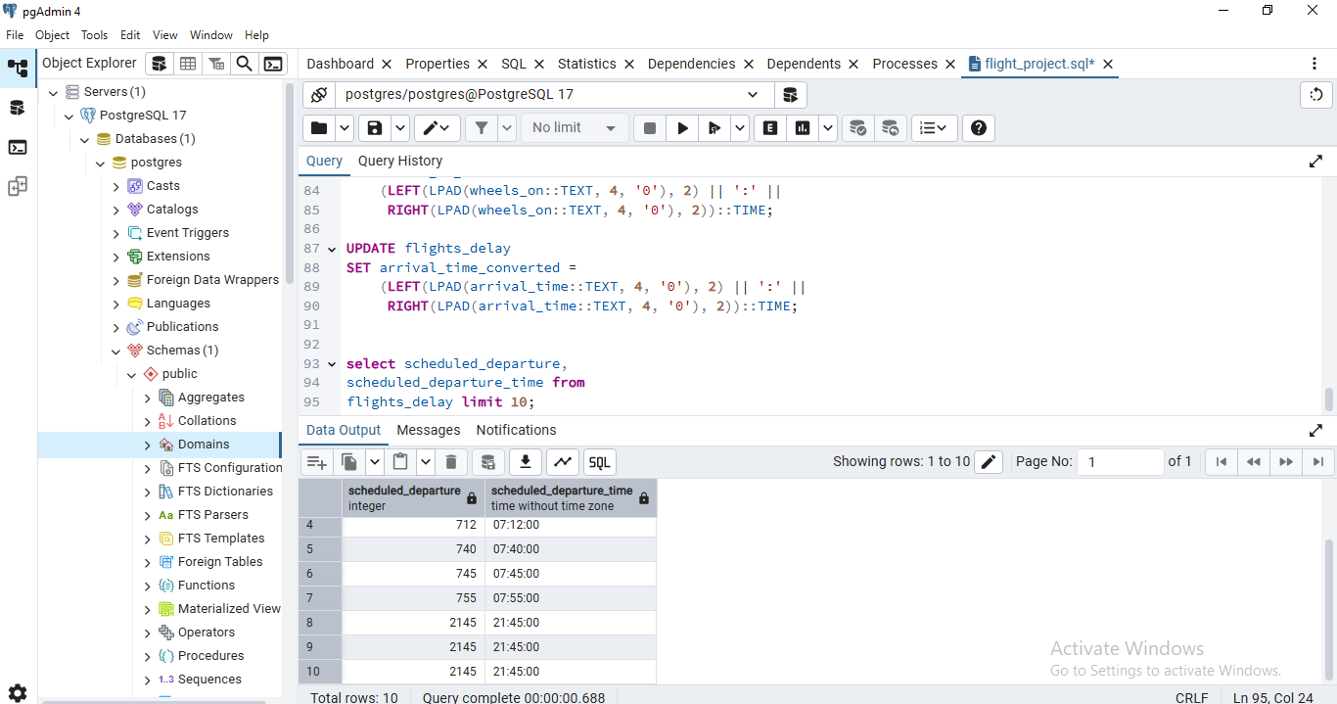
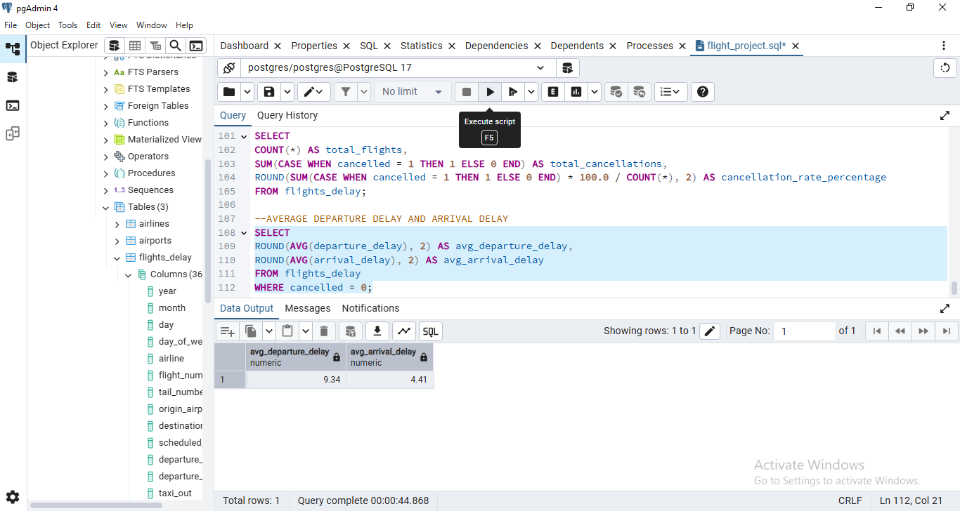
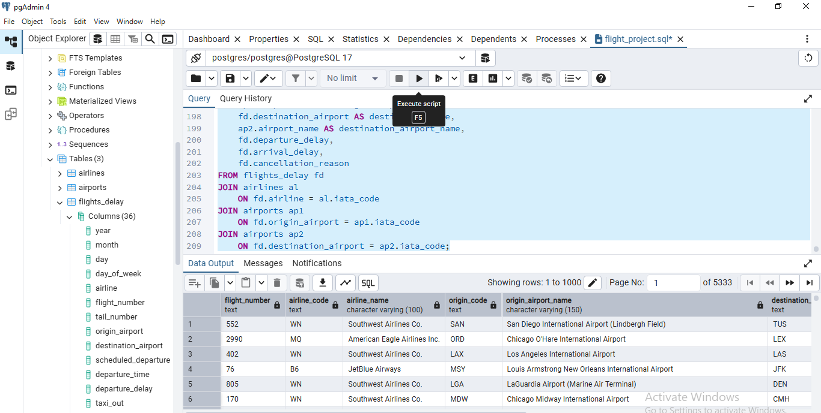

Slide 9
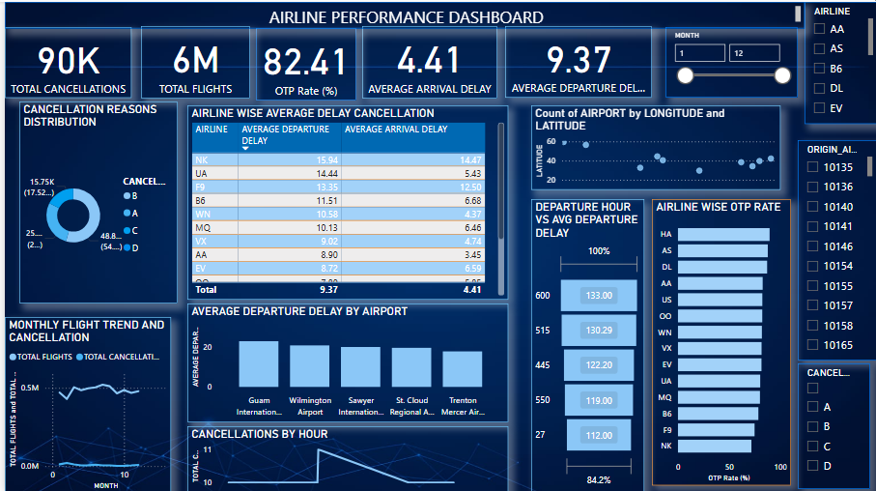
POWER BI DASHBOARD
The dashboard analysis highlights significant variations in flight punctuality across different airlines and airports. Some airlines consistently manage their schedules well, ensuring timely arrivals, while others struggle with recurring delays due to operational inefficiencies. Cancellations are largely driven by internal airline factors like crew availability and maintenance issues, followed by external factors such as adverse weather conditions. Airports with high traffic volumes exhibit moderate delays, whereas certain regional airports face severe departure delays, indicating process bottlenecks at ground operations. Time-of-day patterns reveal that flights scheduled for late mornings are more prone to delays, possibly due to compounded effects of earlier flight disruptions. The dashboard’s visuals also show that delays and cancellations are not heavily influenced by monthly fluctuations, hinting that operational challenges play a larger role than seasonal patterns. Interactive filters allow users to drill down by airline, airport, or cancellation reasons, providing a comprehensive view of performance dynamics. The visual representation of delays and cancellations across different dimensions offers actionable insights for improving schedule reliability and enhancing overall passenger experience.

Slide 10
DATA AND RESEARCH METHODOLOGY
Data Integration in Power BI
Imported flight schedules, airline master data, and airport details into Power BI.
Established data relationships using Airline Codes (IATA) and Airport Codes to ensure accurate linkage between flights, airlines, and airports.
Dashboard Design & Structure Designed interactive KPI Cards to highlight key metrics such as On-Time Performance, Total Cancellations, and Average Delays. Developed bar charts, line graphs, and pie charts to visualize delays and cancellations across airlines, airports, time slots, and reasons.
Calculation of Key Metrics (DAX Measures)Created custom DAX measures to compute arrival/departure delays, cancellation distributions, and OTP rates dynamically. Implemented slicers and filters for Airline, Month, Airport, and Cancellation Reason to allow detailed drill-down analysis.
Objective of the Dashboard To transform raw flight data into actionable insights through an intuitive and interactive visual interface. Enable stakeholders to explore performance trends, identify operational bottlenecks, and support data-driven decision-making.

Slide 11
RESULT AND KEY INSIGHTS
Flight Performance Trends
Airlines showed varied punctuality levels — some maintaining consistent on-time arrivals, while others faced recurring operational delays.
Cancellations were predominantly influenced by airline-internal issues, with weather-related factors contributing to significant disruptions.
Airports Impact on Delays
High-traffic airports exhibited moderate delays, whereas smaller regional airports faced persistent departure lag due to process inefficiencies. Specific airports emerged as delay hotspots, impacting overall flight schedules.
Time of Day Analysis
Flights scheduled for late morning departures faced the highest average delays, indicating congestion during operational peak hours. Early morning and late evening flights showed comparatively better punctuality.
Seasonal Patterns
Monthly trends in delays and cancellations remained relatively stable, suggesting internal operational challenges have a greater influence than seasonal variations.
Interactive Insights through Dashboard
The dashboard provided a clear visualization of performance gaps and allowed detailed exploration through dynamic filters. Enabled identification of high-delay airlines and airports, facilitating targeted improvement strategies.

Slide 12
DICUSSION AND INTERPRETATION
The analysis highlights how internal operational inefficiencies, such as aircraft turnaround times and crew management, play a crucial role in flight cancellations.
Airports with complex layouts or heavy air traffic flow exhibit recurring delay patterns, suggesting a need for ground process optimization.
Time-of-day trends emphasize that morning departures are more prone to delays due to compounded effects of initial operational lags and peak-hour congestion.
Weather-related disruptions, though uncontrollable, account for a large share of cancellations, emphasizing the need for proactive contingency planning.
Airlines with lower OTP rates might benefit from real-time monitoring systems and better resource allocation strategies.

Slide 13
CHALLENGES AND LIMITATIONS
The dataset provided cancellation reasons in coded formats (A, B, C, D) without detailed categorization, limiting the scope for granular root cause analysis.
Real-time external factors like Air Traffic Control (ATC) delays or passenger-induced delays were not available in the dataset.
Certain columns had missing data points (e.g., tail numbers), leading to data integrity challenges.
Seasonal and geographical factors influencing delays could have been further enriched with weather API integrations.
Dashboard insights are derived from historical static data — real-time dynamic data flows would provide a more accurate reflection of current trends.

Slide 14
CONCLUSION
The analysis successfully identified critical delay and cancellation patterns across airlines and airports.
Airlines need to focus on optimizing their controllable delay factors (like crew & maintenance efficiency).Specific airports require operational audits to minimize delays during high-traffic hours.
Proactive planning and alternate scheduling strategies can mitigate weather-induced disruptions.
The interactive Power BI Dashboard provides an effective visual medium for stakeholders to monitor key performance metrics and take data-driven decisions.

Slide 15
RECOMMENDATION
Operational Improvements: Airlines should streamline turnaround processes and ensure better crew & equipment availability to reduce internal delays.
Weather Preparedness: Implement predictive weather impact models and develop flexible re-scheduling protocols.
Airport Collaboration: Airlines and airport authorities must jointly work on reducing ground-level inefficiencies, especially during peak operational hours.
Real-time OTP Monitoring: Develop dashboards for daily OTP tracking with alert mechanisms for performance drops.
Passenger Communication: Enhance transparency and proactive communication regarding delays to improve customer experience.

