Slide 1


p
Project name:- Ola_Ride_Anlysis
Presented by :-Anjali Mishra

Slide 2





The analysis of OLA ride data reveals that Prime Sedans are used for longer trips, while Autos and Mini vehicles are preferred for shorter rides. Customer cancellations are notably higher than driver cancellations, with most driver cancellations due to personal or car-related reasons. A small group of customers accounts for the majority of rides and contributes significantly to total revenue, highlighting the importance of loyal, high-value users. Digital payments dominate, with wallets and cards generating the highest revenue. Ride distances vary daily, but most trips are short to medium, reflecting high urban demand. Driver ratings are generally high, with occasional low ratings in Prime Sedans, indicating areas for service improvement. Customer and driver ratings show a positive correlation, suggesting that satisfied customers rate drivers well. Premium vehicles drive both longer rides and higher revenue. Overall, focusing on reducing cancellations, enhancing service quality for lower-rated drivers, and maintaining top customers can further improve operational efficiency and revenue growth.
Overall
Vehicle Type
Revenue
Cancellation
Ratings

Slide 3









Vehicle Type | Total Booking Value | Success Booking Value | Avg. Distance Travelled | Total Distance Travelled
Prime Sedan | 1234567 | 1100000 | 12.34 | 54,321
Prime SUV | 678,900 | 620,000 | 13.12 | 35678
Prime Plus | 890,000 | 800,000 | 11.50 | 38,200
Mini | 987,654 | 900,000 | 8.45 | 43,210
Auto | 543,210 | 500,000 | 5.67 | 32,100
Bike | 210,000 | 200,000 | 4.50 | 18,900
E-Bike | 150,000 | 140,00 | 3.80 | 12,500
Overall
Vehicle Type
Revenue
Cancellation
Ratings

Slide 4

The revenue analysis shows that Prime Sedans and Prime SUVs generate the highest total booking value, contributing the most to overall earnings. Mini and Mini SUVs provide moderate revenue, catering mainly to short- to medium-distance trips, while Autos and Bikes generate the least revenue due to shorter rides and lower booking amounts. A significant portion of the total revenue comes from successful bookings, indicating a healthy ride fulfillment rate across all vehicle types. Overall, focusing on premium vehicles and loyal, high-value customers can further optimize revenue growth.
Overall
Vehicle Type
Revenue
Cancellation
Ratings

Slide 5

The cancellation analysis shows that customer cancellations are significantly higher than driver cancellations, indicating that ride demand is more affected by user-side changes. Among driver cancellations, most occur due to personal reasons or car-related issues, though these account for a smaller portion of total rides. Premium vehicles like Prime Sedans and SUVs have slightly lower cancellation rates, while smaller vehicles and bikes see more frequent customer cancellations. Reducing customer cancellations and addressing the reasons behind driver cancellations can help improve overall ride completion and operational efficiency.
Overall
Vehicle Type
Revenue
Cancellation
Ratings

Slide 6

Overall
Prime Sedan | Prime SUV | Prime Plus | Mini | Auto | Bike | E-Bike
4.65 | 4.68 | 4.50 | 4.60 | 4.50 | 4.55 | 4.75
Vehicle Type
Revenue
Prime Sedan | Prime SUV | Prime Plus | Mini | Auto | Bike | E-Bike
4.70 | 4.72 | 4.85 | 4.62 | 4.55 | 4.58 | 4.56
Cancellation
Ratings

Slide 7
The OLA Ride Dashboard provides a comprehensive view of ride operations, revenue, cancellations, and ratings across all vehicle types. Prime Sedans and SUVs dominate in total revenue and longer ride distances, while Autos and Bikes cater mainly to short urban trips. Customer cancellations are higher than driver cancellations, with most driver cancellations due to personal or vehicle-related reasons. A small group of top customers contributes disproportionately to overall bookings and revenue, highlighting loyal users. Ride distances vary daily, with longer trips mostly in premium vehicles. Driver and customer ratings are generally high, with Prime Sedans and SUVs achieving the best scores, indicating strong service quality. Payment trends show a preference for digital wallets and cards, contributing significantly to revenue. The dashboard enables monitoring of ride fulfillment, cancellations, and revenue per vehicle type, supporting operational and strategic decision-making. Overall, the insights emphasize improving customer retention, reducing cancellations, and focusing on high-value vehicles and customers to maximize efficiency and revenue.

Slide 8
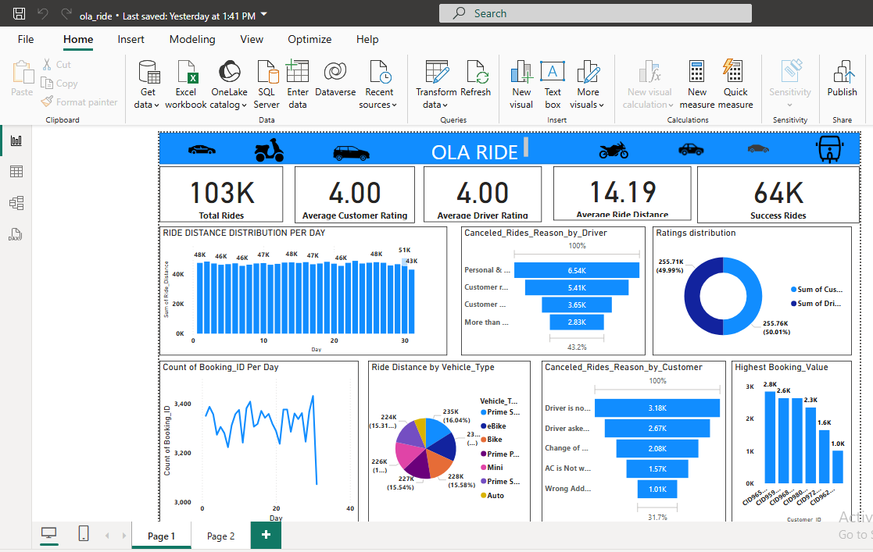
Power bi dashboard

Slide 9
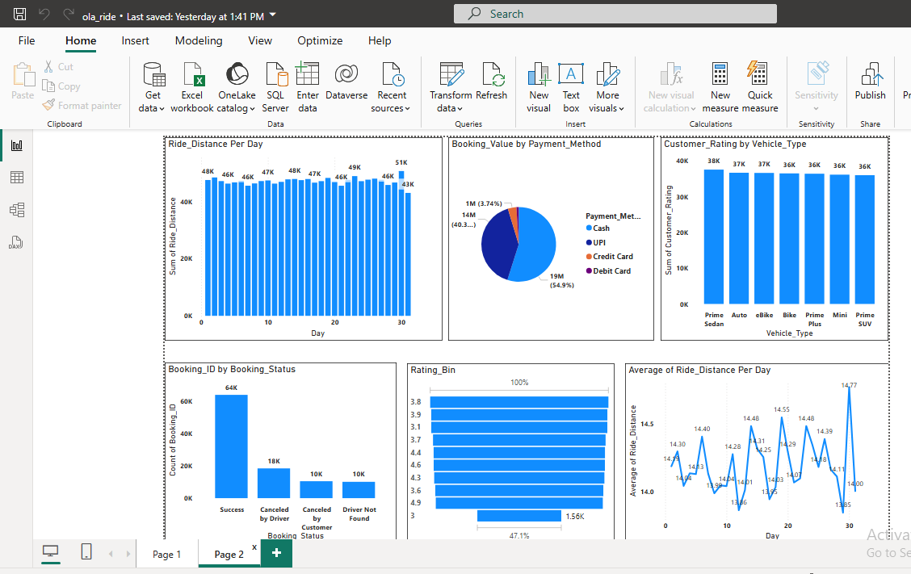
Power bi dashboard

Slide 10
STREAMLIT DASHBOARD
The Streamlit OLA Ride Dashboard is an interactive application that provides a comprehensive view of ride operations, revenue, cancellations, and ratings across all vehicle types. It reads the ride data, cleans numeric columns, and calculates key metrics such as total and successful booking value, average and total distance travelled, and average driver and customer ratings. The dashboard visualizes insights using bar charts, scatter plots, boxplots, and tables, highlighting top customers, vehicle-wise revenue, ride patterns, and cancellations. Users can quickly identify high-performing vehicles, loyal customers, and areas needing improvement, such as reducing cancellations or addressing low ratings. With its intuitive layout, the dashboard allows easy exploration of ride data, enabling better operational and strategic decision-making.

Slide 11
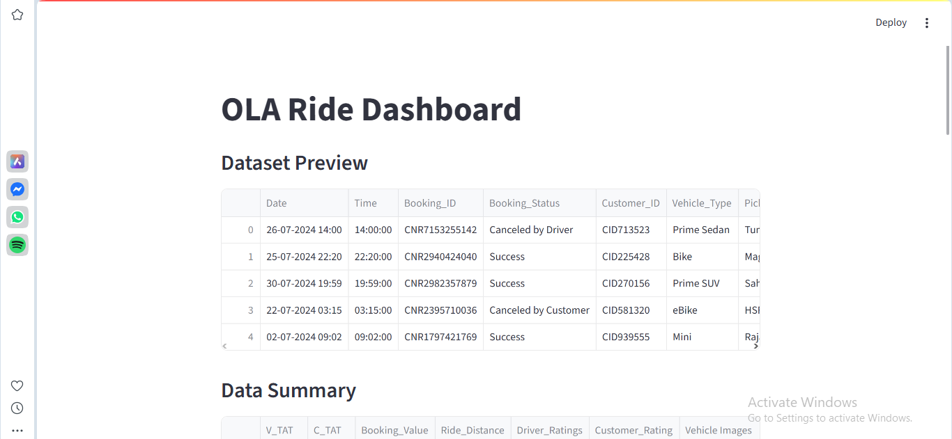
Streamlit dashboard

Slide 12
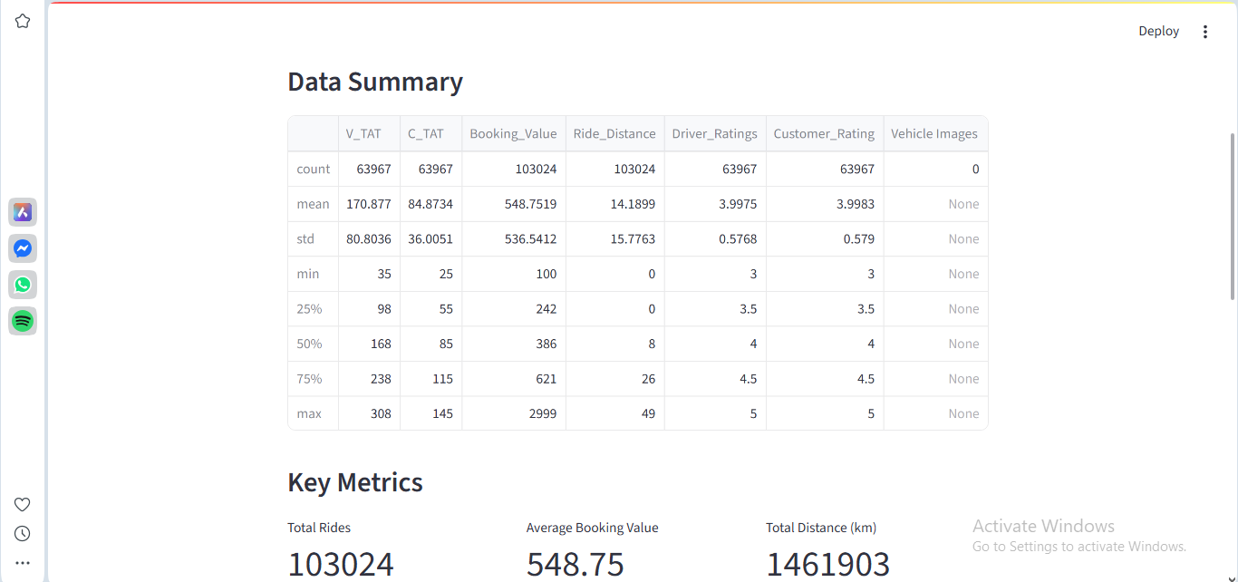
Streamlit dashboard

Slide 13

Streamlit dashboard

Slide 14

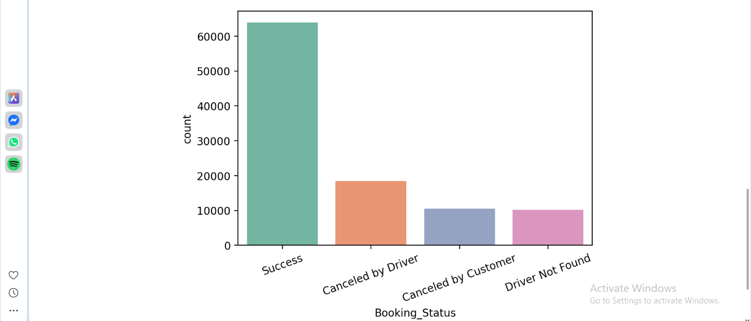
Streamlit dashboard

Slide 15
conclusion
In conclusion, the OLA Ride Dashboard provides valuable insights into ride operations, revenue generation, customer behavior, and service quality across different vehicle types. Premium vehicles like Prime Sedans and SUVs drive the highest revenue and cover longer distances, while Autos and Bikes serve short urban trips. Customer cancellations are higher than driver cancellations, highlighting areas for operational improvement. Driver and customer ratings are generally high, indicating satisfactory service, with premium vehicles achieving the best scores. The dashboard emphasizes the importance of loyal, high-value customers and successful ride fulfillment in maximizing revenue. Overall, these insights can guide strategies to reduce cancellations, enhance service quality, and optimize vehicle utilization for better business performance.

