Slide 1
SUGAR COSMETICS
PRESENTED BY ANJALI MISHRA

Slide 2

ABOUT
SUGAR Cosmetics is an Indian beauty and cosmetics brand that offers a wide range of makeup and skincare products specially designed for Indian skin tones. The company emphasizes high-performance, cruelty-free formulations, and bold, inclusive branding. Since its launch, SUGAR has established a strong presence in both online and retail channels, appealing to millennials and Gen Z in India.

Slide 3
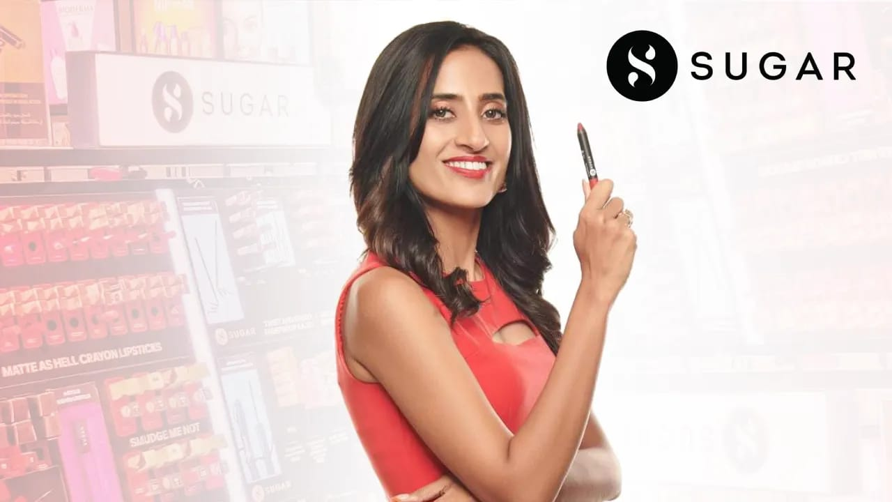
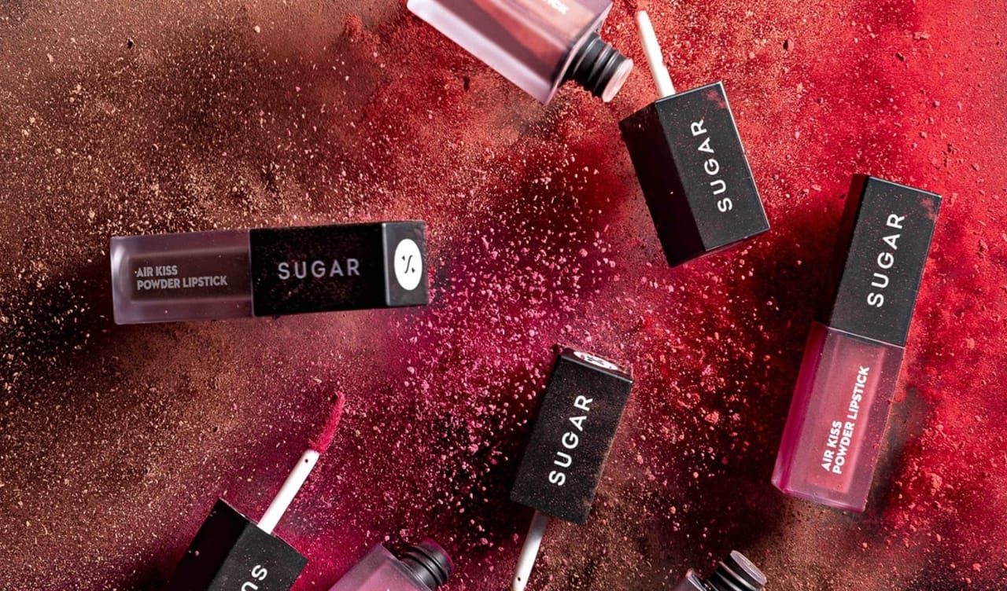
FOUNDER OF SUGAR
HER ENTERPRENEURIAL BEGINNING
The brand was co-founded by Vineeta Singh and Kaushik Mukherjee. Vineeta Singh serves as CEO and has been instrumental in driving the brand’s strategy, positioning SUGAR as a leading Indian beauty firm with inclusive products and a strong D2C and omnichannel approach.
The cosmetic company she founded in 2015, alongside her husband and partner, Kaushik Mukherjee The Mumbai-based startup was making monthly sales of Rs 5 crore to Rs 10 crore January 2020, and had a revenue target of Rs 200crore this year. Sugar Cosmetics came up with just two products. Since then, the company has grown to 450 stock-keeping units.
After five years, including one during which a pandemic occurred, SUGAR expects to end Fiscal Year 21 with a power-play of over Rs. 150 crores SUGAR opened a Shopify store, which it continues to operate. The firm also released an app in November 2019 that has over 800, 000 downloads and a 4.6star rating on Android and Ios. The brand has expanded outside India having a physical outlet in Russia and an online presence in the United States. Sugar Cosmetics operating income increased by 82 percent in FY20, from Rs 57.14 crore in FY19 to over Rs 104 crore
Vineeta Singh’s entrepreneurial journey began with courage, resilience, and a deep desire to build something of her own. After graduating from IIT Madras and IIM Ahmedabad, she was offered a high-paying job, which she boldly declined to pursue her dream of entrepreneurship. Her first venture, a beauty subscription service called FAB BAG, gave her valuable insights into consumer behavior in India’s beauty market. During this time, she realized that most international beauty products did not cater to Indian skin tones or climate. This market gap inspired her to launch SUGAR Cosmetics in 2015 along with her husband, Kaushik Mukherjee. The journey was far from easy — Vineeta faced skepticism, funding challenges, and long periods without profits. However, her belief in creating an Indian brand for Indian women kept her going. She focused on bold, cruelty-free products and relatable digital marketing, which soon connected with millennials and Gen Z audiences. From selling online to becoming an omnichannel success, her persistence turned SUGAR into one of India’s fastest-growing beauty brands. Vineeta’s story today stands as a testament to determination, vision, and fearless entrepreneurship.

Slide 4
SWOT ANALYSIS
Strengths
Strong brand identity, inclusive shade range, digital-first marketing, strong appeal among younger consumers.
Weaknesses
Highly competitive market, possible dependence on fast-moving trends, margin pressures
.
Threats
Global brands entering India, rising input costs, changing consumer preferences and regulatory risks.
Opportunities
Expansion into new categories (skincare, haircare), growth in Tier II/III cities, international markets

Slide 5
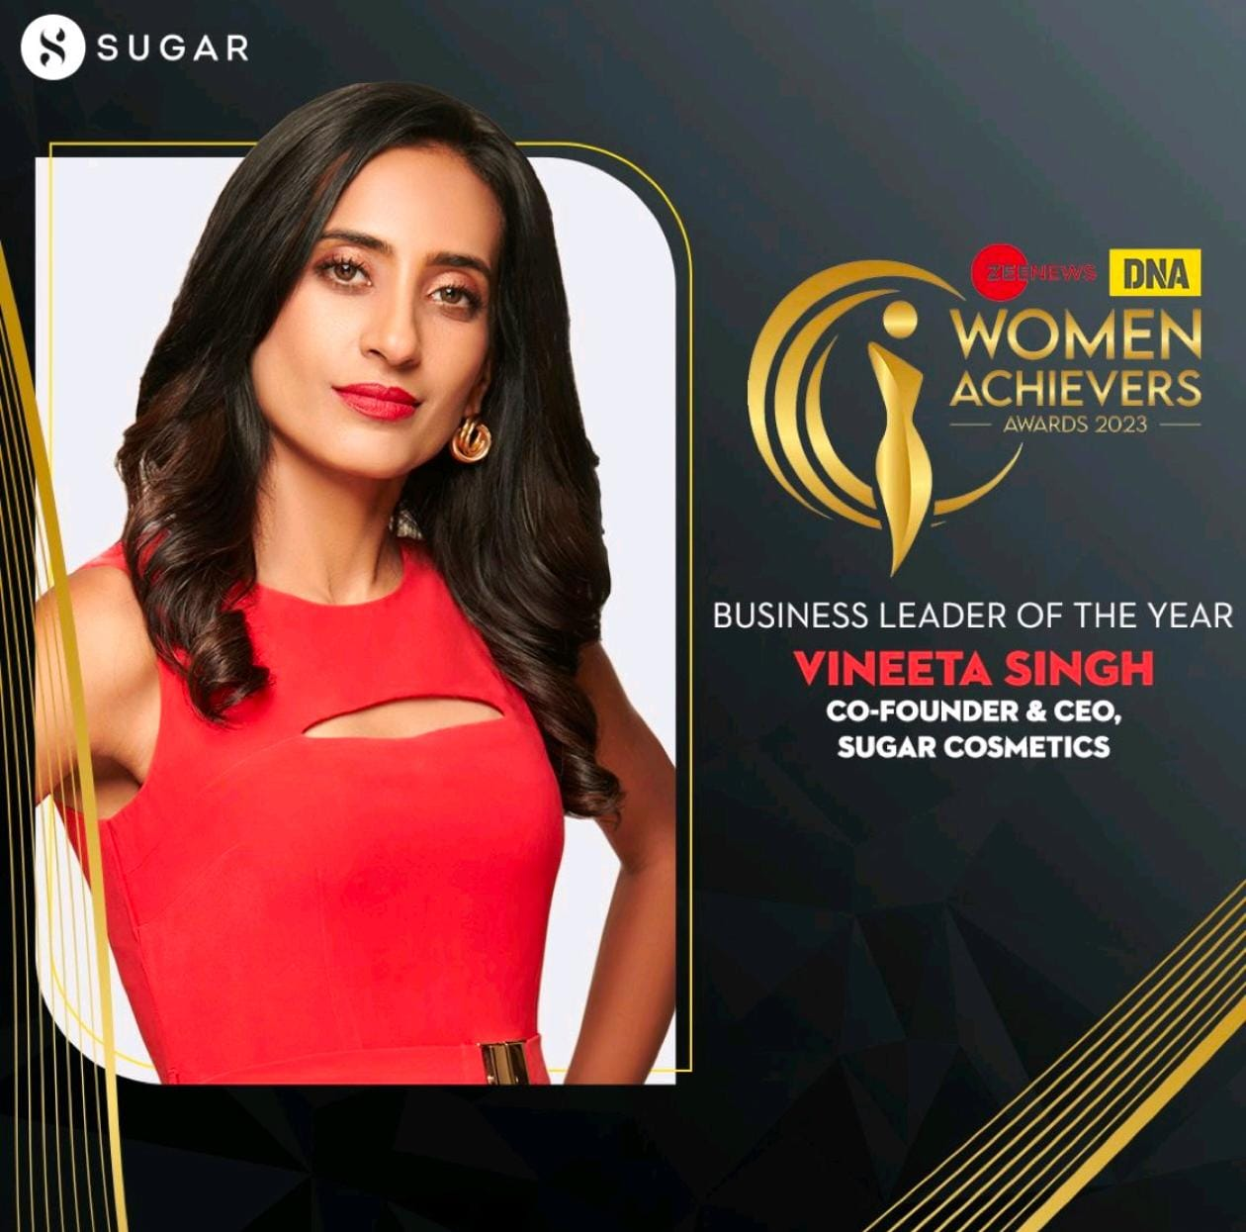
COMPETITORS
REWARDS AND ROLES
The brand has been honoured with titles such as Retail Start-Up of the Year (2019) and Most Promising Brand of the Year by major business publications. Founder Vineeta Singh has also been recognised individually, featuring in lists like 40 Under 40 by The Economic Times and W-Power by Forbes. Under her leadership, the brand took on a key role in the Indian beauty market — promoting inclusive makeup for Indian skin tones and building a digital-first D2C (direct-to-consumer) strategy. SUGAR’s roles include innovating product offerings, rapid retail expansion, and influencing new consumer trends among millennials and Gen-Z. The rewards not only reflect business growth but also brand reputation, innovation awards, and leadership recognition in the retail & consumer goods sector. Vineeta has also taken on the role of mentor and investor (as a judge on a business TV show) further extending the brand’s influence beyond products.
Sugar Cosmetics operates in a highly competitive beauty and personal care market in India. Its key Indian competitors include Lakmé, Mamaearth, MyGlamm, and Nykaa Cosmetics, which also focus on modern, trend-driven, and affordable makeup for young consumers. Global brands like Maybelline, L’Oréal, and Revlon also compete with Sugar through their strong retail presence and wide product range. Unlike these established names, Sugar differentiates itself with bold branding, inclusive shade ranges, and digital-first marketing. MyGlamm and Mamaearth challenge Sugar in the D2C (direct-to-consumer) space with influencer-based marketing and hybrid product lines. Meanwhile, Nykaa poses strong competition as both a retailer and a brand. Despite this, Sugar maintains a loyal customer base by offering cruelty-free, high-quality products tailored for Indian skin tones and climate conditions.

Slide 6
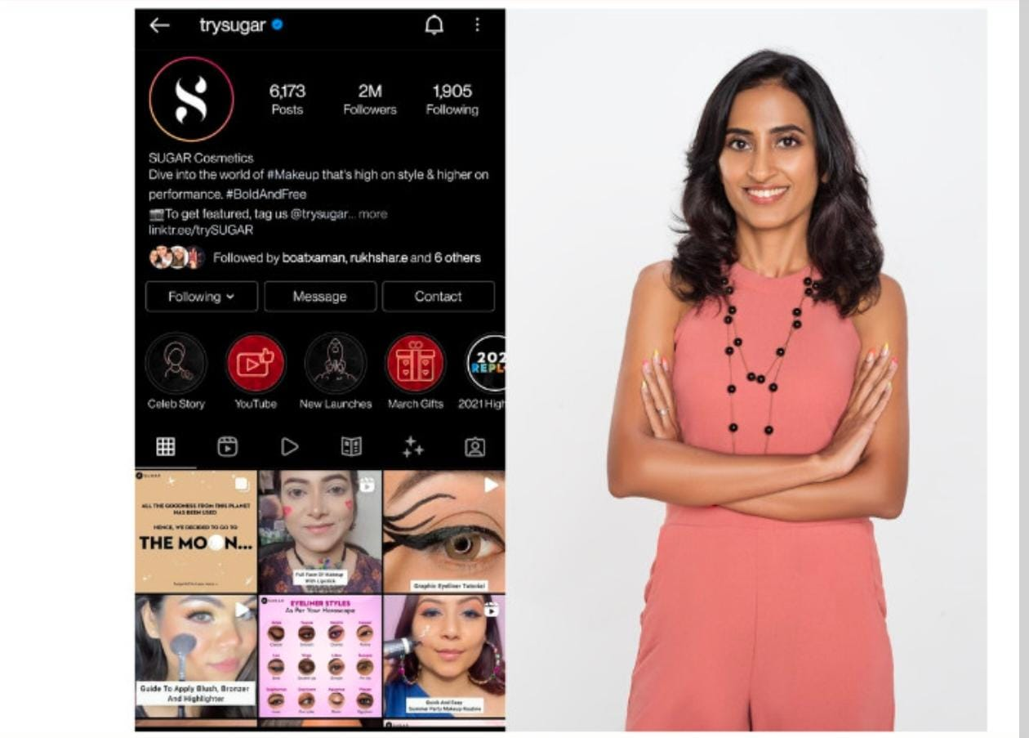
ENGAGEMENT AND COMMUNITY
SUGAR Cosmetics has created a strong digital community of beauty-enthusiasts across India, with millions of followers and high social engagement.
The brand actively uses social media platforms (Instagram, YouTube, short-video apps) to connect with its audience via trends, influencer content, and interactive campaigns.
Campaigns like #GetReadyWithSUGAR (in collaboration with the short video platform Moj) invited user participation, created user-generated content (UGC), and boosted sharing and visibility.
SUGAR features user-generated content (e.g., product looks shared by real users) on its social channels, which helps foster a sense of belonging and authenticity among its community.
The brand uses its community not just for promotion but also to listen, learn and improve: feedback loops and social listening help shape new products and content strategy.
Engagement metrics tell the story: at one point, SUGAR had the highest number of cross-platform “actions” (likes, shares, comments) among Indian beauty brands.
Offline and online integration is also part of the community strategy: interactions, events and retail experiences contribute to a unified community feel beyond just digital.
Because of this strong community focus, SUGAR enjoys brand advocacy users become brand ambassadors, share their looks, and influence peers, which lowers reliance on paid advertising and strengthens organic growth.

Slide 7
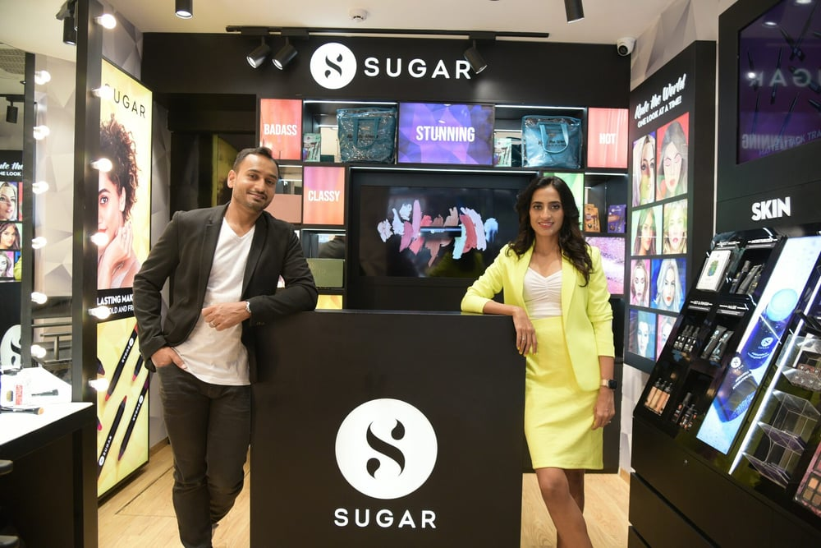
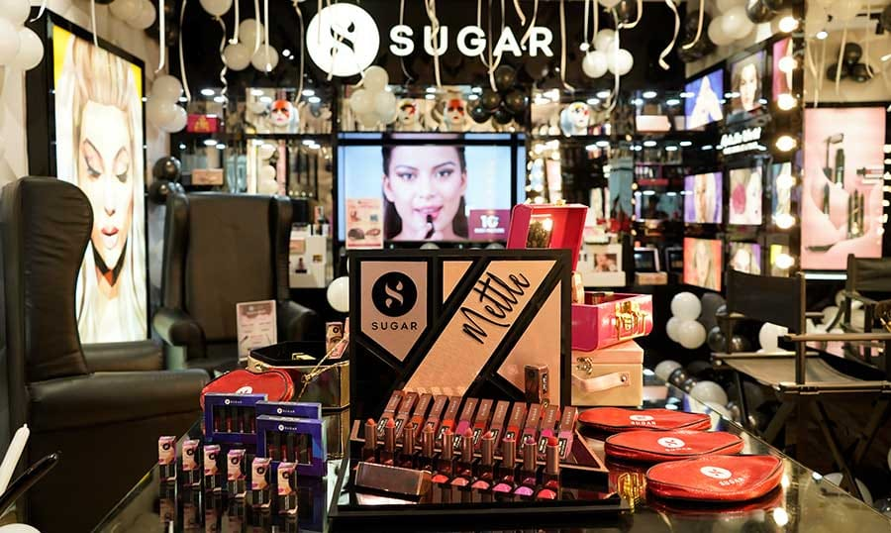
RETAIL AND PARTNERSHIP
Sugar Cosmetics has rapidly grown through an omnichannel retail strategy, combining online sales with a strong offline presence. The brand began as a digital-first company but soon expanded into exclusive brand outlets (EBOs) and multi-brand retailers like Shoppers Stop, Lifestyle, and Nykaa Stores.
It now has 400+ stores across more than 150 cities in India, reaching Tier II and Tier III markets. Strategic partnerships with e-commerce platforms such as Amazon, Nykaa, and Flipkart have amplified visibility and sales. Sugar also collaborates with influencers, makeup artists, and retail chains for pop-up experiences and campaigns. Its retail expansion is driven by the goal of making premium-quality, affordable beauty accessible to all. The brand’s presence in both digital and physical spaces helps build stronger customer trust and engagement. This hybrid retail model ensures consistent growth and a wide consumer reach across India.

Slide 8
CONCLUSION
In conclusion, Sugar Cosmetics stands as a pioneering Indian beauty brand that merges innovation, inclusivity, and bold identity. Founded by Vineeta Singh, the company reshaped the Indian makeup industry by catering to diverse skin tones and modern preferences. Its success is built on strong digital marketing, influencer engagement, and a powerful community-driven approach. Through its omni-channel presence and data-backed campaigns, Sugar has created a loyal customer base of millennials and Gen Z. Despite facing tough competition, the brand continues to thrive through creativity, authenticity, and strategic expansion. It embodies the spirit of modern Indian entrepreneurship confident, independent, and trendsetting. With continuous innovation and customer focus, Sugar Cosmetics is well-positioned to grow as a global beauty powerhouse.

Slide 9
THANK YOU

