Slide 1

Analysis of Player Performance with Predictive modeling: T20 Cricket
TEAM: Harish Polishetti (700744427)
Neeharikha Vemulakonda (700749647)
Anjali Nara (700745071)

Slide 2
ROLES AND RESPONSIBILITES:
We are a team of three members who worked together to build a predictive model using ridge regression, lasso regression and elastic regression. Each member had a specific role and responsibility in the project:
Niharika: Researched on the ridge regression, collected the references and Implemented the code for Ridge regression including the collection of data, normalizing the data, model evaluation and analysis of the results obtained.
Anjali: : Researched on the lasso regression, collected the references and Implemented the code for lasso regression including the collection of data, normalizing the data , model evaluation and analysis of the results obtained.
Harish: Researched on the elastic-net regression, collected the references and Implemented the code for elastic-net regression including the collection of data, normalizing the data , model evaluation and analysis of the results obtained.
We all collaborated on writing the paper, including the introduction, related work, methodology, results, and discussion sections. We also worked together to create the presentation for our findings.

Slide 3

MOTIVATION
Forecasting player performances is an important aspect of cricket matches that allows teams to optimize their team, and departmental strategies
Machine learning techniques have yielded promising results in Predictive modeling and providing solutions.
We investigate the effectiveness of these machine learning techniques for predicting the performance of the players in this study.
We preprocess statistical data of the cricketers and train the model.
The findings of this study can be used to identify the most effective techniques for predicting effectiveness of the player by analyzing their performance.

Slide 4
OBJECTIVES
The objectives of our project are:
To understand the applications of data analytics and machine learning in cricket.
To collect, clean, and process data using Python libraries like Pandas and NumPy
To understand the key performance metrics in cricket and how they can predict player performance.
To build a predictive model using ridge, lasso and elastic regression.
Based on the findings of this study, provide team management and coaches with insights and recommendations for making informed decisions about team selection and management depending upon different kinds of opponent teams.

Slide 5
RELATED WORKS:
Ridge and Lasso Regression Models for Cross-Version Defect Prediction: investigates two famous biased estimation methods (ridge regression (RR) and least absolute shrinkage and selection operator (lasso) regression for sorting software modules in order of defect count over cross-version datasets.
The Application of Bayesian Penalty Regression in Sparse Regularization: This paper applies different regularization methods to solve the overfitting problem of high-dimensional sparse models and compares their accuracy of prediction.
Performance Comparison of Machine Learning Methods with Distinct Features to Estimate Battery SOC : This study analyzes the performances of different machine learning techniques using both conventional features that can be obtained readily and nonconventional features that can be derived using the conventional features
Feature Selection for Learning to Predict Outcomes of Compute Cluster Jobs with Application to Decision Support: A machine learning framework and a new test bed for data mining from the Slurm Workload Manager for high-performance computing (HPC) clusters.

Slide 6
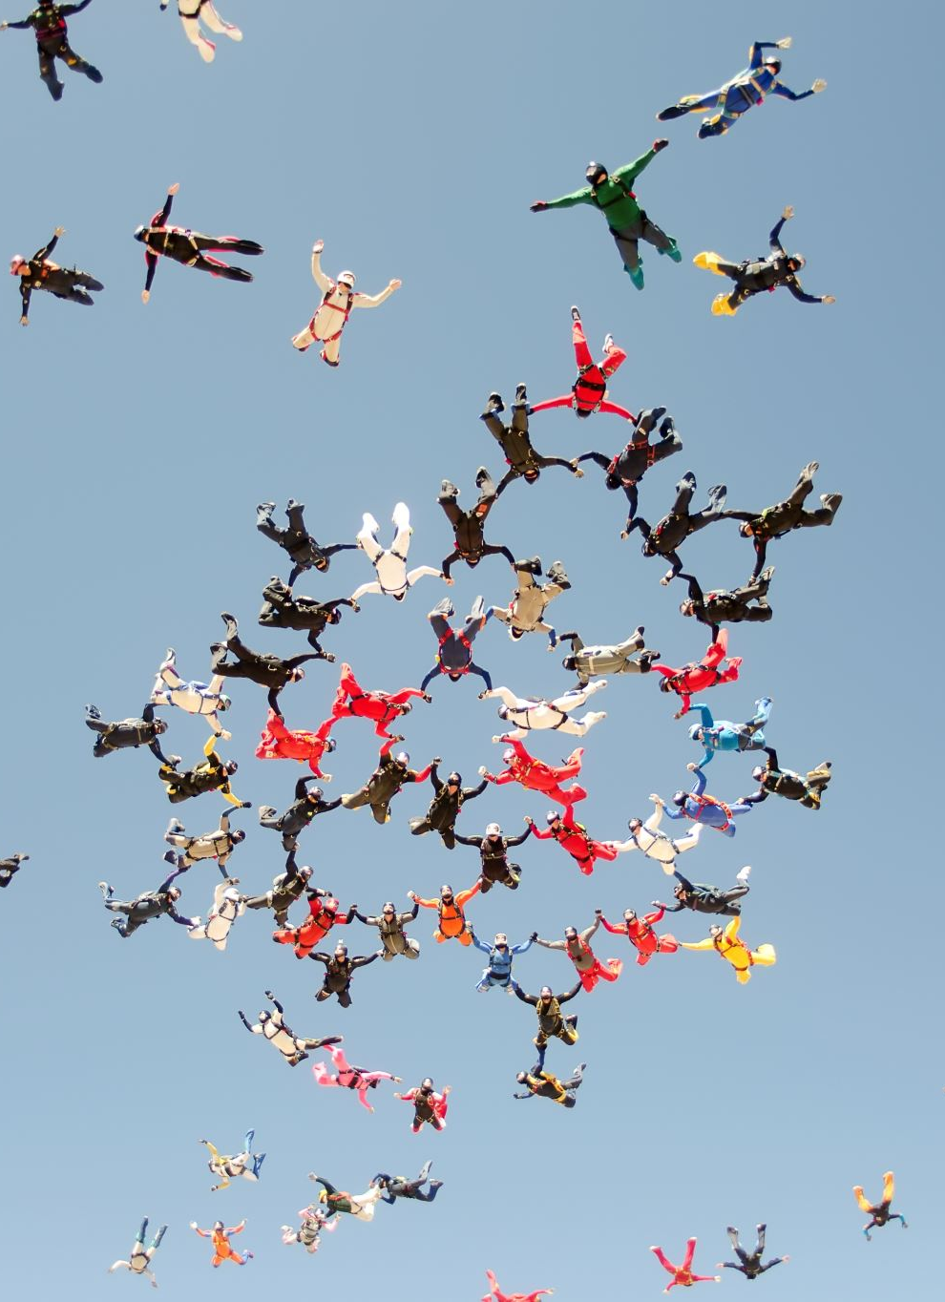
PROBLEM STATEMENT:
The moto of the study is to predict the performance of the players, as it is hard for the coaches, management to keep record of every individual player. it is also a challenging task to select the players in the team according to the opponent team which are based on subjective assessment and experience. however, with the advent of data-driven analytics, one can now use statistical models to gain insights into player performance and make informed decisions about team selection and game strategies.

Slide 7
PROPOSED SOLUTION:
Data collection: We intend to use a dataset that is readily accessible from cricmetric.com.
Preprocessing the data: We will scale the data, remove irrelevant columns, and treat the missing values.
Model implementation: Using ridge regression, lasso regression and elastic regression, a linear regression technique, to train models for predicting future performance based on past performance.
Training the models: To prevent overfitting, we will train the models on the training set while utilizing cross-validation.
Model evaluation: Based on training and testing data we will evaluate the model.
Analysis of the results: We'll examine the findings and evaluate how well the machine learning approach performed.

Slide 8
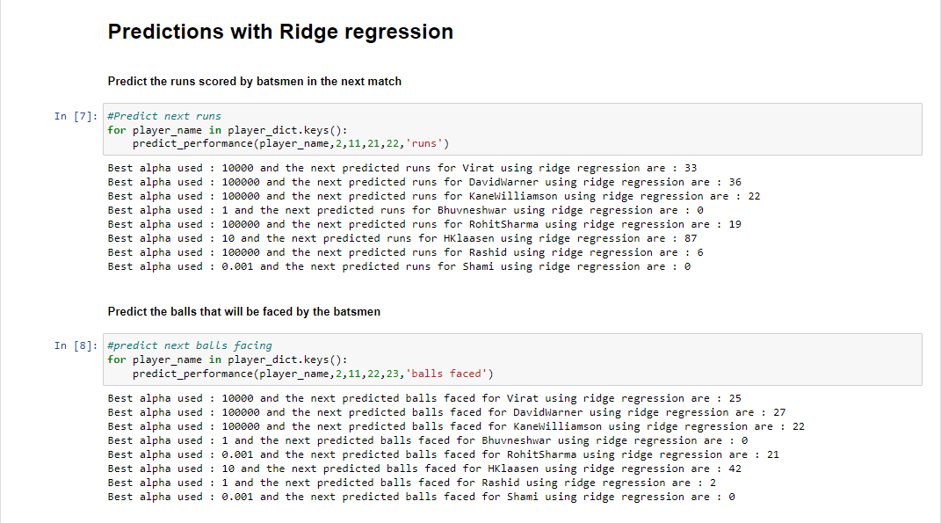
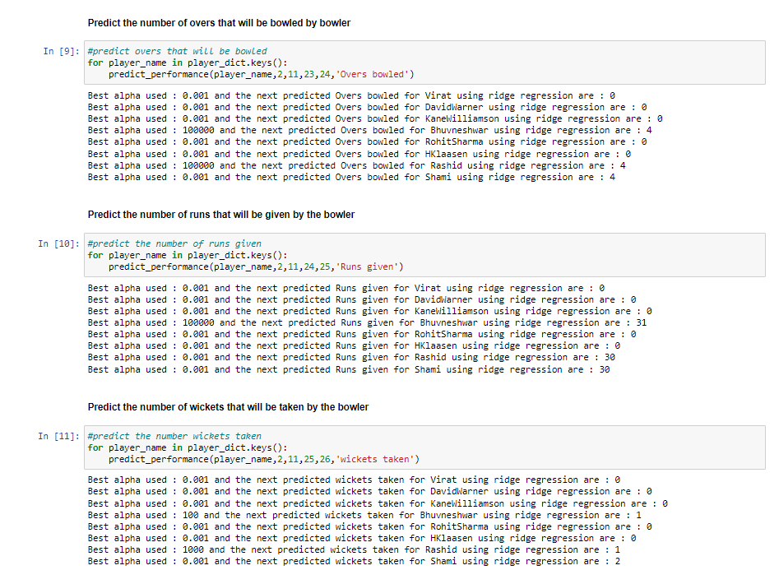
RESULTS/SIMULATIONS:

Slide 9
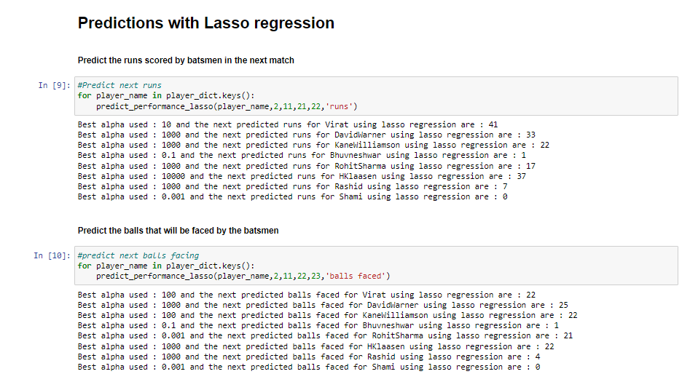
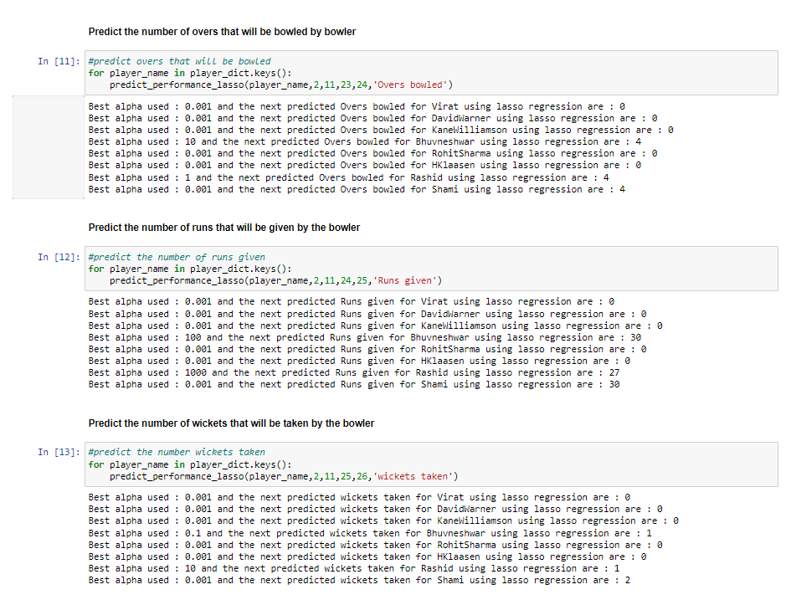

Slide 10
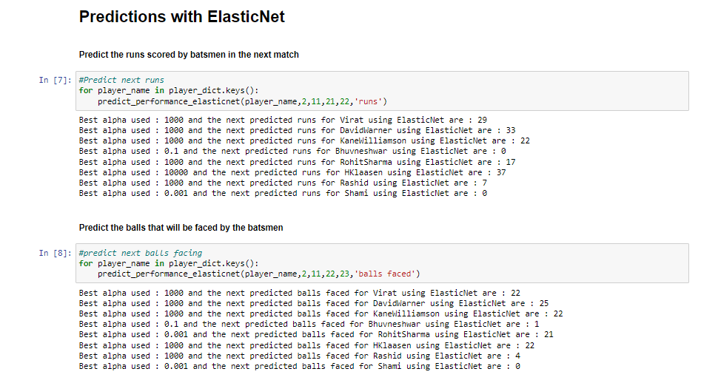
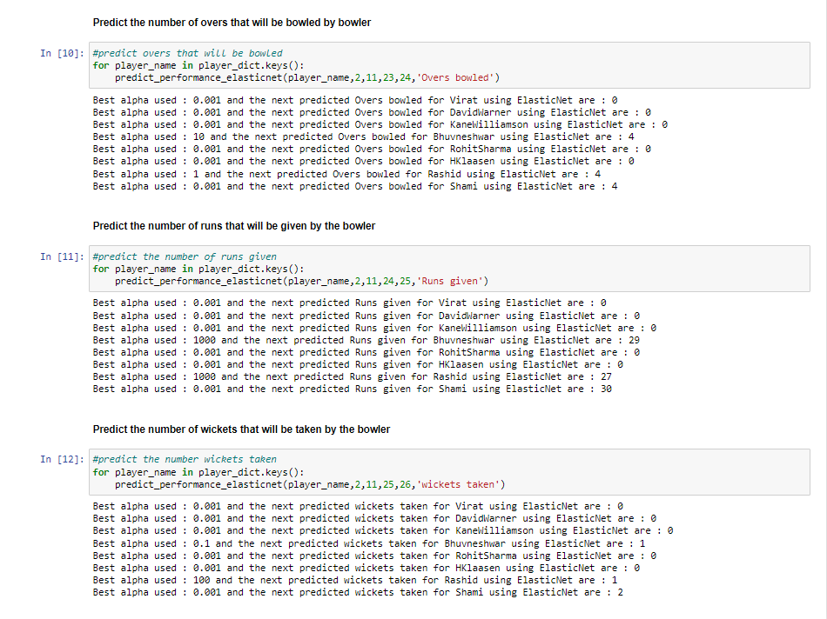

Slide 11
REFERENCES:
[1] X. Yang and W. Wen, "Ridge and Lasso Regression Models for Cross-Version Defect Prediction," in IEEE Transactions on Reliability, vol. 67, no. 3, pp. 885-896, Sept. 2018. doi: 10.1109/TR.2018.2847353. [2] W. Chen, "The Application of Bayesian Penalty Regression in Sparse Regularization," in 2020 International Conference on Big Data & Artificial Intelligence & Software Engineering (ICBASE), Bangkok, Thailand, 2020, pp. 158-165. doi: 10.1109/ICBASE51474.2020.00042. [3] A. S. M. J. Hasan, J. Yusuf, and R. B. Faruque, "Performance Comparison of Machine Learning Methods with Distinct Features to Estimate Battery SOC," in 2019 IEEE Green Energy and Smart Systems Conference (IGESSC), Long Beach, CA, USA, 2019, pp. 1-5. doi: 10.1109/IGESSC47875.2019.9042399. [4] A. Okanlawon, H. Yang, A. Bose, W. Hsu, D. Andresen, and M. Tanash, "Feature Selection for Learning to Predict Outcomes of Compute Cluster Jobs with Application to Decision Support," in 2020 International Conference on Computational Science and Computational Intelligence (CSCI), Las Vegas, NV, USA, 2020, pp. 1231-1236. doi: 10.1109/CSCI51800.2020.00230.

