Slide 1

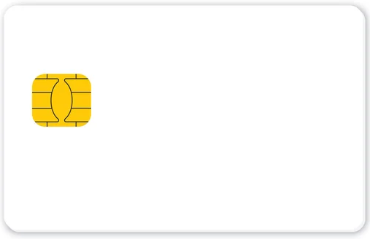
Mining Transactional Data
to Combat Fraudulent Activities
Under the guidance of Dr. Taehee Jeong
Group 7
Anjali Ojha
Akanksha Tyagi
Srushti Doshi
Sakshi Mukkirwar

Slide 2

Agenda
Motivation
Dataset Overview
Data Mining and Analysis
Data Preprocessing
Feature Engineering
Modelling
Technical Novelty
Key Findings and Insights
Summary
References

Slide 3
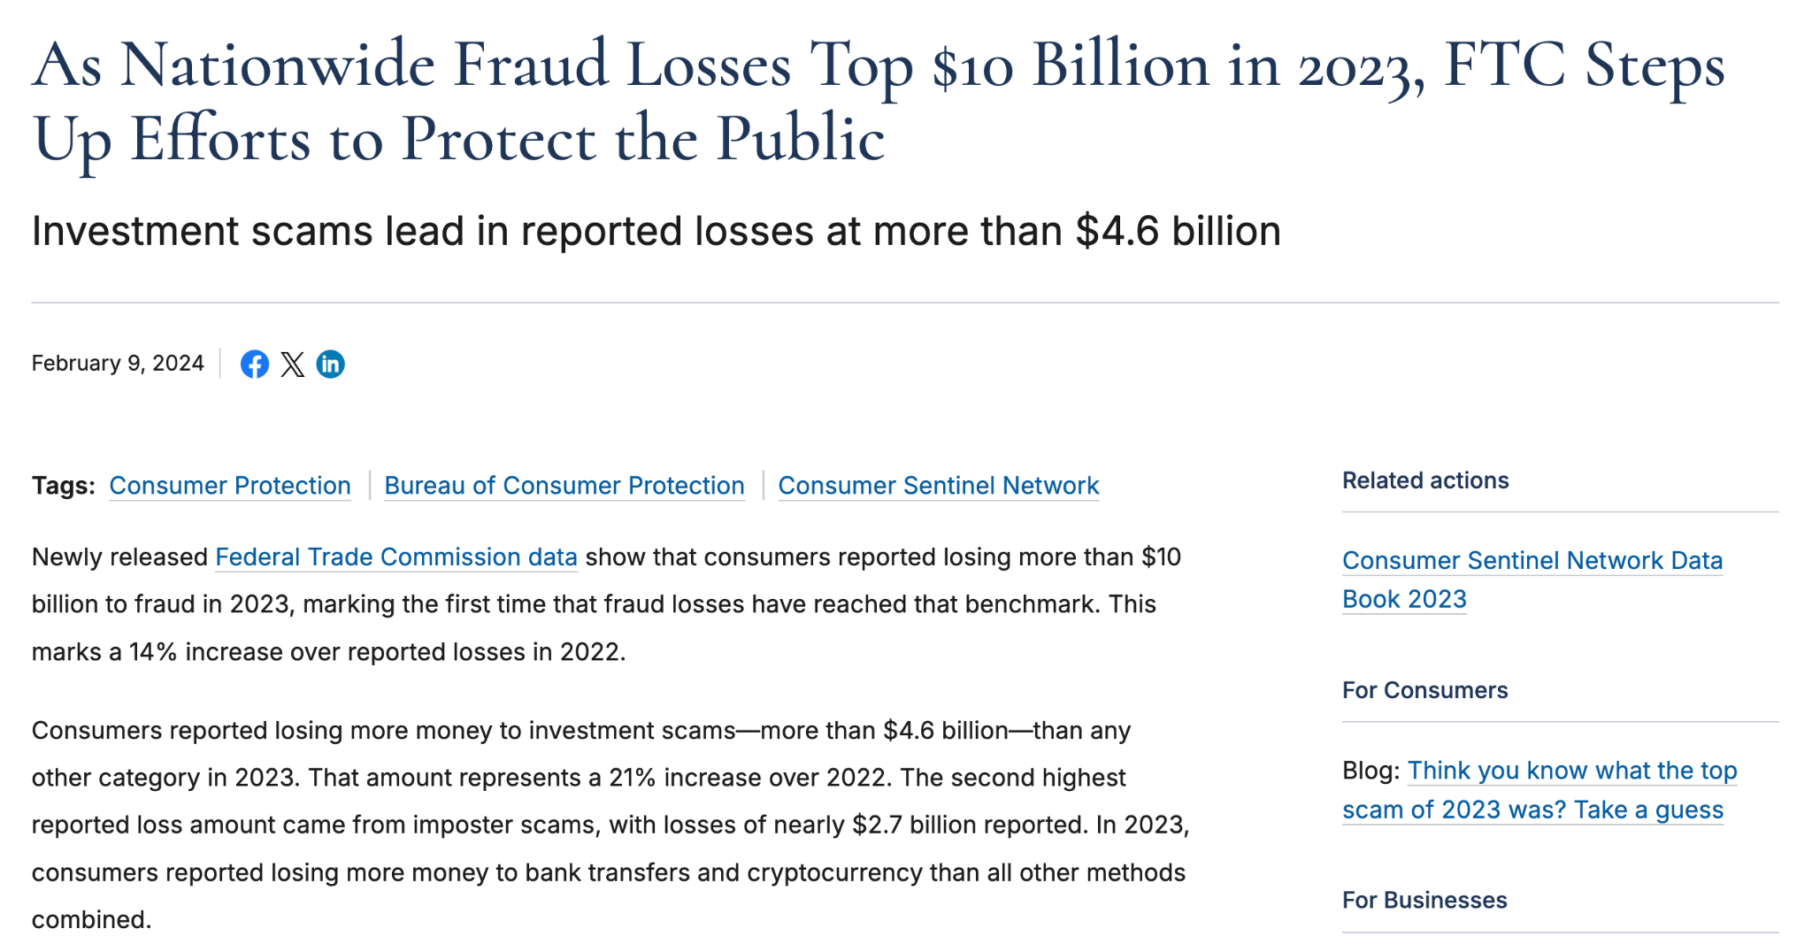
Motivation
Increasing Global Fraud : According to a recent report by the Federal Trade Commission, consumers lost over $10 billion to fraud in 2023, marking a significant 14% increase from the previous year.
Escalating fraud techniques outpace traditional security measures, necessitating more sophisticated solutions.
Project Goal: Understanding hidden patterns and fraud predictions for consumers and small businesses against online transaction fraud using data mining insights.
https://www.ftc.gov/news-events/news/press-releases/2024/02/nationwide-fraud-losses-top-10-billion-2023-ftc-steps-efforts-protect-public

Slide 4
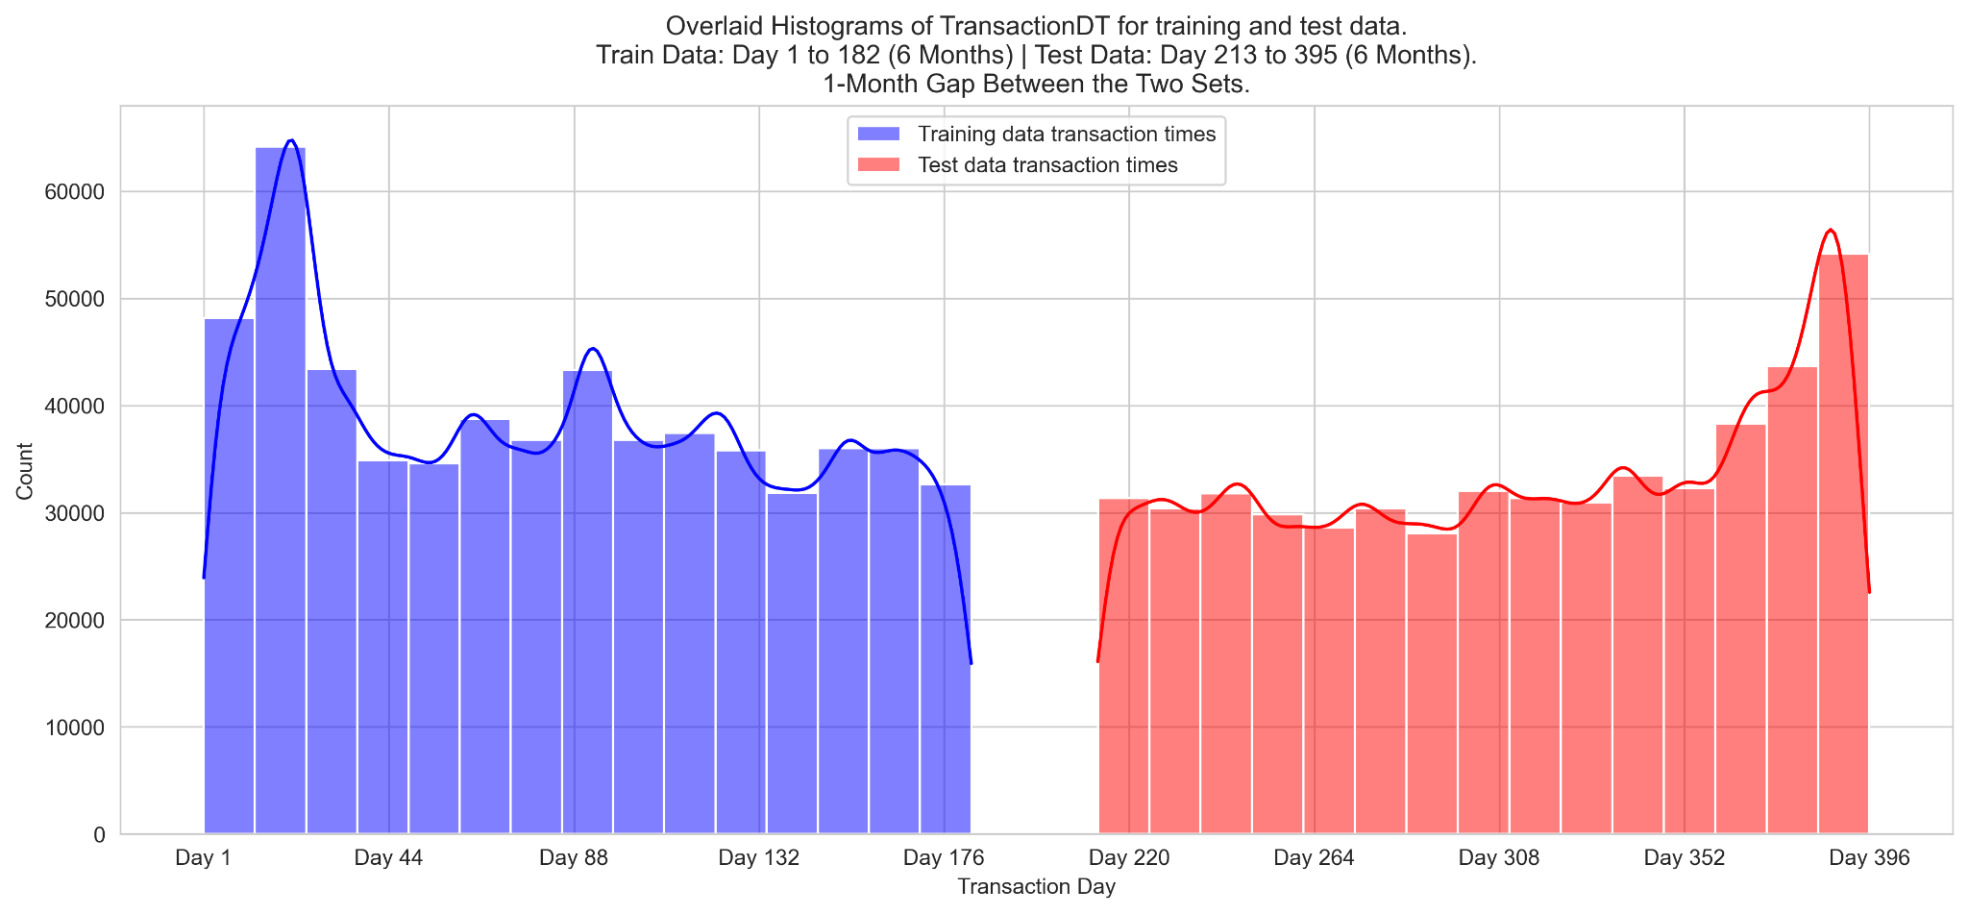
Dataset Overview : IEEE-CIS Fraud Detection
 | Train | Test | Details
Transaction Features = 393 | train_trainsaction.csv samples = 590,540 | test_trainsaction.csv samples = 506,691 | contains transaction-related features, including transaction amounts, timestamps, product-code, card-type, email-domains, address, region, and fraud labels.
Identity Features = 40+1 | train_identity.csv samples = 144,233 | test_identity.csv samples = 141,907 | includes identity-related information, like device type, browser information, operating-system, and anonymized personal details.
Note - The training and test sets are split across transaction and identity files, with option to merge these on a TransactionID field. Our target variable is isFraud column.

Slide 5
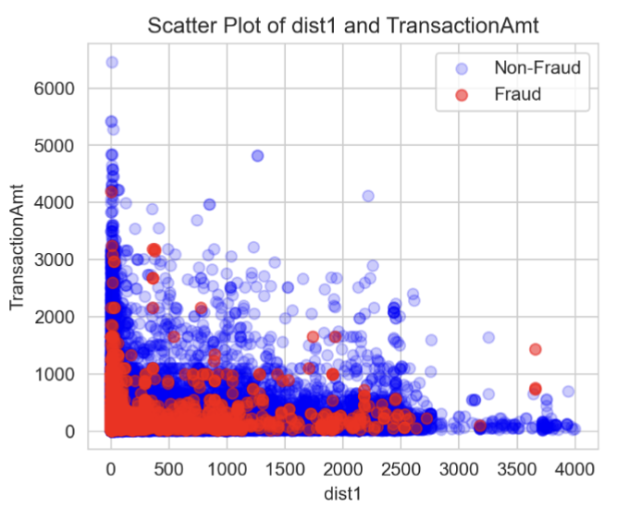
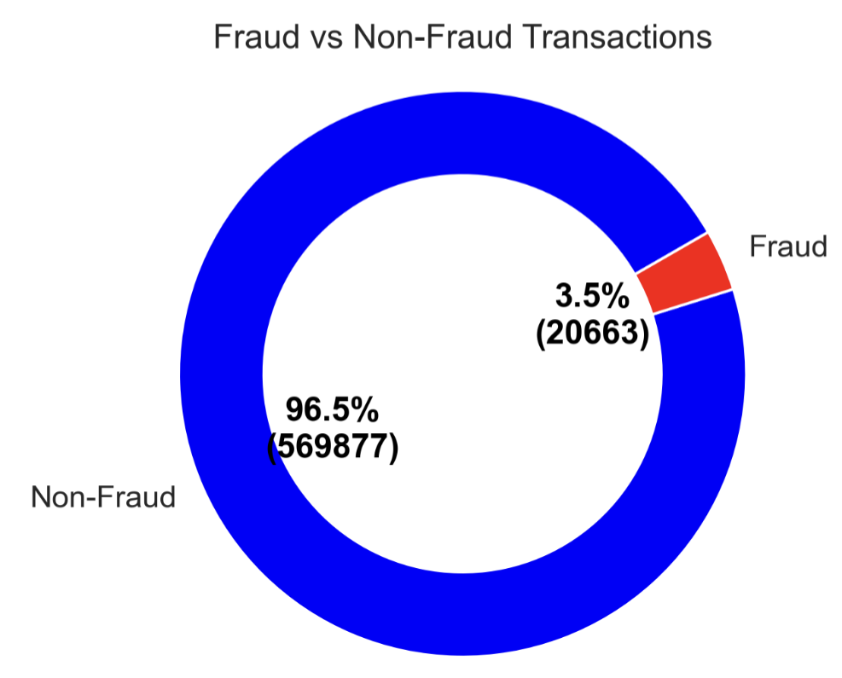
Data Mining and Analysis
Expected Trends and Patterns [1]
> This chart highlights the class imbalance in the dataset, where fraudulent transactions constitute only 3.5% of the total, underscoring the rarity and difficulty in detecting fraud.
> The scatter plot reveals most legitimate transactions occur close to billing addresses with lower amounts, whereas fraudulent transactions tend to involve higher amounts further from the billing address.

Slide 6
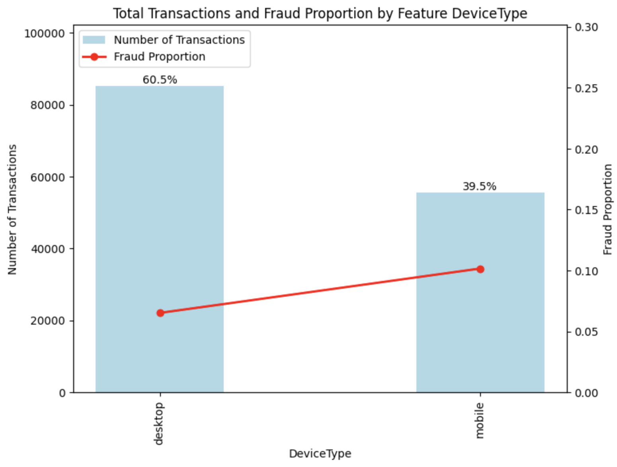
Expected Trends and Patterns [2]
Description:
The chart compares transactions and frauds across device types: desktop and mobile.
The bar chart shows transaction distribution, while the red line highlights fraud occurrences per device.
Analysis:
Desktop accounts for 60.5% of transactions, while mobile covers 39.5%.
Despite fewer transactions on mobile, fraud rates are higher compared to desktop.

Slide 7
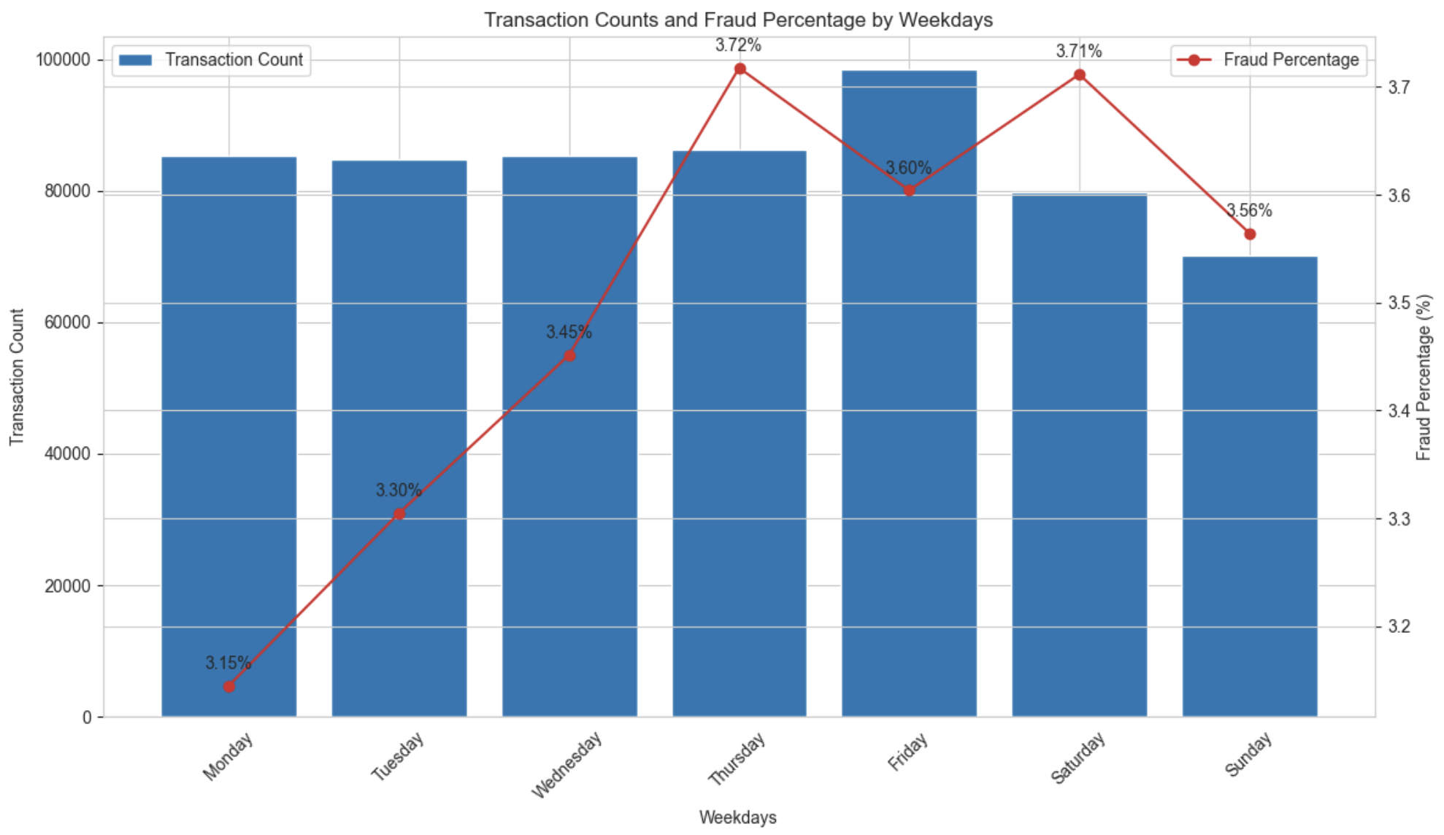
Expected Trends and Patterns [3]
Description:
The plot displays transaction counts and fraud percentages by weekday.
The bar chart illustrates the number of transactions for each weekday, while the red line chart represents the fraud percentage in these transactions.
Analysis:
The number of transactions stays relatively consistent throughout the week, with a slight peak on Friday.
Fraud percentage is lowest on Monday (3.15%) and rises steadily, peaking on Thursday (3.72%) and maintaining the upward trend over the weekend.

Slide 8
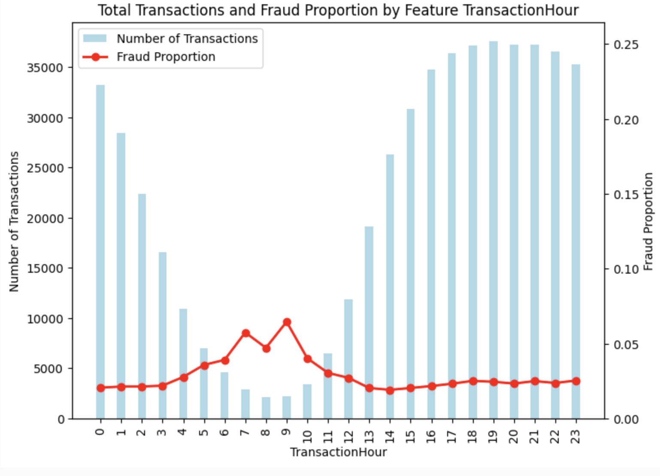
Underlying Trends [1]
Description : The graph shows the trend in fraudulent activities with respective to the transaction hour.
Analysis : Transaction timing insights show certain hours show higher transaction volumes, while other hours are notably lower.
Fraud Patterns:
Fraudulent activities are more common during hours with fewer transactions.
This is a notable finding, as it contrasts with the common belief that fraud is more likely to occur during high-transaction periods.
Frauds peak during early hours when transaction counts are low.
This suggests fraudsters may exploit low-activity periods to evade detection.

Slide 9
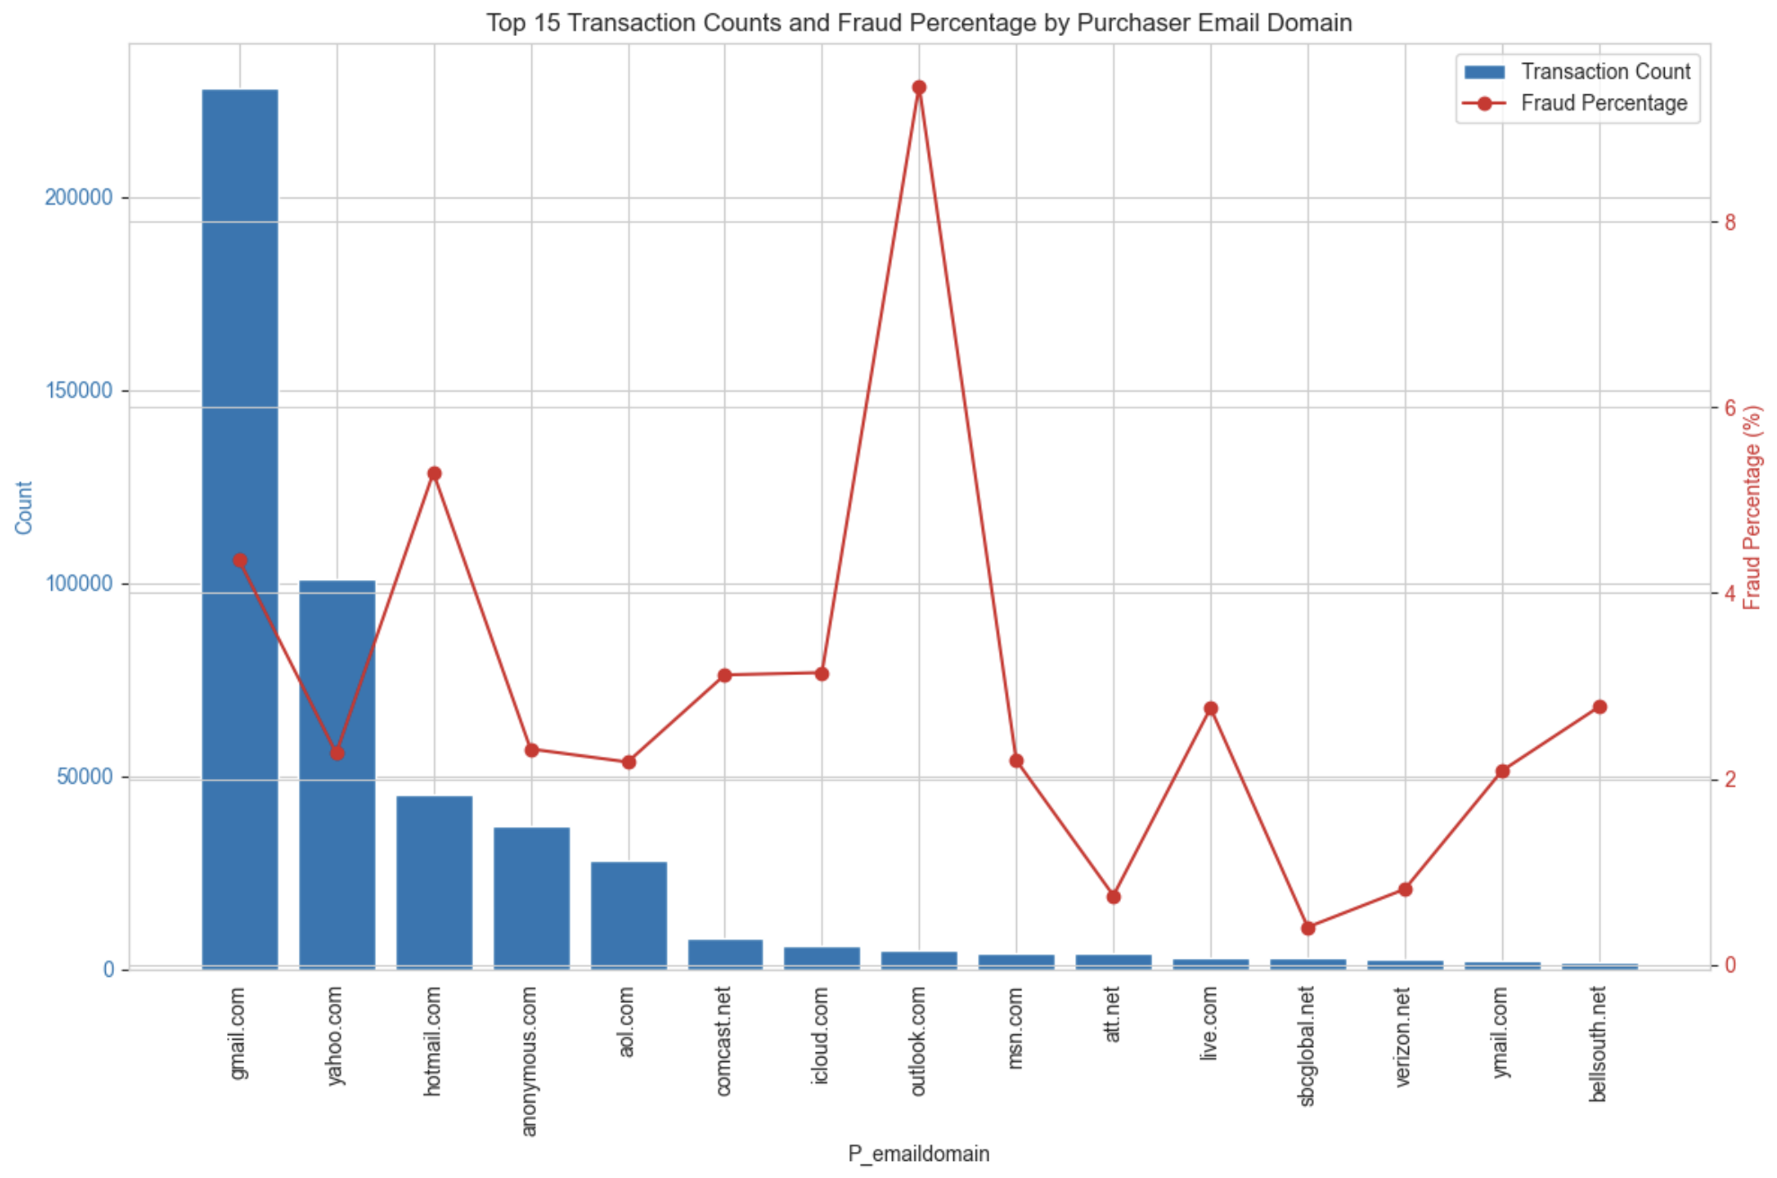
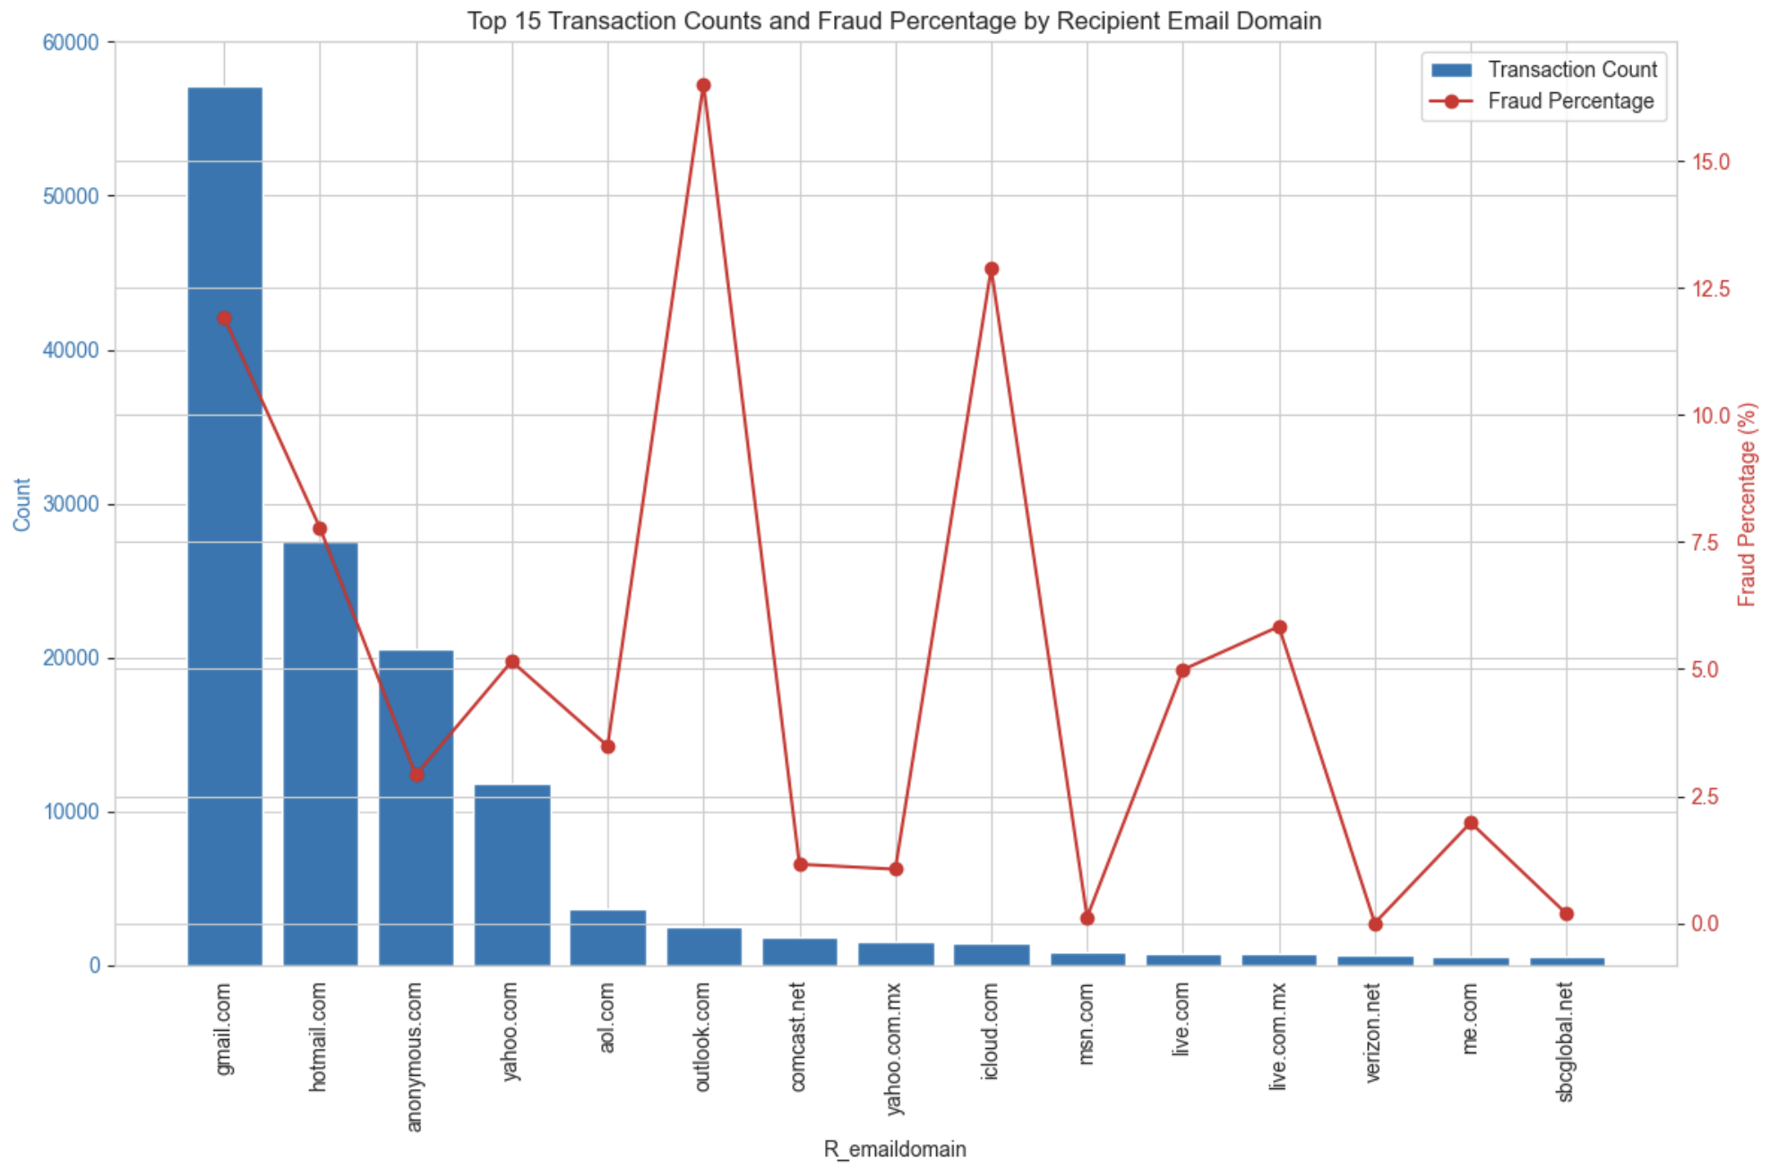
Underlying Trends [2]
Description : Purchaser transaction counts and fraud percentages for the top 15 email domains, showcasing notable variations in fraud risk.
Description : Recipient transaction counts and fraud percentages for the top 15 email domains.
Analysis : High fraud percentages are seen with domains like outlook.com, icloud.com, and gmail.com, suggesting fraudsters hide behind reputable domains. These domains are owned by technology giants like Microsoft, Apple, and Google respectively.

Slide 10
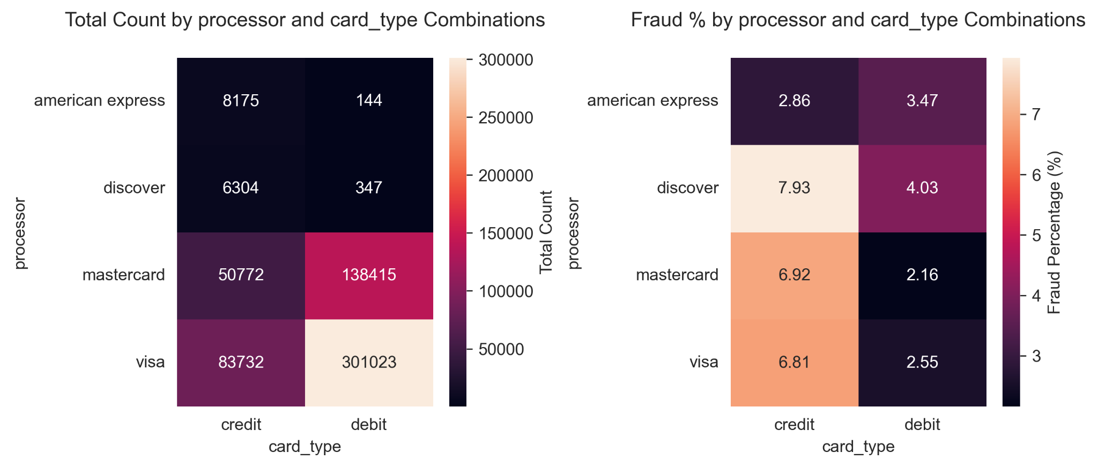
Underlying Trends : Card Type vs Fraud [3]
Description : Heat Map shows number of transactions and fraud percentage for different card companies and card types showing fraud percentages.
Analysis : An unexpected observation is that American Express’s debit card has a higher fraud rate than American Express credit card. It contradicts the popular opinion that credit cards are more prone to fraud.

Slide 11
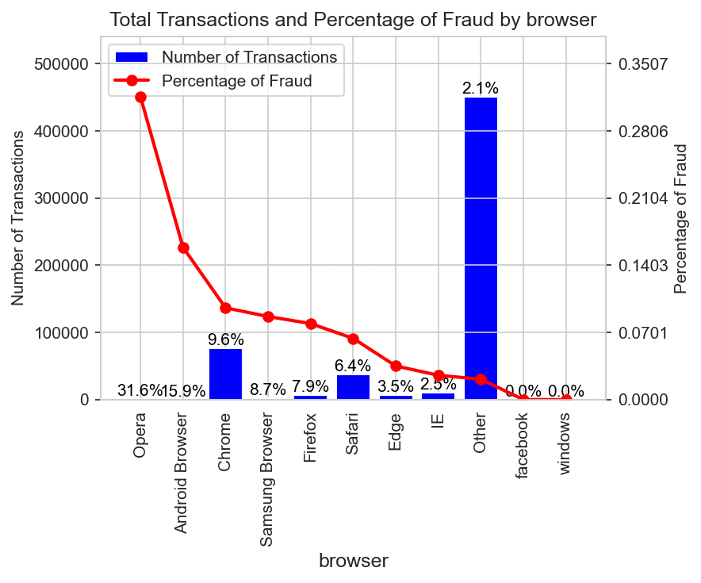
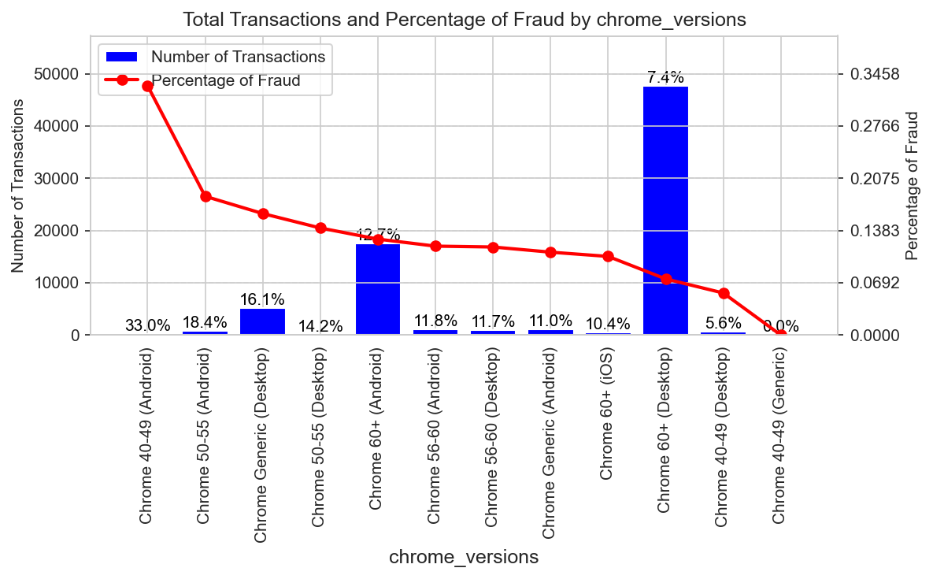
Underlying Trends for Browsers & Chrome [4]
Description : Figure shows fraud transaction within different browsers and Chrome browser’s different versions.
Analysis : Compare to other popular browser, Chrome have highest fraud %. Fraud transactions are higher on mobile Chrome browsers and older desktop versions.
Newer Chrome versions show lower fraud %, likely due to improved security features.

Slide 12
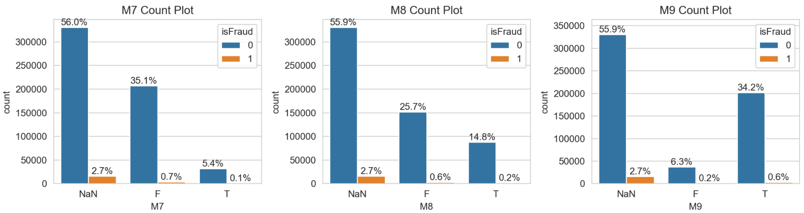
Underlying Trends [5]
Description : Missing Values for the M-Features (M1-M9), and the overall fraud transaction contribution which is 2.7% out of total 3.5%.
Analysis : The M1-M9 features corresponds to the match value such as name on card match or not etc. therefore most of these features should be of the form "T" or "F". But when these variables are not captured during transaction, there is significantly higher chances of fraud. So it's important to keep all the information up to date with the banks.

Slide 13
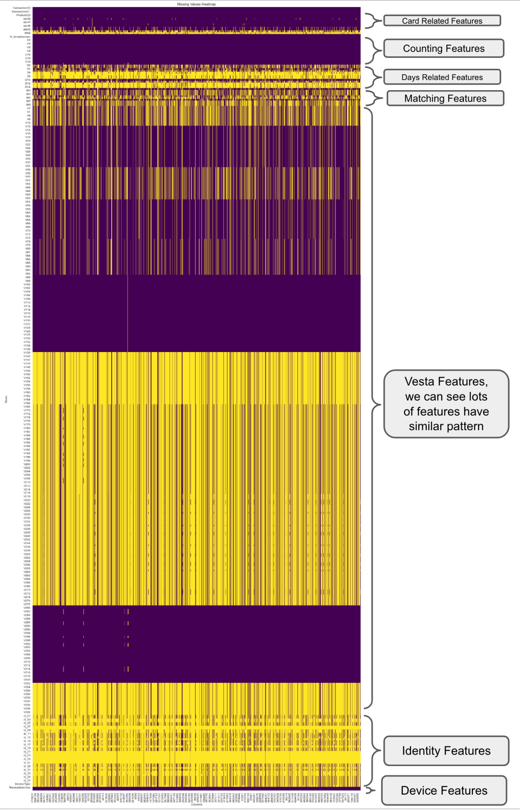
Data Pre-Processing
Drop columns that have more than 90 % missing values. As shown in the figure, there are many columns with lots of missing values.
Remove outliers using IQR method *.
Impute missing values -
Using mean for numerical features.
Using mode for categorical features.
Standardize numerical features using min-max normalization.
The heatmap plot of the data shows the missing values in data (yellow), and also highlights the recurring pattern of them, which later used for PCA.
* Final models don’t use it. We found that removing outliers actually reduced ROC-AUC. This can be explained by the fact that outlier features are indicative of fraudulent behavior.

Slide 14
Feature Engineering [1]
New features
Created correlation-based features to link email domains with fraudulent behavior.
Extracted screen resolution (e.g., width x height) into separate features: screen_width and screen_height.
Extracted patterns like hour-of-day, day-of-week, and seasonal trends to capture behavioral variations and user habits.

Slide 15
Feature Engineering [2]
V1-V339
27 Features
⁠Feature reduction
Correlated features were grouped, and dimensionality was reduced using PCA. Similarly, email domains (e.g., gmail.com, yahoo.com) were categorized to simplify the feature space.
Browsers and their versions were consolidated into broader categories such as Chrome, Firefox, and Safari for better insights.
Operating systems were grouped into broader families, such as Windows, Android, and iOS, for easier analysis..
id_1-id_38
21 Features
M1-M9
10 Features
139 Features
D1-D15
14 Features
Card-1 - Card-6
10 Features
C1-C14
14 Features
others
33 Features
M1-M9
27 Features

Slide 16
Modelling
1
Logistic Regression
Effective for linear patterns but may struggle with non-linear fraud complexities.
Decision Tree
2
A rule-based, non-linear model that captures feature interactions well, making it useful for detecting fraud patterns, but prone to overfitting.
3
Random Forest
Robust ensemble model, excellent for complex fraud patterns and imbalanced data.
XGBoost
Uses depth-first approach and prunes trees backward which is different from traditional gradient boosting methods
4

Slide 17
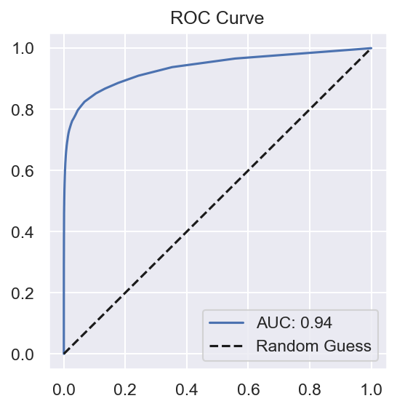
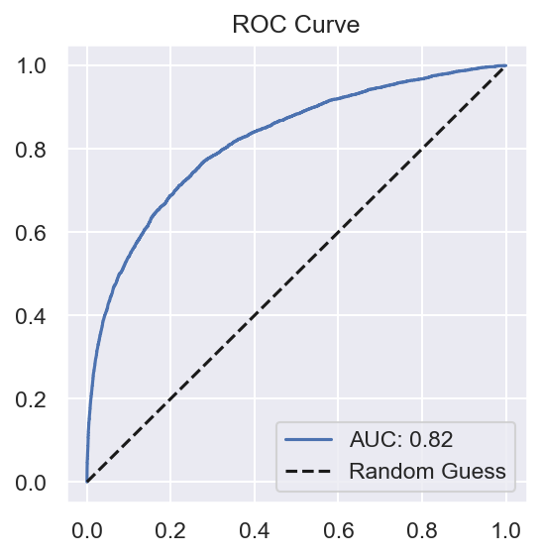
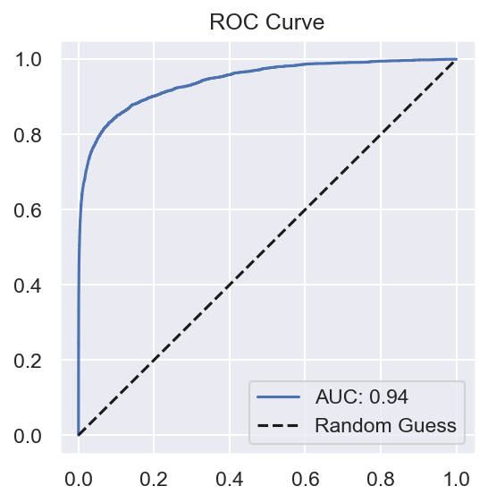
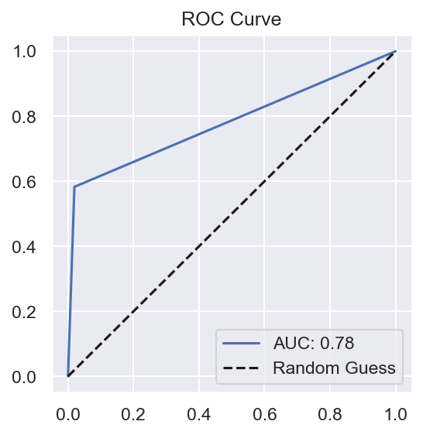
Model Comparison
Metrics | Logistic Regression | XGBoost | Decision Tree | Random Forest
Precision | 0.6881 | 0.8963 | 0.5205 | 0.9508
Recall | 0.0544 | 0.4892 | 0.5829 | 0.4394
F1-Score | 0.1009 | 0.6330 | 0.5499 | 0.6010
Accuracy | 0.9660 | 0.9801 | 0.9666 | 0.97.96
AUC-ROC | 0.8200 | 0.9430 | 0.7817 | 0.9407
ROC for the Logistic Regression
ROC for the XGBoost
ROC for the Decision Tree
ROC for the Random Forest

Slide 18
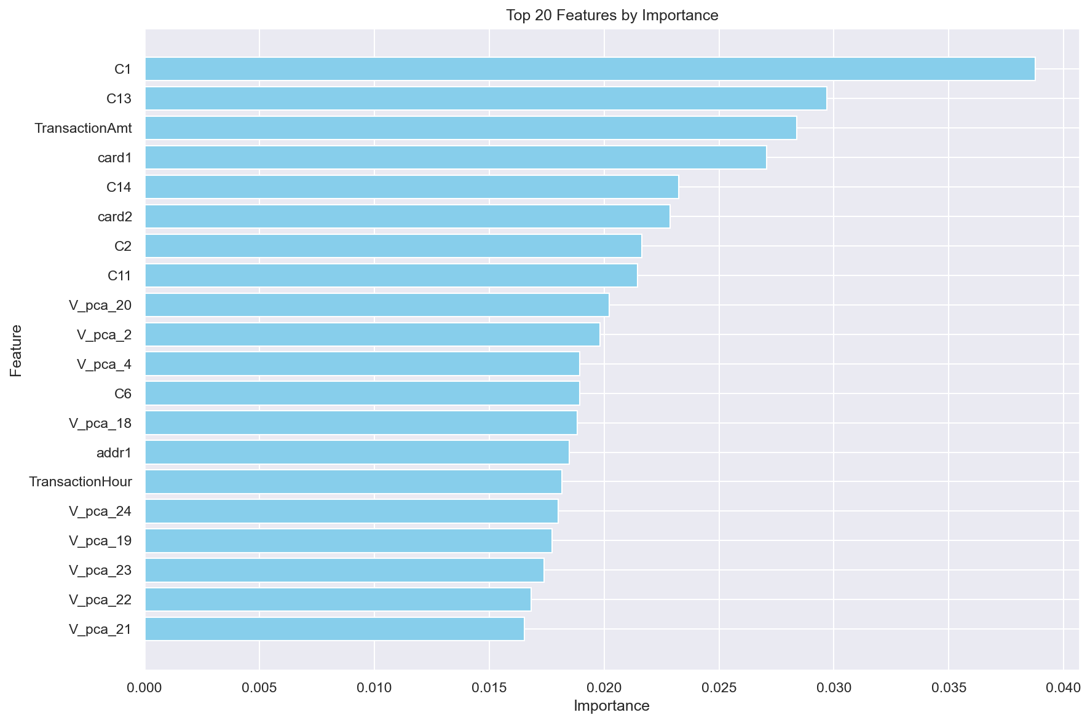
Models Analysis : [Random Forest - Feature Importance]
After grid search the top parameters are
'max_depth': 30, '
max_features': 'log2',
'min_samples_leaf': 1,
'min_samples_split': 2,
'n_estimators': 300
Top 20 selected features used in the random forest algorithm.
We can see that most of the important features are which we engineered using PCA.

Slide 19
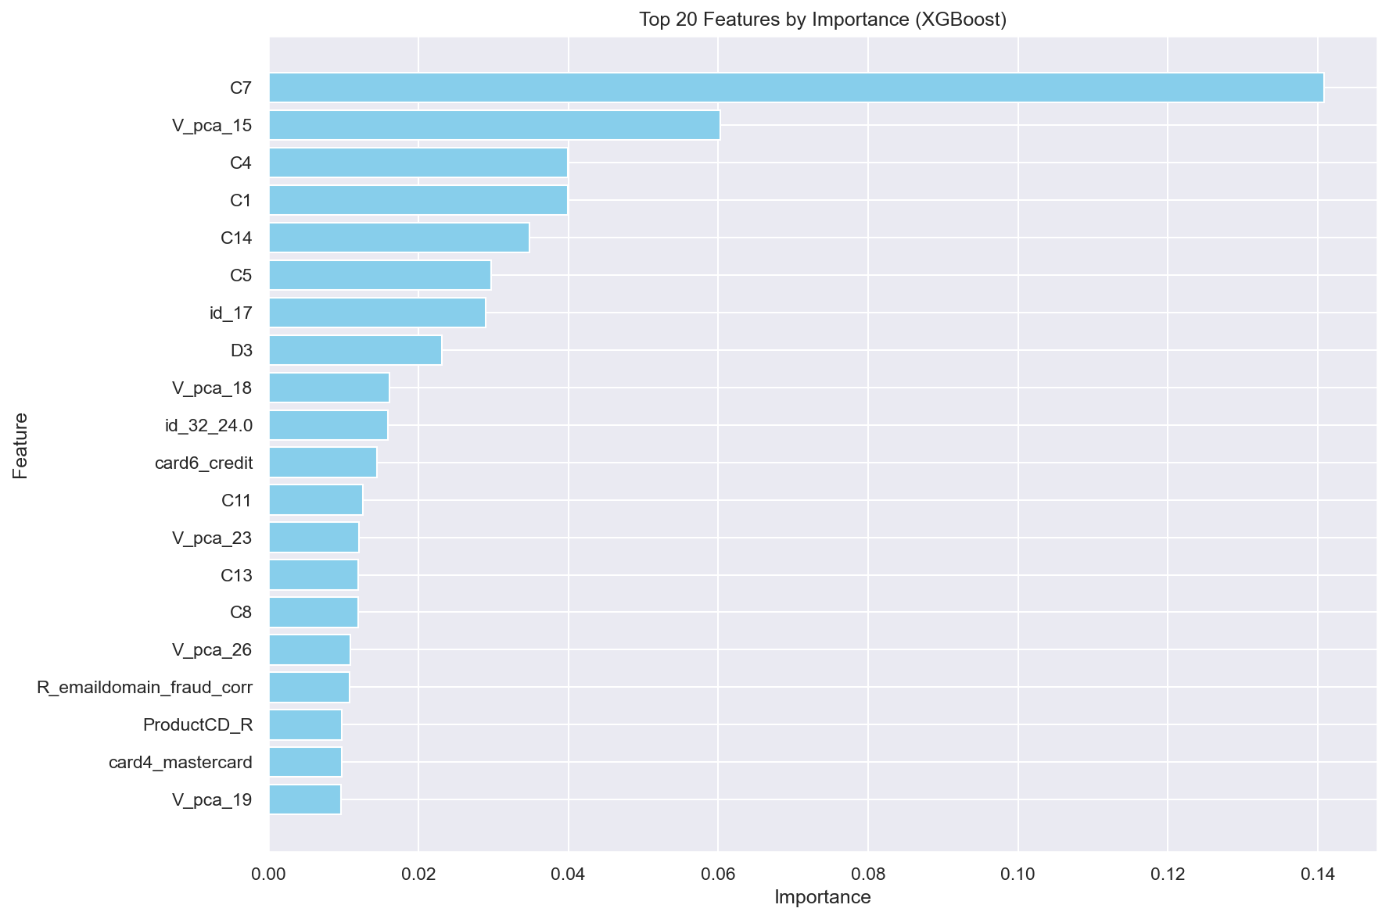
Models Analysis : [XGBoost - Feature Importance]
Top 20 selected features used in the XGBoost algorithm.
We can see that most of the important features are which we engineered using PCA.

Slide 20
Technical Novelty
Grouping by Missing Values: Features were grouped based on missing value patterns to capture similarities.
Dimensionality Reduction: PCA was applied within each group, retaining features that explained 90% of the variance. 339 Vesta features were reduced to 27.
Device Analysis: Extracted details such as device type, operating system, browser, and screen resolution from raw data.
Privacy Constraints: Due to encoded feature names and data, analysis required relatable interpretation patterns (e.g., D9 represents the hour of the day from normalized Transaction DT revealed only by the histogram pattern.).
Model Performance Analysis: Did further analysis for the transaction where model prediction was wrong, to further understand the data.
Notes:
For effective feature selection from Vesta-Features (339 Features), we used innovative method of selecting the relevant features.
First create multiple groups based on the missing values, which captures similarity.
Then within each subset, run PCA and capture n features which covers 90% variance.
Use these features in the final model training.
Detailed analysis of the devices, we capture the Device Type, Operating System, Its version, Browser, its version also. Later we drilled in device resolutions capturing screen resolution.
Its real transaction data, so for privacy concerns data encoding used and feature names were also encoded, which makes analysis very difficult to explain, but we tried different combinations for correct Interpretation. Once such example is D9 is hour of the day (matching that pattern from Transaction DT which was normalized).
Tried to group transaction together at card level based on the identity and card features.

Slide 21
Key Findings and Recommendations
Key Findings | Recommendations
Fraudulent activity is higher during certain hours, even with fewer transactions occurring at those times. Mobile devices are more vulnerable to fraud . Popular email domains were more commonly associated with fraudulent activities. Older browser versions (e.g., Chrome) show higher fraud rates compared to updated ones. In most fraud cases the personal information was not updated in timely manner. Contrary to popular belief, debit cards can sometimes be more vulnerable to fraud than credit cards. | Increased vigilance during high-fraud times. Extra caution with mobile transactions, especially regarding email address verification. Encourage users to keep browsers and operating system updated to reduce fraud risk. Keep the Personal Details like address and Phone number updated with the Issuers. Use multi-factor authentication or face ID to access credit card and debit accounts online.

Slide 22
Community Contribution
1- Guidelines for Fraud Prevention: The project offers data-driven guidelines to help consumers and businesses recognize and avoid fraudulent activity.
3- Encouragement of Safe Practices: Advises consumers to verify email addresses and update browser versions to reduce fraud risks, promoting safe digital habits
5- Increased Consumer Trust: Businesses that actively prevent fraud gain consumer trust, encouraging more support and engagement from the community.
05
06
01
02
03
04
2- Vulnerability Awareness: Highlights time periods and devices (like mobile) that are more prone to fraud, educating the community on higher-risk factors.
4- Enhanced Security: The project provides mechanisms that help protect consumers and small businesses from online fraud and making transactions safer.
6- Financial Resilience for Businesses: Minimizing fraud strengthens businesses financially, allowing them to focus on growth, maintain fair wages, and retain employees.

Slide 23
References
[1] A. Howard, B. Bouchon-Meunier, I. CIS, inversion, J. Lei, Lynn@Vesta, Marcus2010, and P. H. Abbass, “Ieee-cis fraud detection,” https://kagglecom/competitions/ieee-fraud-detection, 2019, kaggle.
[2] National Cyber Security Alliance, “Small Business Cybersecurity Report,” https://www.staysafeonline.org, 2019, [Online; accessed 30-October-2024].
[3] L. Cao, “Ai in finance: challenges, techniques, and opportunities,” ACM Computing Surveys (CSUR), vol. 55, no. 3, pp. 1–38, 2022.
[4] A. Ali, S. Abd Razak, S. H. Othman, T. A. E. Eisa, A. Al-Dhaqm, M. Nasser, T. Elhassan, H. Elshafie, and A. Saif, “Financial fraud detection based on machine learning: a systematic literature review,” Applied Sciences, vol. 12, no. 19, p. 9637, 2022.
[5] X. Niu, L. Wang, and X. Yang, “A comparison study of credit card fraud detection: Supervised versus unsupervised,” arXiv preprint arXiv:1904.10604, 2019.
[6] A. Jain and S. Shinde, “A comprehensive study of data mining-based financial fraud detection research,” in 2019 IEEE 5th International Conference for Convergence in Technology (I2CT). IEEE, 2019, pp. 1–4.
[7] E. Malik, K. Khaw, B. Belaton, W. Wong, and X. Chew, “Credit card fraud detection using a new hybrid machine learning architecture. Mathematics 10: 1480,” 2022.
[8] P. Gomber, J.-A. Koch, and M. Siering, “Digital finance and fintech: current research and future research directions,” Journal of Business Economics, vol. 87, pp. 537–580, 2017.
[9] C.-P. Hsieh, Y.-T. Chen, W.-K. Beh, and A.-Y. A. Wu, “Feature selection framework for xgboost based on electrodermal activity in stress detection,” in 2019 IEEE International Workshop on Signal Processing Systems (SiPS). IEEE, 2019, pp. 330–335

Slide 24
Thank
You

